Slide 1
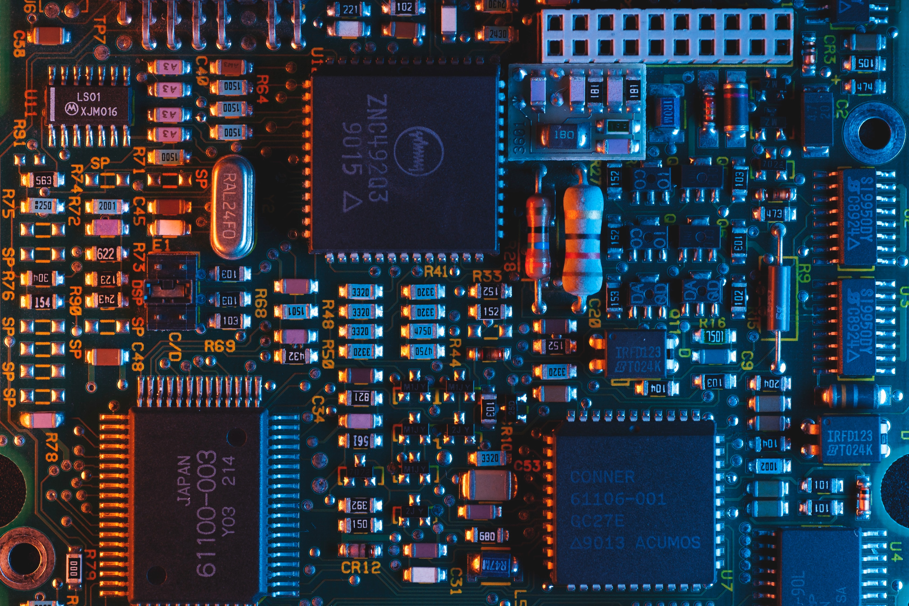
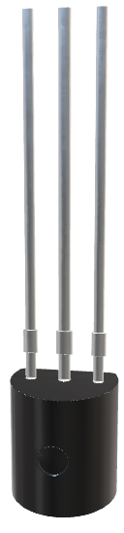
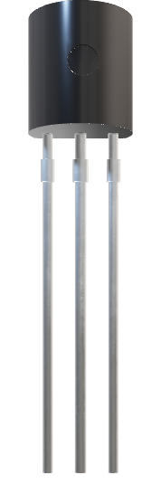
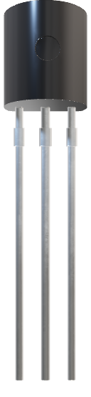
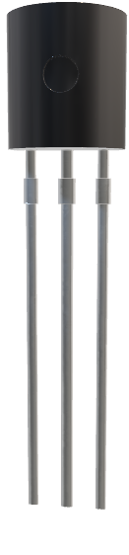
varactor
varactor
Varactor
A presentation about the device
What is the varactor
How does it work
Where can we use it
What is the applications for the varactor

Slide 2

varactor
Varactor
A presentation about the device
What is the varactor
How does it work
Where can we use it
What is the applications for the varactor

