Slide 1
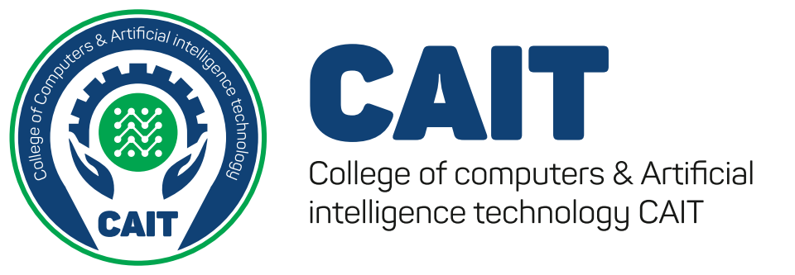





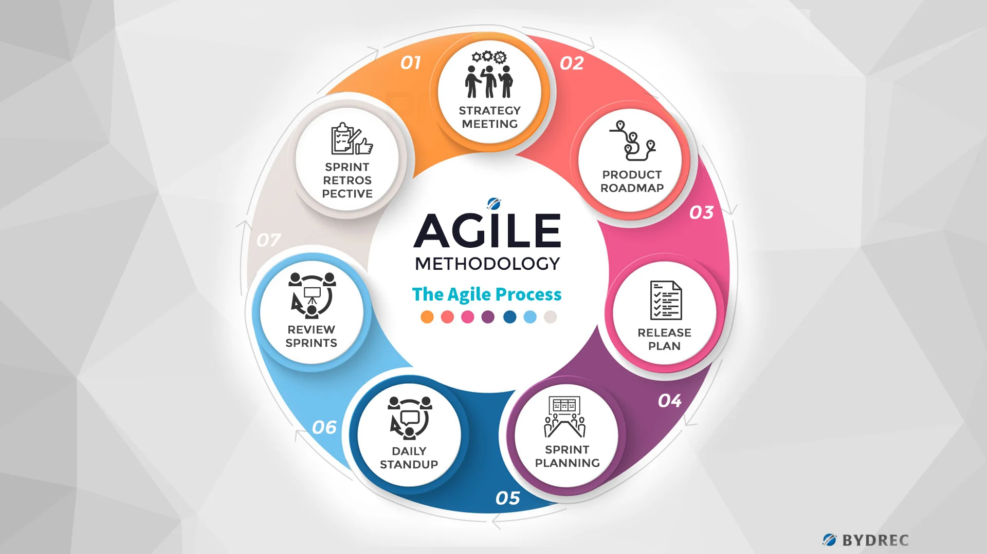
--
Misr University for Science & Technology (MUST)
College of Information Technology
Department of Computer Science,
Restaurant & Hotel Management System
Under the supervision of:
Dr. Mohamed Refaat TA. Mohammed Rasmy
Omer Tarek
Wafaa Morsy
Youssef Tamer
Doaa Taha
89554
89558
89405
89617
ABSTRACT
PROBLEM DEFINITION
RESULTS
REFERENCES
The restaurant and hotel management system is a comprehensive software solution designed to streamline the various aspects of running a restaurant or hotel. The system includes features such as reservation management, table management, order processing, inventory management, customer relationship management, and reporting and analytics.
The system is designed to improve the operational efficiency and customer experience of restaurant and hotel operators, reducing the need for manual data entry and paperwork, improving accuracy and increasing productivity. With features such as reservation management, the system can optimize room utilization and reduce the risk of overbooking, while the table management feature can optimize seating arrangements and reduce wait times for customers.
The inventory management feature helps to reduce waste and optimize inventory levels, resulting in cost savings and improved profitability, while the reporting and analytics capabilities provide real-time information about key performance metrics. The system can also integrate with other software applications and services, enabling operators to manage their entire operation from a single platform.
While the success of the restaurant and hotel management system depends on factors such as the size and complexity of the operation, and the availability of computing resources, it has shown promising results in improving the efficiency and profitability of restaurant and hotel operations. Ultimately, the system has the potential to enhance the customer experience and drive growth and profitability for restaurant and hotel operators.
problem statement restaurant management system, this system basically runs between customers and management in a restaurant. the customer interacts with generally one waiter and places their order, while the waiter takes multiple customers in a day. the customer places an order with the waiter, the waiter generates an invoice with the details of the customer, their order and table number, which is sent to the kitchen. once the order is prepared the runner uses the invoice to serve the food. the waiter usually asks again if the customers want to order anything more, this process can go on till the customer decides he does not want any more food. all the invoices generated by the customer are part of a much larger entity called order. the order is essentially the bill generated in the end by the restaurant for the customer. now we know the customer, waiter and invoice will be present in the order table. the relationship between customer and order is one to one. the relationship between the waiter and order is one to many. the relationship between invoice and order is one to many A Hotel Reservation multiple view model is to be created for a Software Product Line, which can be tailored to the needs of an individual hotel chain or hotel. The system manages information about rooms, reservations, customers, and customer billing. The system provides functionality for making reservations, check in, and check out, in addition to generating reports and displays. In addition, several optional and variant capabilities are provided
In this chapter, The restaurant and hotel management system is a comprehensive software solution designed to streamline the various aspects of running a restaurant or hotel, including reservation management, table management, order processing, inventory management, customer relationship management, and reporting and analytics.
Overall, the restaurant and hotel management system has shown promising results in improving the operational efficiency and customer experience of restaurant and hotel operators. The system has demonstrated the ability to reduce manual data entry and paperwork, improve accuracy, and increase productivity, allowing operators to focus on delivering a high-quality experience to their guests.
With the reservation management feature, the system has helped operators to manage reservations more efficiently, reducing the risk of overbooking and optimizing room utilization. The table management feature has also helped to optimize seating arrangements, reduce wait times for customers, and improve the overall dining experience.
The system's inventory management feature has helped operators to reduce waste and optimize inventory levels, resulting in cost savings and improved profitability. The reporting and analytics capabilities have provided operators with real-time information about their operations, allowing them to track key performance metrics and identify areas for improvement.
One of the key benefits of the restaurant and hotel management system is its ability to integrate with other software applications and services, such as online ordering platforms, delivery services, and accounting software. This has allowed operators to manage their entire operation from a single platform, reducing the need for manual data entry and improving accuracy and efficiency.
However, it is important to note that the success of the restaurant and hotel management system depends on factors such as the size of the operation, the complexity of the operation, and the availability of computing resources. Additionally, the system may require a learning curve for operators and staff who are not familiar with the software.
In conclusion, the restaurant and hotel management system has shown promising results in improving the operational efficiency and customer experience of restaurant and hotel operators. The system's features and benefits have helped to streamline operations, reduce errors, and improve profitability. However, the success of the system will depend on factors such as the size and complexity of the operation, and the availability of computing resources.
METHODOLOGY
INTRODUCTION
Agile methodologies are a set of software development practices that prioritize flexibility, collaboration, and iterative development. Agile methodologies are based on the Agile Manifesto, which was developed in 2001 by a group of software developers who were seeking to improve the traditional approach to software development.
Agile methodologies emphasize working in small teams, frequent communication and collaboration, and adapting to changing requirements and priorities.
Many of the benefits of using restaurant management systems are related to automation and speeding up processes to improve the customer experience. Modern customers expect fast, frictionless service, and restaurant management software plays a key role in meeting these expectations. Additionally, such solutions can serve as a critical piece of restaurant technology because they bring many different processes together in one location. A comprehensive restaurant management system will allow for payment processing, financial management, sales tracking, performance monitoring, personnel management . Using this website, customers just capture QR Code in the restaurant or hotel room for viewing the home page. Through it, they can view the menu and see the available dishes, have a look at offers & coupons, donate a meal to the poor, or make an order. To make an order, the user can filter available meals to find the most suitable for his desire. There’s also a recommendation section based on best selling dishes. The user can order and choose the time of serving. After placing an order, it will be send through to the kitchen and gives the customer an estimated time for preparation and serving. When the customer wants to leave he can close the table form his phone, and choose a payment method and pay his check. Then the user is asked to give his feedback about the food quality, service and the website. This new ways of ordering will ultimately save time for the waiter to take up orders and this application improves the method of 9 taking the order from customer. In addition, restaurant and hotel owners can add or manage their food menus and get notification the ordering food has been send to the customers. As mentioned previously, the traditional way of ordering process requires a lot of manual work; causing some human errors; such as the probability of paper loss and the kitchen’s staff can misinterpret the handwriting of order. All these human errors will cause dissatisfaction with the user experience. One of the problems faced by hotels using the traditional ordering system is the difficulties to update the new menu. If they want to change the menu, they have to reprint again. This will increase the cost and wastage of paper. Based on those problems, by implementing an electronic and efficient ordering service can avoid them. By using the proposed system, the restaurant productivity and customer satisfaction can be improved. Another benefit of using this proposed system is avoiding human contact as much as possible. Also, managers save the wages paid to waiters, or save their time for other tasks
Acknowledgement
I would like to express my deepest gratitude to my professor and supervisor Prof. Dr: Mohamed Refaat for his invaluable guidance, support, and encouragement throughout my research journey. His expertise and insights have been instrumental in shaping my research and helping me overcome obstacles along the way. I am truly grateful for his mentorship and for the time and effort he has dedicatedto my project .
Reffreneces
Future Work
[1]http://www.yhofoodie.com/product/cashier.html
[2]http://umpir.ump.edu.my/id/eprint/12526/
[3]https://techcrunch.com/2012/05/02/chownow-launches-as-a-food-ordering-platformfor-restaurants-on-facebook-and-ios/
[4]https://www.sakaesushi.com.my/?fbclid=IwAR2Aqzqi500M9wQ8cU4xNKfrxGFHWzR2TnKUZRRoSkegUWCtcAGYV8h_Y5M
[5] https://www.geeksforgeeks.org/when-to-use-each-sorting-algorithms/
[6] https://www.freecodecamp.org/news/search-algorithms-linear-and-binary-search-explained/#:~:text=The%20binary%20search%20algorithm%20works,because%20it's%20faster%20to%20run
[7] https://itchronicles.com/artificial-intelligence/speech-recognition-algorithms/
[8] https://medium.com/@goodrebels/how-to-apply-machine-learning-to-customer-feedback-b81cb01d3c3c

