Slide 1
CCAS 2.6 Project
Omar alhaywan
Omar basem
Ziad amr

Slide 2
Machine Learning
Machine learning is subset of AI that allows computers to learn from data and improve their performance over time
It involves training algorithms on large datasets to identify patterns and make predictions or decisions based on newer data for testing
Machine learning is used in the technology we use every day, like facial and speech recognition
Some popular machine learning techniques include supervised learning, unsupervised learning, and reinforcement learning.

Slide 3
Our Goals
In This project 5 different models, including: 1.Logistic regression 2.SVM 3.CNN(deep learning) 4. Random Forest 5.KNN were used.
The Schkit learn and d-lib libraries were used for classification.
The CelebA dataset was used as training data.
Our models covered binary classification: 1. Gender : Male or female 2.Facial expression : Smiling or not smiling

Slide 4
Steps:
Firstly functions are created for extracting the smile labels and the gender labels for classifications.
The labels are then extracted to create training and testing data.
When the data is collected models are then created for each ML technique.
The models are then post processed to assess the best hyperparameters to get the highest accuracy.
The models were then pickled after training to use directly in a demo.

Slide 5
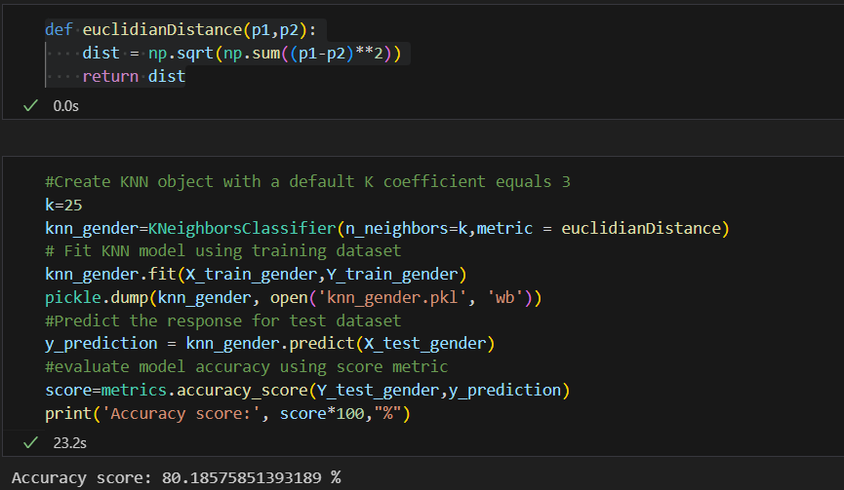
KNN
The first model we tried was KNN
the accuracy for the gender classification was 80.1%
the accuracy for the smile classification was 89.2%

Slide 6
The k-nearest neighbors algorithm, also known as KNN, is a non-parametric, supervised learning classifier.
It uses proximity to make classifications or predictions about the grouping of an individual data point
It can be used for either regression or classification problems, but it is typically used as a classification algorithm.

Slide 7
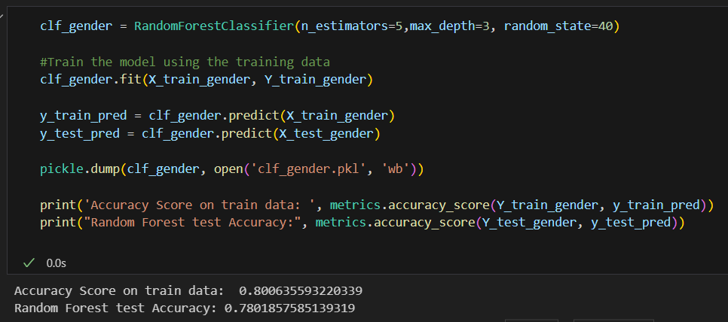
Random forest
The second model was random forest
the accuracy for the gender classification was 78%
the accuracy for the smile classification was 89.2%

Slide 8
Random forests combines the output of multiple decision trees to reach a single result.
It handles both classification and regression problems and its ease of use and flexibility have fueled its adoption.
The random forest model is made up of multiple decision trees. Decision trees start with a basic question and then ask a series of questions to determine an answer. These questions make up the decision nodes in the tree, acting as a means to split the data.
When multiple decision trees form an ensemble in the random forest algorithm, they predict more accurate results, particularly when the individual trees are uncorrelated with each other.

Slide 9
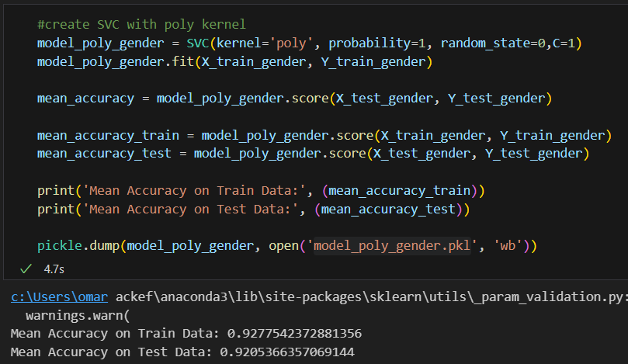
SVM
the accuracy for the gender classification was 92%
the accuracy for the smile classification was 90.7%

Slide 10
Support Vector Machines (SVMs) are a set of supervised learning methods used for classification, and regression.
The main idea behind SVMs is to find a hyperplane that maximally separates the different classes in the training data.
SVMs are effective in high dimensional spaces and are still effective in cases where the number of dimensions is greater than the number of samples.
They use a subset of training points in the decision function (called support vectors), so they are also memory efficient.

Slide 11
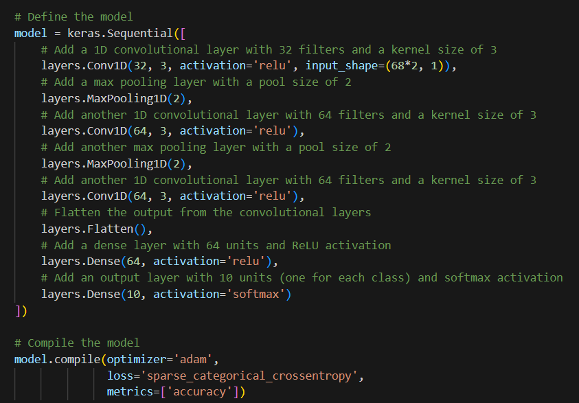
CNN
the accuracy for the classification 85.9%

Slide 12
A Convolutional Neural Network (CNN) is a type of deep learning algorithm that is particularly well-suited for image recognition and processing tasks.
It is made up of multiple layers, including convolutional layers, pooling layers, and fully connected layers.
CNNs are designed to take in input data in a grid-like topology, such as an image, and process the data through multiple layers, each of which extracts important features from the input.
One huge advantage of using CNNs is that you don't need to do a lot of pre-processing on images.

Slide 13
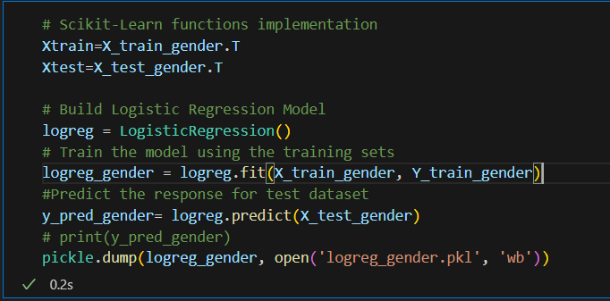
Logistic Regression
the accuracy for the gender classification was 92%
the accuracy for the smile classification was 90.7%

Slide 14
Logistic regression is a type of statistical model that is often used for classification and predictive analytics.
Since the outcome is a probability, the dependent variable is bounded between 0 and 1. In logistic regression, a logit transformation is applied on the odds—that is, the probability of success divided by the probability of failure.
Logistic regression is commonly used for prediction and classification problems. Some of these use cases include fraud detection, where logistic regression models can help teams identify data anomalies, which are predictive of fraud.

Slide 15
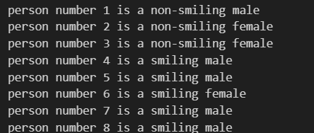
Results
The pickled versions of all of our models were then used on a separate set of images that was not used in training and the most accurate results were obtained from logistic regression and SVM which barely made any mistakes

Slide 16
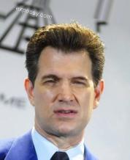
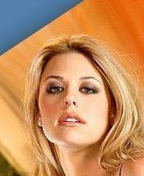

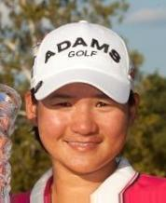
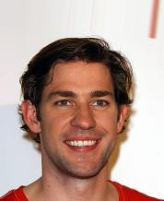
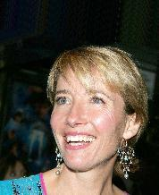
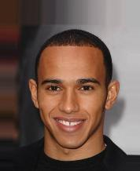
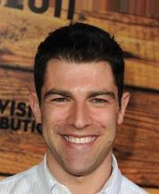
Pictures used:

