Slide 1
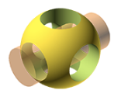

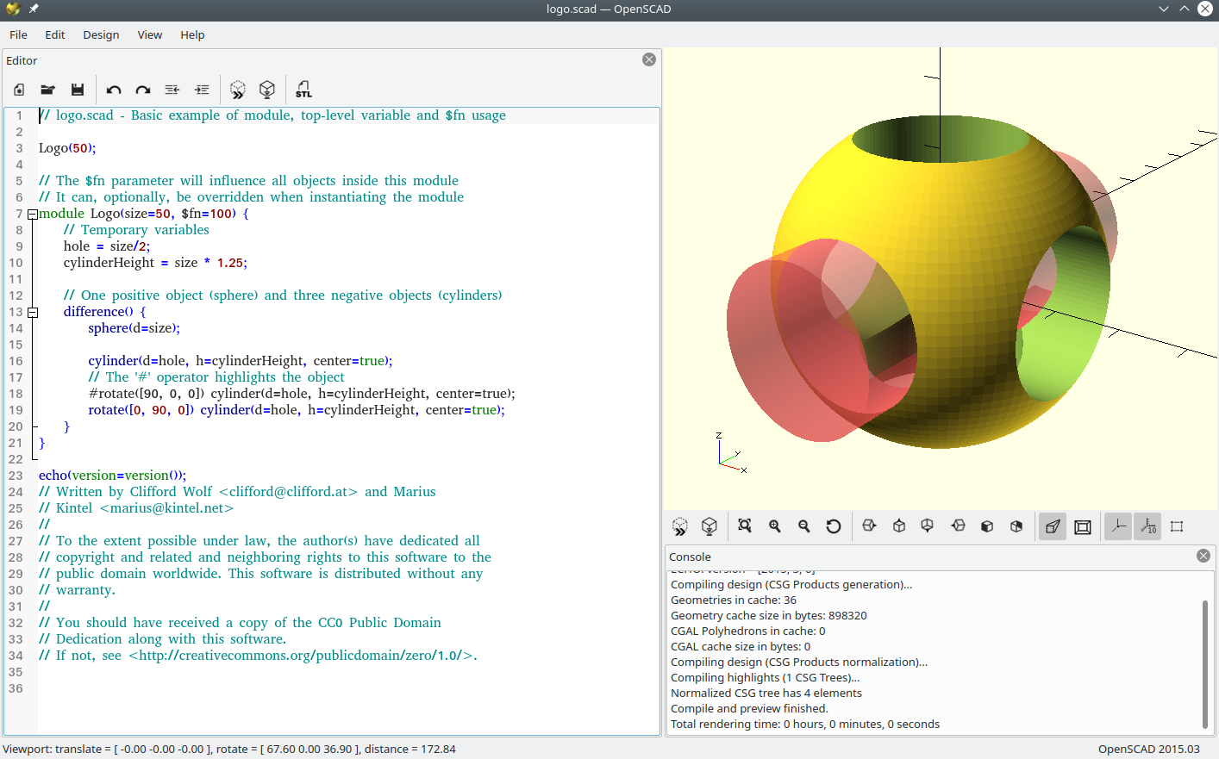
BgLUG
Bergamo, 03/07/2019
rel. Lazzari Omar

Slide 2
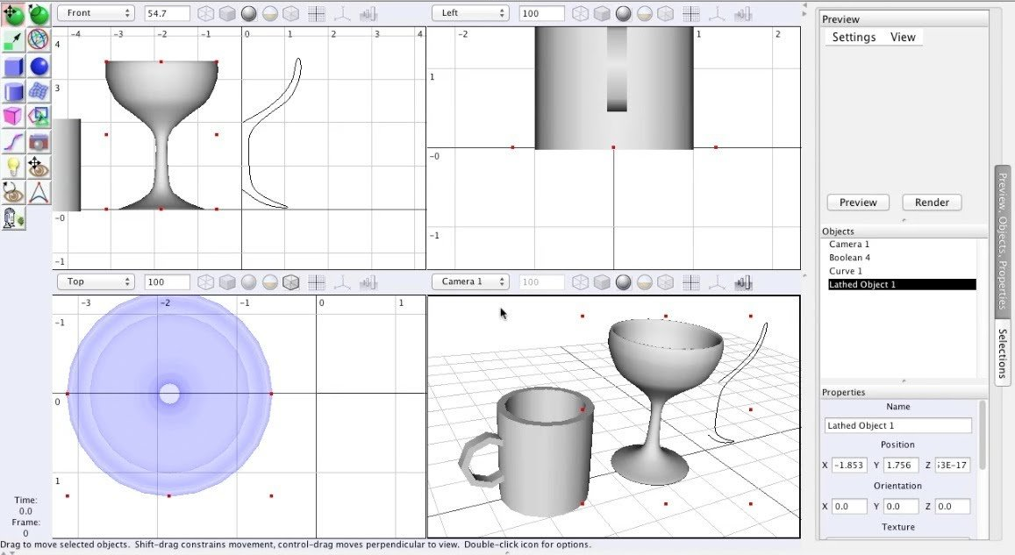
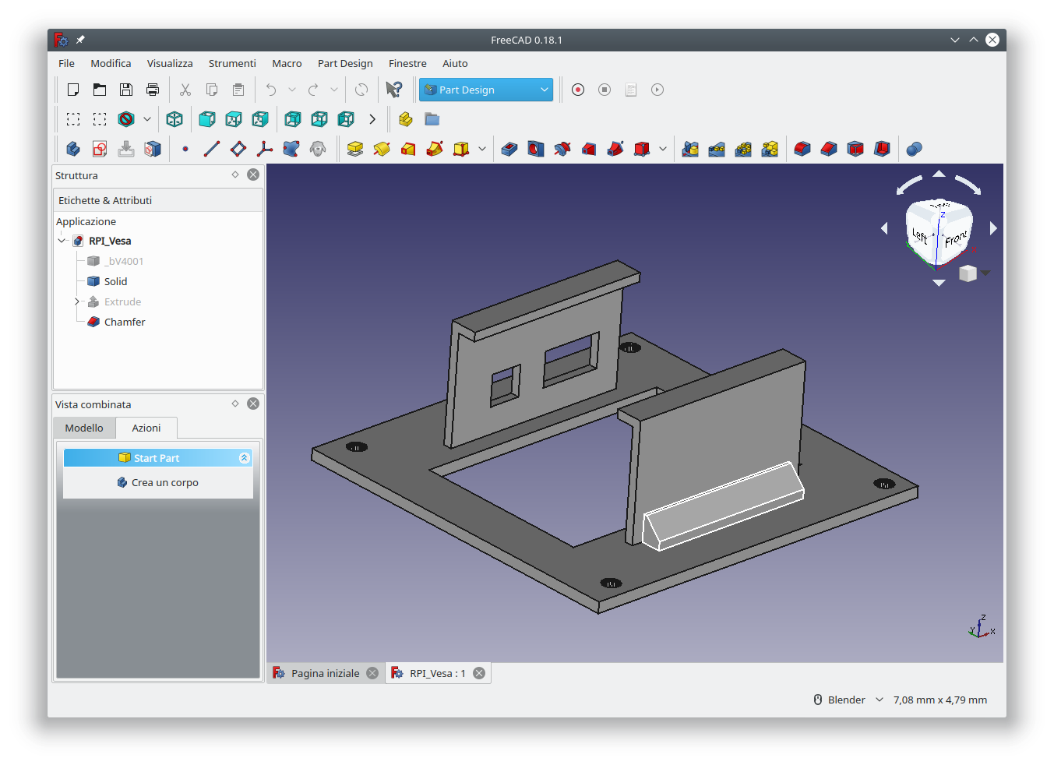
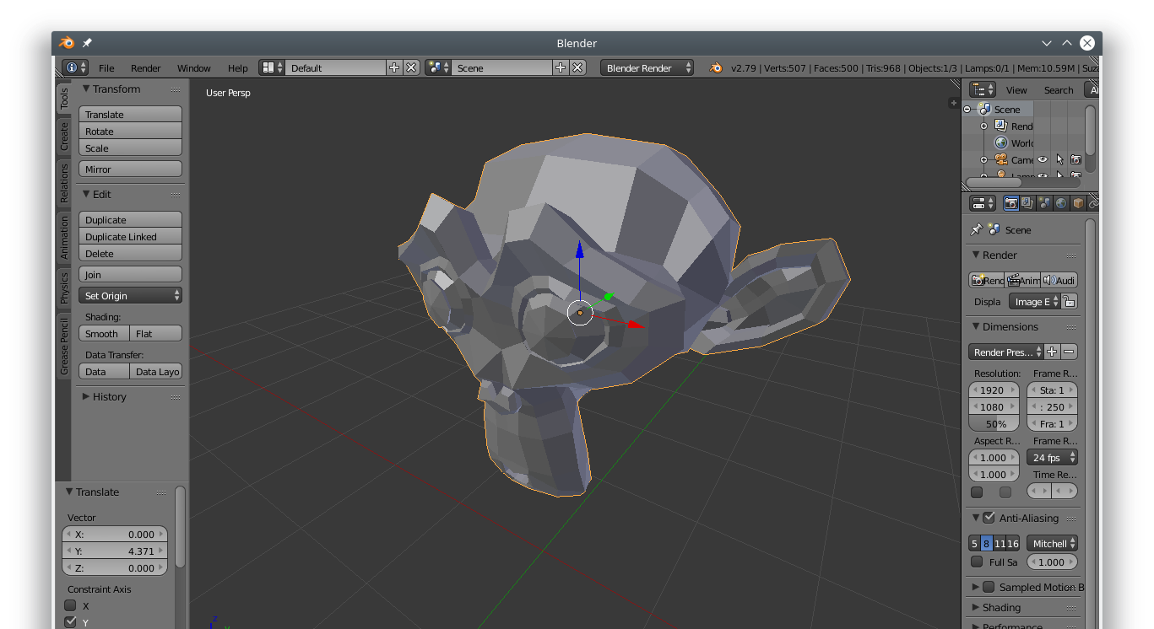
SOFTWARE DI
MODELLAZIONE 3D
Freecad, Blender, BRL-Cad, SweetHome3D, Wing3D, ImplicitCAD, ArtOfIllusion
Inventor, Siemens NX, Solidworks, Rhino, Catia, SketchUP

Slide 3
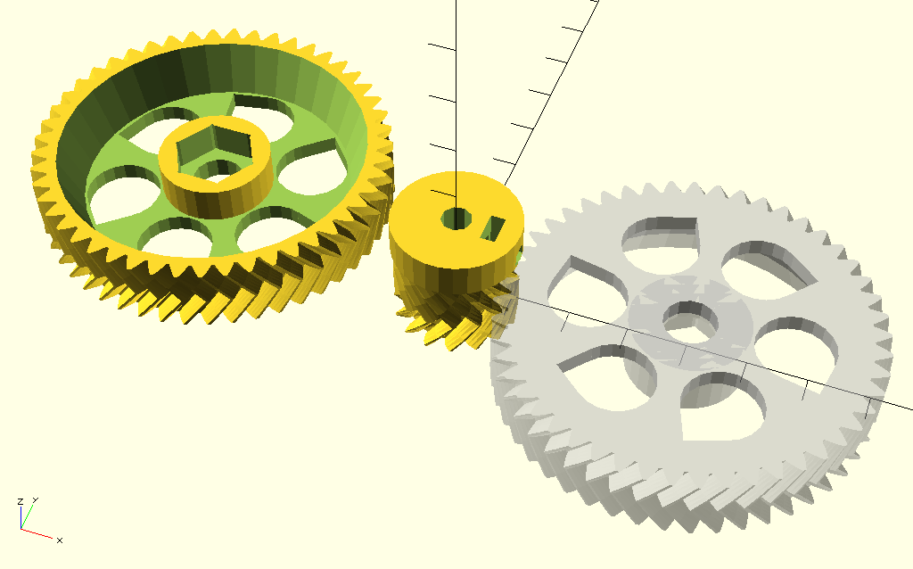
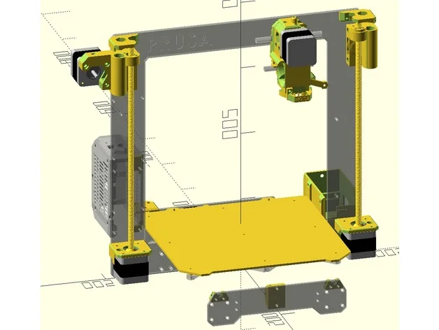
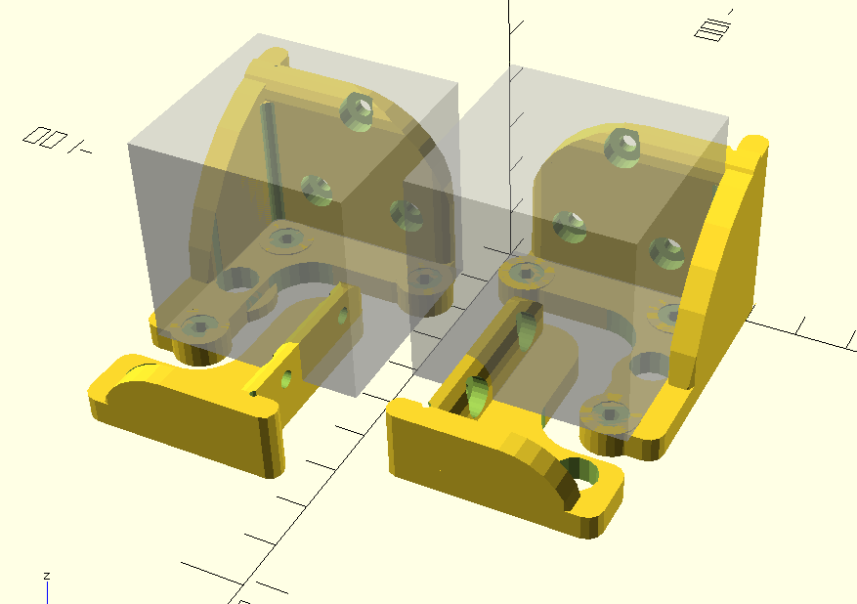
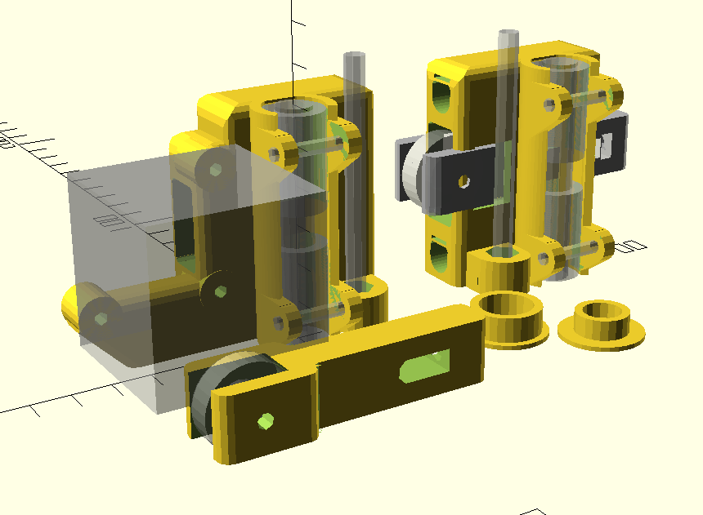
Brevetto FDM e
3D printer open-hardware

Slide 4
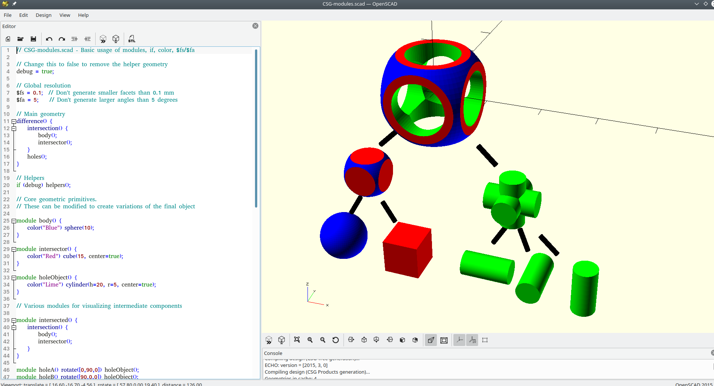
CSG
CONSTRUCTIVE SOLID GEOMETRY

Slide 5
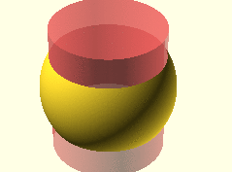
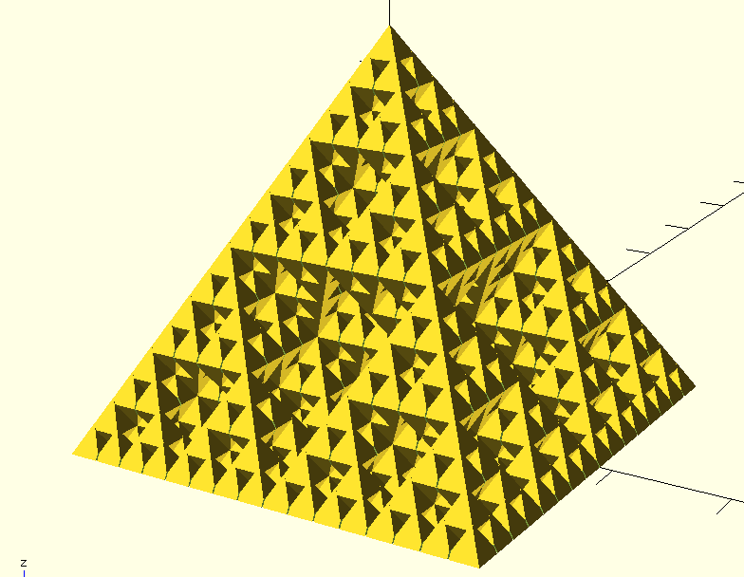
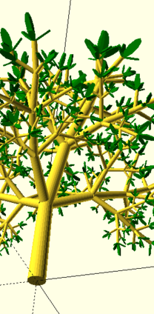
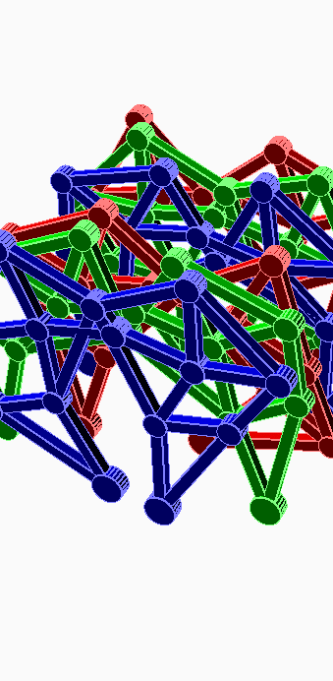
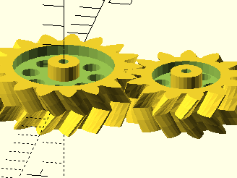

Slide 6
per proseguire digita
bit.ly/bglugopenscad

