Slide 1
Project 02. Image Processing
Gaussian and bilateral filters
Team:
Ahmad Zakor
Mubashir Hanif
Omar Gutiérrez

Slide 2
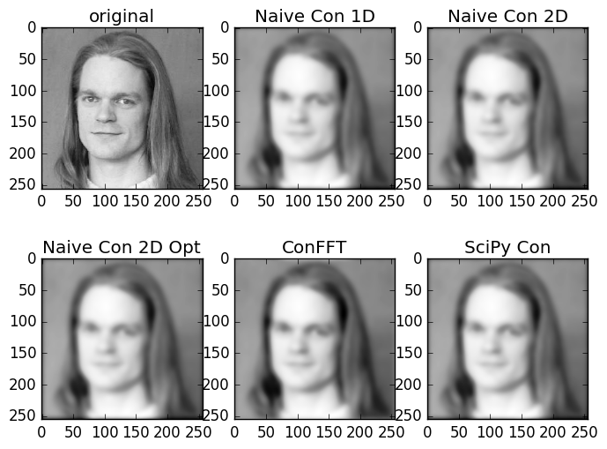
Task 2.1. Smoothing operations
At the right the different filters used to smooth an image.
It does exist a relationship between the size of filter and sigma.
We deal with the borders padding the images.

Slide 3
Task 2.1. Naïve 2D Convolution
Delete loops. We can do the next optimization
summe = 0.0
for i in range( 0, m ):
xdash = int( x + ( i - bound ) )
if( 0 > xdash or w <= xdash ):
summe += 0.0
else:
summe += img[ xdash, y ] * filter1d[ i ]
new_image[ x, y ] = summe
summe = 0.0
extract = padded_img[x:(m+x), y]
mul = np.multiply(extract, filter1d)
summe = mul.sum()
new_img[x,y] = summe

Slide 4
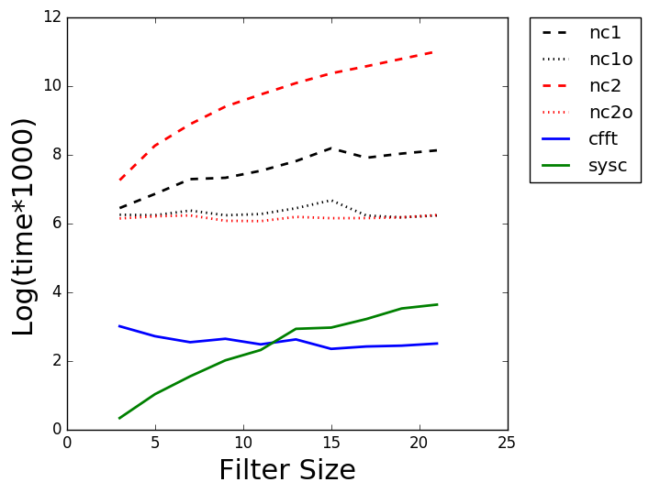
Task 2.1. Timing
Notice the intersection between the green and blue line.
The previous optimization makes difference!

Slide 5
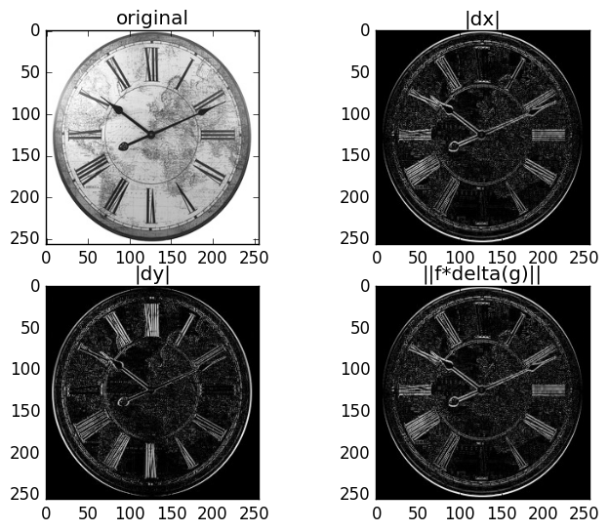
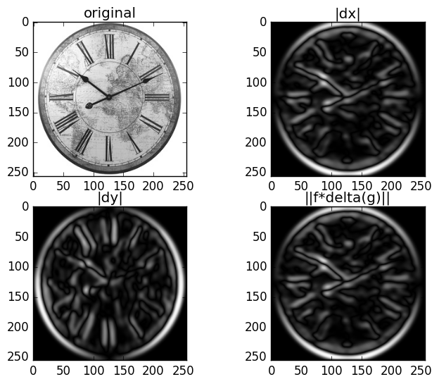
Task 2.2. Gradient images
The gradient operator is applied to an smoothed version.

Slide 6
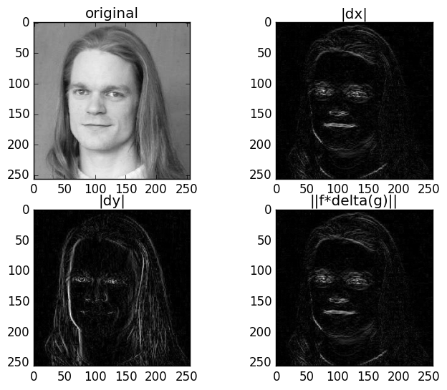
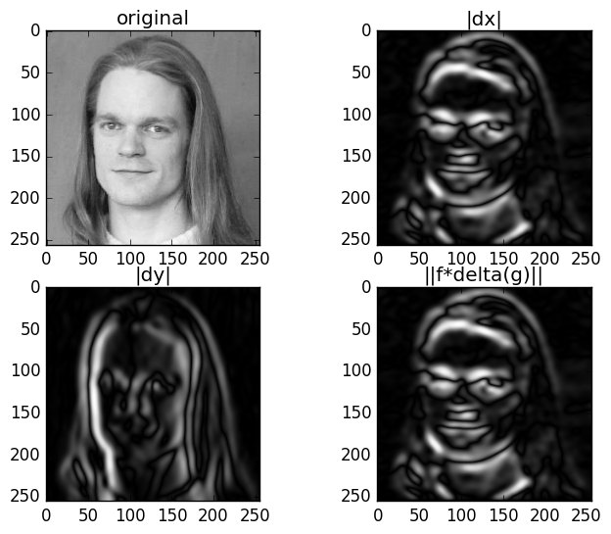
Task 2.2. Gradient images

Slide 7
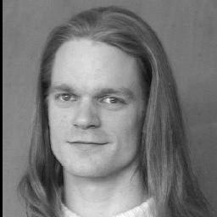
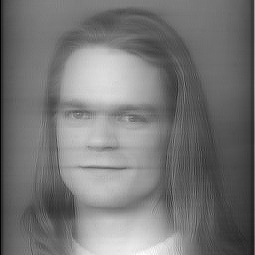
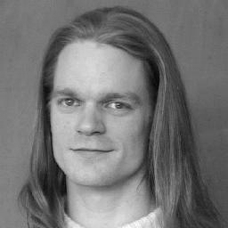
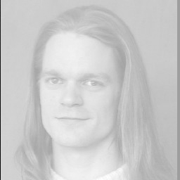
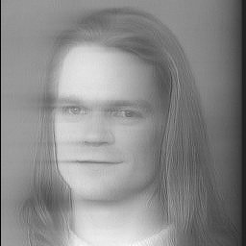
Task 2.3. Gaussian smoothing using recursive filter
causal
sigma= 0.666
sigma= 3.666
result for
sigma = 3.666
original
anti-causal

Slide 8

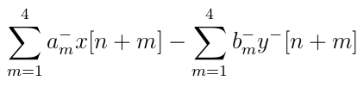
Task 2.3. Gaussian smoothing using recursive filter
Causal filter we do the recursion from right to left.
Anti-causal filter we do the recursion from left to right.
Although, the recursive filter should be faster, using vector libraries we need to be careful with the implementation:
We can do the summations with element-wise operations.
In the recursive process we can avoid to call a function already computed.

Slide 9
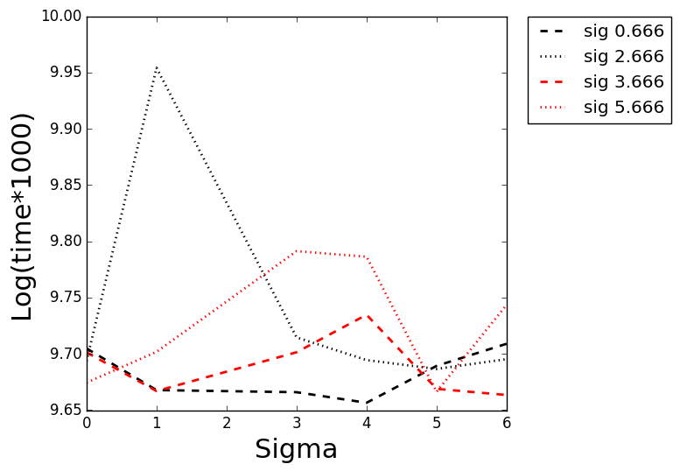
Task 2.3. Timing

Slide 10

Task 2.4. Bilateral filters
A bilateral filter is a non-linear, edge-preserving and noise-reducing smoothing filter for images. The intensity value at each pixel in an image is replaced by a weighted average of intensity values from nearby pixels.

Slide 11

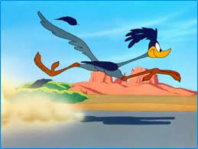
Task 2.4. Bilateral filters
Python
C++
2 Minutes
5 Seconds

Slide 12





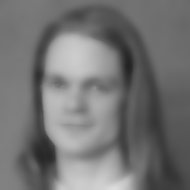

Task 2.4. Bilateral filter

Slide 13
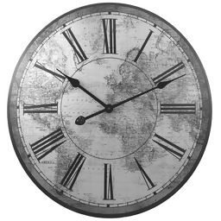





Task 2.4. Bilateral filter

Slide 14
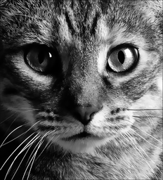
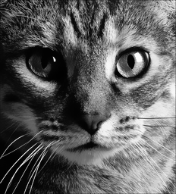




Task 2.4. Bilateral filters

Slide 15
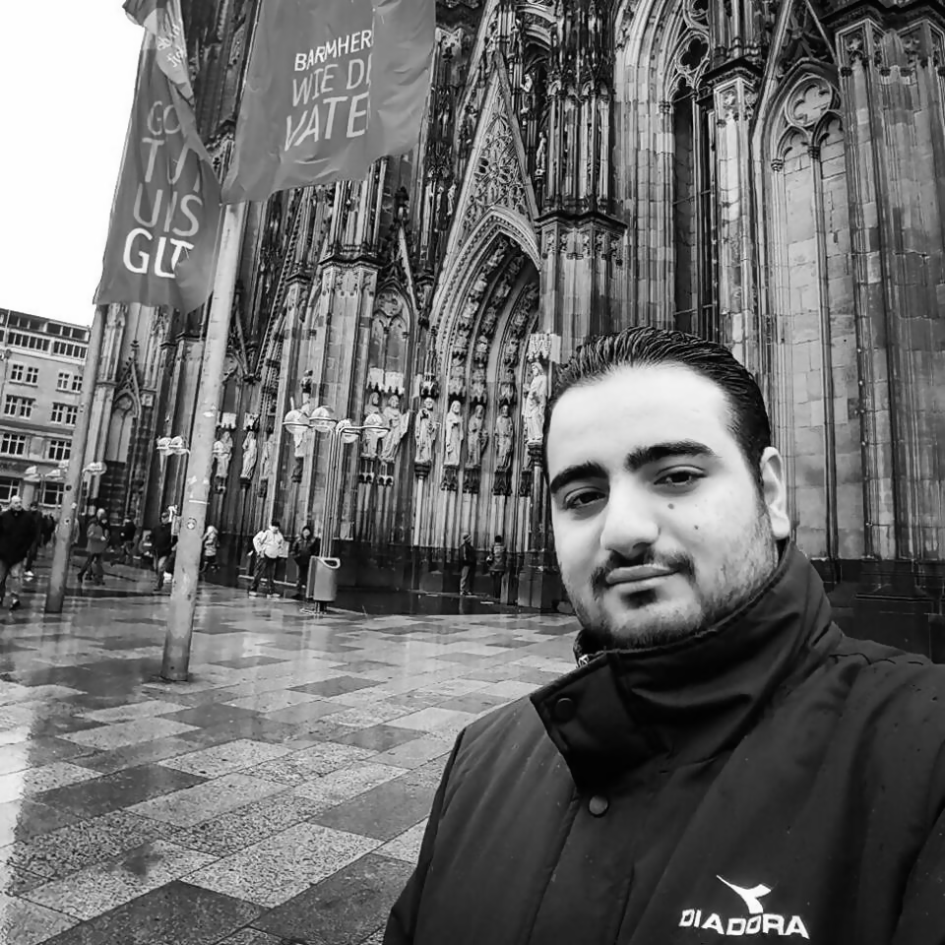





Task 2.4. Bilateral filters

Slide 16
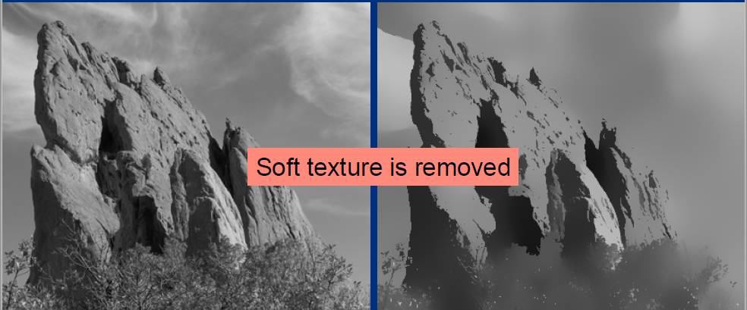
Task 2.4. Bilateral filters
Limitations: Soft texture removed

Slide 17
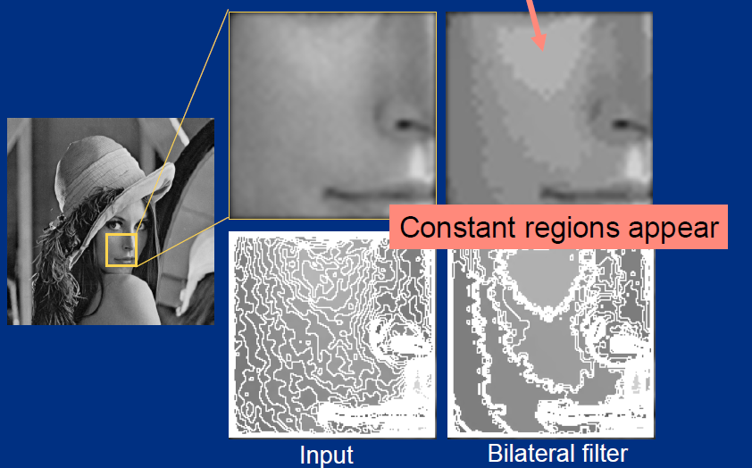
Task 2.4. Bilateral filters
Constant regions appear
Can this be an advantage?

Slide 18
Task 2.4. Bilateral filters
Yes, we can make cartoons!

Slide 19
Task 2.4. Bilateral filters
Cartoonize a photo:
Down sample image using Gaussian pyramid
Apply bilateral filter
Up sample image to original size
Convert to grayscale and apply median blur
Detect and enhance edges
Convert back to color image

Slide 20
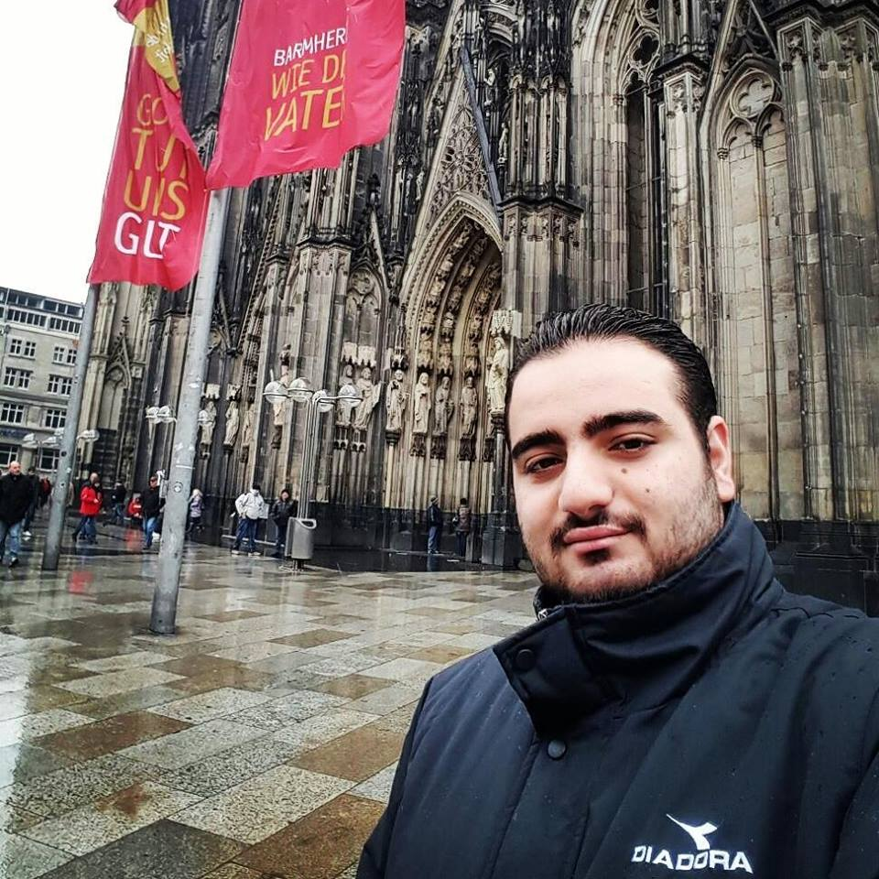
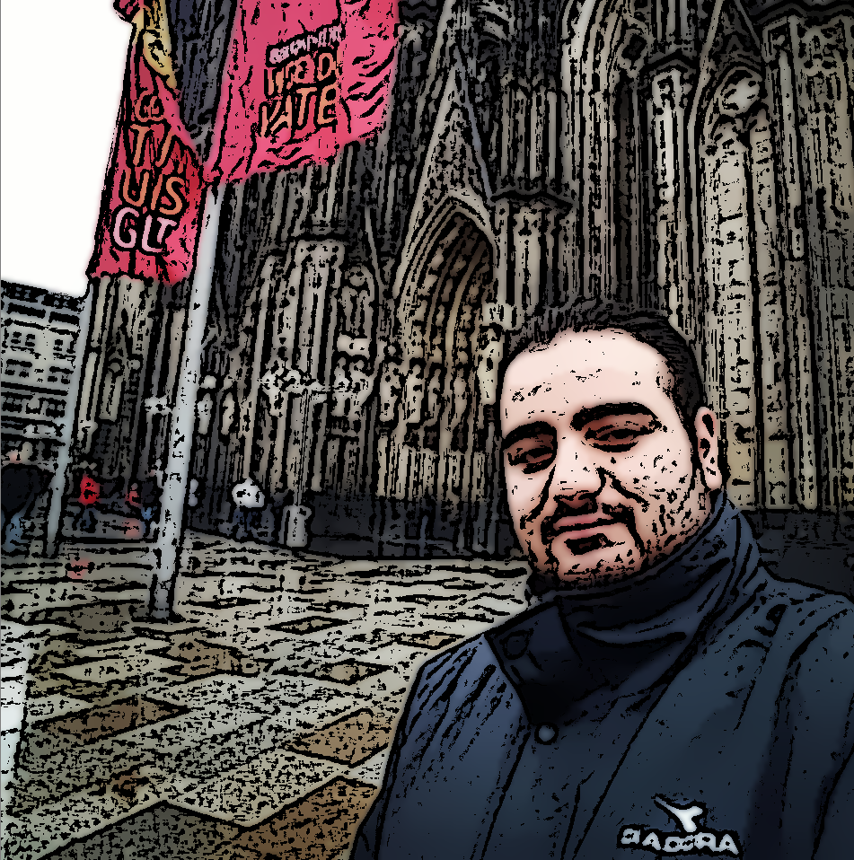
Task 2.4. Bilateral filters

