Slide 1

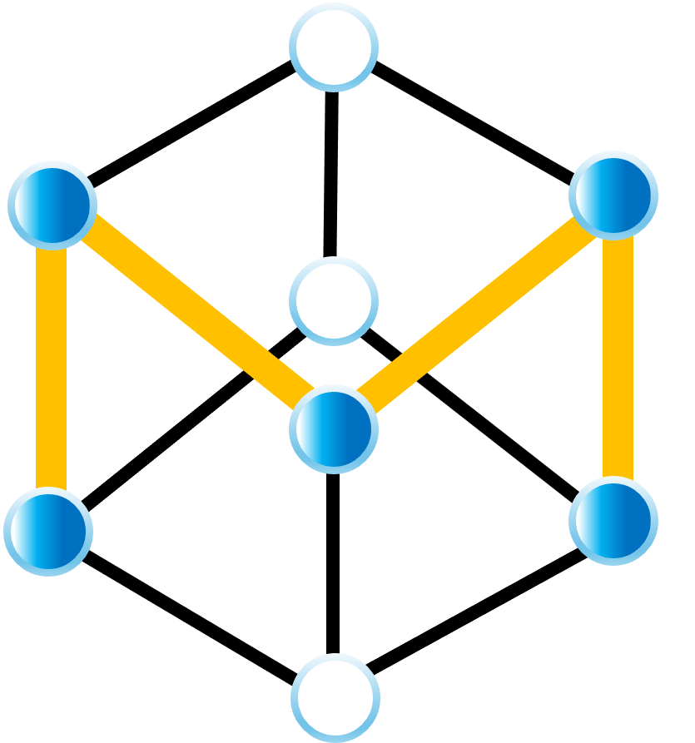
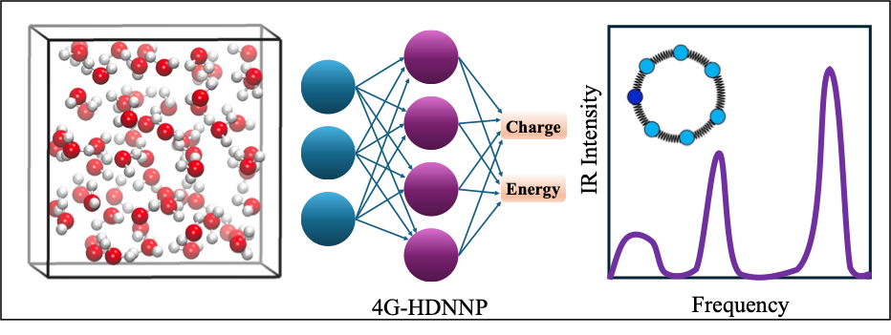

Accurate and Efficient Vibrational Spectra from 4G-NNPs Combined with Path Integral Quantum Dynamics Methods
Momeni Research Group
Md Omar Faruque
School of Science & Engineering
University of Missouri–Kansas City (UMKC)
2026 Midwest Regional Meeting
Manhattan, KS
Oct 26, 2026

Slide 2
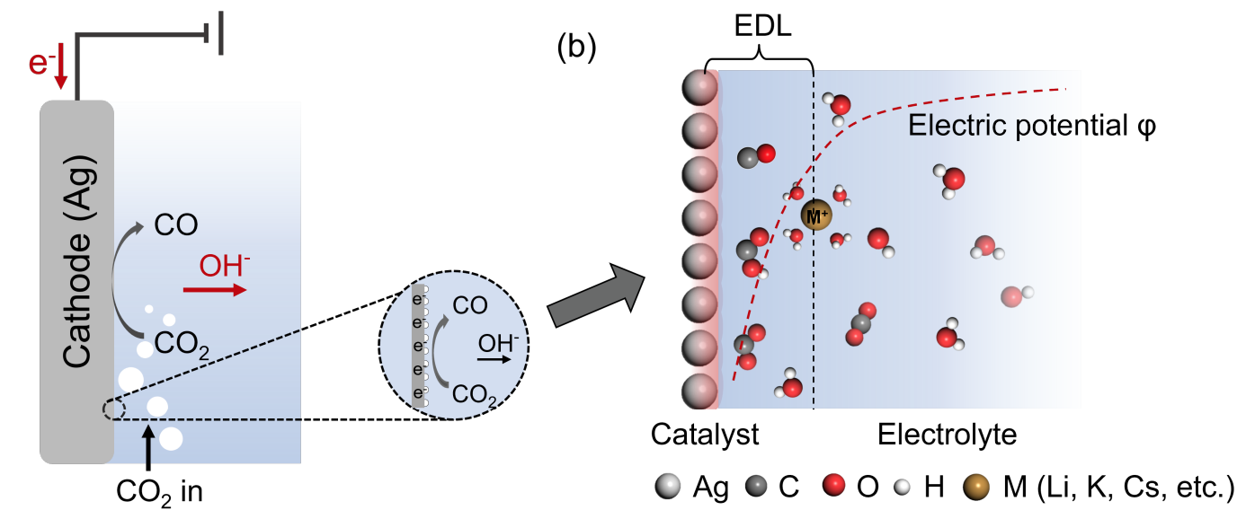
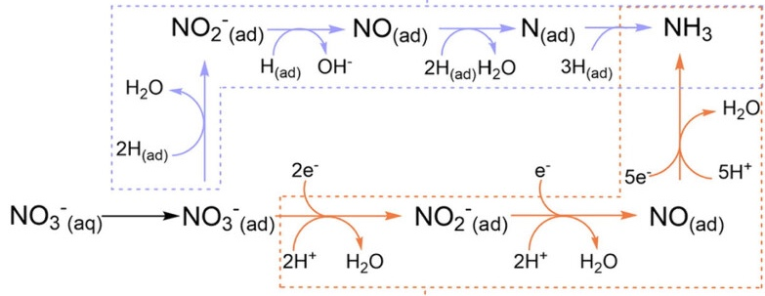
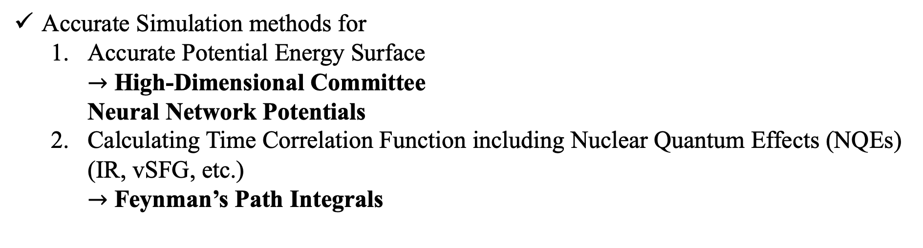
Vibrational Spectra for Probing Chemical Environments
Sensitive spectroscopic tools for probing chemical reactions.
  Infrared (IR) spectra
  Surface-enhanced infrared absorption spectroscopy (SEIRAS)
  Vibrational sum-frequency generation (vSFG)
Rigorous modeling without ad-hoc fittings
or parameterizations.
Electrochemical CO₂ to CO Conversion Reaction
Accurate Simulation methods for
  Accurate Potential Energy Surface
  $→$ High-Dimensional Committee
  Neural Network Potentials
  Calculating Time Correlation Function including Nuclear Quantum Effects (NQEs) (IR, vSFG, etc.)
  $→$ Feynman’s Path Integrals
Nitrate reduction reaction to ammonia
Qiu et al., ACS Appl. Energy Mater. 2024, 7, 10596.
Jin et al., Sci. Rep. 2024, 14, 18805.

Slide 3
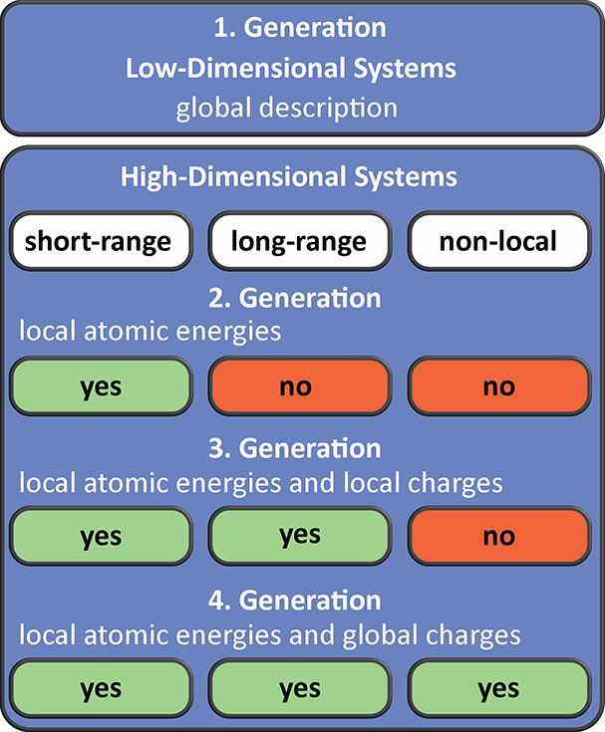
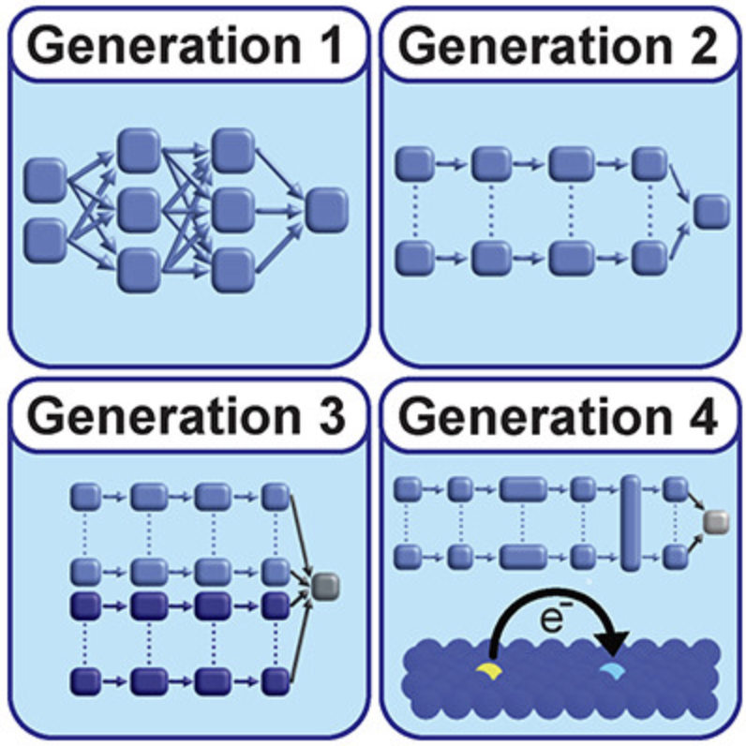
Different Generations of HDNNPs
Behler, J. Chem. Rev. 2021, 121, 10037.

Slide 4
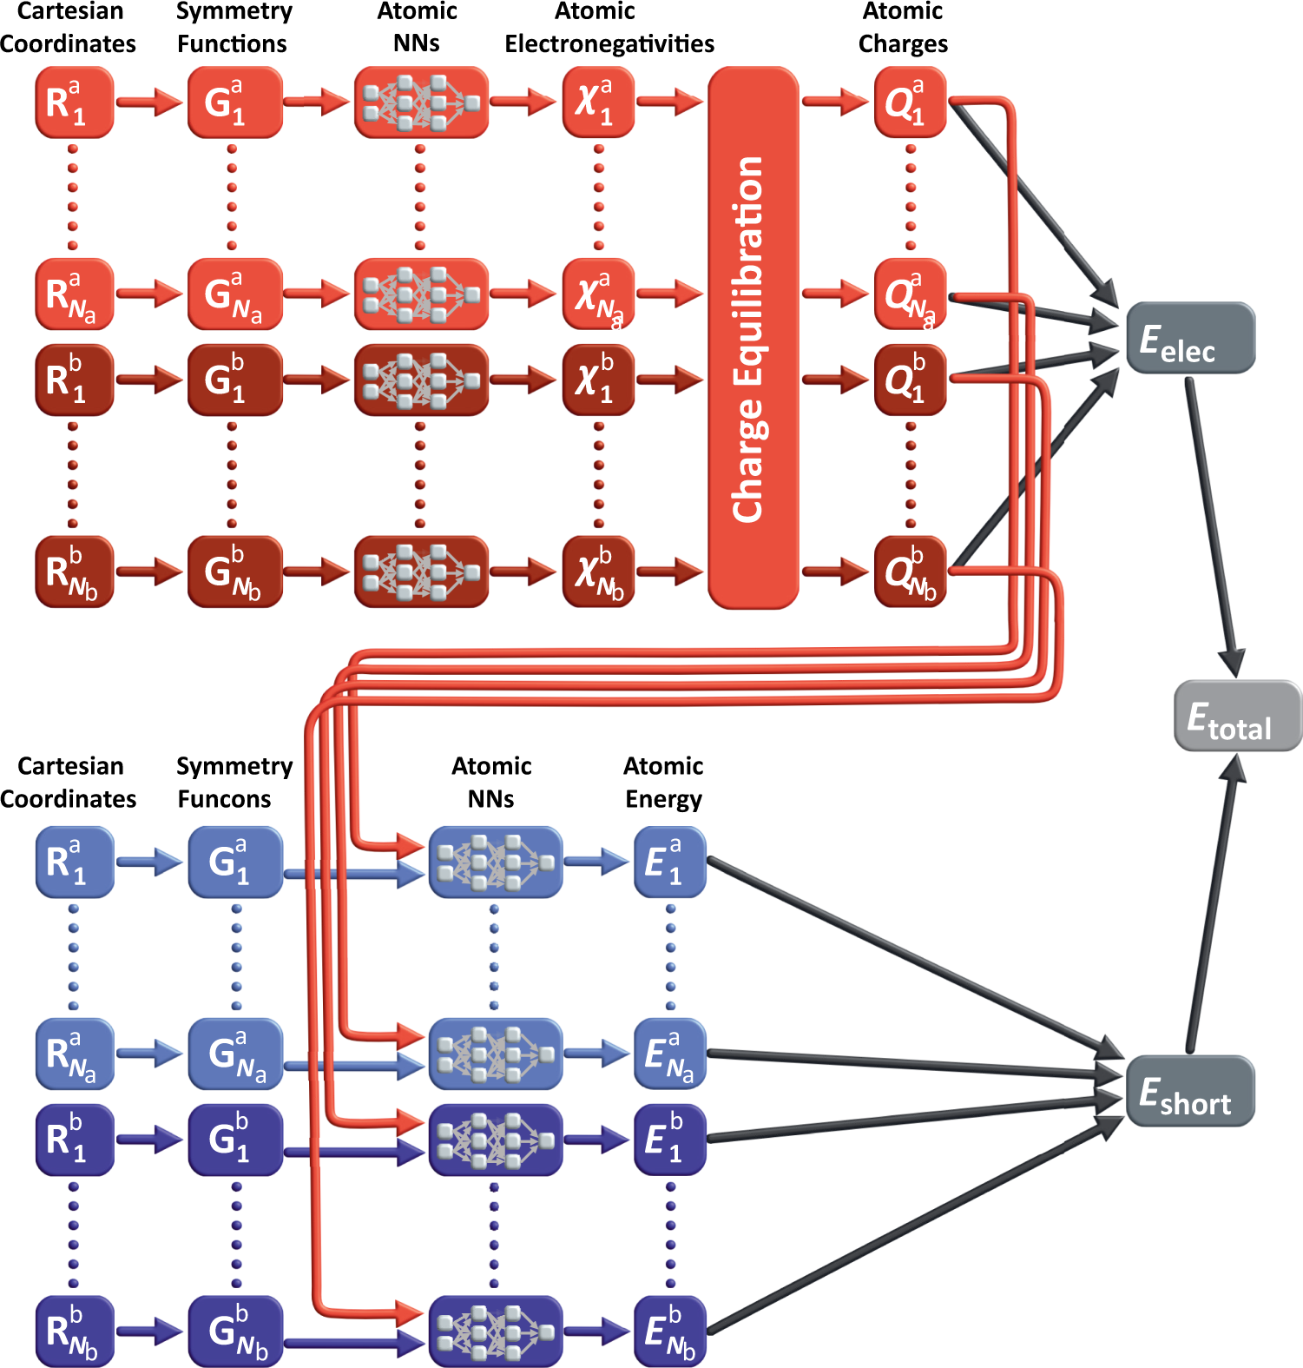
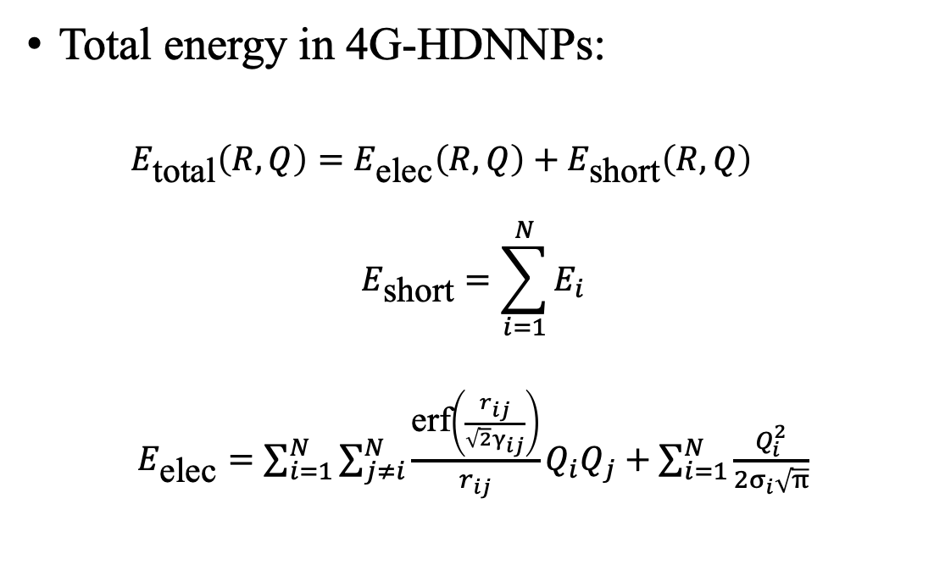

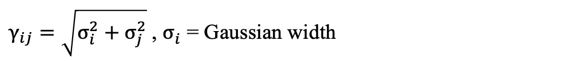
Architecture of 4G-HDNNPs
Total energy in 4G-HDNNPs:
  $$E_{\text{total}}\left(R,Q\right)=E_{\text{elec}}\left(R,Q\right)+E_{\text{short}}\left(R,Q\right)$$
$$E_{\text{short}}=\sum_{i=1}^{N}{E_{i}}$$
$E_{\text{elec}}=\sum_{i=1}^{N}{\sum_{j≠i}^{N}{\frac{\text{erf}\left(\frac{r_{ij}}{\sqrt{2}γ_{ij}}\right)}{r_{ij}}}Q_{i}Q_{j}}+\sum_{i=1}^{N}{\frac{Q_{i}^{2}}{2σ_{i}\sqrt{π}}}$
Cross term
Self term
$r_{ij}$Distance between atoms i and j
$γ_{ij}=\sqrt{σ_{i}^{2}+σ_{j}^{2}}$ , $σ_{i}^{ }$ = Gaussian width
Ko et. al., Nat. Commun. 2021, 12, 398.

Slide 5
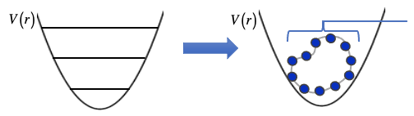
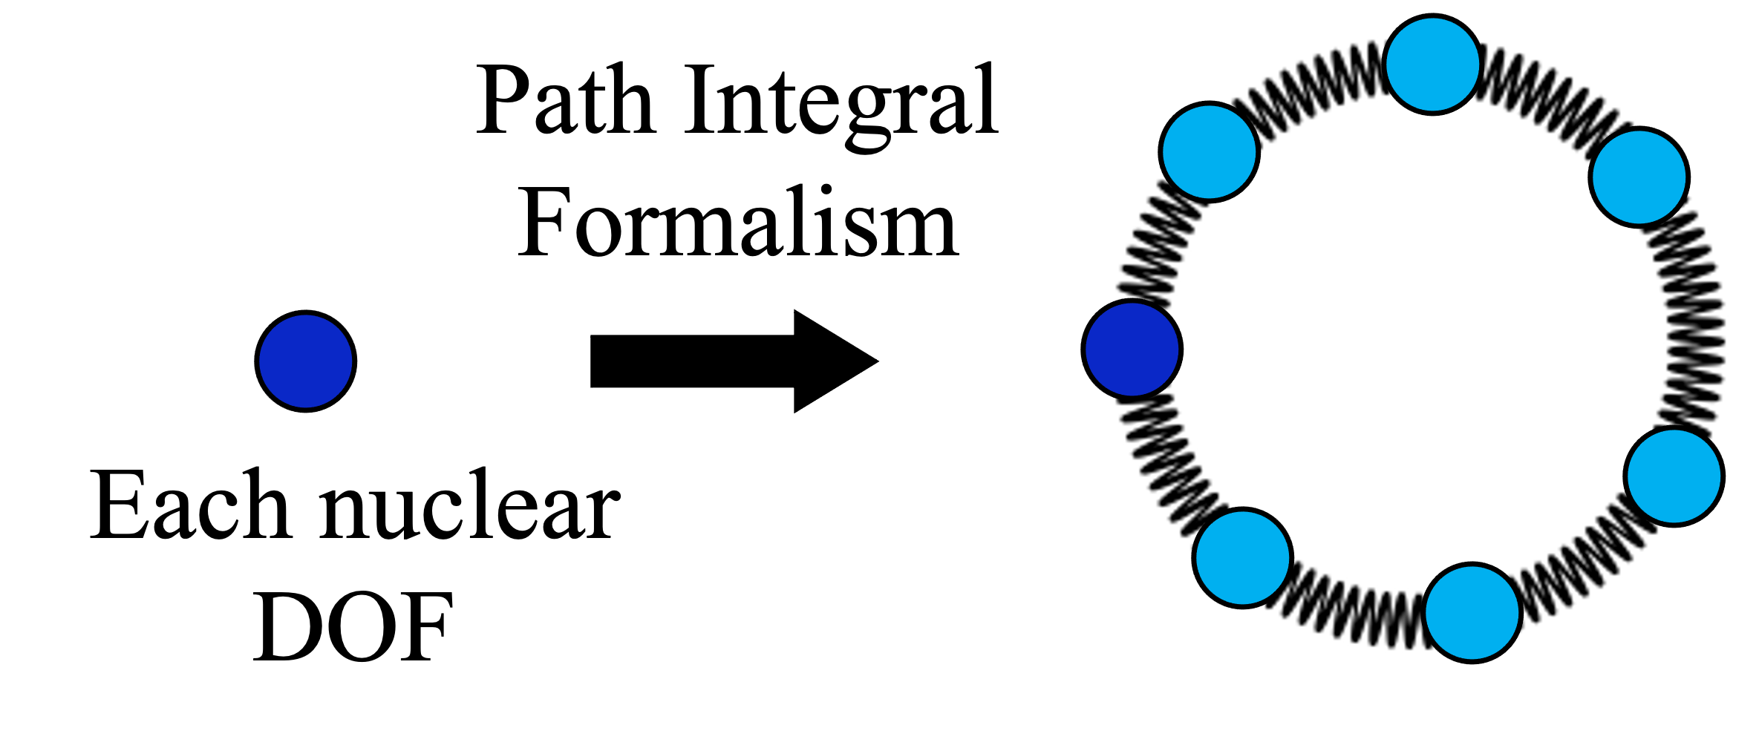
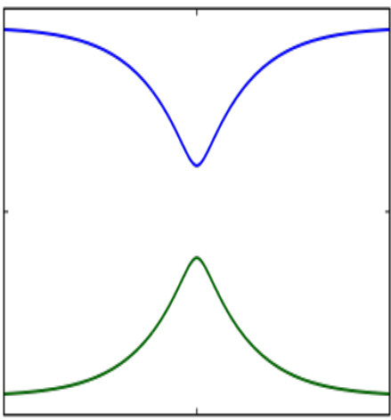

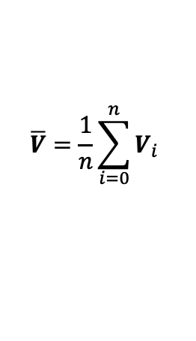

Feynman’s Path Integral Molecular Dynamics (PIMD)
PIMD
Quantum – Classical Isomorphism
Harmonic springs encode
quantum fluctuations
Classical ring Polymer,
comprised of
n beads
$$p$$
Quantum Mechanics
Classical Mechanics
$$r$$
The extended classical phase space of a ring polymer represents quantum equilibrium statistics.
Classical
RPMD
Classical
RPMD
Zero-point energy
$$\overline{V}=\frac{1}{n}\sum_{i=0}^{n}{V_{i}}$$
Quantum tunneling
Chandler D., Introduction to Modern Statistical Mechanics (Oxford University Press, New York, 1987).
Parrinello and Rahman, J. Chem. Phys. 1984, 80, 860

Slide 6
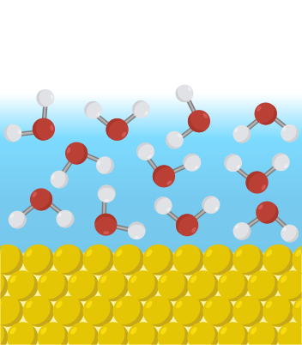
Workflow
Training Dataset
4G Model Training and Improvement
Classical
trajectory
Quantum
trajectory
ML-CMD Model Training
IR and SEIRAS
Faruque & Momeni Manuscript in Preparation.

Slide 7
4G-HDCNNP Calculated Quantum IR Spectra
The experimental O-H stretch peak: 3420 cm⁻¹.
Blue shift for the classical OH stretch due to the neglect of NQEs.
The inclusion of NQEs via the TRPMD and PA-CMD methods largely corrects this deviation.
32-bead simulations, computationally expensive.
We need faster and more accurate methods.
280 cm⁻¹
34 cm⁻¹
34 cm⁻¹
Bertie et al., Appl. Spectrosc. 1996, 50, 1047
Faruque et al., J. Phys. Chem. Lett. 2026, 17, 3240.

Slide 8
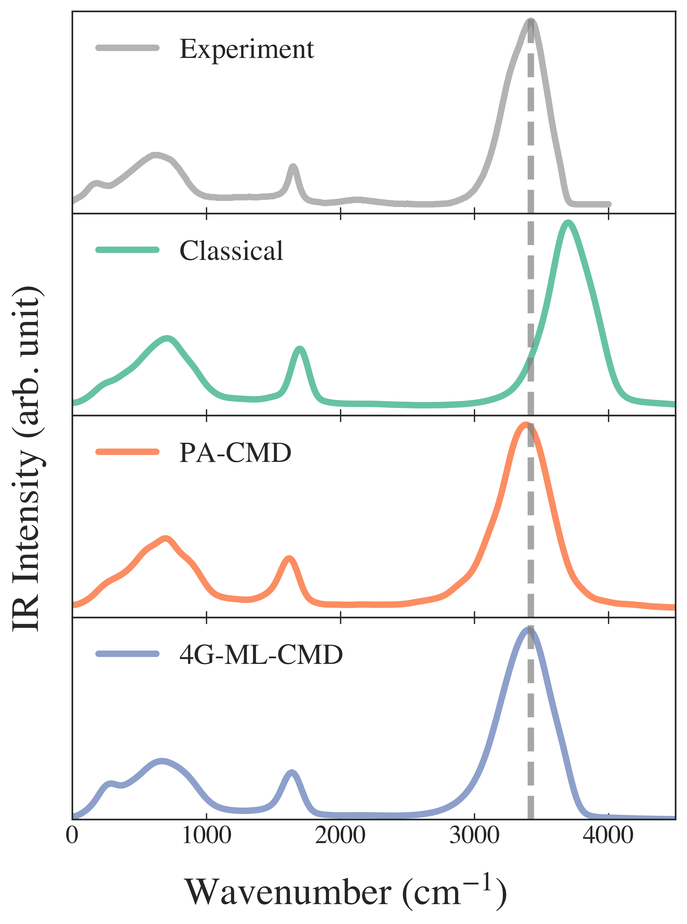
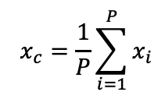
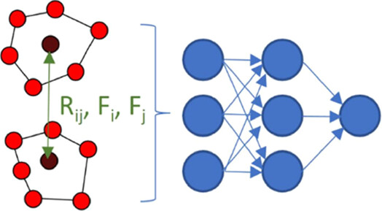
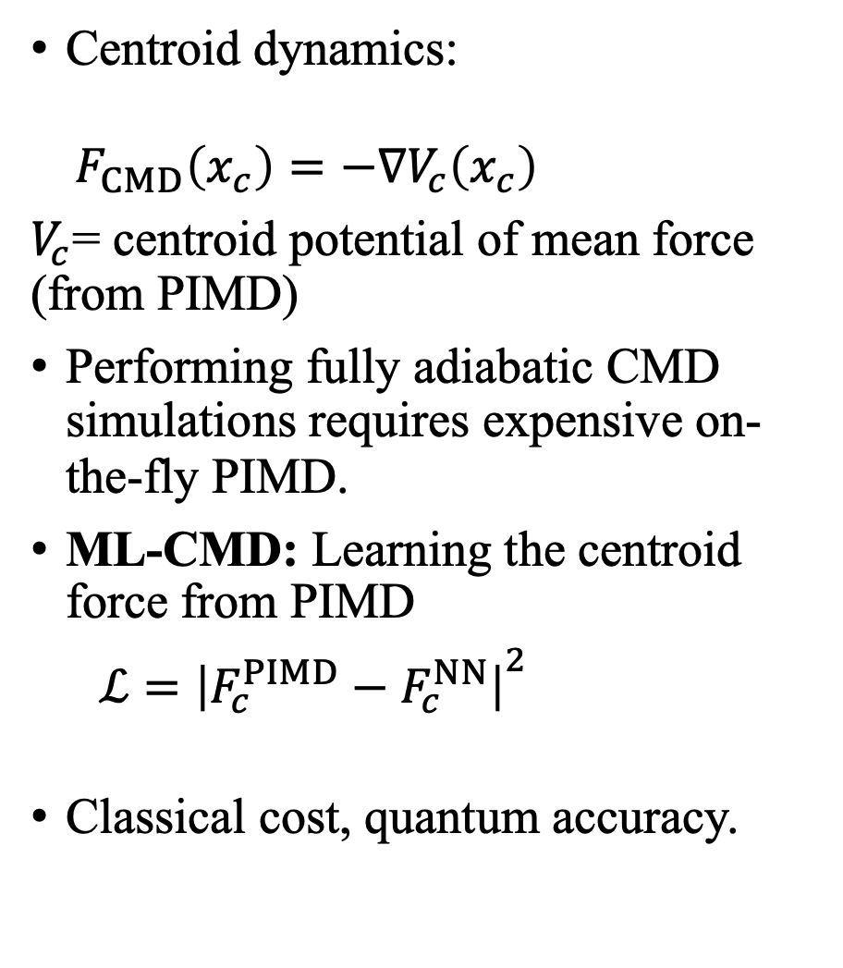
4G-ML-CMD Method for Liquid Bulk Water
Centroid dynamics:
$${ F}_{CMD}\left(x_{c}\right)=−∇V_{c}\left(x_{c}\right)$$
$V_{c}$= centroid potential of mean force (from PIMD)
Performing fully adiabatic CMD simulations requires expensive on-the-fly PIMD.
ML-CMD: Learning the centroid force from PIMD
$ℒ={∣F_{c}^{PIMD}−F_{c}^{NN}∣}^{2}$
Classical cost, quantum accuracy.
280 cm⁻¹
40 cm⁻¹
10 cm⁻¹
Loose et al., J. Chem. Theory Comput. 2022, 18, 5856.
Faruque & Momeni, Manuscript in Preparation.

Slide 9
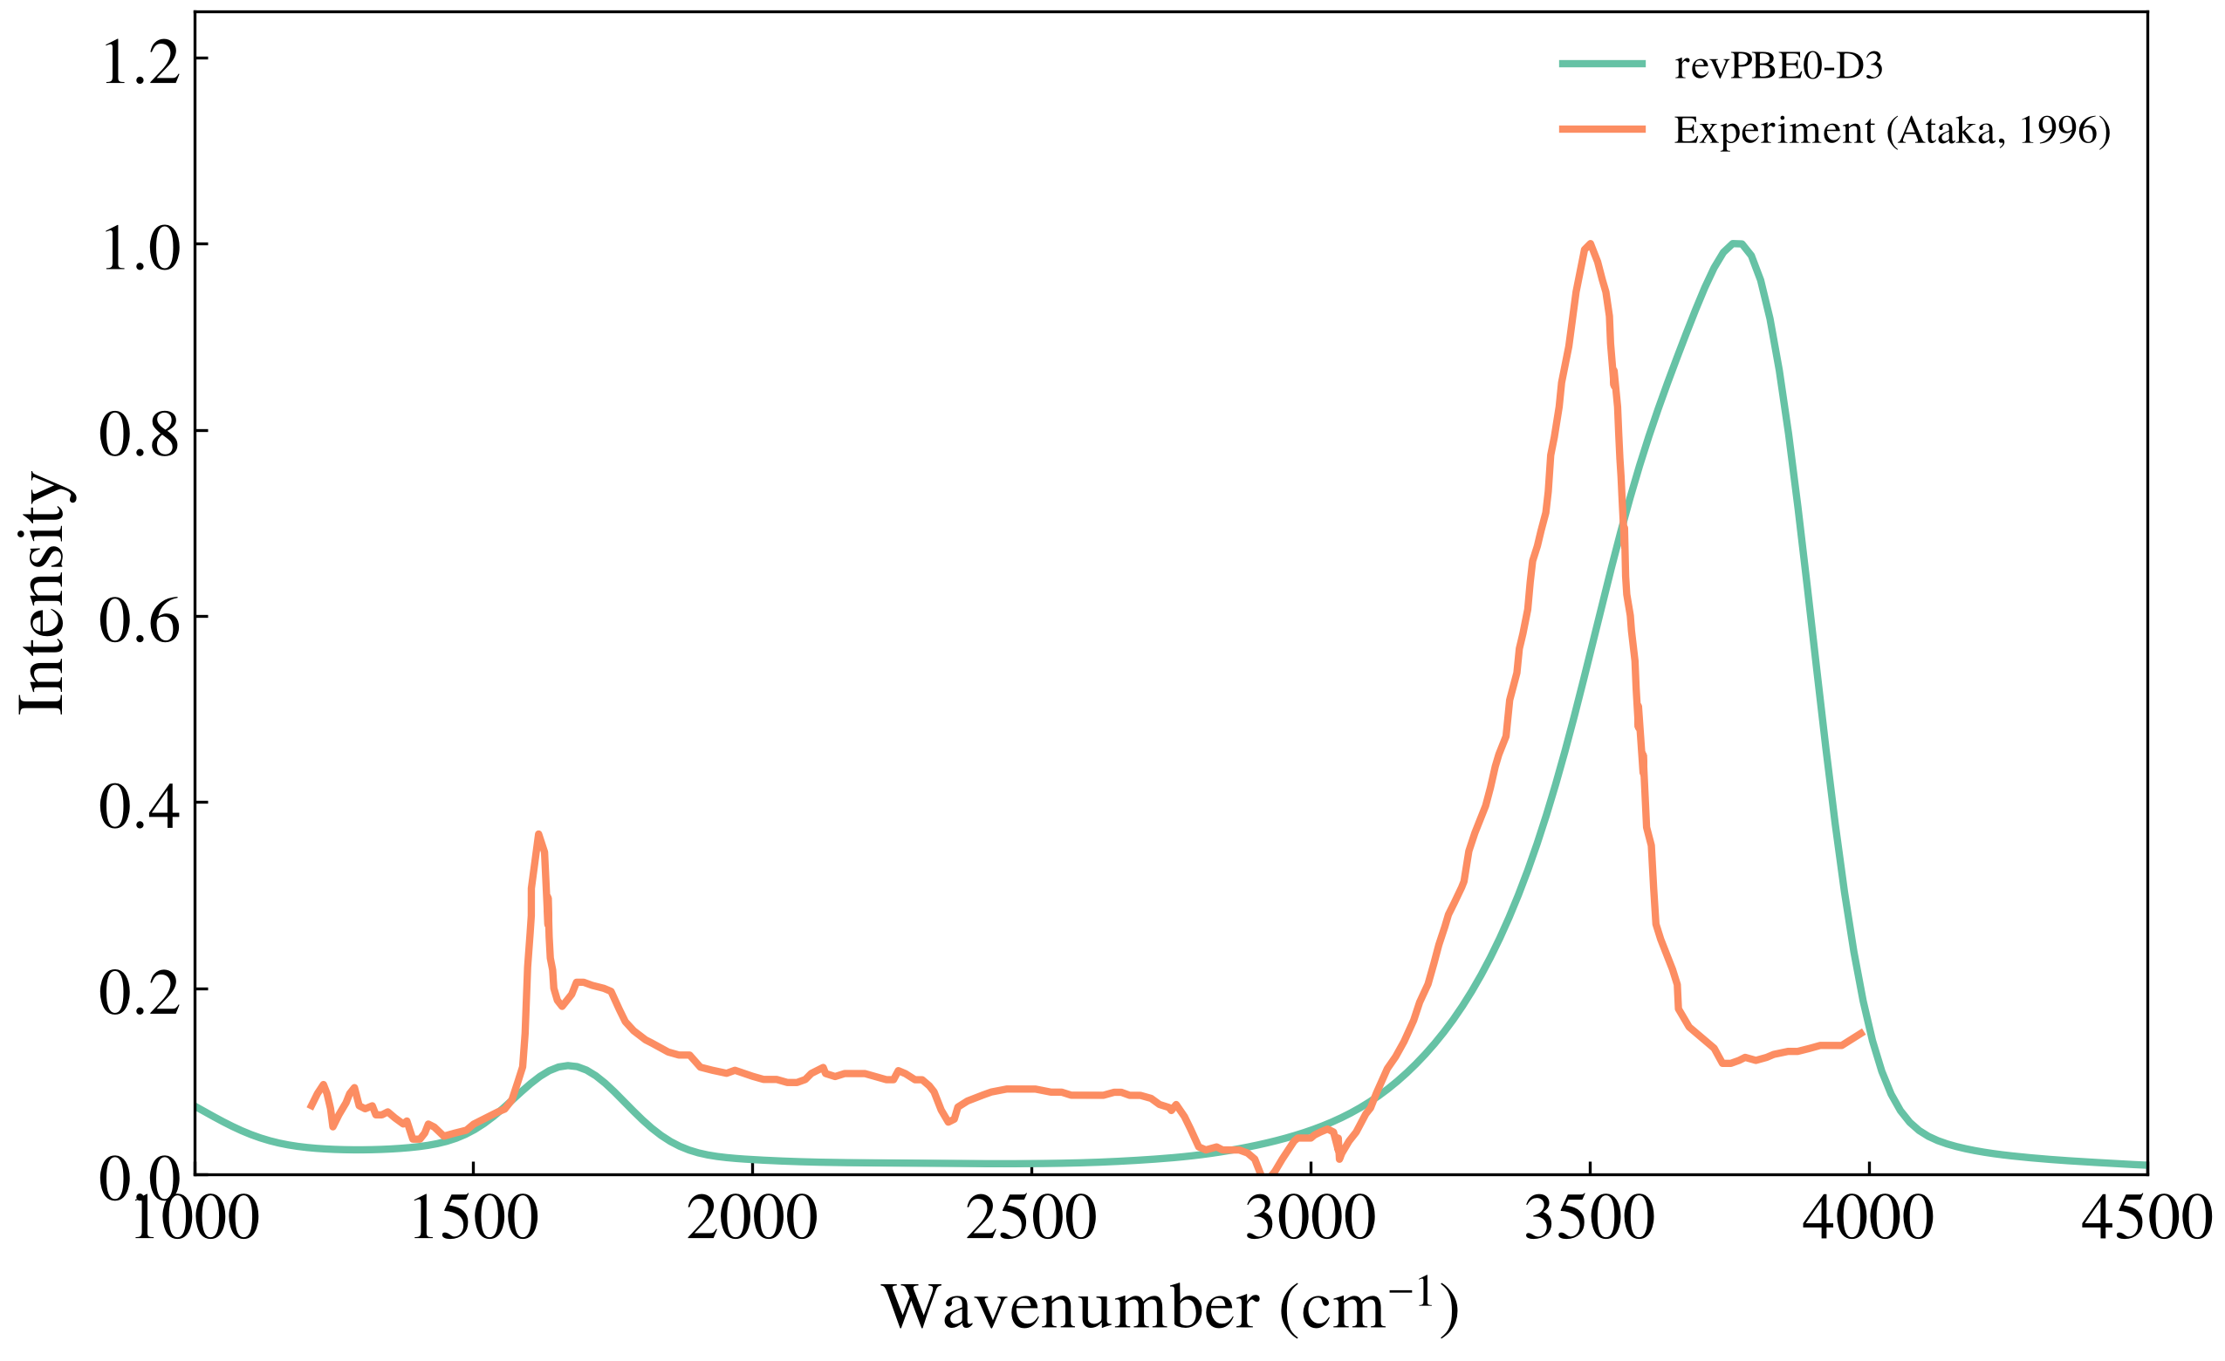
SEIRAS Spectra from 4G-ML-CMD of Au-H₂O Interfaces
Classical surface-enhanced infrared absorption spectra (SEIRAS) of Au/water show a blue shift in the OH stretch region.
The inclusion of NQEs is expected to correct this deviation.
We have recently established the accuracy of BF-PIMD and BF-RPMD methods for calculating thermal equilibrium and dynamical properties of condensed-phase systems.
167 cm⁻¹
Au-111/H₂O
A 4G-ML-CMD method based on the Bead-Fourier PIMD method will be developed to accurately and efficiently incorporate NQEs.
London & Momeni, J. Chem. Phys. 2025, 163, 144123.
London & Momeni, arXiv:2510.09961 [physics.chem-ph].
London & Momeni, Manuscript Submitted.
Faruque & Momeni, Manuscript in Preparation.
Ataka et al., J. Phys. Chem., 1996, 100.

Slide 10
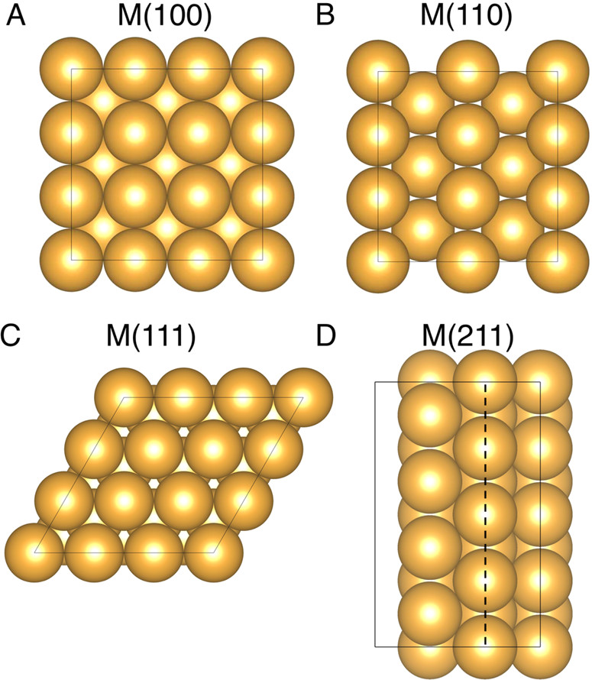
Conclusions and Future Work
4G-ML-CMD is a fast and accurate method for calculating quantum IR spectra.
Future work will involve SEIRAS quantum spectral simulations of the high- and low-index Au-water interface systems using the developed 4G-ML-CMD framework based on BF-PIMD.
Expanding the applications of 4G-ML-CMD to study vibrational strong coupling in polaritonic chemistry.
Back et al., ACS Catal. 2015, 5, 9, 5089.
Faruque & Momeni, Manuscript in Preparation.

Slide 11
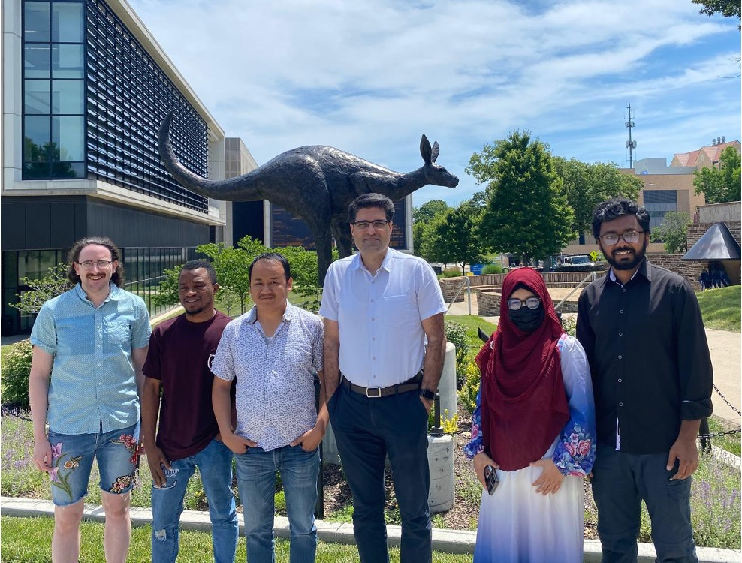



Acknowledgement
PI
Dr. Mohammad R. Momeni
Lab mates
Dr. Nathan London
Suchona Akter
Quadri Adewuyi
From L: Nathan London, Quadri Adewuyi, Dil Limbu, Mohammad Momeni, Suchona Akter, Md Omar Faruque

