Slide 1
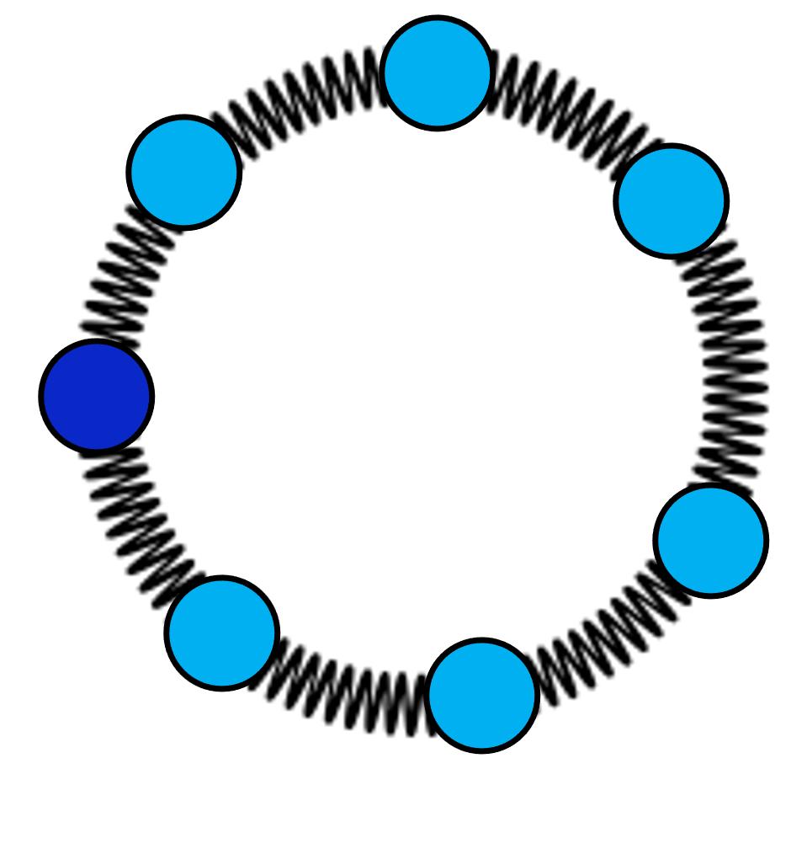
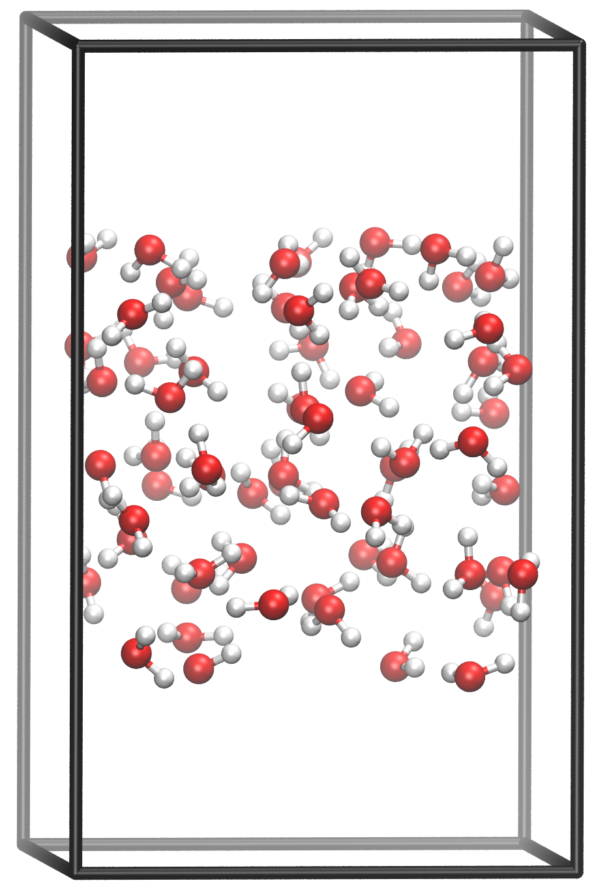
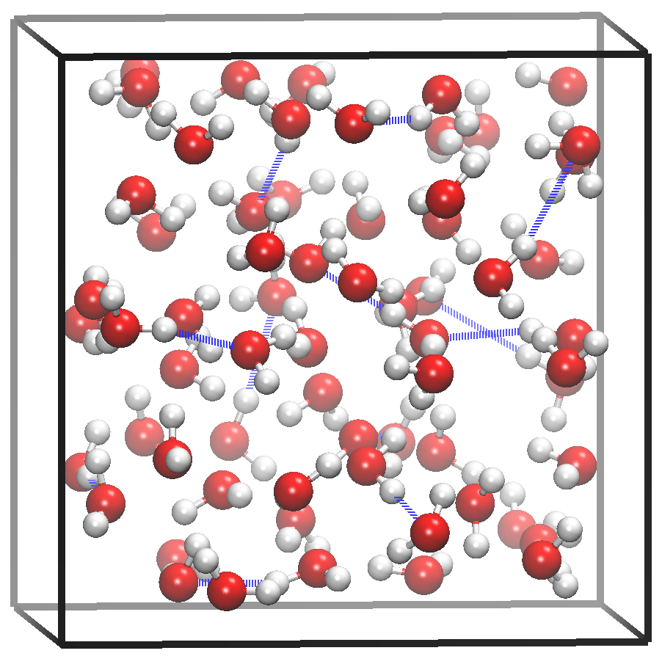
Fast and Accurate IR Spectra with Neural Networks
Md Omar Faruque
Advisor: Dr. Mohammad R. Momeni
Bulk & Interface
4th Generation Neural Network Model
Vibrational Spectra
air
bulk
water
IR Intensity
water
air
Frequency

