Slide 1
Relational Data Model
Parteek Kumar

Slide 2
Keys of a Relation
Super Key
Candidate Key
Primary Key
Alternate Key
Artificial Key
Foreign Key

Slide 3
Keys of a Relation
Super Key
Candidate Key
Primary Key
Alternate Key
Artificial Key
Foreign Key
Unique

Slide 4

Keys of a Relation
Super Key
Candidate Key
Primary Key
Alternate Key
Artificial Key
Foreign Key

Slide 5


Slide 6
Unique
Super key
A superkey in a database is a set
of one or more attributes (columns) that
uniquely identify a row in a table.

Slide 7
Super Key
Key Characteristics:
Uniqueness: A superkey must ensure that no two rows in the table have the same combination of values for its attributes.
Non-minimality: A superkey can include extra attributes that are not necessary to maintain uniqueness. For example, while {A} may uniquely identify a row, {A, B} is still a valid superkey.
Some times also called as Reducible

Slide 8
Consider a table Employee:
EmpID | Name | Email
101 | Alice | alice@example.com
102 | Bob | bob@example.com
103 | Alice | alice1@example.com
Super Keys?

Slide 9
Consider a table Employee:
EmpID | Name | Email
101 | Alice | alice@example.com
102 | Bob | bob@example.com
103 | Alice | alice1@example.com
Super Keys: EmpId
EmailId
{EmpID, Name}
{EmailId, Name}
{EmpID, EmailId}
{EmpId, EmailId, Name}

Slide 10
Example
Consider a table Employee:
EmpID | Name | Email | Phone
101 | Alice | alice@example.com | 1234567890
102 | Bob | bob@example.com | 9876543210
103 | Alice | alice1@example.com | 2134567890

Slide 11
Candidate Key
Candidate Key (Minimal Superkey) :
A candidate key is a minimal (irreducible) superkey, meaning it contains no extra attributes.
In the above example:
{EmpID} and {Email} are candidate keys because they are minimal and sufficient to uniquely identify rows.

Slide 12
A superkey ensures row uniqueness in a database table, while a candidate key is the minimal version of a superkey, containing only the essential attributes needed for uniqueness.

Slide 13
Super key
A superkey in a database is a set
of one or more attributes (columns) that
uniquely identify a row in a table.

Slide 15
Superkey
Candidate
Key

Slide 16
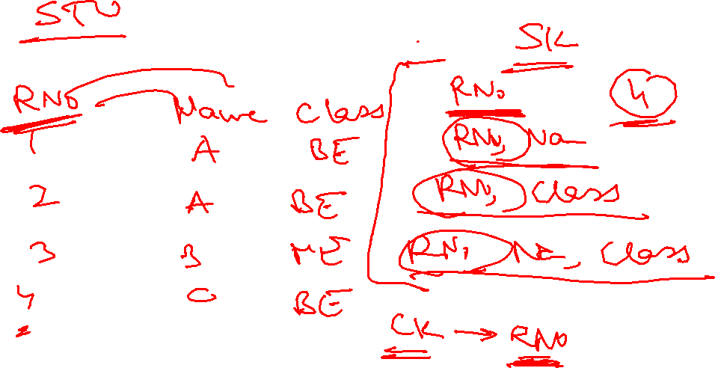

Slide 17
Primary Key
A Primary Key (PK) is a candidate key that is mandatory. Means Not Null
Unique
Minimal (Irreducible)
Not Nulll
It is selected from the table's candidate keys and serves as the main unique identifier for the table.

Slide 18
Key Characteristics of a Primary Key:
Uniqueness: The primary key ensures that no two rows in the table have the same value for the primary key column(s).
Minimality: While the primary key is chosen from the candidate keys, it must be minimal—only the necessary attributes are included.
Non-null: A primary key cannot have NULL values, as it must uniquely identify each row.

Slide 19
Super key
A superkey in a database is a set
of one or more attributes (columns) that
uniquely identify a row in a table.

Slide 21
Superkey
Candidate
Key

Slide 22
Superkey
CK
PK

Slide 23
Alternate Key
An Alternate Key is a candidate key that is not chosen as the primary key in a database table.
While it satisfies the requirements of uniqueness and minimality, it remains as an alternative to the primary key for uniquely identifying rows in the table, as this can have null values.

Slide 24
Key Characteristics of an Alternate Key:
Uniqueness: Like the primary key, an alternate key ensures that no two rows have the same value for its attributes.
Non-selected Candidate Key: An alternate key is a candidate key that was not selected to be the primary key.
Minimality: It includes the smallest set of attributes required for uniqueness.

Slide 25
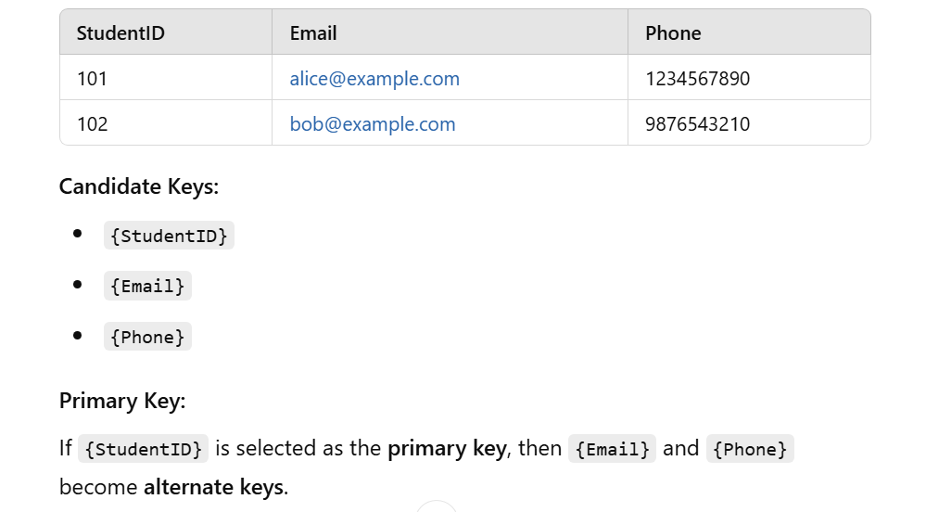

Slide 26
Artificial key
An artificial key (also known as a surrogate key) is a type of key in a database that is artificially created to uniquely identify rows in a table.
It is usually a numeric or alphanumeric value generated by the database system and has no real-world meaning or relevance outside the database.

Slide 27
Artificial key
Key Characteristics of Artificial Keys:
Uniqueness: Ensures every row in the table can be uniquely identified.
Unrelated to Business Logic: It is not derived from the actual data or attributes of the entity.
Database-Generated: Typically, it is automatically generated by the database system, such as through an auto-increment field or a sequence.
Consistency: Artificial keys provide a stable and unchanging identifier for a row, even if other attributes change.

Slide 28
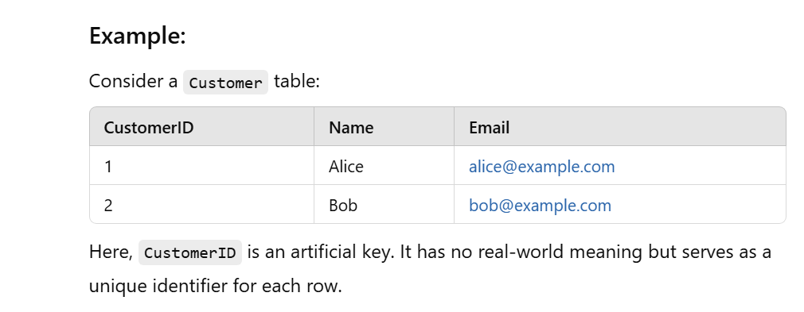
Artificial key

Slide 29
Artificial Keys vs. Natural Keys:
Artificial Key: Created solely for database management and has no inherent meaning in the real world.
  Example: A sequential number like 1, 2, 3.
Natural Key: Derived from real-world data and has intrinsic meaning.
  Example: Social Security Number (SSN), Email Address.

Slide 30
Pros of Artificial Keys
Flexibility: Remains unaffected by changes in the underlying data.
Consistency: Ensures a single, unchanging key for each record.
Indexing and Performance: Typically smaller and more efficient for indexing.

Slide 31
Cons of Artificial Keys
No Business Relevance: Cannot convey meaningful information about the record.
Additional Maintenance: Requires the generation and management of unique values.

Slide 32
Use Cases
Artificial keys are often used when:
  No suitable natural key exists.
  Composite keys (multiple columns combined) would be required for uniqueness.
  The natural key might change over time (e.g., email or phone number).

Slide 33
Primary Key (PK):
{EnrollmentID}: A single-column key uniquely identifying each row.
Chosen for simplicity and efficiency as the main identifier.
Composite Key (Candidate Key):
{StudentID, CourseID, Semester}: A natural key that ensures no student can enroll in the same course in the same semester more than once.
Could also serve as the primary key if EnrollmentID weren't used.
Alternate Key (AK):
{StudentID, CourseID, Semester}: If {EnrollmentID} is chosen as the primary key, the composite key {StudentID, CourseID, Semester} becomes an alternate key because it also uniquely identifies rows but is not the primary key.

Slide 34
Alternate Key
The alternate keys of any table are simply those candidate keys, which are not currently selected as the primary key.

Slide 35
Foreign Key
Foreign keys are the attributes of a table, which refers to the primary key of some another table. Foreign Keys permit only those values, which appears in the primary key of the table to which it refers or may be null. Foreign keys are used to link together two or more different tables which have some form of relationship with each other. The foreign key is a reference to the tuple of a table from which it was taken, this tuple being called the Referenced or Target tuple. The table containing the referenced tuple will be called as Target table.
The matter of integrity of foreign keys is referred to as Referential Integrity.

Slide 36

Foreign Key Contd..

Slide 37

Foreign Key Contd..

Slide 38
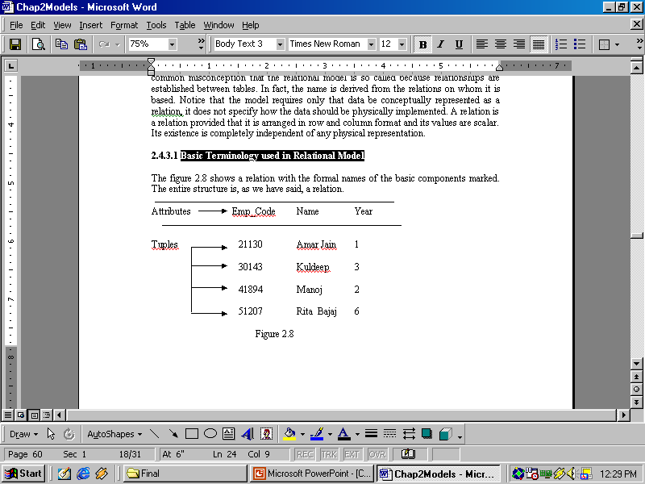
Other Terminologies
Tuples of a Relation
Cardinality of a relation
Cardinality of relation
The number of tuples in a relation determines its cardinality. In this case, the relation has a cardinality of 4.

Slide 39
Other Terminologies
Degree of a relation
Each column in the tuple (row) is called an attribute. The number of attributes in a relation determines its degree. The relation in has a degree of 3.

Slide 40
Other Terminologies
Domains
A domain definition specifies the kind of data represented by the attribute. More particularly, a domain is the set of all possible values that an attribute may validly contain.

Slide 41
Other Terminologies
Domains Vs Data types
Data type is a physical concept while domain is a logical one. “Number” is a data type and “Age” is a domain. To give another example “StreetName” and “Surname” might both be represented as text fields, but they are obviously different kinds of text fields; they belong to different domains.

Slide 42
Other Terminologies
Body of a Relation
The body of the relation consists of an unordered set of zero or more tuples. It means:
Relation is unordered.
A relation with no tuples still qualifies as a relation.
Relation is a set.

Slide 43
Reference
Simplified Approach to DBMS
By
Parteek Bhatia, Kalyani Publishers

