Slide 1
CLINICAL PATHOLOGY RESIDENCY LECTURE SERIES
CLINICAL CHEMISTRY · LECTURE 3 OF 5
Renal, Liver & Cardiac Biomarkers
Interpretation Patterns, Kinetics, and Common Misuse
Dr. Tamima El-Jisr
Chairperson, Department of Laboratory Medicine
Makassed General Hospital, Beirut
Clinical Pathology Residency Curriculum

Slide 2
CLINICAL CHEMISTRY · FRAMING THE PROBLEM
Why This Matters
eGFR
Pattern
Delta
Creatinine is a late, imperfect marker of kidney function
LFTs are read as a pattern, not as isolated numbers
High-sensitivity troponin needs a serial rise/fall, not one value
These are the biomarkers clinicians call about most. The consultative value is in interpretation patterns, kinetics, and recognizing the ways each test is misused.
A single elevated troponin is not an MI; a single normal creatinine is not normal kidney function — context and kinetics decide.
Makassed General Hospital · Department of Laboratory Medicine
CP Lecture Series · 2

Slide 3
CLINICAL CHEMISTRY · ·
Learning Objectives
Interpret creatinine, eGFR equations, and cystatin C.
Apply the KDIGO concept of acute kidney injury.
1
2
Read hepatocellular versus cholestatic LFT patterns and synthetic function.
Apply high-sensitivity troponin kinetics and the universal MI definition.
3
4
Use natriuretic peptides appropriately.
Recognize macro-analytes and biomarker misuse.
5
6
Makassed General Hospital · Department of Laboratory Medicine
CP Lecture Series · 3

Slide 4
CLINICAL CHEMISTRY · WHAT WE WILL COVER
Roadmap
Renal markers — creatinine, eGFR, cystatin C, AKI
1
Liver patterns — hepatocellular vs cholestatic; function
2
Cardiac markers — troponin kinetics, natriuretic peptides
3
Pitfalls & misuse — macro-analytes, overordering
4
Cases & board review
5
Makassed General Hospital · Department of Laboratory Medicine
CP Lecture Series · 4

Slide 5
01
PART ONE
Renal Markers

Slide 6
CLINICAL CHEMISTRY · RENAL
Creatinine, eGFR, and Cystatin C
CREATININE & EGFR
CYSTATIN C
Creatinine depends on muscle mass, diet, and tubular secretion — it rises late as GFR falls.
eGFR (CKD-EPI; 2021 race-free equation) estimates function.
Drugs (trimethoprim, cimetidine) raise creatinine by blocking secretion without changing GFR.
Creatinine lags acute changes — a 'normal' value early in AKI is misleading.
Filtered marker largely independent of muscle mass.
Useful when creatinine is unreliable (extremes of muscle, cirrhosis, amputees).
Combined creatinine–cystatin C eGFR improves accuracy.
Affected by thyroid disease and steroids.
Makassed General Hospital · Department of Laboratory Medicine
CP Lecture Series · 5

Slide 7
CLINICAL CHEMISTRY · RENAL
Acute Kidney Injury
DEFINING AKI (KDIGO)
PRE-RENAL VS INTRINSIC
↑ creatinine ≥ 0.3 mg/dL in 48 h, or ≥1.5× baseline within 7 days, or oliguria.
Staged by the magnitude of creatinine rise and urine output.
Creatinine lags — so early AKI may have a still-'normal' value.
Urinalysis and urine indices help localize the cause.
Pre-renal: BUN:creatinine often &gt; 20:1; bland urine; low FeNa.
Intrinsic (ATN): muddy-brown casts; FeNa often &gt; 2%.
Post-renal: obstruction — imaging.
Interpret FeNa cautiously (diuretics, CKD).
Makassed General Hospital · Department of Laboratory Medicine
CP Lecture Series · 6

Slide 8
02
PART TWO
Liver & Cardiac Markers

Slide 9
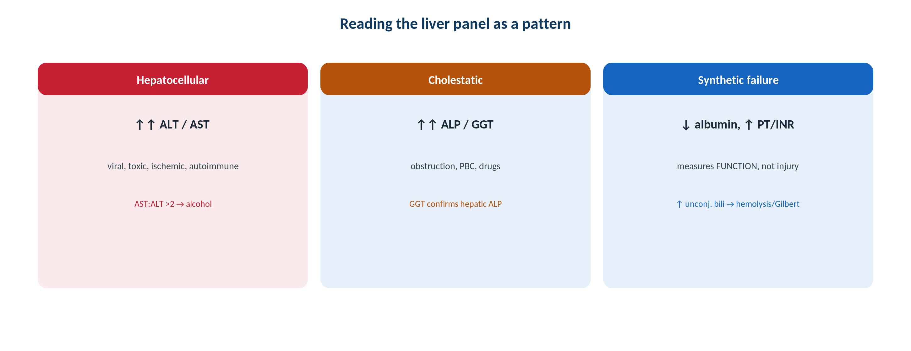
CLINICAL CHEMISTRY · LIVER
Reading the Liver Panel as a Pattern
Original schematic. Separate hepatocellular from cholestatic injury, and injury markers from synthetic function.
Makassed General Hospital · Department of Laboratory Medicine
CP Lecture Series · 7

Slide 10
CLINICAL CHEMISTRY · LIVER
Patterns and Function
HEPATOCELLULAR VS CHOLESTATIC
FUNCTION VS INJURY
Hepatocellular: ALT/AST predominate (viral, toxic, ischemic, autoimmune).
AST:ALT &gt; 2 with modest elevation suggests alcoholic liver disease.
Cholestatic: ALP and GGT predominate (obstruction, PBC, drugs).
GGT confirms a hepatic source of an elevated ALP (vs bone).
ALT/AST/ALP measure injury; bilirubin, albumin, PT/INR measure FUNCTION.
Synthetic failure: low albumin, prolonged PT/INR.
Isolated unconjugated hyperbilirubinemia: hemolysis or Gilbert.
Conjugated hyperbilirubinemia → hepatobiliary disease.
Makassed General Hospital · Department of Laboratory Medicine
CP Lecture Series · 8

Slide 11
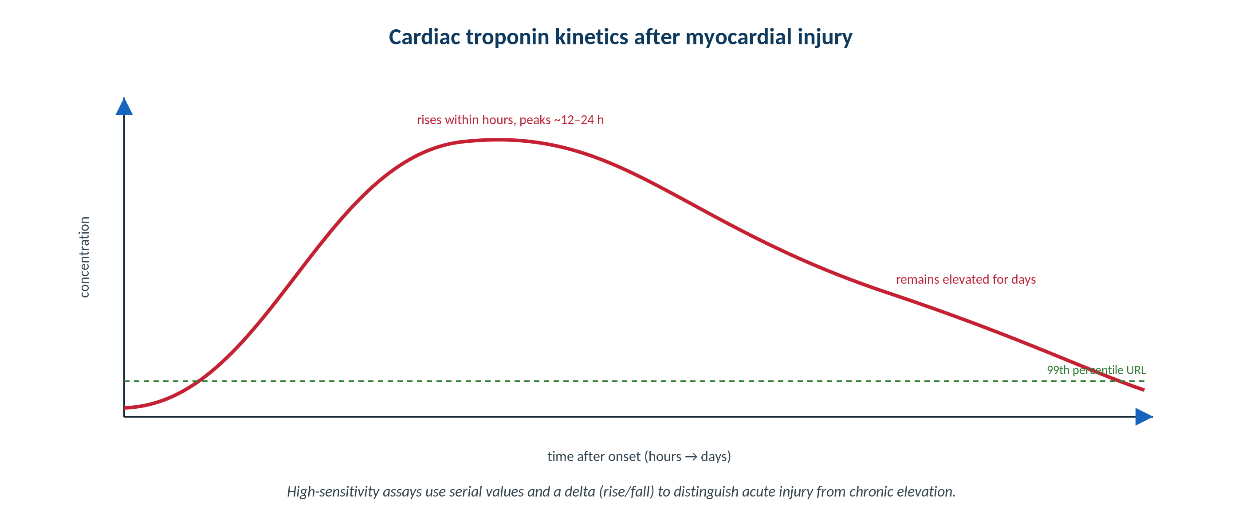
CLINICAL CHEMISTRY · CARDIAC
High-Sensitivity Troponin Kinetics
Original schematic. Acute injury produces a rise-and-fall around the 99th-percentile URL; chronic elevation is stable.
Makassed General Hospital · Department of Laboratory Medicine
CP Lecture Series · 9

Slide 12
CLINICAL CHEMISTRY · CARDIAC
Troponin and Natriuretic Peptides
TROPONIN INTERPRETATION
BNP / NT-PROBNP
A value &gt; 99th-percentile URL defines myocardial injury; a rising/falling pattern defines ACUTE injury.
High-sensitivity assays use sex-specific URLs and 0/1- or 0/2-hour delta protocols.
Chronic stable elevation: CKD, heart failure, structural disease — not MI by itself.
Type 1 (plaque rupture) vs type 2 (supply-demand) needs clinical correlation.
Rise with ventricular wall stress — strong NEGATIVE predictive value to rule out heart failure.
Higher with age and renal impairment; lower in obesity.
NT-proBNP is renally cleared and runs higher than BNP.
Support, don’t replace, the clinical diagnosis.
Makassed General Hospital · Department of Laboratory Medicine
CP Lecture Series · 10

Slide 13
03
PART THREE
Pitfalls, Cases & Board

Slide 14
CLINICAL CHEMISTRY · PITFALLS
Macro-Analytes & Common Misuse
MACRO-ANALYTES
COMMON MISUSE
Macro-CK and macro-AST: immunoglobulin-bound → persistently high, silent.
Macroprolactin: spurious hyperprolactinemia — confirm with PEG precipitation.
Suspect when an isolated marker is high without clinical correlate.
Resolve with alternative methods or PEG.
Ordering troponin without a pretest probability of ACS → false-positive-driven workups.
Using BNP in isolation to diagnose dyspnea.
Repeating LFTs without a pattern-based plan.
Ignoring drug effects on creatinine.
Makassed General Hospital · Department of Laboratory Medicine
CP Lecture Series · 11

Slide 15
CLINICAL CHEMISTRY · CASE 1
Case 1
CLINICAL VIGNETTE
A patient with advanced CKD has a troponin persistently just above the URL, unchanged across three serial draws, with no ischemic symptoms or ECG changes.
?
Is this an acute MI? How does the pattern guide you?
Makassed General Hospital · Department of Laboratory Medicine
CP Lecture Series · 12

Slide 16
CLINICAL CHEMISTRY · CASE 1 · RESOLUTION
Case 1: Chronic Troponin Elevation
A stable elevation without a rise/fall is chronic myocardial injury, not an acute MI.
CKD, heart failure, and structural disease cause stable elevations.
Acute MI requires a dynamic rise and/or fall on serial hs-troponin plus clinical/ECG context.
Establish each patient’s baseline.
TEACHING POINT
With high-sensitivity troponin, the DELTA matters more than a single value — stable = chronic, dynamic = acute.
Makassed General Hospital · Department of Laboratory Medicine
CP Lecture Series · 13

Slide 17
CLINICAL CHEMISTRY · CASE 2
Case 2
CLINICAL VIGNETTE
A patient has ALP three times the upper limit. The team asks whether this is from liver or bone.
?
Which single add-on test resolves the source, and how?
Makassed General Hospital · Department of Laboratory Medicine
CP Lecture Series · 14

Slide 18
CLINICAL CHEMISTRY · CASE 2 · RESOLUTION
Case 2: Isolated High ALP
Check GGT: an elevated GGT confirms a hepatic (biliary) source of the high ALP.
A normal GGT points to a non-hepatic source (bone, placenta, intestine).
ALP isoenzyme fractionation is an alternative.
Correlate with the clinical context and other LFTs.
TEACHING POINT
GGT is the reflex test for an isolated high ALP: GGT up → hepatic; GGT normal → bone/placenta/intestine.
Makassed General Hospital · Department of Laboratory Medicine
CP Lecture Series · 15

Slide 19
CLINICAL CHEMISTRY · CASE 3
Case 3
CLINICAL VIGNETTE
An asymptomatic woman has an isolated, persistently elevated prolactin. Imaging is normal. PEG precipitation recovers a normal prolactin.
?
What was the cause of the apparent hyperprolactinemia?
Makassed General Hospital · Department of Laboratory Medicine
CP Lecture Series · 16

Slide 20
CLINICAL CHEMISTRY · CASE 3 · RESOLUTION
Case 3: Macroprolactin
Macroprolactin (prolactin–IgG complex) caused spurious hyperprolactinemia.
It is biologically inactive but immunoreactive.
PEG precipitation removes it; normal recovered prolactin confirms macroprolactin.
Recognizing it avoids unnecessary imaging and treatment.
TEACHING POINT
Isolated, asymptomatic hyperprolactinemia warrants a macroprolactin check (PEG) before pursuing a prolactinoma.
Makassed General Hospital · Department of Laboratory Medicine
CP Lecture Series · 17

Slide 21
CLINICAL CHEMISTRY · BOARD REVIEW · Q1
Board-Style Review
Which best distinguishes acute MI from chronic troponin elevation?
A. Any value above the URL
B. A dynamic rise and/or fall on serial testing
C. A single very high value
D. Coexisting high BNP
E. Elevated creatinine
Makassed General Hospital · Department of Laboratory Medicine
CP Lecture Series · 18

Slide 22
CLINICAL CHEMISTRY · BOARD REVIEW · Q1
Board-Style Review
Which best distinguishes acute MI from chronic troponin elevation?
A. Any value above the URL
B. A dynamic rise and/or fall on serial testing
C. A single very high value
D. Coexisting high BNP
E. Elevated creatinine
ANSWER B — A dynamic rise/fall on serial testing
Acute injury shows a changing pattern around the URL; chronic conditions show stable elevations.
Makassed General Hospital · Department of Laboratory Medicine
CP Lecture Series · 18

Slide 23
CLINICAL CHEMISTRY · BOARD REVIEW · Q2
Board-Style Review
An elevated ALP with a normal GGT most likely originates from:
A. Bile ducts
B. Liver
C. Bone (or placenta/intestine)
D. Red cells
E. Muscle
Makassed General Hospital · Department of Laboratory Medicine
CP Lecture Series · 19

Slide 24
CLINICAL CHEMISTRY · BOARD REVIEW · Q2
Board-Style Review
An elevated ALP with a normal GGT most likely originates from:
A. Bile ducts
B. Liver
C. Bone (or placenta/intestine)
D. Red cells
E. Muscle
ANSWER C — Bone (non-hepatic)
GGT confirms a hepatic source of ALP; a normal GGT points to bone, placenta, or intestine.
Makassed General Hospital · Department of Laboratory Medicine
CP Lecture Series · 19

Slide 25
CLINICAL CHEMISTRY · BOARD REVIEW · Q3
Board-Style Review
A drug raises serum creatinine without reducing true GFR. The mechanism is:
A. Increased muscle breakdown
B. Inhibition of tubular creatinine secretion
C. Hemoconcentration
D. Assay cross-reactivity only
E. Increased dietary protein
Makassed General Hospital · Department of Laboratory Medicine
CP Lecture Series · 20

Slide 26
CLINICAL CHEMISTRY · BOARD REVIEW · Q3
Board-Style Review
A drug raises serum creatinine without reducing true GFR. The mechanism is:
A. Increased muscle breakdown
B. Inhibition of tubular creatinine secretion
C. Hemoconcentration
D. Assay cross-reactivity only
E. Increased dietary protein
ANSWER B — Inhibition of tubular secretion
Trimethoprim and cimetidine block tubular creatinine secretion, raising serum creatinine without changing GFR.
Makassed General Hospital · Department of Laboratory Medicine
CP Lecture Series · 20

Slide 27
CLINICAL CHEMISTRY · BOARD REVIEW · Q4
Board-Style Review
Which finding best supports a PRE-renal cause of acute kidney injury?
A. Muddy-brown granular casts
B. FeNa &gt; 2%
C. BUN:creatinine &gt; 20:1 with bland urine
D. Hydronephrosis on imaging
E. Eosinophiluria
Makassed General Hospital · Department of Laboratory Medicine
CP Lecture Series · 21

Slide 28
CLINICAL CHEMISTRY · BOARD REVIEW · Q4
Board-Style Review
Which finding best supports a PRE-renal cause of acute kidney injury?
A. Muddy-brown granular casts
B. FeNa &gt; 2%
C. BUN:creatinine &gt; 20:1 with bland urine
D. Hydronephrosis on imaging
E. Eosinophiluria
ANSWER C — BUN:Cr &gt; 20:1 with bland urine
Pre-renal azotemia shows a high BUN:creatinine ratio, low FeNa, and bland urine; muddy-brown casts and high FeNa indicate ATN.
Makassed General Hospital · Department of Laboratory Medicine
CP Lecture Series · 21

Slide 29
CLINICAL CHEMISTRY
Key Take-Home Points
Creatinine rises late; use eGFR (race-free CKD-EPI) and cystatin C when creatinine is unreliable; know KDIGO AKI.
1
Read LFTs as a pattern and separate injury (ALT/AST/ALP) from function (albumin, PT/INR, bilirubin); GGT localizes a high ALP.
2
High-sensitivity troponin: the serial delta defines acute injury; stable elevation = chronic.
3
Use BNP/NT-proBNP mainly to rule out heart failure; adjust for age, renal function, obesity.
4
Suspect macro-analytes (macro-CK, macroprolactin) for isolated, clinically silent elevations.
5
Makassed General Hospital · Department of Laboratory Medicine
22

Slide 30
CLINICAL CHEMISTRY · REFERENCES & FURTHER READING
References
1. Rifai N, et al. Tietz Textbook of Clinical Chemistry, 6th ed. Elsevier, 2018.
2. Thygesen K, et al. Fourth Universal Definition of Myocardial Infarction. Circulation. 2018.
3. Inker LA, et al. New creatinine- and cystatin C-based eGFR equations. N Engl J Med. 2021.
4. KDIGO Clinical Practice Guideline for Acute Kidney Injury.
Makassed General Hospital · Department of Laboratory Medicine
CP Lecture Series · 23

