Slide 1
CLINICAL PATHOLOGY RESIDENCY LECTURE SERIES
CLINICAL CHEMISTRY · LECTURE 4 OF 5
Endocrine & Protein Testing
Thyroid & Adrenal Axes, SPEP Zones, and Free Light Chains
Dr. Tamima El-Jisr
Chairperson, Department of Laboratory Medicine
Makassed General Hospital, Beirut
Clinical Pathology Residency Curriculum

Slide 2
CLINICAL CHEMISTRY · FRAMING THE PROBLEM
Why This Matters
TSH
Zones
FLC
The most sensitive single screen for thyroid status
Each SPEP region maps to specific proteins and diseases
Serum free light chains detect light-chain-only disease
Endocrine and protein testing reward an understanding of feedback axes, dynamic testing, and electrophoretic patterns — and a healthy suspicion for assay interference. The SPEP section follows the department’s own teaching (D. Keren).
Interpret hormones as axes (stimulator + effector) and proteins as patterns (SPEP/IFE/FLC together), not as isolated numbers.
Makassed General Hospital · Department of Laboratory Medicine
CP Lecture Series · 2

Slide 3
CLINICAL CHEMISTRY · ·
Learning Objectives
Interpret thyroid function tests and recognize interferences.
Apply caveats to cortisol and ACTH dynamic testing.
1
2
Read SPEP zone-by-zone and identify acute-phase, nephrotic, and cirrhosis patterns.
Distinguish polyclonal from monoclonal gammopathy and reflex to immunofixation.
3
4
Use serum free light chains and the ratio in monoclonal gammopathy.
Recognize biotin, heterophile, and macro-analyte interferences in endocrine testing.
5
6
Makassed General Hospital · Department of Laboratory Medicine
CP Lecture Series · 3

Slide 4
CLINICAL CHEMISTRY · WHAT WE WILL COVER
Roadmap
Thyroid axis — TSH-reflex strategy and interferences
1
Adrenal & dynamic testing — cortisol/ACTH caveats
2
SPEP zones — proteins by region (Keren)
3
Gammopathy workup — patterns, IFE, free light chains
4
Cases & board review
5
Makassed General Hospital · Department of Laboratory Medicine
CP Lecture Series · 4

Slide 5
01
PART ONE
Thyroid & Adrenal Axes

Slide 6
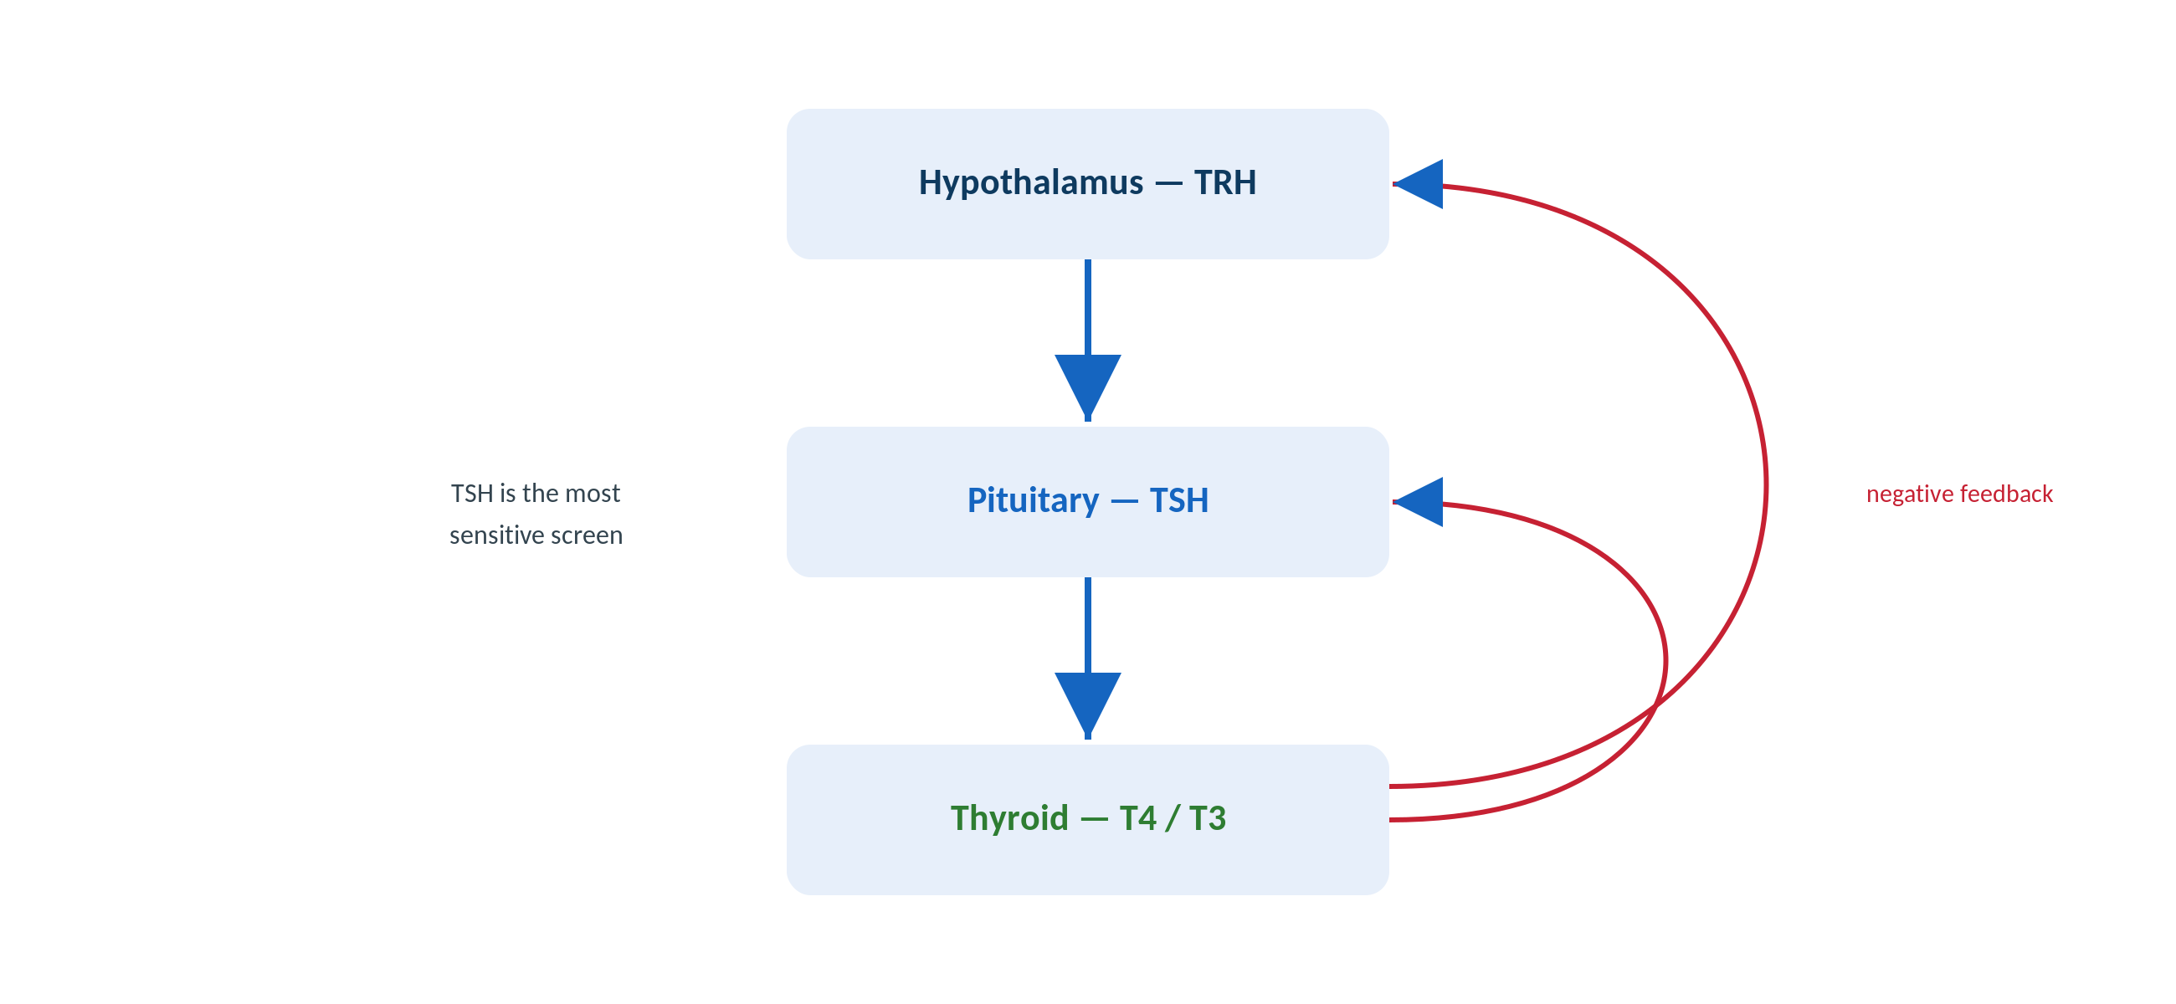
CLINICAL CHEMISTRY · THYROID
The Hypothalamic-Pituitary-Thyroid Axis
Original schematic. TSH is the most sensitive screen because of the log-linear feedback with free T4.
Makassed General Hospital · Department of Laboratory Medicine
CP Lecture Series · 5

Slide 7
CLINICAL CHEMISTRY · THYROID
Interpreting Thyroid Tests
PATTERNS
INTERFERENCES
Primary hypothyroidism: ↑TSH, ↓free T4.
Primary hyperthyroidism: ↓TSH, ↑free T4 (or T3 toxicosis).
Central disease: inappropriately normal/low TSH with abnormal free T4.
Non-thyroidal illness ('sick euthyroid'): low T3, variable TSH — avoid testing in acute illness.
Biotin: low TSH + high free T4 mimicking hyperthyroidism — hold biotin before testing.
Heterophile antibodies can falsely raise TSH.
Anti-T4/T3 autoantibodies and assay-specific effects.
Reconcile with the clinical picture; repeat on another platform if discordant.
Makassed General Hospital · Department of Laboratory Medicine
CP Lecture Series · 6

Slide 8
CLINICAL CHEMISTRY · ADRENAL
Cortisol, ACTH & Dynamic Testing
CAVEATS
ACTH & LOCALIZATION
Cortisol has a diurnal rhythm — timing matters; stress and illness raise it.
Hypercortisolism screen: late-night salivary cortisol, 1-mg dexamethasone suppression, 24-h urine free cortisol.
Adrenal insufficiency: morning cortisol ± ACTH stimulation.
Estrogen raises CBG (total cortisol); exogenous steroids confound.
Pair cortisol with ACTH to localize (ACTH-dependent vs independent).
Dynamic suppression/stimulation outperforms single static levels.
ACTH is labile — chilled EDTA, rapid processing.
Interpret with pretest probability.
Makassed General Hospital · Department of Laboratory Medicine
CP Lecture Series · 7

Slide 9
02
PART TWO
Protein Electrophoresis & Gammopathies

Slide 10
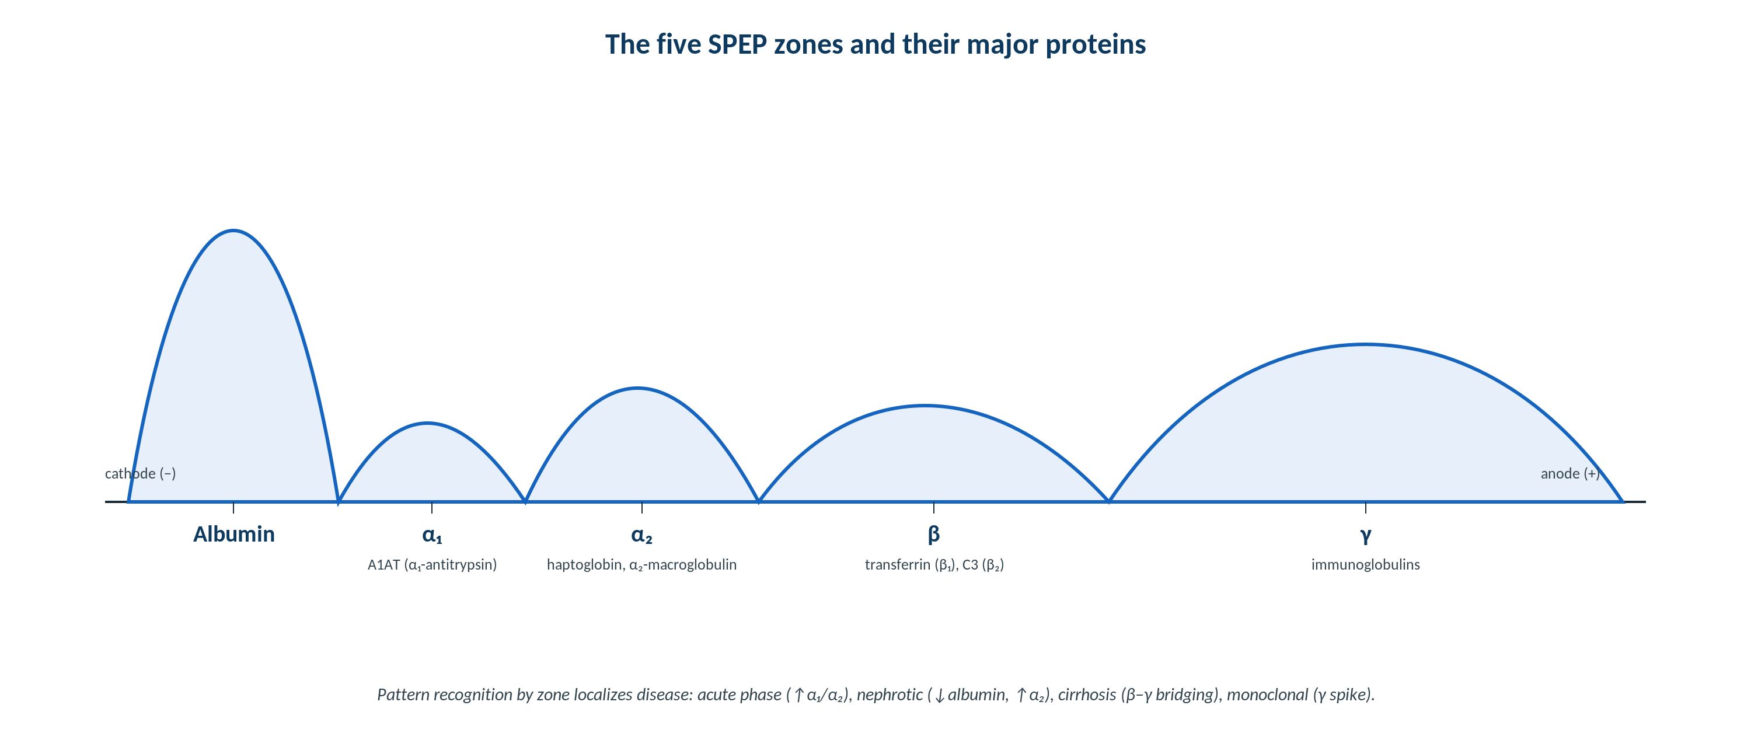
CLINICAL CHEMISTRY · PROTEINS
The Five SPEP Zones and Their Proteins
Original schematic (department teaching: D. Keren). Each zone maps to specific proteins, enabling pattern-based interpretation.
Makassed General Hospital · Department of Laboratory Medicine
CP Lecture Series · 8

Slide 11
CLINICAL CHEMISTRY · PROTEINS
Zone-by-Zone Interpretation
ALBUMIN, Α₁, Α₂
Β AND Γ REGIONS
α₁ — mainly α₁-antitrypsin (A1AT); a flat/absent α₁ band suggests A1AT deficiency (MZ/ZZ).
α₂ — haptoglobin and α₂-macroglobulin.
Acute phase: ↑ α₁ and α₂ (positive acute-phase reactants); albumin falls (negative).
Nephrotic: low albumin with a prominent α₂ (retained α₂-macroglobulin).
β — transferrin (β₁) and C3 (β₂); iron deficiency raises transferrin (β).
Cirrhosis: β–γ bridging (polyclonal IgA) and low albumin.
γ — immunoglobulins; broad rise = polyclonal (infection/inflammation/liver).
A discrete γ (or β) spike = monoclonal → reflex immunofixation.
Makassed General Hospital · Department of Laboratory Medicine
CP Lecture Series · 9

Slide 12
CLINICAL CHEMISTRY · GAMMOPATHY
SPEP, UPEP, and Immunofixation
READING THE TRACING
URINE & QUANTITATION
A discrete M-spike suggests a monoclonal process; a broad γ rise is polyclonal.
Hypogammaglobulinemia may be the only SPEP clue to light-chain-only myeloma.
An M-protein can hide in the β region (IgA) — IFE resolves it.
Reflex immunofixation identifies the heavy- and light-chain class.
UPEP/urine IFE detect Bence-Jones (free light-chain) proteinuria.
Quantify the M-protein (densitometry) for monitoring.
Contrast-dye and fibrinogen can mimic small bands — know the artifacts.
Combine with serum free light chains for sensitivity.
Makassed General Hospital · Department of Laboratory Medicine
CP Lecture Series · 10

Slide 13
CLINICAL CHEMISTRY · GAMMOPATHY
Free Light Chains & the IMWG Workup
SERUM FREE LIGHT CHAINS
PUTTING IT TOGETHER
Measure free κ and λ and the κ/λ ratio — sensitive for light-chain disease and AL amyloid.
An abnormal ratio indicates clonal excess.
More sensitive than UPEP for some light-chain disorders.
Renal impairment raises both chains — interpret the RATIO.
Workup: SPEP + serum IFE + serum free light chains (± UPEP/urine IFE).
Distinguish MGUS, smoldering, and myeloma by M-protein, marrow plasma cells, and CRAB.
Report quantitatively for trend monitoring.
Refer significant findings for hematology evaluation.
Makassed General Hospital · Department of Laboratory Medicine
CP Lecture Series · 11

Slide 14
03
PART THREE
Cases & Board Review

Slide 15
CLINICAL CHEMISTRY · CASE 1
Case 1
CLINICAL VIGNETTE
A clinically euthyroid patient on a hair-and-nail supplement has a suppressed TSH with elevated free T4. Repeat testing after a 3-day pause is normal.
?
What caused the misleading pattern, and the practical advice?
Makassed General Hospital · Department of Laboratory Medicine
CP Lecture Series · 12

Slide 16
CLINICAL CHEMISTRY · CASE 1 · RESOLUTION
Case 1: Biotin Interference
High-dose biotin interfered with streptavidin-biotin thyroid immunoassays.
The pattern (low TSH, high free T4) mimicked hyperthyroidism in a euthyroid patient.
Holding biotin (often 48–72 h) resolves it.
Reconcile thyroid numbers with the clinical state.
TEACHING POINT
Ask about biotin whenever thyroid results don’t fit — a one-question history prevents an erroneous diagnosis.
Makassed General Hospital · Department of Laboratory Medicine
CP Lecture Series · 13

Slide 17
CLINICAL CHEMISTRY · CASE 2
Case 2
CLINICAL VIGNETTE
An SPEP shows low albumin, a prominent α₂ band, and reduced γ globulins in a patient with heavy proteinuria and edema.
?
What SPEP pattern is this, and what is the mechanism?
Makassed General Hospital · Department of Laboratory Medicine
CP Lecture Series · 14

Slide 18
CLINICAL CHEMISTRY · CASE 2 · RESOLUTION
Case 2: Nephrotic SPEP Pattern
Nephrotic pattern — urinary loss of smaller proteins (albumin, immunoglobulins) with retention of large α₂-macroglobulin.
Low albumin + prominent α₂ + low γ is characteristic.
Confirms heavy selective proteinuria.
Correlate with urine protein and clinical nephrotic syndrome.
TEACHING POINT
SPEP patterns are diagnostic: the nephrotic pattern (↓albumin, ↑α₂, ↓γ) reflects size-selective renal protein loss.
Makassed General Hospital · Department of Laboratory Medicine
CP Lecture Series · 15

Slide 19
CLINICAL CHEMISTRY · CASE 3
Case 3
CLINICAL VIGNETTE
An older patient with anemia and renal impairment has a normal SPEP but hypogammaglobulinemia. Serum free light chains show markedly elevated κ with a very high κ/λ ratio; urine IFE shows free κ.
?
Diagnosis pathway, and why was the SPEP nearly normal?
Makassed General Hospital · Department of Laboratory Medicine
CP Lecture Series · 16

Slide 20
CLINICAL CHEMISTRY · CASE 3 · RESOLUTION
Case 3: Light-Chain Multiple Myeloma
Light-chain-only myeloma — the clone secretes free light chains, not intact immunoglobulin, so the SPEP lacks an M-spike.
Hypogammaglobulinemia and an abnormal free light-chain ratio are the clues.
Urine IFE confirms Bence-Jones (free κ) proteinuria.
Confirm with marrow plasma cells and CRAB end-organ features.
TEACHING POINT
A normal SPEP does not exclude plasma-cell disease — serum free light chains and the ratio catch light-chain-only disease.
Makassed General Hospital · Department of Laboratory Medicine
CP Lecture Series · 17

Slide 21
CLINICAL CHEMISTRY · BOARD REVIEW · Q1
Board-Style Review
Which single test is the most sensitive initial screen for thyroid dysfunction in an ambulatory patient?
A. Total T4
B. Free T3
C. TSH
D. Thyroid antibodies
E. Reverse T3
Makassed General Hospital · Department of Laboratory Medicine
CP Lecture Series · 18

Slide 22
CLINICAL CHEMISTRY · BOARD REVIEW · Q1
Board-Style Review
Which single test is the most sensitive initial screen for thyroid dysfunction in an ambulatory patient?
A. Total T4
B. Free T3
C. TSH
D. Thyroid antibodies
E. Reverse T3
ANSWER C — TSH
Log-linear pituitary feedback makes TSH the most sensitive first-line screen (barring central disease or interference).
Makassed General Hospital · Department of Laboratory Medicine
CP Lecture Series · 18

Slide 23
CLINICAL CHEMISTRY · BOARD REVIEW · Q2
Board-Style Review
On SPEP, β–γ bridging with low albumin is characteristic of:
A. Acute inflammation
B. Cirrhosis / chronic liver disease
C. Nephrotic syndrome
D. Multiple myeloma
E. Iron deficiency
Makassed General Hospital · Department of Laboratory Medicine
CP Lecture Series · 19

Slide 24
CLINICAL CHEMISTRY · BOARD REVIEW · Q2
Board-Style Review
On SPEP, β–γ bridging with low albumin is characteristic of:
A. Acute inflammation
B. Cirrhosis / chronic liver disease
C. Nephrotic syndrome
D. Multiple myeloma
E. Iron deficiency
ANSWER B — Cirrhosis
Polyclonal IgA in liver disease fills the trough between β and γ (bridging); albumin falls with reduced synthesis.
Makassed General Hospital · Department of Laboratory Medicine
CP Lecture Series · 19

Slide 25
CLINICAL CHEMISTRY · BOARD REVIEW · Q3
Board-Style Review
A discrete spike in the gamma region on SPEP should prompt which reflex test?
A. Repeat SPEP
B. Immunofixation electrophoresis
C. C-reactive protein
D. Serum iron
E. Haptoglobin
Makassed General Hospital · Department of Laboratory Medicine
CP Lecture Series · 20

Slide 26
CLINICAL CHEMISTRY · BOARD REVIEW · Q3
Board-Style Review
A discrete spike in the gamma region on SPEP should prompt which reflex test?
A. Repeat SPEP
B. Immunofixation electrophoresis
C. C-reactive protein
D. Serum iron
E. Haptoglobin
ANSWER B — Immunofixation
Immunofixation identifies the heavy- and light-chain type of the monoclonal protein, confirming the M-spike.
Makassed General Hospital · Department of Laboratory Medicine
CP Lecture Series · 20

Slide 27
CLINICAL CHEMISTRY · BOARD REVIEW · Q4
Board-Style Review
A patient with suspected light-chain disease has a normal SPEP. Which test best detects clonal light-chain excess?
A. Total protein
B. Serum free light chains with κ/λ ratio
C. Albumin
D. Beta-2 microglobulin alone
E. ESR
Makassed General Hospital · Department of Laboratory Medicine
CP Lecture Series · 21

Slide 28
CLINICAL CHEMISTRY · BOARD REVIEW · Q4
Board-Style Review
A patient with suspected light-chain disease has a normal SPEP. Which test best detects clonal light-chain excess?
A. Total protein
B. Serum free light chains with κ/λ ratio
C. Albumin
D. Beta-2 microglobulin alone
E. ESR
ANSWER B — Serum free light chains with ratio
The serum free light-chain assay and ratio detect light-chain-only disease that a normal SPEP can miss; the ratio corrects for renal retention.
Makassed General Hospital · Department of Laboratory Medicine
CP Lecture Series · 21

Slide 29
CLINICAL CHEMISTRY
Key Take-Home Points
TSH is the most sensitive thyroid screen; biotin and heterophile interferences can mimic thyroid disease — reconcile with the patient.
1
Pair effector hormones with their stimulators and prefer dynamic testing for adrenal axes.
2
Read SPEP by zone: α₁ (A1AT), α₂ (haptoglobin), β (transferrin/C3), γ (Ig); recognize acute-phase, nephrotic, and cirrhosis patterns.
3
A discrete spike → immunofixation; a normal SPEP does not exclude light-chain disease — use serum free light chains and the ratio.
4
Quantify M-protein and light chains for monitoring; interpret the ratio in renal impairment.
5
Makassed General Hospital · Department of Laboratory Medicine
22

Slide 30
CLINICAL CHEMISTRY · REFERENCES & FURTHER READING
References
1. Keren DF. Protein Electrophoresis in Clinical Diagnosis. ASCP Press (department teaching reference).
2. Rifai N, et al. Tietz Textbook of Clinical Chemistry, 6th ed. Elsevier, 2018.
3. Rajkumar SV, et al. IMWG criteria for the diagnosis of multiple myeloma. Lancet Oncol. 2014.
4. Clarke W (ed). Contemporary Practice in Clinical Chemistry, AACC Press.
Makassed General Hospital · Department of Laboratory Medicine
CP Lecture Series · 23

