Slide 1
CLINICAL PATHOLOGY RESIDENCY LECTURE SERIES
CLINICAL CHEMISTRY · LECTURE 5 OF 5
Toxicology, TDM & Point-of-Care Testing
Screening vs Confirmation, Drug Monitoring, and Governance
Dr. Tamima El-Jisr
Chairperson, Department of Laboratory Medicine
Makassed General Hospital, Beirut
Clinical Pathology Residency Curriculum

Slide 2
CLINICAL CHEMISTRY · FRAMING THE PROBLEM
Why This Matters
Confirm
Trough
POCT
A positive drug screen is presumptive until mass spectrometry confirms
Most therapeutic drug monitoring is interpreted at steady-state trough
Point-of-care testing needs the same oversight as the main lab
Toxicology and TDM are interpretation-and-governance disciplines: knowing the difference between a screen and a confirmation, when to sample, and how to keep decentralized testing safe.
Cross-reactivity makes screens fast but fallible — never report a definitive toxicology result on an immunoassay screen alone.
Makassed General Hospital · Department of Laboratory Medicine
CP Lecture Series · 2

Slide 3
CLINICAL CHEMISTRY · ·
Learning Objectives
Distinguish screening immunoassays from confirmatory mass spectrometry.
Recognize common drug-screen cross-reactivities and adulteration.
1
2
Apply TDM principles (steady state, trough/peak, free drug).
Interpret specific high-yield drug levels (vancomycin, digoxin, lithium, phenytoin).
3
4
State point-of-care testing governance and quality requirements.
Outline method validation essentials and reference intervals.
5
6
Makassed General Hospital · Department of Laboratory Medicine
CP Lecture Series · 3

Slide 4
CLINICAL CHEMISTRY · WHAT WE WILL COVER
Roadmap
Toxicology testing — screen vs confirm; cross-reactivity
1
Therapeutic drug monitoring — sampling and free drug
2
High-yield drug levels — vancomycin, digoxin, lithium, phenytoin
3
POCT & validation — governance and performance
4
Cases & board review
5
Makassed General Hospital · Department of Laboratory Medicine
CP Lecture Series · 4

Slide 5
01
PART ONE
Toxicology: Screen vs Confirm

Slide 6
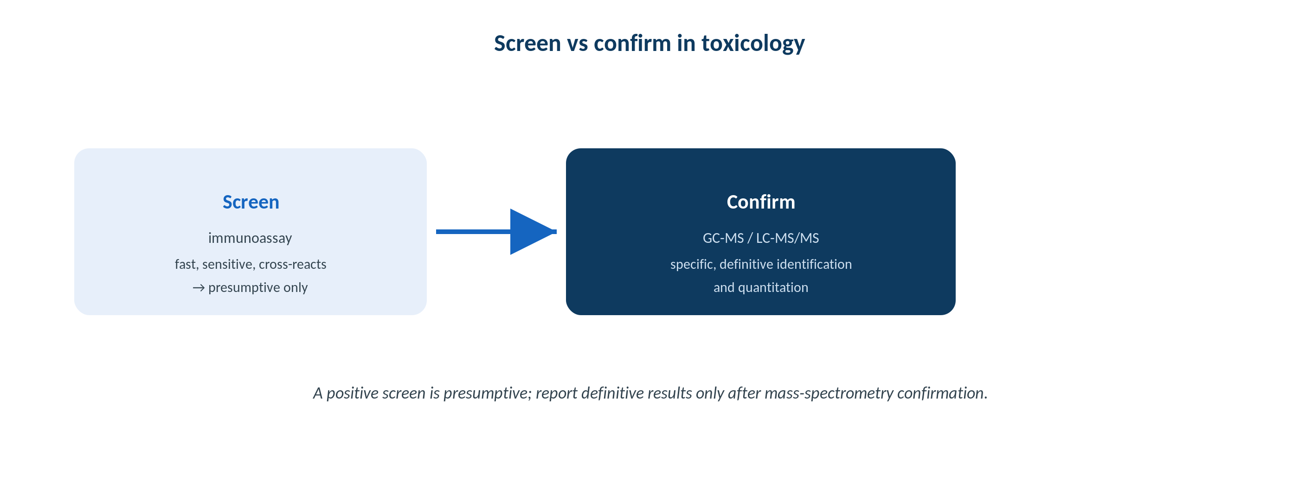
CLINICAL CHEMISTRY · TOXICOLOGY
Screening and Confirmation
Original schematic. Immunoassay screens are presumptive; GC-MS / LC-MS/MS provide definitive identification and quantitation.
Makassed General Hospital · Department of Laboratory Medicine
CP Lecture Series · 5

Slide 7
CLINICAL CHEMISTRY · TOXICOLOGY
Cross-Reactivity and Adulteration
FALSE POSITIVES & NEGATIVES
CONFIRMATION
Cross-reactivity: some decongestants/antihistamines with amphetamines; quinolones with opiates.
Opiate screens may MISS synthetic/semisynthetic opioids (fentanyl, oxycodone) — use targeted assays.
Adulteration/dilution affects urine screens (check creatinine, pH, oxidants, specific gravity).
A negative screen does not exclude all drugs.
GC-MS and LC-MS/MS identify and quantify specific compounds.
Required for any consequential (clinical, forensic, employment) result.
Resolves cross-reactivity by exact mass/fragmentation.
Report presumptive vs confirmed clearly.
Makassed General Hospital · Department of Laboratory Medicine
CP Lecture Series · 6

Slide 8
02
PART TWO
Therapeutic Drug Monitoring

Slide 9
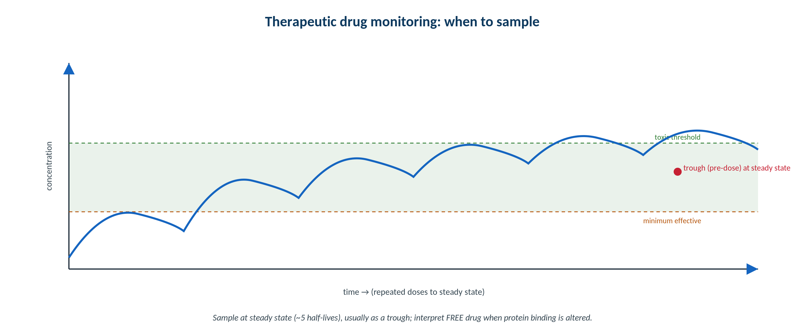
CLINICAL CHEMISTRY · TDM
When to Sample for TDM
Original schematic. Sample at steady state (~5 half-lives), usually as a trough; interpret FREE drug when binding is altered.
Makassed General Hospital · Department of Laboratory Medicine
CP Lecture Series · 7

Slide 10
CLINICAL CHEMISTRY · TDM
Principles of Drug Monitoring
WHEN AND WHAT TO SAMPLE
FREE DRUG & METABOLITES
Monitor narrow-therapeutic-index drugs (vancomycin, aminoglycosides, digoxin, lithium, antiepileptics, immunosuppressants).
Sample at STEADY STATE (~5 half-lives) unless assessing toxicity.
Trough for most agents; specific peak/AUC for aminoglycosides/vancomycin.
Timing errors are the commonest cause of misinterpretation.
Free (unbound) drug matters when protein binding changes (phenytoin in hypoalbuminemia/uremia).
Active metabolites may not be measured by the assay.
Digoxin: draw ≥ 6–8 h post-dose (avoid the distribution phase).
Correlate the level with clinical effect and toxicity.
Makassed General Hospital · Department of Laboratory Medicine
CP Lecture Series · 8

Slide 11
CLINICAL CHEMISTRY · HIGH-YIELD LEVELS
Specific Drugs to Know
Drug | Sampling / caveat | Toxicity clue
Vancomycin | AUC-guided (or trough); steady state | Nephrotoxicity
Aminoglycosides | Peak (efficacy) and trough (toxicity) | Nephro-/ototoxicity
Digoxin | ≥ 6–8 h post-dose; ↑ by hypokalemia | Nausea, arrhythmia, visual changes
Lithium | 12-h post-dose trough; narrow window | Tremor, confusion, renal/thyroid effects
Phenytoin | FREE level if low albumin/uremia | Nystagmus, ataxia despite normal total
Timing and protein binding define interpretation — the right level at the wrong time gives the wrong answer.
Makassed General Hospital · Department of Laboratory Medicine
CP Lecture Series · 9

Slide 12
03
PART THREE
POCT, Validation, Cases & Board

Slide 13
CLINICAL CHEMISTRY · POCT
Point-of-Care Testing Governance
WHY GOVERNANCE MATTERS
VALIDATION ESSENTIALS
POCT is performed by non-laboratorians across many sites — a large error surface.
Requires operator training/competency, QC, connectivity, and documentation.
Lot verification and reagent storage are common failure points.
Oversight sits with the laboratory medical director under CLIA/accreditation.
Accuracy, precision, analytical sensitivity (LoD), specificity, reportable range, reference interval.
FDA-cleared assays require verification; laboratory-developed tests require full validation.
Method comparison/correlation with the central lab.
Critical-value pathways from the bedside into the record.
Makassed General Hospital · Department of Laboratory Medicine
CP Lecture Series · 10

Slide 14
CLINICAL CHEMISTRY · CASE 1
Case 1
CLINICAL VIGNETTE
A pre-employment urine screen is positive for amphetamines. The donor takes an OTC decongestant and denies stimulant use. The sample goes for confirmation.
?
How should the laboratory handle the discrepancy, and what does confirmation add?
Makassed General Hospital · Department of Laboratory Medicine
CP Lecture Series · 11

Slide 15
CLINICAL CHEMISTRY · CASE 1 · RESOLUTION
Case 1: Presumptive Positive Screen
The immunoassay screen is presumptive and cross-reacts with sympathomimetics like some decongestants.
Definitive results require GC-MS or LC-MS/MS.
Confirmation distinguishes true amphetamine/methamphetamine from cross-reactors.
Report screens as presumptive; act only on confirmed results in consequential settings.
TEACHING POINT
Never release a consequential toxicology result on a screen alone — confirm by mass spectrometry, which resolves cross-reactivity.
Makassed General Hospital · Department of Laboratory Medicine
CP Lecture Series · 12

Slide 16
CLINICAL CHEMISTRY · CASE 2
Case 2
CLINICAL VIGNETTE
A patient on phenytoin with hypoalbuminemia has a low-normal TOTAL phenytoin but clinical toxicity (nystagmus, ataxia).
?
Why is the total level misleading, and what test clarifies it?
Makassed General Hospital · Department of Laboratory Medicine
CP Lecture Series · 13

Slide 17
CLINICAL CHEMISTRY · CASE 2 · RESOLUTION
Case 2: Free Phenytoin in Hypoalbuminemia
Phenytoin is highly protein-bound; in hypoalbuminemia the free (active) fraction rises while total appears normal/low.
The patient is clinically toxic because free drug is elevated.
Measure FREE phenytoin (or correct with the Sheiner-Tozer estimate).
Adjust dosing to the free level and clinical effect.
TEACHING POINT
For highly protein-bound drugs in altered-binding states (low albumin, uremia), interpret the FREE level, not the total.
Makassed General Hospital · Department of Laboratory Medicine
CP Lecture Series · 14

Slide 18
CLINICAL CHEMISTRY · CASE 3
Case 3
CLINICAL VIGNETTE
A digoxin level drawn 2 hours after the dose is high, but the patient is asymptomatic with a normal ECG.
?
Why may this level be misleading, and when should it be drawn?
Makassed General Hospital · Department of Laboratory Medicine
CP Lecture Series · 15

Slide 19
CLINICAL CHEMISTRY · CASE 3 · RESOLUTION
Case 3: Digoxin Sampling Timing
A level drawn during the distribution phase (too soon) overestimates the tissue-equilibrated concentration.
Draw digoxin at least 6–8 hours post-dose.
Hypokalemia and hypomagnesemia potentiate toxicity at any level.
Interpret with symptoms and the ECG, not the number alone.
TEACHING POINT
Digoxin must be sampled after distribution (≥ 6–8 h); an early draw reads falsely high.
Makassed General Hospital · Department of Laboratory Medicine
CP Lecture Series · 16

Slide 20
CLINICAL CHEMISTRY · BOARD REVIEW · Q1
Board-Style Review
A urine immunoassay is positive for opiates but the patient only takes oxycodone. The likely explanation is:
A. A true positive for morphine
B. Opiate screens may not reliably detect semisynthetic/synthetic opioids; targeted testing is needed
C. Sample adulteration
D. The hook effect
E. Heterophile antibody
Makassed General Hospital · Department of Laboratory Medicine
CP Lecture Series · 17

Slide 21
CLINICAL CHEMISTRY · BOARD REVIEW · Q1
Board-Style Review
A urine immunoassay is positive for opiates but the patient only takes oxycodone. The likely explanation is:
A. A true positive for morphine
B. Opiate screens may not reliably detect semisynthetic/synthetic opioids; targeted testing is needed
C. Sample adulteration
D. The hook effect
E. Heterophile antibody
ANSWER B — Screens may miss semisynthetic/synthetic opioids
Standard opiate immunoassays are calibrated to morphine/codeine and can under-detect oxycodone/fentanyl; targeted assays or LC-MS/MS are required.
Makassed General Hospital · Department of Laboratory Medicine
CP Lecture Series · 17

Slide 22
CLINICAL CHEMISTRY · BOARD REVIEW · Q2
Board-Style Review
When should a trough be drawn for routine TDM?
A. Immediately after the first dose
B. At the peak after any dose
C. At steady state, just before the next dose
D. Randomly
E. Only when toxicity is suspected
Makassed General Hospital · Department of Laboratory Medicine
CP Lecture Series · 18

Slide 23
CLINICAL CHEMISTRY · BOARD REVIEW · Q2
Board-Style Review
When should a trough be drawn for routine TDM?
A. Immediately after the first dose
B. At the peak after any dose
C. At steady state, just before the next dose
D. Randomly
E. Only when toxicity is suspected
ANSWER C — At steady state, pre-dose (trough)
Steady state (~5 half-lives) with a pre-dose trough gives the most interpretable, reproducible level for most monitored drugs.
Makassed General Hospital · Department of Laboratory Medicine
CP Lecture Series · 18

Slide 24
CLINICAL CHEMISTRY · BOARD REVIEW · Q3
Board-Style Review
A laboratory-developed test (not FDA-cleared) requires which before clinical use?
A. Verification of manufacturer claims only
B. Full validation of accuracy, precision, sensitivity, specificity, linearity, reference interval
C. No additional study
D. Only a reference interval
E. Only proficiency testing
Makassed General Hospital · Department of Laboratory Medicine
CP Lecture Series · 19

Slide 25
CLINICAL CHEMISTRY · BOARD REVIEW · Q3
Board-Style Review
A laboratory-developed test (not FDA-cleared) requires which before clinical use?
A. Verification of manufacturer claims only
B. Full validation of accuracy, precision, sensitivity, specificity, linearity, reference interval
C. No additional study
D. Only a reference interval
E. Only proficiency testing
ANSWER B — Full validation
FDA-cleared assays require verification; laboratory-developed tests require full validation of all performance characteristics.
Makassed General Hospital · Department of Laboratory Medicine
CP Lecture Series · 19

Slide 26
CLINICAL CHEMISTRY · BOARD REVIEW · Q4
Board-Style Review
A toxic phenytoin effect with a normal TOTAL level in a hypoalbuminemic patient is best explained by:
A. Assay interference
B. Elevated FREE (unbound) phenytoin
C. Hook effect
D. Wrong sampling time
E. Macro-analyte
Makassed General Hospital · Department of Laboratory Medicine
CP Lecture Series · 20

Slide 27
CLINICAL CHEMISTRY · BOARD REVIEW · Q4
Board-Style Review
A toxic phenytoin effect with a normal TOTAL level in a hypoalbuminemic patient is best explained by:
A. Assay interference
B. Elevated FREE (unbound) phenytoin
C. Hook effect
D. Wrong sampling time
E. Macro-analyte
ANSWER B — Elevated free phenytoin
Low albumin raises the unbound active fraction; total level underestimates the effective concentration. Measure free phenytoin.
Makassed General Hospital · Department of Laboratory Medicine
CP Lecture Series · 20

Slide 28
CLINICAL CHEMISTRY
Key Take-Home Points
Drug screens are presumptive and cross-react; confirm consequential results by GC-MS / LC-MS/MS.
1
Standard opiate screens can miss synthetic/semisynthetic opioids — use targeted assays.
2
TDM: sample at steady state, usually as a trough; interpret FREE drug when protein binding is altered; time digoxin ≥ 6–8 h post-dose.
3
POCT needs main-lab-grade governance: competency, QC, correlation, connectivity, director oversight.
4
Validate laboratory-developed tests fully; verify FDA-cleared assays.
5
Makassed General Hospital · Department of Laboratory Medicine
21

Slide 29
CLINICAL CHEMISTRY · REFERENCES & FURTHER READING
References
1. Rifai N, et al. Tietz Textbook of Clinical Chemistry, 6th ed. Elsevier, 2018.
2. CLSI EP15/EP06/EP07: precision, linearity, and interference.
3. Clarke W (ed). Contemporary Practice in Clinical Chemistry, AACC Press.
4. CLSI POCT documents (governance and quality).
Makassed General Hospital · Department of Laboratory Medicine
CP Lecture Series · 22

