Slide 1
CLINICAL PATHOLOGY RESIDENCY LECTURE SERIES
HEMATOLOGY & COAGULATION · LECTURE 5 OF 5
Coagulation Testing, Bleeding & Thrombosis
PT/aPTT Logic, Mixing Studies, and the High-Yield Disorders
Dr. Tamima El-Jisr
Chairperson, Department of Laboratory Medicine
Makassed General Hospital, Beirut
Clinical Pathology Residency Curriculum

Slide 2
HEMATOLOGY & COAGULATION · FRAMING THE PROBLEM
Why This Matters
PT/aPTT
Mixing
Pre-analytic
Localize the defect to a pathway
Corrects = deficiency; doesn’t = inhibitor
Citrate ratio and fill make or break coag results
Coagulation testing is logic on a pathway map: interpret PT and aPTT together, use mixing studies to separate deficiency from inhibitor, and respect the uniquely strict pre-analytics. Mixing-study interpretation follows the department’s teaching reference.
Read PT and aPTT together to localize the defect, then mix to ask: deficiency or inhibitor?
Makassed General Hospital · Department of Laboratory Medicine
CP Lecture Series · 2

Slide 3
HEMATOLOGY & COAGULATION · ·
Learning Objectives
Describe the coagulation cascade as PT and aPTT pathways.
Interpret combinations of prolonged PT and/or aPTT.
1
2
Apply mixing studies to separate factor deficiency from inhibitor.
Recognize key pre-analytic pitfalls in coagulation testing.
3
4
Evaluate common bleeding and thrombotic disorders.
Interpret D-dimer, fibrinogen, and special coagulation tests appropriately.
5
6
Makassed General Hospital · Department of Laboratory Medicine
CP Lecture Series · 3

Slide 4
HEMATOLOGY & COAGULATION · WHAT WE WILL COVER
Roadmap
Cascade & screens — PT and aPTT pathways
1
Interpreting prolongation — PT/aPTT combinations
2
Mixing studies — deficiency vs inhibitor
3
Bleeding & thrombosis — key disorders, pre-analytics
4
Cases & board review
5
Makassed General Hospital · Department of Laboratory Medicine
CP Lecture Series · 4

Slide 5
01
PART ONE
The Cascade & the Screens

Slide 6
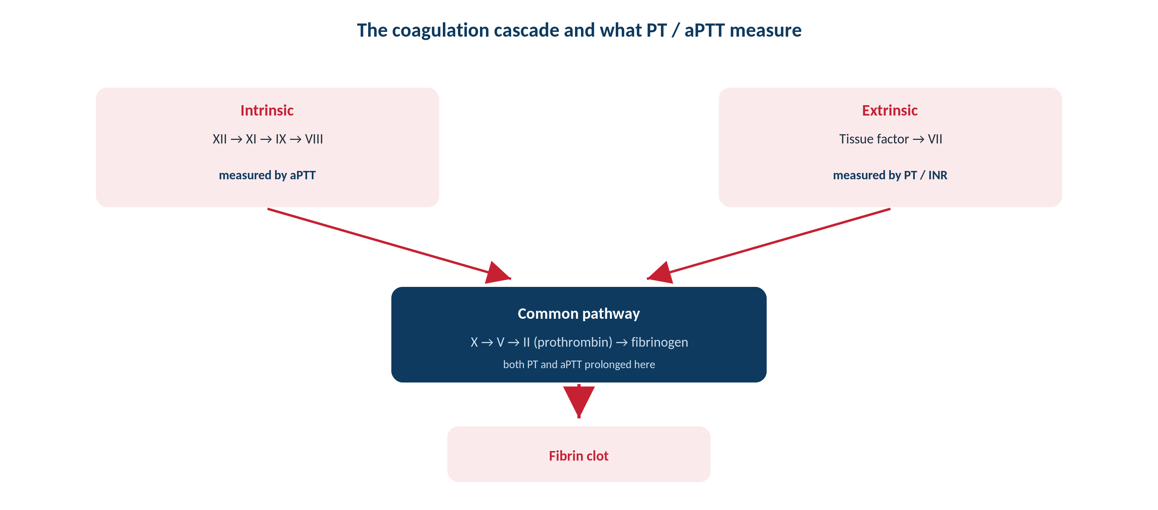
HEMATOLOGY & COAGULATION · CASCADE
PT and aPTT on the Cascade
Original schematic. PT interrogates the extrinsic/common pathway; aPTT the intrinsic/common pathway.
Makassed General Hospital · Department of Laboratory Medicine
CP Lecture Series · 5

Slide 7
HEMATOLOGY & COAGULATION · SCREENS
What PT and aPTT Measure
PT / INR
APTT
PT reflects the extrinsic and common pathways (factors VII, X, V, II, fibrinogen).
INR standardizes PT for vitamin-K-antagonist monitoring.
Sensitive to factor VII (shortest half-life) — early in liver disease/warfarin.
Prolonged by warfarin, vitamin-K deficiency, liver disease.
aPTT reflects the intrinsic and common pathways (XII, XI, IX, VIII, X, V, II, fibrinogen).
Monitors unfractionated heparin.
Prolonged by hemophilia, heparin, and inhibitors (incl. lupus anticoagulant).
Interpret with the PT.
Makassed General Hospital · Department of Laboratory Medicine
CP Lecture Series · 6

Slide 8
02
PART TWO
Interpreting Prolongation & Mixing Studies

Slide 9
HEMATOLOGY & COAGULATION · PATTERN
Reading PT/aPTT Combinations
Pattern | Typical causes
↑PT, normal aPTT | Factor VII deficiency; early warfarin/vit-K deficiency, liver disease
Normal PT, ↑aPTT | Hemophilia A/B, factor XI; heparin; lupus anticoagulant; factor XII
↑PT and ↑aPTT | Common-pathway defect; DIC, severe liver disease, high-dose warfarin
Both normal, bleeding | Von Willebrand disease, platelet dysfunction, factor XIII deficiency
Localize first with the pattern, then decide whether to mix or pursue specific factor/vWF testing.
Makassed General Hospital · Department of Laboratory Medicine
CP Lecture Series · 7

Slide 10
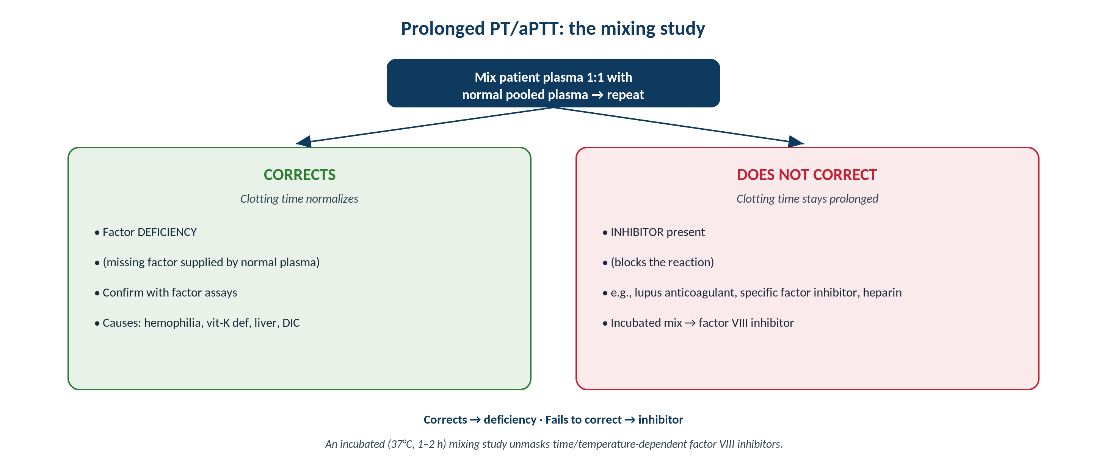
HEMATOLOGY & COAGULATION · MIXING STUDY
Mixing Study: Deficiency vs Inhibitor
Original schematic (department teaching reference). Corrects with normal plasma = factor deficiency; fails to correct = inhibitor.
Makassed General Hospital · Department of Laboratory Medicine
CP Lecture Series · 8

Slide 11
HEMATOLOGY & COAGULATION · MIXING STUDY
Interpreting the Mix
CORRECTS
DOES NOT CORRECT
Normalization on 1:1 mix with normal plasma indicates a FACTOR DEFICIENCY.
The normal plasma supplies the missing factor.
Confirm with specific factor assays.
Causes: hemophilia, vitamin-K deficiency, liver disease, DIC.
Persistent prolongation indicates an INHIBITOR.
Lupus anticoagulant, specific factor inhibitor, or heparin.
An incubated (37°C, 1–2 h) mix unmasks time-dependent factor VIII inhibitors.
Pursue inhibitor-specific testing.
Makassed General Hospital · Department of Laboratory Medicine
CP Lecture Series · 9

Slide 12
03
PART THREE
Disorders, Pre-Analytics, Cases & Board

Slide 13
HEMATOLOGY & COAGULATION · DISORDERS / PRE-ANALYTICS
Key Disorders and Sample Integrity
BLEEDING & THROMBOSIS
PRE-ANALYTIC PITFALLS
Von Willebrand disease is the commonest inherited bleeding disorder (often normal PT/aPTT).
Hemophilia A/B prolong aPTT and correct on mixing.
DIC: ↓platelets/fibrinogen, ↑PT/aPTT, ↑D-dimer.
D-dimer has high negative predictive value for VTE — not a rule-in test.
Use the correct 3.2% sodium citrate tube with a 9:1 blood-to-anticoagulant ratio.
Under-filled tubes falsely prolong results.
Correct citrate volume for high hematocrit (polycythemia).
Heparin contamination (line draws) prolongs aPTT.
Makassed General Hospital · Department of Laboratory Medicine
CP Lecture Series · 10

Slide 14
HEMATOLOGY & COAGULATION · CASE 1
Case 1
CLINICAL VIGNETTE
A patient has an isolated prolonged aPTT that fully corrects on a 1:1 mix with normal plasma.
?
What does this indicate and what is the next test?
Makassed General Hospital · Department of Laboratory Medicine
CP Lecture Series · 11

Slide 15
HEMATOLOGY & COAGULATION · CASE 1 · RESOLUTION
Case 1: Factor Deficiency
Correction on mixing indicates a factor deficiency in the intrinsic pathway (e.g., factor VIII or IX).
Confirm with specific factor assays.
Correlate with bleeding history (e.g., hemophilia).
Normal plasma supplied the missing factor.
TEACHING POINT
An aPTT that corrects on mixing means deficiency — confirm the specific factor; failure to correct would mean an inhibitor.
Makassed General Hospital · Department of Laboratory Medicine
CP Lecture Series · 12

Slide 16
HEMATOLOGY & COAGULATION · CASE 2
Case 2
CLINICAL VIGNETTE
An aPTT does not correct on immediate mixing; the patient has a history of clotting, not bleeding.
?
What inhibitor should be considered?
Makassed General Hospital · Department of Laboratory Medicine
CP Lecture Series · 13

Slide 17
HEMATOLOGY & COAGULATION · CASE 2 · RESOLUTION
Case 2: Lupus Anticoagulant
Failure to correct with a thrombotic (not bleeding) history suggests lupus anticoagulant.
Confirm with phospholipid-dependent testing per criteria.
Despite the in-vitro prolongation, it is associated with thrombosis.
Distinguish from a specific factor inhibitor (which causes bleeding).
TEACHING POINT
A non-correcting aPTT with thrombosis suggests lupus anticoagulant — an in-vitro artifact that is clinically prothrombotic.
Makassed General Hospital · Department of Laboratory Medicine
CP Lecture Series · 14

Slide 18
HEMATOLOGY & COAGULATION · CASE 3
Case 3
CLINICAL VIGNETTE
All coagulation results from one patient are erratically prolonged; the citrate tube was under-filled.
?
What is the problem and the fix?
Makassed General Hospital · Department of Laboratory Medicine
CP Lecture Series · 15

Slide 19
HEMATOLOGY & COAGULATION · CASE 3 · RESOLUTION
Case 3: Pre-Analytic Error
An under-filled citrate tube changes the blood-to-anticoagulant ratio and falsely prolongs results.
Recollect a properly filled 3.2% citrate tube (9:1 ratio).
Adjust citrate for very high hematocrit.
Exclude heparin contamination from line draws.
TEACHING POINT
Coagulation testing is uniquely pre-analytic-sensitive — the correct citrate tube, fill, and ratio are essential for valid results.
Makassed General Hospital · Department of Laboratory Medicine
CP Lecture Series · 16

Slide 20
HEMATOLOGY & COAGULATION · BOARD REVIEW · Q1
Board-Style Review
A prolonged aPTT that does NOT correct on 1:1 mixing indicates:
A. A factor deficiency
B. An inhibitor
C. Warfarin effect
D. Vitamin-K deficiency
E. Factor VII deficiency
Makassed General Hospital · Department of Laboratory Medicine
CP Lecture Series · 17

Slide 21
HEMATOLOGY & COAGULATION · BOARD REVIEW · Q1
Board-Style Review
A prolonged aPTT that does NOT correct on 1:1 mixing indicates:
A. A factor deficiency
B. An inhibitor
C. Warfarin effect
D. Vitamin-K deficiency
E. Factor VII deficiency
ANSWER B — An inhibitor
Failure to correct indicates an inhibitor (lupus anticoagulant, specific factor inhibitor, or heparin); correction indicates deficiency.
Makassed General Hospital · Department of Laboratory Medicine
CP Lecture Series · 17

Slide 22
HEMATOLOGY & COAGULATION · BOARD REVIEW · Q2
Board-Style Review
An isolated prolonged PT with a normal aPTT most suggests a deficiency of:
A. Factor VIII
B. Factor IX
C. Factor VII
D. Factor XII
E. Fibrinogen
Makassed General Hospital · Department of Laboratory Medicine
CP Lecture Series · 18

Slide 23
HEMATOLOGY & COAGULATION · BOARD REVIEW · Q2
Board-Style Review
An isolated prolonged PT with a normal aPTT most suggests a deficiency of:
A. Factor VIII
B. Factor IX
C. Factor VII
D. Factor XII
E. Fibrinogen
ANSWER C — Factor VII
Factor VII is unique to the extrinsic pathway and has the shortest half-life, so the PT prolongs first.
Makassed General Hospital · Department of Laboratory Medicine
CP Lecture Series · 18

Slide 24
HEMATOLOGY & COAGULATION · BOARD REVIEW · Q3
Board-Style Review
The correct specimen for routine coagulation testing is:
A. EDTA, fully filled
B. 3.2% sodium citrate at a 9:1 ratio, properly filled
C. Heparinized plasma
D. Serum
E. Any anticoagulant
Makassed General Hospital · Department of Laboratory Medicine
CP Lecture Series · 19

Slide 25
HEMATOLOGY & COAGULATION · BOARD REVIEW · Q3
Board-Style Review
The correct specimen for routine coagulation testing is:
A. EDTA, fully filled
B. 3.2% sodium citrate at a 9:1 ratio, properly filled
C. Heparinized plasma
D. Serum
E. Any anticoagulant
ANSWER B — 3.2% citrate, 9:1, properly filled
Citrate at the correct ratio and fill preserves the factors; under-filling or wrong tubes invalidate results.
Makassed General Hospital · Department of Laboratory Medicine
CP Lecture Series · 19

Slide 26
HEMATOLOGY & COAGULATION · BOARD REVIEW · Q4
Board-Style Review
Which test best fits a screen with high negative predictive value for venous thromboembolism?
A. Fibrinogen
B. D-dimer
C. PT
D. aPTT
E. Factor VIII level
Makassed General Hospital · Department of Laboratory Medicine
CP Lecture Series · 20

Slide 27
HEMATOLOGY & COAGULATION · BOARD REVIEW · Q4
Board-Style Review
Which test best fits a screen with high negative predictive value for venous thromboembolism?
A. Fibrinogen
B. D-dimer
C. PT
D. aPTT
E. Factor VIII level
ANSWER B — D-dimer
A normal D-dimer helps exclude VTE in low/intermediate pretest probability; it is not specific enough to rule in.
Makassed General Hospital · Department of Laboratory Medicine
CP Lecture Series · 20

Slide 28
HEMATOLOGY & COAGULATION
Key Take-Home Points
Read PT and aPTT together to localize the defect: PT = extrinsic/common, aPTT = intrinsic/common.
1
Mixing study: correction = factor deficiency; failure to correct = inhibitor (incubated mix unmasks factor VIII inhibitors).
2
Know the patterns: isolated ↑PT → factor VII; isolated ↑aPTT → hemophilia/heparin/lupus anticoagulant; both ↑ → common pathway/DIC/liver.
3
Von Willebrand disease (often normal screens) is the commonest inherited bleeding disorder; D-dimer rules out, not in, VTE.
4
Respect coagulation pre-analytics: correct 3.2% citrate tube, 9:1 ratio, proper fill, hematocrit correction, and no heparin contamination.
5
Makassed General Hospital · Department of Laboratory Medicine
21

Slide 29
HEMATOLOGY & COAGULATION · REFERENCES & FURTHER READING
References
1. Marques MB, Fritsma GA. Quick Guide to Coagulation Testing.
2. Transfusion Medicine and Hemostasis, Section 2: Hemostasis — mixing studies (department teaching reference).
3. CLSI H21: Collection, Transport, and Processing of Blood Specimens for Coagulation Testing.
4. Hoffman R, et al. Hematology: Basic Principles and Practice.
Makassed General Hospital · Department of Laboratory Medicine
CP Lecture Series · 22

