Slide 1
CLINICAL PATHOLOGY RESIDENCY LECTURE SERIES
HEMATOLOGY & COAGULATION · LECTURE 1 OF 5
The CBC & Peripheral Smear
Indices, Analyzer Flags, and Morphologic Correlation
Dr. Tamima El-Jisr
Chairperson, Department of Laboratory Medicine
Makassed General Hospital, Beirut
Clinical Pathology Residency Curriculum

Slide 2
HEMATOLOGY & COAGULATION · FRAMING THE PROBLEM
Why This Matters
CBC
Flags
Smear
The most ordered test — and most misread
Analyzer flags exist to trigger a smear
Morphology confirms what the analyzer can only suspect
The CBC and smear are the foundation of hematology. Reading them well means understanding the indices, respecting analyzer flags, and correlating numbers with morphology — and recognizing spurious results.
The analyzer flags; the smear confirms — the two together, not either alone, make the hematologic diagnosis.
Makassed General Hospital · Department of Laboratory Medicine
CP Lecture Series · 2

Slide 3
HEMATOLOGY & COAGULATION · ·
Learning Objectives
Interpret CBC parameters and red-cell indices (MCV, MCH, MCHC, RDW).
Use the differential and absolute counts correctly.
1
2
Recognize when analyzer flags require a manual smear.
Identify spurious CBC results and their causes.
3
4
Describe key red-cell morphologic abnormalities.
Integrate CBC and smear into a diagnostic impression.
5
6
Makassed General Hospital · Department of Laboratory Medicine
CP Lecture Series · 3

Slide 4
HEMATOLOGY & COAGULATION · WHAT WE WILL COVER
Roadmap
CBC parameters — indices and differential
1
Analyzer flags — when to make a smear
2
Spurious results — clumps, agglutinins, lipemia
3
Morphology — red-cell clues
4
Cases & board review
5
Makassed General Hospital · Department of Laboratory Medicine
CP Lecture Series · 4

Slide 5
01
PART ONE
The CBC

Slide 6
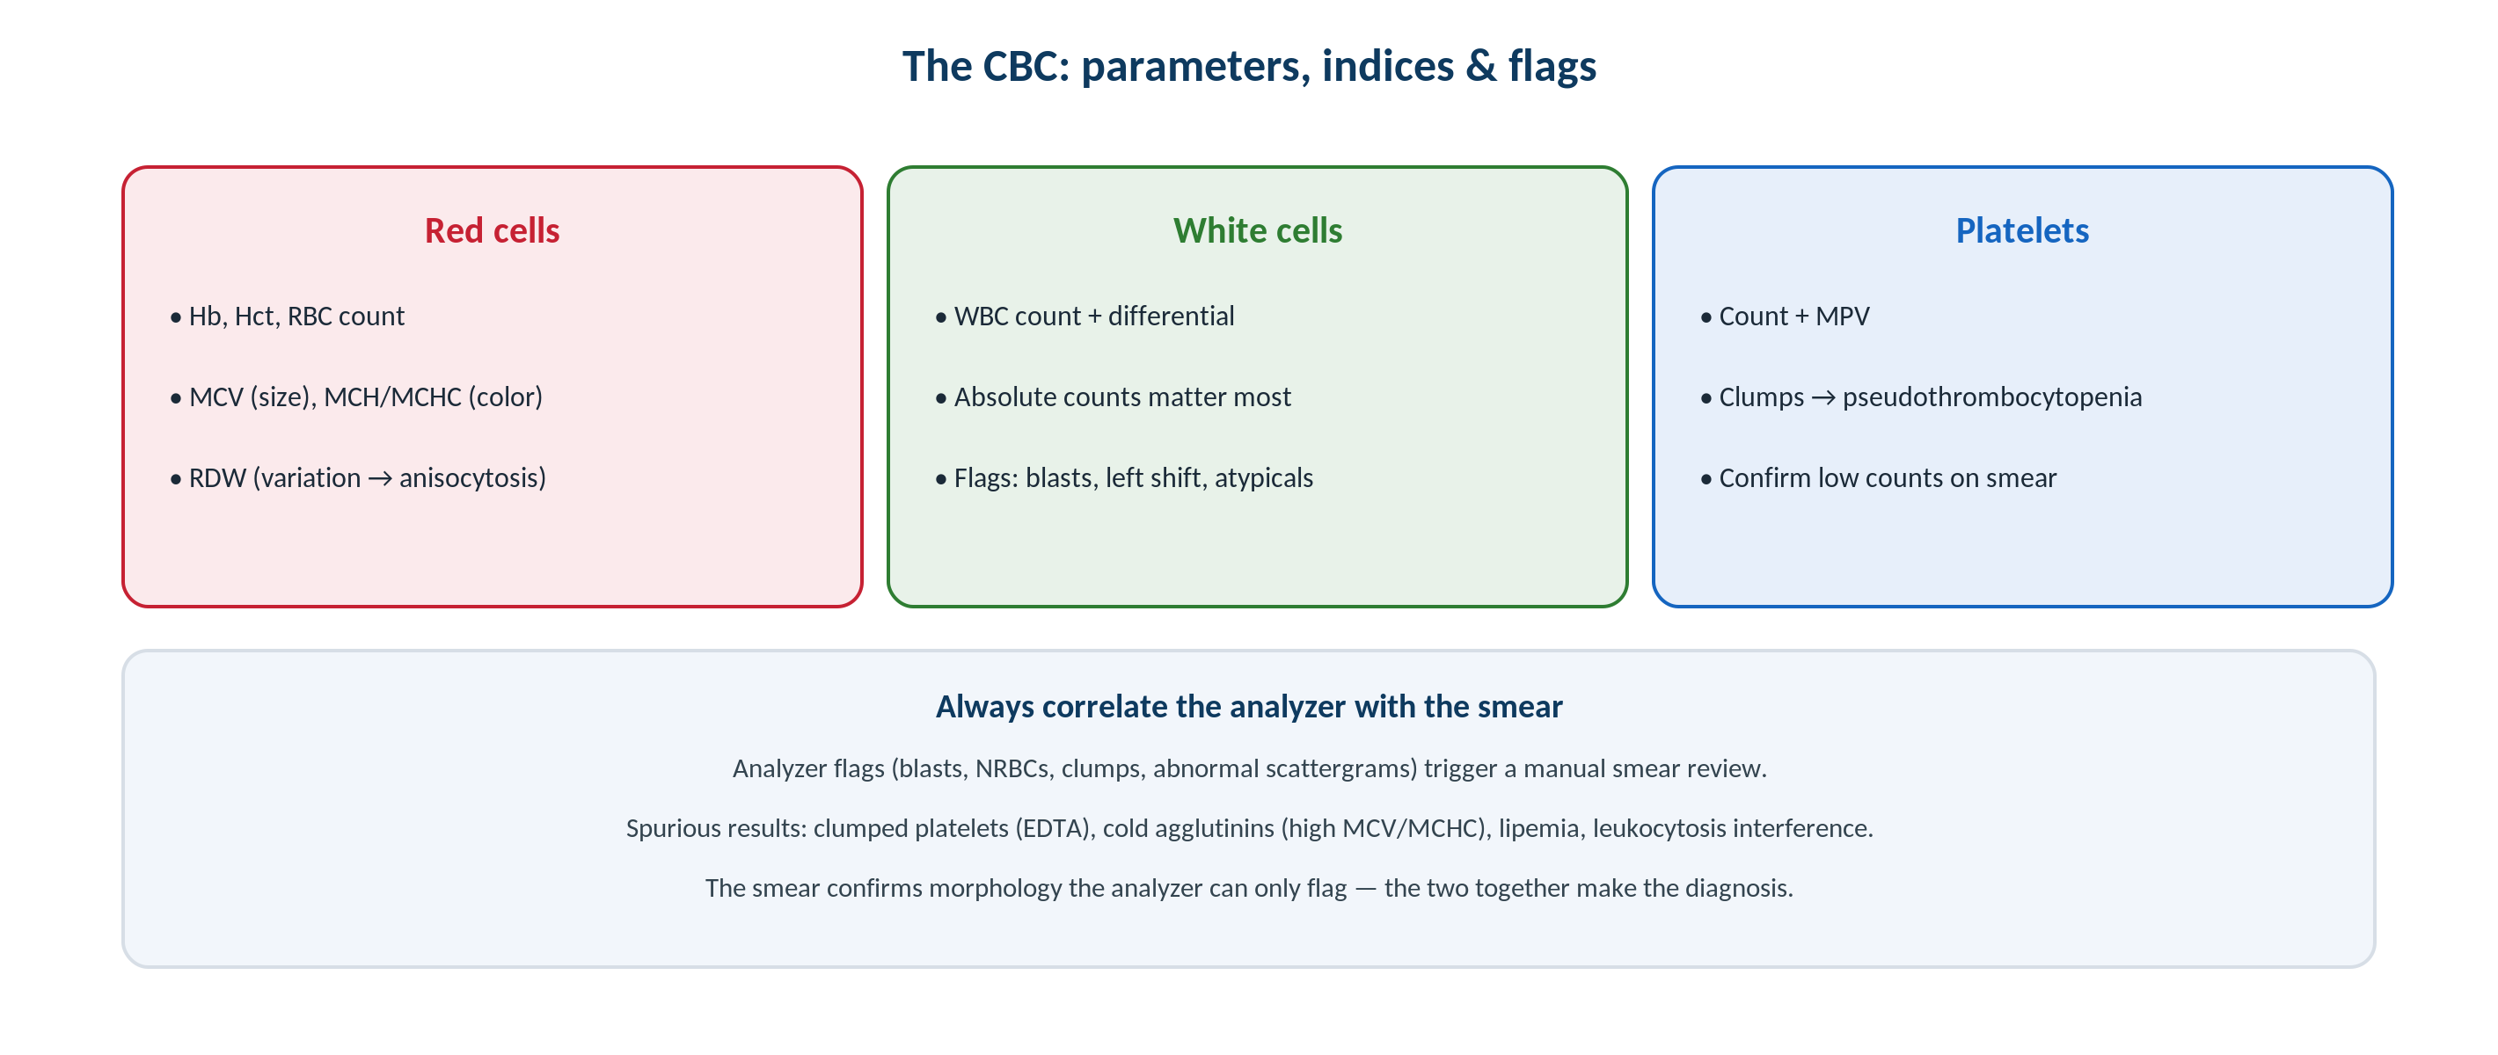
HEMATOLOGY & COAGULATION · CBC
Parameters, Indices & Flags
Original schematic. Red-cell, white-cell, and platelet parameters — always correlated with the smear.
Makassed General Hospital · Department of Laboratory Medicine
CP Lecture Series · 5

Slide 7
HEMATOLOGY & COAGULATION · INDICES
Red-Cell Indices
SIZE AND COLOR
COUNTS THAT MATTER
MCV classifies anemia as micro-, normo-, or macrocytic.
MCH/MCHC reflect hemoglobin content (hypo- vs normochromic).
RDW measures size variation (anisocytosis).
High RDW + low MCV suggests iron deficiency over thalassemia trait.
Use ABSOLUTE counts (e.g., absolute neutrophil/lymphocyte) not just percentages.
Reticulocyte count gauges marrow response.
Hct tracks with Hb (roughly 3×).
Interpret against age- and sex-specific ranges.
Makassed General Hospital · Department of Laboratory Medicine
CP Lecture Series · 6

Slide 8
HEMATOLOGY & COAGULATION · SPURIOUS
Recognizing Spurious Results
COMMON ARTIFACTS
HOW TO RESOLVE
EDTA-induced platelet clumping → pseudothrombocytopenia (confirm on smear/citrate tube).
Cold agglutinins → falsely low RBC, high MCV/MCHC.
Lipemia/icterus/hemolysis interfere with some parameters.
Leukocytosis or NRBCs can skew automated counts.
A smear review resolves most spurious flags.
Warm the sample for cold agglutinins; recollect in citrate for clumping.
Correct WBC for NRBCs when needed.
Never report an implausible count without review.
Makassed General Hospital · Department of Laboratory Medicine
CP Lecture Series · 7

Slide 9
02
PART TWO
The Peripheral Smear

Slide 10
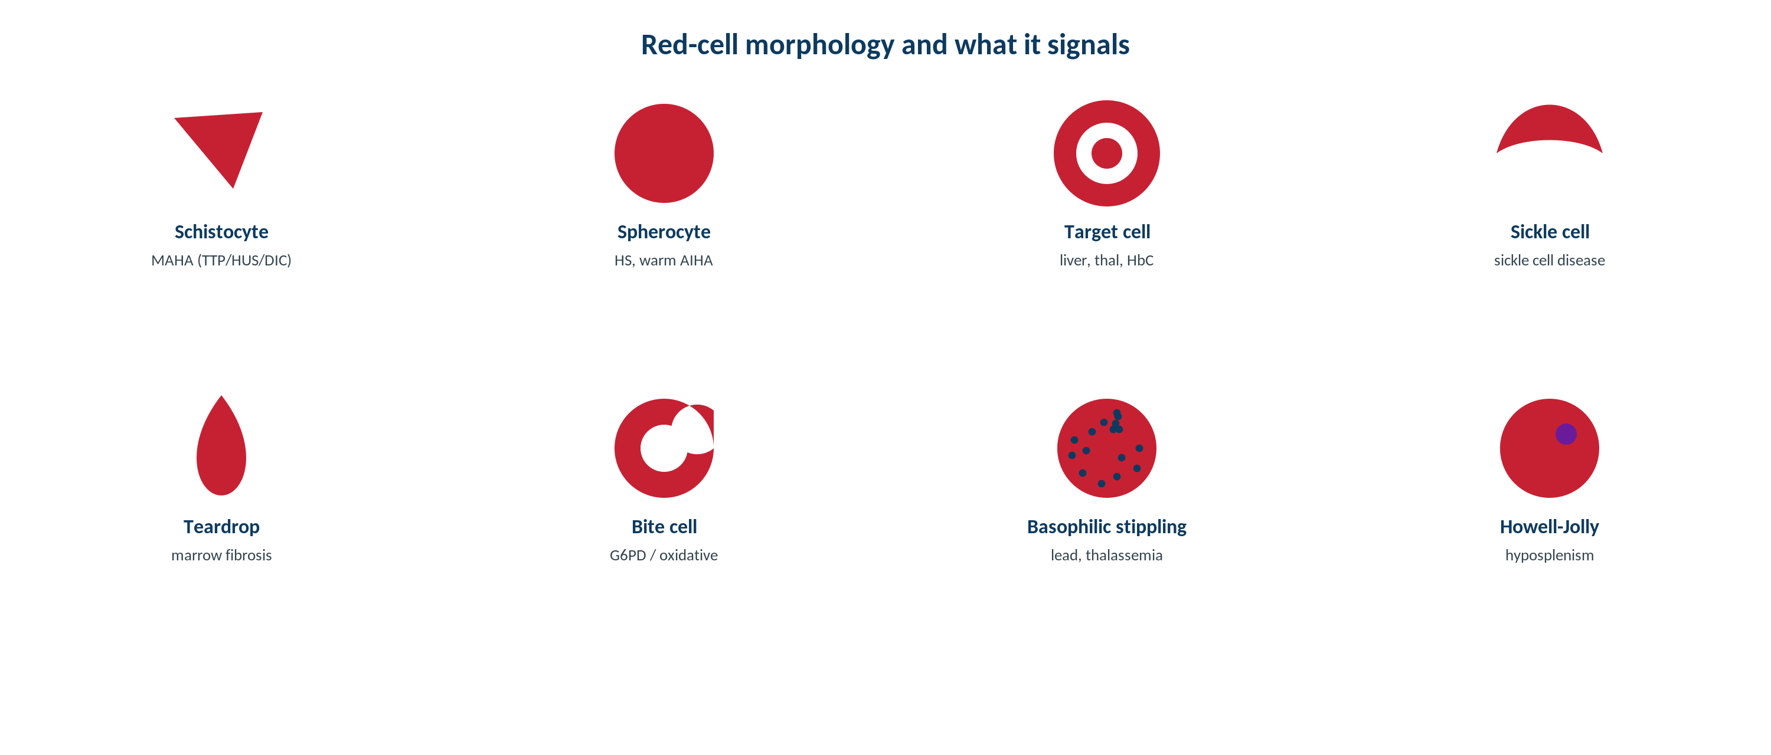
HEMATOLOGY & COAGULATION · MORPHOLOGY
Red-Cell Morphology
Original schematic. Specific shapes (schistocytes, spherocytes, target cells, teardrops) point to specific diagnoses.
Makassed General Hospital · Department of Laboratory Medicine
CP Lecture Series · 8

Slide 11
HEMATOLOGY & COAGULATION · MORPHOLOGY
Morphologic Clues and Their Meaning
Finding | Suggests
Schistocytes (fragments) | Microangiopathy (TTP/HUS, DIC), mechanical
Spherocytes | Hereditary spherocytosis, immune hemolysis
Target cells | Liver disease, thalassemia, hemoglobinopathy
Teardrop cells (dacrocytes) | Marrow infiltration / myelofibrosis
Bite cells / Heinz bodies | Oxidative hemolysis (G6PD)
Rouleaux | Paraproteinemia / high globulins
A single characteristic shape can redirect the entire workup — e.g., schistocytes trigger an urgent microangiopathy evaluation.
Makassed General Hospital · Department of Laboratory Medicine
CP Lecture Series · 9

Slide 12
HEMATOLOGY & COAGULATION · WHEN TO REVIEW
Triggers for a Manual Smear
ANALYZER TRIGGERS
CLINICAL TRIGGERS
Blast, immature-granulocyte, or NRBC flags.
Abnormal scattergrams or impossible indices.
New or severe cytopenia.
Atypical-lymphocyte flag.
Unexplained anemia, suspected hemolysis, or organomegaly.
Suspected acute leukemia (urgent).
Thrombocytopenia needing confirmation.
Discordance between numbers and the patient.
Makassed General Hospital · Department of Laboratory Medicine
CP Lecture Series · 10

Slide 13
03
PART THREE
Cases & Board Review

Slide 14
HEMATOLOGY & COAGULATION · CASE 1
Case 1
CLINICAL VIGNETTE
An automated platelet count is very low, but the patient has no bleeding. The smear shows platelet clumps.
?
What is the diagnosis and the fix?
Makassed General Hospital · Department of Laboratory Medicine
CP Lecture Series · 11

Slide 15
HEMATOLOGY & COAGULATION · CASE 1 · RESOLUTION
Case 1: Pseudothrombocytopenia
EDTA-induced platelet clumping caused a spuriously low automated count (pseudothrombocytopenia).
The smear reveals clumps — the true count is higher.
Recollect in sodium citrate (or another anticoagulant) and recount.
Avoid unnecessary workup or transfusion.
TEACHING POINT
A low platelet count without bleeding should be confirmed on a smear — clumps mean pseudothrombocytopenia, not true thrombocytopenia.
Makassed General Hospital · Department of Laboratory Medicine
CP Lecture Series · 12

Slide 16
HEMATOLOGY & COAGULATION · CASE 2
Case 2
CLINICAL VIGNETTE
An elderly patient has a low RBC count with an implausibly high MCV and MCHC; results change when the sample is warmed.
?
What artifact is responsible?
Makassed General Hospital · Department of Laboratory Medicine
CP Lecture Series · 13

Slide 17
HEMATOLOGY & COAGULATION · CASE 2 · RESOLUTION
Case 2: Cold Agglutinins
Cold agglutinins clump red cells, causing a falsely low RBC and spuriously high MCV/MCHC.
Warming the sample to 37°C resolves the artifact.
An MCHC above the physiologic ceiling is a red flag for an artifact.
Confirm with a warmed redraw.
TEACHING POINT
An impossibly high MCHC signals an artifact — cold agglutinins (or lipemia) — warm the sample and reanalyze.
Makassed General Hospital · Department of Laboratory Medicine
CP Lecture Series · 14

Slide 18
HEMATOLOGY & COAGULATION · CASE 3
Case 3
CLINICAL VIGNETTE
A CBC shows pancytopenia; the analyzer flags blasts.
?
What is the immediate next step?
Makassed General Hospital · Department of Laboratory Medicine
CP Lecture Series · 15

Slide 19
HEMATOLOGY & COAGULATION · CASE 3 · RESOLUTION
Case 3: Blast Flag
A blast flag with pancytopenia requires an urgent manual smear review.
Confirming circulating blasts raises concern for acute leukemia.
Expedite to morphology, flow cytometry, and the clinical team.
Time matters — some leukemias are emergencies.
TEACHING POINT
A blast flag is never ignored — it triggers an immediate smear and, if confirmed, an urgent leukemia workup.
Makassed General Hospital · Department of Laboratory Medicine
CP Lecture Series · 16

Slide 20
HEMATOLOGY & COAGULATION · BOARD REVIEW · Q1
Board-Style Review
Which finding most strongly favors iron deficiency over thalassemia trait?
A. Low MCV with normal RDW
B. Low MCV with high RDW
C. Normal MCV
D. High MCHC
E. Target cells only
Makassed General Hospital · Department of Laboratory Medicine
CP Lecture Series · 17

Slide 21
HEMATOLOGY & COAGULATION · BOARD REVIEW · Q1
Board-Style Review
Which finding most strongly favors iron deficiency over thalassemia trait?
A. Low MCV with normal RDW
B. Low MCV with high RDW
C. Normal MCV
D. High MCHC
E. Target cells only
ANSWER B — Low MCV with high RDW
Iron deficiency typically shows microcytosis with elevated RDW (anisocytosis); thalassemia trait often has a more uniform low MCV with normal RDW.
Makassed General Hospital · Department of Laboratory Medicine
CP Lecture Series · 17

Slide 22
HEMATOLOGY & COAGULATION · BOARD REVIEW · Q2
Board-Style Review
A physiologically impossible MCHC elevation most suggests:
A. True hyperchromia
B. An artifact (cold agglutinins, lipemia)
C. Iron deficiency
D. Thalassemia
E. Myelofibrosis
Makassed General Hospital · Department of Laboratory Medicine
CP Lecture Series · 18

Slide 23
HEMATOLOGY & COAGULATION · BOARD REVIEW · Q2
Board-Style Review
A physiologically impossible MCHC elevation most suggests:
A. True hyperchromia
B. An artifact (cold agglutinins, lipemia)
C. Iron deficiency
D. Thalassemia
E. Myelofibrosis
ANSWER B — An artifact
Red cells cannot be truly hyperchromic; a very high MCHC indicates an artifact such as cold agglutinins or lipemia.
Makassed General Hospital · Department of Laboratory Medicine
CP Lecture Series · 18

Slide 24
HEMATOLOGY & COAGULATION · BOARD REVIEW · Q3
Board-Style Review
Schistocytes on the smear should prompt evaluation for:
A. Iron deficiency
B. Microangiopathic hemolysis (TTP/HUS, DIC)
C. Vitamin B12 deficiency
D. Hereditary spherocytosis
E. Rouleaux
Makassed General Hospital · Department of Laboratory Medicine
CP Lecture Series · 19

Slide 25
HEMATOLOGY & COAGULATION · BOARD REVIEW · Q3
Board-Style Review
Schistocytes on the smear should prompt evaluation for:
A. Iron deficiency
B. Microangiopathic hemolysis (TTP/HUS, DIC)
C. Vitamin B12 deficiency
D. Hereditary spherocytosis
E. Rouleaux
ANSWER B — Microangiopathic hemolysis
Fragmented red cells indicate mechanical/microangiopathic processes requiring urgent assessment.
Makassed General Hospital · Department of Laboratory Medicine
CP Lecture Series · 19

Slide 26
HEMATOLOGY & COAGULATION · BOARD REVIEW · Q4
Board-Style Review
Pseudothrombocytopenia from EDTA is best confirmed by:
A. Repeating in EDTA
B. Reviewing the smear for clumps and recollecting in citrate
C. Transfusing platelets
D. A bone marrow biopsy
E. Ignoring it
Makassed General Hospital · Department of Laboratory Medicine
CP Lecture Series · 20

Slide 27
HEMATOLOGY & COAGULATION · BOARD REVIEW · Q4
Board-Style Review
Pseudothrombocytopenia from EDTA is best confirmed by:
A. Repeating in EDTA
B. Reviewing the smear for clumps and recollecting in citrate
C. Transfusing platelets
D. A bone marrow biopsy
E. Ignoring it
ANSWER B — Smear review + citrate redraw
Platelet clumps on the smear confirm the artifact; recollection in citrate yields an accurate count.
Makassed General Hospital · Department of Laboratory Medicine
CP Lecture Series · 20

Slide 28
HEMATOLOGY & COAGULATION
Key Take-Home Points
Interpret red-cell indices together: MCV (size), MCH/MCHC (color), and RDW (variation) — use absolute, not percentage, differential counts.
1
Analyzer flags exist to trigger a manual smear; never report implausible counts without review.
2
Recognize spurious results: EDTA platelet clumping (pseudothrombocytopenia), cold agglutinins (high MCHC), lipemia.
3
Specific red-cell shapes redirect the workup (schistocytes → microangiopathy; spherocytes → hemolysis; teardrops → marrow infiltration).
4
A blast flag or unexplained severe cytopenia is an urgent smear — the analyzer and smear together make the diagnosis.
5
Makassed General Hospital · Department of Laboratory Medicine
21

Slide 29
HEMATOLOGY & COAGULATION · REFERENCES & FURTHER READING
References
1. Bain BJ. A Beginner’s Guide to Blood Cells / Blood Cells: A Practical Guide, 6th ed.
2. Keohane E, et al. Rodak’s Hematology, 6th ed.
3. CLSI H20: Reference Leukocyte Differential Count.
4. Bain BJ. Diagnosis from the blood smear. N Engl J Med.
Makassed General Hospital · Department of Laboratory Medicine
CP Lecture Series · 22

