Slide 1
CLINICAL PATHOLOGY RESIDENCY LECTURE SERIES
HEMATOLOGY & COAGULATION · LECTURE 3 OF 5
Leukocytosis, Cytopenias & Leukemia Screening
Reading the White Cells and Knowing When It’s Urgent
Dr. Tamima El-Jisr
Chairperson, Department of Laboratory Medicine
Makassed General Hospital, Beirut
Clinical Pathology Residency Curriculum

Slide 2
HEMATOLOGY & COAGULATION · FRAMING THE PROBLEM
Why This Matters
Absolute
Left shift
Blasts
Always interpret absolute, not relative, counts
Immature forms: reactive or neoplastic?
Circulating blasts can be an emergency
White-cell abnormalities range from benign reactive changes to acute leukemia. The skill is distinguishing reactive patterns from neoplastic ones and recognizing the findings that demand urgent action.
The question is always the same: is this reactive or neoplastic — and is it urgent? Blasts and severe neutropenia change the timeline.
Makassed General Hospital · Department of Laboratory Medicine
CP Lecture Series · 2

Slide 3
HEMATOLOGY & COAGULATION · ·
Learning Objectives
Interpret leukocytosis and the differential using absolute counts.
Distinguish reactive changes from neoplastic populations.
1
2
Evaluate neutropenia and lymphocytosis.
Recognize the smear features of acute leukemia.
3
4
Describe the role of flow cytometry and ancillary testing.
Identify hematologic emergencies requiring urgent action.
5
6
Makassed General Hospital · Department of Laboratory Medicine
CP Lecture Series · 3

Slide 4
HEMATOLOGY & COAGULATION · WHAT WE WILL COVER
Roadmap
Leukocytosis — reactive vs neoplastic
1
Neutropenia & lymphocytosis — focused evaluation
2
Leukemia screening — smear and flow
3
Emergencies — when to act now
4
Cases & board review
5
Makassed General Hospital · Department of Laboratory Medicine
CP Lecture Series · 4

Slide 5
01
PART ONE
Reading the White Cells

Slide 6
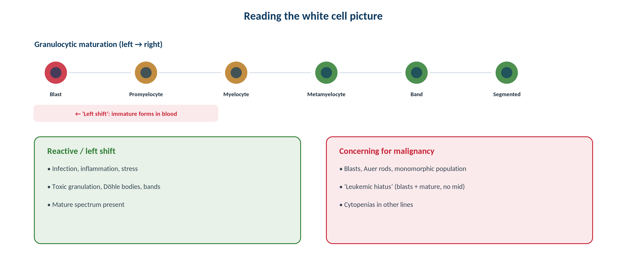
HEMATOLOGY & COAGULATION · WHITE CELLS
Maturation, Left Shift & Concerning Features
Original schematic. Reactive left shift shows a maturation spectrum; blasts with a ‘leukemic hiatus’ raise concern for malignancy.
Makassed General Hospital · Department of Laboratory Medicine
CP Lecture Series · 5

Slide 7
HEMATOLOGY & COAGULATION · LEUKOCYTOSIS
Reactive vs Neoplastic
REACTIVE PATTERNS
NEOPLASTIC CLUES
Neutrophilia with toxic granulation, Döhle bodies, and a full maturation spectrum suggests infection/inflammation.
Reactive lymphocytosis (e.g., viral) shows varied, atypical but mature cells.
Eosinophilia: allergy, parasites, drugs.
Leukemoid reaction is reactive, not leukemic.
A monomorphic population, blasts, Auer rods, or a ‘leukemic hiatus’ suggests malignancy.
Basophilia and a left shift may suggest CML.
Cytopenias in other lineages are concerning.
Confirm with flow/cytogenetics/molecular.
Makassed General Hospital · Department of Laboratory Medicine
CP Lecture Series · 6

Slide 8
02
PART TWO
Cytopenias & Leukemia Screening

Slide 9
HEMATOLOGY & COAGULATION · CYTOPENIAS
Neutropenia & Lymphocytosis
NEUTROPENIA
LYMPHOCYTOSIS
Severe neutropenia (very low ANC) risks serious infection — a clinical urgency.
Causes: drugs, infection, immune, marrow failure.
Assess other lineages for marrow involvement.
Communicate critically low counts promptly.
Reactive (viral) vs clonal (e.g., CLL) — smear and flow distinguish them.
Smudge cells suggest CLL.
Persistent unexplained lymphocytosis warrants flow.
Correlate with age and clinical picture.
Makassed General Hospital · Department of Laboratory Medicine
CP Lecture Series · 7

Slide 10
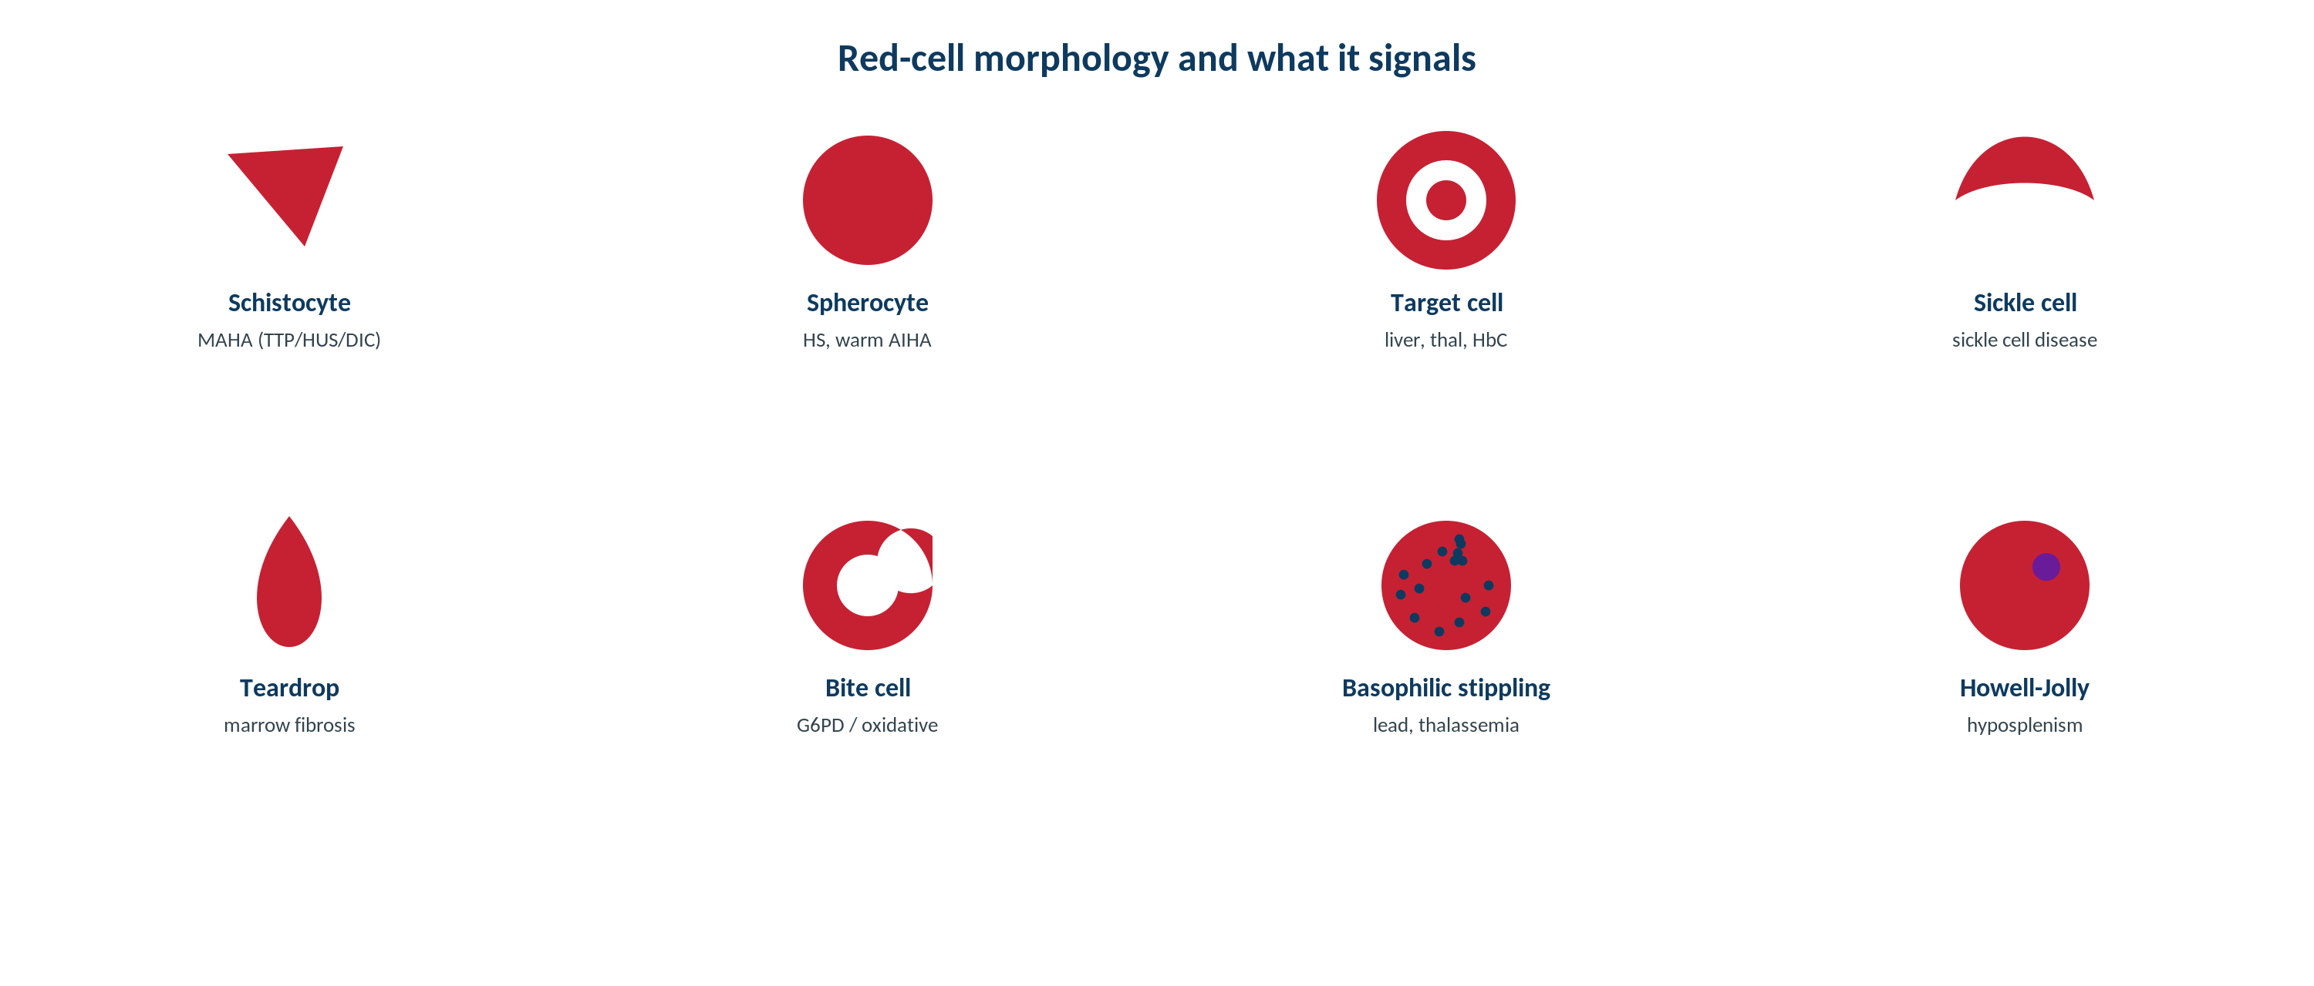
HEMATOLOGY & COAGULATION · MORPHOLOGY
Smear Features in Leukemia Screening
Original schematic. Blasts, Auer rods, and abnormal populations on the smear drive urgent flow cytometry and further testing.
Makassed General Hospital · Department of Laboratory Medicine
CP Lecture Series · 8

Slide 11
HEMATOLOGY & COAGULATION · WORKUP
Flow Cytometry & Ancillary Testing
IMMUNOPHENOTYPING
INTEGRATED DIAGNOSIS
Flow cytometry classifies blasts (myeloid vs lymphoid) and detects clonal populations.
Rapidly characterizes acute leukemia lineage.
Detects aberrant antigen expression.
Guides further cytogenetic/molecular testing.
Morphology + flow + cytogenetics + molecular define the entity (WHO/ICC).
Cytochemistry has a historical/adjunct role.
Correlate with the clinical scenario.
Ensure rapid communication for emergencies.
Makassed General Hospital · Department of Laboratory Medicine
CP Lecture Series · 9

Slide 12
03
PART THREE
Emergencies, Cases & Board

Slide 13
HEMATOLOGY & COAGULATION · EMERGENCIES
Hematologic Emergencies
RECOGNIZE AT ONCE
ACT DECISIVELY
Circulating blasts / suspected acute leukemia — especially suspected APL.
Hyperleukocytosis with leukostasis symptoms.
Severe neutropenia with fever (neutropenic sepsis risk).
Severe thrombocytopenia with bleeding.
Expedite smear review, flow cytometry, and communication.
Notify the clinical team immediately.
Suspected APL needs urgent confirmation and treatment.
Document critical-value notification.
Makassed General Hospital · Department of Laboratory Medicine
CP Lecture Series · 10

Slide 14
HEMATOLOGY & COAGULATION · CASE 1
Case 1
CLINICAL VIGNETTE
A febrile patient has neutrophilia with toxic granulation, Döhle bodies, and a few bands, but no blasts.
?
Reactive or neoplastic?
Makassed General Hospital · Department of Laboratory Medicine
CP Lecture Series · 11

Slide 15
HEMATOLOGY & COAGULATION · CASE 1 · RESOLUTION
Case 1: Leukemoid Reaction
Toxic changes with a full maturation spectrum and no blasts indicate a reactive (leukemoid) response to infection.
A leukemoid reaction is reactive, not leukemic.
LAP score (historical) is high in reactive states, low in CML.
Treat the underlying infection.
TEACHING POINT
A reactive left shift shows the whole maturation spectrum with toxic changes — distinct from the blasts/hiatus of leukemia.
Makassed General Hospital · Department of Laboratory Medicine
CP Lecture Series · 12

Slide 16
HEMATOLOGY & COAGULATION · CASE 2
Case 2
CLINICAL VIGNETTE
An older patient has marked lymphocytosis with numerous smudge cells.
?
What does this suggest and how is it confirmed?
Makassed General Hospital · Department of Laboratory Medicine
CP Lecture Series · 13

Slide 17
HEMATOLOGY & COAGULATION · CASE 2 · RESOLUTION
Case 2: CLL
Lymphocytosis with smudge cells suggests chronic lymphocytic leukemia.
Flow cytometry confirms a clonal B-cell population with the characteristic phenotype.
Correlate with clinical staging.
Distinguish from reactive lymphocytosis.
TEACHING POINT
Persistent lymphocytosis with smudge cells points to CLL — flow cytometry confirms the clonal B-cell population.
Makassed General Hospital · Department of Laboratory Medicine
CP Lecture Series · 14

Slide 18
HEMATOLOGY & COAGULATION · CASE 3
Case 3
CLINICAL VIGNETTE
A smear shows numerous blasts; some contain Auer rods. The patient is acutely ill.
?
What is the urgent interpretation and action?
Makassed General Hospital · Department of Laboratory Medicine
CP Lecture Series · 15

Slide 19
HEMATOLOGY & COAGULATION · CASE 3 · RESOLUTION
Case 3: Acute Myeloid Leukemia
Blasts with Auer rods indicate acute myeloid leukemia — a hematologic emergency.
Expedite flow cytometry, cytogenetics, and molecular testing.
If promyelocytic features/coagulopathy → suspect APL and act urgently.
Immediate communication with the clinical team.
TEACHING POINT
Auer rods confirm myeloid blasts — AML; rapid characterization is urgent, and suspected APL is a true emergency.
Makassed General Hospital · Department of Laboratory Medicine
CP Lecture Series · 16

Slide 20
HEMATOLOGY & COAGULATION · BOARD REVIEW · Q1
Board-Style Review
White-cell counts should be interpreted as:
A. Percentages only
B. Absolute counts
C. Ratios only
D. Relative to platelets
E. Without the differential
Makassed General Hospital · Department of Laboratory Medicine
CP Lecture Series · 17

Slide 21
HEMATOLOGY & COAGULATION · BOARD REVIEW · Q1
Board-Style Review
White-cell counts should be interpreted as:
A. Percentages only
B. Absolute counts
C. Ratios only
D. Relative to platelets
E. Without the differential
ANSWER B — Absolute counts
Absolute counts (e.g., ANC, ALC) determine clinical risk; percentages alone can mislead.
Makassed General Hospital · Department of Laboratory Medicine
CP Lecture Series · 17

Slide 22
HEMATOLOGY & COAGULATION · BOARD REVIEW · Q2
Board-Style Review
Auer rods on a smear indicate:
A. Reactive neutrophilia
B. Myeloid blasts (AML)
C. CLL
D. Viral infection
E. Megaloblastic anemia
Makassed General Hospital · Department of Laboratory Medicine
CP Lecture Series · 18

Slide 23
HEMATOLOGY & COAGULATION · BOARD REVIEW · Q2
Board-Style Review
Auer rods on a smear indicate:
A. Reactive neutrophilia
B. Myeloid blasts (AML)
C. CLL
D. Viral infection
E. Megaloblastic anemia
ANSWER B — Myeloid blasts (AML)
Auer rods are pathognomonic of myeloid lineage blasts, seen in AML.
Makassed General Hospital · Department of Laboratory Medicine
CP Lecture Series · 18

Slide 24
HEMATOLOGY & COAGULATION · BOARD REVIEW · Q3
Board-Style Review
A ‘leukemic hiatus’ (blasts and mature cells without intermediate forms) suggests:
A. Reactive left shift
B. Acute leukemia
C. CML
D. Leukemoid reaction
E. Normal marrow
Makassed General Hospital · Department of Laboratory Medicine
CP Lecture Series · 19

Slide 25
HEMATOLOGY & COAGULATION · BOARD REVIEW · Q3
Board-Style Review
A ‘leukemic hiatus’ (blasts and mature cells without intermediate forms) suggests:
A. Reactive left shift
B. Acute leukemia
C. CML
D. Leukemoid reaction
E. Normal marrow
ANSWER B — Acute leukemia
The gap between blasts and mature cells (absent intermediates) is characteristic of acute leukemia, unlike a reactive spectrum.
Makassed General Hospital · Department of Laboratory Medicine
CP Lecture Series · 19

Slide 26
HEMATOLOGY & COAGULATION · BOARD REVIEW · Q4
Board-Style Review
Smudge cells with marked lymphocytosis in an older adult suggest:
A. AML
B. Chronic lymphocytic leukemia
C. Reactive neutrophilia
D. Myelofibrosis
E. Iron deficiency
Makassed General Hospital · Department of Laboratory Medicine
CP Lecture Series · 20

Slide 27
HEMATOLOGY & COAGULATION · BOARD REVIEW · Q4
Board-Style Review
Smudge cells with marked lymphocytosis in an older adult suggest:
A. AML
B. Chronic lymphocytic leukemia
C. Reactive neutrophilia
D. Myelofibrosis
E. Iron deficiency
ANSWER B — CLL
Smudge (basket) cells accompany the fragile lymphocytes of CLL; flow cytometry confirms clonality.
Makassed General Hospital · Department of Laboratory Medicine
CP Lecture Series · 20

Slide 28
HEMATOLOGY & COAGULATION
Key Take-Home Points
Interpret white cells by absolute counts; reactive changes show a full maturation spectrum with toxic features.
1
Neoplastic clues: monomorphic populations, blasts, Auer rods, leukemic hiatus, basophilia, and other-lineage cytopenias.
2
Evaluate severe neutropenia (infection risk) and distinguish reactive from clonal lymphocytosis (smudge cells → CLL).
3
Flow cytometry classifies blasts and clonal populations; diagnosis integrates morphology, flow, cytogenetics, and molecular.
4
Recognize emergencies: circulating blasts/suspected APL, hyperleukocytosis, neutropenic fever, severe thrombocytopenia.
5
Makassed General Hospital · Department of Laboratory Medicine
21

Slide 29
HEMATOLOGY & COAGULATION · REFERENCES & FURTHER READING
References
1. Keohane E, et al. Rodak’s Hematology, 6th ed.
2. Bain BJ. Blood Cells: A Practical Guide, 6th ed.
3. WHO Classification of Haematolymphoid Tumours (current ed.).
4. Arber DA, et al. International Consensus Classification. Blood. 2022.
Makassed General Hospital · Department of Laboratory Medicine
CP Lecture Series · 22

