Slide 1
CLINICAL PATHOLOGY RESIDENCY LECTURE SERIES
HEMATOLOGY & COAGULATION · LECTURE 4 OF 5
Platelet Disorders & Thrombocytopenia
Mechanisms, the Smear, and High-Stakes Diagnoses
Dr. Tamima El-Jisr
Chairperson, Department of Laboratory Medicine
Makassed General Hospital, Beirut
Clinical Pathology Residency Curriculum

Slide 2
HEMATOLOGY & COAGULATION · FRAMING THE PROBLEM
Why This Matters
Confirm
Mechanism
HIT/TTP
Always exclude pseudothrombocytopenia first
Decreased production vs increased destruction
Some thrombocytopenias are emergencies
Thrombocytopenia is common and ranges from artifact to life-threatening. A mechanism-based approach — after excluding artifact — and recognition of the emergencies (TTP, HIT, DIC) are essential.
First exclude pseudothrombocytopenia; then ask production vs destruction; then rule out the emergencies (TTP, HIT, DIC).
Makassed General Hospital · Department of Laboratory Medicine
CP Lecture Series · 2

Slide 3
HEMATOLOGY & COAGULATION · ·
Learning Objectives
Exclude pseudothrombocytopenia and confirm a true low count.
Classify thrombocytopenia by mechanism.
1
2
Evaluate immune thrombocytopenia (ITP).
Recognize thrombotic microangiopathies (TTP/HUS).
3
4
Apply the HIT 4T concept and DIC pattern.
Describe qualitative platelet disorders and their testing.
5
6
Makassed General Hospital · Department of Laboratory Medicine
CP Lecture Series · 3

Slide 4
HEMATOLOGY & COAGULATION · WHAT WE WILL COVER
Roadmap
Confirm the count — exclude artifact
1
Mechanism — production vs destruction
2
ITP & TMA — immune and microangiopathic
3
HIT & DIC — high-stakes patterns
4
Cases & board review
5
Makassed General Hospital · Department of Laboratory Medicine
CP Lecture Series · 4

Slide 5
01
PART ONE
Confirming & Classifying

Slide 6
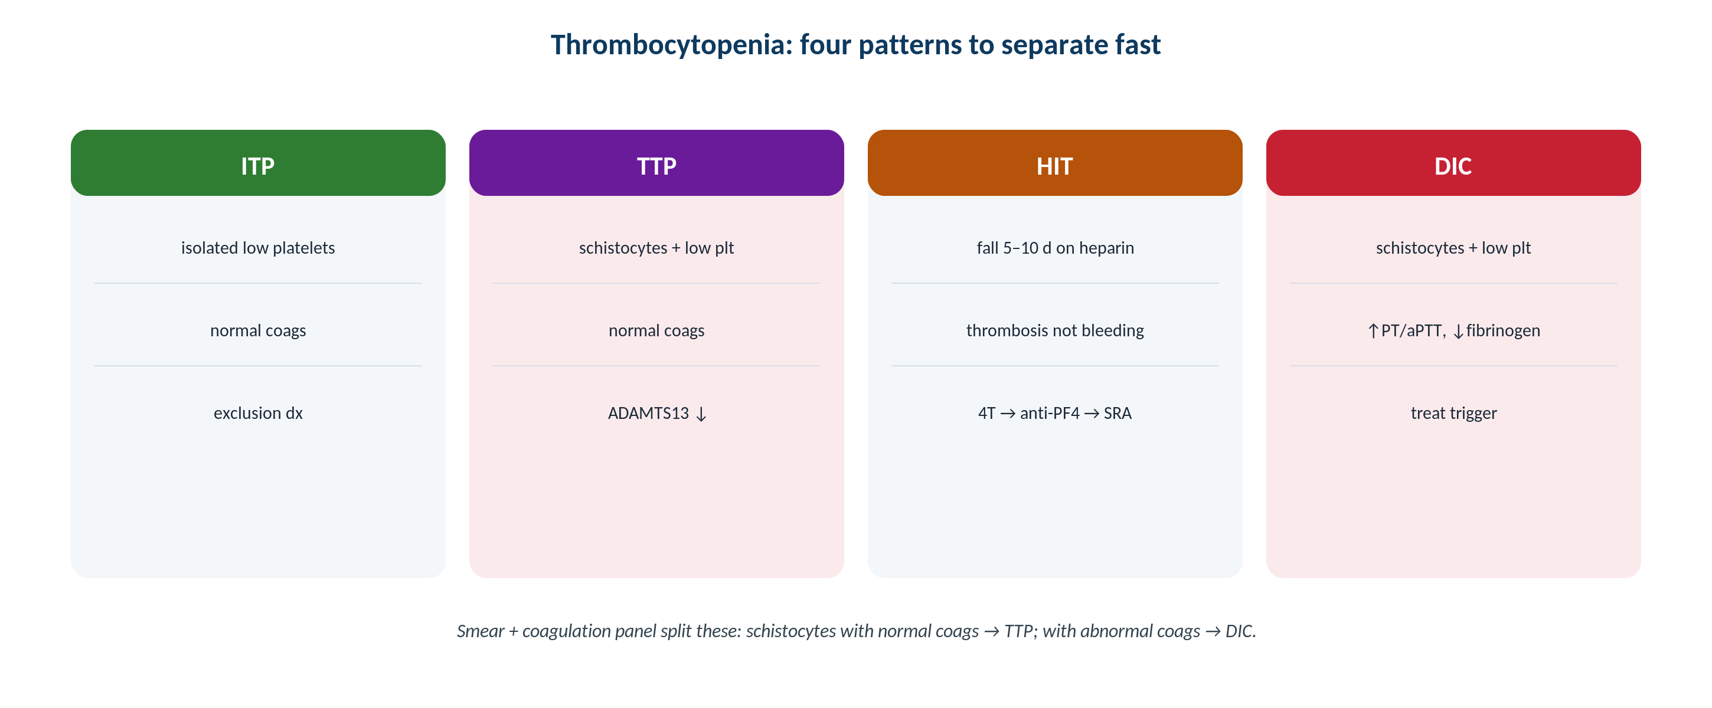
HEMATOLOGY & COAGULATION · PLATELETS
A Mechanism-Based Approach to Thrombocytopenia
Original schematic. After excluding artifact, separate decreased production from increased destruction/consumption.
Makassed General Hospital · Department of Laboratory Medicine
CP Lecture Series · 5

Slide 7
HEMATOLOGY & COAGULATION · CONFIRM
Exclude Pseudothrombocytopenia
FIRST STEP
THEN CHARACTERIZE
Review the smear for platelet clumps before any workup.
EDTA-induced clumping causes a spuriously low count.
Recollect in citrate (or another tube) if clumps are present.
Avoid unnecessary treatment for an artifact.
Assess severity and other cell lines; look for schistocytes.
Isolated vs multilineage cytopenia.
Acute vs chronic; bleeding vs none.
History: drugs, infection, pregnancy, heparin.
Makassed General Hospital · Department of Laboratory Medicine
CP Lecture Series · 6

Slide 8
HEMATOLOGY & COAGULATION · MECHANISM
Production vs Destruction
DECREASED PRODUCTION
INCREASED DESTRUCTION/CONSUMPTION
Marrow failure/infiltration, chemotherapy, B12/folate deficiency, alcohol.
Often with other cytopenias.
May need marrow evaluation.
Smear/other lines give clues.
Immune (ITP), microangiopathic (TTP/HUS, DIC), splenic sequestration.
Often isolated (ITP) or with schistocytes (TMA).
Reticulated/young platelets may be increased.
Identify the specific cause urgently when needed.
Makassed General Hospital · Department of Laboratory Medicine
CP Lecture Series · 7

Slide 9
02
PART TWO
ITP, TMA, HIT & DIC

Slide 10
HEMATOLOGY & COAGULATION · ITP / TMA
Immune and Microangiopathic
IMMUNE THROMBOCYTOPENIA
TTP / HUS
ITP is a diagnosis of exclusion: isolated thrombocytopenia, otherwise well.
Smear shows large, young platelets without schistocytes.
No specific confirmatory test.
Exclude drugs, infection, and other causes.
Thrombotic microangiopathy: thrombocytopenia + microangiopathic hemolysis (schistocytes).
TTP: severe ADAMTS13 deficiency — a medical emergency.
Do not wait for all features; act on suspicion.
Urgent hematology involvement.
Makassed General Hospital · Department of Laboratory Medicine
CP Lecture Series · 8

Slide 11
HEMATOLOGY & COAGULATION · HIT / DIC
Heparin-Induced Thrombocytopenia & DIC
HIT
DIC
A prothrombotic, immune reaction to heparin — platelets typically fall ~5–10 days after exposure.
Use the 4T pretest probability before testing.
Immunoassay screens; functional assay confirms.
Stop heparin and use a non-heparin anticoagulant — paradoxically, thrombosis is the danger.
Consumptive coagulopathy: low platelets and fibrinogen, prolonged PT/aPTT, high D-dimer.
Schistocytes on smear.
Always secondary — treat the trigger.
Distinguish from TTP and liver disease.
Makassed General Hospital · Department of Laboratory Medicine
CP Lecture Series · 9

Slide 12
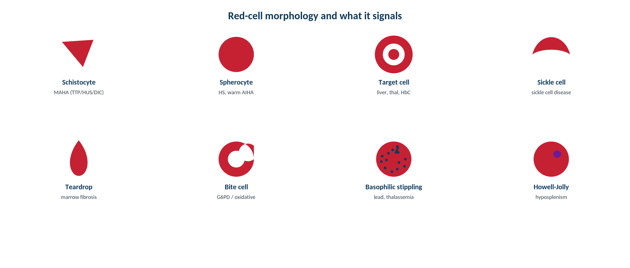
HEMATOLOGY & COAGULATION · MORPHOLOGY
Schistocytes: the Microangiopathy Clue
Original schematic. Schistocytes signal a thrombotic microangiopathy (TTP/HUS, DIC) — an urgent, platelet-related smear finding.
Makassed General Hospital · Department of Laboratory Medicine
CP Lecture Series · 10

Slide 13
HEMATOLOGY & COAGULATION · QUALITATIVE
Qualitative Platelet Disorders
FUNCTION VS NUMBER
TESTING
Bleeding with a normal count suggests a qualitative platelet defect.
Acquired: antiplatelet drugs, uremia, cardiopulmonary bypass.
Inherited: e.g., Glanzmann, Bernard-Soulier.
History of mucocutaneous bleeding is a clue.
Platelet-function analyzers and aggregometry assess function.
Correlate with medication and clinical history.
The bleeding time is largely obsolete.
Specialized testing for inherited disorders.
Makassed General Hospital · Department of Laboratory Medicine
CP Lecture Series · 11

Slide 14
03
PART THREE
Cases & Board Review

Slide 15
HEMATOLOGY & COAGULATION · CASE 1
Case 1
CLINICAL VIGNETTE
A well adult has isolated thrombocytopenia; the smear shows large platelets and no schistocytes or clumps.
?
What is the likely diagnosis and its nature?
Makassed General Hospital · Department of Laboratory Medicine
CP Lecture Series · 12

Slide 16
HEMATOLOGY & COAGULATION · CASE 1 · RESOLUTION
Case 1: ITP
Isolated thrombocytopenia in an otherwise well patient, with large young platelets and no schistocytes, suggests ITP.
ITP is a diagnosis of exclusion — no confirmatory test.
Exclude drugs, infection, and secondary causes.
Treat based on bleeding and count.
TEACHING POINT
ITP is isolated thrombocytopenia by exclusion — the smear (large platelets, no schistocytes, no clumps) supports it.
Makassed General Hospital · Department of Laboratory Medicine
CP Lecture Series · 13

Slide 17
HEMATOLOGY & COAGULATION · CASE 2
Case 2
CLINICAL VIGNETTE
A patient has thrombocytopenia, anemia with many schistocytes, high LDH, and neurologic symptoms.
?
What must be considered immediately?
Makassed General Hospital · Department of Laboratory Medicine
CP Lecture Series · 14

Slide 18
HEMATOLOGY & COAGULATION · CASE 2 · RESOLUTION
Case 2: TTP
Microangiopathic hemolysis with thrombocytopenia and neurologic features should prompt urgent consideration of TTP.
Severe ADAMTS13 deficiency underlies TTP.
It is a medical emergency — do not await all classic features.
Urgent hematology and treatment.
TEACHING POINT
Thrombocytopenia + schistocytes is a thrombotic microangiopathy until proven otherwise — TTP is an emergency; act on suspicion.
Makassed General Hospital · Department of Laboratory Medicine
CP Lecture Series · 15

Slide 19
HEMATOLOGY & COAGULATION · CASE 3
Case 3
CLINICAL VIGNETTE
A post-surgical patient on heparin develops a falling platelet count around day 7 and a new thrombosis.
?
What is the concern and the immediate action?
Makassed General Hospital · Department of Laboratory Medicine
CP Lecture Series · 16

Slide 20
HEMATOLOGY & COAGULATION · CASE 3 · RESOLUTION
Case 3: HIT
The timing (~5–10 days), platelet fall, and new thrombosis raise concern for heparin-induced thrombocytopenia.
Apply the 4T score; screen with immunoassay, confirm with a functional assay.
Stop all heparin and start a non-heparin anticoagulant.
HIT is prothrombotic — the risk is clotting, not bleeding.
TEACHING POINT
HIT presents as a falling platelet count with thrombosis ~5–10 days after heparin — stop heparin and anticoagulate with a non-heparin agent.
Makassed General Hospital · Department of Laboratory Medicine
CP Lecture Series · 17

Slide 21
HEMATOLOGY & COAGULATION · BOARD REVIEW · Q1
Board-Style Review
The first step when facing a low automated platelet count is to:
A. Transfuse platelets
B. Review the smear to exclude clumping
C. Start steroids
D. Order a marrow biopsy
E. Give IVIG
Makassed General Hospital · Department of Laboratory Medicine
CP Lecture Series · 18

Slide 22
HEMATOLOGY & COAGULATION · BOARD REVIEW · Q1
Board-Style Review
The first step when facing a low automated platelet count is to:
A. Transfuse platelets
B. Review the smear to exclude clumping
C. Start steroids
D. Order a marrow biopsy
E. Give IVIG
ANSWER B — Review the smear
Excluding EDTA-induced clumping (pseudothrombocytopenia) prevents unnecessary, potentially harmful treatment.
Makassed General Hospital · Department of Laboratory Medicine
CP Lecture Series · 18

Slide 23
HEMATOLOGY & COAGULATION · BOARD REVIEW · Q2
Board-Style Review
Thrombocytopenia with schistocytes and microangiopathic hemolysis suggests:
A. ITP
B. A thrombotic microangiopathy (e.g., TTP/HUS, DIC)
C. Pseudothrombocytopenia
D. Bernard-Soulier syndrome
E. Iron deficiency
Makassed General Hospital · Department of Laboratory Medicine
CP Lecture Series · 19

Slide 24
HEMATOLOGY & COAGULATION · BOARD REVIEW · Q2
Board-Style Review
Thrombocytopenia with schistocytes and microangiopathic hemolysis suggests:
A. ITP
B. A thrombotic microangiopathy (e.g., TTP/HUS, DIC)
C. Pseudothrombocytopenia
D. Bernard-Soulier syndrome
E. Iron deficiency
ANSWER B — Thrombotic microangiopathy
Schistocytes with thrombocytopenia indicate a microangiopathic process requiring urgent evaluation.
Makassed General Hospital · Department of Laboratory Medicine
CP Lecture Series · 19

Slide 25
HEMATOLOGY & COAGULATION · BOARD REVIEW · Q3
Board-Style Review
The principal danger of heparin-induced thrombocytopenia (HIT) is:
A. Bleeding
B. Thrombosis
C. Hemolysis
D. Iron overload
E. Marrow failure
Makassed General Hospital · Department of Laboratory Medicine
CP Lecture Series · 20

Slide 26
HEMATOLOGY & COAGULATION · BOARD REVIEW · Q3
Board-Style Review
The principal danger of heparin-induced thrombocytopenia (HIT) is:
A. Bleeding
B. Thrombosis
C. Hemolysis
D. Iron overload
E. Marrow failure
ANSWER B — Thrombosis
HIT is prothrombotic; management is to stop heparin and start a non-heparin anticoagulant, not to transfuse platelets.
Makassed General Hospital · Department of Laboratory Medicine
CP Lecture Series · 20

Slide 27
HEMATOLOGY & COAGULATION · BOARD REVIEW · Q4
Board-Style Review
Mucocutaneous bleeding with a NORMAL platelet count suggests:
A. A qualitative platelet disorder
B. DIC
C. TTP
D. Pseudothrombocytopenia
E. ITP
Makassed General Hospital · Department of Laboratory Medicine
CP Lecture Series · 21

Slide 28
HEMATOLOGY & COAGULATION · BOARD REVIEW · Q4
Board-Style Review
Mucocutaneous bleeding with a NORMAL platelet count suggests:
A. A qualitative platelet disorder
B. DIC
C. TTP
D. Pseudothrombocytopenia
E. ITP
ANSWER A — Qualitative platelet disorder
Normal numbers with bleeding point to platelet dysfunction (drugs, uremia, inherited defects).
Makassed General Hospital · Department of Laboratory Medicine
CP Lecture Series · 21

Slide 29
HEMATOLOGY & COAGULATION
Key Take-Home Points
Always exclude pseudothrombocytopenia (smear for clumps; citrate redraw) before any workup.
1
Classify by mechanism: decreased production (often multilineage) vs increased destruction/consumption (ITP, TMA, DIC, sequestration).
2
ITP is isolated thrombocytopenia by exclusion; thrombocytopenia + schistocytes = thrombotic microangiopathy (TTP is an emergency).
3
HIT: platelet fall ~5–10 days after heparin with thrombosis — use the 4T score, stop heparin, and use a non-heparin anticoagulant.
4
Bleeding with a normal count indicates a qualitative platelet disorder (drugs, uremia, inherited).
5
Makassed General Hospital · Department of Laboratory Medicine
22

Slide 30
HEMATOLOGY & COAGULATION · REFERENCES & FURTHER READING
References
1. Keohane E, et al. Rodak’s Hematology, 6th ed.
2. Arnold DM, et al. Approach to thrombocytopenia. Blood.
3. American Society of Hematology ITP guidelines.
4. Cuker A, et al. HIT diagnosis and management (ASH guidelines).
Makassed General Hospital · Department of Laboratory Medicine
CP Lecture Series · 23

