Slide 1
CLINICAL PATHOLOGY RESIDENCY LECTURE SERIES
IMMUNOLOGY & SEROLOGY · LECTURE 1 OF 4
Immunoassay Principles & Test Performance
Formats, Interferences, and Interpreting Results Correctly
Dr. Tamima El-Jisr
Chairperson, Department of Laboratory Medicine
Makassed General Hospital, Beirut
Clinical Pathology Residency Curriculum

Slide 2
IMMUNOLOGY & SEROLOGY · FRAMING THE PROBLEM
Why This Matters
Sandwich
Hook
PPV
Two-antibody capture detects antigen
Very high analyte can paradoxically read low
Prevalence governs what a positive result means
Immunoassays underpin endocrine, cardiac, infectious, and autoimmune testing. Reliable interpretation requires understanding the assay format, the classic interferences, and how disease prevalence shapes predictive value.
A result is the product of an assay format and a population — know both before you trust the number.
Makassed General Hospital · Department of Laboratory Medicine
CP Lecture Series · 2

Slide 3
IMMUNOLOGY & SEROLOGY · ·
Learning Objectives
Describe competitive and sandwich (immunometric) immunoassay formats.
Explain labels and signal detection (enzyme, chemiluminescence).
1
2
Recognize key interferences: hook effect, heterophile/biotin, cross-reactivity.
Apply sensitivity, specificity, and predictive values with prevalence.
3
4
Interpret borderline and discordant results.
State confirmation strategies for high-stakes results.
5
6
Makassed General Hospital · Department of Laboratory Medicine
CP Lecture Series · 3

Slide 4
IMMUNOLOGY & SEROLOGY · WHAT WE WILL COVER
Roadmap
Assay formats — competitive vs sandwich
1
Detection — labels and signal
2
Interferences — hook, heterophile, biotin
3
Performance — predictive value and prevalence
4
Cases & board review
5
Makassed General Hospital · Department of Laboratory Medicine
CP Lecture Series · 4

Slide 5
01
PART ONE
Formats & Detection

Slide 6
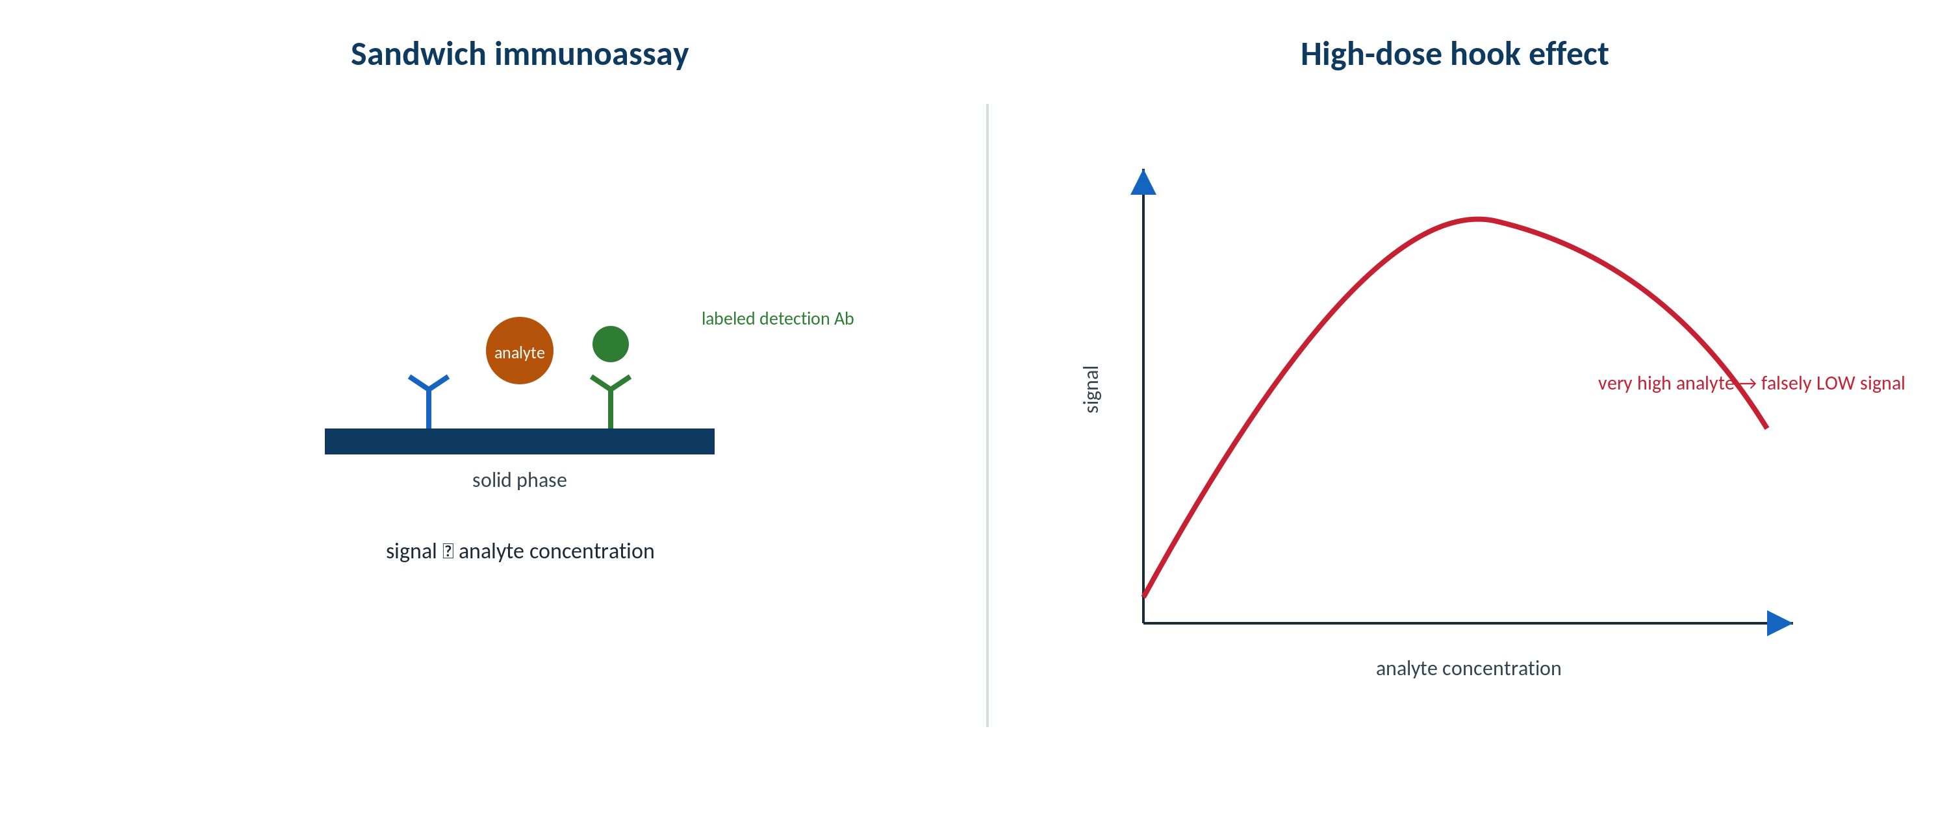
IMMUNOLOGY & SEROLOGY · FORMATS
Competitive vs Sandwich Immunoassay
Original schematic. Sandwich assays suit larger analytes with two epitopes; competitive assays suit small molecules.
Makassed General Hospital · Department of Laboratory Medicine
CP Lecture Series · 5

Slide 7
IMMUNOLOGY & SEROLOGY · FORMATS
How the Two Formats Behave
SANDWICH (IMMUNOMETRIC)
COMPETITIVE
Capture + detection antibody bracket the analyte; signal increases with concentration.
Best for larger molecules with ≥2 epitopes.
High sensitivity and specificity.
Susceptible to the high-dose hook effect.
Labeled analyte competes with patient analyte; signal is inversely related to concentration.
Used for small molecules (haptens, many drugs/hormones).
One epitope is sufficient.
Different interference profile.
Makassed General Hospital · Department of Laboratory Medicine
CP Lecture Series · 6

Slide 8
IMMUNOLOGY & SEROLOGY · DETECTION
Labels & Signal
COMMON LABELS
CALIBRATION & QC
Enzyme (EIA/ELISA), chemiluminescent, and fluorescent labels generate measurable signal.
Chemiluminescence offers wide dynamic range and automation.
Calibration curves relate signal to concentration.
Lot-to-lot calibration and QC are essential.
Results depend on a valid calibration curve and in-control QC.
Standardization/harmonization affects comparability across platforms.
Carryover and matrix effects must be controlled.
Method changes can shift reference intervals.
Makassed General Hospital · Department of Laboratory Medicine
CP Lecture Series · 7

Slide 9
02
PART TWO
Interferences & Performance

Slide 10
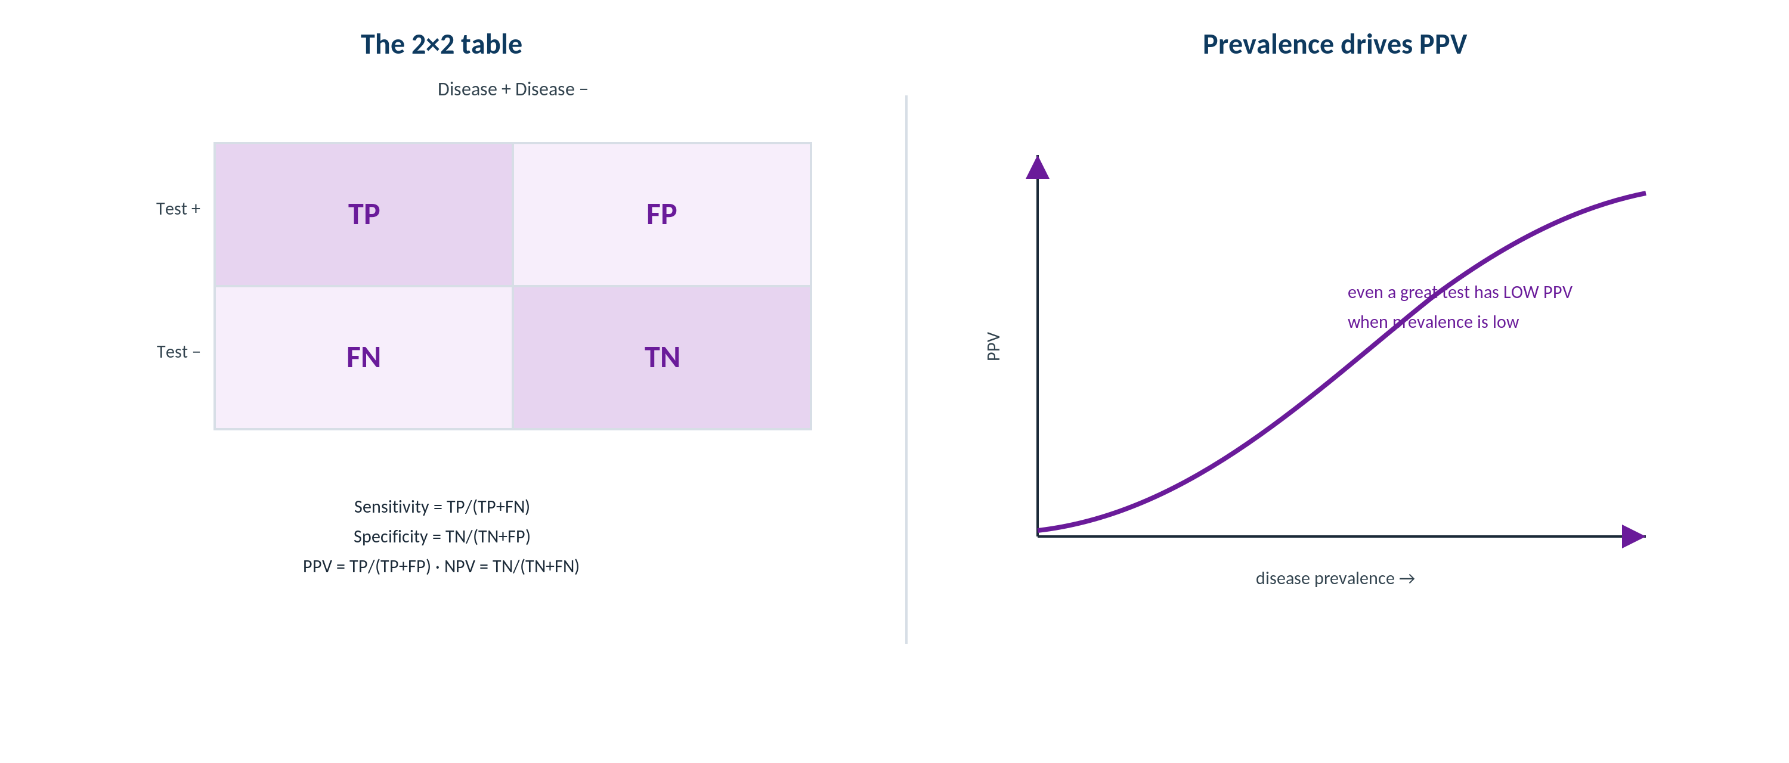
IMMUNOLOGY & SEROLOGY · PERFORMANCE
Sensitivity, Specificity & Predictive Value
Original schematic. Predictive values shift with disease prevalence even when sensitivity/specificity are fixed.
Makassed General Hospital · Department of Laboratory Medicine
CP Lecture Series · 8

Slide 11
IMMUNOLOGY & SEROLOGY · INTERFERENCES
Classic Immunoassay Interferences
FALSELY LOW / HIGH SIGNAL
HETEROPHILE & AUTOANTIBODIES
Hook effect: extremely high analyte saturates antibodies → falsely LOW result (dilute to unmask).
Biotin interferes with streptavidin-biotin assays (e.g., low TSH, high free T4).
Cross-reactivity with structurally similar molecules.
Matrix effects (lipemia, icterus, hemolysis).
Heterophile antibodies bridge assay antibodies → false positives/negatives.
Macro-analytes (macroprolactin, macro-CK) cause spurious elevations.
Anti-analyte autoantibodies distort results.
Suspect interference when results don’t fit the patient.
Makassed General Hospital · Department of Laboratory Medicine
CP Lecture Series · 9

Slide 12
IMMUNOLOGY & SEROLOGY · PERFORMANCE
Predictive Value & Prevalence
THE CORE RELATIONSHIP
BORDERLINE & DISCORDANT
Sensitivity/specificity are assay properties; predictive values depend on prevalence.
In low-prevalence screening, even good tests yield many false positives (low PPV).
Confirm screen-positives with a more specific method.
Choose cutoffs by the clinical purpose (screen vs confirm).
Equivocal results warrant repeat, alternate method, or follow-up testing.
Discordant results suggest interference or a pre-analytic issue.
Report uncertainty rather than forcing a binary call.
Communicate caveats to the clinician.
Makassed General Hospital · Department of Laboratory Medicine
CP Lecture Series · 10

Slide 13
03
PART THREE
Cases & Board Review

Slide 14
IMMUNOLOGY & SEROLOGY · CASE 1
Case 1
CLINICAL VIGNETTE
A patient with a large tumor has a surprisingly low tumor-marker level that does not fit the clinical picture; on dilution the value rises markedly.
?
What artifact explains this, and how is it confirmed?
Makassed General Hospital · Department of Laboratory Medicine
CP Lecture Series · 11

Slide 15
IMMUNOLOGY & SEROLOGY · CASE 1 · RESOLUTION
Case 1: High-Dose Hook Effect
Extremely high analyte saturated both antibodies, producing a falsely low result (hook effect).
Serial dilution unmasks the true high concentration.
Occurs in one-step sandwich assays.
Suspect it when a low value contradicts a high clinical suspicion.
TEACHING POINT
When a sandwich-assay result is implausibly low for the clinical context, dilute the sample to exclude the hook effect.
Makassed General Hospital · Department of Laboratory Medicine
CP Lecture Series · 12

Slide 16
IMMUNOLOGY & SEROLOGY · CASE 2
Case 2
CLINICAL VIGNETTE
A healthy person screens positive on a low-prevalence infectious serology; a specific confirmatory assay is negative.
?
How do you interpret the discordance?
Makassed General Hospital · Department of Laboratory Medicine
CP Lecture Series · 13

Slide 17
IMMUNOLOGY & SEROLOGY · CASE 2 · RESOLUTION
Case 2: Low Prevalence, Low PPV
In low-prevalence settings, a positive screen has a low positive predictive value — many positives are false.
A negative specific confirmatory test supports a false-positive screen.
Algorithms pair a sensitive screen with a specific confirmation.
Avoid alarming the patient on a single screen result.
TEACHING POINT
Predictive value depends on prevalence: confirm screen-positives in low-prevalence populations before acting.
Makassed General Hospital · Department of Laboratory Medicine
CP Lecture Series · 14

Slide 18
IMMUNOLOGY & SEROLOGY · CASE 3
Case 3
CLINICAL VIGNETTE
A patient on a high-dose biotin supplement has thyroid results suggesting hyperthyroidism but is clinically euthyroid.
?
What is the likely cause and the fix?
Makassed General Hospital · Department of Laboratory Medicine
CP Lecture Series · 15

Slide 19
IMMUNOLOGY & SEROLOGY · CASE 3 · RESOLUTION
Case 3: Biotin Interference
Biotin interferes with streptavidin-biotin immunoassays, distorting thyroid results.
Pattern (low TSH, high free T4) mimics hyperthyroidism in a euthyroid patient.
Hold biotin and repeat.
Always reconcile assay results with the clinical state.
TEACHING POINT
Ask about biotin when immunoassay results don’t fit the patient — a brief medication history prevents misdiagnosis.
Makassed General Hospital · Department of Laboratory Medicine
CP Lecture Series · 16

Slide 20
IMMUNOLOGY & SEROLOGY · BOARD REVIEW · Q1
Board-Style Review
The high-dose hook effect causes:
A. A falsely high result
B. A falsely low result at very high analyte concentrations
C. No effect
D. Increased specificity
E. A shifted calibration only
Makassed General Hospital · Department of Laboratory Medicine
CP Lecture Series · 17

Slide 21
IMMUNOLOGY & SEROLOGY · BOARD REVIEW · Q1
Board-Style Review
The high-dose hook effect causes:
A. A falsely high result
B. A falsely low result at very high analyte concentrations
C. No effect
D. Increased specificity
E. A shifted calibration only
ANSWER B — Falsely low at very high concentrations
Antibody saturation in one-step sandwich assays produces a paradoxically low signal; dilution reveals the true value.
Makassed General Hospital · Department of Laboratory Medicine
CP Lecture Series · 17

Slide 22
IMMUNOLOGY & SEROLOGY · BOARD REVIEW · Q2
Board-Style Review
Positive predictive value decreases when:
A. Sensitivity increases
B. Specificity increases
C. Disease prevalence decreases
D. The cutoff is raised
E. Precision improves
Makassed General Hospital · Department of Laboratory Medicine
CP Lecture Series · 18

Slide 23
IMMUNOLOGY & SEROLOGY · BOARD REVIEW · Q2
Board-Style Review
Positive predictive value decreases when:
A. Sensitivity increases
B. Specificity increases
C. Disease prevalence decreases
D. The cutoff is raised
E. Precision improves
ANSWER C — Prevalence decreases
With fixed sensitivity/specificity, lower prevalence yields more false positives and a lower PPV.
Makassed General Hospital · Department of Laboratory Medicine
CP Lecture Series · 18

Slide 24
IMMUNOLOGY & SEROLOGY · BOARD REVIEW · Q3
Board-Style Review
A sandwich immunoassay is best suited for:
A. Small haptens with one epitope
B. Large analytes with two or more epitopes
C. Electrolytes
D. Blood gases
E. Osmolality
Makassed General Hospital · Department of Laboratory Medicine
CP Lecture Series · 19

Slide 25
IMMUNOLOGY & SEROLOGY · BOARD REVIEW · Q3
Board-Style Review
A sandwich immunoassay is best suited for:
A. Small haptens with one epitope
B. Large analytes with two or more epitopes
C. Electrolytes
D. Blood gases
E. Osmolality
ANSWER B — Large analytes with ≥2 epitopes
Two antibodies must bind distinct epitopes; small single-epitope molecules use competitive formats.
Makassed General Hospital · Department of Laboratory Medicine
CP Lecture Series · 19

Slide 26
IMMUNOLOGY & SEROLOGY · BOARD REVIEW · Q4
Board-Style Review
Heterophile antibody interference is best suspected when:
A. Results match the clinical picture
B. A result is discordant with the clinical scenario and other tests
C. QC is out of range
D. The calibration failed
E. The sample is lipemic
Makassed General Hospital · Department of Laboratory Medicine
CP Lecture Series · 20

Slide 27
IMMUNOLOGY & SEROLOGY · BOARD REVIEW · Q4
Board-Style Review
Heterophile antibody interference is best suspected when:
A. Results match the clinical picture
B. A result is discordant with the clinical scenario and other tests
C. QC is out of range
D. The calibration failed
E. The sample is lipemic
ANSWER B — Result discordant with clinical picture
Heterophile antibodies cause clinically implausible results; blocking reagents or alternate platforms confirm the artifact.
Makassed General Hospital · Department of Laboratory Medicine
CP Lecture Series · 20

Slide 28
IMMUNOLOGY & SEROLOGY
Key Take-Home Points
Sandwich assays detect larger multi-epitope analytes (signal rises with concentration); competitive assays suit small molecules (signal falls).
1
Know the classic interferences: hook effect (falsely low), biotin, heterophile antibodies, cross-reactivity, macro-analytes.
2
Sensitivity/specificity are assay properties; predictive values depend on prevalence — confirm screen-positives in low-prevalence settings.
3
Suspect interference when results don’t fit the patient; dilute, switch platforms, or use blocking reagents.
4
Valid calibration and in-control QC underlie every result.
5
Makassed General Hospital · Department of Laboratory Medicine
21

Slide 29
IMMUNOLOGY & SEROLOGY · REFERENCES & FURTHER READING
References
1. Rifai N, et al. Tietz Textbook of Clinical Chemistry, 6th ed. Elsevier, 2018.
2. Wild D (ed). The Immunoassay Handbook, 4th ed.
3. CLSI EP07: interference testing.
4. Ward G, et al. Interferences in immunoassay. Clin Biochem Rev.
Makassed General Hospital · Department of Laboratory Medicine
CP Lecture Series · 22

