Slide 1
CLINICAL PATHOLOGY RESIDENCY LECTURE SERIES
IMMUNOLOGY & SEROLOGY · LECTURE 2 OF 4
Autoimmune Serology
ANA Patterns, Specific Autoantibodies, and Complement
Dr. Tamima El-Jisr
Chairperson, Department of Laboratory Medicine
Makassed General Hospital, Beirut
Clinical Pathology Residency Curriculum

Slide 2
IMMUNOLOGY & SEROLOGY · FRAMING THE PROBLEM
Why This Matters
ANA
Pattern
Complement
A sensitive screen — but not specific for any one disease
IIF pattern points toward specific antibodies
Low C3/C4 tracks active immune-complex disease
Autoimmune serology is a tiered, pattern-based discipline: a sensitive ANA screen, then specific autoantibodies, interpreted with complement and the clinical picture. Misuse drives false alarms and unnecessary referrals.
ANA is a screen, not a diagnosis — specific antibodies and clinical context turn a positive ANA into meaning.
Makassed General Hospital · Department of Laboratory Medicine
CP Lecture Series · 2

Slide 3
IMMUNOLOGY & SEROLOGY · ·
Learning Objectives
Describe ANA testing by indirect immunofluorescence and the meaning of titer and pattern.
Map common IIF patterns to specific antibodies.
1
2
Interpret disease-specific autoantibodies (dsDNA, Smith, SSA/SSB, etc.).
Use complement (C3/C4, CH50) in autoimmune disease.
3
4
Apply ANCA testing in vasculitis.
Avoid the pitfalls of testing low-probability patients.
5
6
Makassed General Hospital · Department of Laboratory Medicine
CP Lecture Series · 3

Slide 4
IMMUNOLOGY & SEROLOGY · WHAT WE WILL COVER
Roadmap
ANA screen — IIF, titer, pattern
1
Specific antibodies — disease associations
2
Complement — activity and monitoring
3
ANCA & vasculitis — patterns and targets
4
Cases & board review
5
Makassed General Hospital · Department of Laboratory Medicine
CP Lecture Series · 4

Slide 5
01
PART ONE
ANA & Specific Antibodies

Slide 6
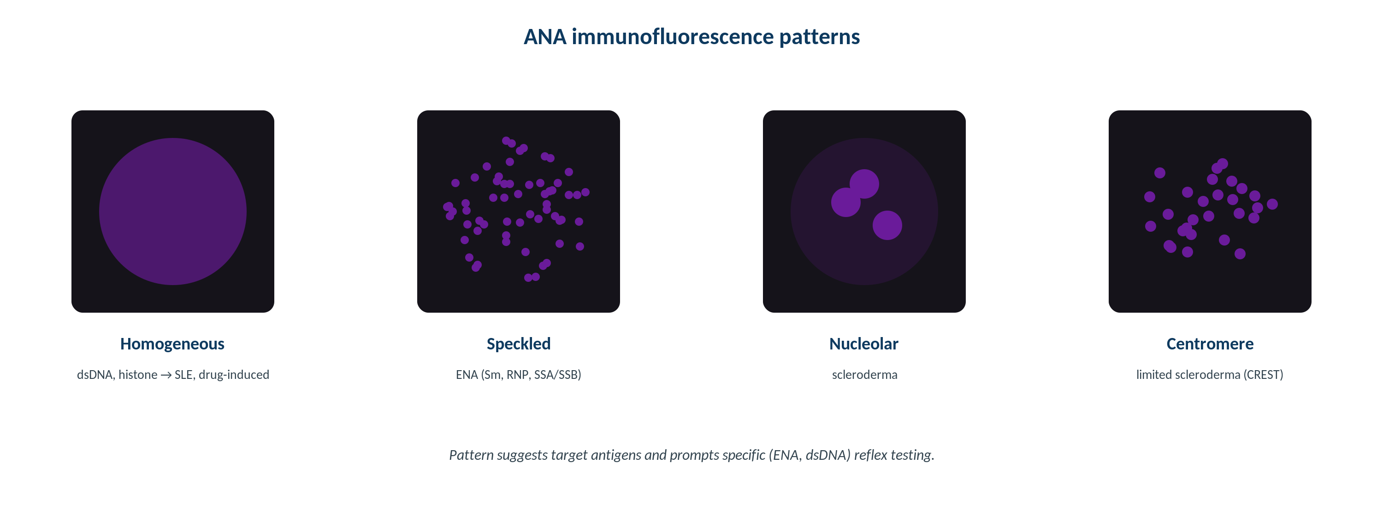
IMMUNOLOGY & SEROLOGY · ANA
ANA Indirect Immunofluorescence Patterns
Original schematic. The IIF pattern (homogeneous, speckled, centromere, nucleolar) suggests which specific antibodies to pursue.
Makassed General Hospital · Department of Laboratory Medicine
CP Lecture Series · 5

Slide 7
IMMUNOLOGY & SEROLOGY · ANA
Reading the ANA
TITER AND PATTERN
PATTERN → ANTIBODY
ANA is reported as a titer and a pattern; higher titers are more likely clinically meaningful.
Low-titer ANA occurs in healthy people, especially with age.
IIF on HEp-2 cells is the reference method.
A positive ANA must be interpreted with symptoms.
Homogeneous → dsDNA/histone; speckled → SSA/SSB, Sm, RNP.
Centromere → limited systemic sclerosis (CREST).
Nucleolar → systemic sclerosis.
Pattern guides the specific antibody panel.
Makassed General Hospital · Department of Laboratory Medicine
CP Lecture Series · 6

Slide 8
IMMUNOLOGY & SEROLOGY · SPECIFIC ANTIBODIES
High-Yield Autoantibody Associations
Antibody | Association | Note
dsDNA | SLE (specific) | Tracks activity/nephritis
Anti-Smith | SLE (specific) | Low sensitivity
SSA/SSB | Sjögren, SLE | Neonatal lupus / heart block
Scl-70 | Diffuse systemic sclerosis | Interstitial lung disease
Centromere | Limited SSc (CREST) | —
Jo-1 | Polymyositis | Antisynthetase syndrome
Specific antibodies refine an ANA-positive result into a disease-level interpretation.
Makassed General Hospital · Department of Laboratory Medicine
CP Lecture Series · 7

Slide 9
02
PART TWO
Complement & ANCA

Slide 10
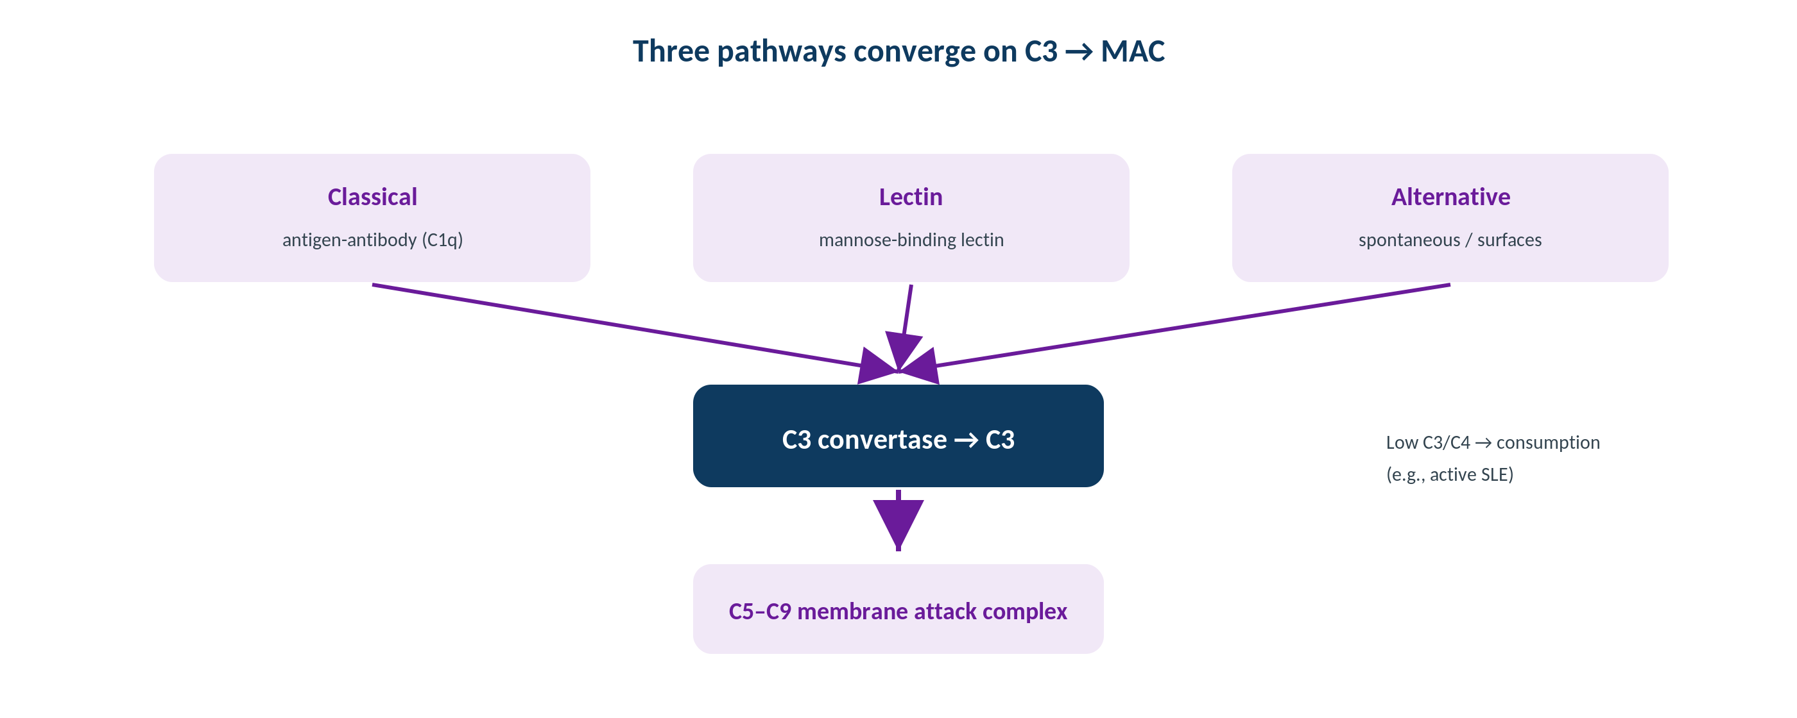
IMMUNOLOGY & SEROLOGY · COMPLEMENT
Complement Pathways and Testing
Original schematic. CH50 screens the classical pathway; low C3/C4 reflects consumption in active immune-complex disease.
Makassed General Hospital · Department of Laboratory Medicine
CP Lecture Series · 8

Slide 11
IMMUNOLOGY & SEROLOGY · COMPLEMENT
Using Complement
ACTIVITY & CONSUMPTION
DEFICIENCY
Low C3 and C4 indicate complement consumption — active immune-complex disease (e.g., lupus nephritis flare).
CH50 screens the integrity of the classical pathway.
A very low/absent CH50 suggests a component deficiency.
Trend complement to monitor disease activity.
Early classical-pathway deficiencies predispose to lupus-like disease; terminal deficiencies to Neisseria infection.
AH50 evaluates the alternative pathway.
Distinguish acquired consumption from inherited deficiency.
Correlate with the clinical syndrome.
Makassed General Hospital · Department of Laboratory Medicine
CP Lecture Series · 9

Slide 12
IMMUNOLOGY & SEROLOGY · ANCA
ANCA in Vasculitis
PATTERNS AND TARGETS
CAVEATS
c-ANCA → anti-PR3 (granulomatosis with polyangiitis); p-ANCA → anti-MPO (microscopic polyangiitis, EGPA).
IIF screen plus antigen-specific (PR3/MPO) confirmation.
Titers may parallel disease activity.
Interpret in the clinical vasculitis context.
Atypical p-ANCA occurs in IBD and other conditions — not all ANCA means vasculitis.
Drug-induced ANCA can occur.
Combine serology with biopsy where indicated.
Avoid testing without clinical suspicion.
Makassed General Hospital · Department of Laboratory Medicine
CP Lecture Series · 10

Slide 13
03
PART THREE
Cases & Board Review

Slide 14
IMMUNOLOGY & SEROLOGY · CASE 1
Case 1
CLINICAL VIGNETTE
A young woman with arthralgias, rash, and proteinuria has a high-titer homogeneous ANA, positive dsDNA, and low C3/C4.
?
What is the unifying interpretation?
Makassed General Hospital · Department of Laboratory Medicine
CP Lecture Series · 11

Slide 15
IMMUNOLOGY & SEROLOGY · CASE 1 · RESOLUTION
Case 1: Active Lupus Nephritis
High-titer ANA with anti-dsDNA and low complement supports active SLE with renal involvement.
Anti-dsDNA is specific for SLE and tracks nephritis.
Falling C3/C4 reflects complement consumption in a flare.
Trend dsDNA and complement to monitor activity.
TEACHING POINT
The triad of anti-dsDNA positivity and low complement signals active, often renal, lupus — and serves as a monitoring tool.
Makassed General Hospital · Department of Laboratory Medicine
CP Lecture Series · 12

Slide 16
IMMUNOLOGY & SEROLOGY · CASE 2
Case 2
CLINICAL VIGNETTE
A healthy 70-year-old has a low-titer speckled ANA found on a screen ordered without specific symptoms.
?
How should this be interpreted?
Makassed General Hospital · Department of Laboratory Medicine
CP Lecture Series · 13

Slide 17
IMMUNOLOGY & SEROLOGY · CASE 2 · RESOLUTION
Case 2: Low-Titer ANA in a Well Patient
Low-titer ANA is common in healthy older adults and is not diagnostic of autoimmune disease.
Without symptoms, it has low predictive value.
Avoid a cascade of specific tests in the absence of clinical features.
Reassure and correlate clinically.
TEACHING POINT
Order ANA only with a pretest suspicion of connective-tissue disease — indiscriminate testing yields meaningless low-titer positives.
Makassed General Hospital · Department of Laboratory Medicine
CP Lecture Series · 14

Slide 18
IMMUNOLOGY & SEROLOGY · CASE 3
Case 3
CLINICAL VIGNETTE
A patient with sinusitis, hemoptysis, and acute kidney injury is c-ANCA positive with anti-PR3 antibodies.
?
What does this serology indicate?
Makassed General Hospital · Department of Laboratory Medicine
CP Lecture Series · 15

Slide 19
IMMUNOLOGY & SEROLOGY · CASE 3 · RESOLUTION
Case 3: PR3-ANCA Vasculitis
c-ANCA/anti-PR3 with this triad supports granulomatosis with polyangiitis.
Antigen-specific PR3 confirmation strengthens the IIF screen.
Tissue biopsy confirms where feasible.
Serology supports diagnosis and monitoring.
TEACHING POINT
c-ANCA/PR3 in an upper-airway + pulmonary-renal syndrome points to GPA; confirm with antigen-specific testing and biopsy.
Makassed General Hospital · Department of Laboratory Medicine
CP Lecture Series · 16

Slide 20
IMMUNOLOGY & SEROLOGY · BOARD REVIEW · Q1
Board-Style Review
Which autoantibody is most specific for SLE and tracks nephritis activity?
A. Anti-SSA
B. Anti-dsDNA
C. ANA (homogeneous)
D. Anti-centromere
E. Rheumatoid factor
Makassed General Hospital · Department of Laboratory Medicine
CP Lecture Series · 17

Slide 21
IMMUNOLOGY & SEROLOGY · BOARD REVIEW · Q1
Board-Style Review
Which autoantibody is most specific for SLE and tracks nephritis activity?
A. Anti-SSA
B. Anti-dsDNA
C. ANA (homogeneous)
D. Anti-centromere
E. Rheumatoid factor
ANSWER B — Anti-dsDNA
Anti-dsDNA is specific for SLE and correlates with disease/renal activity; ANA is sensitive but not specific.
Makassed General Hospital · Department of Laboratory Medicine
CP Lecture Series · 17

Slide 22
IMMUNOLOGY & SEROLOGY · BOARD REVIEW · Q2
Board-Style Review
Low C3 and C4 in an autoimmune flare indicate:
A. Complement deficiency only
B. Complement consumption in active immune-complex disease
C. Laboratory error
D. Hypergammaglobulinemia
E. Liver synthetic failure exclusively
Makassed General Hospital · Department of Laboratory Medicine
CP Lecture Series · 18

Slide 23
IMMUNOLOGY & SEROLOGY · BOARD REVIEW · Q2
Board-Style Review
Low C3 and C4 in an autoimmune flare indicate:
A. Complement deficiency only
B. Complement consumption in active immune-complex disease
C. Laboratory error
D. Hypergammaglobulinemia
E. Liver synthetic failure exclusively
ANSWER B — Consumption in active disease
Immune-complex disease (e.g., lupus nephritis) consumes complement, lowering C3/C4; trending them monitors activity.
Makassed General Hospital · Department of Laboratory Medicine
CP Lecture Series · 18

Slide 24
IMMUNOLOGY & SEROLOGY · BOARD REVIEW · Q3
Board-Style Review
A centromere ANA pattern is most associated with:
A. Diffuse systemic sclerosis
B. Limited systemic sclerosis (CREST)
C. Polymyositis
D. Rheumatoid arthritis
E. Mixed connective tissue disease
Makassed General Hospital · Department of Laboratory Medicine
CP Lecture Series · 19

Slide 25
IMMUNOLOGY & SEROLOGY · BOARD REVIEW · Q3
Board-Style Review
A centromere ANA pattern is most associated with:
A. Diffuse systemic sclerosis
B. Limited systemic sclerosis (CREST)
C. Polymyositis
D. Rheumatoid arthritis
E. Mixed connective tissue disease
ANSWER B — Limited systemic sclerosis (CREST)
The centromere pattern is characteristic of limited cutaneous systemic sclerosis.
Makassed General Hospital · Department of Laboratory Medicine
CP Lecture Series · 19

Slide 26
IMMUNOLOGY & SEROLOGY · BOARD REVIEW · Q4
Board-Style Review
c-ANCA most commonly targets which antigen?
A. Myeloperoxidase (MPO)
B. Proteinase 3 (PR3)
C. dsDNA
D. Histones
E. Ro/SSA
Makassed General Hospital · Department of Laboratory Medicine
CP Lecture Series · 20

Slide 27
IMMUNOLOGY & SEROLOGY · BOARD REVIEW · Q4
Board-Style Review
c-ANCA most commonly targets which antigen?
A. Myeloperoxidase (MPO)
B. Proteinase 3 (PR3)
C. dsDNA
D. Histones
E. Ro/SSA
ANSWER B — Proteinase 3 (PR3)
c-ANCA corresponds to anti-PR3, classically associated with granulomatosis with polyangiitis; p-ANCA corresponds to anti-MPO.
Makassed General Hospital · Department of Laboratory Medicine
CP Lecture Series · 20

Slide 28
IMMUNOLOGY & SEROLOGY
Key Take-Home Points
ANA is a sensitive screen reported as titer + pattern; low-titer ANA is common in healthy people — test only with clinical suspicion.
1
IIF pattern guides specific-antibody testing (homogeneous → dsDNA; centromere → limited SSc; nucleolar → SSc).
2
Specific antibodies (dsDNA, Sm, SSA/SSB, Scl-70, Jo-1) refine the diagnosis; anti-dsDNA tracks lupus activity.
3
Low C3/C4 indicates active immune-complex disease; CH50/AH50 assess pathway integrity and deficiency.
4
ANCA: c-ANCA/PR3 and p-ANCA/MPO support vasculitis — confirm with antigen-specific testing and biopsy.
5
Makassed General Hospital · Department of Laboratory Medicine
21

Slide 29
IMMUNOLOGY & SEROLOGY · REFERENCES & FURTHER READING
References
1. Rich RR, et al. Clinical Immunology: Principles and Practice, 5th ed.
2. Detrick B, et al. Manual of Molecular and Clinical Laboratory Immunology, 8th ed.
3. ACR/EULAR classification criteria for SLE.
4. Bossuyt X, et al. ANA testing harmonization. Nat Rev Rheumatol.
Makassed General Hospital · Department of Laboratory Medicine
CP Lecture Series · 22

