Slide 1
CLINICAL PATHOLOGY RESIDENCY LECTURE SERIES
IMMUNOLOGY & SEROLOGY · LECTURE 3 OF 4
Infectious Disease Serology
IgM/IgG Kinetics, Window Periods, and Confirmatory Algorithms
Dr. Tamima El-Jisr
Chairperson, Department of Laboratory Medicine
Makassed General Hospital, Beirut
Clinical Pathology Residency Curriculum

Slide 2
IMMUNOLOGY & SEROLOGY · FRAMING THE PROBLEM
Why This Matters
IgM→IgG
Window
Algorithm
Antibody class dates the infection
Early infection can be antibody-negative
Screen then confirm to control false positives
Infectious serology infers infection and immunity from the antibody response. Interpreting it well means understanding antibody kinetics, the window period, and the screen-then-confirm algorithms that protect predictive value.
Antibodies lag infection — a negative serology in the window period does not exclude acute infection.
Makassed General Hospital · Department of Laboratory Medicine
CP Lecture Series · 2

Slide 3
IMMUNOLOGY & SEROLOGY · ·
Learning Objectives
Interpret IgM and IgG kinetics and seroconversion.
Define the window period and its implications.
1
2
Apply hepatitis B serologic panels.
Use HIV and syphilis testing algorithms.
3
4
Distinguish acute infection, past infection, and immunity.
Recognize false positives/negatives and confirmatory testing.
5
6
Makassed General Hospital · Department of Laboratory Medicine
CP Lecture Series · 3

Slide 4
IMMUNOLOGY & SEROLOGY · WHAT WE WILL COVER
Roadmap
Antibody kinetics — IgM, IgG, seroconversion
1
Window period — antigen/NAAT coverage
2
Hepatitis B panel — interpreting markers
3
HIV & syphilis algorithms — screen then confirm
4
Cases & board review
5
Makassed General Hospital · Department of Laboratory Medicine
CP Lecture Series · 4

Slide 5
01
PART ONE
Antibody Kinetics & the Window

Slide 6
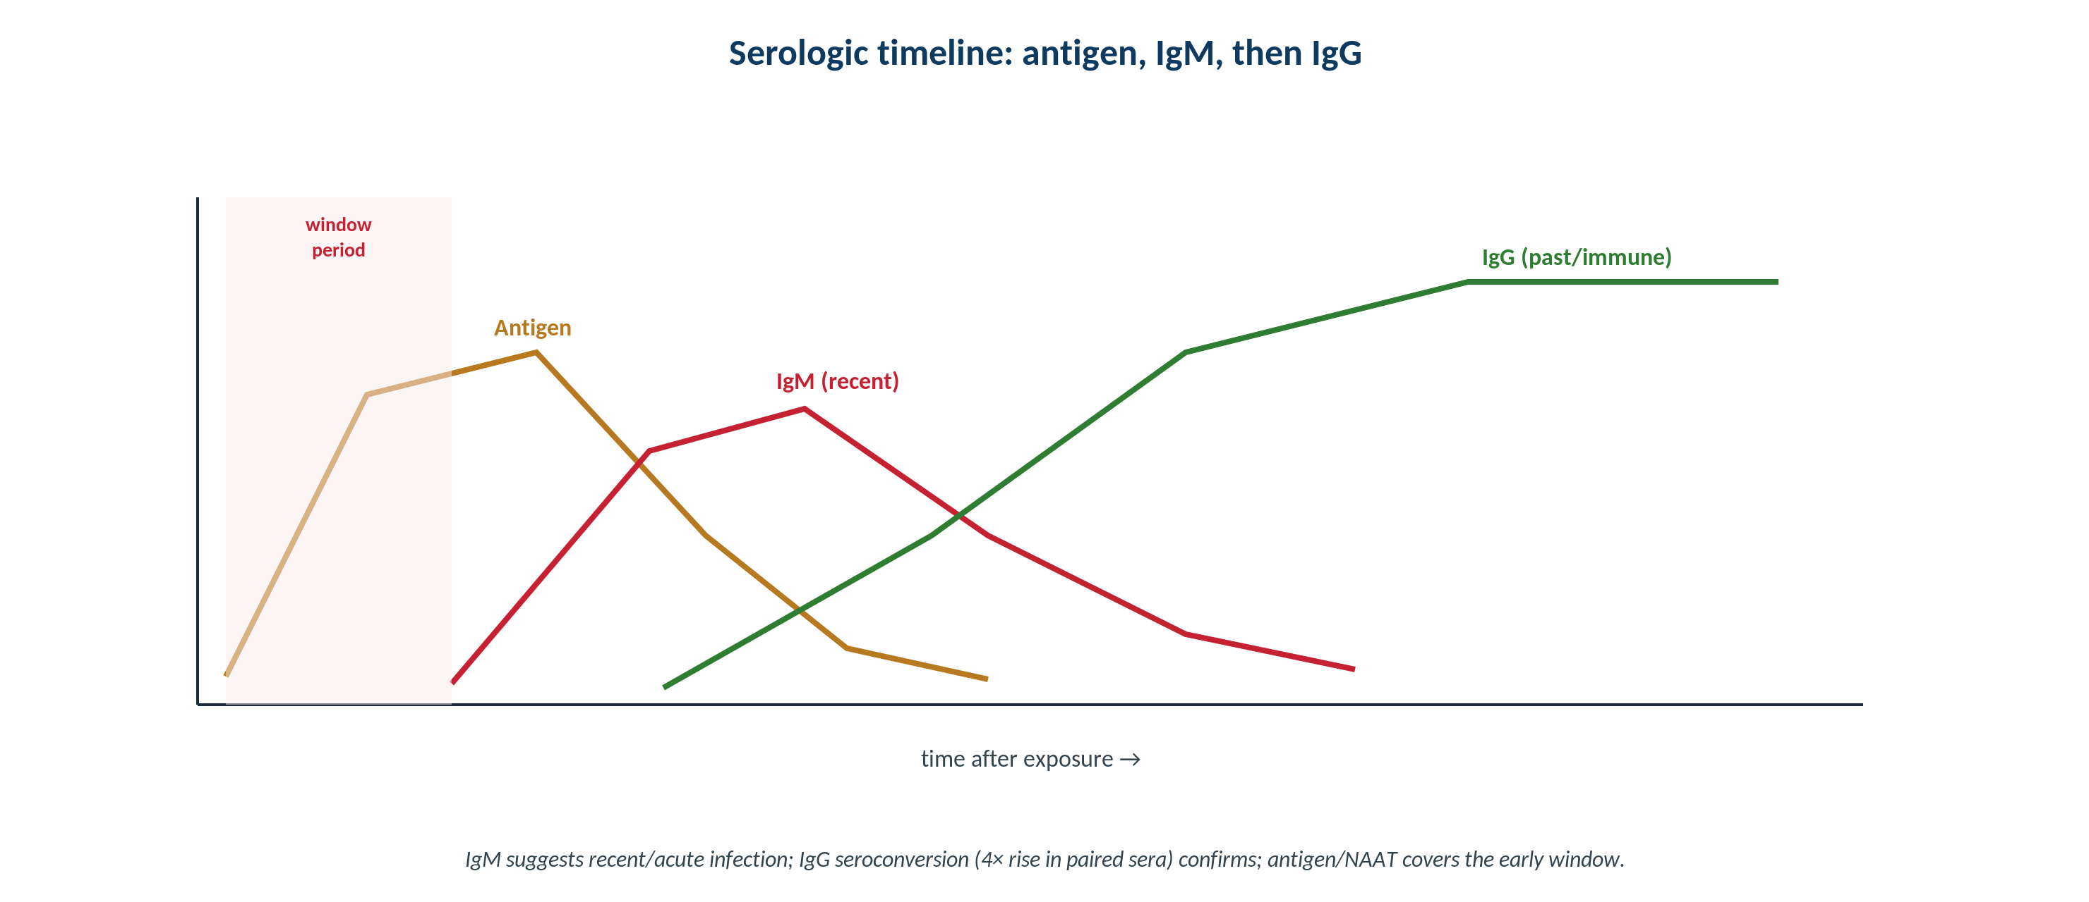
IMMUNOLOGY & SEROLOGY · KINETICS
The Serologic Timeline
Original schematic. Antigen rises first, then IgM (recent), then IgG (past/immune); the window period is antibody-negative.
Makassed General Hospital · Department of Laboratory Medicine
CP Lecture Series · 5

Slide 7
IMMUNOLOGY & SEROLOGY · KINETICS
What the Antibody Class Tells You
IGM VS IGG
THE WINDOW PERIOD
IgM suggests recent/acute infection; IgG indicates past exposure or immunity.
Seroconversion (a 4-fold IgG rise in paired sera) confirms recent infection.
IgG avidity can help date some infections.
IgM can persist or be falsely positive — interpret with care.
Early after exposure, antibodies may be undetectable — the window period.
Antigen tests and NAAT shorten the diagnostic window.
A negative antibody test does not exclude very recent infection.
Repeat or add direct detection when suspicion is high.
Makassed General Hospital · Department of Laboratory Medicine
CP Lecture Series · 6

Slide 8
02
PART TWO
Hepatitis B & Algorithmic Testing

Slide 9
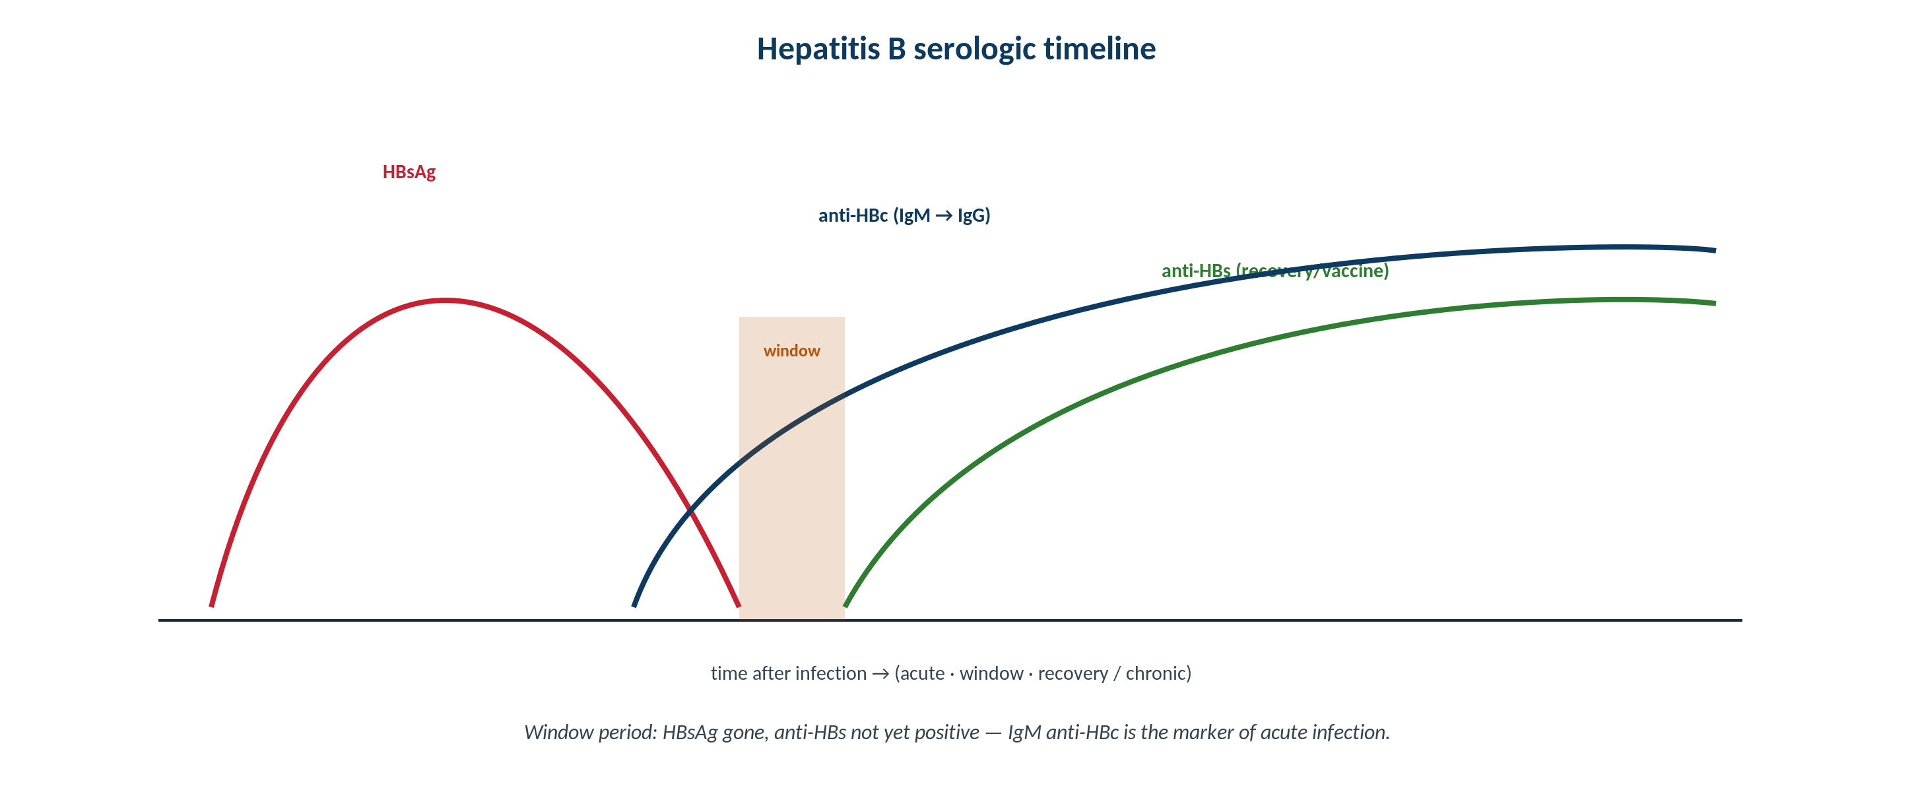
IMMUNOLOGY & SEROLOGY · HEPATITIS B
Interpreting the Hepatitis B Panel
Original schematic. HBsAg, anti-HBs, anti-HBc (IgM/total), and HBeAg/anti-HBe define infection stage and immunity.
Makassed General Hospital · Department of Laboratory Medicine
CP Lecture Series · 7

Slide 10
IMMUNOLOGY & SEROLOGY · HEPATITIS B
Common Serologic Profiles
Profile | HBsAg / anti-HBs / anti-HBc | Interpretation
Acute | HBsAg+ / – / IgM anti-HBc+ | Acute infection
Chronic | HBsAg+ / – / total anti-HBc+ | Chronic infection
Resolved | – / anti-HBs+ / anti-HBc+ | Past, immune
Vaccinated | – / anti-HBs+ / – | Immunity from vaccine
Window | – / – / IgM anti-HBc+ | Window period
Anti-HBc distinguishes natural infection (present) from vaccination (absent); IgM anti-HBc flags acute/window.
Makassed General Hospital · Department of Laboratory Medicine
CP Lecture Series · 8

Slide 11
IMMUNOLOGY & SEROLOGY · ALGORITHMS
HIV & Syphilis Testing
HIV (4TH-GENERATION ALGORITHM)
SYPHILIS (REVERSE ALGORITHM)
Ag/Ab combination screen detects p24 antigen + antibodies, shortening the window.
Reactive screen → HIV-1/2 antibody differentiation assay.
Discordant → HIV-1 RNA (NAAT).
NAAT detects acute infection before seroconversion.
Treponemal screen (e.g., immunoassay) → reflex non-treponemal (RPR) for activity.
Discordant → second treponemal test.
Non-treponemal titers monitor treatment response.
Treponemal tests usually stay positive for life.
Makassed General Hospital · Department of Laboratory Medicine
CP Lecture Series · 9

Slide 12
03
PART THREE
Cases & Board Review

Slide 13
IMMUNOLOGY & SEROLOGY · CASE 1
Case 1
CLINICAL VIGNETTE
A patient is HBsAg-negative, anti-HBs-positive, anti-HBc-negative.
?
What does this profile indicate?
Makassed General Hospital · Department of Laboratory Medicine
CP Lecture Series · 10

Slide 14
IMMUNOLOGY & SEROLOGY · CASE 1 · RESOLUTION
Case 1: Vaccine Immunity
Anti-HBs positive with anti-HBc negative indicates immunity from vaccination, not past infection.
Natural infection produces anti-HBc; vaccination does not.
HBsAg negative excludes active infection.
No further action beyond documenting immunity.
TEACHING POINT
Anti-HBc is the key discriminator: present after natural infection, absent after vaccination.
Makassed General Hospital · Department of Laboratory Medicine
CP Lecture Series · 11

Slide 15
IMMUNOLOGY & SEROLOGY · CASE 2
Case 2
CLINICAL VIGNETTE
A high-risk patient has a negative HIV antibody test days after a likely exposure but ongoing concern for acute infection.
?
What testing is appropriate, and why?
Makassed General Hospital · Department of Laboratory Medicine
CP Lecture Series · 12

Slide 16
IMMUNOLOGY & SEROLOGY · CASE 2 · RESOLUTION
Case 2: Acute HIV / Window Period
Antibody may be negative in the window; use a 4th-generation Ag/Ab assay and/or HIV RNA (NAAT).
p24 antigen and RNA detect infection before seroconversion.
A negative antibody test alone does not exclude acute HIV.
Repeat testing per algorithm.
TEACHING POINT
Suspected acute HIV requires antigen/NAAT testing — antibody-only testing misses the window period.
Makassed General Hospital · Department of Laboratory Medicine
CP Lecture Series · 13

Slide 17
IMMUNOLOGY & SEROLOGY · CASE 3
Case 3
CLINICAL VIGNETTE
A treponemal screen is positive but the RPR is non-reactive in a patient with no symptoms.
?
How is this reverse-algorithm result interpreted?
Makassed General Hospital · Department of Laboratory Medicine
CP Lecture Series · 14

Slide 18
IMMUNOLOGY & SEROLOGY · CASE 3 · RESOLUTION
Case 3: Reverse Syphilis Algorithm
A positive treponemal test with non-reactive RPR suggests past/treated syphilis or, occasionally, very early or a false-positive screen.
A second treponemal test resolves discordance.
Treponemal tests typically remain reactive lifelong.
Correlate with history and treatment records.
TEACHING POINT
In the reverse algorithm, treponemal-positive/RPR-negative usually means past or treated infection; confirm with a second treponemal assay.
Makassed General Hospital · Department of Laboratory Medicine
CP Lecture Series · 15

Slide 19
IMMUNOLOGY & SEROLOGY · BOARD REVIEW · Q1
Board-Style Review
Which marker distinguishes natural hepatitis B infection from vaccination?
A. HBsAg
B. Anti-HBs
C. Anti-HBc
D. HBeAg
E. ALT
Makassed General Hospital · Department of Laboratory Medicine
CP Lecture Series · 16

Slide 20
IMMUNOLOGY & SEROLOGY · BOARD REVIEW · Q1
Board-Style Review
Which marker distinguishes natural hepatitis B infection from vaccination?
A. HBsAg
B. Anti-HBs
C. Anti-HBc
D. HBeAg
E. ALT
ANSWER C — Anti-HBc
Anti-HBc develops after natural infection but not after vaccination; anti-HBs alone can result from either.
Makassed General Hospital · Department of Laboratory Medicine
CP Lecture Series · 16

Slide 21
IMMUNOLOGY & SEROLOGY · BOARD REVIEW · Q2
Board-Style Review
During the window period of an infection, the best test is often:
A. IgG antibody
B. IgM antibody only
C. Antigen or nucleic acid detection
D. Avidity testing
E. No testing
Makassed General Hospital · Department of Laboratory Medicine
CP Lecture Series · 17

Slide 22
IMMUNOLOGY & SEROLOGY · BOARD REVIEW · Q2
Board-Style Review
During the window period of an infection, the best test is often:
A. IgG antibody
B. IgM antibody only
C. Antigen or nucleic acid detection
D. Avidity testing
E. No testing
ANSWER C — Antigen or NAAT
Antibodies may be undetectable early; antigen and nucleic acid tests detect infection during the window.
Makassed General Hospital · Department of Laboratory Medicine
CP Lecture Series · 17

Slide 23
IMMUNOLOGY & SEROLOGY · BOARD REVIEW · Q3
Board-Style Review
In the standard HIV algorithm, a reactive Ag/Ab screen is followed by:
A. Repeat the same screen
B. HIV-1/2 antibody differentiation assay
C. CD4 count
D. Western blot only
E. Viral culture
Makassed General Hospital · Department of Laboratory Medicine
CP Lecture Series · 18

Slide 24
IMMUNOLOGY & SEROLOGY · BOARD REVIEW · Q3
Board-Style Review
In the standard HIV algorithm, a reactive Ag/Ab screen is followed by:
A. Repeat the same screen
B. HIV-1/2 antibody differentiation assay
C. CD4 count
D. Western blot only
E. Viral culture
ANSWER B — HIV-1/2 differentiation assay
A reactive 4th-generation screen reflexes to an antibody differentiation assay; discordance prompts HIV-1 RNA.
Makassed General Hospital · Department of Laboratory Medicine
CP Lecture Series · 18

Slide 25
IMMUNOLOGY & SEROLOGY · BOARD REVIEW · Q4
Board-Style Review
Non-treponemal titers (e.g., RPR) are primarily used to:
A. Confirm lifelong infection
B. Monitor disease activity and treatment response
C. Detect the window period
D. Replace treponemal testing
E. Diagnose neurosyphilis alone
Makassed General Hospital · Department of Laboratory Medicine
CP Lecture Series · 19

Slide 26
IMMUNOLOGY & SEROLOGY · BOARD REVIEW · Q4
Board-Style Review
Non-treponemal titers (e.g., RPR) are primarily used to:
A. Confirm lifelong infection
B. Monitor disease activity and treatment response
C. Detect the window period
D. Replace treponemal testing
E. Diagnose neurosyphilis alone
ANSWER B — Monitor activity/treatment
Non-treponemal titers fall with successful treatment; treponemal tests usually remain reactive for life.
Makassed General Hospital · Department of Laboratory Medicine
CP Lecture Series · 19

Slide 27
IMMUNOLOGY & SEROLOGY
Key Take-Home Points
IgM suggests recent infection; IgG indicates past exposure/immunity; a 4-fold IgG rise confirms seroconversion.
1
The window period is antibody-negative — antigen/NAAT detect early infection; a negative antibody test does not exclude acute disease.
2
Hepatitis B: anti-HBc separates natural infection from vaccination; IgM anti-HBc flags acute/window.
3
HIV uses a 4th-generation Ag/Ab screen → differentiation assay → RNA; syphilis uses screen-then-confirm with non-treponemal titers for monitoring.
4
Screen-then-confirm algorithms protect predictive value, especially at low prevalence.
5
Makassed General Hospital · Department of Laboratory Medicine
20

Slide 28
IMMUNOLOGY & SEROLOGY · REFERENCES & FURTHER READING
References
1. Detrick B, et al. Manual of Molecular and Clinical Laboratory Immunology, 8th ed.
2. CDC/APHL HIV and syphilis testing algorithms.
3. AASLD hepatitis B guidance.
4. Theel ES, et al. Serologic testing. Clin Microbiol Rev.
Makassed General Hospital · Department of Laboratory Medicine
CP Lecture Series · 21

