Slide 1
CLINICAL PATHOLOGY RESIDENCY LECTURE SERIES
IMMUNOLOGY & SEROLOGY · LECTURE 4 OF 4
Allergy, Immunodeficiency & Protein Testing
IgE Testing, Tiered Immune Workup, and Immunoglobulin Evaluation
Dr. Tamima El-Jisr
Chairperson, Department of Laboratory Medicine
Makassed General Hospital, Beirut
Clinical Pathology Residency Curriculum

Slide 2
IMMUNOLOGY & SEROLOGY · FRAMING THE PROBLEM
Why This Matters
sIgE
Tiers
Ig
Sensitization is not the same as clinical allergy
Immunodeficiency is worked up in steps
Quantitative immunoglobulins anchor the protein workup
This lecture brings together allergy testing, the tiered evaluation of suspected immunodeficiency, and immunoglobulin/protein assessment — areas where interpretation depends heavily on pairing the laboratory result with the clinical history. Protein electrophoresis interpretation follows the department’s teaching (D. Keren).
Allergy and immunodeficiency tests are only meaningful alongside the clinical phenotype — the lab result is half the answer.
Makassed General Hospital · Department of Laboratory Medicine
CP Lecture Series · 2

Slide 3
IMMUNOLOGY & SEROLOGY · ·
Learning Objectives
Interpret total IgE and allergen-specific IgE.
Distinguish sensitization from clinical allergy.
1
2
Apply a tiered workup for suspected immunodeficiency.
Interpret quantitative immunoglobulins and functional antibody responses.
3
4
Relate protein electrophoresis to immunoglobulin evaluation.
Use complement and lymphocyte testing appropriately.
5
6
Makassed General Hospital · Department of Laboratory Medicine
CP Lecture Series · 3

Slide 4
IMMUNOLOGY & SEROLOGY · WHAT WE WILL COVER
Roadmap
Allergy testing — total vs specific IgE
1
Sensitization vs allergy — interpretation
2
Immunodeficiency tiers — screen → function → advanced
3
Immunoglobulins & protein — quant Ig, SPEP/IFE
4
Cases & board review
5
Makassed General Hospital · Department of Laboratory Medicine
CP Lecture Series · 4

Slide 5
01
PART ONE
Allergy Testing

Slide 6
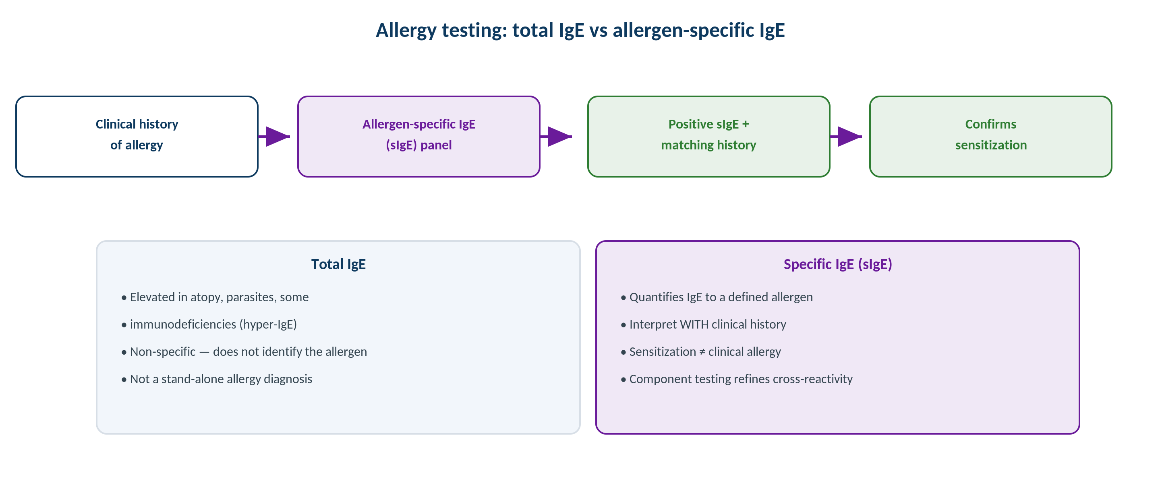
IMMUNOLOGY & SEROLOGY · ALLERGY
Total IgE vs Allergen-Specific IgE
Original schematic. Specific IgE plus a matching clinical history confirms sensitization; total IgE is non-specific.
Makassed General Hospital · Department of Laboratory Medicine
CP Lecture Series · 5

Slide 7
IMMUNOLOGY & SEROLOGY · ALLERGY
Interpreting IgE Results
TOTAL VS SPECIFIC IGE
SENSITIZATION ≠ ALLERGY
Total IgE is non-specific — elevated in atopy, parasites, and some immunodeficiencies (hyper-IgE).
Allergen-specific IgE (sIgE) quantifies IgE to a defined allergen.
Component-resolved testing refines cross-reactivity.
sIgE complements, not replaces, skin testing and history.
A positive sIgE indicates sensitization, which is clinically meaningful only with a matching history.
Asymptomatic sensitization is common.
Higher sIgE levels raise the probability of clinical allergy.
Interpret panels in the clinical context to avoid over-diagnosis.
Makassed General Hospital · Department of Laboratory Medicine
CP Lecture Series · 6

Slide 8
02
PART TWO
Immunodeficiency & Protein Testing

Slide 9
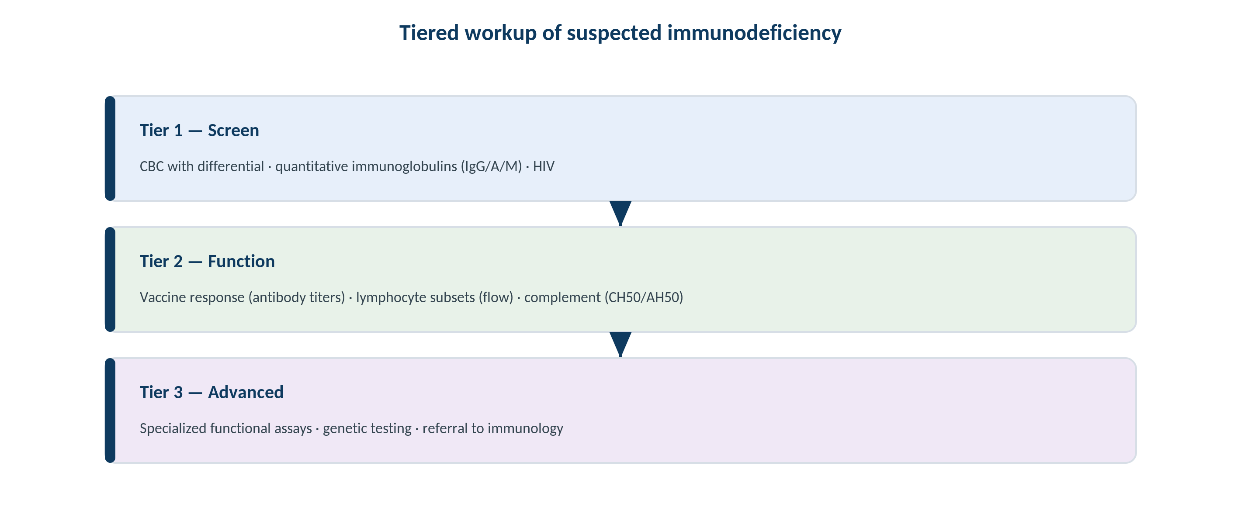
IMMUNOLOGY & SEROLOGY · IMMUNODEFICIENCY
Tiered Workup of Suspected Immunodeficiency
Original schematic. Screen (CBC, quantitative Ig, HIV) → function (vaccine response, subsets, complement) → advanced/genetic.
Makassed General Hospital · Department of Laboratory Medicine
CP Lecture Series · 7

Slide 10
IMMUNOLOGY & SEROLOGY · IMMUNODEFICIENCY
Working Up the Immune System
SCREEN AND FUNCTION
WHEN TO ESCALATE
Start with CBC/differential, quantitative immunoglobulins, and HIV.
Assess function with vaccine-response (antibody) titers.
Lymphocyte subsets (flow cytometry) evaluate cellular immunity.
Complement (CH50/AH50) for suspected complement defects.
Recurrent, severe, or unusual infections warrant a structured workup.
Advanced functional and genetic testing for confirmed defects.
Refer to clinical immunology for management.
Interpret in the context of age and infection pattern.
Makassed General Hospital · Department of Laboratory Medicine
CP Lecture Series · 8

Slide 11
IMMUNOLOGY & SEROLOGY · PROTEIN
Immunoglobulins & Electrophoresis
QUANTITATIVE IG & SPEP
IFE & FREE LIGHT CHAINS
Quantitative IgG/IgA/IgM define hypo- or hypergammaglobulinemia.
SPEP shows a polyclonal rise (infection/inflammation) vs a monoclonal spike.
Hypogammaglobulinemia may signal antibody deficiency or light-chain disease.
A discrete spike → reflex immunofixation.
Immunofixation types a monoclonal protein; serum free light chains detect light-chain-only disease.
Interpret SPEP/IFE/FLC together (department teaching, D. Keren).
Distinguish CVID-type deficiency from clonal disease.
Quantify for monitoring.
Makassed General Hospital · Department of Laboratory Medicine
CP Lecture Series · 9

Slide 12
03
PART THREE
Cases & Board Review

Slide 13
IMMUNOLOGY & SEROLOGY · CASE 1
Case 1
CLINICAL VIGNETTE
A child with no symptoms on exposure has a positive specific IgE to peanut on a broad panel ordered by a worried parent.
?
How should this isolated positive sIgE be interpreted?
Makassed General Hospital · Department of Laboratory Medicine
CP Lecture Series · 10

Slide 14
IMMUNOLOGY & SEROLOGY · CASE 1 · RESOLUTION
Case 1: Sensitization Without Allergy
A positive sIgE without a clinical reaction indicates sensitization, not necessarily clinical allergy.
Broad untargeted panels generate clinically irrelevant positives.
Diagnosis requires a matching history (± supervised challenge).
Avoid unnecessary dietary restriction based on sIgE alone.
TEACHING POINT
Test specific IgE based on a clinical history — indiscriminate panels detect sensitization that may never cause symptoms.
Makassed General Hospital · Department of Laboratory Medicine
CP Lecture Series · 11

Slide 15
IMMUNOLOGY & SEROLOGY · CASE 2
Case 2
CLINICAL VIGNETTE
An adult with recurrent sinopulmonary infections has low IgG, IgA, and IgM and poor response to vaccination.
?
What category of disorder does this suggest, and what next steps?
Makassed General Hospital · Department of Laboratory Medicine
CP Lecture Series · 12

Slide 16
IMMUNOLOGY & SEROLOGY · CASE 2 · RESOLUTION
Case 2: Antibody Deficiency
Pan-hypogammaglobulinemia with impaired vaccine responses suggests a primary antibody deficiency (e.g., CVID).
Confirm with functional antibody testing and exclude secondary causes.
Lymphocyte subsets and referral to immunology guide management.
Replacement immunoglobulin may be indicated.
TEACHING POINT
Low immunoglobulins plus poor vaccine responses define a functional antibody deficiency — functional testing, not just levels, makes the diagnosis.
Makassed General Hospital · Department of Laboratory Medicine
CP Lecture Series · 13

Slide 17
IMMUNOLOGY & SEROLOGY · CASE 3
Case 3
CLINICAL VIGNETTE
An older adult has hypogammaglobulinemia on SPEP but a high serum free κ with an abnormal κ/λ ratio.
?
How do you reconcile low gamma globulins with a clonal light-chain finding?
Makassed General Hospital · Department of Laboratory Medicine
CP Lecture Series · 14

Slide 18
IMMUNOLOGY & SEROLOGY · CASE 3 · RESOLUTION
Case 3: Light-Chain Clone vs Deficiency
A clonal plasma-cell process can secrete free light chains while suppressing normal immunoglobulin (immunoparesis).
SPEP may show low gamma without an obvious spike; free light chains reveal the clone.
Immunofixation and the FLC ratio clarify the picture.
Refer for hematologic evaluation.
TEACHING POINT
Hypogammaglobulinemia does not exclude clonal disease — the free light-chain ratio uncovers light-chain-only clones with immunoparesis.
Makassed General Hospital · Department of Laboratory Medicine
CP Lecture Series · 15

Slide 19
IMMUNOLOGY & SEROLOGY · BOARD REVIEW · Q1
Board-Style Review
A positive allergen-specific IgE indicates:
A. Definite clinical allergy
B. Sensitization, meaningful only with a matching history
C. Immunodeficiency
D. Active infection
E. Past infection
Makassed General Hospital · Department of Laboratory Medicine
CP Lecture Series · 16

Slide 20
IMMUNOLOGY & SEROLOGY · BOARD REVIEW · Q1
Board-Style Review
A positive allergen-specific IgE indicates:
A. Definite clinical allergy
B. Sensitization, meaningful only with a matching history
C. Immunodeficiency
D. Active infection
E. Past infection
ANSWER B — Sensitization, needs history
Specific IgE shows sensitization; clinical allergy requires a corresponding reaction history.
Makassed General Hospital · Department of Laboratory Medicine
CP Lecture Series · 16

Slide 21
IMMUNOLOGY & SEROLOGY · BOARD REVIEW · Q2
Board-Style Review
The best initial functional test of humoral immunity is:
A. Total IgE
B. Vaccine (antibody) response titers
C. CH50
D. Lymphocyte subsets
E. SPEP
Makassed General Hospital · Department of Laboratory Medicine
CP Lecture Series · 17

Slide 22
IMMUNOLOGY & SEROLOGY · BOARD REVIEW · Q2
Board-Style Review
The best initial functional test of humoral immunity is:
A. Total IgE
B. Vaccine (antibody) response titers
C. CH50
D. Lymphocyte subsets
E. SPEP
ANSWER B — Vaccine response titers
Pre/post-vaccine antibody titers assess the ability to mount a protective humoral response.
Makassed General Hospital · Department of Laboratory Medicine
CP Lecture Series · 17

Slide 23
IMMUNOLOGY & SEROLOGY · BOARD REVIEW · Q3
Board-Style Review
On SPEP, a broad-based increase in the gamma region indicates:
A. Monoclonal gammopathy
B. Polyclonal increase (infection/inflammation/liver disease)
C. Hypogammaglobulinemia
D. Nephrotic syndrome
E. Light-chain disease
Makassed General Hospital · Department of Laboratory Medicine
CP Lecture Series · 18

Slide 24
IMMUNOLOGY & SEROLOGY · BOARD REVIEW · Q3
Board-Style Review
On SPEP, a broad-based increase in the gamma region indicates:
A. Monoclonal gammopathy
B. Polyclonal increase (infection/inflammation/liver disease)
C. Hypogammaglobulinemia
D. Nephrotic syndrome
E. Light-chain disease
ANSWER B — Polyclonal increase
A broad gamma rise reflects polyclonal immunoglobulin from infection, inflammation, or liver disease; a discrete spike suggests monoclonality.
Makassed General Hospital · Department of Laboratory Medicine
CP Lecture Series · 18

Slide 25
IMMUNOLOGY & SEROLOGY · BOARD REVIEW · Q4
Board-Style Review
An elevated total IgE is LEAST specific for which of the following?
A. Atopy
B. Parasitic infection
C. A single defined food allergy
D. Some immunodeficiencies (hyper-IgE)
E. Allergic conditions generally
Makassed General Hospital · Department of Laboratory Medicine
CP Lecture Series · 19

Slide 26
IMMUNOLOGY & SEROLOGY · BOARD REVIEW · Q4
Board-Style Review
An elevated total IgE is LEAST specific for which of the following?
A. Atopy
B. Parasitic infection
C. A single defined food allergy
D. Some immunodeficiencies (hyper-IgE)
E. Allergic conditions generally
ANSWER C — A single defined food allergy
Total IgE is non-specific; identifying a specific allergy requires allergen-specific IgE and clinical correlation.
Makassed General Hospital · Department of Laboratory Medicine
CP Lecture Series · 19

Slide 27
IMMUNOLOGY & SEROLOGY
Key Take-Home Points
Total IgE is non-specific; allergen-specific IgE shows sensitization — clinical allergy requires a matching history.
1
Avoid broad untargeted IgE panels: they detect clinically irrelevant sensitization.
2
Work up immunodeficiency in tiers: screen (CBC, quantitative Ig, HIV) → function (vaccine response, subsets, complement) → advanced/genetic.
3
Quantitative immunoglobulins plus functional antibody testing diagnose antibody deficiency — levels alone are insufficient.
4
Interpret SPEP/IFE/free light chains together; hypogammaglobulinemia does not exclude clonal light-chain disease.
5
Makassed General Hospital · Department of Laboratory Medicine
20

Slide 28
IMMUNOLOGY & SEROLOGY · REFERENCES & FURTHER READING
References
1. Rich RR, et al. Clinical Immunology: Principles and Practice, 5th ed.
2. Keren DF. Protein Electrophoresis in Clinical Diagnosis (department teaching reference).
3. Bonilla FA, et al. Practice parameter for primary immunodeficiency. J Allergy Clin Immunol.
4. Detrick B, et al. Manual of Molecular and Clinical Laboratory Immunology, 8th ed.
Makassed General Hospital · Department of Laboratory Medicine
CP Lecture Series · 21

