Slide 1
CLINICAL PATHOLOGY RESIDENCY LECTURE SERIES
LABORATORY MANAGEMENT · LECTURE 1 OF 5
Quality Management Systems
QC, Quality Indicators, and a Culture of Improvement
Dr. Tamima El-Jisr
Chairperson, Department of Laboratory Medicine
Makassed General Hospital, Beirut
Clinical Pathology Residency Curriculum

Slide 2
LAB MANAGEMENT & QUALITY · FRAMING THE PROBLEM
Why This Matters
QC
Random vs systematic
QMS
Statistical control detects error before it reaches patients
The type of error points to the fix
Quality is a managed system, not an event
A quality management system turns good intentions into reliable results: defined processes, statistical quality control, monitored indicators, and a culture that surfaces and fixes problems.
Quality control catches error statistically; a quality management system prevents it organizationally.
Makassed General Hospital · Department of Laboratory Medicine
CP Lecture Series · 2

Slide 3
LAB MANAGEMENT & QUALITY · ·
Learning Objectives
Describe the elements of a laboratory quality management system.
Apply Levey-Jennings charts and Westgard rules.
1
2
Distinguish random from systematic error.
Use quality indicators across the total testing process.
3
4
Apply continuous-improvement methods (PDCA, root-cause thinking).
Connect QC practice to patient safety.
5
6
Makassed General Hospital · Department of Laboratory Medicine
CP Lecture Series · 3

Slide 4
LAB MANAGEMENT & QUALITY · WHAT WE WILL COVER
Roadmap
QMS elements — the quality system essentials
1
Statistical QC — Levey-Jennings & Westgard
2
Error types — random vs systematic
3
Indicators & improvement — monitoring and PDCA
4
Cases & board review
5
Makassed General Hospital · Department of Laboratory Medicine
CP Lecture Series · 4

Slide 5
01
PART ONE
The Quality System & Statistical QC

Slide 6
LAB MANAGEMENT & QUALITY · QMS
What a Quality System Includes
SYSTEM ELEMENTS
QC VS QA
Documents/records, equipment, personnel competency, process control, and occurrence management.
Quality control and quality assurance across all phases.
Defined SOPs and a document-control system.
Management review and continual improvement.
QC monitors the analytic process in real time; QA evaluates the whole system over time.
QC: control materials, rules, corrective action.
QA: indicators, audits, proficiency testing.
Both feed continuous improvement.
Makassed General Hospital · Department of Laboratory Medicine
CP Lecture Series · 5

Slide 7
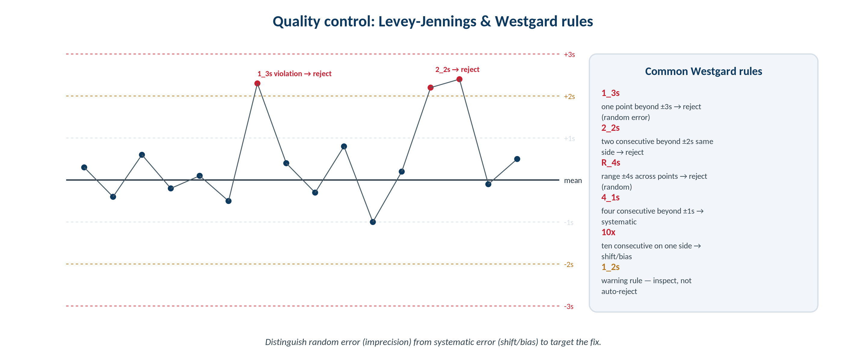
LAB MANAGEMENT & QUALITY · STATISTICAL QC
Levey-Jennings Charts & Westgard Rules
Original schematic. Control values are plotted against mean ± SD; multirules flag rejectable random and systematic error.
Makassed General Hospital · Department of Laboratory Medicine
CP Lecture Series · 6

Slide 8
LAB MANAGEMENT & QUALITY · STATISTICAL QC
Reading the Control Chart
LEVEY-JENNINGS
WESTGARD MULTIRULES
Plot control results against the mean and standard-deviation limits over time.
Visualizes drift, shift, and scatter.
Establish the mean/SD from a stable control period.
Review before releasing patient results.
1_3s and R_4s flag random error; 2_2s, 4_1s, and 10x flag systematic error.
1_2s is a warning, not an automatic rejection.
Multirules balance error detection and false rejection.
Tie each rule to a corrective-action pathway.
Makassed General Hospital · Department of Laboratory Medicine
CP Lecture Series · 7

Slide 9
02
PART TWO
Error Types, Indicators & Improvement

Slide 10
LAB MANAGEMENT & QUALITY · ERROR TYPES
Random vs Systematic Error
RANDOM ERROR (IMPRECISION)
SYSTEMATIC ERROR (BIAS)
Scatter around the mean — detected by rules like 1_3s and R_4s.
Causes: bubbles, pipetting variation, instability.
Worsens reproducibility.
Address the source of variability.
A shift or trend away from the mean — detected by 2_2s, 4_1s, 10x.
Causes: calibration drift, reagent lot change, deterioration.
Affects accuracy in one direction.
Recalibrate / investigate reagents.
Makassed General Hospital · Department of Laboratory Medicine
CP Lecture Series · 8

Slide 11
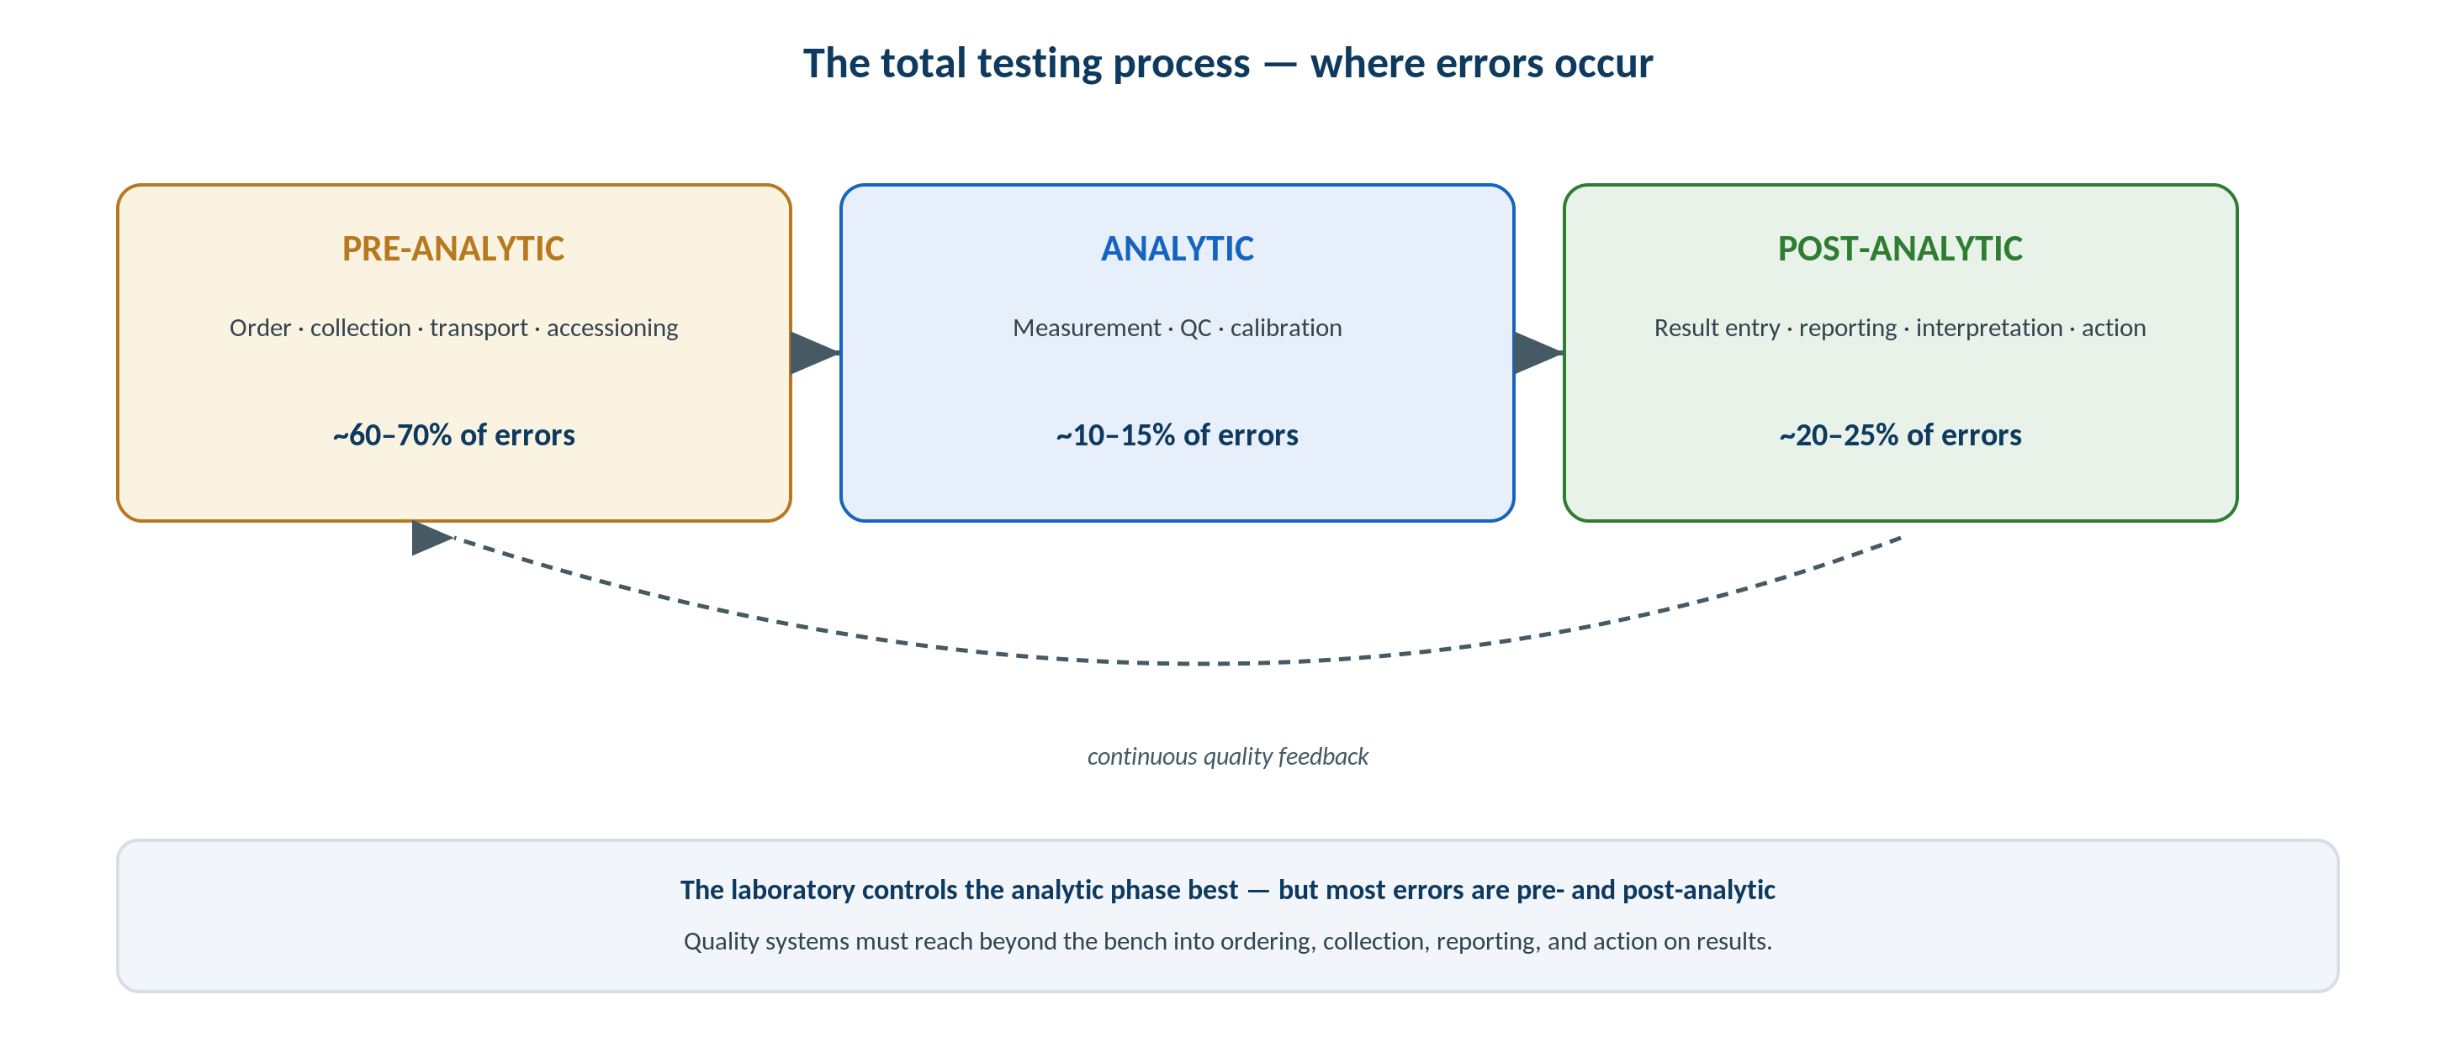
LAB MANAGEMENT & QUALITY · INDICATORS
Quality Across the Total Testing Process
Original schematic. Quality indicators must span pre-analytic, analytic, and post-analytic phases — not just the bench.
Makassed General Hospital · Department of Laboratory Medicine
CP Lecture Series · 9

Slide 12
LAB MANAGEMENT & QUALITY · IMPROVEMENT
Monitoring & Continuous Improvement
QUALITY INDICATORS
PDCA CYCLE
Track measurable metrics across all phases (e.g., specimen rejection, TAT, critical-value reporting, amended reports).
Set targets and monitor trends.
Benchmark internally and externally.
Use data, not anecdote, to drive change.
Plan-Do-Check-Act structures iterative improvement.
Pair with root-cause analysis for problems.
Engage staff in identifying issues.
Close the loop and verify effectiveness.
Makassed General Hospital · Department of Laboratory Medicine
CP Lecture Series · 10

Slide 13
03
PART THREE
Cases & Board Review

Slide 14
LAB MANAGEMENT & QUALITY · CASE 1
Case 1
CLINICAL VIGNETTE
After a reagent lot change, controls drift to consistently higher values, triggering a 4_1s and then a 10x rule.
?
What type of error is this, and what is the likely cause?
Makassed General Hospital · Department of Laboratory Medicine
CP Lecture Series · 11

Slide 15
LAB MANAGEMENT & QUALITY · CASE 1 · RESOLUTION
Case 1: Systematic Shift
A consistent one-directional shift indicates systematic error (bias), here following a reagent lot change.
4_1s and 10x are systematic-error rules.
Investigate calibration and the new lot; recalibrate as needed.
Hold reporting until resolved.
TEACHING POINT
Systematic-error rules (2_2s, 4_1s, 10x) point to bias — look at calibration, reagent lots, and instrument drift.
Makassed General Hospital · Department of Laboratory Medicine
CP Lecture Series · 12

Slide 16
LAB MANAGEMENT & QUALITY · CASE 2
Case 2
CLINICAL VIGNETTE
A single control value falls beyond +3 SD with no trend; the next run is in control.
?
Which rule applies and what error type is suggested?
Makassed General Hospital · Department of Laboratory Medicine
CP Lecture Series · 13

Slide 17
LAB MANAGEMENT & QUALITY · CASE 2 · RESOLUTION
Case 2: Random Error
A single point beyond ±3 SD violates 1_3s, suggesting random error.
Likely causes: a bubble, pipetting error, or transient instability.
Investigate, repeat, and document.
If isolated and resolved, controlled results can resume.
TEACHING POINT
1_3s and R_4s flag random error (imprecision) — often a one-off; investigate and repeat before releasing results.
Makassed General Hospital · Department of Laboratory Medicine
CP Lecture Series · 14

Slide 18
LAB MANAGEMENT & QUALITY · CASE 3
Case 3
CLINICAL VIGNETTE
The specimen-rejection rate rises sharply on one inpatient unit.
?
How should a quality program respond?
Makassed General Hospital · Department of Laboratory Medicine
CP Lecture Series · 15

Slide 19
LAB MANAGEMENT & QUALITY · CASE 3 · RESOLUTION
Case 3: A Pre-Analytic Indicator
A rising rejection rate is a pre-analytic quality signal warranting investigation.
Use root-cause analysis (collection technique, labeling, training).
Apply a PDCA improvement cycle and re-measure.
Most errors are pre-analytic — quality must reach beyond the bench.
TEACHING POINT
Quality indicators across the total testing process catch pre-analytic problems that pure analytic QC would miss.
Makassed General Hospital · Department of Laboratory Medicine
CP Lecture Series · 16

Slide 20
LAB MANAGEMENT & QUALITY · BOARD REVIEW · Q1
Board-Style Review
A 1_3s Westgard rule violation most suggests:
A. Systematic error
B. Random error
C. Calibration bias
D. Reagent deterioration trend
E. A warning only
Makassed General Hospital · Department of Laboratory Medicine
CP Lecture Series · 17

Slide 21
LAB MANAGEMENT & QUALITY · BOARD REVIEW · Q1
Board-Style Review
A 1_3s Westgard rule violation most suggests:
A. Systematic error
B. Random error
C. Calibration bias
D. Reagent deterioration trend
E. A warning only
ANSWER B — Random error
A single point beyond ±3 SD indicates random error (imprecision); systematic rules involve consecutive directional violations.
Makassed General Hospital · Department of Laboratory Medicine
CP Lecture Series · 17

Slide 22
LAB MANAGEMENT & QUALITY · BOARD REVIEW · Q2
Board-Style Review
A 10x rule (ten consecutive points on one side of the mean) indicates:
A. Random error
B. Systematic error (shift/bias)
C. Acceptable performance
D. A warning to ignore
E. Improved precision
Makassed General Hospital · Department of Laboratory Medicine
CP Lecture Series · 18

Slide 23
LAB MANAGEMENT & QUALITY · BOARD REVIEW · Q2
Board-Style Review
A 10x rule (ten consecutive points on one side of the mean) indicates:
A. Random error
B. Systematic error (shift/bias)
C. Acceptable performance
D. A warning to ignore
E. Improved precision
ANSWER B — Systematic error
A run of points on one side reflects a shift/bias, often from calibration or reagent changes.
Makassed General Hospital · Department of Laboratory Medicine
CP Lecture Series · 18

Slide 24
LAB MANAGEMENT & QUALITY · BOARD REVIEW · Q3
Board-Style Review
Most laboratory errors occur in which phase?
A. Analytic
B. Pre-analytic
C. Post-analytic
D. Calibration
E. Maintenance
Makassed General Hospital · Department of Laboratory Medicine
CP Lecture Series · 19

Slide 25
LAB MANAGEMENT & QUALITY · BOARD REVIEW · Q3
Board-Style Review
Most laboratory errors occur in which phase?
A. Analytic
B. Pre-analytic
C. Post-analytic
D. Calibration
E. Maintenance
ANSWER B — Pre-analytic
The majority of errors arise pre-analytically (ordering, collection, transport), so quality systems must extend beyond the bench.
Makassed General Hospital · Department of Laboratory Medicine
CP Lecture Series · 19

Slide 26
LAB MANAGEMENT & QUALITY · BOARD REVIEW · Q4
Board-Style Review
The 1_2s rule is best used as:
A. An automatic rejection rule
B. A warning rule prompting inspection
C. A systematic-error rule
D. A calibration rule
E. A proficiency-testing rule
Makassed General Hospital · Department of Laboratory Medicine
CP Lecture Series · 20

Slide 27
LAB MANAGEMENT & QUALITY · BOARD REVIEW · Q4
Board-Style Review
The 1_2s rule is best used as:
A. An automatic rejection rule
B. A warning rule prompting inspection
C. A systematic-error rule
D. A calibration rule
E. A proficiency-testing rule
ANSWER B — A warning rule
1_2s is a warning that triggers review of other rules; it is not an automatic rejection by itself.
Makassed General Hospital · Department of Laboratory Medicine
CP Lecture Series · 20

Slide 28
LAB MANAGEMENT & QUALITY
Key Take-Home Points
A QMS spans documents, equipment, personnel, process control, and occurrence management — QC is one part of it.
1
Levey-Jennings charts plus Westgard multirules detect error; 1_3s/R_4s flag random, 2_2s/4_1s/10x flag systematic.
2
Distinguish random error (imprecision) from systematic error (bias) to target the correct fix.
3
Monitor quality indicators across the total testing process — most errors are pre- and post-analytic.
4
Use PDCA and root-cause analysis to drive continuous improvement and verify effectiveness.
5
Makassed General Hospital · Department of Laboratory Medicine
21

Slide 29
LAB MANAGEMENT & QUALITY · REFERENCES & FURTHER READING
References
1. Westgard JO. Basic QC Practices, 4th ed.
2. CLSI C24: Statistical Quality Control for Quantitative Measurement Procedures.
3. CLSI QMS01: A Quality Management System Model.
4. Plebani M. Errors in the total testing process. Clin Chem Lab Med.
Makassed General Hospital · Department of Laboratory Medicine
CP Lecture Series · 22

