Slide 1
CLINICAL PATHOLOGY RESIDENCY LECTURE SERIES
LABORATORY MANAGEMENT · LECTURE 2 OF 5
Regulatory & Accreditation
CLIA, Accreditation, Proficiency Testing, and Test Complexity
Dr. Tamima El-Jisr
Chairperson, Department of Laboratory Medicine
Makassed General Hospital, Beirut
Clinical Pathology Residency Curriculum

Slide 2
LAB MANAGEMENT & QUALITY · FRAMING THE PROBLEM
Why This Matters
CLIA
PT
Complexity
The regulatory floor for clinical testing
External proof that results are accurate
Test category sets the requirements
Regulation and accreditation define the non-negotiable framework the laboratory operates within: who may test, how performance is proven, and how the laboratory is inspected and held accountable.
Know the hierarchy: CLIA is the floor, accreditation builds on it, and proficiency testing externally verifies performance.
Makassed General Hospital · Department of Laboratory Medicine
CP Lecture Series · 2

Slide 3
LAB MANAGEMENT & QUALITY · ·
Learning Objectives
Describe CLIA and test-complexity categories.
Explain accreditation and deemed status.
1
2
State proficiency-testing requirements and the response to failure.
Outline personnel and competency requirements.
3
4
Describe waived testing and its risks.
Prepare for and respond to inspections.
5
6
Makassed General Hospital · Department of Laboratory Medicine
CP Lecture Series · 3

Slide 4
LAB MANAGEMENT & QUALITY · WHAT WE WILL COVER
Roadmap
Oversight layers — CLIA, accreditation, ISO, PT
1
Test complexity — waived to high complexity
2
Proficiency testing — requirements and failures
3
Personnel & inspection — competency and readiness
4
Cases & board review
5
Makassed General Hospital · Department of Laboratory Medicine
CP Lecture Series · 4

Slide 5
01
PART ONE
The Regulatory Framework

Slide 6
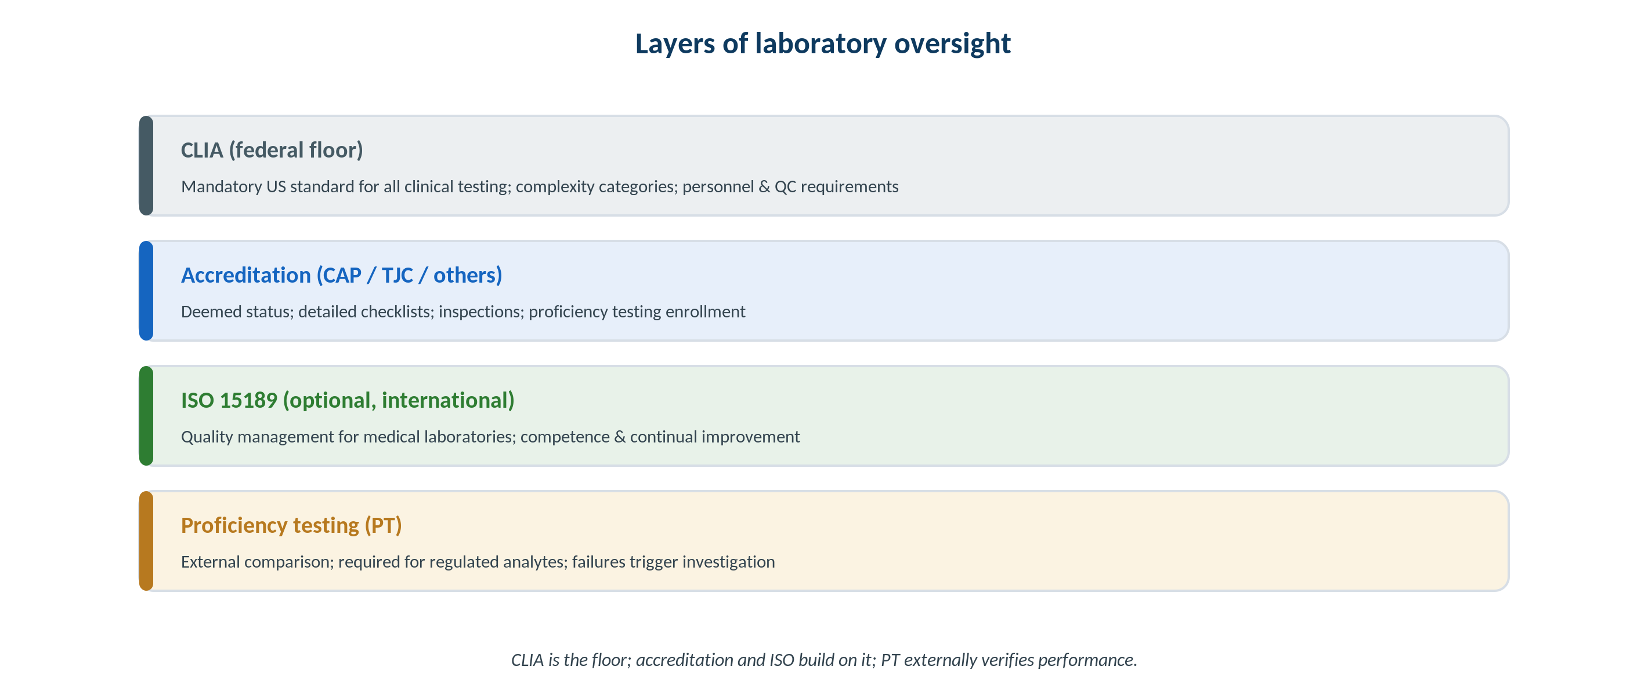
LAB MANAGEMENT & QUALITY · OVERSIGHT
Layers of Laboratory Oversight
Original schematic. CLIA is the federal floor; accreditation and ISO 15189 build on it; proficiency testing verifies performance.
Makassed General Hospital · Department of Laboratory Medicine
CP Lecture Series · 5

Slide 7
LAB MANAGEMENT & QUALITY · REGULATION
CLIA & Accreditation
CLIA
ACCREDITATION & DEEMED STATUS
Federal regulations governing all clinical laboratory testing on human specimens.
Sets personnel, QC, and proficiency-testing requirements.
Requirements scale with test complexity.
Enforced via certificates and inspection.
Accreditors (e.g., CAP, TJC) with deemed status inspect against detailed checklists.
Meeting accreditation satisfies CLIA via deemed status.
Inspections are typically periodic and may be unannounced.
ISO 15189 is an optional international standard.
Makassed General Hospital · Department of Laboratory Medicine
CP Lecture Series · 6

Slide 8
LAB MANAGEMENT & QUALITY · COMPLEXITY
Test Complexity Categories
THE CATEGORIES
WAIVED TESTING
Waived, moderate complexity, and high complexity — requirements increase accordingly.
Complexity reflects knowledge, steps, and interpretation needed.
Personnel qualifications scale with complexity.
Modifying an FDA-cleared test raises it to high complexity.
Waived tests are simple with low error risk but still require correct performance.
‘Waived’ does not mean ‘no oversight’.
Follow manufacturer instructions exactly.
Point-of-care programs need governance.
Makassed General Hospital · Department of Laboratory Medicine
CP Lecture Series · 7

Slide 9
02
PART TWO
Proficiency Testing, Personnel & Inspection

Slide 10
LAB MANAGEMENT & QUALITY · PROFICIENCY
Proficiency Testing
WHAT PT DOES
RESPONDING TO FAILURE
External samples are tested blindly and compared to peers/reference — objective proof of accuracy.
Required for regulated analytes; alternative assessment otherwise.
Handle PT samples like patient samples.
Do NOT refer PT samples to another lab or discuss them — a serious violation.
A failure triggers investigation, root-cause analysis, and corrective action.
Unsuccessful performance can restrict testing.
Document remediation and verify effectiveness.
Repeated failure has regulatory consequences.
Makassed General Hospital · Department of Laboratory Medicine
CP Lecture Series · 8

Slide 11
LAB MANAGEMENT & QUALITY · PERSONNEL
Competency & Qualifications
PERSONNEL REQUIREMENTS
COMPETENCY ASSESSMENT
Defined roles (director, supervisor, testing personnel) with qualifications scaled to complexity.
The laboratory director holds overall responsibility.
Documented training and authorization to test.
Adequate staffing for safe operation.
Ongoing competency uses the six required elements (e.g., direct observation, result review, blind samples, problem-solving).
Assessed at defined intervals.
Remediate identified gaps.
Maintain records for inspection.
Makassed General Hospital · Department of Laboratory Medicine
CP Lecture Series · 9

Slide 12
LAB MANAGEMENT & QUALITY · INSPECTION
Inspection Readiness
CONTINUOUS READINESS
RESPONDING TO FINDINGS
Maintain documentation, QC records, and corrective actions so the lab is always inspection-ready.
Self-inspections find gaps proactively.
Track and close deficiencies.
Engage staff in readiness.
Address citations with documented corrective action and timelines.
Demonstrate sustained compliance.
Use findings to strengthen the system.
Escalate systemic issues to leadership.
Makassed General Hospital · Department of Laboratory Medicine
CP Lecture Series · 10

Slide 13
03
PART THREE
Cases & Board Review

Slide 14
LAB MANAGEMENT & QUALITY · CASE 1
Case 1
CLINICAL VIGNETTE
A technologist, unsure of a result, sends a proficiency-testing sample to a reference lab for confirmation.
?
Why is this a serious problem?
Makassed General Hospital · Department of Laboratory Medicine
CP Lecture Series · 11

Slide 15
LAB MANAGEMENT & QUALITY · CASE 1 · RESOLUTION
Case 1: PT Referral Violation
Referring a PT sample to another laboratory is a serious regulatory violation, even if well-intentioned.
PT must be handled exactly like a patient sample and not shared.
Penalties can include loss of certification.
Educate staff on PT rules.
TEACHING POINT
Never refer or discuss proficiency-testing samples — PT referral is among the most serious CLIA violations.
Makassed General Hospital · Department of Laboratory Medicine
CP Lecture Series · 12

Slide 16
LAB MANAGEMENT & QUALITY · CASE 2
Case 2
CLINICAL VIGNETTE
A laboratory modifies an FDA-cleared assay to use a different specimen type.
?
How does this change the regulatory requirements?
Makassed General Hospital · Department of Laboratory Medicine
CP Lecture Series · 13

Slide 17
LAB MANAGEMENT & QUALITY · CASE 2 · RESOLUTION
Case 2: Modified FDA-Cleared Test
Modifying an FDA-cleared assay makes it high complexity and requires full validation.
The lab assumes responsibility for performance characteristics.
Personnel and QC requirements increase.
Document the validation thoroughly.
TEACHING POINT
Any modification of an FDA-cleared test converts it to a high-complexity, laboratory-validated assay with full requirements.
Makassed General Hospital · Department of Laboratory Medicine
CP Lecture Series · 14

Slide 18
LAB MANAGEMENT & QUALITY · CASE 3
Case 3
CLINICAL VIGNETTE
A laboratory fails a proficiency-testing event for one analyte.
?
What is the appropriate response?
Makassed General Hospital · Department of Laboratory Medicine
CP Lecture Series · 15

Slide 19
LAB MANAGEMENT & QUALITY · CASE 3 · RESOLUTION
Case 3: PT Failure
Investigate with root-cause analysis, implement corrective action, and document the response.
Verify the fix before resuming confident reporting.
Unsuccessful performance can restrict testing for that analyte.
Use the event to improve the process.
TEACHING POINT
A PT failure is a managed event: root-cause, corrective action, verification, and documentation — not just a repeat test.
Makassed General Hospital · Department of Laboratory Medicine
CP Lecture Series · 16

Slide 20
LAB MANAGEMENT & QUALITY · BOARD REVIEW · Q1
Board-Style Review
Referring a proficiency-testing sample to another laboratory is:
A. Encouraged for accuracy
B. A serious regulatory violation
C. Required for confirmation
D. Allowed if documented
E. Standard practice
Makassed General Hospital · Department of Laboratory Medicine
CP Lecture Series · 17

Slide 21
LAB MANAGEMENT & QUALITY · BOARD REVIEW · Q1
Board-Style Review
Referring a proficiency-testing sample to another laboratory is:
A. Encouraged for accuracy
B. A serious regulatory violation
C. Required for confirmation
D. Allowed if documented
E. Standard practice
ANSWER B — A serious violation
PT samples must be tested like patient samples and never referred; PT referral can cost a laboratory its certification.
Makassed General Hospital · Department of Laboratory Medicine
CP Lecture Series · 17

Slide 22
LAB MANAGEMENT & QUALITY · BOARD REVIEW · Q2
Board-Style Review
CLIA requirements for a test increase with:
A. The lab’s size
B. Test complexity (waived → high)
C. The number of staff
D. The instrument brand
E. The time of year
Makassed General Hospital · Department of Laboratory Medicine
CP Lecture Series · 18

Slide 23
LAB MANAGEMENT & QUALITY · BOARD REVIEW · Q2
Board-Style Review
CLIA requirements for a test increase with:
A. The lab’s size
B. Test complexity (waived → high)
C. The number of staff
D. The instrument brand
E. The time of year
ANSWER B — Test complexity
Requirements for personnel, QC, and PT scale with complexity from waived to high complexity.
Makassed General Hospital · Department of Laboratory Medicine
CP Lecture Series · 18

Slide 24
LAB MANAGEMENT & QUALITY · BOARD REVIEW · Q3
Board-Style Review
Modifying an FDA-cleared assay generally makes it:
A. Waived
B. Moderate complexity
C. High complexity requiring full validation
D. Exempt from CLIA
E. Research-use only by default
Makassed General Hospital · Department of Laboratory Medicine
CP Lecture Series · 19

Slide 25
LAB MANAGEMENT & QUALITY · BOARD REVIEW · Q3
Board-Style Review
Modifying an FDA-cleared assay generally makes it:
A. Waived
B. Moderate complexity
C. High complexity requiring full validation
D. Exempt from CLIA
E. Research-use only by default
ANSWER C — High complexity, full validation
Modifications void the cleared status; the lab must fully validate the test as high complexity.
Makassed General Hospital · Department of Laboratory Medicine
CP Lecture Series · 19

Slide 26
LAB MANAGEMENT & QUALITY · BOARD REVIEW · Q4
Board-Style Review
Accreditation with deemed status means the laboratory:
A. Is exempt from CLIA
B. Meets CLIA through the accreditor’s inspection
C. Needs no proficiency testing
D. Cannot be inspected
E. Is research-only
Makassed General Hospital · Department of Laboratory Medicine
CP Lecture Series · 20

Slide 27
LAB MANAGEMENT & QUALITY · BOARD REVIEW · Q4
Board-Style Review
Accreditation with deemed status means the laboratory:
A. Is exempt from CLIA
B. Meets CLIA through the accreditor’s inspection
C. Needs no proficiency testing
D. Cannot be inspected
E. Is research-only
ANSWER B — Meets CLIA via accreditor
Deemed-status accreditors enforce standards that satisfy CLIA requirements through their inspection process.
Makassed General Hospital · Department of Laboratory Medicine
CP Lecture Series · 20

Slide 28
LAB MANAGEMENT & QUALITY
Key Take-Home Points
CLIA is the federal floor; accreditation (with deemed status) and ISO 15189 build on it; PT verifies performance externally.
1
Requirements scale with test complexity (waived → moderate → high); modifying an FDA-cleared test makes it high complexity.
2
Handle PT samples exactly like patient samples — never refer or discuss them; referral is a severe violation.
3
Personnel qualifications and ongoing competency (six elements) scale with complexity; the director holds overall responsibility.
4
Maintain continuous inspection readiness; respond to PT failures and citations with documented corrective action.
5
Makassed General Hospital · Department of Laboratory Medicine
21

Slide 29
LAB MANAGEMENT & QUALITY · REFERENCES & FURTHER READING
References
1. Clinical Laboratory Improvement Amendments (CLIA) regulations (42 CFR 493).
2. College of American Pathologists Laboratory Accreditation Program.
3. CMS proficiency-testing requirements and referral policy.
4. ISO 15189: Medical laboratories — requirements for quality and competence.
Makassed General Hospital · Department of Laboratory Medicine
CP Lecture Series · 22

