Slide 1
CLINICAL PATHOLOGY RESIDENCY LECTURE SERIES
MICROBIOLOGY · LECTURE 3 OF 5
Antimicrobial Susceptibility Testing
MICs, Breakpoints, Resistance & Stewardship
Dr. Tamima El-Jisr
Chairperson, Department of Laboratory Medicine
Makassed General Hospital, Beirut
Clinical Pathology Residency Curriculum

Slide 2
MICROBIOLOGY · FRAMING THE PROBLEM
Why This Matters
MIC
Breakpoint
Report
The lowest concentration that inhibits visible growth
Turns an MIC into S, I, or R
Selective reporting steers prescribing and stewardship
Susceptibility testing converts a numeric MIC into an interpretation the clinician can act on. Understanding breakpoints, resistance mechanisms, and selective reporting is central to the laboratory’s stewardship role.
An MIC is meaningless without its breakpoint and the resistance mechanism behind it — interpret, don’t just measure.
Makassed General Hospital · Department of Laboratory Medicine
CP Lecture Series · 2

Slide 3
MICROBIOLOGY · ·
Learning Objectives
Define MIC and interpret it against current breakpoints.
Compare disk diffusion, broth microdilution, and gradient methods.
1
2
Explain S/I/R categories and the susceptible-dose-dependent concept.
Recognize key resistance mechanisms and markers (MRSA, ESBL, carbapenemase, VRE).
3
4
Apply intrinsic resistance and reflex/confirmatory testing.
Use selective reporting and the antibiogram for stewardship.
5
6
Makassed General Hospital · Department of Laboratory Medicine
CP Lecture Series · 3

Slide 4
MICROBIOLOGY · WHAT WE WILL COVER
Roadmap
MIC & methods — how susceptibility is measured
1
Breakpoints & categories — S, I, R, SDD
2
Resistance mechanisms — markers and reflex tests
3
Reporting & antibiogram — stewardship
4
Cases & board review
5
Makassed General Hospital · Department of Laboratory Medicine
CP Lecture Series · 4

Slide 5
01
PART ONE
Measuring Susceptibility

Slide 6
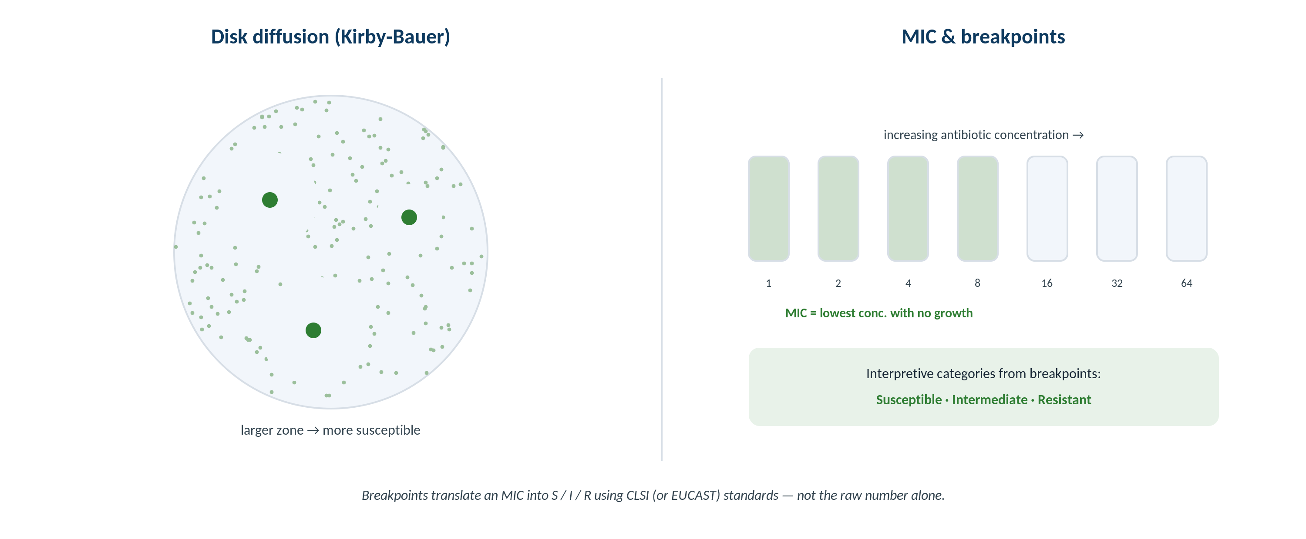
MICROBIOLOGY · METHODS
Disk Diffusion and MIC
Original schematic. Zone of inhibition and MIC both estimate susceptibility; breakpoints convert them to S/I/R.
Makassed General Hospital · Department of Laboratory Medicine
CP Lecture Series · 5

Slide 7
MICROBIOLOGY · METHODS
How Susceptibility Is Tested
QUANTITATIVE METHODS
QUALITATIVE / ZONE METHODS
Broth microdilution is the reference: lowest concentration inhibiting growth = MIC.
Gradient strips (e.g., Etest) give an MIC on a plate.
Automated systems provide MICs at scale.
Quality control with reference strains is mandatory.
Disk diffusion measures a zone of inhibition; larger zone → more susceptible.
Zone diameters are interpreted against breakpoint tables.
Useful, inexpensive, flexible.
Some drug-bug combinations require MIC methods.
Makassed General Hospital · Department of Laboratory Medicine
CP Lecture Series · 6

Slide 8
02
PART TWO
Breakpoints, Categories & Resistance

Slide 9
MICROBIOLOGY · INTERPRETATION
Breakpoints and S/I/R
FROM MIC TO CATEGORY
INTRINSIC RESISTANCE
Breakpoints (CLSI/EUCAST) translate an MIC into Susceptible, Intermediate, or Resistant.
Breakpoints incorporate pharmacokinetics, dosing, and outcomes — and are periodically revised.
'Susceptible-dose-dependent' (SDD) means susceptibility depends on using an adequate dosing regimen.
The same MIC can mean different categories for different drugs/organisms.
Some organisms are inherently resistant (e.g., anaerobes to aminoglycosides) — such results are suppressed.
Intrinsic-resistance rules catch implausible 'susceptible' results.
Verify unexpected susceptibilities before reporting.
Know expected phenotypes for common organisms.
Makassed General Hospital · Department of Laboratory Medicine
CP Lecture Series · 7

Slide 10
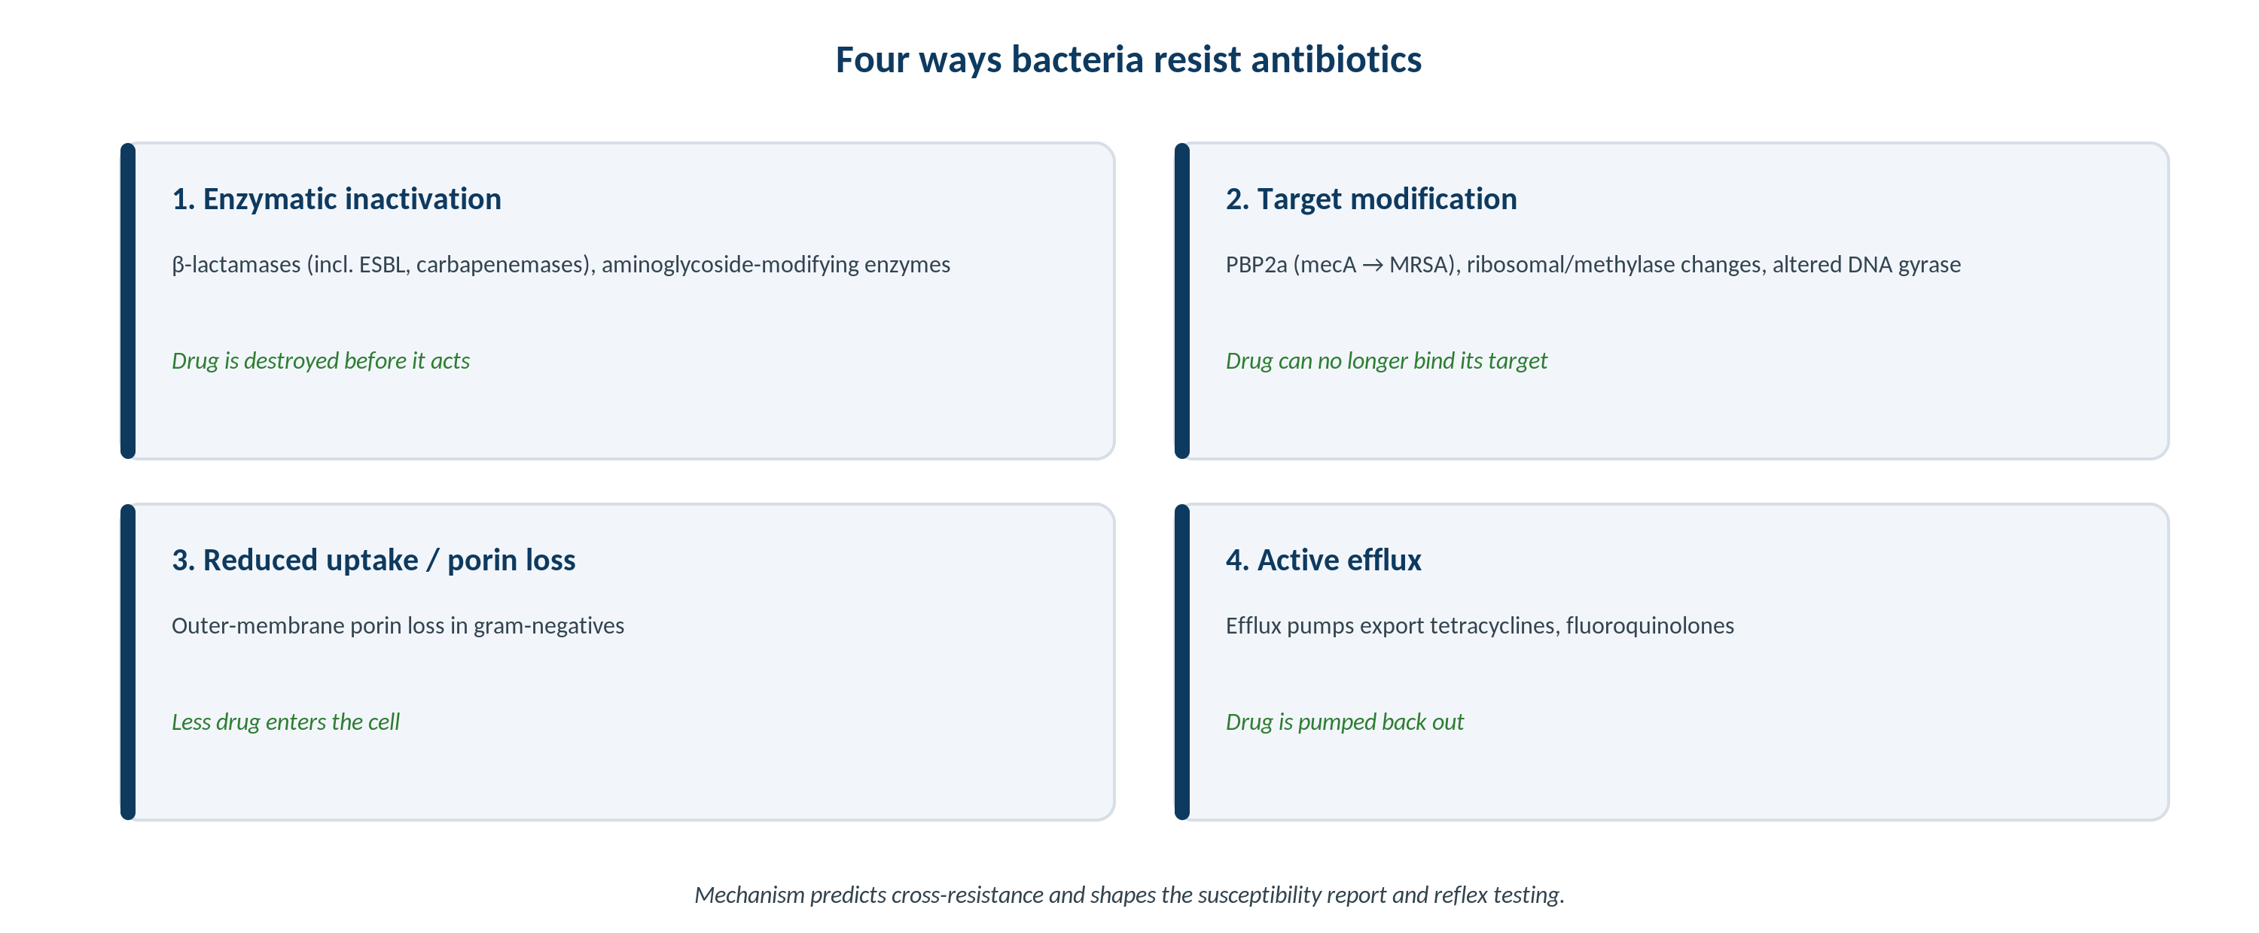
MICROBIOLOGY · RESISTANCE
Four Mechanisms of Resistance
Original schematic. Enzymatic inactivation, target modification, reduced uptake, and efflux — each predicts cross-resistance.
Makassed General Hospital · Department of Laboratory Medicine
CP Lecture Series · 8

Slide 11
MICROBIOLOGY · KEY MARKERS
High-Yield Resistance Phenotypes
Marker | Mechanism | Practical impact
MRSA | mecA → PBP2a | Resistant to β-lactams (except newer agents)
ESBL | Extended-spectrum β-lactamase | Resistant to most cephalosporins
Carbapenemase (CRE) | KPC, NDM, OXA | Resistant to carbapenems; infection-control alert
VRE | vanA/vanB | Vancomycin-resistant enterococci
Inducible clinda (MLSb) | erm | D-test positive → report clinda R
Mechanism drives confirmatory tests, reporting rules, and infection-control notification.
Makassed General Hospital · Department of Laboratory Medicine
CP Lecture Series · 9

Slide 12
03
PART THREE
Reporting, Cases & Board

Slide 13
MICROBIOLOGY · STEWARDSHIP
Selective Reporting & the Antibiogram
SELECTIVE (CASCADE) REPORTING
THE ANTIBIOGRAM
Report narrow-spectrum agents first; suppress broad agents unless needed.
Guides prescribers toward appropriate, narrow therapy.
Reduces selection pressure for resistance.
Built with the stewardship team.
A periodic summary of %-susceptible by organism for the institution.
Informs empiric therapy and local guidelines.
Tracks resistance trends over time.
Requires sufficient isolate numbers to be valid.
Makassed General Hospital · Department of Laboratory Medicine
CP Lecture Series · 10

Slide 14
MICROBIOLOGY · CASE 1
Case 1
CLINICAL VIGNETTE
S. aureus is erythromycin-resistant and clindamycin-susceptible. The D-test is positive.
?
How should clindamycin be reported, and why?
Makassed General Hospital · Department of Laboratory Medicine
CP Lecture Series · 11

Slide 15
MICROBIOLOGY · CASE 1 · RESOLUTION
Case 1: Inducible Clindamycin Resistance
A positive D-test indicates inducible MLSb resistance — clindamycin should be reported as resistant.
The erythromycin-resistant/clindamycin-susceptible phenotype triggers the D-test.
Reporting clindamycin susceptible could lead to clinical failure.
Mechanism (erm) explains the inducibility.
TEACHING POINT
The erythromycin-R/clindamycin-S pattern mandates a D-test; if positive, report clindamycin resistant to prevent treatment failure.
Makassed General Hospital · Department of Laboratory Medicine
CP Lecture Series · 12

Slide 16
MICROBIOLOGY · CASE 2
Case 2
CLINICAL VIGNETTE
A Klebsiella is resistant to ceftriaxone and ceftazidime but susceptible to carbapenems; ESBL is suspected.
?
What does this phenotype imply for therapy and reporting?
Makassed General Hospital · Department of Laboratory Medicine
CP Lecture Series · 13

Slide 17
MICROBIOLOGY · CASE 2 · RESOLUTION
Case 2: ESBL Producer
An ESBL hydrolyzes most cephalosporins; cephalosporins should not be relied upon even if an isolated MIC looks borderline.
Carbapenems are typically the definitive therapy for serious infection.
Modern breakpoints often allow direct reporting without a separate confirmatory step.
Mechanism predicts broad cephalosporin failure.
TEACHING POINT
Recognize the ESBL phenotype (cephalosporin resistance) and steer away from cephalosporins; report per current breakpoints.
Makassed General Hospital · Department of Laboratory Medicine
CP Lecture Series · 14

Slide 18
MICROBIOLOGY · CASE 3
Case 3
CLINICAL VIGNETTE
An anaerobe’s panel reports 'susceptible' to an aminoglycoside.
?
Should this be reported, and what principle applies?
Makassed General Hospital · Department of Laboratory Medicine
CP Lecture Series · 15

Slide 19
MICROBIOLOGY · CASE 3 · RESOLUTION
Case 3: Intrinsic Resistance
Anaerobes are intrinsically resistant to aminoglycosides (oxygen-dependent uptake) — a 'susceptible' result is implausible and should be suppressed.
Intrinsic-resistance rules catch such errors.
Verify and suppress the result rather than reporting it.
Know expected phenotypes to spot impossible results.
TEACHING POINT
Apply intrinsic-resistance rules: a result that contradicts a known organism phenotype is an error to suppress, not a finding to report.
Makassed General Hospital · Department of Laboratory Medicine
CP Lecture Series · 16

Slide 20
MICROBIOLOGY · BOARD REVIEW · Q1
Board-Style Review
The MIC is defined as:
A. The highest concentration with growth
B. The lowest concentration that inhibits visible growth
C. The zone diameter
D. The serum drug level
E. The breakpoint
Makassed General Hospital · Department of Laboratory Medicine
CP Lecture Series · 17

Slide 21
MICROBIOLOGY · BOARD REVIEW · Q1
Board-Style Review
The MIC is defined as:
A. The highest concentration with growth
B. The lowest concentration that inhibits visible growth
C. The zone diameter
D. The serum drug level
E. The breakpoint
ANSWER B — Lowest concentration inhibiting visible growth
The MIC is the minimum inhibitory concentration; breakpoints translate it into S/I/R.
Makassed General Hospital · Department of Laboratory Medicine
CP Lecture Series · 17

Slide 22
MICROBIOLOGY · BOARD REVIEW · Q2
Board-Style Review
A positive D-test in S. aureus means clindamycin should be reported as:
A. Susceptible
B. Intermediate
C. Resistant
D. Not tested
E. Susceptible-dose-dependent
Makassed General Hospital · Department of Laboratory Medicine
CP Lecture Series · 18

Slide 23
MICROBIOLOGY · BOARD REVIEW · Q2
Board-Style Review
A positive D-test in S. aureus means clindamycin should be reported as:
A. Susceptible
B. Intermediate
C. Resistant
D. Not tested
E. Susceptible-dose-dependent
ANSWER C — Resistant
A positive D-test reveals inducible MLSb resistance; clindamycin is reported resistant despite apparent in-vitro susceptibility.
Makassed General Hospital · Department of Laboratory Medicine
CP Lecture Series · 18

Slide 24
MICROBIOLOGY · BOARD REVIEW · Q3
Board-Style Review
Which marker should trigger an infection-control alert for transmissible carbapenem resistance?
A. MRSA
B. ESBL
C. Carbapenemase (e.g., KPC/NDM)
D. Penicillin-resistant pneumococcus
E. Inducible clindamycin resistance
Makassed General Hospital · Department of Laboratory Medicine
CP Lecture Series · 19

Slide 25
MICROBIOLOGY · BOARD REVIEW · Q3
Board-Style Review
Which marker should trigger an infection-control alert for transmissible carbapenem resistance?
A. MRSA
B. ESBL
C. Carbapenemase (e.g., KPC/NDM)
D. Penicillin-resistant pneumococcus
E. Inducible clindamycin resistance
ANSWER C — Carbapenemase
Carbapenemase-producing organisms (CRE) are a major infection-control concern and require notification and isolation.
Makassed General Hospital · Department of Laboratory Medicine
CP Lecture Series · 19

Slide 26
MICROBIOLOGY · BOARD REVIEW · Q4
Board-Style Review
'Susceptible-dose-dependent' (SDD) indicates that susceptibility:
A. Is independent of dose
B. Depends on achieving an adequate dosing regimen
C. Means the organism is resistant
D. Requires combination therapy
E. Applies only to anaerobes
Makassed General Hospital · Department of Laboratory Medicine
CP Lecture Series · 20

Slide 27
MICROBIOLOGY · BOARD REVIEW · Q4
Board-Style Review
'Susceptible-dose-dependent' (SDD) indicates that susceptibility:
A. Is independent of dose
B. Depends on achieving an adequate dosing regimen
C. Means the organism is resistant
D. Requires combination therapy
E. Applies only to anaerobes
ANSWER B — Depends on adequate dosing
SDD signals that clinical success requires a dosing regimen that achieves adequate drug exposure at that MIC.
Makassed General Hospital · Department of Laboratory Medicine
CP Lecture Series · 20

Slide 28
MICROBIOLOGY
Key Take-Home Points
The MIC is the lowest inhibitory concentration; breakpoints (CLSI/EUCAST) convert it to S/I/R and are periodically revised.
1
Disk diffusion, broth microdilution, and gradient strips each have appropriate roles and require QC.
2
Resistance mechanisms (MRSA, ESBL, carbapenemase, VRE, inducible clindamycin) drive confirmatory tests and reporting rules.
3
Apply intrinsic-resistance rules — suppress implausible results that contradict known phenotypes.
4
Use selective reporting and the antibiogram to support antimicrobial stewardship.
5
Makassed General Hospital · Department of Laboratory Medicine
21

Slide 29
MICROBIOLOGY · REFERENCES & FURTHER READING
References
1. CLSI M100: Performance Standards for Antimicrobial Susceptibility Testing (current ed.).
2. EUCAST breakpoint tables (current version).
3. Carroll KC, et al. Manual of Clinical Microbiology, 12th ed. ASM Press.
4. Jorgensen JH, Ferraro MJ. Antimicrobial susceptibility testing. Clin Infect Dis.
Makassed General Hospital · Department of Laboratory Medicine
CP Lecture Series · 22

