Slide 1
CLINICAL PATHOLOGY RESIDENCY LECTURE SERIES
MICROBIOLOGY · LECTURE 4 OF 5
Rapid Diagnostics & Molecular Microbiology
Syndromic Panels, NAAT, and Antigen Testing
Dr. Tamima El-Jisr
Chairperson, Department of Laboratory Medicine
Makassed General Hospital, Beirut
Clinical Pathology Residency Curriculum

Slide 2
MICROBIOLOGY · FRAMING THE PROBLEM
Why This Matters
Hours
Panels
Context
Molecular panels deliver answers in 1–2 hours
Syndromic testing detects many targets at once
Detection is not always the same as disease
Rapid antigen and molecular methods compress diagnosis from days to hours, but they shift the interpretive burden: detecting nucleic acid is not the same as proving active, causative infection.
Faster is only better when paired with stewardship and interpretation — a positive NAAT must be read in clinical context.
Makassed General Hospital · Department of Laboratory Medicine
CP Lecture Series · 2

Slide 3
MICROBIOLOGY · ·
Learning Objectives
Compare antigen, NAAT, and syndromic panel methods.
Explain the speed/throughput/cost trade-offs of rapid testing.
1
2
Interpret detection vs colonization vs disease.
Apply cycle-threshold and qualitative-vs-quantitative concepts.
3
4
Recognize the stewardship value and risks of syndromic panels.
Use rapid diagnostics appropriately within testing algorithms.
5
6
Makassed General Hospital · Department of Laboratory Medicine
CP Lecture Series · 3

Slide 4
MICROBIOLOGY · WHAT WE WILL COVER
Roadmap
Methods — antigen, NAAT, syndromic panels
1
Speed vs interpretation — trade-offs
2
Detection vs disease — colonization, shedding
3
Stewardship — using panels wisely
4
Cases & board review
5
Makassed General Hospital · Department of Laboratory Medicine
CP Lecture Series · 4

Slide 5
01
PART ONE
Rapid & Molecular Methods

Slide 6
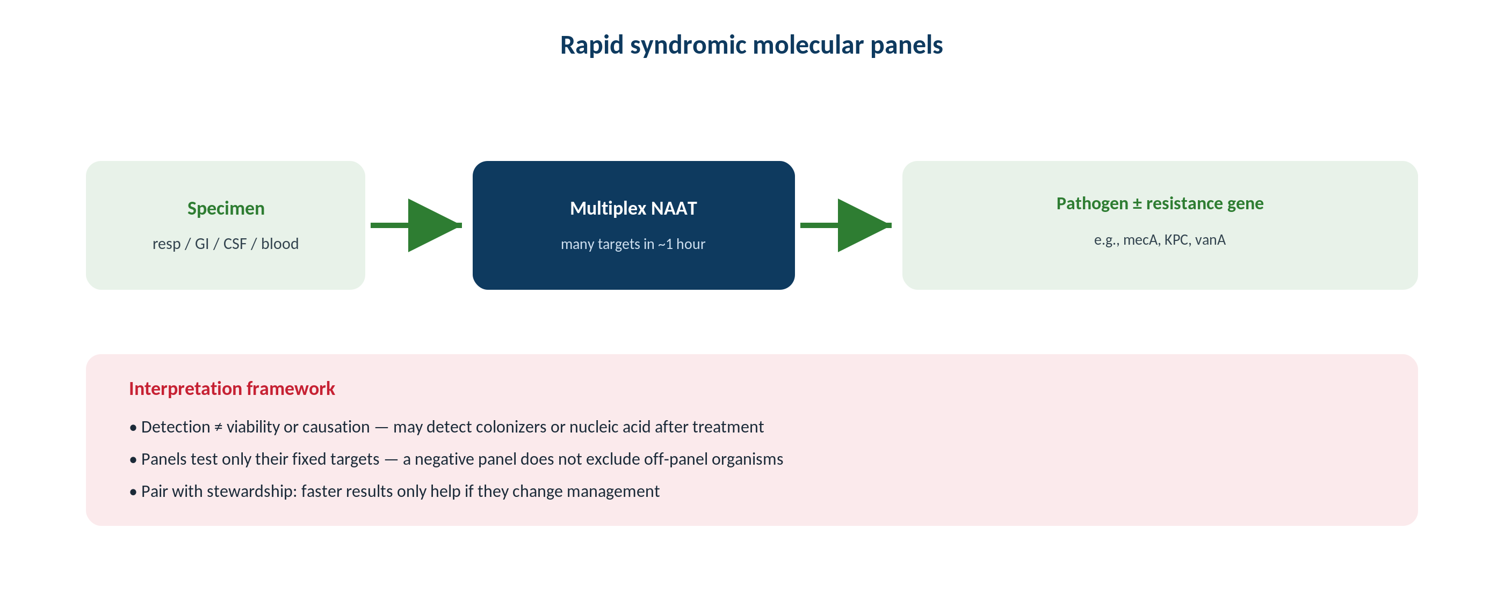
MICROBIOLOGY · SYNDROMIC
How Syndromic Panels Fit the Workflow
Original schematic. Multiplex panels detect many pathogens from one specimen, compressing time-to-result.
Makassed General Hospital · Department of Laboratory Medicine
CP Lecture Series · 5

Slide 7
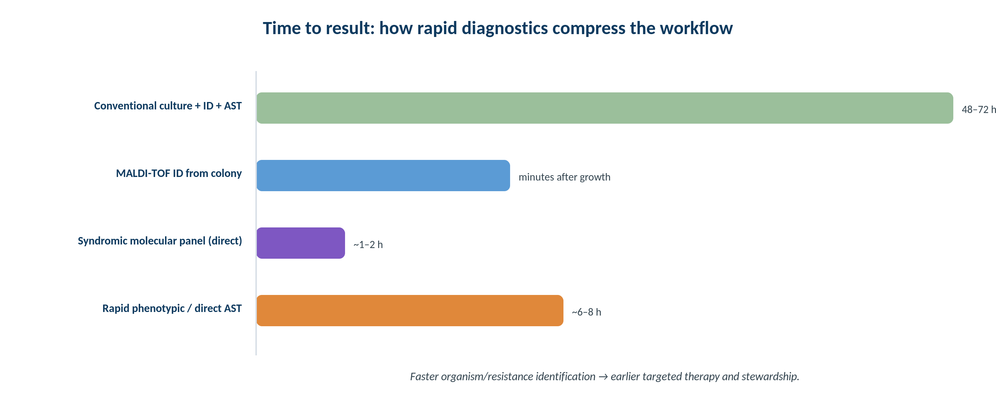
MICROBIOLOGY · TURNAROUND
Time to Result Across Methods
Original schematic. Molecular and MALDI methods dramatically shorten the path to organism and resistance identification.
Makassed General Hospital · Department of Laboratory Medicine
CP Lecture Series · 6

Slide 8
MICROBIOLOGY · METHODS
Antigen, NAAT & Multiplex
ANTIGEN TESTS
NAAT & SYNDROMIC PANELS
Detect microbial antigen rapidly (e.g., influenza, RSV, Strep A, Legionella/pneumococcal urine).
Fast and simple but generally less sensitive than NAAT.
A negative antigen test may need molecular confirmation.
Useful for point-of-care triage.
NAAT amplifies nucleic acid — high sensitivity and specificity.
Syndromic panels test many targets at once (respiratory, GI, meningitis/encephalitis, blood).
Results in ~1–2 hours.
Higher cost; require thoughtful use.
Makassed General Hospital · Department of Laboratory Medicine
CP Lecture Series · 7

Slide 9
02
PART TWO
Interpretation & Stewardship

Slide 10
MICROBIOLOGY · INTERPRETATION
Detection Is Not Always Disease
COLONIZATION & SHEDDING
CYCLE THRESHOLD (CT)
NAAT can detect colonizing or shed nucleic acid that is not causing current disease.
Prolonged shedding can yield positives after recovery.
C. difficile NAAT detects the gene, not necessarily active disease — correlate with symptoms.
Multiplex panels may detect incidental co-targets.
Ct inversely reflects target quantity but is NOT a standardized viral load.
Pre-analytic and assay factors affect Ct.
Use qualitative results unless a validated quantitative assay is used.
Interpret with the clinical picture.
Makassed General Hospital · Department of Laboratory Medicine
CP Lecture Series · 8

Slide 11
MICROBIOLOGY · STEWARDSHIP
Using Panels Wisely
VALUE
RISKS
Rapid pathogen and resistance-marker detection enables earlier targeted therapy and de-escalation.
Blood-culture ID panels report organism + key resistance genes quickly.
Can shorten unnecessary antibiotics and isolation.
Supports outbreak detection.
Over-testing, incidental detections, and cost can drive unnecessary treatment.
Genotype may not capture all phenotypic resistance.
Confirm with culture/AST when needed.
Pair panels with stewardship guidance.
Makassed General Hospital · Department of Laboratory Medicine
CP Lecture Series · 9

Slide 12
MICROBIOLOGY · ALGORITHMS
Placing Rapid Tests in Algorithms
TRIAGE AND REFLEX
LIMITS TO REMEMBER
Use rapid tests where speed changes management (sepsis, meningitis, respiratory season).
Reflex from screen to confirmatory test when indicated.
Define who can order high-cost panels.
Align with empiric-therapy pathways.
A panel only detects its designed targets — a negative panel does not exclude an off-panel pathogen.
Culture still needed for full AST and novel resistance.
Pre-analytic quality still governs accuracy.
Document interpretation for the team.
Makassed General Hospital · Department of Laboratory Medicine
CP Lecture Series · 10

Slide 13
03
PART THREE
Cases & Board Review

Slide 14
MICROBIOLOGY · CASE 1
Case 1
CLINICAL VIGNETTE
A C. difficile NAAT is positive in a patient on laxatives with formed stools and no leukocytosis.
?
Does the positive NAAT establish C. difficile infection?
Makassed General Hospital · Department of Laboratory Medicine
CP Lecture Series · 11

Slide 15
MICROBIOLOGY · CASE 1 · RESOLUTION
Case 1: NAAT-Positive C. difficile
NAAT detects the toxin gene, indicating carriage — not necessarily active disease.
In a patient with formed stool and no clinical signs, this likely reflects colonization.
Testing should be limited to patients with clinically significant diarrhea.
Correlate with symptoms; consider toxin EIA in algorithms.
TEACHING POINT
Only test for C. difficile in patients with unexplained, clinically significant diarrhea — a positive NAAT in a colonized patient causes overtreatment.
Makassed General Hospital · Department of Laboratory Medicine
CP Lecture Series · 12

Slide 16
MICROBIOLOGY · CASE 2
Case 2
CLINICAL VIGNETTE
A rapid influenza antigen test is negative during peak season in a symptomatic patient.
?
How should this negative result be interpreted and managed?
Makassed General Hospital · Department of Laboratory Medicine
CP Lecture Series · 13

Slide 17
MICROBIOLOGY · CASE 2 · RESOLUTION
Case 2: Negative Antigen in High Prevalence
Antigen tests are less sensitive than NAAT; a negative result during high prevalence has a meaningful false-negative rate.
Confirm with influenza NAAT when the result will change management.
Pretest probability is high in peak season.
Do not exclude influenza on a single negative antigen test.
TEACHING POINT
In high-prevalence settings, confirm a negative rapid antigen test with NAAT — sensitivity limits make a single negative unreliable.
Makassed General Hospital · Department of Laboratory Medicine
CP Lecture Series · 14

Slide 18
MICROBIOLOGY · CASE 3
Case 3
CLINICAL VIGNETTE
A blood-culture molecular panel reports an organism plus a mecA gene within an hour of positivity.
?
How does this change management compared with waiting for culture-based AST?
Makassed General Hospital · Department of Laboratory Medicine
CP Lecture Series · 15

Slide 19
MICROBIOLOGY · CASE 3 · RESOLUTION
Case 3: Rapid Blood-Culture Panel
Rapid organism + resistance-marker detection enables earlier appropriate therapy (e.g., recognizing methicillin resistance) and de-escalation.
Confirm with culture-based AST for full susceptibility.
Pair results with stewardship guidance.
Time saved can improve outcomes in bacteremia.
TEACHING POINT
Rapid blood-culture panels accelerate both escalation and de-escalation — but culture-based AST still confirms the full susceptibility profile.
Makassed General Hospital · Department of Laboratory Medicine
CP Lecture Series · 16

Slide 20
MICROBIOLOGY · BOARD REVIEW · Q1
Board-Style Review
The main interpretive caution with a positive C. difficile NAAT is that it:
A. Is highly insensitive
B. Detects the toxin gene and may reflect colonization
C. Cannot detect toxigenic strains
D. Requires culture confirmation always
E. Is quantitative
Makassed General Hospital · Department of Laboratory Medicine
CP Lecture Series · 17

Slide 21
MICROBIOLOGY · BOARD REVIEW · Q1
Board-Style Review
The main interpretive caution with a positive C. difficile NAAT is that it:
A. Is highly insensitive
B. Detects the toxin gene and may reflect colonization
C. Cannot detect toxigenic strains
D. Requires culture confirmation always
E. Is quantitative
ANSWER B — Detects gene; may reflect colonization
NAAT detects the toxin gene; in patients without clinically significant diarrhea it may indicate carriage, leading to overtreatment.
Makassed General Hospital · Department of Laboratory Medicine
CP Lecture Series · 17

Slide 22
MICROBIOLOGY · BOARD REVIEW · Q2
Board-Style Review
Compared with NAAT, rapid antigen tests are generally:
A. More sensitive
B. Less sensitive
C. Equally sensitive
D. Quantitative
E. Slower
Makassed General Hospital · Department of Laboratory Medicine
CP Lecture Series · 18

Slide 23
MICROBIOLOGY · BOARD REVIEW · Q2
Board-Style Review
Compared with NAAT, rapid antigen tests are generally:
A. More sensitive
B. Less sensitive
C. Equally sensitive
D. Quantitative
E. Slower
ANSWER B — Less sensitive
Antigen tests trade sensitivity for speed/simplicity; negatives often need molecular confirmation when prevalence or stakes are high.
Makassed General Hospital · Department of Laboratory Medicine
CP Lecture Series · 18

Slide 24
MICROBIOLOGY · BOARD REVIEW · Q3
Board-Style Review
A key limitation of any syndromic molecular panel is that it:
A. Detects only its designed targets
B. Always overcalls disease
C. Cannot detect resistance genes
D. Replaces culture entirely
E. Provides full AST
Makassed General Hospital · Department of Laboratory Medicine
CP Lecture Series · 19

Slide 25
MICROBIOLOGY · BOARD REVIEW · Q3
Board-Style Review
A key limitation of any syndromic molecular panel is that it:
A. Detects only its designed targets
B. Always overcalls disease
C. Cannot detect resistance genes
D. Replaces culture entirely
E. Provides full AST
ANSWER A — Detects only designed targets
A negative panel does not exclude off-panel pathogens, and culture is still needed for full susceptibility and novel resistance.
Makassed General Hospital · Department of Laboratory Medicine
CP Lecture Series · 19

Slide 26
MICROBIOLOGY · BOARD REVIEW · Q4
Board-Style Review
Cycle threshold (Ct) values should be interpreted as:
A. A standardized viral load
B. Inversely related to target amount but not a standardized quantitation
C. Directly proportional to target amount
D. Irrelevant to target quantity
E. A susceptibility measure
Makassed General Hospital · Department of Laboratory Medicine
CP Lecture Series · 20

Slide 27
MICROBIOLOGY · BOARD REVIEW · Q4
Board-Style Review
Cycle threshold (Ct) values should be interpreted as:
A. A standardized viral load
B. Inversely related to target amount but not a standardized quantitation
C. Directly proportional to target amount
D. Irrelevant to target quantity
E. A susceptibility measure
ANSWER B — Inversely related, not standardized
Ct inversely reflects target quantity but is affected by pre-analytic/assay factors and is not a validated quantitative viral load.
Makassed General Hospital · Department of Laboratory Medicine
CP Lecture Series · 20

Slide 28
MICROBIOLOGY
Key Take-Home Points
Antigen tests are fast but less sensitive; NAAT and syndromic panels are highly sensitive and quick (~1–2 h) but costlier.
1
Detection ≠ disease: account for colonization and shedding (e.g., C. difficile NAAT) and correlate clinically.
2
Ct inversely reflects target amount but is not a standardized viral load.
3
Rapid blood-culture panels speed targeted therapy and de-escalation; confirm with culture-based AST.
4
Place rapid tests in stewardship-aligned algorithms; a negative panel does not exclude off-panel pathogens.
5
Makassed General Hospital · Department of Laboratory Medicine
21

Slide 29
MICROBIOLOGY · REFERENCES & FURTHER READING
References
1. Carroll KC, et al. Manual of Clinical Microbiology, 12th ed. ASM Press.
2. IDSA C. difficile clinical practice guidelines.
3. Ramanan P, et al. Syndromic panel-based testing. Clin Microbiol Rev.
4. CLSI molecular methods guidance.
Makassed General Hospital · Department of Laboratory Medicine
CP Lecture Series · 22

