Slide 1
CLINICAL PATHOLOGY RESIDENCY LECTURE SERIES
MOLECULAR & CYTOGENETICS · LECTURE 1 OF 5
Molecular Methods for Residents
PCR, Real-Time/Digital PCR, Sequencing & Hybridization
Dr. Tamima El-Jisr
Chairperson, Department of Laboratory Medicine
Makassed General Hospital, Beirut
Clinical Pathology Residency Curriculum

Slide 2
MOLECULAR & CYTOGENETICS · FRAMING THE PROBLEM
Why This Matters
PCR
qPCR
NGS
Amplifies a target sequence exponentially
Quantifies in real time via cycle threshold
Massively parallel sequencing reads millions of fragments
Molecular diagnostics rests on a handful of core methods. Knowing what each technique measures — and its limits — lets you choose the right test and interpret it correctly.
Match the method to the question: known target vs discovery, qualitative vs quantitative, single locus vs genome-wide.
Makassed General Hospital · Department of Laboratory Medicine
CP Lecture Series · 2

Slide 3
MOLECULAR & CYTOGENETICS · ·
Learning Objectives
Explain conventional PCR and its components.
Describe real-time (quantitative) and digital PCR.
1
2
Contrast Sanger and next-generation sequencing.
Describe hybridization methods (FISH, arrays) at a high level.
3
4
Recognize contamination and pre-analytic pitfalls in molecular testing.
Select the appropriate method for a clinical question.
5
6
Makassed General Hospital · Department of Laboratory Medicine
CP Lecture Series · 3

Slide 4
MOLECULAR & CYTOGENETICS · WHAT WE WILL COVER
Roadmap
PCR fundamentals — amplification and components
1
Real-time & digital PCR — quantitation
2
Sequencing — Sanger vs NGS
3
Hybridization — FISH, arrays
4
Cases & board review
5
Makassed General Hospital · Department of Laboratory Medicine
CP Lecture Series · 4

Slide 5
01
PART ONE
PCR & Quantitation

Slide 6
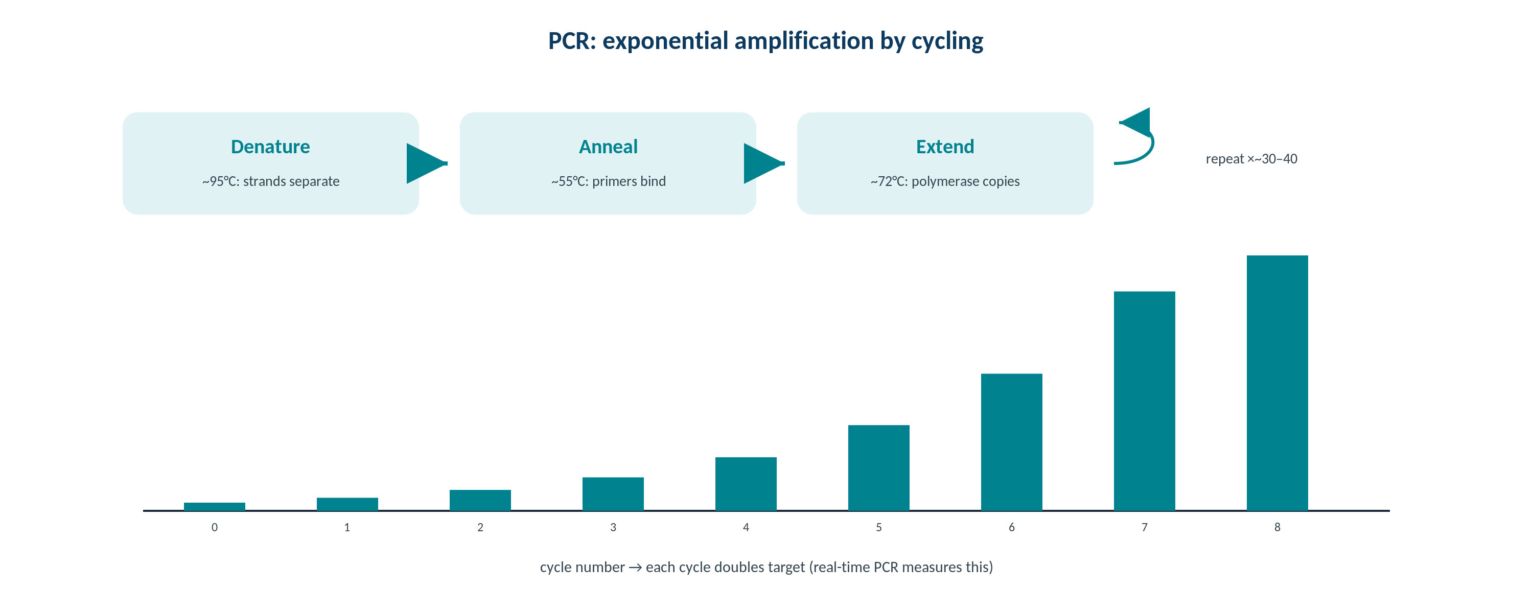
MOLECULAR & CYTOGENETICS · PCR
The Polymerase Chain Reaction
Original schematic. Denature–anneal–extend cycling amplifies a defined target exponentially.
Makassed General Hospital · Department of Laboratory Medicine
CP Lecture Series · 5

Slide 7
MOLECULAR & CYTOGENETICS · PCR
Components & Cycling
WHAT PCR NEEDS
STRENGTHS & LIMITS
Template, primers, dNTPs, thermostable polymerase, and buffer with magnesium.
Three steps per cycle: denaturation, annealing, extension.
Primer design and specificity determine performance.
Reverse transcription (RT-PCR) converts RNA to cDNA first.
Exquisitely sensitive — which makes contamination control critical.
Detects known targets, not unknown sequences.
Inhibitors (heparin, hemoglobin) can cause false negatives.
Use controls to detect inhibition and contamination.
Makassed General Hospital · Department of Laboratory Medicine
CP Lecture Series · 6

Slide 8
MOLECULAR & CYTOGENETICS · QUANTITATION
Real-Time and Digital PCR
REAL-TIME (QPCR)
DIGITAL PCR
Fluorescence is measured each cycle; the cycle threshold (Ct) reflects starting target amount.
Lower Ct → more starting template.
Enables relative or absolute quantitation against standards.
Melt-curve analysis checks amplicon specificity.
Partitions the sample into thousands of reactions for absolute quantitation without a standard curve.
Excellent for low-level targets and small fold-changes.
Useful for minimal residual disease and rare variants.
More tolerant of some inhibitors.
Makassed General Hospital · Department of Laboratory Medicine
CP Lecture Series · 7

Slide 9
02
PART TWO
Sequencing & Hybridization

Slide 10
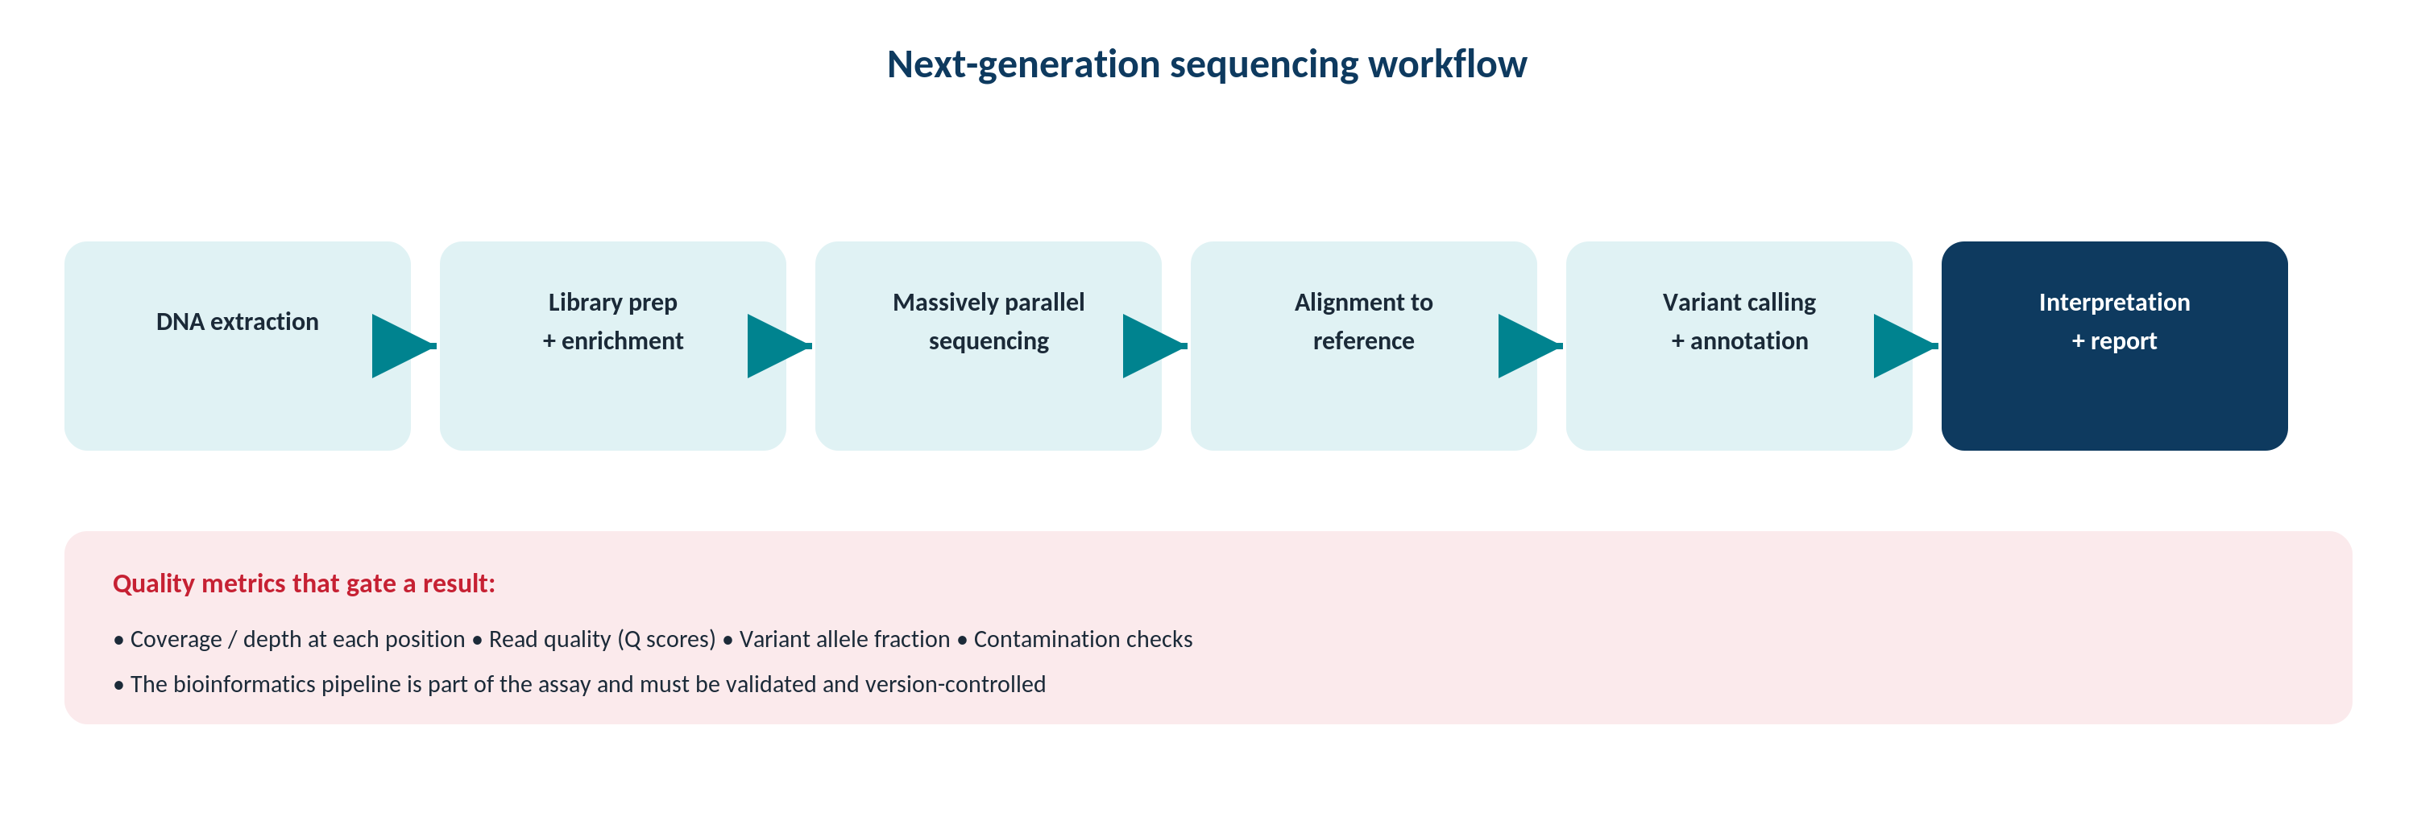
MOLECULAR & CYTOGENETICS · SEQUENCING
Sanger vs Next-Generation Sequencing
Original schematic. Sanger reads one amplicon at high confidence; NGS reads millions of fragments in parallel.
Makassed General Hospital · Department of Laboratory Medicine
CP Lecture Series · 8

Slide 11
MOLECULAR & CYTOGENETICS · SEQUENCING
Choosing a Sequencing Approach
SANGER SEQUENCING
NEXT-GENERATION SEQUENCING
Gold standard for single amplicons; ~15–20% limit of detection for variants.
Simple, fast for one target.
Often used to confirm NGS findings.
Not suited to many targets or low-level variants.
Massively parallel; panels, exomes, or genomes; detects low variant allele fractions.
Depth of coverage governs sensitivity.
Generates large bioinformatic output (alignment, variant calling).
Ideal for multi-gene panels and discovery.
Makassed General Hospital · Department of Laboratory Medicine
CP Lecture Series · 9

Slide 12
MOLECULAR & CYTOGENETICS · HYBRIDIZATION
FISH & Microarrays
FISH
MICROARRAYS
Fluorescent probes detect specific fusions, deletions, or amplifications in situ.
Works on interphase or metaphase cells.
Targeted — you must know what to look for.
Rapid for known rearrangements (e.g., fusions).
Genome-wide copy-number and (with SNPs) loss of heterozygosity.
Detects microdeletions/duplications beyond karyotype resolution.
Cannot detect balanced rearrangements.
Complements sequencing and FISH.
Makassed General Hospital · Department of Laboratory Medicine
CP Lecture Series · 10

Slide 13
03
PART THREE
Pitfalls, Cases & Board

Slide 14
MOLECULAR & CYTOGENETICS · PITFALLS
Contamination & Pre-Analytics
CONTAMINATION CONTROL
PRE-ANALYTIC INTEGRITY
Amplicon carryover and cross-contamination cause false positives — separate pre/post-PCR areas.
Use unidirectional workflow and controls.
No-template controls detect contamination.
dUTP/UNG systems reduce carryover.
Nucleic acid quality depends on specimen type, fixation, and storage.
FFPE degrades and chemically damages DNA.
Heparin inhibits PCR; use appropriate tubes.
RNA is labile — handle and store carefully.
Makassed General Hospital · Department of Laboratory Medicine
CP Lecture Series · 11

Slide 15
MOLECULAR & CYTOGENETICS · CASE 1
Case 1
CLINICAL VIGNETTE
A qualitative PCR for a viral target is negative, but clinical suspicion is high and the internal control failed to amplify.
?
How do you interpret this result?
Makassed General Hospital · Department of Laboratory Medicine
CP Lecture Series · 12

Slide 16
MOLECULAR & CYTOGENETICS · CASE 1 · RESOLUTION
Case 1: PCR Inhibition
A failed internal control indicates inhibition — the negative result is uninterpretable, not truly negative.
Inhibitors (heparin, hemoglobin) or poor extraction may be responsible.
Repeat after dilution or re-extraction.
Never report a 'negative' when controls fail.
TEACHING POINT
Always check amplification controls — a negative target with a failed control means inhibition, not absence of the target.
Makassed General Hospital · Department of Laboratory Medicine
CP Lecture Series · 13

Slide 17
MOLECULAR & CYTOGENETICS · CASE 2
Case 2
CLINICAL VIGNETTE
A low-level variant suspected at ~5% allele fraction is not seen on Sanger sequencing.
?
Why, and what method would detect it?
Makassed General Hospital · Department of Laboratory Medicine
CP Lecture Series · 14

Slide 18
MOLECULAR & CYTOGENETICS · CASE 2 · RESOLUTION
Case 2: Limit of Detection
Sanger’s detection limit (~15–20%) is above a 5% variant, so it can miss low-level variants.
NGS with adequate depth or digital PCR detects low allele fractions.
Choose the method by the expected variant level.
Confirm critical low-level calls appropriately.
TEACHING POINT
Match method sensitivity to the question — Sanger misses low-fraction variants that NGS or digital PCR can detect.
Makassed General Hospital · Department of Laboratory Medicine
CP Lecture Series · 15

Slide 19
MOLECULAR & CYTOGENETICS · CASE 3
Case 3
CLINICAL VIGNETTE
A run shows amplification in the no-template control.
?
What does this indicate and what must be done?
Makassed General Hospital · Department of Laboratory Medicine
CP Lecture Series · 16

Slide 20
MOLECULAR & CYTOGENETICS · CASE 3 · RESOLUTION
Case 3: Contaminated Run
Amplification in the no-template control indicates contamination — results from that run are invalid.
Investigate and remediate (workflow separation, reagents, surfaces).
Repeat testing after decontamination.
Document the corrective action.
TEACHING POINT
A positive no-template control invalidates the run; molecular labs depend on rigorous contamination control and unidirectional workflow.
Makassed General Hospital · Department of Laboratory Medicine
CP Lecture Series · 17

Slide 21
MOLECULAR & CYTOGENETICS · BOARD REVIEW · Q1
Board-Style Review
In qPCR, a lower cycle threshold (Ct) indicates:
A. Less starting template
B. More starting template
C. Contamination
D. Inhibition
E. A failed run
Makassed General Hospital · Department of Laboratory Medicine
CP Lecture Series · 18

Slide 22
MOLECULAR & CYTOGENETICS · BOARD REVIEW · Q1
Board-Style Review
In qPCR, a lower cycle threshold (Ct) indicates:
A. Less starting template
B. More starting template
C. Contamination
D. Inhibition
E. A failed run
ANSWER B — More starting template
Ct is inversely related to the amount of starting target; lower Ct means more template.
Makassed General Hospital · Department of Laboratory Medicine
CP Lecture Series · 18

Slide 23
MOLECULAR & CYTOGENETICS · BOARD REVIEW · Q2
Board-Style Review
Which method provides absolute quantitation without a standard curve?
A. Conventional PCR
B. Sanger sequencing
C. Digital PCR
D. FISH
E. Microarray
Makassed General Hospital · Department of Laboratory Medicine
CP Lecture Series · 19

Slide 24
MOLECULAR & CYTOGENETICS · BOARD REVIEW · Q2
Board-Style Review
Which method provides absolute quantitation without a standard curve?
A. Conventional PCR
B. Sanger sequencing
C. Digital PCR
D. FISH
E. Microarray
ANSWER C — Digital PCR
Digital PCR partitions the reaction to count targets directly, giving absolute quantitation without a standard curve.
Makassed General Hospital · Department of Laboratory Medicine
CP Lecture Series · 19

Slide 25
MOLECULAR & CYTOGENETICS · BOARD REVIEW · Q3
Board-Style Review
A balanced (reciprocal) translocation is NOT detectable by:
A. Karyotype
B. FISH (break-apart probe)
C. Chromosomal microarray
D. RT-PCR for the fusion
E. Metaphase analysis
Makassed General Hospital · Department of Laboratory Medicine
CP Lecture Series · 20

Slide 26
MOLECULAR & CYTOGENETICS · BOARD REVIEW · Q3
Board-Style Review
A balanced (reciprocal) translocation is NOT detectable by:
A. Karyotype
B. FISH (break-apart probe)
C. Chromosomal microarray
D. RT-PCR for the fusion
E. Metaphase analysis
ANSWER C — Chromosomal microarray
Arrays detect copy-number change; a balanced translocation has no net copy-number change and is missed.
Makassed General Hospital · Department of Laboratory Medicine
CP Lecture Series · 20

Slide 27
MOLECULAR & CYTOGENETICS · BOARD REVIEW · Q4
Board-Style Review
The main reason to separate pre- and post-PCR work areas is to:
A. Improve sensitivity
B. Prevent amplicon carryover contamination
C. Speed up cycling
D. Reduce reagent cost
E. Increase Ct
Makassed General Hospital · Department of Laboratory Medicine
CP Lecture Series · 21

Slide 28
MOLECULAR & CYTOGENETICS · BOARD REVIEW · Q4
Board-Style Review
The main reason to separate pre- and post-PCR work areas is to:
A. Improve sensitivity
B. Prevent amplicon carryover contamination
C. Speed up cycling
D. Reduce reagent cost
E. Increase Ct
ANSWER B — Prevent amplicon carryover
Post-PCR amplicons are a major contamination source; unidirectional workflow prevents false positives.
Makassed General Hospital · Department of Laboratory Medicine
CP Lecture Series · 21

Slide 29
MOLECULAR & CYTOGENETICS
Key Take-Home Points
PCR amplifies a known target exponentially — highly sensitive, so contamination control is essential.
1
qPCR quantifies via Ct (lower Ct = more template); digital PCR gives absolute counts and detects rare targets.
2
Sanger is the single-amplicon gold standard (~15–20% LoD); NGS reads millions of fragments and detects low allele fractions.
3
FISH targets known rearrangements; microarrays give genome-wide copy number but miss balanced rearrangements.
4
Always interpret controls: failed internal control = inhibition; positive no-template control = contamination.
5
Makassed General Hospital · Department of Laboratory Medicine
22

Slide 30
MOLECULAR & CYTOGENETICS · REFERENCES & FURTHER READING
References
1. Buckingham L. Molecular Diagnostics, 3rd ed. F.A. Davis.
2. Coleman WB, Tsongalis GJ. Molecular Diagnostics for the Clinical Laboratorian.
3. CLSI MM01/MM09 (molecular methods).
4. Leonard DGB. Molecular Pathology in Clinical Practice, 2nd ed.
Makassed General Hospital · Department of Laboratory Medicine
CP Lecture Series · 23

