Slide 1
CLINICAL PATHOLOGY RESIDENCY LECTURE SERIES
MOLECULAR & CYTOGENETICS · LECTURE 3 OF 5
Molecular Testing in Hematologic Malignancy
Fusions, Mutations, Cytogenetics, and Minimal Residual Disease
Dr. Tamima El-Jisr
Chairperson, Department of Laboratory Medicine
Makassed General Hospital, Beirut
Clinical Pathology Residency Curriculum

Slide 2
MOLECULAR & CYTOGENETICS · FRAMING THE PROBLEM
Why This Matters
BCR-ABL1
Karyotype
MRD
Defines CML and is monitored quantitatively
Cytogenetics still anchors risk stratification
Deep monitoring detects relapse early
Hematologic malignancies are where molecular and cytogenetic testing most directly drive diagnosis, prognosis, therapy, and monitoring — from defining fusions to quantitative minimal residual disease.
In heme malignancy, the lab does it all: diagnosis (fusion/mutation), risk (cytogenetics), therapy target, and MRD monitoring.
Makassed General Hospital · Department of Laboratory Medicine
CP Lecture Series · 2

Slide 3
MOLECULAR & CYTOGENETICS · ·
Learning Objectives
Describe diagnostic fusion genes and their detection.
Apply cytogenetics and FISH for risk stratification.
1
2
Interpret key mutations in myeloid and lymphoid neoplasms.
Explain quantitative monitoring (e.g., BCR-ABL1 IS) and MRD.
3
4
Integrate molecular results with morphology and flow cytometry.
Recognize results that change management.
5
6
Makassed General Hospital · Department of Laboratory Medicine
CP Lecture Series · 3

Slide 4
MOLECULAR & CYTOGENETICS · WHAT WE WILL COVER
Roadmap
Fusions — diagnostic translocations
1
Cytogenetics & FISH — risk stratification
2
Mutations & MRD — prognosis and monitoring
3
Integration — with morphology/flow
4
Cases & board review
5
Makassed General Hospital · Department of Laboratory Medicine
CP Lecture Series · 4

Slide 5
01
PART ONE
Fusions & Cytogenetics

Slide 6
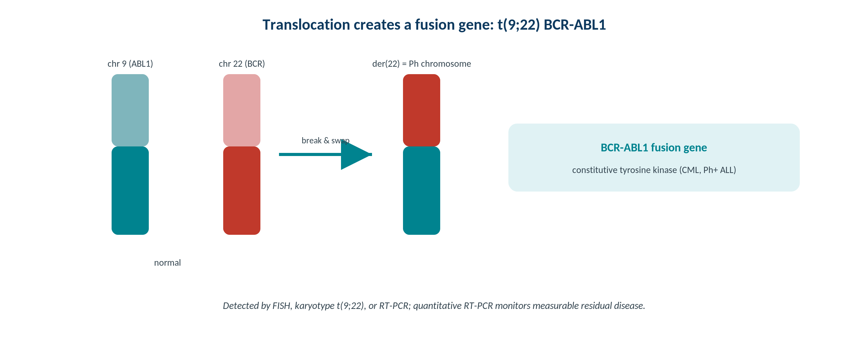
MOLECULAR & CYTOGENETICS · FUSIONS
Fusion Genes Drive Diagnosis
Original schematic. A translocation juxtaposes two genes into a driver fusion (e.g., BCR-ABL1) detectable by FISH or RT-PCR.
Makassed General Hospital · Department of Laboratory Medicine
CP Lecture Series · 5

Slide 7
MOLECULAR & CYTOGENETICS · FUSIONS
Detecting Driver Fusions
KEY EXAMPLES
METHOD CHOICE
BCR-ABL1 (CML; Ph+ ALL); PML-RARA (APL — a medical emergency).
Many recurrent fusions define entities and therapy.
RT-PCR, FISH, and karyotype each have roles.
Some fusions are targets for specific inhibitors.
FISH and RT-PCR rapidly detect known fusions; karyotype gives a genome-wide view.
RT-PCR enables quantitative monitoring.
NGS fusion panels detect many partners.
Correlate with morphology and flow.
Makassed General Hospital · Department of Laboratory Medicine
CP Lecture Series · 6

Slide 8
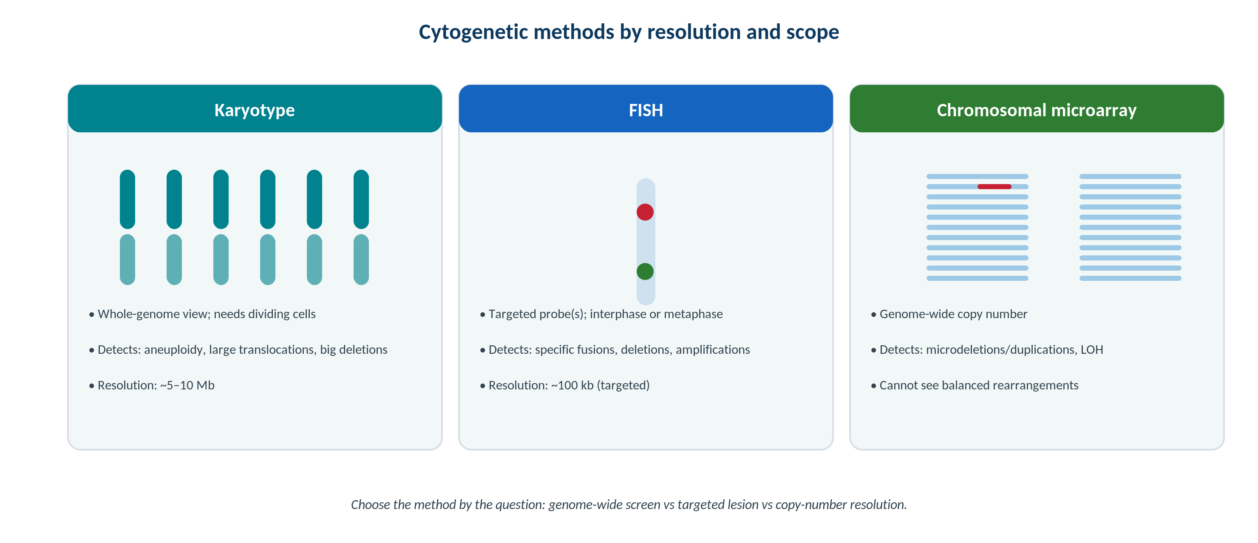
MOLECULAR & CYTOGENETICS · CYTOGENETICS
Cytogenetic Methods and Resolution
Original schematic. Karyotype, FISH, and microarray differ in scope and resolution — chosen by the clinical question.
Makassed General Hospital · Department of Laboratory Medicine
CP Lecture Series · 7

Slide 9
MOLECULAR & CYTOGENETICS · RISK
Cytogenetic Risk Stratification
PROGNOSTIC CYTOGENETICS
FISH ADDS PRECISION
Karyotype/FISH define favorable, intermediate, and adverse risk in AML and other neoplasms.
Specific abnormalities guide therapy intensity and transplant decisions.
Complex karyotype generally indicates adverse risk.
Cytogenetics remains foundational despite molecular advances.
FISH detects specific lesions when karyotype fails or is normal.
Useful for cryptic rearrangements and deletions.
Interphase FISH works without dividing cells.
Combine with molecular panels.
Makassed General Hospital · Department of Laboratory Medicine
CP Lecture Series · 8

Slide 10
02
PART TWO
Mutations, MRD & Integration

Slide 11
MOLECULAR & CYTOGENETICS · MUTATIONS
High-Yield Mutations
MYELOID
LYMPHOID & MONITORING
FLT3, NPM1, IDH1/2, CEBPA inform AML prognosis and therapy.
JAK2 V617F in myeloproliferative neoplasms.
Mutation panels increasingly standard at diagnosis.
Some are direct drug targets.
Clonality (IGH/TCR rearrangement) supports lymphoproliferative diagnosis.
MRD by quantitative PCR, flow, or NGS detects low-level disease.
Rising markers can precede morphologic relapse.
Serial monitoring guides therapy.
Makassed General Hospital · Department of Laboratory Medicine
CP Lecture Series · 9

Slide 12
MOLECULAR & CYTOGENETICS · MONITORING
Quantitative Monitoring & MRD
BCR-ABL1 MONITORING
MRD PRINCIPLES
Quantitative RT-PCR on the International Scale tracks CML response to therapy.
Defined molecular-response milestones guide management.
Rising transcripts prompt resistance evaluation.
Standardization enables comparison across labs.
MRD detects residual disease below morphologic resolution.
Sensitivity depends on the method and marker.
Results must be reported with the limit of detection.
Integrate with clinical and other lab data.
Makassed General Hospital · Department of Laboratory Medicine
CP Lecture Series · 10

Slide 13
MOLECULAR & CYTOGENETICS · INTEGRATION
Putting It Together
MULTIMODAL DIAGNOSIS
ACTIONABLE RESULTS
Morphology + flow cytometry + cytogenetics + molecular together define the diagnosis (WHO/ICC).
No single modality is sufficient.
Discordances prompt review.
Communicate an integrated interpretation.
Recognize emergencies (e.g., PML-RARA in APL) requiring immediate action.
Flag targetable lesions for therapy.
Provide risk classification for management.
Ensure timely critical communication.
Makassed General Hospital · Department of Laboratory Medicine
CP Lecture Series · 11

Slide 14
03
PART THREE
Cases & Board Review

Slide 15
MOLECULAR & CYTOGENETICS · CASE 1
Case 1
CLINICAL VIGNETTE
A patient with leukocytosis and basophilia has a Philadelphia chromosome; RT-PCR confirms BCR-ABL1.
?
What is the diagnosis and how is the lab used going forward?
Makassed General Hospital · Department of Laboratory Medicine
CP Lecture Series · 12

Slide 16
MOLECULAR & CYTOGENETICS · CASE 1 · RESOLUTION
Case 1: CML and Monitoring
BCR-ABL1 with a compatible picture establishes CML.
Quantitative BCR-ABL1 (International Scale) monitors response to tyrosine-kinase inhibitors.
Failure to reach milestones or rising transcripts prompts resistance/mutation testing.
The lab supports diagnosis, monitoring, and resistance evaluation.
TEACHING POINT
In CML the laboratory both diagnoses (BCR-ABL1) and monitors response quantitatively on the International Scale.
Makassed General Hospital · Department of Laboratory Medicine
CP Lecture Series · 13

Slide 17
MOLECULAR & CYTOGENETICS · CASE 2
Case 2
CLINICAL VIGNETTE
A patient with promyelocytic morphology and coagulopathy has suspected APL.
?
Why is rapid molecular/cytogenetic testing urgent here?
Makassed General Hospital · Department of Laboratory Medicine
CP Lecture Series · 14

Slide 18
MOLECULAR & CYTOGENETICS · CASE 2 · RESOLUTION
Case 2: APL Emergency
PML-RARA (t(15;17)) defines APL, a medical emergency due to life-threatening coagulopathy.
Rapid FISH/RT-PCR confirmation supports urgent targeted therapy.
Early treatment dramatically improves outcomes.
Coordinate immediate communication with the clinical team.
TEACHING POINT
Suspected APL demands urgent confirmation of PML-RARA — the laboratory’s speed directly affects survival.
Makassed General Hospital · Department of Laboratory Medicine
CP Lecture Series · 15

Slide 19
MOLECULAR & CYTOGENETICS · CASE 3
Case 3
CLINICAL VIGNETTE
After AML therapy, an NPM1-based MRD assay shows rising transcript levels while morphology still looks in remission.
?
What does the rising MRD indicate?
Makassed General Hospital · Department of Laboratory Medicine
CP Lecture Series · 16

Slide 20
MOLECULAR & CYTOGENETICS · CASE 3 · RESOLUTION
Case 3: Molecular Relapse
Rising MRD can precede morphologic relapse, signaling impending recurrence.
It allows earlier intervention.
Report with the assay’s limit of detection and trend.
Integrate with clinical assessment.
TEACHING POINT
MRD detects disease below morphologic resolution — a rising molecular marker can flag relapse before the marrow looks abnormal.
Makassed General Hospital · Department of Laboratory Medicine
CP Lecture Series · 17

Slide 21
MOLECULAR & CYTOGENETICS · BOARD REVIEW · Q1
Board-Style Review
BCR-ABL1 quantitative monitoring in CML is reported on the:
A. Local arbitrary scale
B. International Scale (IS)
C. Ct only
D. Karyotype score
E. VAF percentage
Makassed General Hospital · Department of Laboratory Medicine
CP Lecture Series · 18

Slide 22
MOLECULAR & CYTOGENETICS · BOARD REVIEW · Q1
Board-Style Review
BCR-ABL1 quantitative monitoring in CML is reported on the:
A. Local arbitrary scale
B. International Scale (IS)
C. Ct only
D. Karyotype score
E. VAF percentage
ANSWER B — International Scale
Standardized IS reporting enables comparison of BCR-ABL1 levels across laboratories and time.
Makassed General Hospital · Department of Laboratory Medicine
CP Lecture Series · 18

Slide 23
MOLECULAR & CYTOGENETICS · BOARD REVIEW · Q2
Board-Style Review
Which finding is a hematologic emergency requiring immediate action?
A. JAK2 V617F
B. PML-RARA (APL)
C. Isolated VUS
D. IGH rearrangement
E. Normal karyotype
Makassed General Hospital · Department of Laboratory Medicine
CP Lecture Series · 19

Slide 24
MOLECULAR & CYTOGENETICS · BOARD REVIEW · Q2
Board-Style Review
Which finding is a hematologic emergency requiring immediate action?
A. JAK2 V617F
B. PML-RARA (APL)
C. Isolated VUS
D. IGH rearrangement
E. Normal karyotype
ANSWER B — PML-RARA (APL)
APL carries a high risk of fatal coagulopathy; rapid confirmation and treatment are urgent.
Makassed General Hospital · Department of Laboratory Medicine
CP Lecture Series · 19

Slide 25
MOLECULAR & CYTOGENETICS · BOARD REVIEW · Q3
Board-Style Review
A balanced translocation creating a fusion is best detected by:
A. Chromosomal microarray
B. FISH break-apart or RT-PCR
C. Total protein
D. Karyotype only when cryptic
E. Flow cytometry
Makassed General Hospital · Department of Laboratory Medicine
CP Lecture Series · 20

Slide 26
MOLECULAR & CYTOGENETICS · BOARD REVIEW · Q3
Board-Style Review
A balanced translocation creating a fusion is best detected by:
A. Chromosomal microarray
B. FISH break-apart or RT-PCR
C. Total protein
D. Karyotype only when cryptic
E. Flow cytometry
ANSWER B — FISH/RT-PCR
Balanced fusions have no copy-number change (missed by arrays); FISH or RT-PCR detect them directly.
Makassed General Hospital · Department of Laboratory Medicine
CP Lecture Series · 20

Slide 27
MOLECULAR & CYTOGENETICS · BOARD REVIEW · Q4
Board-Style Review
The primary value of minimal residual disease (MRD) testing is to:
A. Replace morphology
B. Detect disease below morphologic resolution and predict relapse
C. Diagnose at presentation only
D. Eliminate cytogenetics
E. Measure tumor purity
Makassed General Hospital · Department of Laboratory Medicine
CP Lecture Series · 21

Slide 28
MOLECULAR & CYTOGENETICS · BOARD REVIEW · Q4
Board-Style Review
The primary value of minimal residual disease (MRD) testing is to:
A. Replace morphology
B. Detect disease below morphologic resolution and predict relapse
C. Diagnose at presentation only
D. Eliminate cytogenetics
E. Measure tumor purity
ANSWER B — Detect sub-morphologic disease/relapse
MRD quantifies residual disease beneath morphologic detection and can flag relapse earlier.
Makassed General Hospital · Department of Laboratory Medicine
CP Lecture Series · 21

Slide 29
MOLECULAR & CYTOGENETICS
Key Take-Home Points
Driver fusions (BCR-ABL1, PML-RARA) define entities and are detected by FISH/RT-PCR; some are therapeutic targets.
1
Cytogenetics/FISH remain foundational for risk stratification (favorable/intermediate/adverse).
2
Key mutations (FLT3, NPM1, IDH1/2, JAK2) inform prognosis and therapy; clonality testing supports lymphoid diagnosis.
3
Quantitative BCR-ABL1 (IS) and MRD assays monitor response and detect early relapse — report with limit of detection.
4
Diagnosis is integrated: morphology + flow + cytogenetics + molecular; recognize emergencies like APL.
5
Makassed General Hospital · Department of Laboratory Medicine
22

Slide 30
MOLECULAR & CYTOGENETICS · REFERENCES & FURTHER READING
References
1. WHO Classification of Haematolymphoid Tumours (current ed.).
2. Arber DA, et al. International Consensus Classification. Blood. 2022.
3. Cross NCP, et al. BCR-ABL1 International Scale. Leukemia.
4. Leonard DGB. Molecular Pathology in Clinical Practice, 2nd ed.
Makassed General Hospital · Department of Laboratory Medicine
CP Lecture Series · 23

