Slide 1
CLINICAL PATHOLOGY RESIDENCY LECTURE SERIES
MOLECULAR & CYTOGENETICS · LECTURE 4 OF 5
Solid Tumor & Germline Testing
Companion Diagnostics, Tumor Profiling, and Hereditary Risk
Dr. Tamima El-Jisr
Chairperson, Department of Laboratory Medicine
Makassed General Hospital, Beirut
Clinical Pathology Residency Curriculum

Slide 2
MOLECULAR & CYTOGENETICS · FRAMING THE PROBLEM
Why This Matters
Targeted
Somatic≠germline
Consent
Biomarkers match patients to targeted therapy
Tumor findings can reveal inherited risk
Germline testing carries family implications
Solid-tumor molecular testing pairs patients with targeted and immunotherapies, while germline testing addresses heritable cancer risk. The two intersect when tumor sequencing uncovers a possible inherited variant.
Somatic profiling guides therapy; germline testing guides inherited risk — and a tumor result can cross into germline territory.
Makassed General Hospital · Department of Laboratory Medicine
CP Lecture Series · 2

Slide 3
MOLECULAR & CYTOGENETICS · ·
Learning Objectives
Describe companion diagnostics and predictive biomarkers.
Interpret common solid-tumor markers (e.g., EGFR, KRAS, BRAF, ALK, MSI/TMB).
1
2
Distinguish somatic from germline findings.
Explain liquid biopsy (cfDNA) uses and limits.
3
4
State consent and counseling needs for germline testing.
Recognize incidental germline findings from tumor testing.
5
6
Makassed General Hospital · Department of Laboratory Medicine
CP Lecture Series · 3

Slide 4
MOLECULAR & CYTOGENETICS · WHAT WE WILL COVER
Roadmap
Companion diagnostics — predictive biomarkers
1
Tumor markers — targetable alterations, MSI/TMB
2
Somatic vs germline — VAF and confirmation
3
Liquid biopsy — cfDNA uses/limits
4
Cases & board review
5
Makassed General Hospital · Department of Laboratory Medicine
CP Lecture Series · 4

Slide 5
01
PART ONE
Companion Diagnostics & Tumor Markers

Slide 6
MOLECULAR & CYTOGENETICS · COMPANION DX
Matching Patients to Therapy
PREDICTIVE BIOMARKERS
EXAMPLES
Companion diagnostics identify patients likely to respond to a specific therapy.
Predictive (response) vs prognostic (outcome) markers differ.
Some markers indicate resistance (e.g., KRAS for anti-EGFR).
Testing must match the approved assay/context.
EGFR (lung) → EGFR inhibitors; ALK/ROS1 fusions → targeted agents.
BRAF V600E → BRAF/MEK inhibitors.
HER2 amplification → anti-HER2 therapy.
KRAS/NRAS mutation → anti-EGFR resistance in colorectal cancer.
Makassed General Hospital · Department of Laboratory Medicine
CP Lecture Series · 5

Slide 7
MOLECULAR & CYTOGENETICS · IMMUNOTHERAPY
MSI, MMR & Tumor Mutational Burden
MSI / MMR
TUMOR MUTATIONAL BURDEN
Microsatellite instability / mismatch-repair deficiency predicts immunotherapy response.
Also screens for Lynch syndrome — a germline link.
Detected by PCR (MSI), IHC (MMR proteins), or NGS.
Abnormal MMR may prompt germline evaluation.
High TMB can predict immunotherapy benefit in some contexts.
Assay and threshold dependent.
Interpret with tumor type and other markers.
Part of broader genomic profiling.
Makassed General Hospital · Department of Laboratory Medicine
CP Lecture Series · 6

Slide 8
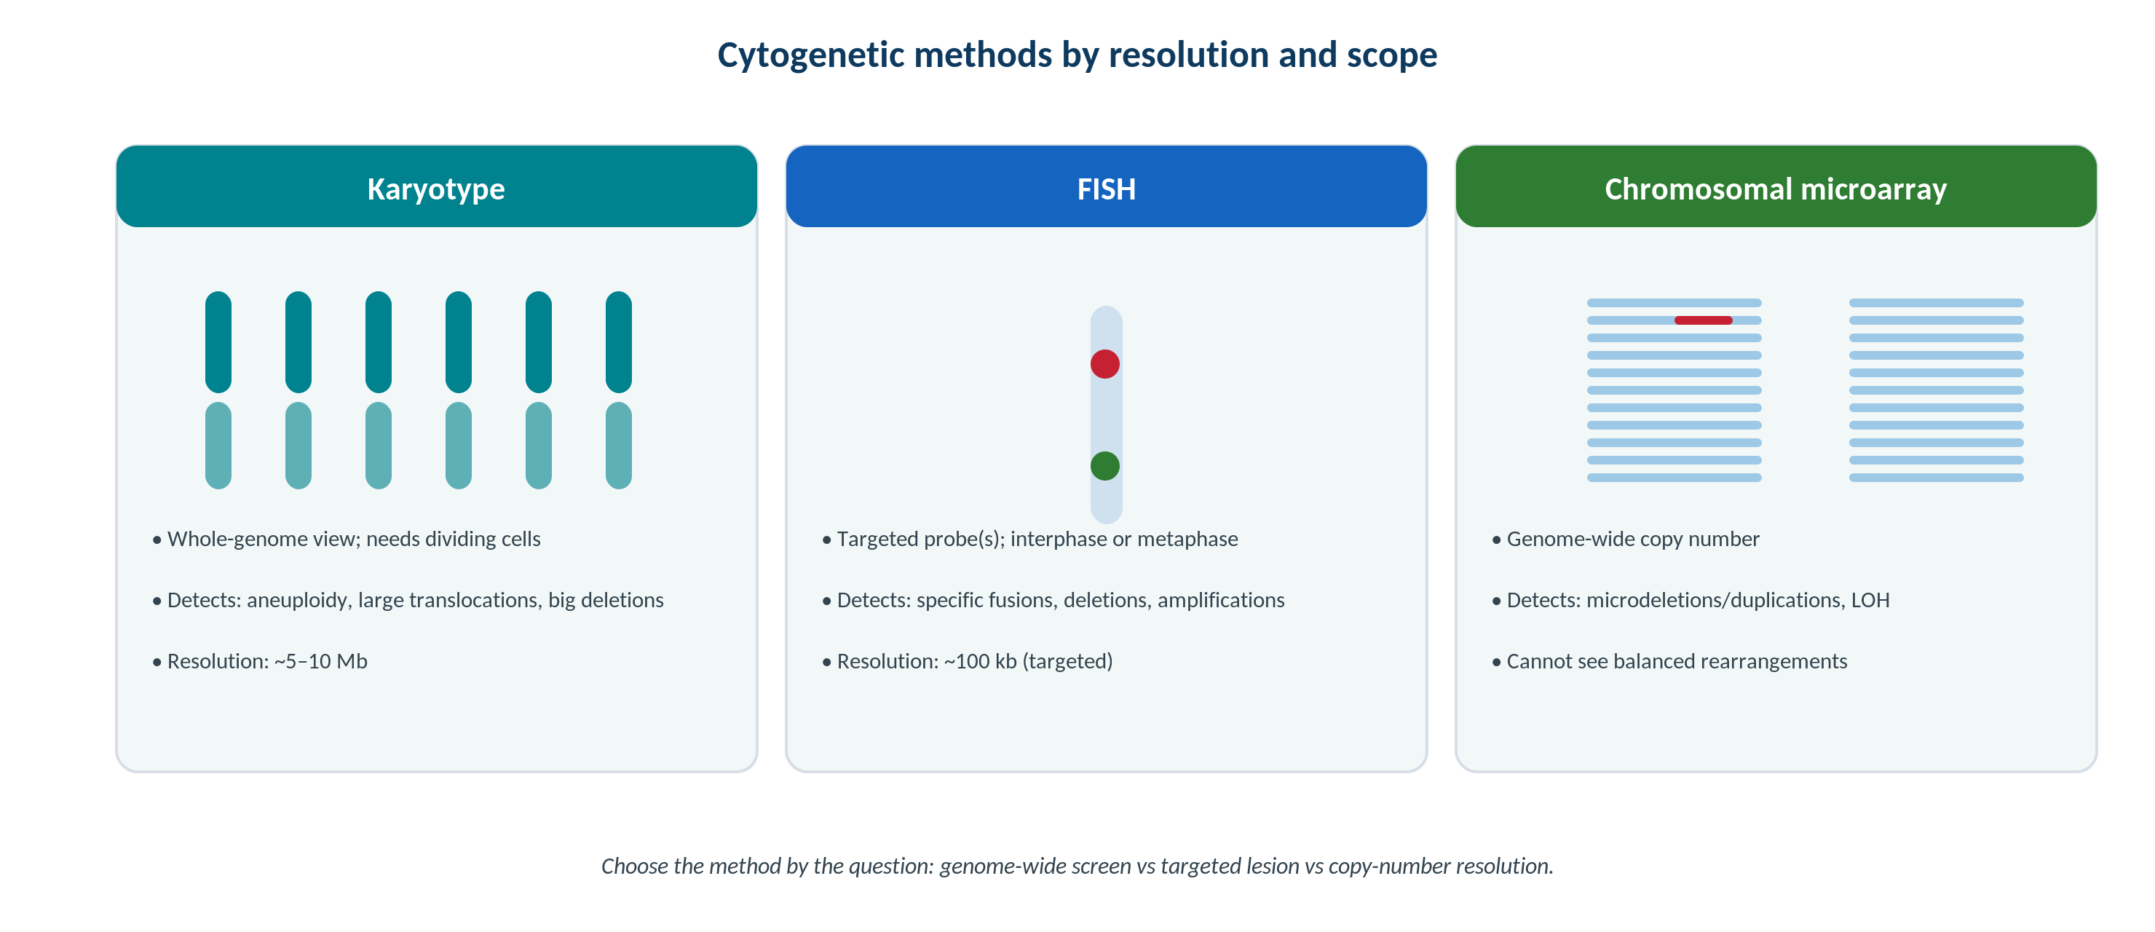
MOLECULAR & CYTOGENETICS · CYTOGENETICS
Copy Number and Structural Methods
Original schematic. Microarray (copy number/LOH) and FISH (amplification/fusion) complement sequencing in solid tumors.
Makassed General Hospital · Department of Laboratory Medicine
CP Lecture Series · 7

Slide 9
02
PART TWO
Somatic vs Germline & Liquid Biopsy

Slide 10
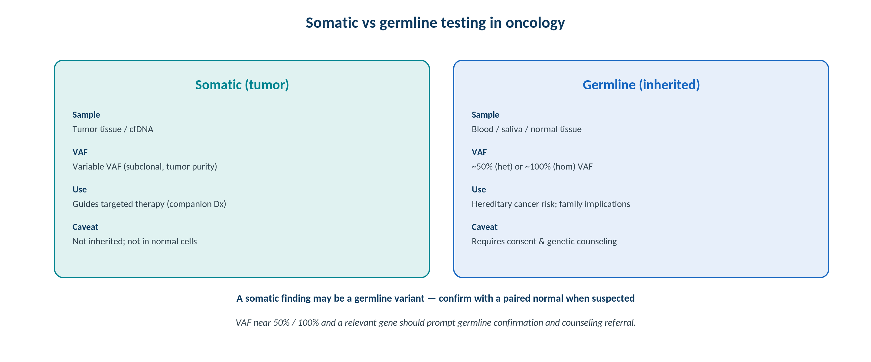
MOLECULAR & CYTOGENETICS · SOMATIC vs GERMLINE
Distinguishing Somatic from Germline
Original schematic. Sample type, VAF, and clinical use differ; a ~50% VAF in a relevant gene should prompt germline confirmation.
Makassed General Hospital · Department of Laboratory Medicine
CP Lecture Series · 8

Slide 11
MOLECULAR & CYTOGENETICS · GERMLINE
Hereditary Risk & Consent
WHEN GERMLINE MATTERS
INCIDENTAL GERMLINE
Hereditary syndromes (e.g., BRCA1/2, Lynch) carry risk for the patient and relatives.
Germline results inform screening and prevention.
Require informed consent and genetic counseling.
Distinct reporting from somatic findings.
Tumor-only testing can incidentally suggest a germline variant (high VAF in a predisposition gene).
Confirm in normal tissue before attributing inheritance.
Refer for counseling.
Have a policy for secondary findings.
Makassed General Hospital · Department of Laboratory Medicine
CP Lecture Series · 9

Slide 12
MOLECULAR & CYTOGENETICS · LIQUID BIOPSY
Circulating Tumor DNA
USES
LIMITS
cfDNA can detect actionable mutations when tissue is insufficient.
Useful for monitoring response and resistance.
Minimally invasive, repeatable.
Detects some resistance mutations early.
Lower sensitivity than tissue — a negative result does not exclude a mutation.
Clonal hematopoiesis can confound interpretation.
Low tumor shedding reduces yield.
Confirm key results when feasible.
Makassed General Hospital · Department of Laboratory Medicine
CP Lecture Series · 10

Slide 13
03
PART THREE
Cases & Board Review

Slide 14
MOLECULAR & CYTOGENETICS · CASE 1
Case 1
CLINICAL VIGNETTE
A metastatic colorectal cancer is KRAS-mutated.
?
What does this predict about anti-EGFR therapy?
Makassed General Hospital · Department of Laboratory Medicine
CP Lecture Series · 11

Slide 15
MOLECULAR & CYTOGENETICS · CASE 1 · RESOLUTION
Case 1: KRAS and Anti-EGFR Resistance
KRAS (or NRAS) mutation predicts resistance to anti-EGFR antibody therapy in colorectal cancer.
It is a negative predictive biomarker.
Testing prevents ineffective, costly treatment.
Guides alternative therapy choices.
TEACHING POINT
Predictive biomarkers can indicate resistance: KRAS/NRAS mutation tells you anti-EGFR therapy will not work.
Makassed General Hospital · Department of Laboratory Medicine
CP Lecture Series · 12

Slide 16
MOLECULAR & CYTOGENETICS · CASE 2
Case 2
CLINICAL VIGNETTE
Tumor profiling in a young patient shows MMR deficiency; MSI-high is confirmed.
?
What two implications follow?
Makassed General Hospital · Department of Laboratory Medicine
CP Lecture Series · 13

Slide 17
MOLECULAR & CYTOGENETICS · CASE 2 · RESOLUTION
Case 2: MSI-High / MMR Deficiency
MSI-high/MMR-deficient tumors may respond to immunotherapy and may signal Lynch syndrome.
This links a somatic finding to possible germline risk.
Refer for germline evaluation and counseling.
Both therapeutic and hereditary implications apply.
TEACHING POINT
MSI-high/MMR-deficient results carry dual meaning — immunotherapy responsiveness and a prompt to evaluate for Lynch syndrome.
Makassed General Hospital · Department of Laboratory Medicine
CP Lecture Series · 14

Slide 18
MOLECULAR & CYTOGENETICS · CASE 3
Case 3
CLINICAL VIGNETTE
A cfDNA (liquid biopsy) panel is negative in a patient with a small-volume tumor, but suspicion of a targetable mutation remains.
?
How should the negative result be interpreted?
Makassed General Hospital · Department of Laboratory Medicine
CP Lecture Series · 15

Slide 19
MOLECULAR & CYTOGENETICS · CASE 3 · RESOLUTION
Case 3: Negative Liquid Biopsy
A negative cfDNA result does not exclude a mutation — low tumor shedding reduces sensitivity.
Tissue testing may be needed for confirmation.
Consider tumor burden and shedding.
Correlate with the clinical picture.
TEACHING POINT
Liquid biopsy is specific but less sensitive — a negative cfDNA result should be confirmed on tissue when suspicion is high.
Makassed General Hospital · Department of Laboratory Medicine
CP Lecture Series · 16

Slide 20
MOLECULAR & CYTOGENETICS · BOARD REVIEW · Q1
Board-Style Review
A KRAS mutation in colorectal cancer is a:
A. Positive predictive marker for anti-EGFR therapy
B. Negative predictive marker (resistance) for anti-EGFR therapy
C. Germline-only finding
D. Marker of MSI
E. Prognostic marker only
Makassed General Hospital · Department of Laboratory Medicine
CP Lecture Series · 17

Slide 21
MOLECULAR & CYTOGENETICS · BOARD REVIEW · Q1
Board-Style Review
A KRAS mutation in colorectal cancer is a:
A. Positive predictive marker for anti-EGFR therapy
B. Negative predictive marker (resistance) for anti-EGFR therapy
C. Germline-only finding
D. Marker of MSI
E. Prognostic marker only
ANSWER B — Resistance to anti-EGFR
KRAS/NRAS mutations predict lack of response to anti-EGFR antibodies in colorectal cancer.
Makassed General Hospital · Department of Laboratory Medicine
CP Lecture Series · 17

Slide 22
MOLECULAR & CYTOGENETICS · BOARD REVIEW · Q2
Board-Style Review
MSI-high status in a tumor may indicate both immunotherapy responsiveness and:
A. Resistance to all therapy
B. Possible Lynch syndrome (germline)
C. A benign tumor
D. Low TMB
E. A balanced translocation
Makassed General Hospital · Department of Laboratory Medicine
CP Lecture Series · 18

Slide 23
MOLECULAR & CYTOGENETICS · BOARD REVIEW · Q2
Board-Style Review
MSI-high status in a tumor may indicate both immunotherapy responsiveness and:
A. Resistance to all therapy
B. Possible Lynch syndrome (germline)
C. A benign tumor
D. Low TMB
E. A balanced translocation
ANSWER B — Possible Lynch syndrome
MMR deficiency/MSI-high can reflect germline Lynch syndrome and predicts response to immune checkpoint inhibitors.
Makassed General Hospital · Department of Laboratory Medicine
CP Lecture Series · 18

Slide 24
MOLECULAR & CYTOGENETICS · BOARD REVIEW · Q3
Board-Style Review
A tumor variant at ~50% VAF in BRCA1 should prompt:
A. Reporting as somatic only
B. Germline confirmation with consent and counseling
C. No action
D. Immediate diagnosis of hereditary cancer
E. Repeat tumor testing only
Makassed General Hospital · Department of Laboratory Medicine
CP Lecture Series · 19

Slide 25
MOLECULAR & CYTOGENETICS · BOARD REVIEW · Q3
Board-Style Review
A tumor variant at ~50% VAF in BRCA1 should prompt:
A. Reporting as somatic only
B. Germline confirmation with consent and counseling
C. No action
D. Immediate diagnosis of hereditary cancer
E. Repeat tumor testing only
ANSWER B — Germline confirmation/counseling
A ~50% VAF in a predisposition gene may be germline; confirm in normal tissue with appropriate consent and counseling.
Makassed General Hospital · Department of Laboratory Medicine
CP Lecture Series · 19

Slide 26
MOLECULAR & CYTOGENETICS · BOARD REVIEW · Q4
Board-Style Review
A key limitation of cfDNA (liquid biopsy) testing is:
A. It is more sensitive than tissue
B. A negative result does not exclude a mutation
C. It cannot detect any mutations
D. It requires surgery
E. It detects only germline variants
Makassed General Hospital · Department of Laboratory Medicine
CP Lecture Series · 20

Slide 27
MOLECULAR & CYTOGENETICS · BOARD REVIEW · Q4
Board-Style Review
A key limitation of cfDNA (liquid biopsy) testing is:
A. It is more sensitive than tissue
B. A negative result does not exclude a mutation
C. It cannot detect any mutations
D. It requires surgery
E. It detects only germline variants
ANSWER B — Negative does not exclude
Low tumor shedding limits sensitivity; negative cfDNA results may require tissue confirmation.
Makassed General Hospital · Department of Laboratory Medicine
CP Lecture Series · 20

Slide 28
MOLECULAR & CYTOGENETICS
Key Take-Home Points
Companion diagnostics match patients to targeted therapy; some markers (KRAS/NRAS) predict resistance.
1
Know high-yield solid-tumor markers (EGFR, ALK/ROS1, BRAF, HER2) and immunotherapy markers (MSI/MMR, TMB).
2
MSI-high/MMR deficiency predicts immunotherapy response and can signal Lynch syndrome (germline link).
3
Distinguish somatic from germline by sample, VAF, and context; a ~50% VAF in a predisposition gene needs germline confirmation and counseling.
4
Liquid biopsy (cfDNA) is useful but less sensitive — a negative result does not exclude a mutation.
5
Makassed General Hospital · Department of Laboratory Medicine
21

Slide 29
MOLECULAR & CYTOGENETICS · REFERENCES & FURTHER READING
References
1. Li MM, et al. AMP/ASCO/CAP somatic variant interpretation. J Mol Diagn. 2017.
2. NCCN biomarker testing guidance (by tumor type).
3. Merker JD, et al. Circulating tumor DNA (ASCO/CAP review). J Clin Oncol.
4. Leonard DGB. Molecular Pathology in Clinical Practice, 2nd ed.
Makassed General Hospital · Department of Laboratory Medicine
CP Lecture Series · 22

