Slide 1
CLINICAL PATHOLOGY RESIDENCY LECTURE SERIES
MOLECULAR & CYTOGENETICS · LECTURE 5 OF 5
Validation, QC & Bioinformatics
Bringing a Molecular Assay Online — and Keeping It Reliable
Dr. Tamima El-Jisr
Chairperson, Department of Laboratory Medicine
Makassed General Hospital, Beirut
Clinical Pathology Residency Curriculum

Slide 2
MOLECULAR & CYTOGENETICS · FRAMING THE PROBLEM
Why This Matters
Validate
Wet + dry
QC
Establish performance before clinical use
The bioinformatics pipeline is part of the test
Ongoing monitoring sustains quality
A molecular result is only as trustworthy as the validation and quality systems behind it. For NGS, that means validating both the wet-bench process and the bioinformatics pipeline, then monitoring both over time.
In NGS the pipeline is part of the assay — validate and version-control the software as rigorously as the wet bench.
Makassed General Hospital · Department of Laboratory Medicine
CP Lecture Series · 2

Slide 3
MOLECULAR & CYTOGENETICS · ·
Learning Objectives
Define analytic validation parameters for molecular assays.
Distinguish validation (LDT) from verification (FDA-cleared).
1
2
Describe NGS-specific validation (depth, LoD, regions).
Explain bioinformatics pipeline validation and version control.
3
4
Apply ongoing QC and proficiency testing.
Recognize sources of error across the workflow.
5
6
Makassed General Hospital · Department of Laboratory Medicine
CP Lecture Series · 3

Slide 4
MOLECULAR & CYTOGENETICS · WHAT WE WILL COVER
Roadmap
Validation parameters — accuracy, precision, LoD
1
Validation vs verification — LDT vs FDA-cleared
2
NGS pipeline — wet and dry bench
3
Ongoing QC & PT — sustaining quality
4
Cases & board review
5
Makassed General Hospital · Department of Laboratory Medicine
CP Lecture Series · 4

Slide 5
01
PART ONE
Validation Fundamentals

Slide 6
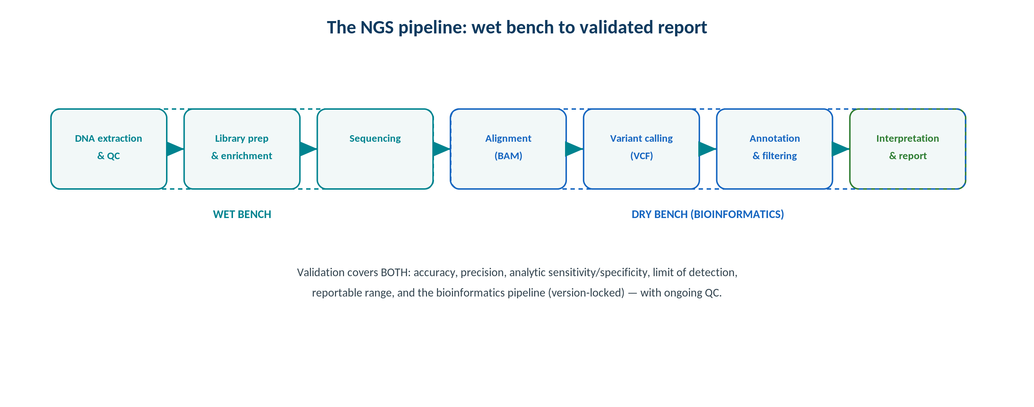
MOLECULAR & CYTOGENETICS · PIPELINE
The NGS Pipeline: Wet Bench to Report
Original schematic. Validation must cover both the wet-bench process and the (version-locked) bioinformatics pipeline.
Makassed General Hospital · Department of Laboratory Medicine
CP Lecture Series · 5

Slide 7
MOLECULAR & CYTOGENETICS · VALIDATION
Performance Characteristics
CORE PARAMETERS
VALIDATION VS VERIFICATION
Accuracy, precision (repeatability/reproducibility), analytic sensitivity and specificity.
Limit of detection (e.g., lowest variant allele fraction).
Reportable range and reference range as applicable.
Documented before clinical use.
Laboratory-developed tests require full validation; FDA-cleared assays require verification of claims.
Any modification of an FDA-cleared assay triggers validation.
Define intended use and specimen types.
Maintain validation documentation for inspection.
Makassed General Hospital · Department of Laboratory Medicine
CP Lecture Series · 6

Slide 8
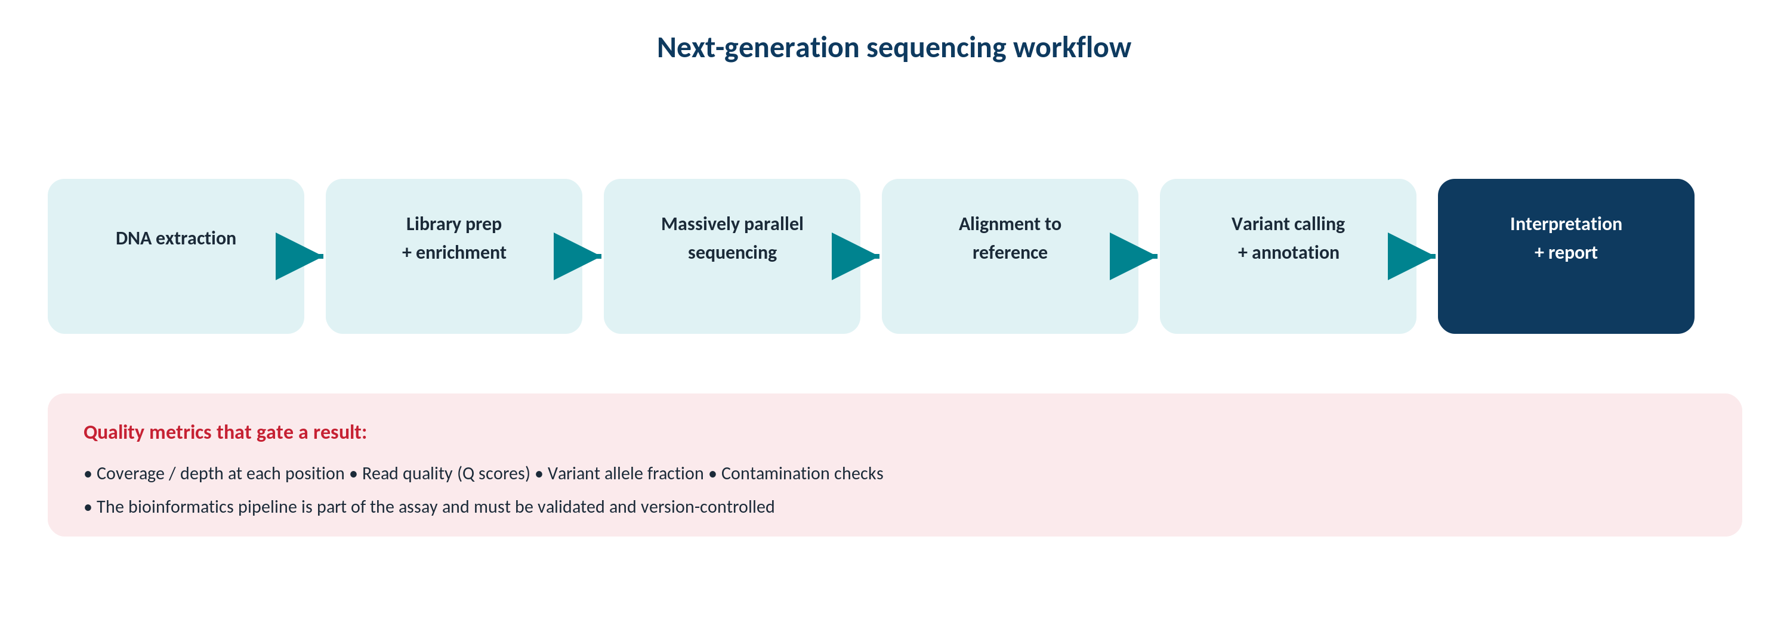
MOLECULAR & CYTOGENETICS · SEQUENCING
Sequencing Scale and Coverage
Original schematic. Depth of coverage drives variant-detection sensitivity; define minimum coverage in validation.
Makassed General Hospital · Department of Laboratory Medicine
CP Lecture Series · 7

Slide 9
02
PART TWO
NGS Validation, Bioinformatics & QC

Slide 10
MOLECULAR & CYTOGENETICS · NGS VALIDATION
What NGS Validation Must Cover
ANALYTIC SCOPE
REFERENCE MATERIALS
Define variant types detected (SNVs, indels, CNVs, fusions) and the limits for each.
Establish minimum depth and coverage uniformity.
Characterize difficult regions (homopolymers, GC-rich).
Set the limit of detection per variant type.
Use well-characterized reference samples and orthogonal confirmation.
Include known positives across the reportable range.
Assess reproducibility across runs/operators.
Document representative regions and gaps.
Makassed General Hospital · Department of Laboratory Medicine
CP Lecture Series · 8

Slide 11
MOLECULAR & CYTOGENETICS · BIOINFORMATICS
Validating the Dry Bench
PIPELINE AS PART OF THE TEST
INTERPRETATION DATABASES
Alignment, variant calling, annotation, and filtering all affect results — validate them together.
Version-control software and databases.
Revalidate after significant pipeline changes.
Lock and document the production pipeline.
Annotation/classification depend on curated, versioned databases.
Track database versions used for each report.
Reanalysis policies for reclassified variants.
Guard against silent reference changes.
Makassed General Hospital · Department of Laboratory Medicine
CP Lecture Series · 9

Slide 12
MOLECULAR & CYTOGENETICS · ONGOING QC
Sustaining Quality
RUN AND BATCH QC
PROFICIENCY TESTING
Monitor run metrics (coverage, quality scores, contamination indicators).
Controls in each run; defined acceptance criteria.
Track trends to catch drift.
Investigate and document failures.
Enroll in PT or use alternative assessment where PT is unavailable.
Compare performance against peers.
Use failures as improvement triggers.
Maintain competency and documentation.
Makassed General Hospital · Department of Laboratory Medicine
CP Lecture Series · 10

Slide 13
03
PART THREE
Cases & Board Review

Slide 14
MOLECULAR & CYTOGENETICS · CASE 1
Case 1
CLINICAL VIGNETTE
A laboratory wants to offer a new NGS panel it designed in-house.
?
What is required before clinical use, and what is special about NGS?
Makassed General Hospital · Department of Laboratory Medicine
CP Lecture Series · 11

Slide 15
MOLECULAR & CYTOGENETICS · CASE 1 · RESOLUTION
Case 1: Validating an LDT Panel
A laboratory-developed test requires full validation of all performance characteristics before clinical use.
For NGS, this includes the bioinformatics pipeline, not just the wet bench.
Define variant types, depth, and limit of detection.
Document thoroughly for accreditation.
TEACHING POINT
For an in-house NGS panel, validate both the wet-bench process and the bioinformatics pipeline — the software is part of the assay.
Makassed General Hospital · Department of Laboratory Medicine
CP Lecture Series · 12

Slide 16
MOLECULAR & CYTOGENETICS · CASE 2
Case 2
CLINICAL VIGNETTE
The team upgrades the variant-calling software to a new version.
?
What must happen before reporting clinical results with it?
Makassed General Hospital · Department of Laboratory Medicine
CP Lecture Series · 13

Slide 17
MOLECULAR & CYTOGENETICS · CASE 2 · RESOLUTION
Case 2: Pipeline Change
A significant bioinformatics change requires revalidation to confirm equivalent or better performance.
Compare against the prior validated pipeline and reference samples.
Document version control and the change.
Do not silently deploy software changes.
TEACHING POINT
Treat pipeline updates like assay changes — revalidate and document before clinical reporting.
Makassed General Hospital · Department of Laboratory Medicine
CP Lecture Series · 14

Slide 18
MOLECULAR & CYTOGENETICS · CASE 3
Case 3
CLINICAL VIGNETTE
A clinically important region of a gene falls in a low-coverage area below the validated minimum depth.
?
How should this be handled and reported?
Makassed General Hospital · Department of Laboratory Medicine
CP Lecture Series · 15

Slide 19
MOLECULAR & CYTOGENETICS · CASE 3 · RESOLUTION
Case 3: Coverage Gap
Regions below the validated minimum depth cannot be reliably called and should be flagged.
Use orthogonal methods (e.g., Sanger fill-in) for critical regions.
Report limitations transparently.
Coverage requirements come from validation.
TEACHING POINT
Report only what coverage supports — flag low-coverage regions and fill critical gaps with an orthogonal method.
Makassed General Hospital · Department of Laboratory Medicine
CP Lecture Series · 16

Slide 20
MOLECULAR & CYTOGENETICS · BOARD REVIEW · Q1
Board-Style Review
A laboratory-developed molecular test requires which before clinical use?
A. Verification of manufacturer claims only
B. Full validation of performance characteristics
C. No study
D. Reference interval only
E. PT enrollment only
Makassed General Hospital · Department of Laboratory Medicine
CP Lecture Series · 17

Slide 21
MOLECULAR & CYTOGENETICS · BOARD REVIEW · Q1
Board-Style Review
A laboratory-developed molecular test requires which before clinical use?
A. Verification of manufacturer claims only
B. Full validation of performance characteristics
C. No study
D. Reference interval only
E. PT enrollment only
ANSWER B — Full validation
LDTs require full validation; FDA-cleared assays require verification of the manufacturer’s claims.
Makassed General Hospital · Department of Laboratory Medicine
CP Lecture Series · 17

Slide 22
MOLECULAR & CYTOGENETICS · BOARD REVIEW · Q2
Board-Style Review
For an NGS assay, the bioinformatics pipeline should be:
A. Ignored in validation
B. Validated and version-controlled as part of the test
C. Changed freely without documentation
D. Validated only once regardless of changes
E. Outsourced without oversight
Makassed General Hospital · Department of Laboratory Medicine
CP Lecture Series · 18

Slide 23
MOLECULAR & CYTOGENETICS · BOARD REVIEW · Q2
Board-Style Review
For an NGS assay, the bioinformatics pipeline should be:
A. Ignored in validation
B. Validated and version-controlled as part of the test
C. Changed freely without documentation
D. Validated only once regardless of changes
E. Outsourced without oversight
ANSWER B — Validated and version-controlled
The pipeline materially affects results and must be validated, locked, and revalidated after significant changes.
Makassed General Hospital · Department of Laboratory Medicine
CP Lecture Series · 18

Slide 24
MOLECULAR & CYTOGENETICS · BOARD REVIEW · Q3
Board-Style Review
The limit of detection for an NGS variant assay primarily depends on:
A. Ambient temperature
B. Depth of coverage and assay design
C. The patient’s age
D. Tube color
E. Renal function
Makassed General Hospital · Department of Laboratory Medicine
CP Lecture Series · 19

Slide 25
MOLECULAR & CYTOGENETICS · BOARD REVIEW · Q3
Board-Style Review
The limit of detection for an NGS variant assay primarily depends on:
A. Ambient temperature
B. Depth of coverage and assay design
C. The patient’s age
D. Tube color
E. Renal function
ANSWER B — Depth of coverage/design
Adequate, uniform coverage enables detection of low-allele-fraction variants; LoD is established in validation.
Makassed General Hospital · Department of Laboratory Medicine
CP Lecture Series · 19

Slide 26
MOLECULAR & CYTOGENETICS · BOARD REVIEW · Q4
Board-Style Review
After a major variant-caller software upgrade, the laboratory should:
A. Report immediately
B. Revalidate and document before clinical reporting
C. Use it only for research forever
D. Avoid documentation
E. Lower the coverage threshold
Makassed General Hospital · Department of Laboratory Medicine
CP Lecture Series · 20

Slide 27
MOLECULAR & CYTOGENETICS · BOARD REVIEW · Q4
Board-Style Review
After a major variant-caller software upgrade, the laboratory should:
A. Report immediately
B. Revalidate and document before clinical reporting
C. Use it only for research forever
D. Avoid documentation
E. Lower the coverage threshold
ANSWER B — Revalidate and document
Significant pipeline changes require revalidation against reference materials before clinical use.
Makassed General Hospital · Department of Laboratory Medicine
CP Lecture Series · 20

Slide 28
MOLECULAR & CYTOGENETICS
Key Take-Home Points
Validate accuracy, precision, analytic sensitivity/specificity, limit of detection, and reportable range before clinical use.
1
LDTs require full validation; FDA-cleared assays require verification — any modification triggers validation.
2
For NGS, define variant types, depth, and difficult regions; the bioinformatics pipeline is part of the assay.
3
Version-control and revalidate the pipeline and interpretation databases after significant changes.
4
Sustain quality with run QC, controls, trend monitoring, and proficiency testing; flag coverage gaps.
5
Makassed General Hospital · Department of Laboratory Medicine
21

Slide 29
MOLECULAR & CYTOGENETICS · REFERENCES & FURTHER READING
References
1. Jennings LJ, et al. Guidelines for validation of NGS (AMP/CAP). J Mol Diagn. 2017.
2. Roy S, et al. Bioinformatics pipeline validation (AMP/CAP). J Mol Diagn. 2018.
3. CLSI MM09/MM17 (molecular methods/validation).
4. CAP molecular pathology checklist.
Makassed General Hospital · Department of Laboratory Medicine
CP Lecture Series · 22

