Slide 1
CLINICAL PATHOLOGY RESIDENCY LECTURE SERIES
TRANSFUSION MEDICINE · LECTURE 1 OF 5
ABO/Rh, Antibody Screen & Compatibility Testing
The Foundations of Safe Transfusion
Dr. Tamima El-Jisr
Chairperson, Department of Laboratory Medicine
Makassed General Hospital, Beirut
Clinical Pathology Residency Curriculum

Slide 2
TRANSFUSION MEDICINE · FRAMING THE PROBLEM
Why This Matters
ABO
Type & Screen
Clerical
The only blood group with naturally occurring antibodies — an incompatible unit can kill within minutes
ABO/Rh + antibody screen: the safety gate before any crossmatch
Misidentification, not serology, causes most fatal ABO incompatibilities
Pretransfusion testing exists to answer one question safely: can this unit be given to this patient? It rests on ABO/Rh typing, the antibody screen, and the crossmatch — backed by relentless attention to patient and sample identity.
ABO antibodies are IgM, naturally occurring, and complement-fixing — which is why ABO-incompatible transfusion produces acute intravascular hemolysis.
Makassed General Hospital · Department of Laboratory Medicine
CP Lecture Series · 2

Slide 3
TRANSFUSION MEDICINE · LECTURE 1 OF 5
Learning Objectives
Explain ABO genetics, the H antigen, subgroups, and Landsteiner’s rule.
Perform and interpret forward and reverse ABO typing, and resolve discrepancies.
1
2
Describe Rh(D) typing, weak D, and partial D and their testing implications.
Outline the type-and-screen workflow and the basis of antibody detection.
3
4
Contrast immediate-spin, antiglobulin, and electronic crossmatch.
Apply emergency-release and component-selection rules safely.
5
6
Makassed General Hospital · Department of Laboratory Medicine
CP Lecture Series · 3

Slide 4
TRANSFUSION MEDICINE · WHAT WE WILL COVER
Roadmap
ABO & H antigen — genetics, antigens, antibodies, subgroups, Bombay
1
Rh system — D, C, c, E, e; weak D and partial D
2
Pretransfusion testing — type & screen; the detection principle
3
Compatibility & crossmatch — immediate-spin, AHG, electronic; emergency release
4
Cases & board review — discrepancies, weak D, emergency release
5
Makassed General Hospital · Department of Laboratory Medicine
CP Lecture Series · 4

Slide 5
01
PART ONE
ABO, H Antigen & Rh

Slide 6
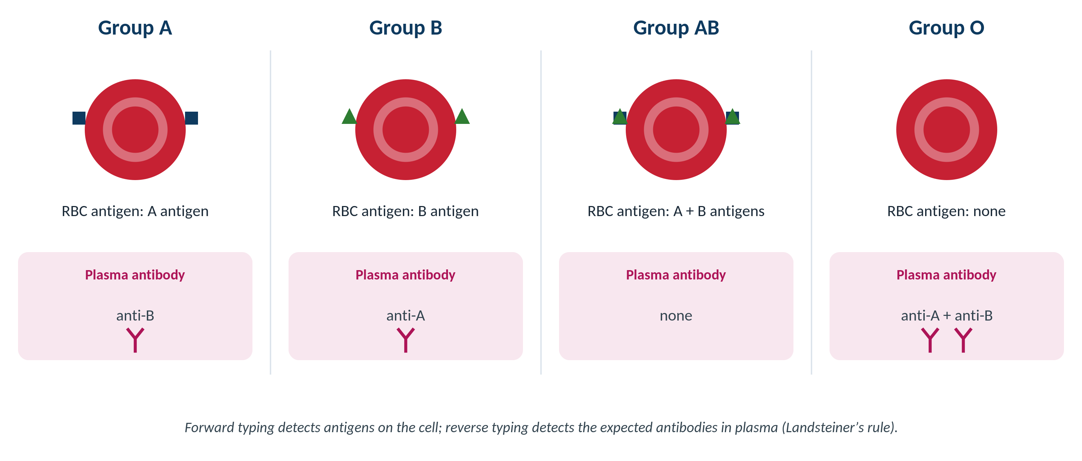
TRANSFUSION MEDICINE · ABO SYSTEM
The ABO Blood Groups
Original schematic. Each group expresses specific antigens on the red cell and the reciprocal antibodies in plasma.
Makassed General Hospital · Department of Laboratory Medicine
CP Lecture Series · 5

Slide 7
TRANSFUSION MEDICINE · ABO SYSTEM
ABO Antigens and the H Precursor
GENETICS & ANTIGENS
BOMBAY PHENOTYPE (OH)
A and B genes encode glycosyltransferases that add sugars to the H antigen precursor.
The H antigen (from the FUT1 gene) is the substrate; O individuals have unmodified H.
A1 vs A2 subgroups differ in antigen quantity and branching; A2 can have anti-A1.
ABH antigens are also secreted (secretors) and are enzyme-enhanced (carbohydrate antigens).
Absent H antigen (hh) → cannot make A or B even if A/B genes are present.
Types as group O on forward typing but has potent anti-H (plus anti-A, anti-B).
Compatible ONLY with other Bombay units — not with ordinary group O.
A classic discrepancy trap: 'O' patient incompatible with O donor cells.
Makassed General Hospital · Department of Laboratory Medicine
CP Lecture Series · 6

Slide 8
TRANSFUSION MEDICINE · ABO SYSTEM
ABO Antibodies and Forward/Reverse Typing
THE ANTIBODIES
TWO-WAY CONFIRMATION
Naturally occurring, IgM, complement-fixing — the exception to most blood-bank antibodies.
Anti-A in group B; anti-B in group A; anti-A, anti-B, and anti-A,B in group O.
Develop after the first few months of life (so neonatal reverse typing is unreliable).
Cause immediate intravascular hemolysis if mismatched.
Forward typing: patient cells + reagent anti-A and anti-B.
Reverse typing: patient plasma + reagent A1 and B cells.
The two must agree — forward and reverse are an internal cross-check (Landsteiner’s rule).
A mismatch between them is an 'ABO discrepancy' that must be resolved before transfusion.
Makassed General Hospital · Department of Laboratory Medicine
CP Lecture Series · 7

Slide 9
TRANSFUSION MEDICINE · ABO SYSTEM
Resolving ABO Discrepancies
Pattern | Common causes | Approach
Missing / weak reverse reaction | Neonates / elderly, hypogammaglobulinemia, immunosuppression, subgroups | Incubate at room temp / 4°C, enhance, check history
Extra reverse reaction | Cold autoantibody, anti-A1 in A2/A2B, alloantibody, rouleaux | Prewarm, saline replacement, antigen typing
Weak / missing forward reaction | ABO subgroups (A2, A3), leukemia (weakened antigens), recent ABO-mismatched transplant | Extended incubation, molecular / history review
Mixed-field forward reaction | Recent ABO-mismatched transfusion or transplant, chimerism | Transfusion / transplant history; repeat sample
Always reconcile a discrepancy with the patient’s clinical history; never release ABO-typed units until it is resolved — use group O red cells if urgent.
Makassed General Hospital · Department of Laboratory Medicine
CP Lecture Series · 8

Slide 10
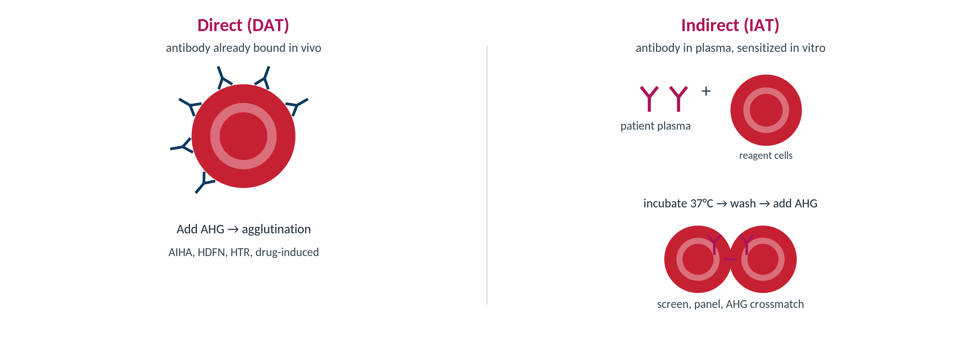
TRANSFUSION MEDICINE · Rh SYSTEM
Rh: The Most Immunogenic Protein System
Five principal antigens: D, C, c, E, e. D is by far the most immunogenic.
Rh antibodies are IgG, immune (not naturally occurring), and react at 37°C / AHG.
Cause delayed and acute hemolytic transfusion reactions and HDFN.
Rh-negative patients should receive Rh-negative red cells, especially females of childbearing potential.
C/c/E/e show dosage; D does not.
Anti-D is preventable with Rh immune globulin (Lecture 5).
Rh antibodies are IgG — detected at the AHG / IAT phase.
Makassed General Hospital · Department of Laboratory Medicine
CP Lecture Series · 9

Slide 11
TRANSFUSION MEDICINE · Rh SYSTEM
Weak D and Partial D
WEAK D
PARTIAL D
Reduced QUANTITY of otherwise complete D antigen; reacts weakly, often only at AHG.
Most weak-D types (1, 2, 3) do not make anti-D and can receive Rh-positive blood.
Historically detected by the 'weak D test' (D typing carried to the AHG phase).
RHD genotyping increasingly guides management.
Missing PORTIONS (epitopes) of the D antigen — a qualitative defect.
Partial-D individuals CAN form anti-D against the missing epitopes.
Safe-side rule: treat PATIENTS as Rh-NEGATIVE when D status is uncertain; treat DONORS as Rh-POSITIVE.
This avoids both alloimmunization (patients) and missing D-positive units (donors).
Makassed General Hospital · Department of Laboratory Medicine
CP Lecture Series · 10

Slide 12
02
PART TWO
Pretransfusion Testing

Slide 13
TRANSFUSION MEDICINE · PRETRANSFUSION TESTING
The Type-and-Screen Workflow
Patient & sample identity
(the safety foundation)
ABO / Rh typing
forward + reverse
Antibody screen (IAT)
reagent screening cells
Crossmatch / release
electronic or serologic
The 3-day rule: a new specimen is required within 3 days when the patient has been transfused or pregnant in the previous 3 months — a new antibody may have formed since the last sample.
'Wrong blood in tube' is a preventable, potentially fatal error — positive patient identification at collection is non-negotiable.
Many services require a second independent ABO determination before issuing non-O red cells.
Makassed General Hospital · Department of Laboratory Medicine
CP Lecture Series · 11

Slide 14
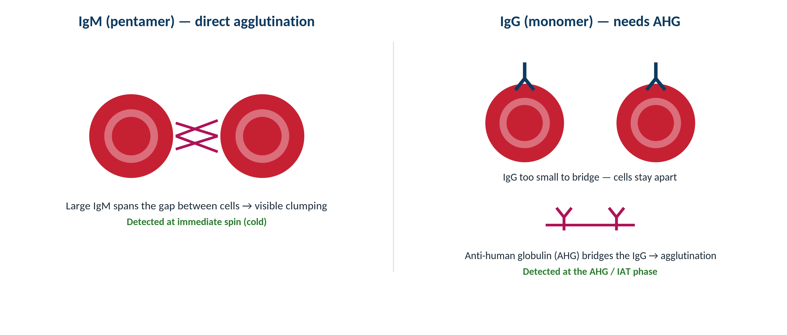
TRANSFUSION MEDICINE · DETECTION PRINCIPLE
How Antibodies Are Detected: Agglutination
Original schematic. IgM agglutinates directly (immediate spin); IgG is detected only after anti-human globulin bridges sensitized cells (AHG / IAT phase).
Makassed General Hospital · Department of Laboratory Medicine
CP Lecture Series · 12

Slide 15
TRANSFUSION MEDICINE · PRETRANSFUSION TESTING
The Antibody Screen
WHAT IT IS
LIMITATIONS TO RESPECT
Patient plasma tested against 2–3 reagent screening cells of known antigen profile by IAT.
Detects clinically significant, unexpected alloantibodies before they meet donor antigen.
Reactive at 37°C / AHG = clinically significant; pursue identification (Lecture 2).
A negative screen permits an electronic or immediate-spin crossmatch in eligible patients.
Cannot detect antibodies to LOW-frequency antigens absent from the screening cells.
Dosage can weaken detection of some antibodies on heterozygous screen cells.
Evanescent antibodies (e.g., Kidd) may fall below detection — honor the antibody history.
A negative screen does not replace the clerical and identity checks.
Makassed General Hospital · Department of Laboratory Medicine
CP Lecture Series · 13

Slide 16
03
PART THREE
Compatibility & Crossmatch

Slide 17
TRANSFUSION MEDICINE · COMPATIBILITY
The Three Crossmatch Methods
Method | What it confirms | When used
Immediate spin | ABO compatibility between recipient plasma and donor cells | Negative antibody screen, no antibody history (serologic ABO check)
Antiglobulin (AHG) crossmatch | Detects IgG antibodies against donor cells (full serologic compatibility) | Positive antibody screen now or a history of clinically significant antibodies
Electronic (computer) crossmatch | ABO compatibility verified by validated computer logic — no serologic test | Two concordant ABO determinations + current negative screen + no antibody history
The crossmatch never replaces the antibody screen; it is the final compatibility check between a specific unit and the recipient.
Makassed General Hospital · Department of Laboratory Medicine
CP Lecture Series · 14

Slide 18
TRANSFUSION MEDICINE · COMPATIBILITY
Electronic Crossmatch & Emergency Release
ELECTRONIC CROSSMATCH CRITERIA
EMERGENCY RELEASE
Current sample with a NEGATIVE antibody screen and no history of significant antibodies.
Two concordant ABO/Rh determinations on the patient (often two samples or two methods).
A validated computer system that blocks ABO-incompatible assignments.
Fast and reliable for the large majority of patients.
When transfusion cannot wait for testing, issue uncrossmatched group O red cells.
O Rh-NEGATIVE for females of childbearing potential; O Rh-positive is acceptable for others to conserve O-negative stock.
AB plasma is the universal plasma for emergency release.
Document the clinical authorization; complete testing on the sample retrospectively.
Makassed General Hospital · Department of Laboratory Medicine
CP Lecture Series · 15

Slide 19
TRANSFUSION MEDICINE · COMPATIBILITY
ABO Compatibility — Red Cells and Plasma
Recipient | Compatible red cells | Compatible plasma
O | O only | O, A, B, AB
A | A, O | A, AB
B | B, O | B, AB
AB | A, B, AB, O (universal RBC recipient) | AB only (AB is the universal plasma donor)
Red cells and plasma are mirror images: group O is the universal red-cell donor; group AB is the universal plasma donor.
Makassed General Hospital · Department of Laboratory Medicine
CP Lecture Series · 16

Slide 20
04
PART FOUR
Safety & Special Situations

Slide 21
TRANSFUSION MEDICINE · SAFETY
The Identity Chain — Where Fatal Errors Happen
WRONG BLOOD IN TUBE (WBIT)
SPECIMEN RULES
Most fatal ABO-incompatible transfusions stem from misidentification, not serologic error.
Errors cluster at collection (mislabeled tube) and at the bedside (wrong patient).
Positive patient identification at draw and at issue is mandatory.
A second independent ABO check reduces WBIT risk before non-O units are issued.
Label at the bedside, from the patient’s wristband, at the time of draw.
3-day specimen validity if transfused/pregnant in the last 3 months.
Reject mislabeled or unlabeled samples — no exceptions for blood bank specimens.
Hemolyzed or clotted samples may compromise testing.
Makassed General Hospital · Department of Laboratory Medicine
CP Lecture Series · 17

Slide 22
TRANSFUSION MEDICINE · SAFETY
Neonatal and Special Selection
NEONATAL TRANSFUSION
WHEN IN DOUBT, GROUP O
Reverse typing is unreliable in neonates — ABO antibodies are not yet produced.
Antibodies present are maternal; test maternal/neonatal plasma as appropriate.
Group O red cells are commonly selected for small neonatal transfusions.
Special requirements (irradiated, CMV-safe) are covered in Lecture 5.
Unresolved ABO discrepancy or emergent need → group O red cells.
Rh-negative red cells when Rh status is uncertain in a female of childbearing potential.
AB plasma when plasma group is unknown and transfusion is urgent.
Resolve the discrepancy in parallel — do not delay life-saving transfusion.
Makassed General Hospital · Department of Laboratory Medicine
CP Lecture Series · 18

Slide 23
05
PART FIVE
Cases & Board Review

Slide 24
TRANSFUSION MEDICINE · CASE 1
Case 1
CLINICAL VIGNETTE
An 84-year-old man types as group A on forward typing (cells react with anti-A, not anti-B), but his plasma reacts with neither A1 nor B reagent cells on reverse typing. He has no transfusion history.
?
What kind of ABO discrepancy is this, what is the likely cause, and how do you work it up?
Makassed General Hospital · Department of Laboratory Medicine
CP Lecture Series · 19

Slide 25
TRANSFUSION MEDICINE · CASE 1 · RESOLUTION
Case 1: Missing Reverse Reaction
Forward (group A) and reverse (no antibodies) disagree — a missing/weak reverse reaction.
In the elderly (and in immunodeficiency or immunosuppression), ABO isoagglutinin titers fall and reverse reactions weaken.
Work-up: incubate the reverse type at room temperature or 4°C to enhance weak IgM, and review history.
If transfusion is needed before resolution, give group O red cells.
TEACHING POINT
Weak/absent reverse reactions are common at the extremes of age and in immunocompromise; enhancement techniques usually recover the expected antibody.
Makassed General Hospital · Department of Laboratory Medicine
CP Lecture Series · 20

Slide 26
TRANSFUSION MEDICINE · CASE 2
Case 2
CLINICAL VIGNETTE
A pregnant patient types Rh(D)-negative on immediate spin, but the D typing becomes positive at the antiglobulin phase (weak D detected). The laboratory must decide how to classify her for transfusion and Rh immune globulin.
?
Should she be treated as Rh-positive or Rh-negative, and why does the patient-vs-donor distinction matter?
Makassed General Hospital · Department of Laboratory Medicine
CP Lecture Series · 21

Slide 27
TRANSFUSION MEDICINE · CASE 2 · RESOLUTION
Case 2: Weak D — Patient vs Donor
For a PATIENT (recipient) with serologic weak D and uncertain status, the safe default is to treat as Rh-NEGATIVE.
This means Rh-negative red cells and Rh immune globulin candidacy — avoiding anti-D alloimmunization, especially in pregnancy.
RHD genotyping can clarify: most weak-D types 1/2/3 can safely be managed as Rh-positive and do not need RhIG.
A DONOR with weak D is labeled Rh-POSITIVE, so a D-positive unit is never given to an Rh-negative recipient.
TEACHING POINT
Patient = err Rh-negative (protect from anti-D); donor = err Rh-positive (protect recipients). Genotyping increasingly resolves weak-D management.
Makassed General Hospital · Department of Laboratory Medicine
CP Lecture Series · 22

Slide 28
TRANSFUSION MEDICINE · CASE 3
Case 3
CLINICAL VIGNETTE
A trauma patient arrives hypotensive and exsanguinating. There is no time for a type and screen, and no historical blood type is available. The team activates massive transfusion.
?
Which red cells and plasma do you release immediately, and what differs for a young woman versus an older man?
Makassed General Hospital · Department of Laboratory Medicine
CP Lecture Series · 23

Slide 29
TRANSFUSION MEDICINE · CASE 3 · RESOLUTION
Case 3: Emergency Release
Issue uncrossmatched group O red cells immediately under emergency-release authorization.
Use O Rh-NEGATIVE for a female of childbearing potential to prevent anti-D and future HDFN.
O Rh-positive red cells are acceptable for an older man, conserving scarce O-negative stock.
Give AB plasma (universal) until the ABO group is known; draw a sample and complete testing as soon as possible.
TEACHING POINT
Emergency release trades serologic certainty for speed safely: group O cells + AB plasma, with Rh choice driven by childbearing potential.
Makassed General Hospital · Department of Laboratory Medicine
CP Lecture Series · 24

Slide 30
06
PART SIX
Board Review

Slide 31
TRANSFUSION MEDICINE · BOARD REVIEW · Q1
Board-Style Review
Why is an ABO-incompatible red cell transfusion capable of causing immediate, severe intravascular hemolysis?
A. ABO antibodies are IgG and cause extravascular clearance
B. ABO antibodies are naturally occurring IgM that fix complement
C. ABO antigens are poorly expressed on red cells
D. ABO antibodies require AHG to react
E. ABO antibodies only cause delayed reactions
Makassed General Hospital · Department of Laboratory Medicine
CP Lecture Series · 25

Slide 32
TRANSFUSION MEDICINE · BOARD REVIEW · Q1
Board-Style Review
Why is an ABO-incompatible red cell transfusion capable of causing immediate, severe intravascular hemolysis?
A. ABO antibodies are IgG and cause extravascular clearance
B. ABO antibodies are naturally occurring IgM that fix complement
C. ABO antigens are poorly expressed on red cells
D. ABO antibodies require AHG to react
E. ABO antibodies only cause delayed reactions
ANSWER B — Naturally occurring IgM that fix complement
ABO antibodies are IgM, present without prior exposure, and activate the full complement cascade — producing acute intravascular hemolysis. This is why ABO identity is the most safety-critical step.
Makassed General Hospital · Department of Laboratory Medicine
CP Lecture Series · 25

Slide 33
TRANSFUSION MEDICINE · BOARD REVIEW · Q2
Board-Style Review
A patient types as group O on forward typing but is incompatible with all group O donor units and has anti-H. What is the explanation?
A. Subgroup A2
B. Acquired B phenotype
C. Bombay phenotype (Oh)
D. Cold autoantibody
E. Rouleaux
Makassed General Hospital · Department of Laboratory Medicine
CP Lecture Series · 26

Slide 34
TRANSFUSION MEDICINE · BOARD REVIEW · Q2
Board-Style Review
A patient types as group O on forward typing but is incompatible with all group O donor units and has anti-H. What is the explanation?
A. Subgroup A2
B. Acquired B phenotype
C. Bombay phenotype (Oh)
D. Cold autoantibody
E. Rouleaux
ANSWER C — Bombay phenotype (Oh)
Bombay individuals lack H antigen (hh) and make potent anti-H, so they appear group O but are incompatible with ordinary O cells and require Bombay units.
Makassed General Hospital · Department of Laboratory Medicine
CP Lecture Series · 26

Slide 35
TRANSFUSION MEDICINE · BOARD REVIEW · Q3
Board-Style Review
A recipient sample shows serologic weak D of uncertain type. How should the patient be managed for transfusion?
A. As Rh-positive; give Rh-positive units
B. As Rh-negative; give Rh-negative units and consider RhIG
C. No Rh consideration is needed
D. Give only AB plasma
E. Withhold all transfusion
Makassed General Hospital · Department of Laboratory Medicine
CP Lecture Series · 27

Slide 36
TRANSFUSION MEDICINE · BOARD REVIEW · Q3
Board-Style Review
A recipient sample shows serologic weak D of uncertain type. How should the patient be managed for transfusion?
A. As Rh-positive; give Rh-positive units
B. As Rh-negative; give Rh-negative units and consider RhIG
C. No Rh consideration is needed
D. Give only AB plasma
E. Withhold all transfusion
ANSWER B — Treat the patient as Rh-negative
For recipients, serologic weak D of uncertain type is managed as Rh-negative to avoid anti-D alloimmunization; RHD genotyping can reclassify many as Rh-positive. Donors with weak D are labeled Rh-positive.
Makassed General Hospital · Department of Laboratory Medicine
CP Lecture Series · 27

Slide 37
TRANSFUSION MEDICINE · BOARD REVIEW · Q4
Board-Style Review
Which combination is correct for emergency release before a type and screen is available?
A. Group AB red cells and group O plasma
B. Group O red cells and group AB plasma
C. Group A red cells and group A plasma
D. Patient must wait for full crossmatch
E. Group O plasma and group AB red cells
Makassed General Hospital · Department of Laboratory Medicine
CP Lecture Series · 28

Slide 38
TRANSFUSION MEDICINE · BOARD REVIEW · Q4
Board-Style Review
Which combination is correct for emergency release before a type and screen is available?
A. Group AB red cells and group O plasma
B. Group O red cells and group AB plasma
C. Group A red cells and group A plasma
D. Patient must wait for full crossmatch
E. Group O plasma and group AB red cells
ANSWER B — Group O red cells and AB plasma
Group O is the universal red-cell donor and AB is the universal plasma donor. Use O-negative red cells for females of childbearing potential; O-positive is acceptable otherwise.
Makassed General Hospital · Department of Laboratory Medicine
CP Lecture Series · 28

Slide 39
TRANSFUSION MEDICINE
Key Take-Home Points
ABO antibodies are naturally occurring, IgM, complement-fixing — ABO identity is the most safety-critical step in transfusion.
1
Forward and reverse typing must agree; an ABO discrepancy must be resolved before non-O units are released (use group O if urgent).
2
Rh(D) is the most immunogenic protein antigen; treat weak-D patients as Rh-negative and weak-D donors as Rh-positive.
3
Type & screen + crossmatch: a negative screen permits electronic/immediate-spin crossmatch; a positive screen mandates an AHG crossmatch.
4
Most fatal ABO incompatibilities are clerical — positive patient/sample identification and the 3-day rule are non-negotiable.
5
Emergency release: group O red cells (O-negative for childbearing-potential females) plus AB plasma.
6
Makassed General Hospital · Department of Laboratory Medicine
29

Slide 40
TRANSFUSION MEDICINE · REFERENCES & FURTHER READING
References
1. Cohn CS, et al. (eds). AABB Technical Manual, 20th ed. AABB Press, 2020 (ABO/H, Rh, pretransfusion testing).
2. Fung MK, et al. (eds). AABB Standards for Blood Banks and Transfusion Services (current edition).
3. Harmening DM. Modern Blood Banking & Transfusion Practices, 7th ed. F.A. Davis, 2019 (Ch. 6, 7, 10, 11).
4. Sandler SG, et al. It’s time to phase in RHD genotyping for patients with a serologic weak D phenotype. Transfusion. 2015;55:680–689.
Makassed General Hospital · Department of Laboratory Medicine
CP Lecture Series · 30

