Slide 1
CLINICAL PATHOLOGY RESIDENCY LECTURE SERIES
TRANSFUSION MEDICINE · LECTURE 4 OF 5
Component Therapy & Massive Transfusion
The Right Product, Dose, and Ratio
Dr. Tamima El-Jisr
Chairperson, Department of Laboratory Medicine
Makassed General Hospital, Beirut
Clinical Pathology Residency Curriculum

Slide 2
TRANSFUSION MEDICINE · FRAMING THE PROBLEM
Why This Matters
Hb 7
1:1:1
Ca²⁺
Restrictive red-cell thresholds are as safe as liberal ones in most stable patients
Balanced ratios in massive hemorrhage mimic whole blood
Citrate from rapid transfusion lowers ionized calcium — monitor and replace
Whole blood is fractionated so each patient receives only the component they need. Knowing each product’s content, indication, dose, and expected increment — and how to resuscitate massive hemorrhage — is daily consultative blood-bank work.
Over-transfusion has real harm (TACO, alloimmunization, cost) — the goal is the minimum effective dose, not a normal number.
Makassed General Hospital · Department of Laboratory Medicine
CP Lecture Series · 2

Slide 3
TRANSFUSION MEDICINE · LECTURE 4 OF 5
Learning Objectives
Describe each blood component’s content, indication, and expected dose response.
Apply evidence-based red-cell and platelet transfusion thresholds.
1
2
Use plasma and cryoprecipitate appropriately, including fibrinogen replacement.
Outline a massive transfusion protocol and balanced resuscitation ratios.
3
4
Recognize and manage the metabolic complications of massive transfusion.
Define platelet refractoriness and its laboratory evaluation.
5
6
Makassed General Hospital · Department of Laboratory Medicine
CP Lecture Series · 3

Slide 4
TRANSFUSION MEDICINE · WHAT WE WILL COVER
Roadmap
The components — content, indications, dose and increment
1
Transfusion thresholds — restrictive practice and stewardship
2
Massive transfusion — balanced ratios and viscoelastic guidance
3
Metabolic complications — citrate, potassium, temperature
4
Cases & board review — trauma, thresholds, citrate toxicity
5
Makassed General Hospital · Department of Laboratory Medicine
CP Lecture Series · 4

Slide 5
01
PART ONE
The Blood Components

Slide 6
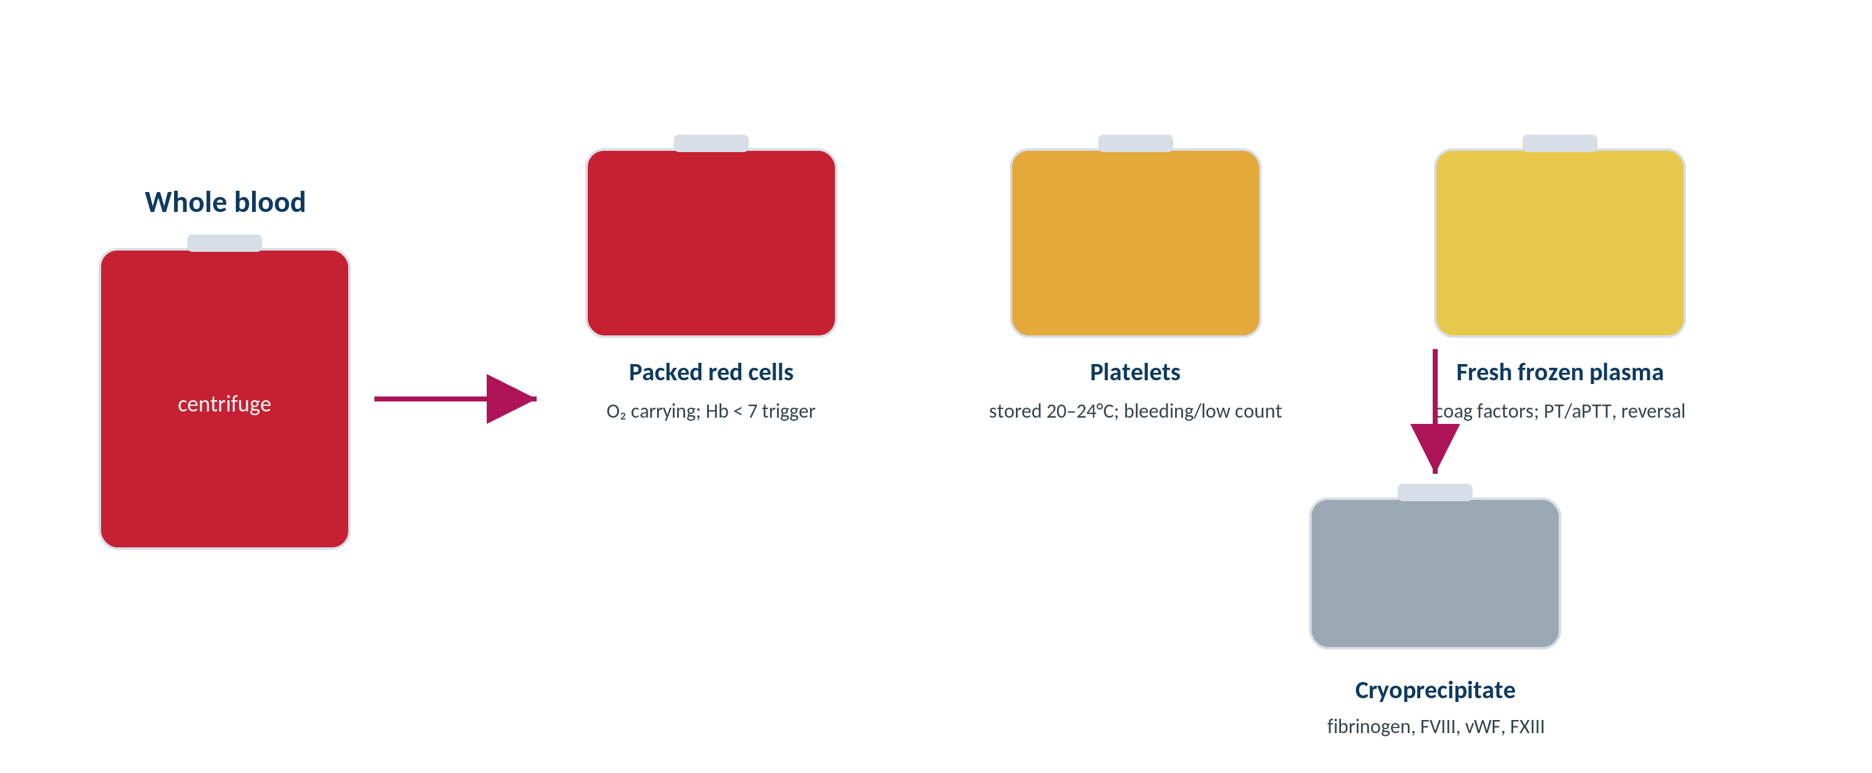
TRANSFUSION MEDICINE · COMPONENTS
From Whole Blood to Components
Original schematic. One donation is fractionated so each patient receives only the component indicated.
Makassed General Hospital · Department of Laboratory Medicine
CP Lecture Series · 5

Slide 7
TRANSFUSION MEDICINE · COMPONENTS
The Components at a Glance
Component | Contains | Main indication | Typical effect
Packed red cells | Red cells (Hct ~55–65%) | Symptomatic anemia / O₂ delivery | 1 unit ↑ Hb ~1 g/dL
Platelets (apheresis) | ~3–4 × 10¹¹ platelets | Thrombocytopenia / dysfunction with bleeding | ↑ ~30–50 × 10⁹/L
Fresh frozen plasma | All coagulation factors | Multifactor deficiency, reversal, TTP (TPE) | 10–15 mL/kg dosing
Cryoprecipitate | Fibrinogen, FVIII, vWF, FXIII | Hypofibrinogenemia (e.g., DIC, trauma) | Raises fibrinogen
Components are chosen by deficit: red cells for oxygen delivery, platelets for primary hemostasis, plasma for factor replacement, cryoprecipitate for fibrinogen.
Makassed General Hospital · Department of Laboratory Medicine
CP Lecture Series · 6

Slide 8
TRANSFUSION MEDICINE · COMPONENTS
Dose, Increment, and Refractoriness
EXPECTED RESPONSES
PLATELET REFRACTORINESS
One unit of red cells raises hemoglobin by ~1 g/dL (hematocrit ~3%) in a stable adult.
One apheresis platelet dose raises the count ~30–50 × 10⁹/L.
Plasma is dosed by weight (~10–15 mL/kg) to correct factor levels.
Reassess clinically and with labs rather than chasing a single number.
Inadequate increment after platelet transfusion on ≥ 2 occasions.
Calculate the corrected count increment (CCI) at ~10–60 min and ~1 h.
Non-immune causes (fever, sepsis, splenomegaly, DIC, drugs) are most common — poor 1-hour CCI.
Immune (HLA / HPA alloimmunization) — poor 10–60-min CCI → HLA-matched platelets.
Makassed General Hospital · Department of Laboratory Medicine
CP Lecture Series · 7

Slide 9
02
PART TWO
Thresholds & Stewardship

Slide 10
TRANSFUSION MEDICINE · THRESHOLDS
Red-Cell and Platelet Triggers
RED CELLS — RESTRICTIVE PRACTICE
PLATELETS — COMMON THRESHOLDS
A restrictive threshold (Hb ~7 g/dL) is as safe as a liberal one for most hospitalized, hemodynamically stable patients.
~8 g/dL is reasonable in symptomatic cardiac disease or peri-operatively in some patients.
Transfuse to relieve symptoms / restore oxygen delivery, not to a number.
Acute hemorrhage is judged clinically, not by a single hemoglobin.
~10 × 10⁹/L — prophylaxis in stable hypoproliferative thrombocytopenia.
~20 × 10⁹/L — added risk factors (fever, sepsis).
~50 × 10⁹/L — most invasive procedures / active bleeding.
~100 × 10⁹/L — neurosurgery / CNS bleeding.
Avoid platelets in TTP/HIT unless life-threatening bleeding.
Makassed General Hospital · Department of Laboratory Medicine
CP Lecture Series · 8

Slide 11
TRANSFUSION MEDICINE · THRESHOLDS
Plasma and Cryoprecipitate — Use Them Right
PLASMA (FFP)
CRYOPRECIPITATE
Indicated for bleeding/procedures with MULTIPLE factor deficiencies (e.g., liver disease, DIC, warfarin with bleeding when PCC unavailable).
Not for minor INR elevations without bleeding, and not as a volume expander.
Each mL/kg has a modest effect — under-dosing is common.
The plasma for TTP is delivered by therapeutic plasma exchange.
Concentrated source of fibrinogen (plus FVIII, vWF, FXIII).
First-line to replace fibrinogen in hypofibrinogenemia (DIC, trauma, obstetric hemorrhage).
Targeted fibrinogen replacement, not general factor replacement.
Fibrinogen concentrate is an alternative where available.
Makassed General Hospital · Department of Laboratory Medicine
CP Lecture Series · 9

Slide 12
03
PART THREE
Massive Transfusion

Slide 13
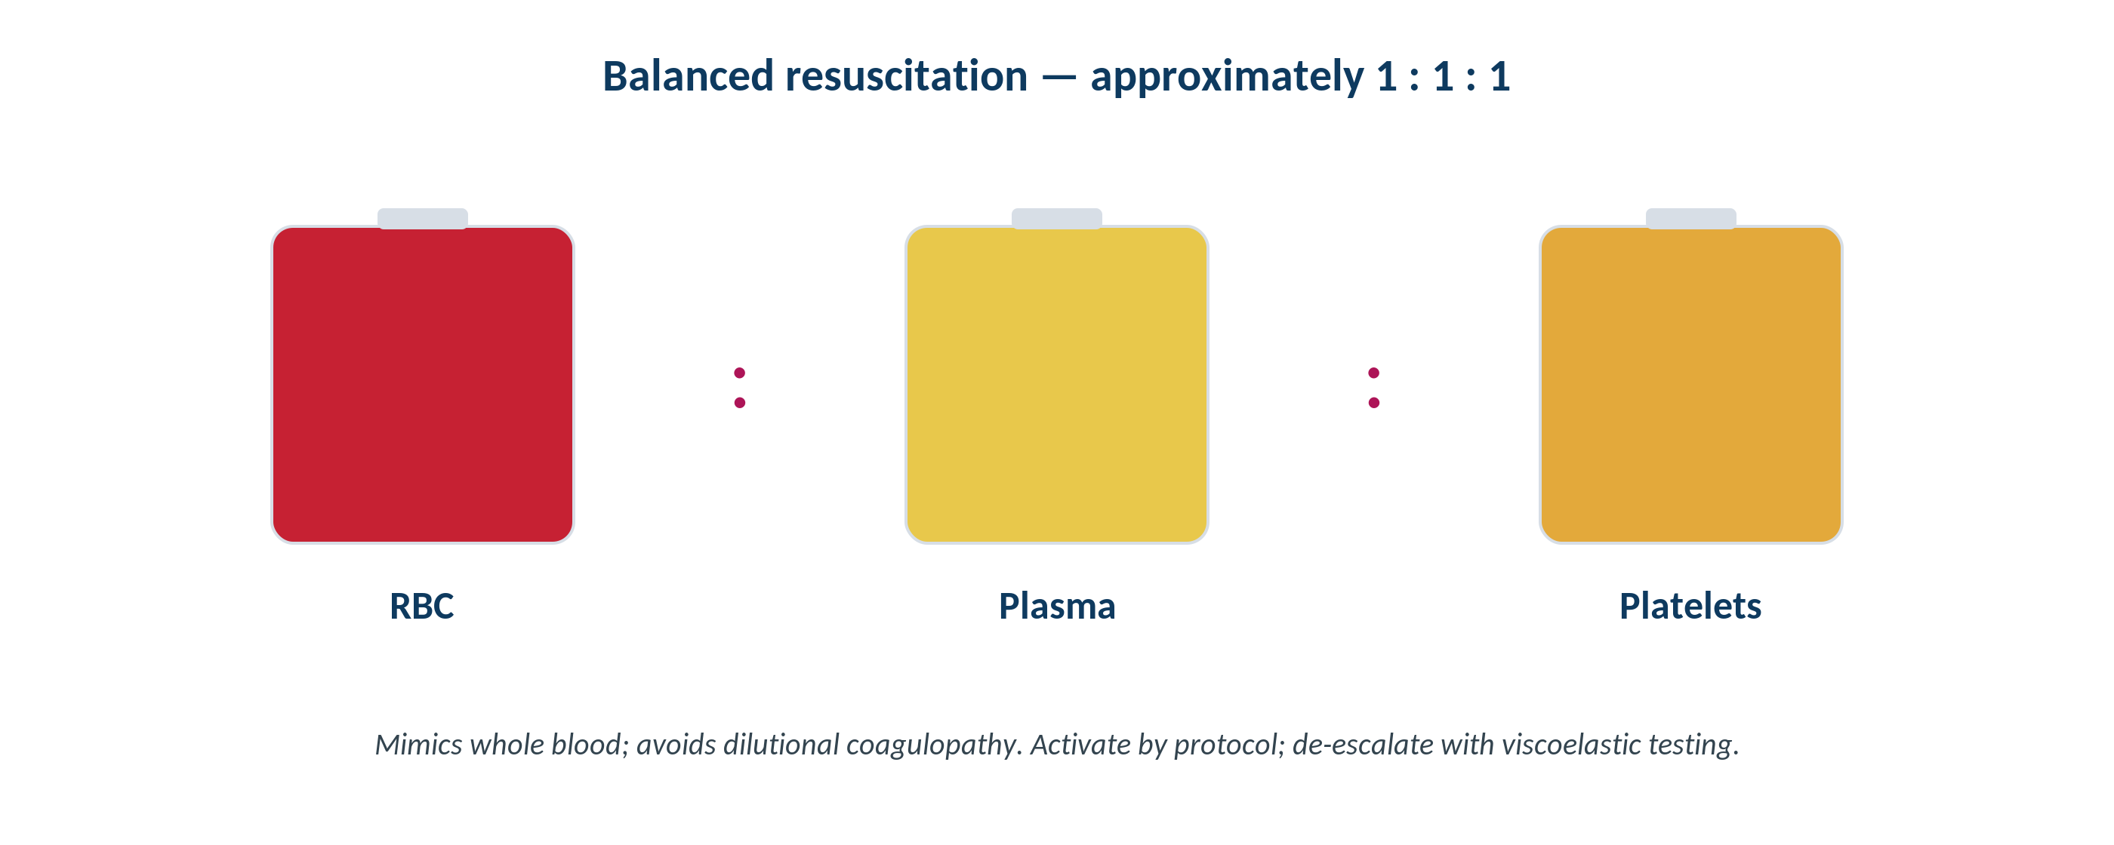
TRANSFUSION MEDICINE · MASSIVE TRANSFUSION
Balanced Resuscitation
Original schematic. Approximately equal ratios of red cells, plasma, and platelets reconstitute whole blood and limit dilutional coagulopathy.
Makassed General Hospital · Department of Laboratory Medicine
CP Lecture Series · 10

Slide 14
TRANSFUSION MEDICINE · MASSIVE TRANSFUSION
Protocol and Viscoelastic Guidance
THE MASSIVE TRANSFUSION PROTOCOL
VISCOELASTIC-GUIDED THERAPY
Defined as large-volume replacement (e.g., ≥ ~10 units RBC / 24 h, or rapid loss of one blood volume).
Pre-set, balanced packs delivered immediately on activation (RBC : plasma : platelets ≈ 1 : 1 : 1).
Avoids the dilutional, hypothermic, acidotic 'lethal triad' of trauma.
Add tranexamic acid and calcium per protocol; communicate clearly with the blood bank.
TEG / ROTEM give rapid, whole-blood clot dynamics at the bedside.
Guide targeted replacement: low fibrinogen → cryoprecipitate; prolonged clotting → plasma; poor clot strength → platelets.
Help de-escalate from fixed ratios to goal-directed therapy.
Reduce unnecessary product use once hemorrhage is controlled.
Makassed General Hospital · Department of Laboratory Medicine
CP Lecture Series · 11

Slide 15
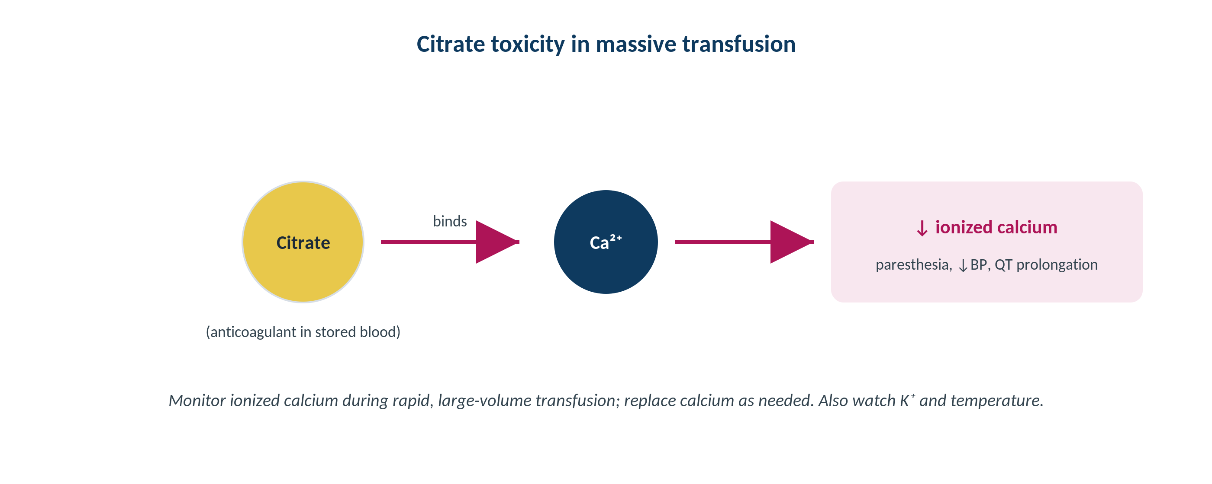
TRANSFUSION MEDICINE · COMPLICATIONS
Citrate Toxicity & Ionized Calcium
Original schematic. Citrate anticoagulant chelates ionized calcium during rapid, large-volume transfusion or apheresis.
Makassed General Hospital · Department of Laboratory Medicine
CP Lecture Series · 12

Slide 16
TRANSFUSION MEDICINE · COMPLICATIONS
The Metabolic Hazards of Massive Transfusion
ELECTROLYTE & METABOLIC
HEMATOLOGIC
Citrate toxicity → ↓ ionized calcium (paresthesia, hypotension, QT prolongation) — monitor and replace calcium.
Hyperkalemia from stored-cell potassium leak (worse with old units, rapid infusion, neonates).
Hypothermia from cold products → use warmers; cold worsens coagulopathy.
Acid-base shifts (early acidosis, later citrate-derived metabolic alkalosis).
Dilutional coagulopathy and thrombocytopenia if replacement is unbalanced.
The 'lethal triad': hypothermia + acidosis + coagulopathy.
Balanced ratios and viscoelastic guidance mitigate these.
Monitor ionized calcium, potassium, fibrinogen, and temperature throughout.
Makassed General Hospital · Department of Laboratory Medicine
CP Lecture Series · 13

Slide 17
04
PART FOUR
Cases & Board Review

Slide 18
TRANSFUSION MEDICINE · CASE 1
Case 1
CLINICAL VIGNETTE
A trauma patient arrives in hemorrhagic shock with ongoing bleeding. The massive transfusion protocol is activated. After several units of red cells alone, the patient becomes diffusely oozy and hypothermic; fibrinogen is low.
?
What went wrong with red-cells-only resuscitation, and how should the strategy change?
Makassed General Hospital · Department of Laboratory Medicine
CP Lecture Series · 14

Slide 19
TRANSFUSION MEDICINE · CASE 1 · RESOLUTION
Case 1: Balanced Resuscitation
Red-cells-only resuscitation dilutes platelets and clotting factors → dilutional coagulopathy and oozing.
Switch to balanced ratios (RBC : plasma : platelets ≈ 1 : 1 : 1) per the massive transfusion protocol.
Replace fibrinogen with cryoprecipitate; give calcium for citrate-induced hypocalcemia; actively warm the patient.
Use TEG/ROTEM to target ongoing product needs and de-escalate when bleeding is controlled.
TEACHING POINT
Massive hemorrhage needs whole-blood-like replacement from the start; correcting hypothermia and hypocalcemia is part of the resuscitation, not an afterthought.
Makassed General Hospital · Department of Laboratory Medicine
CP Lecture Series · 15

Slide 20
TRANSFUSION MEDICINE · CASE 2
Case 2
CLINICAL VIGNETTE
A stable patient with hypoproliferative thrombocytopenia (platelets 14 × 10⁹/L) and no bleeding is scheduled for a lumbar puncture. The team asks whether to transfuse platelets and to what target.
?
What threshold applies for the procedure, and what would you advise?
Makassed General Hospital · Department of Laboratory Medicine
CP Lecture Series · 16

Slide 21
TRANSFUSION MEDICINE · CASE 2 · RESOLUTION
Case 2: Procedural Platelet Threshold
Prophylaxis at rest is reasonable around 10 × 10⁹/L, but a procedure raises the target.
Most invasive procedures, including lumbar puncture, target roughly 50 × 10⁹/L.
Transfuse to reach the procedural threshold close to the time of the procedure.
Document indication; avoid reflexive over-transfusion once the target is met.
TEACHING POINT
Match the platelet target to the bleeding risk of the setting: ~10 at rest, ~50 for most procedures, ~100 for CNS.
Makassed General Hospital · Department of Laboratory Medicine
CP Lecture Series · 17

Slide 22
TRANSFUSION MEDICINE · CASE 3
Case 3
CLINICAL VIGNETTE
During rapid transfusion of multiple units, a patient develops perioral tingling, muscle twitching, and a falling blood pressure. The ECG shows a prolonged QT interval. Potassium is normal.
?
What is the metabolic cause, and what is the immediate treatment?
Makassed General Hospital · Department of Laboratory Medicine
CP Lecture Series · 18

Slide 23
TRANSFUSION MEDICINE · CASE 3 · RESOLUTION
Case 3: Citrate-Induced Hypocalcemia
Citrate from rapidly infused products chelates ionized calcium → symptomatic hypocalcemia.
Signs: paresthesia, tetany/twitching, hypotension, and a prolonged QT interval.
Measure IONIZED calcium (total calcium is misleading) and replace calcium.
Slow the infusion if feasible and continue monitoring during ongoing transfusion.
TEACHING POINT
In rapid or large-volume transfusion (and apheresis), follow ionized calcium — citrate toxicity is common, predictable, and treatable.
Makassed General Hospital · Department of Laboratory Medicine
CP Lecture Series · 19

Slide 24
05
PART FIVE
Board Review

Slide 25
TRANSFUSION MEDICINE · BOARD REVIEW · Q1
Board-Style Review
For most stable, hospitalized adults without active cardiac ischemia, the evidence supports which red-cell transfusion threshold?
A. Hemoglobin 10 g/dL
B. Hemoglobin 9 g/dL
C. A restrictive threshold around 7 g/dL
D. Transfuse based on hematocrit > 30% only
E. Transfuse all symptomatic and asymptomatic anemia
Makassed General Hospital · Department of Laboratory Medicine
CP Lecture Series · 20

Slide 26
TRANSFUSION MEDICINE · BOARD REVIEW · Q1
Board-Style Review
For most stable, hospitalized adults without active cardiac ischemia, the evidence supports which red-cell transfusion threshold?
A. Hemoglobin 10 g/dL
B. Hemoglobin 9 g/dL
C. A restrictive threshold around 7 g/dL
D. Transfuse based on hematocrit > 30% only
E. Transfuse all symptomatic and asymptomatic anemia
ANSWER C — Restrictive threshold ~7 g/dL
Randomized data show a restrictive strategy (~7 g/dL, ~8 in selected cardiac/peri-operative patients) is as safe as a liberal strategy and reduces exposure. Transfuse for symptoms, not a number.
Makassed General Hospital · Department of Laboratory Medicine
CP Lecture Series · 20

Slide 27
TRANSFUSION MEDICINE · BOARD REVIEW · Q2
Board-Style Review
A bleeding patient with DIC has a fibrinogen of 80 mg/dL. Which product most directly and efficiently replaces fibrinogen?
A. Packed red cells
B. Platelets
C. Cryoprecipitate
D. Albumin
E. Normal saline
Makassed General Hospital · Department of Laboratory Medicine
CP Lecture Series · 21

Slide 28
TRANSFUSION MEDICINE · BOARD REVIEW · Q2
Board-Style Review
A bleeding patient with DIC has a fibrinogen of 80 mg/dL. Which product most directly and efficiently replaces fibrinogen?
A. Packed red cells
B. Platelets
C. Cryoprecipitate
D. Albumin
E. Normal saline
ANSWER C — Cryoprecipitate
Cryoprecipitate is the concentrated source of fibrinogen (also FVIII, vWF, FXIII) and is first-line for hypofibrinogenemia. Fibrinogen concentrate is an alternative where available.
Makassed General Hospital · Department of Laboratory Medicine
CP Lecture Series · 21

Slide 29
TRANSFUSION MEDICINE · BOARD REVIEW · Q3
Board-Style Review
During a massive transfusion, a patient develops tetany, hypotension, and a prolonged QT. Which is the best immediate test and treatment?
A. Total calcium; give potassium
B. Ionized calcium; give calcium
C. Magnesium; give magnesium only
D. Lactate; give bicarbonate
E. No action needed
Makassed General Hospital · Department of Laboratory Medicine
CP Lecture Series · 22

Slide 30
TRANSFUSION MEDICINE · BOARD REVIEW · Q3
Board-Style Review
During a massive transfusion, a patient develops tetany, hypotension, and a prolonged QT. Which is the best immediate test and treatment?
A. Total calcium; give potassium
B. Ionized calcium; give calcium
C. Magnesium; give magnesium only
D. Lactate; give bicarbonate
E. No action needed
ANSWER B — Ionized calcium; replace calcium
Citrate chelates ionized calcium. Measure ionized (not total) calcium and replace it. Hypothermia and hyperkalemia should also be monitored during massive transfusion.
Makassed General Hospital · Department of Laboratory Medicine
CP Lecture Series · 22

Slide 31
TRANSFUSION MEDICINE · BOARD REVIEW · Q4
Board-Style Review
A patient shows a poor platelet increment at 10–60 minutes after several transfusions, with good counts predicted otherwise. Which mechanism is most likely?
A. Fever and sepsis
B. Splenomegaly
C. HLA alloimmunization
D. Disseminated intravascular coagulation
E. Dilution
Makassed General Hospital · Department of Laboratory Medicine
CP Lecture Series · 23

Slide 32
TRANSFUSION MEDICINE · BOARD REVIEW · Q4
Board-Style Review
A patient shows a poor platelet increment at 10–60 minutes after several transfusions, with good counts predicted otherwise. Which mechanism is most likely?
A. Fever and sepsis
B. Splenomegaly
C. HLA alloimmunization
D. Disseminated intravascular coagulation
E. Dilution
ANSWER C — HLA alloimmunization
A poor immediate (10–60 min) corrected count increment suggests immune (HLA/HPA) refractoriness → HLA-matched platelets. Non-immune causes (fever, sepsis, splenomegaly, DIC) typically show a poor 1-hour CCI.
Makassed General Hospital · Department of Laboratory Medicine
CP Lecture Series · 23

Slide 33
TRANSFUSION MEDICINE
Key Take-Home Points
Choose components by deficit: red cells for oxygen delivery, platelets for primary hemostasis, plasma for factors, cryoprecipitate for fibrinogen.
1
Use restrictive red-cell thresholds (~7 g/dL; ~8 in selected cardiac patients); match platelet targets to the setting (~10 / ~50 / ~100).
2
Massive hemorrhage: balanced ~1:1:1 ratios from the start, then de-escalate with viscoelastic testing.
3
Monitor ionized calcium (citrate), potassium, fibrinogen, and temperature during massive transfusion.
4
Distinguish immune (poor early CCI → HLA-matched) from non-immune (poor 1-h CCI) platelet refractoriness.
5
Makassed General Hospital · Department of Laboratory Medicine
24

Slide 34
TRANSFUSION MEDICINE · REFERENCES & FURTHER READING
References
1. Carson JL, et al. Clinical Practice Guidelines From the AABB: Red Blood Cell Transfusion Thresholds and Storage. JAMA. 2016/2023 updates.
2. Kaufman RM, et al. Platelet Transfusion: A Clinical Practice Guideline From the AABB. Ann Intern Med. 2015.
3. Cohn CS, et al. (eds). AABB Technical Manual, 20th ed. AABB Press, 2020 (components; massive transfusion).
4. Cap AP, et al. Damage-control resuscitation and balanced transfusion ratios (current reviews).
Makassed General Hospital · Department of Laboratory Medicine
CP Lecture Series · 25

