Slide 1
CLINICAL PATHOLOGY RESIDENCY LECTURE SERIES
TRANSFUSION MEDICINE · LECTURE 5 OF 5
Special Topics in Blood Bank
HDFN, Neonatal Transfusion, Modifications & Apheresis
Dr. Tamima El-Jisr
Chairperson, Department of Laboratory Medicine
Makassed General Hospital, Beirut
Clinical Pathology Residency Curriculum

Slide 2
TRANSFUSION MEDICINE · FRAMING THE PROBLEM
Why This Matters
Anti-D
Irradiate
TPE
HDFN from anti-D is largely preventable with Rh immune globulin
The only way to prevent transfusion-associated GVHD in at-risk recipients
Therapeutic plasma exchange is first-line, category I, for TTP
These special situations carry the highest stakes in transfusion: the unborn, the newborn, the immunocompromised, and patients needing apheresis. Each has specific products, timing, and prevention rules.
Prevention is the theme: RhIG prevents anti-D HDFN; irradiation prevents TA-GVHD; correct product selection prevents harm in neonates.
Makassed General Hospital · Department of Laboratory Medicine
CP Lecture Series · 2

Slide 3
TRANSFUSION MEDICINE · LECTURE 5 OF 5
Learning Objectives
Describe the pathophysiology and prevention of HDFN.
State Rh immune globulin indications, timing, and dosing based on fetomaternal hemorrhage.
1
2
Apply neonatal transfusion requirements and intrauterine transfusion principles.
Select the correct product modification (leukoreduced, irradiated, washed, CMV-safe).
3
4
Outline therapeutic apheresis modalities and high-yield indications.
Recognize apheresis and HPC-collection complications.
5
6
Makassed General Hospital · Department of Laboratory Medicine
CP Lecture Series · 3

Slide 4
TRANSFUSION MEDICINE · WHAT WE WILL COVER
Roadmap
HDFN — mechanism, severity, monitoring
1
Rh immune globulin — indications, timing, FMH dosing
2
Neonatal & special products — requirements and modifications
3
Therapeutic apheresis — modalities and ASFA indications
4
Cases & board review — RhIG, irradiation, plasma exchange
5
Makassed General Hospital · Department of Laboratory Medicine
CP Lecture Series · 4

Slide 5
01
PART ONE
Hemolytic Disease of the Fetus & Newborn

Slide 6
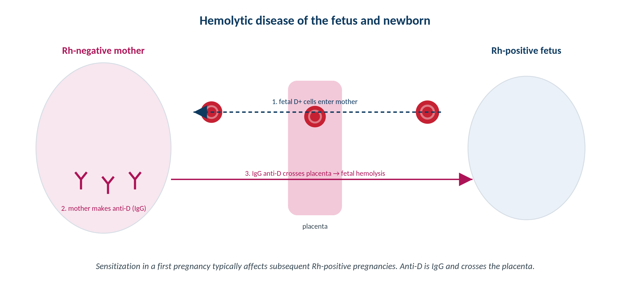
TRANSFUSION MEDICINE · HDFN
How HDFN Develops
Original schematic. Maternal IgG alloantibody crosses the placenta and hemolyzes antigen-positive fetal red cells.
Makassed General Hospital · Department of Laboratory Medicine
CP Lecture Series · 5

Slide 7
TRANSFUSION MEDICINE · HDFN
Causes and Severity
WHICH ANTIBODIES CAUSE HDFN
MONITORING SEVERITY
Anti-D is the classic and most severe cause; anti-c and anti-K are also important.
Anti-Kell causes severe disease partly by SUPPRESSING fetal erythropoiesis — anemia out of proportion to bilirubin.
ABO HDN occurs in group O mothers with group A/B infants — usually MILD (IgG anti-A,B; fetal antigens weakly expressed).
Lewis and other IgM antibodies do not cause HDFN (don’t cross the placenta).
Maternal antibody identification and titers guide surveillance.
Middle cerebral artery (MCA) Doppler peak velocity detects fetal anemia non-invasively.
Paternal/fetal antigen status (including cell-free fetal DNA) assesses risk.
For Kell, titers/amniotic bilirubin under-estimate severity — follow MCA Doppler.
Makassed General Hospital · Department of Laboratory Medicine
CP Lecture Series · 6

Slide 8
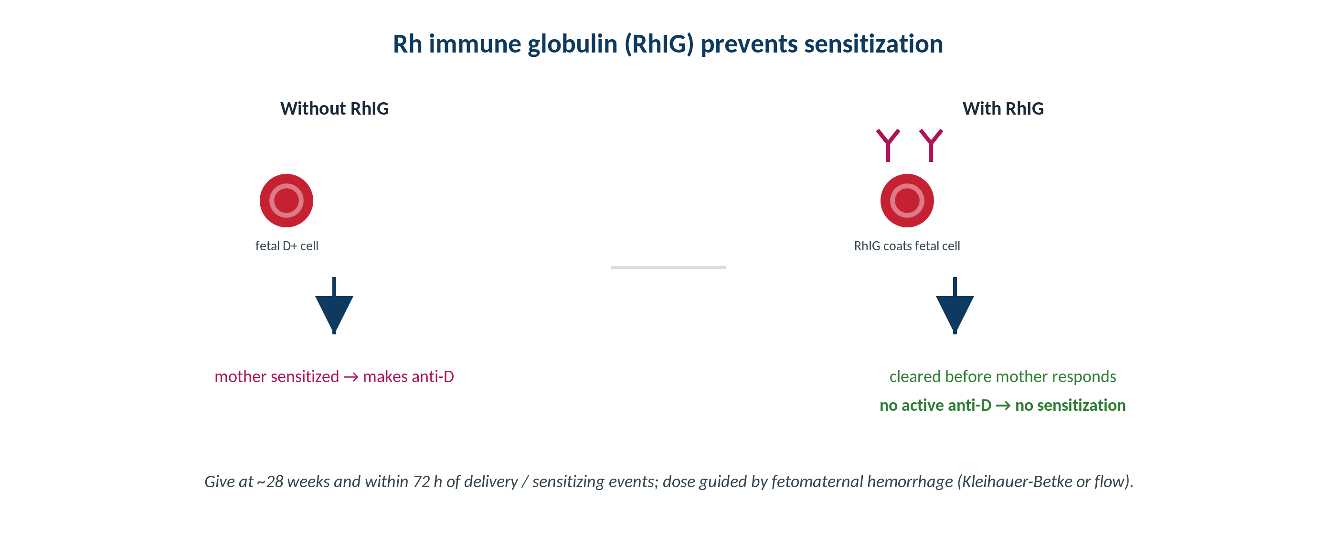
TRANSFUSION MEDICINE · PREVENTION
Rh Immune Globulin Prevents Sensitization
Original schematic. RhIG clears fetal D-positive cells before the mother mounts an active anti-D response.
Makassed General Hospital · Department of Laboratory Medicine
CP Lecture Series · 7

Slide 9
TRANSFUSION MEDICINE · PREVENTION
RhIG: Indications, Timing, and Dose
WHEN TO GIVE
DOSING BY FETOMATERNAL HEMORRHAGE
Rh-negative, non-sensitized mother carrying (or possibly carrying) an Rh-positive fetus.
Routine antepartum dose at ~28 weeks.
Within 72 hours of delivery of an Rh-positive infant.
After sensitizing events: miscarriage, amniocentesis, abdominal trauma, ectopic, antepartum bleeding.
A standard dose covers a defined volume of fetal whole blood; large bleeds need more.
Quantify FMH with the Kleihauer-Betke acid-elution test or flow cytometry.
Calculate the number of vials from the fetal-cell percentage / volume.
RhIG is ineffective once the mother is already sensitized (has active anti-D).
Makassed General Hospital · Department of Laboratory Medicine
CP Lecture Series · 8

Slide 10
02
PART TWO
Neonatal Transfusion & Product Modifications

Slide 11
TRANSFUSION MEDICINE · NEONATAL
Transfusing Neonates
WHAT IS DIFFERENT
INTRAUTERINE TRANSFUSION
Neonates do not make ABO antibodies — antibodies present are maternal; reverse typing is not used.
Group O red cells are commonly used for small-volume top-ups; compatibility is with maternal antibody.
Small aliquots from a dedicated unit limit donor exposure.
Often irradiated and CMV-safe; fresh, low-potassium units for large/exchange transfusions.
For severe fetal anemia (e.g., HDFN) detected by MCA Doppler.
Group O, Rh-negative, antigen-negative for the maternal antibody.
Irradiated, CMV-safe, fresh, and hematocrit-adjusted.
Performed by maternal-fetal medicine with blood-bank support.
Makassed General Hospital · Department of Laboratory Medicine
CP Lecture Series · 9

Slide 12
TRANSFUSION MEDICINE · PRODUCT MODIFICATIONS
Matching the Modification to the Need
Modification | What it does | Indications
Leukoreduction | Removes most white cells | Recurrent FNHTR; reduce HLA alloimmunization; reduce CMV transmission
Irradiation | Inactivates donor T-lymphocytes | Prevent TA-GVHD: immunocompromised, neonates/intrauterine, HLA-matched or related-donor units
Washing | Removes plasma proteins | Recurrent severe allergic / anaphylactic reactions; IgA deficiency (with anti-IgA)
CMV-safe | CMV-seronegative or leukoreduced | CMV-seronegative at-risk: pregnancy, neonates, transplant, severe immunodeficiency
Leukoreduction reduces — but does not reliably prevent — TA-GVHD; only irradiation prevents it.
Makassed General Hospital · Department of Laboratory Medicine
CP Lecture Series · 10

Slide 13
03
PART THREE
Therapeutic Apheresis

Slide 14
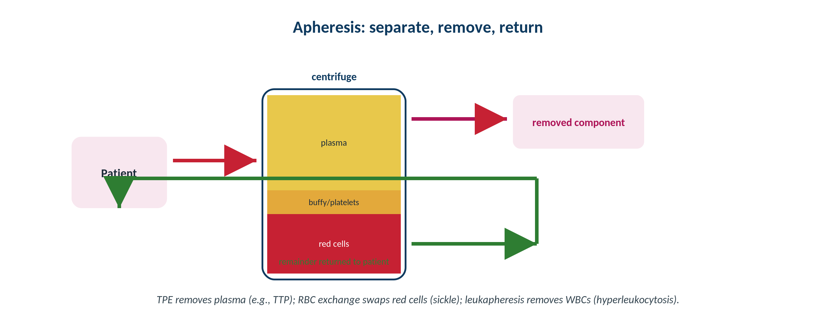
TRANSFUSION MEDICINE · APHERESIS
Therapeutic Apheresis: Separate, Remove, Return
Original schematic. Blood is separated by centrifugation; the target component is removed and the remainder is returned.
Makassed General Hospital · Department of Laboratory Medicine
CP Lecture Series · 11

Slide 15
TRANSFUSION MEDICINE · APHERESIS
Modalities and High-Yield Indications
MODALITIES
ASFA CATEGORIES
Therapeutic plasma exchange (TPE) — removes plasma (antibodies, immune complexes), replaced with albumin/plasma.
Red cell exchange — swaps sickle cells for normal (acute chest, stroke).
Leukapheresis — removes white cells in symptomatic hyperleukocytosis / leukostasis.
Plateletpheresis (extreme thrombocytosis) and photopheresis (cutaneous T-cell lymphoma, GVHD).
The ASFA category system grades evidence for apheresis by indication (I–IV).
Category I = first-line therapy (e.g., TTP → TPE; some neuro/renal indications).
TPE for TTP replaces ADAMTS13 and removes the inhibitor and ultra-large vWF multimers.
Match modality and replacement fluid to the target being removed.
Makassed General Hospital · Department of Laboratory Medicine
CP Lecture Series · 12

Slide 16
TRANSFUSION MEDICINE · APHERESIS
HPC Collection and Procedure Complications
HEMATOPOIETIC PROGENITOR CELLS
COMPLICATIONS TO ANTICIPATE
Apheresis collects mobilized HPCs from peripheral blood for transplantation.
CD34+ enumeration guides adequacy of the collection.
Supports autologous and allogeneic transplant programs.
Cellular therapy products have specialized processing and labeling.
Citrate toxicity (hypocalcemia) is the most common — paresthesia, give calcium.
Vascular access issues; hypotension and volume shifts.
Removal of needed components (e.g., platelets) with repeated procedures.
Allergic reactions to replacement plasma.
Makassed General Hospital · Department of Laboratory Medicine
CP Lecture Series · 13

Slide 17
04
PART FOUR
Cases & Board Review

Slide 18
TRANSFUSION MEDICINE · CASE 1
Case 1
CLINICAL VIGNETTE
An Rh-negative, antibody-screen-negative woman delivers an Rh-positive infant. A postpartum Kleihauer-Betke test shows a larger-than-expected proportion of fetal cells, suggesting a sizable fetomaternal hemorrhage.
?
What must be given, in what timeframe, and how does the FMH result change management?
Makassed General Hospital · Department of Laboratory Medicine
CP Lecture Series · 14

Slide 19
TRANSFUSION MEDICINE · CASE 1 · RESOLUTION
Case 1: RhIG with Large FMH
Give Rh immune globulin within 72 hours of delivery to prevent anti-D sensitization.
A standard dose covers a limited volume of fetal blood; a large FMH requires additional vials.
Use the Kleihauer-Betke (or flow) result to calculate the number of vials needed.
Confirm the mother is not already sensitized — RhIG does not help once active anti-D is present.
TEACHING POINT
Quantifying FMH prevents under-dosing RhIG after large bleeds; antepartum (28 wk) and post-sensitizing-event dosing complete the program.
Makassed General Hospital · Department of Laboratory Medicine
CP Lecture Series · 15

Slide 20
TRANSFUSION MEDICINE · CASE 2
Case 2
CLINICAL VIGNETTE
A severely immunocompromised patient (recent stem cell transplant) requires red cells and platelets. The team asks which product modifications are mandatory to prevent a specific, often-fatal complication.
?
Which modification is essential and why, and what does leukoreduction add?
Makassed General Hospital · Department of Laboratory Medicine
CP Lecture Series · 16

Slide 21
TRANSFUSION MEDICINE · CASE 2 · RESOLUTION
Case 2: Irradiation to Prevent TA-GVHD
Irradiate cellular components to inactivate donor T-lymphocytes and prevent transfusion-associated GVHD.
TA-GVHD is near-uniformly fatal; irradiation is the only reliable prevention.
Leukoreduction reduces FNHTR, HLA alloimmunization, and CMV risk — but does NOT reliably prevent TA-GVHD.
Provide CMV-safe products for CMV-seronegative transplant recipients.
TEACHING POINT
At-risk recipients (immunocompromised, neonates, HLA-matched or related-donor units) require irradiated cellular components — every time.
Makassed General Hospital · Department of Laboratory Medicine
CP Lecture Series · 17

Slide 22
TRANSFUSION MEDICINE · CASE 3
Case 3
CLINICAL VIGNETTE
A patient presents with microangiopathic hemolytic anemia, thrombocytopenia, neurologic changes, normal coagulation, and a severely deficient ADAMTS13. The team plans definitive therapy.
?
Which apheresis procedure is first-line, what ASFA category is it, and what does it accomplish?
Makassed General Hospital · Department of Laboratory Medicine
CP Lecture Series · 18

Slide 23
TRANSFUSION MEDICINE · CASE 3 · RESOLUTION
Case 3: TPE for TTP
Therapeutic plasma exchange is first-line (ASFA category I) for TTP.
It removes the ADAMTS13 inhibitor and ultra-large vWF multimers and replaces functional ADAMTS13 (plasma replacement).
Start urgently — untreated TTP has high mortality.
Avoid platelet transfusion unless life-threatening bleeding.
TEACHING POINT
TTP is the prototypical category I plasma-exchange indication: replace ADAMTS13, remove the inhibitor, and do it without delay.
Makassed General Hospital · Department of Laboratory Medicine
CP Lecture Series · 19

Slide 24
05
PART FIVE
Board Review

Slide 25
TRANSFUSION MEDICINE · BOARD REVIEW · Q1
Board-Style Review
After delivery of an Rh-positive infant by an Rh-negative mother, a large fetomaternal hemorrhage is detected. What determines the RhIG dose?
A. Maternal weight
B. The quantified volume of fetal cells (Kleihauer-Betke or flow)
C. Infant bilirubin
D. Maternal antibody titer
E. Gestational age only
Makassed General Hospital · Department of Laboratory Medicine
CP Lecture Series · 20

Slide 26
TRANSFUSION MEDICINE · BOARD REVIEW · Q1
Board-Style Review
After delivery of an Rh-positive infant by an Rh-negative mother, a large fetomaternal hemorrhage is detected. What determines the RhIG dose?
A. Maternal weight
B. The quantified volume of fetal cells (Kleihauer-Betke or flow)
C. Infant bilirubin
D. Maternal antibody titer
E. Gestational age only
ANSWER B — Quantified fetal-cell volume
RhIG dose is based on the volume of fetomaternal hemorrhage, measured by Kleihauer-Betke or flow cytometry; large bleeds require additional vials beyond the standard dose.
Makassed General Hospital · Department of Laboratory Medicine
CP Lecture Series · 20

Slide 27
TRANSFUSION MEDICINE · BOARD REVIEW · Q2
Board-Style Review
Which modification is required to prevent transfusion-associated graft-versus-host disease in an at-risk recipient?
A. Leukoreduction
B. Washing
C. Irradiation of cellular components
D. CMV-seronegative units
E. Fresh units only
Makassed General Hospital · Department of Laboratory Medicine
CP Lecture Series · 21

Slide 28
TRANSFUSION MEDICINE · BOARD REVIEW · Q2
Board-Style Review
Which modification is required to prevent transfusion-associated graft-versus-host disease in an at-risk recipient?
A. Leukoreduction
B. Washing
C. Irradiation of cellular components
D. CMV-seronegative units
E. Fresh units only
ANSWER C — Irradiation
Only irradiation reliably inactivates donor T-lymphocytes to prevent TA-GVHD. Leukoreduction reduces FNHTR/HLA alloimmunization/CMV risk but does not reliably prevent TA-GVHD.
Makassed General Hospital · Department of Laboratory Medicine
CP Lecture Series · 21

Slide 29
TRANSFUSION MEDICINE · BOARD REVIEW · Q3
Board-Style Review
A patient with TTP and severe ADAMTS13 deficiency needs definitive treatment. Which is first-line?
A. Platelet transfusion
B. Red cell exchange
C. Therapeutic plasma exchange
D. Leukapheresis
E. Cryoprecipitate
Makassed General Hospital · Department of Laboratory Medicine
CP Lecture Series · 22

Slide 30
TRANSFUSION MEDICINE · BOARD REVIEW · Q3
Board-Style Review
A patient with TTP and severe ADAMTS13 deficiency needs definitive treatment. Which is first-line?
A. Platelet transfusion
B. Red cell exchange
C. Therapeutic plasma exchange
D. Leukapheresis
E. Cryoprecipitate
ANSWER C — Therapeutic plasma exchange
TPE is first-line (ASFA category I) for TTP: it removes the ADAMTS13 inhibitor and ultra-large vWF multimers and replaces ADAMTS13. Platelets are generally avoided.
Makassed General Hospital · Department of Laboratory Medicine
CP Lecture Series · 22

Slide 31
TRANSFUSION MEDICINE · BOARD REVIEW · Q4
Board-Style Review
Compared with anti-D HDFN, ABO hemolytic disease of the newborn is typically:
A. More severe and requires intrauterine transfusion
B. Usually mild, occurring in group O mothers with group A or B infants
C. Caused by IgM antibodies crossing the placenta
D. Prevented by RhIG
E. Associated with suppressed erythropoiesis
Makassed General Hospital · Department of Laboratory Medicine
CP Lecture Series · 23

Slide 32
TRANSFUSION MEDICINE · BOARD REVIEW · Q4
Board-Style Review
Compared with anti-D HDFN, ABO hemolytic disease of the newborn is typically:
A. More severe and requires intrauterine transfusion
B. Usually mild, occurring in group O mothers with group A or B infants
C. Caused by IgM antibodies crossing the placenta
D. Prevented by RhIG
E. Associated with suppressed erythropoiesis
ANSWER B — Usually mild; group O mother, A/B infant
ABO HDN is generally mild because fetal A/B antigens are weakly expressed and IgG anti-A,B is variable. Anti-Kell (not ABO) suppresses erythropoiesis; RhIG prevents anti-D, not ABO, disease.
Makassed General Hospital · Department of Laboratory Medicine
CP Lecture Series · 23

Slide 33
TRANSFUSION MEDICINE
Key Take-Home Points
HDFN is caused by maternal IgG (classically anti-D; also anti-c, anti-K); anti-Kell also suppresses fetal erythropoiesis.
1
RhIG prevents anti-D sensitization — give at 28 weeks, within 72 h of delivery, and after sensitizing events; dose by FMH (Kleihauer-Betke / flow).
2
Neonates: maternal antibodies only; use group O, often irradiated and CMV-safe, small-volume units.
3
Match the modification: irradiation prevents TA-GVHD; leukoreduction reduces FNHTR/HLA/CMV; washing for severe allergic / IgA deficiency.
4
Therapeutic plasma exchange is first-line (category I) for TTP; anticipate citrate-induced hypocalcemia in any apheresis.
5
Makassed General Hospital · Department of Laboratory Medicine
24

Slide 34
TRANSFUSION MEDICINE · REFERENCES & FURTHER READING
References
1. Cohn CS, et al. (eds). AABB Technical Manual, 20th ed. AABB Press, 2020 (perinatal; neonatal; components; apheresis).
2. Connelly-Smith L, et al. Guidelines on the Use of Therapeutic Apheresis in Clinical Practice (ASFA), current edition. J Clin Apher.
3. Fung MK, et al. (eds). AABB Standards for Blood Banks and Transfusion Services (current edition).
4. Harmening DM. Modern Blood Banking & Transfusion Practices, 7th ed. F.A. Davis, 2019 (HDFN; apheresis).
Makassed General Hospital · Department of Laboratory Medicine
CP Lecture Series · 25

