Slide 1

Talan global hackathon 2023:
RescueWings:AIDR’s Sky Heroes
Team members: Omar Zribi
Roua Bellaswed
Iheb Belhaj

Slide 2
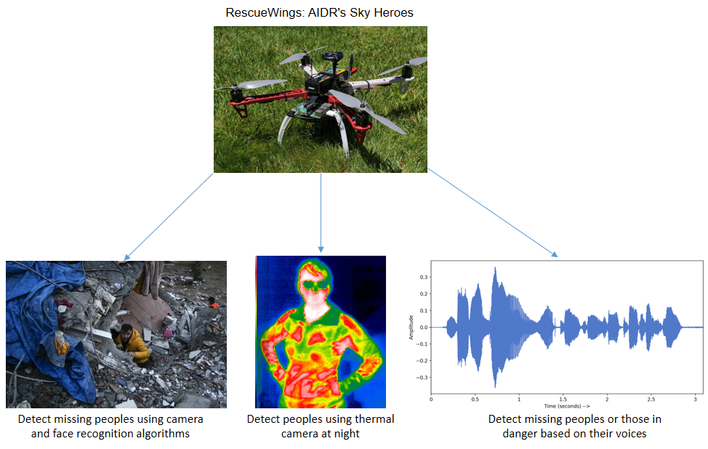
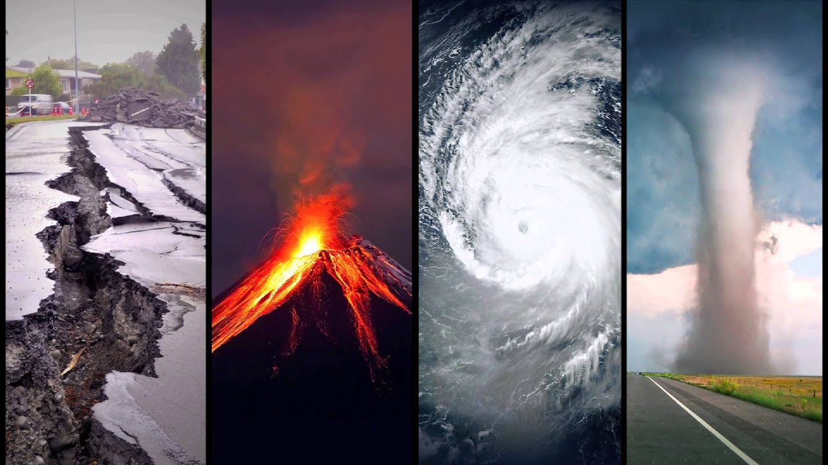
Challenge
Solution
+Each year, natural disasters pose a significant threat to lives and communities.
+In these crucial moments, every second counts.
+Swift and efficient disaster response remains a critical challenge.
RescueWings: AIDR's Sky Heroes
It's designed to save lives by quickly locating and rescuing survivors, even in the toughest conditions.

Slide 3
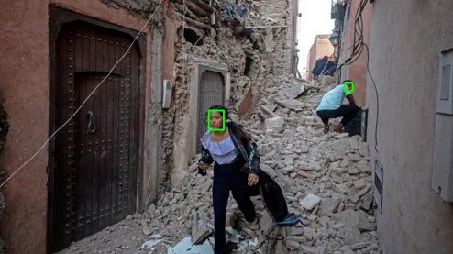
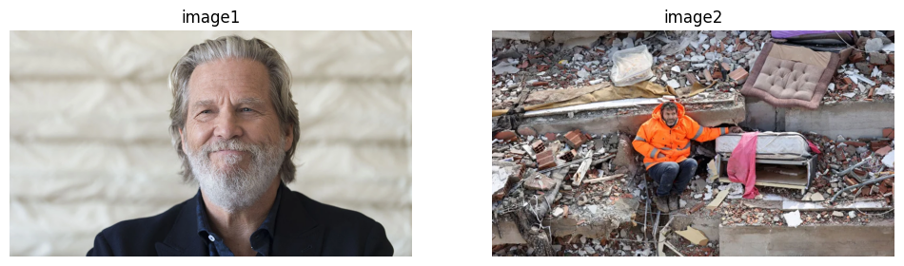
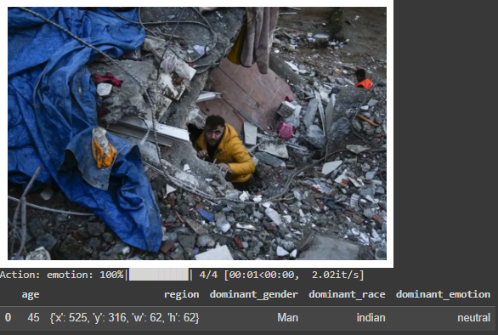
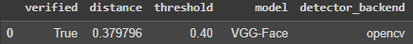

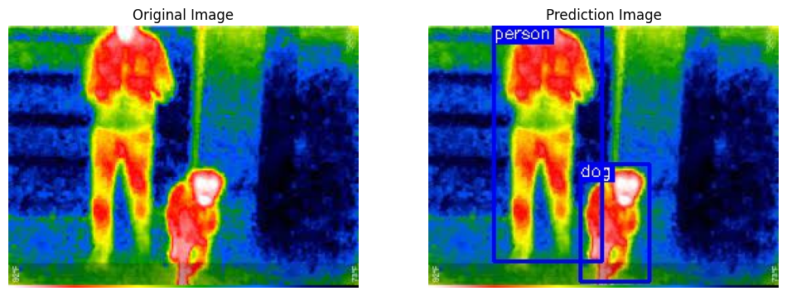
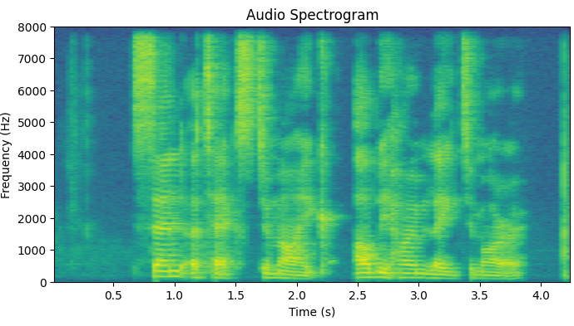

Ai software
Face detection
Face verification
Face analysis
Thermal image classification
Audio classification
Notes:
Relier les points obtenu pour obtenir la trajectoire

Slide 4
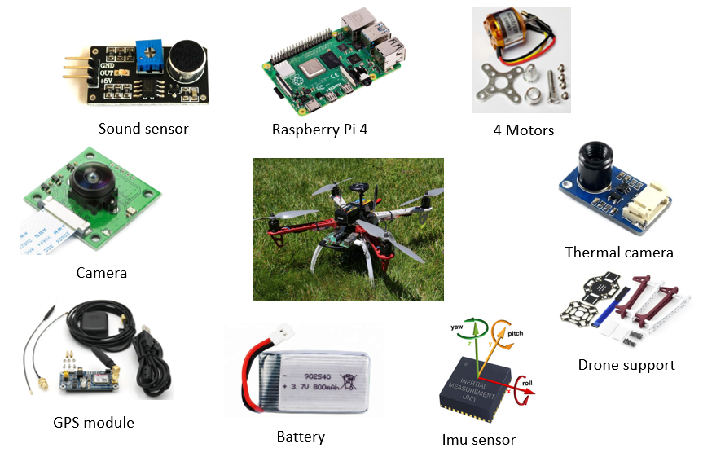
Drone

Slide 5
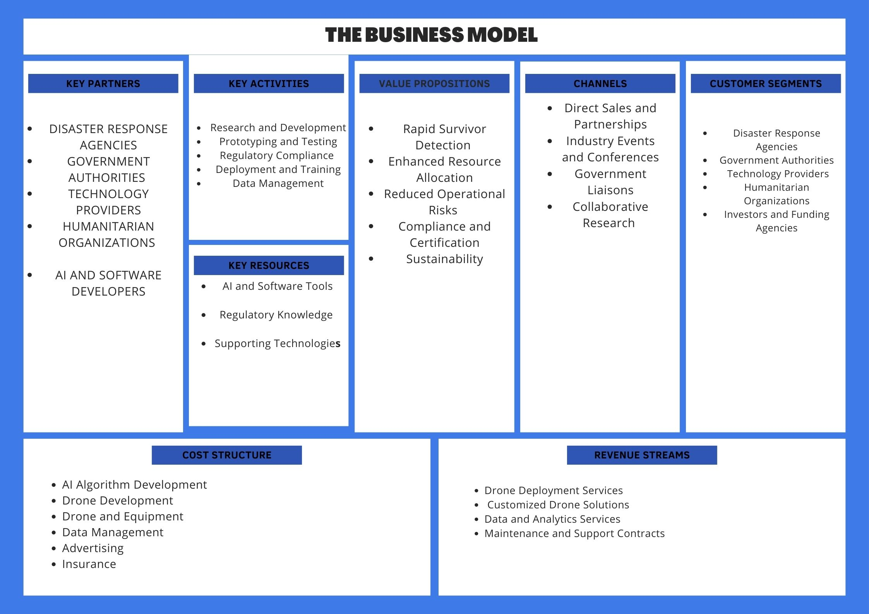
Business plan

