Slide 1
Breast Cancer Classification
IBM Advanced Data Science Capstone
Created by Oxana Matveyuk
Notes:
HI, my name is Oxana Matveyuk. I would like to present Breast Cancer Classification problem.

Slide 2
Use case
A woman’s chance of getting cancer is 1 in 8 chances
The chance a woman will die is about 1 in 38 chances
Early detection can catch the disease when it’s more treatable
Notes:
According to the American Cancer Society (ACS), breast cancer is the most common cancer in American women, except for skin cancers. Today, a woman’s chance of getting breast cancer is 1 in 8 chances. The chance that a woman will die from breast cancer is about 2.6%, or a 1 in 38 chance. Breast cancer still causes about 685.000 deaths annually in the world. Breast cancer research opens the door to finding better ways to prevent, detect, and treat breast cancer.
Early detection, often through screening (mammogram, breast ultrasound, MRI), can catch the disease when it is most treatable. Its detection ability depends on tumor size and breast tissue density.

Slide 3
dataset
Breast Cancer Wisconsin (Diagnostic) Dataset:
Description and size of specific cells
Diagnosis (Malignant (cancerous) and Benign (non-cancerous)
https://www.kaggle.com/yasserh/breast-cancer-dataset
Notes:
Breast Cancer Wisconsin (Diagnostic) Dataset is a public dataset. The dataset contains a description and size of specific cells in the breast with diagnosis. The goal is to classify tumors as malignant (cancerous) or benign (non-cancerous).
Dataset was downloaded from Kaggle .

Slide 4
Architectural choices (python)
For data analysis:
Pandas
Numpy
Matplotlib
Seaborn
For model:
Sklearn
Imblearn
Keras
Tensorflow
To delivery results to stakeholders:
Report - BreastCancerClassification.pdf
Jupyter Notebooks:
BreastCancerClassification.data_exp.v1.ipynb
BreastCancerClassification.etl.v1.ipynb
BreastCancerClassification.feature_eng.v1.ipynb
BreastCancerClassification.model_def_train_eval.v1.ipynb
Notes:
Our technology choice is open source: Python and its libraries which are good supported and actively updated tools. We do not use ApacheSpark, PySpark because Our dataset is too small. Single computer is enough to process data.
List of the libraries:
pandas and numpy to explore and transform data
matplotlib and seaborn for visualization
sklearn, imblearn, keras, tensorflow to build and evaluate models

Slide 5
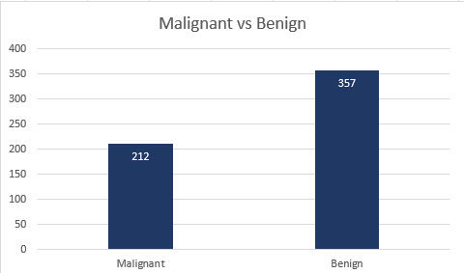
Data Exploring
Data types of features match their content
The dataset does not contain null values and duplicates
The value distribution of each feature makes sense
Outliers exist
Some features have skewed distribution
Highly correlated features exist
The dataset is slightly imbalanced
Total cases: 569
Notes:
During data exploring we investigated:
Data types of columns match their content. All columns have float data type and the datatype relates to the columns meaning (radius_mean, texture_mean, etc.)
All values are non-null in the source file.
The dataset does not have duplicates.
Column 'id' is meaningless for our study.
The value distribution of each feature makes sense.
Outliers exist and some features have skewed distribution.
Highly correlated features exist. These features contribute very less in predicting the output but can increase the computational cost
The dataset is slightly imbalanced – 37% is Malignant cases and 36% is Benign.

Slide 6
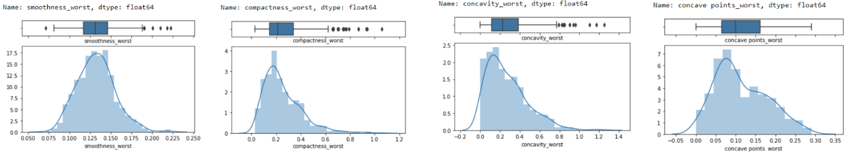
Data Visualization
EXISTING FEATURES (4 of 30)
Notes:
Here is visualization of some features: we can see outlieres and skewed distribution for some of them.

Slide 7
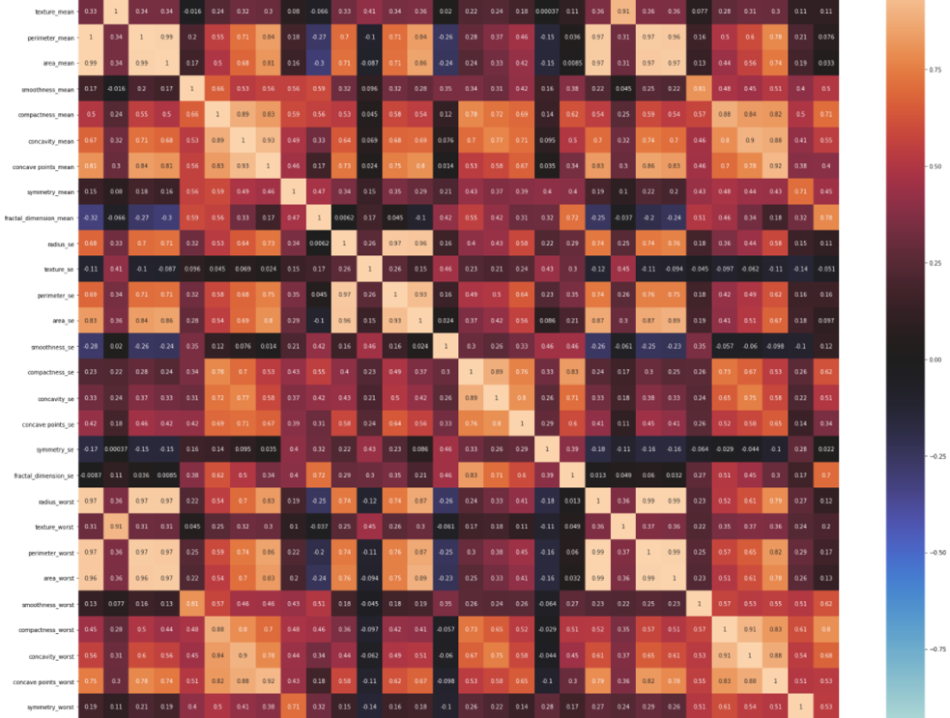
Data Visualization
Features correlation
Notes:
We can see that some features correlated more than 95%

Slide 8
Feature Engineering
Feature ‘id’ is removed
Outliers are updated using Inter Quantile Range technique
The features with correlation more than 95% are removed from the dataset
MinMaxScaller is applied for feature normalization
SMOTE algorithm is used to create a balanced dataset
Binary encoding is used to transform categorical target (Diagnosis)
Finally, we have 23 features:
'radius_mean', 'texture_mean', 'smoothness_mean', 'compactness_mean', concavity_mean', 'concave points_mean', 'symmetry_mean', 'fractal_dimension_mean', 'radius_se', texture_se', 'smoothness_se', 'compactness_se', 'concavity_se', 'concave points_se', ‘symmetry_se', 'fractal_dimension_se', 'texture_worst', ‘smoothness_worst', 'compactness_worst', 'concavity_worst', 'concave points_worst', 'symmetry_worst', 'fractal_dimension_worst'
Notes:
As a result of this step, we get more performed, manageable data and finally we can understand if our data make sense and helps to answer to our question. Feature creation significantly affects model train process because the dataset becomes optimal. We can reduce training time and computation cost, use less memory, avoid overfitting. Also correct features help to interpret model results easily.
What we did:
All values are non-null in the source file, so we do not need to handle missing values.
The dataset does not have duplicates.
Column 'id' was removed from the dataset because it is meaningless for our study.
Outliers were updated using Inter Quantile Range technique
The features with correlation more than 95% are removed (total - 7 features).
MinMaxScaller was applied for features normalization.
For categorical target we used Binary encoding: Malignant – 1; Benign - 0
For creating a balanced train dataset was used SMOTE algorithm - synthetic minority oversampling technique. It aims to balance class distribution by randomly increasing minority class examples by replicating them.

Slide 9
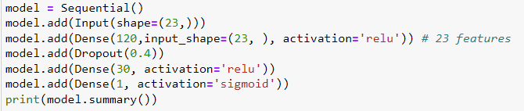
MODEL DEFINITION
Logistic Regression
Decision Tree
Gradient Boosting
Artificial Neural Network:
Sequential model with Input, Dense, Drop and output layers
Loss function: binary crossentropy
Optimizer: adam
Activation functions: relu and sigmoid
Notes:
The task is binary classification (Breast Cancer Classification). A target is 1 as 'Malignant' and 0 as 'Benign'.
4 models were chosen:
Logistic Regression - the best and commonly used model for binary classification. The output of Logistic Regression is a binary value (0 or 1).
Decision Tree - Each node is test of an attribute/feature, each branch presents full test. At the end (final leaf) we have class (0 or 1). So, this algorithm can be easily interpreted as set of rules.
Gradient Boosting - ensembled algorithm which uses decision tree models. Each model learns from the output of previous model - corrects the prediction errors made by prior models. This method usually has a good accuracy but can be easily overfitted.
Neural Network - the output layer with sigmoid activation function returns estimated probability which can be easily converted to 0/1 output using threshold.

Slide 10
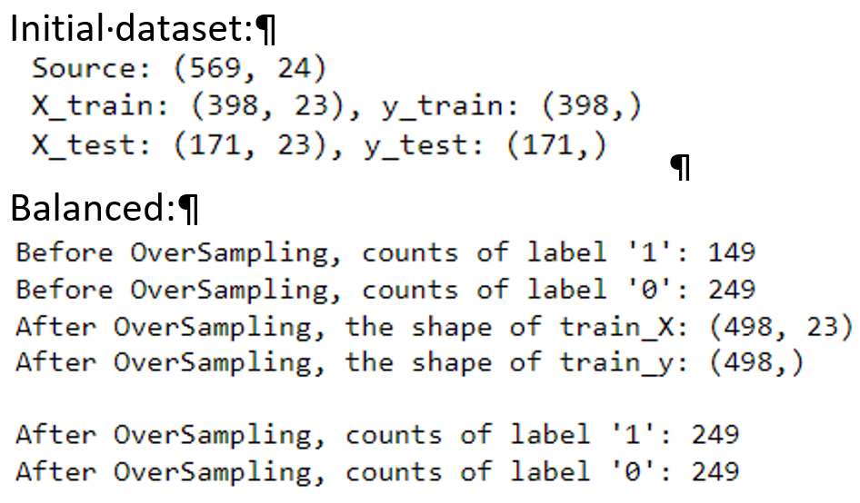
Model EVALUATION
Split initial dataset to train and test set(30%)
Created balanced dataset
Evaluation metrics:
Accuracy
Precision
Recall
F1
Notes:
For evaluation model we split our dataset on train and test datasets. Also we created balanced dataset to compare results.
For evaluation of Binary Classification was used Accuracy, Precision and F1 score.

Slide 11
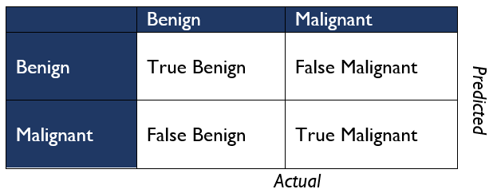
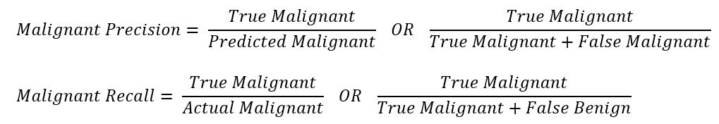
Model evaluation
Confusion matrix, Recall, Precision
Notes:
Accuracy does not always correctly demonstrate if the model is good or not for classification task (especially for unbalanced dataset) but it's always great to have good Accuracy.
Recall and Precision could work better but we should decide on what question we want to ask. What is better for us to have some False 'Malignant ' or False 'Benign'. Obviously to have False 'Malignant' is better because it's better to check than to miss. From other side we do not want to miss real Malignant cases, so Recall metric is also important for us. We should decrease False Benign.
F1 is harmonic mean of Precision and Recall and can help us to choose what classifier is better in common.

Slide 12
REsults
Logistic Regression
Gradient Boosting
Dataset | Accuracy | Precision (Malignant) | Recall (Malignant) | F1(avg)
Initial | 97% | 98% | 94% | 97%
Scaled | 98% | 98% | 95% | 97%
Balanced | 96% | 97% | 94% | 96%
Dataset | Accuracy | Precision (Malignant) | Recall (Malignant) | F1(avg)
Initial | 95% | 94% | 92% | 95%
Scaled | 94% | 92% | 92% | 94%
Balanced | 95% | 92% | 94% | 94%
Decision Tree
NN
Dataset | Accuracy | Precision (Malignant) | Recall (Malignant) | F1 (avg)
Initial | 91% | 84% | 92% | 90%
Scaled | 94% | 88% | 95% | 93%
Balanced | 91% | 82% | 95% | 91%
Dataset | Accuracy | Precision (Malignant) | Recall (Malignant) | F1 (avg)
Initial | 96% | 84% | 95% | 96%
Scaled | 98% | 97% | 97% | 97%
Balanced | 95% | 92% | 95% | 95%
Notes:
All models work pretty good for solving Breast Cancer Classification. The best model is NN model with adam optimizer, relu/sigmoid activation functions. And loss as binary-crossentropy.

Slide 13
Results (Tuning NN)
Different optimizers
Decrease number of units of hidden layers (16 units instead 120)
Optimizer | Activation | Activation(output) | Accuracy | Precision(M) | Recall (M) | F1(avg)
adam | relu | sigmoid | 98% | 97% | 98% | 98%
adagrad | relu | sigmoid | 92% | 95% | 84% | 92%
sgd | relu | sigmoid | 96% | 97% | 92% | 96%
Optimizer | Activation | Activation(output) | Accuracy | Precision(M) | Recall (M) | F1(avg)
adam | relu | sigmoid | 98% | 97% | 98% | 98%
Notes:
We see again that the best result was achieved by combination adam optimizer, acticvation function relu and sigmoid. It’s interesting that a smaller number of units gave us the same results.
So, we can simplify the model without losing accuracy.

Slide 14
Conclusion
The dataset was slightly transformed (highly correlated features were isolated, normalization was applied)
All models shows very good results (almost all metrics > 90%)
The best model is ANN:
Only 2 of 108 Benign cases were predicted as Malignant
Only 1 of 63 Malignant cases were predicted as Benign
https://github.com/omatveyuk/ibm_advanced_ds
Notes:
The source dataset did not need a lot of transformation.
All models work good for solving Breast Cancer Classification (almost all metrics more than 90%).
With small margin ANN model won. Also, we found, that we can simplify the model by decreasing number of units of hidden layers without losing accuracy.
Results for ANN (Artificial Neural Network) is amazing:
- Only 2 of 108 Benign cases were predicted as Malignant. But as we remember it’s better to check than to miss!
Only 1 of 63 Malignant cases were predicted as Benign. Not bad at all!
Thank you for your attention.

