Slide 1
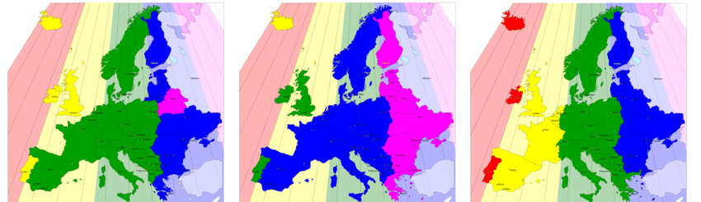
current
daylight savings
circadian
shifting european time zones to reduce peak energy demand
figure:
https://www.researchgate.net/figure/A-map-of-Europe-equivalent-to-Figure-1-the-actual-sun-based-time-zones-are-drawn-as_fig2_335021442

Slide 2
current time zones
vector image:
https://www.vecteezy.com/vector-art/5353680-doodle-freehand-drawing-of-europe-map

Slide 3
proposed changes
no shift more than one hour
largest economies all one hour apart to support each others peak demand

Slide 4
methodology
https://github.com/omaxim/Timezone-Shift

