Slide 1
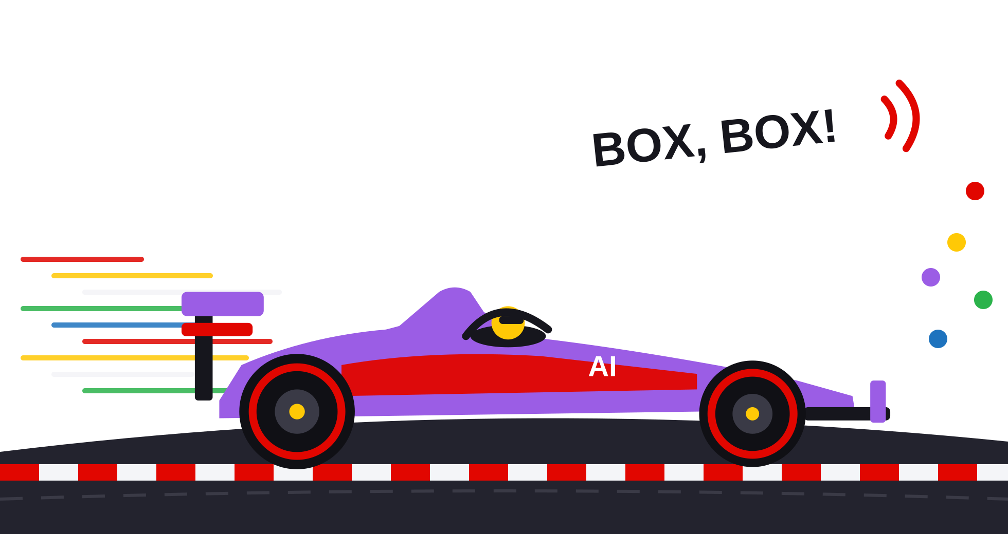
PitWall AI
CA-3 · Agentic AI proof of concept
Five AI agents that make the Formula 1 pit-stop call, and show their work.
Python · Streamlit · Groq gpt-oss-120b · scikit-learn · 162 real races (2019–2026)
Notes:
Introduce yourself and the project. PitWall AI is a proof of concept for agentic AI: five software agents share one workspace to decide a Formula 1 pit-stop call (when to stop and which tyres), using a Python simulation for every number and a rule-based Critic as a safety gate. It runs on made-up scenarios and on 162 real races, and can compare its call with what the team really did. Add your name and course details here if needed.

Slide 2






A pit stop is a race-changing bet
THE PROBLEM
Every lap the pit wall decides: box now, box later or stay out, and which tyres. The best answer changes the moment something happens on track.
~22 s
× 0.5
+10 s / lap
26–50 laps
lost driving through the pit lane and changing tyres
the cost of a stop under a Safety Car
for slick tyres on a wet track
safe life of soft, medium and hard tyres
PitWall's default; real races measure it from real stops
Miss the window and rivals gain a cheap stop
The wrong tyre at the wrong moment ruins a race
Old tyres lose time every lap, then fall off a cliff
Figures are the model assumptions used in PitWall AI (pitwall/config.py), shown to explain the trade-offs.
Notes:
Explain why strategy is hard: a stop costs around 20-25 seconds, but a Safety Car halves that cost; rain makes slick tyres useless; tyres wear and eventually fall off. These numbers are the assumptions inside our model (config.py), not official F1 data. The decision has to be made quickly, with incomplete information.

Slide 3



Who needs it, and what's missing today
WHO IT'S FOR
Students
Calculates
Explains
Checks rules
learning race strategy and agentic AI with something they can poke at
Chatbot alone
✕
✓
✕
F1 fans and analysts
Spreadsheet / simulator
✓
✕
~
replaying real moments and asking “what if?”
Black-box ML
✓
✕
✕
Teachers
showing an AI that has to justify itself and obey rules
PitWall AI
✓
✓
✓
Typical approaches, simplified, to show the design goal: answers that are calculated, explained and checked.
Notes:
Intended users: students, fans and analysts, and teachers. The gap: a chatbot alone can explain but may invent numbers; a spreadsheet or simulator calculates but doesn't explain or enforce rules; a black-box ML model predicts without reasons or safety checks. PitWall AI combines the three: an AI that reasons, a simulator that calculates, and a rule-based Critic that checks. This matrix is a simplification of typical tools, used to motivate the design.

Slide 4
What we set out to build
OBJECTIVES AND SCOPE
1
Five agents with clear roles, sharing one workspace (an agentic workflow, not just a chatbot)
Built and working
Out of scope
Example scenarios + 162 real races
AI-model brain or rules
ML tyre model
Chat that runs scenarios
Hindsight “what really happened”
Decision records, Docker + AWS guide
Live timing feed
Overtaking, DRS and tyre-temperature physics
Predicting Safety Cars or rain
Use by a real team
2
Every number from a transparent, lap-by-lap Python simulation
3
Every plan checked against racing rules, with a bounded revision loop
4
Tested on real races and compared with what the teams actually did
5
Plain-English explanations: live agent view, chat, decision records
Notes:
Five objectives, matching the assignment's requirement for an agentic workflow with validation. Be clear about scope: this is a proof of concept that replays history; it does not use a live feed, does not model overtaking or tyre temperature, and never predicts Safety Cars or rain (those are given as forecasts or, optionally, from the real race).

Slide 5



AI proposes · Python calculates · Rules check
THE SOLUTION
AI proposes
Python calculates
Rules check
The AI model writes the plan (which strategies to test) and makes the final call from a safe shortlist. Groq's gpt-oss-120b by default; Gemini or Ollama also work.
A lap-by-lap simulator times every option: tyres, fuel, weather, traffic, Safety Cars. Tyre wear from a formula or an ML model.
The Critic rejects anything unsafe or illegal and sends work back (max two times). It is deliberately not AI.
What you can do with it
162 real races, offline
Watch the agents live
Chat runs whole scenarios
Reveal what really happened
ML tyre model
Every decision recorded
Notes:
The core idea in one line: the AI proposes, Python calculates, rules check. The AI model is used where judgement and language help (planning which options to try, choosing among safe options, explaining). Numbers always come from the simulator, and the Critic's rules can't be overridden by the AI. Without an API key, the same agents run on rules, so the demo never breaks.

Slide 6



How the pieces connect
SYSTEM ARCHITECTURE
Streamlit UI · 8 pages
Race Control · Agents · Chat · Strategy Lab · Model Lab · Setup · Records · About
Race inputs
Outputs
Example scenarios
Orchestrator · one shared workspace · bounded revision loop
Call + team radio
4 fictional races
risk, margin, explanation
Real races (built in)
162 races, 2019–2026
Planner
Race Research
Strategy Executor
Strategy Critic
Pit Wall Operations
Decision record
FastF1 (optional)
AI model
Python tools
Python simulator
Rules
AI model
JSON Lines, JSON/CSV export
downloads a race
Reality check
Events and chat scenarios
Critic sends work back: new plan or re-run (max 2)
vs the team's real strategy
SC, VSC, rain, wear
ML tyre model
Rules + parameters
The Critic's rules never come from the AI.
learned tyre-wear curves
pitwall/config.py
AI model client Groq · Gemini · Ollama through one OpenAI-style client; also powers the chat
Notes:
Walk the diagram left to right. Inputs come from example scenarios, 162 built-in real races, optional FastF1 downloads, or events and chat scenarios. The orchestrator passes one shared workspace through the five agents. The Critic can send work back to the Planner (new plan) or the Executor (re-run), at most twice. Supporting services sit underneath: the AI client (used by Planner, Operations and the chat), the ML tyre model (used by the Executor) and the rule parameters (used by the Critic). Outputs: the call with a team-radio message, a saved decision record, and for real races a reality check. The Streamlit UI on top drives everything.

Slide 7
One job each, one shared workspace
THE FIVE AGENTS
Planner
Race Research
Strategy Executor
Strategy Critic
Pit Wall Operations
AI model
Python tools
Python simulator
Rules
AI model
Reads the race and decides what to analyse and which pit-stop plans to test, including its own custom plans.
Measures track status, tyre age and safe life, gaps to other cars and the weather forecast.
Simulates every plan lap by lap to the flag, and projects rivals and finishing order.
Checks every plan against racing rules and every number; sends work back when needed.
Makes the call, explains it, writes the team radio and saves the decision record.
Guard rail: Unknown tyres dropped; stay out and box now always kept
Guard rail: Only runs the analyses the plan asks for
Guard rail: The AI never produces a lap time
Guard rail: Max two revisions, then “review required”
Guard rail: Only Critic-approved options within 2 s of the fastest
Notes:
Each agent has one job. The Planner and Pit Wall Operations use the AI model; Race Research and the Executor are Python tools; the Critic is pure rules. Every agent writes what it was given, what it did and what it decided into the shared workspace and the activity log, which the Agents page shows step by step.

Slide 8

Leclerc, Monza 2024, after lap 10
WORKING PROCESS · A REAL EXAMPLE
Real timing up to lap 10 only. Ferrari on 10-lap-old mediums, running P2 of the 5 simulated cars, 43 laps to go.
1 Check inputs
2 Plan
3 Research
4 Simulate
5 Check
6 Call
All valid. Pit loss 22 s assumed (too few real stops before lap 10 to measure).
7 options: stay out, box lap 11 or 14, on soft, medium or hard.
Track status, tyres, gaps: PIA 1.2 s ahead, NOR 1.8 s behind.
7 lap-by-lap runs to the flag, with rivals' likely strategies.
2 valid, 5 rejected, e.g. mediums would be 39 laps old (limit 38).
Stay out, then box lap 14 for Hard. 5.2 s better than the next option. Low risk.
Reveal: the team boxed on lap 15 for Hard → Match. Leclerc won. The model's time to the flag for the team's strategy was 3.0 s off the real 60:30.1 (0.1%).
Notes:
A real, reproducible example from the app. The agents only see laps 1 to 10. The Planner tests seven options; the Critic rejects five (tyres would exceed their safe life, or the two-compound rule); Operations picks 'stay out, then box lap 14 for hards'. Only then does the user press Reveal: Ferrari boxed on lap 15 for hards, so the verdict is a match, and the model's estimate of the race time was within 3 seconds. Note the pit-loss value was an assumption here, which the app labels in its data provenance.

Slide 9
Every number comes from a lap-by-lap model
IMPLEMENTATION · THE SIMULATOR
Lap time =
The Critic's rules
base pace
+ tyre effect
+ weather
Stops inside the remaining race, never on a closed pit lane
A new tyre set must be available
No tyre past its safe life (shorter with high wear)
Two different dry compounds, unless wet tyres are used
At most 2 laps on slicks on a wet track
Every number finite, adding up exactly, each stop counted once
+ traffic
+ fuel + track
+ SC / VSC
Time to the flag = every remaining lap + each stop's pit loss
Safety Car / VSC: laps 1.40× / 1.30× slower, stops cost 50% / 60%
Tyre effect: hand-written formula, or the ML model's learned curve for that circuit
Without AI, the call is the fastest valid option (ties: fewer stops, then the later stop).
A stop on lap P
Lap P−1
Lap P
Pit stop
Lap P+1
Lap P+2
the convention every agent and test uses
old tyres
in-lap, still old tyres
pit loss added once
new tyres, age 0
new tyres, age 1
Notes:
The simulator is deliberately simple and transparent so every number can be explained. Each lap is a sum of named effects. Safety Car and VSC factors are assumptions stored in config.py. The Critic's rules come from F1 practice (two-compound rule, safe tyre life) plus number checks that catch any bad simulation output.

Slide 10



Using an AI model without trusting it blindly
IMPLEMENTATION · THE AI MODEL
Race brief
AI model
JSON reply
Validator
Agents act
short JSON of the facts: lap, tyres, safe life, pit loss, SC, rain, gaps
Groq · OpenAI gpt-oss-120b (free plan); Gemini or Ollama
plan to test, or the chosen option + why + radio
checks every field before anything is used
plan becomes options; choice becomes the call
If the AI is missing, slow, rate-limited or gives an unusable answer → the agent's rules take over, and the activity log says so. The demo never depends on the AI.
Planner: Unknown tyres or unreadable laps dropped; illegal plans kept so the Critic visibly rejects them
Operations: May only pick a Critic-approved option within 2 s of the fastest; anything else is refused
Team radio: An AI message that contradicts the plan (wrong lap, tyre or “box now”) is replaced
Free plan: ~30 requests/min, 1,000/day, 8,000 tokens/min [1]: short briefs, low reasoning effort, one retry
Notes:
The AI is called through one small OpenAI-compatible client written with Python's standard library, so Groq, Google Gemini and a local Ollama all work. The agent sends a compact factual brief and asks for JSON. A validator checks every field. The guard rails are the important part: the AI can only choose among options the Critic approved, it never produces numbers, and its radio message is checked against the plan. Free-plan limits (from Groq's published rate limits, source [1]) shaped the design: short prompts and an automatic rules fallback.

Slide 11



Learning tyre wear from 139,025 real laps
IMPLEMENTATION · ML TYRE MODEL
162 real races
Clean laps only
139,025 laps
Gradient-boosted trees
Curves for the simulator
timing data 2019–2026, built in
dry tyres, green flag, no pit laps, no rain
each vs the driver's typical lap
scikit-learn, monotonic
wear + race progress per circuit
Inputs: compound · tyre age · race progress · circuit · season · gap to the car ahead · stint number
Constraints: older tyres can only be slower; later in the race and more space ahead can only be faster.
2019
2020
2021
2022
2023
2024
2025
2026
Step 1 · train on 2019–2023, score on 2024 → choose the model size (50 trees)
Step 2 · train on 2019–2024 (102,869 laps) → test on 40 races from 2025–2026 it never saw (36,156 laps)
Step 3 · refit on every season → curves the Strategy Executor can use
Notes:
Each clean lap is compared with the same driver's typical lap in that race, which removes car and driver speed, so the model learns tyres and fuel. The model is scikit-learn's HistGradientBoostingRegressor with monotonic constraints for physical sense. The key methodological choice: model size was chosen on the 2024 season, never on the test seasons, because adding trees made results worse on newer seasons. 156 of the 162 races contribute usable laps after filtering.

Slide 12
21% lower lap-time error on unseen races
RESULTS · ML TYRE MODEL
0.559 s
0.44 vs 0.03
#1 input
ML error per lap
R², ML vs formula
race progress (fuel + track grip)
Lap times are noisy (traffic, battles, mistakes): an R² of 0.44 means the model explains under half the lap-to-lap variation.
Notes:
On 40 races from 2025 and 2026 that the model never saw, the ML model's average error is 0.559 seconds per lap, against 0.704 for our hand-written formula and 0.792 for no model at all: 21 percent lower than the formula, and better on every compound, especially softs. Be honest about R-squared: 0.44 is modest because lap times are noisy, but the formula only reaches 0.03.

Slide 13
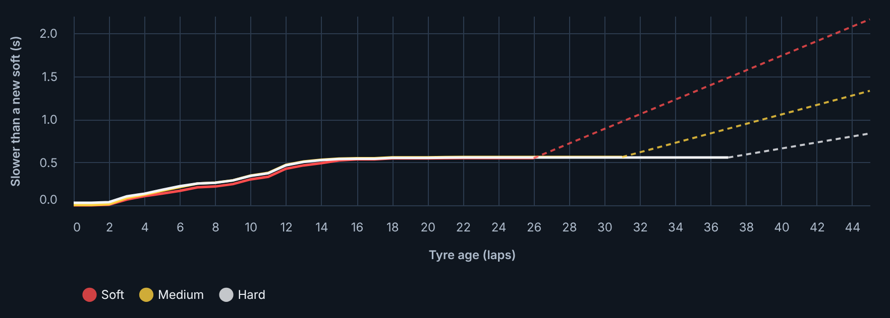


Real tyres wear more alike than the textbook says
INSIGHT FROM THE DATA
What the model learned about tyre wear (all circuits, average)
Solid lines are learned from real laps: soft, medium and hard lose time at almost the same rate for ~25 laps.
Dashed lines go beyond the real data (bars, bottom left) and are extended at their recent slope.
Race progress matters most: shuffling it adds 0.45 s of error; tyre age adds 0.09 s.
Real screenshot · Model Lab → ML tyre model (chart area)
Where the real data stops: 95% of laps (solid); dashed = extended, up to 45 laps
Likely survivorship: teams stop before tyres fall off, so the data rarely shows the cliff.
Soft
26 laps
Medium
31 laps
Hard
37 laps
Notes:
This chart is a real screenshot of the app. The ML model learned that, in real races, the three dry compounds degrade similarly for the first 25 or so laps, much more alike than our formula assumes. Beyond the ages seen in the data, the curve is extended at its recent slope (never flatter than the formula). A plausible reason for the flat curves is survivorship: teams pit before tyres collapse, so the dataset rarely contains the cliff.

Slide 14




What each tool does in this project
TECHNOLOGY STACK
Python 3.11–3.13
Streamlit
All agents, simulation, validation and data handling
8-page web app, live agent view, chat, top navigation
pandas + NumPy
Altair
Lap data, race states, simulation arithmetic
Interactive charts: options, race timeline, ML results
scikit-learn
Groq API · gpt-oss-120b
Gradient-boosted tyre model, evaluation, feature importance
Agent brain (free plan); Gemini or Ollama as alternatives
Real F1 timing data
JSON Lines records
162 races from the TracingInsights archive [4]; FastF1 optional [5]
Every decision and reality check saved, exportable
pytest + AppTest
Docker + AWS EC2
192 automated tests, including headless page tests
Container image and step-by-step deployment guide
Notes:
Explain the role of each technology rather than just naming it. Python holds all logic. Streamlit gives a web UI without front-end code. pandas and NumPy handle the lap data and arithmetic; Altair draws the charts; scikit-learn trains the tyre model. Groq hosts OpenAI's open-weight gpt-oss-120b for free with an API key. Real timing comes from the TracingInsights archive (MIT licence), itself built with FastF1. pytest plus Streamlit's AppTest test the logic and the pages. Docker and an EC2 server are used for deployment.

Slide 15
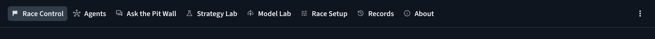
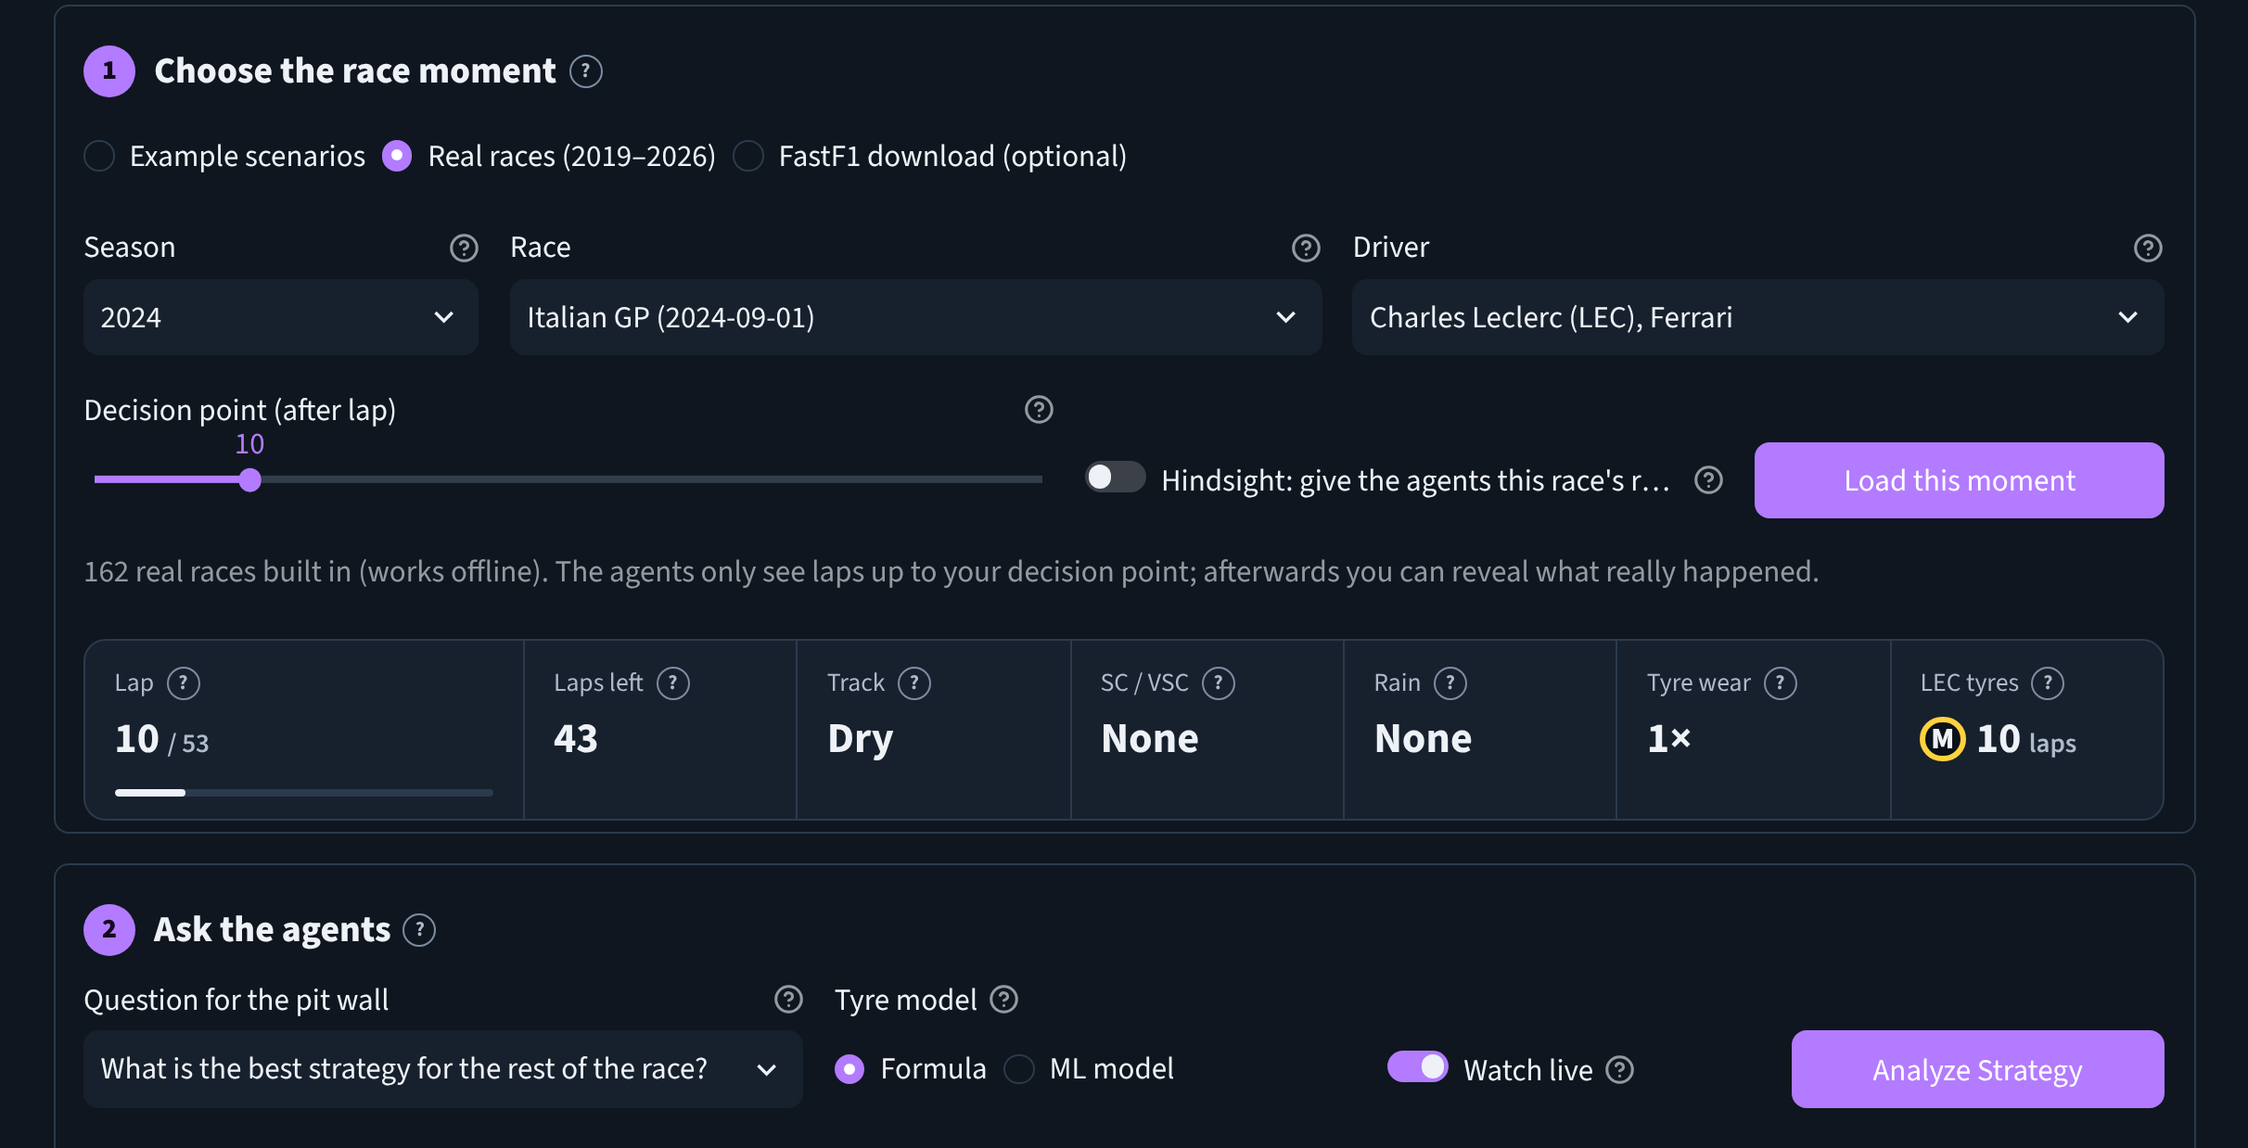
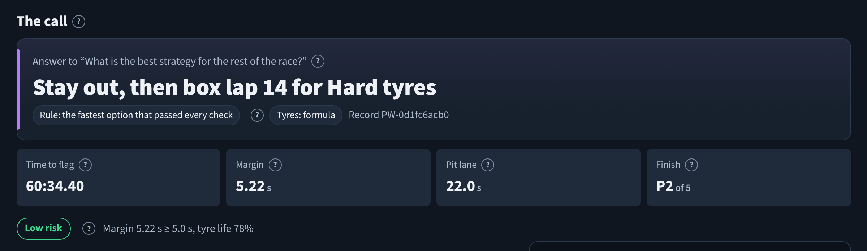
Pick a moment, ask the agents, get a call
INTERFACE · RACE CONTROL
1
3
1
Season, race, driver and lap: real timing, offline
2
Question, tyre model (formula or ML) and live view
2
3
The call: time to the flag, margin, finish and risk
Real screenshots of the running app (rules mode).
Notes:
Real screenshots. The top bar has eight pages, one job each. On Race Control the user picks a real race moment (here Leclerc at Monza 2024 after lap 10), chooses the question and tyre model, and presses Analyze Strategy. The call appears with its numbers and a risk rating computed by an explicit rule.

Slide 16
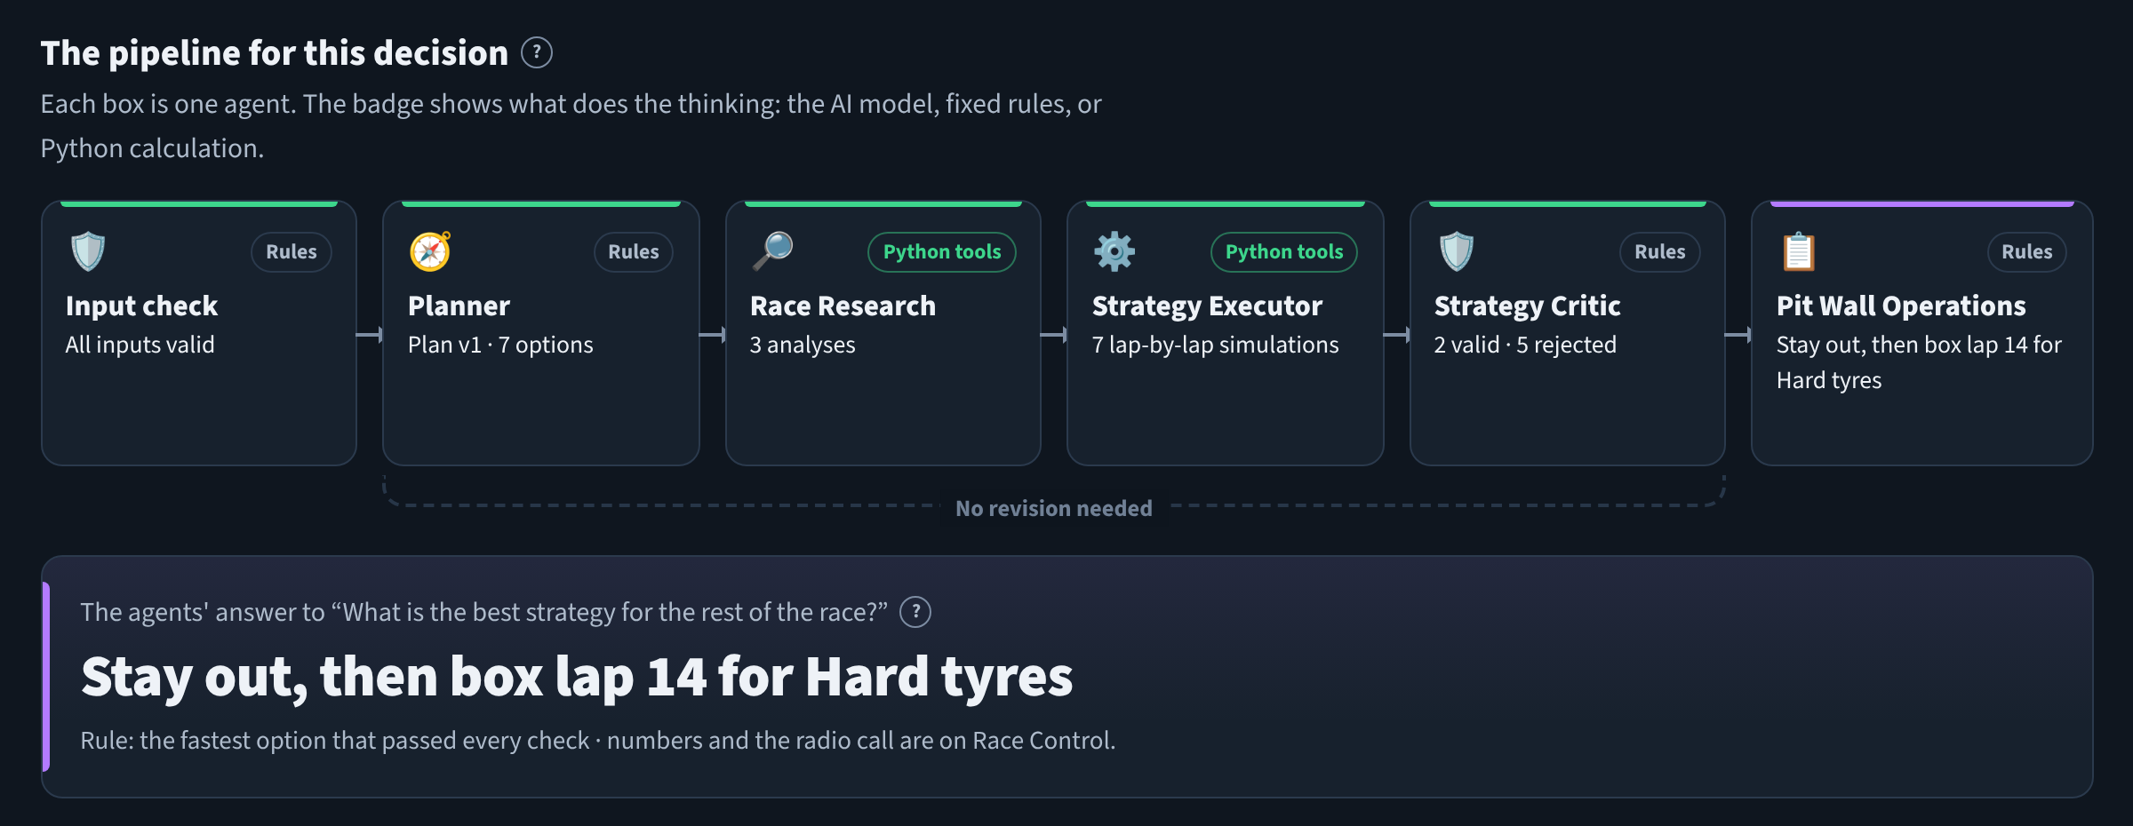
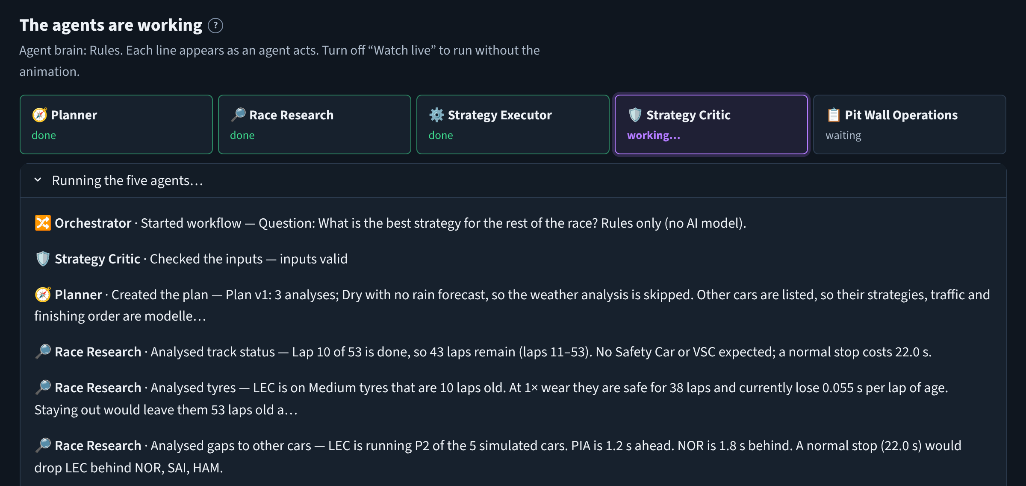
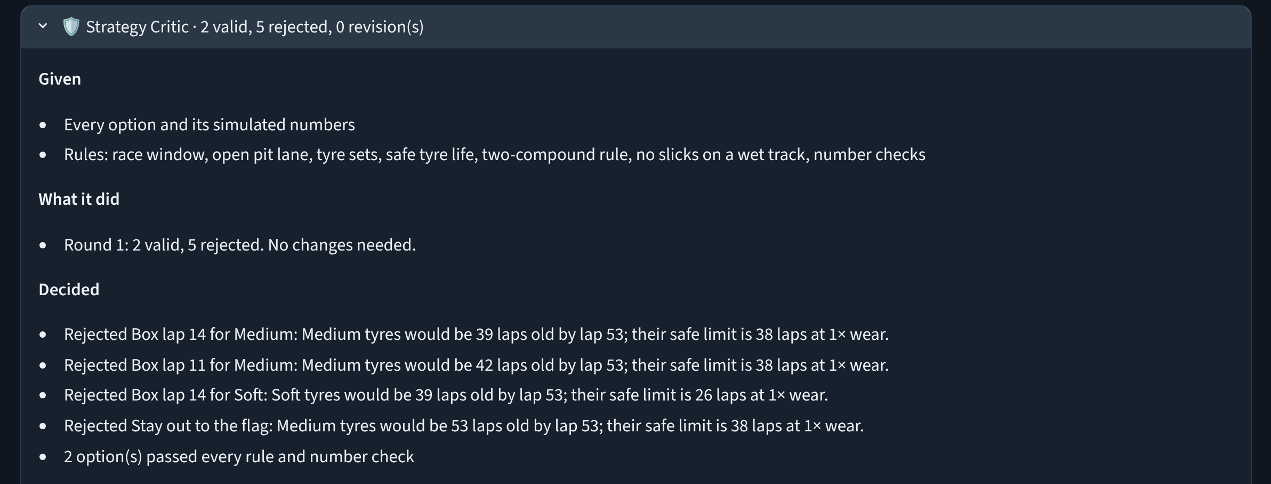
Watch the agents think, step by step
INTERFACE · AGENTS PAGE
1
2
1
Pipeline: each agent's result and its brain (AI model, rules or Python)
3
2
Watch live: each line appears as the agent acts; the working agent glows
3
Every agent's panel: given · did · decided · passed on. Here the Critic rejects 5 of 7 options
Notes:
This is the 'agentic' part made visible. With Watch live on, each step appears as the agent performs it. Afterwards the pipeline shows each agent's result, and expandable panels show what each agent was given, what it did, what it decided and what it passed on, all taken from the real run log.

Slide 17
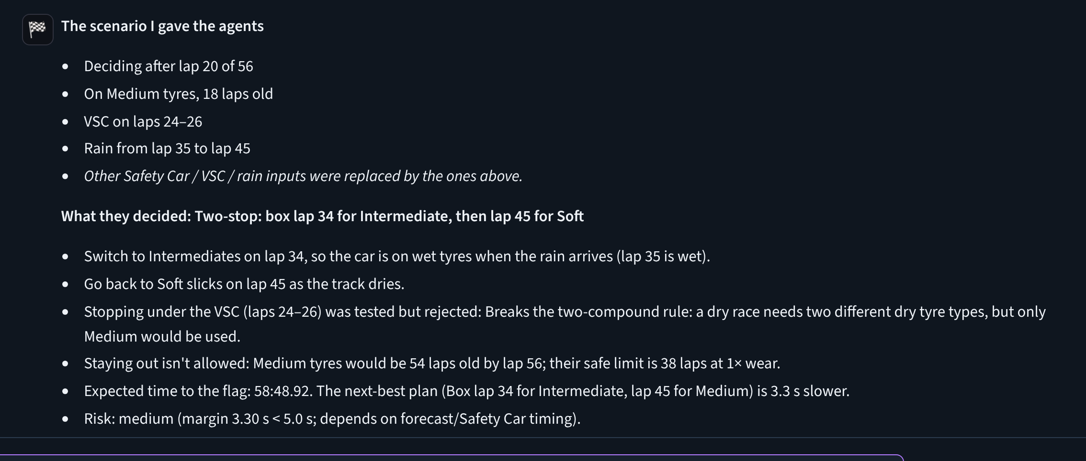
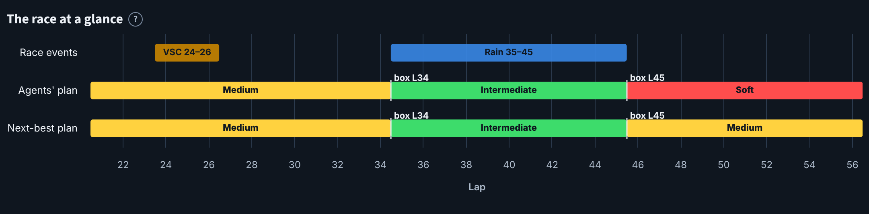
Describe a race; the agents play it out
INTERFACE · ASK THE PIT WALL
“After lap 20 of 56 on 18-lap-old mediums, VSC on laps 24–26 and rain from lap 35 to 45”
What the user typed in the chat
Reads lap, tyres, Safety Car, VSC, rain, wear, pit-stop time
Runs all five agents on a copy (never saved)
Answers in plain English with a race-timeline chart
One click loads it into the race inputs
With an AI model, it also reads unusual wording
Notes:
The chat is connected to the agents. A whole scenario can be described in plain words; the app builds a copy of the race inputs, runs all five agents and explains the outcome simply: here, switch to intermediates on lap 34 just before the rain, back to softs on lap 45. The timeline chart shows the race events and the plan.

Slide 18
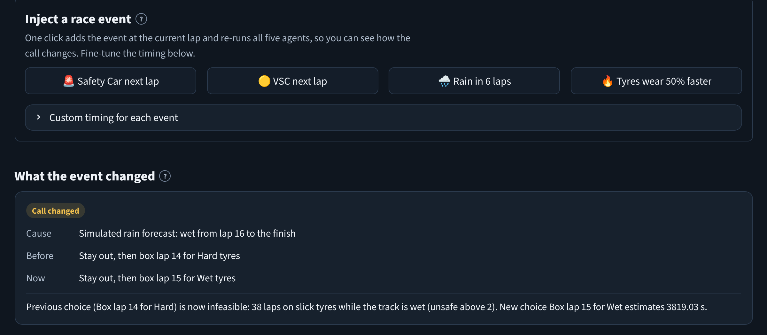
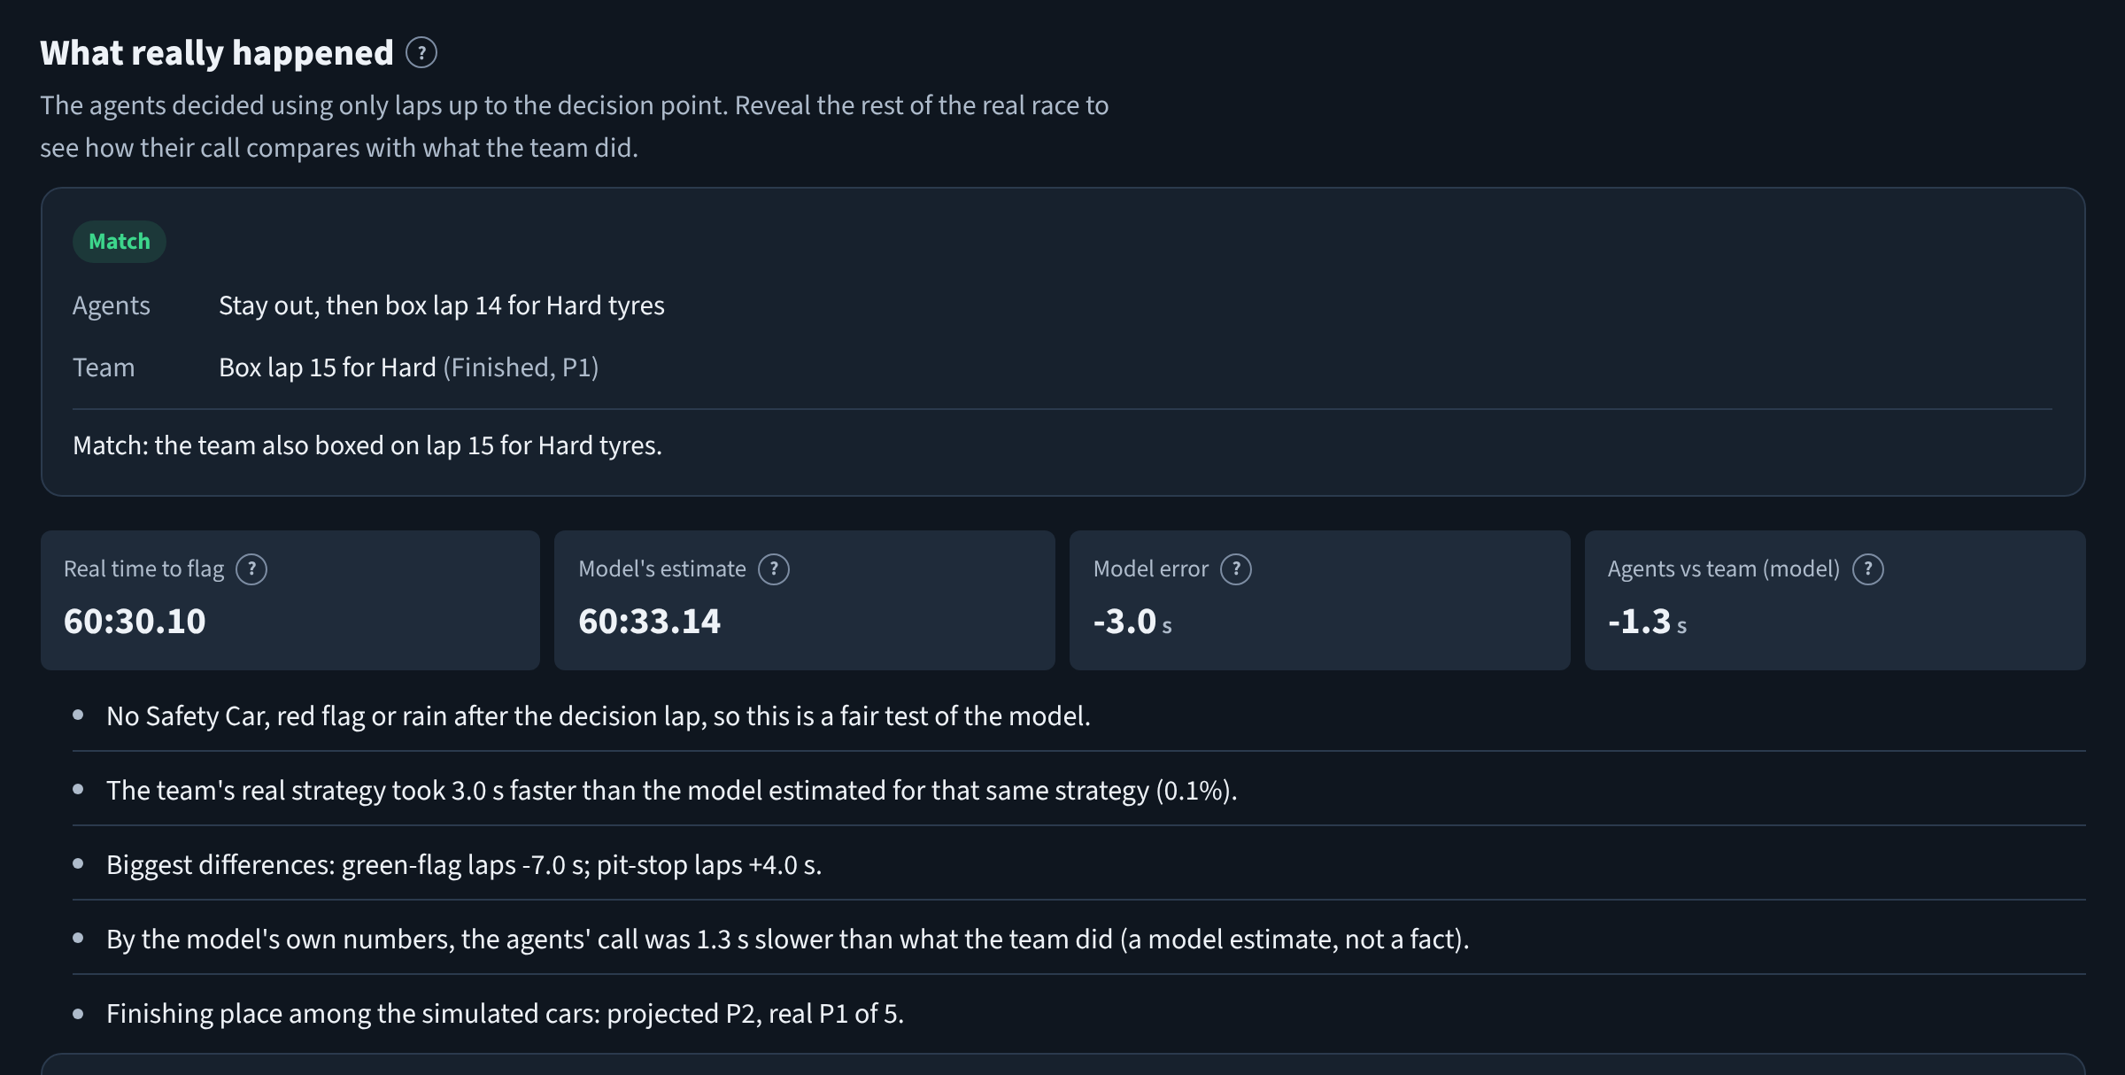
Throw events at it, then check against history
INTERFACE · STRATEGY LAB AND REALITY CHECK
One click: rain in 6 laps → the call changes from Hard to Wet tyres, with the reason.
After deciding, reveal the rest of the real race: same call as Ferrari, model 3.0 s off the real time.
Notes:
Strategy Lab injects events like a Safety Car, a VSC, rain or extra tyre wear in one click, re-runs the agents and shows what changed and why. On real races, 'Reveal what really happened' reads the laps after the decision only after the agents have decided, so hindsight can't leak into the decision.

Slide 19
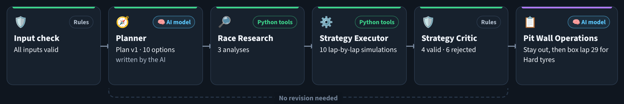
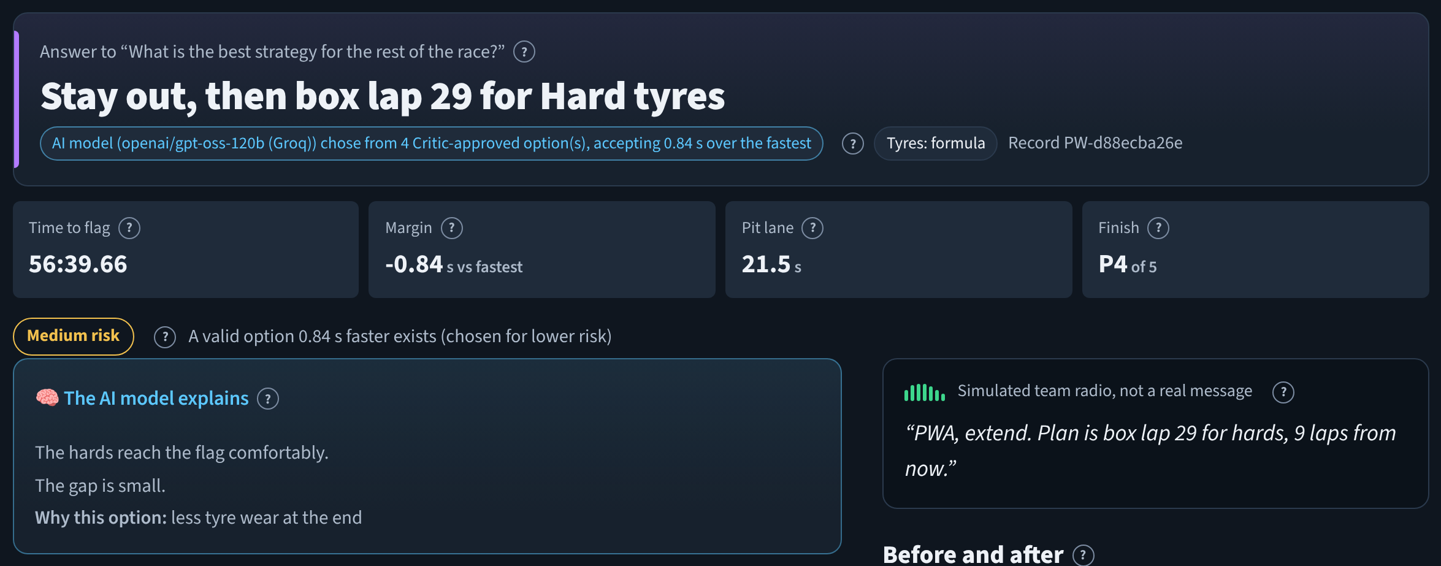
With the AI model switched on
INTERFACE · AI MODE (TEST RUN)
Test run: replies from a local stand-in server that mimics Groq's API. The AI texts shown are canned test replies, not gpt-oss-120b output.
1
2
1
Planner and Pit Wall Operations show the 🧠 AI model badge; the plan was written by the AI
2
The chip says who decided: the AI chose from 4 Critic-approved options, accepting 0.84 s for less tyre wear
3
Its radio message said “box this lap”, which contradicted the plan, so the template message was used
Notes:
Be transparent: the build environment could not reach Groq, so these screenshots come from a local test server that speaks the same API and returns canned replies. They show how the interface reports AI decisions and how the guard rails act: the AI's choice was accepted because it was on the approved shortlist, while its radio message was rejected because it contradicted the plan. With a real Groq key the same screens show real model output.

Slide 20

192 automated tests, all passing
TESTING AND VALIDATION
No hindsight
a real race state is identical after deleting every later lap
Rules hold
illegal or impossible plans are rejected; revisions stop at 2
AI can fail safely
bad JSON, refused choices, rate limits and wrong keys fall back to rules
Pages work
all 8 pages render; inputs survive page switches and live runs
ML beats formula
on unseen seasons, for every compound (shipped model)
Passed on 3 setups: Python 3.13 + Streamlit 1.65 · Python 3.13 + Streamlit 1.60 (oldest supported) · Python 3.12 + Streamlit 1.66
Notes:
The test suite has 192 tests, all passing on three combinations of Python and Streamlit versions. Highlight the ones that prove the design claims: no hindsight leakage, rules always enforced, safe AI failure, pages that work, and the ML model's advantage. The AI tests use a local stand-in server, because a real API can't be part of automated tests. Pages were also checked in a real browser.

Slide 21
How often did the agents make the team's call?
RESULTS · AGENTS VS REAL TEAMS
406 real moments: drivers who finished P1, P5 and P10 in each race, 3 laps before their first real pit stop. Rule-based agents, so results repeat exactly.
Clean = no Safety Car, VSC, red flag or rain after the decision.
Reading it: ML tyres predict race time far better, but their tyre choices match teams a little less often. Agreement is a sanity check, not a score: teams know tyre temperatures and rivals' plans.
Caveat: the shipped ML model is trained on every season, so 2019–24 is partly in-sample; on unseen 2025–26 the clean-race error is 5.8 s vs 16.0 s (2025) and 1.3 s vs 9.0 s (2026), from small samples.
Notes:
This is the most honest result in the project. Across 406 real moments the agents made exactly the team's call 43 percent of the time with the formula, 39 percent with ML tyres; the tyre choice matched 68 and 61 percent. Where nothing unpredictable happened, the race-time error drops from 17.4 to 10.1 seconds with the ML model. Mention the caveat: the evaluation uses the model trained on all seasons, so only 2025-26 is a fully fair test there.

Slide 22

What was hard, and how it was solved
CHALLENGES
Hindsight leaking into real races
Messy historical data
Race state built only from laps up to the decision; the reveal is a separate step, tested
2018, six incomplete 2019 races and Belgium 2021 excluded; 162 clean races kept
AI answers can't be trusted blindly
ML overfitting to old seasons
JSON validation, approved shortlist, radio check, retry, rules fallback
More trees scored worse on 2025–26, so model size is picked on 2024 instead
Inputs lost between pages
Free-plan token limits
Widget state kept across pages; verified on Streamlit 1.60 to 1.66
Compact briefs, low reasoning effort, rules-based baseline in the chat
Notes:
Pick two or three to discuss in detail. The hindsight problem is subtle: if any later lap leaks into the race state, the agents would cheat. The data had real problems (2018 tyre labels didn't match real stops). The AI needed guard rails. The ML model looked better with more trees on a random split but worse on newer seasons, which a season-based validation revealed.

Slide 23
Honest limits, realistic next steps
LIMITATIONS AND FUTURE SCOPE
Limits today
Next steps (planned, not built)
Simplified physics: no overtaking, DRS, tyre temperature or damage
Few plan shapes: now, +3 laps, event-timed, AI custom plans
Safety Cars and rain are given, never predicted
AI quality and speed depend on a free plan; rules take over when it fails
Agreement with teams is an approximate measure
Historical replay, not a live tool
Test every stop lap, not just a few shapes
Safety Car and rain risk as probabilities (Monte Carlo runs)
Traffic and overtaking model learned from real gaps
Tune the AI prompts against the 406-moment evaluation
Live timing feed during a race weekend
HTTPS and login for the AWS deployment
Notes:
Keep limits and plans clearly separated: everything on the right is a proposal, not a feature. The most valuable next step is probably probabilistic Safety Car and rain risk, because unpredictable events cause most of the disagreement with real teams.

Slide 24


An AI pit wall you can check
THE TAKEAWAY
Useful because it is checkable: the AI proposes, the simulator calculates, the Critic enforces the rules, and every step is visible and recorded.
5 agents
162 races
AI model or rules as the brain
real moments, compared with teams
−21%
192 tests
lap-time error with the ML model
passing on 3 setups
Thank you · Questions?
Notes:
Close with the main message: what makes this agentic AI useful is not that it is clever but that it is checkable. Repeat the four numbers, then invite questions. Good demo to offer: load a real race, press Analyze, watch the agents live, then reveal what really happened.

Slide 25
Sources
REFERENCES AND NOTES
[1] Groq API free tier: rate limits (30 requests/min, 1,000/day, 8,000 tokens/min for openai/gpt-oss-120b), read 2026-10-16. benchlm.ai/md/free-tier/groq.md
[2] Streamlit forum: “Deploying on AWS App Runner”, WebSockets not supported, 2025. discuss.streamlit.io/t/deploying-on-aws-app-runner/85000
[3] AWS Free Plan for new accounts (credits, 6 months, eligible EC2 types), 2025. dev.classmethod.jp/en/articles/try-new-aws-free-tier-2025
[4] TracingInsights F1 timing archive (FastF1-derived, MIT licence). github.com/TracingInsights
[5] FastF1 Python library. docs.fastf1.dev
[6] scikit-learn HistGradientBoostingRegressor and permutation importance. scikit-learn.org
About the visuals: app screenshots are real captures of PitWall AI (slide 19 uses a labelled stand-in AI server). Illustrations, stickers and icon badges were drawn in code for this deck; no AI image generator was used. All project figures come from the project's code, model card and evaluation files.
Notes:
Sources for external claims about free plans and deployment, and the data and library credits.

