Slide 1



G.H. RAISONI INSTITUTE OF ENGINEERING
& TECHNOLOGY, NAGPUR
Department of Artificial Intelligence
Introductory Seminar
On
Robotic Path Planning
Guide:
Prof. Rahul Suryawanshi
Name of Projectees
Aditya Bhagwat Khushal Shinde
Monali Patle Om Barde

Slide 2
Contents
Introduction
Justifications for Selecting the Title
Problem Statement
Literature Survey
Block Diagram
Expected Result
Work plan
References

Slide 3
Introduction
Path planning is a problem that has received a lot of attention in recent years.
Map representation
Finding an obstacle-free trajectory from an initial configuration to a final configuration.
Solve the problem when the robot is located between two obstacles
Feasible route to target coordinates, using both real-time sensory information and environment maps.
Basic requirement for directed motion

Slide 4
Justification For Selecting The Title
Static Path Planning Steps
Selection of the Safe Path
Determination of the Shortest Path
Collision Danger
Avoid obstacles and move between two obstacles

Slide 5
Problem Statement
Path planning lets an autonomous vehicle or a robot find the shortest path.
Most obstacle-free path from a start to goal state.
The path can be a set of states (position and orientation) or waypoints.
Path planning requires a map of the environment along with start and goal states as input.

Slide 6
Cases
Based on environmental changes
Implementation of the RRT algorithm
Holonomic Robot
move in any direction in the configuration space
reduce the space of the configurations and thus the degrees of freedom.
Non-Holonomic Robot
velocities (magnitude and or direction) and other derivatives of the position are constraint
do not reduce the space of configurations.

Slide 7
Literature Survey
Sr. No. | Paper Title and its Author | Details of Publication | Findings
1 | Hu, Zeqi, Lin Hua, Xunpeng Qin, Mao Ni, Zhimin Liu, and Congming Liang. "Region-based path planning | Science Direct | improve the forming uniformity of deposited curved layer on complex surface
2 | Dam, Tuan, Georgia Chalvatzaki, Jan Peters, and Joni Pajarinen. "Monte-Carlo Robot Path Planning." | IEEE Robotics and Automation | tasks with less planning time
3 | Wang, Jiankun, Tingguang Li, Baopu Li, and Max Q-H. Meng. "GMR-RRT*: Sampling-based Path Planning | IEEE Transactions on Intelligent Vehicles | estimated spatial position is utilized
4 | Wang, Xuewu, Jianbin Wei, Xin Zhou, Zelong Xia, and Xingsheng Gu. "AEB-RRT*: an adaptive extension bidirectional RRT* algorithm." | Autonomous Robots 46 | robot realizes the collision-free path
5 | Lonklang, Aphilak, and János Botzheim. "Improved Rapidly Exploring Random Tree with Bacterial Mutation and Node Deletion for Offline Path Planning of Mobile Robot." | Electronics 11 | mobile robot path-planning tasks

Slide 8
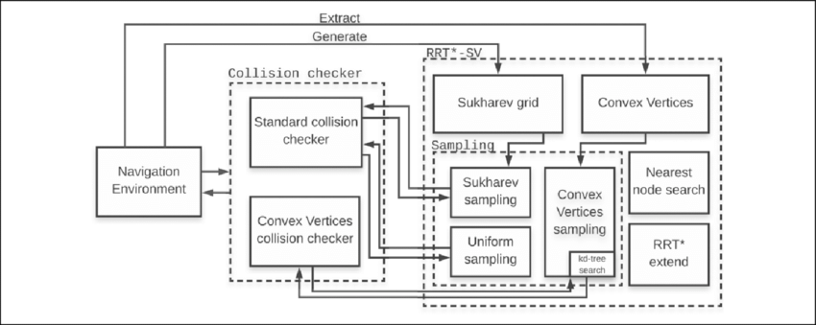
Block Diagram

Slide 9
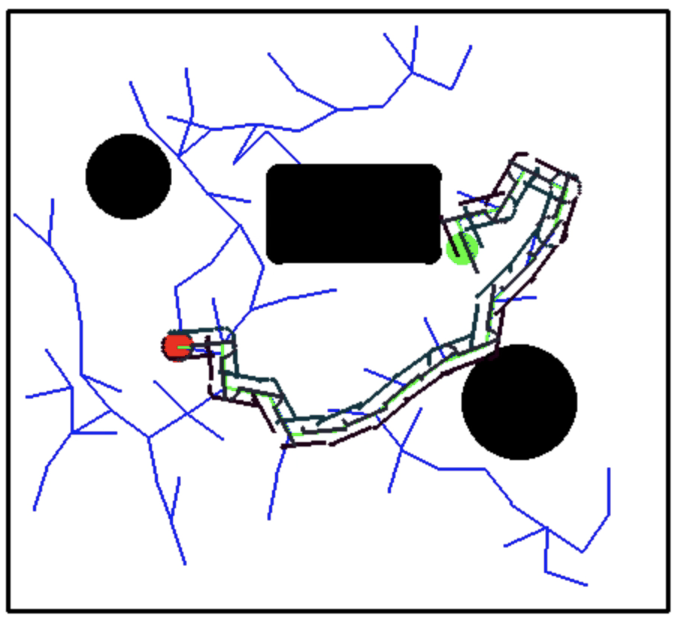
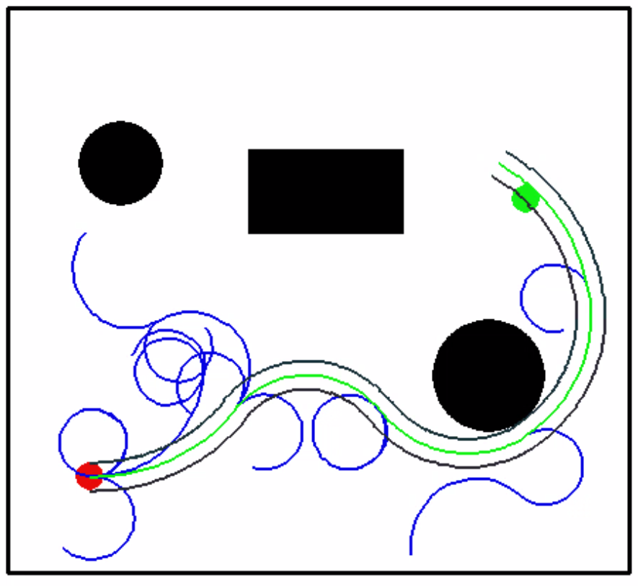
Expected Result
Holonomic Robot
Non-Holonomic Robot

Slide 10
Work – Plan
Months Activities | SEPT 22 | OCT 22 | NOV 22 | NOV 22
Literature Reviews | √
Component Identification & Selection |  | √
Designing |  | √
Experimental Analysis |  |  | √
Fabrication |  |  | √
Testing and Debugging |  |  |  | √
Preparation of Project Report

Slide 11
References
https://www.ibm.com/in-en/products/robotic-process-automation?utm_content=SRCWW&p1=Search&p4=43700066307694014&p5=p&gclid=271e3f62fb9011ce997f5c419bea929c&gclsrc=3p.ds
http://robotplatform.com/knowledge/Classification_of_Robots/Holonomic_and_Non-Holonomic_drive.html
https://www.gestalt-robotics.com/technology-modules/path-planning

Slide 12
Thank you !

