Slide 1

Environment Specific
Application Configuration
and Deployment Using Ansible
Theory Internal Assessment
Student 1: ____________________ Roll: ______________
Student 2: ____________________ Roll: ______________
Notes:
Presenter 1. Introduce the full project title. We use one Ansible playbook to configure a shared application differently for development, staging, and production. Fill the two student name and roll-number lines before presenting. The letterhead image comes from the user-provided report-format reference.

Slide 2
The configuration problem
Development needs detailed diagnostics.
Staging needs settings suitable for release review.
Production needs the intended settings for users.
Manual edits can leave the environments inconsistent.
02
Notes:
Presenter 1. The same application can need different settings in different environments. Manual copying can leave the wrong value on a server. Our project separates environment data from shared deployment tasks. This is a configuration-management example, not a performance-testing project. Source: https://docs.ansible.com/projects/ansible/latest/playbook_guide/playbooks_intro.html

Slide 3
Ansible concepts in our project
Concept | Project example
Inventory | development, staging, production
Playbook | playbooks/deploy.yml
Variables | app_environment and app_log_level
Template | One shared Nginx and application design
Handler | Reload Nginx when its configuration changes
03
Notes:
Presenter 1. Inventory means the list of hosts. A playbook is a YAML task list. Variables supply environment values. Templates produce files. A handler runs after a relevant change. Ansible connects to these Linux nodes over SSH and uses Python. Sources: https://docs.ansible.com/projects/ansible/latest/installation_guide/intro_installation.html
https://docs.ansible.com/projects/ansible/latest/inventory_guide/intro_inventory.html
https://docs.ansible.com/projects/ansible/latest/collections/ansible/builtin/template_module.html
https://docs.ansible.com/projects/ansible/latest/playbook_guide/playbooks_handlers.html

Slide 4
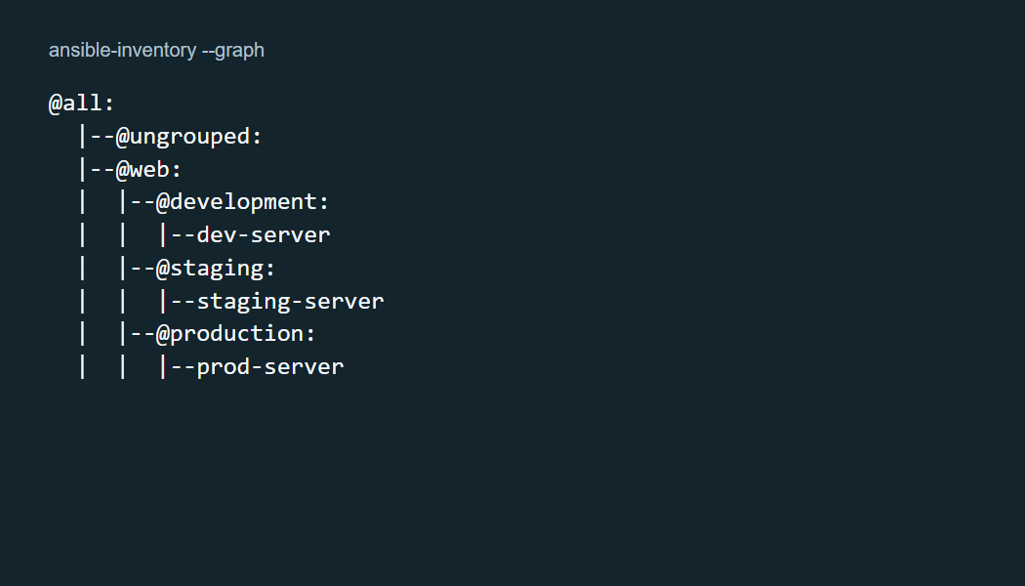
Control node and managed nodes
One Linux controller runs Ansible.
Three separate containers represent the environments.
SSH carries the configuration tasks.
Docker creates the lab machines.
04
Notes:
Presenter 1. Docker provides the Linux lab machines. The controller reads the project files and makes actual SSH connections to three managed nodes. Each target has Nginx and Python, with no persistent Ansible agent. This graph is captured from the actual ansible-inventory command. Source: https://docs.ansible.com/projects/ansible/latest/installation_guide/intro_installation.html
Project evidence: evidence/inventory-graph.txt

Slide 5
Environment settings
Environment | Debug flag | Log level | Browser port
Development | Enabled | info | 8081
Staging | Disabled | notice | 8082
Production | Disabled | warn | 8083
Group variables supply the differences. The deployment tasks stay shared.
05
Notes:
Presenter 1. Open inventory/group_vars and compare the environment YAML files. The same application and templates receive these different values. The debug flag illustrates a configuration value in this static site. The Nginx error-log level affects actual server configuration. Docker Compose owns the host-side port mappings. Source: project inventory/group_vars and compose.yaml.

Slide 6
Variables and shared templates
Production group variables
Shared Nginx template
app_environment: production
app_debug: false
app_log_level: warn
error_log
/var/log/nginx/error.log
{{ app_log_level }};
Ansible renders a different configuration file for each host.
06
Notes:
Presenter 1. The YAML file defines values. Jinja2 placeholders insert them into a shared file. This small Nginx example uses the real log-level value. The playbook template tasks also generate the page and JSON file. Sources: https://docs.ansible.com/projects/ansible/latest/inventory_guide/intro_inventory.html
https://docs.ansible.com/projects/ansible/latest/collections/ansible/builtin/template_module.html

Slide 7
Deployment tasks and handlers
Validate the settings
Create the application directory
Deploy the generated files
Verify the running environment
Nginx configuration changes
The template notifies a handler.
The handler reloads Nginx.
An unchanged file triggers no reload.
The configuration must pass nginx -t before Ansible installs it.
07
Notes:
Presenter 2. Open playbooks/deploy.yml. The tasks validate input, create the directory, deploy the page and JSON, validate Nginx configuration, then verify HTTP health. A changed Nginx template notifies the reload handler. Explain that nginx -t tests the proposed configuration before installation. Source: https://docs.ansible.com/projects/ansible/latest/collections/ansible/builtin/template_module.html
https://docs.ansible.com/projects/ansible/latest/playbook_guide/playbooks_handlers.html
Project source: playbooks/deploy.yml.

Slide 8
An unchanged rerun
Idempotence means asking for the same state again needs no additional changes.
dev-server changed=0 failed=0
staging-server changed=0 failed=0
prod-server changed=0 failed=0
Recorded result from the tested lab
08
Notes:
Presenter 2. Show the baseline deployment, then rerun exactly the same playbook. The actual verification below reported no changes on any target, with no failed or unreachable hosts. Idempotence depends on the tasks used; a shell command does not automatically compare desired state. The handler is absent on this unchanged run. Source: https://docs.ansible.com/projects/ansible/latest/playbook_guide/playbooks_intro.html
Recorded evidence: evidence/06-baseline-repeat.txt

Slide 9
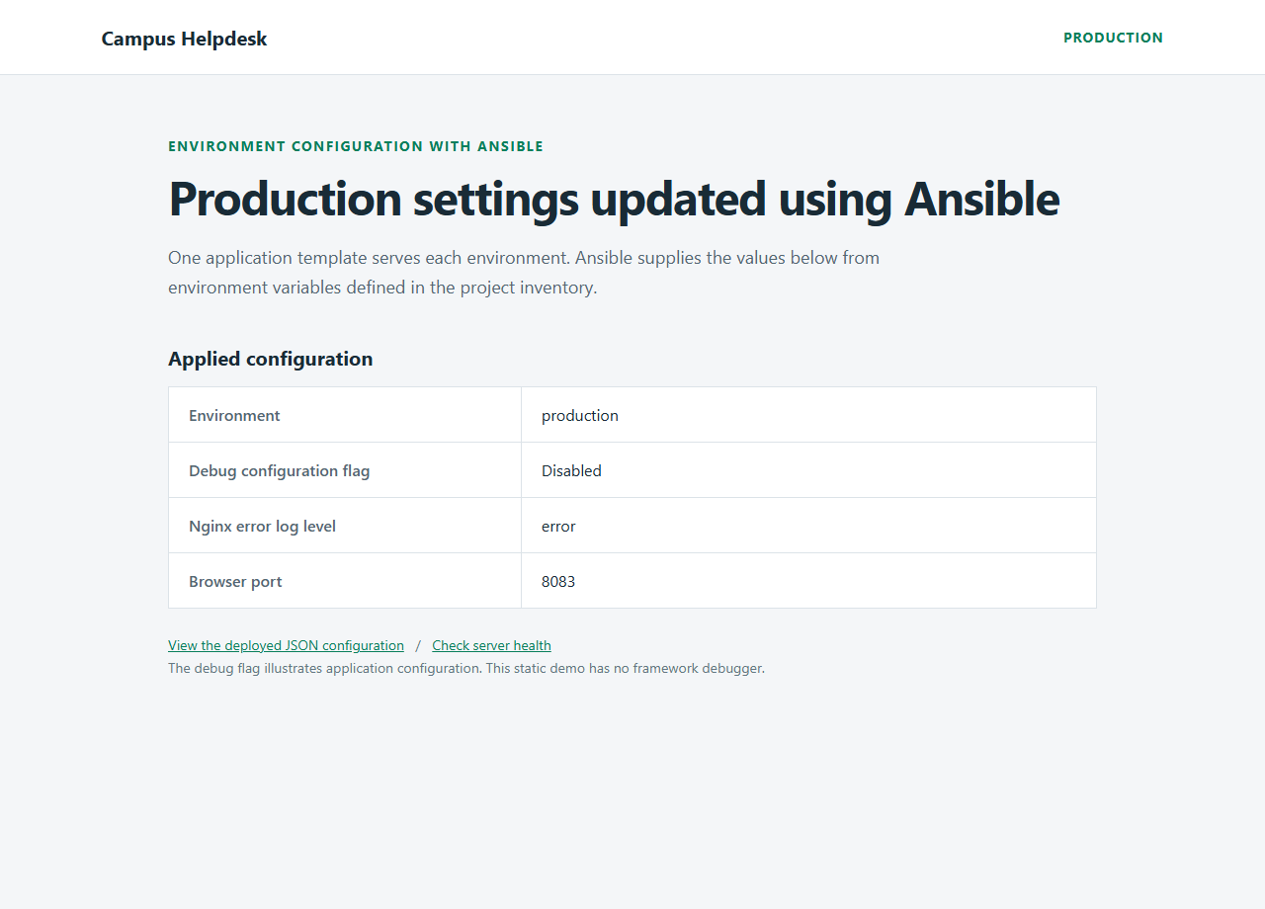
Production only update
Baseline: log level warn
Updated: log level error
The banner changes too.
Development and staging
retain their baseline values.
09
Notes:
Presenter 2. Preview the production override with --check --diff, then apply it with --limit production and the prepared extra-variable file. The preview left live configuration unchanged. The actual update changed production alone. Development and staging retained their original JSON settings. This image renders HTML captured from the running production node after the update. Source: https://docs.ansible.com/projects/ansible/latest/playbook_guide/playbooks_checkmode.html
Recorded evidence: evidence/07-preview-production.txt and evidence/08-apply-production-update.txt

Slide 10
Live demonstration sequence
1 Check all three SSH connections
2 Apply the baseline playbook
3 Rerun and show changed=0
4 Preview and apply the production update
5 Refresh the pages and repeat the update
Full commands: docs/DEMO-GUIDE.md
10
Notes:
Presenter 2 operates the terminal and browser while Presenter 1 explains observations. Follow docs/DEMO-GUIDE.md for complete copy-ready Windows and macOS commands. Prefix each Ansible command with docker compose run --rm controller. Before class, build and start the targets. During the demo, show connectivity, baseline settings, an unchanged rerun, a production preview and update, and a repeat of the same override. Open localhost:8081, localhost:8082 and localhost:8083.

Slide 11
Recorded validation results
Operation | Observed result
Initial baseline | 5 changed tasks on each host
Baseline repeated | 0 changed tasks on every host
Production update | 4 changed tasks on production only
Update repeated | 0 changed tasks on production
The preview left the deployed configuration unchanged.
11
Notes:
Presenter 2. These values come from the actual Windows-laptop run on 19 October 2026. A changed count is a count of tasks, not settings or servers. Five initial changes include the directory, three templates and reload handler. The production update changes three templates and runs its handler. Check mode proposed file changes but wrote no deployment changes. All deployment runs had failed=0 and unreachable=0. The macOS commands are documented, but this execution occurred on Windows. Evidence: evidence/results.json.

Slide 12
Conclusion and scope
One playbook applies environment-specific settings.
The verified demo shows a scoped update
and repeat runs with zero changes.
Local Linux containers represent the environments.
The application is static and contains no database.
12
Notes:
Presenter 1 closes. One playbook and shared templates produce each environment configuration. Scoped updates and repeated runs make the process easy to demonstrate and review. This is a local Docker lab with a static site, not publicly hosted infrastructure. Future extensions can add real servers, roles, protected secrets and application monitoring. No GitHub Actions workflow is needed for this assessment. References: https://docs.ansible.com/projects/ansible/latest/installation_guide/intro_installation.html
https://docs.ansible.com/projects/ansible/latest/inventory_guide/intro_inventory.html
https://docs.ansible.com/projects/ansible/latest/collections/ansible/builtin/template_module.html
https://docs.ansible.com/projects/ansible/latest/playbook_guide/playbooks_intro.html
https://docs.ansible.com/projects/ansible/latest/playbook_guide/playbooks_handlers.html
https://docs.ansible.com/projects/ansible/latest/playbook_guide/playbooks_checkmode.html

