Slide 1
Final Ideas

Slide 2
Stock Market or Bitcoin Analysis
ML for Stock Market Analysis
Create a Web Dashboard to Explore Data
Plotly
Flask
JS
Pros
Lots of data
Relatively easy
ML will probably fit homework
Cons
ML algorithm will not work in reality
Not really noteworthy

Slide 3
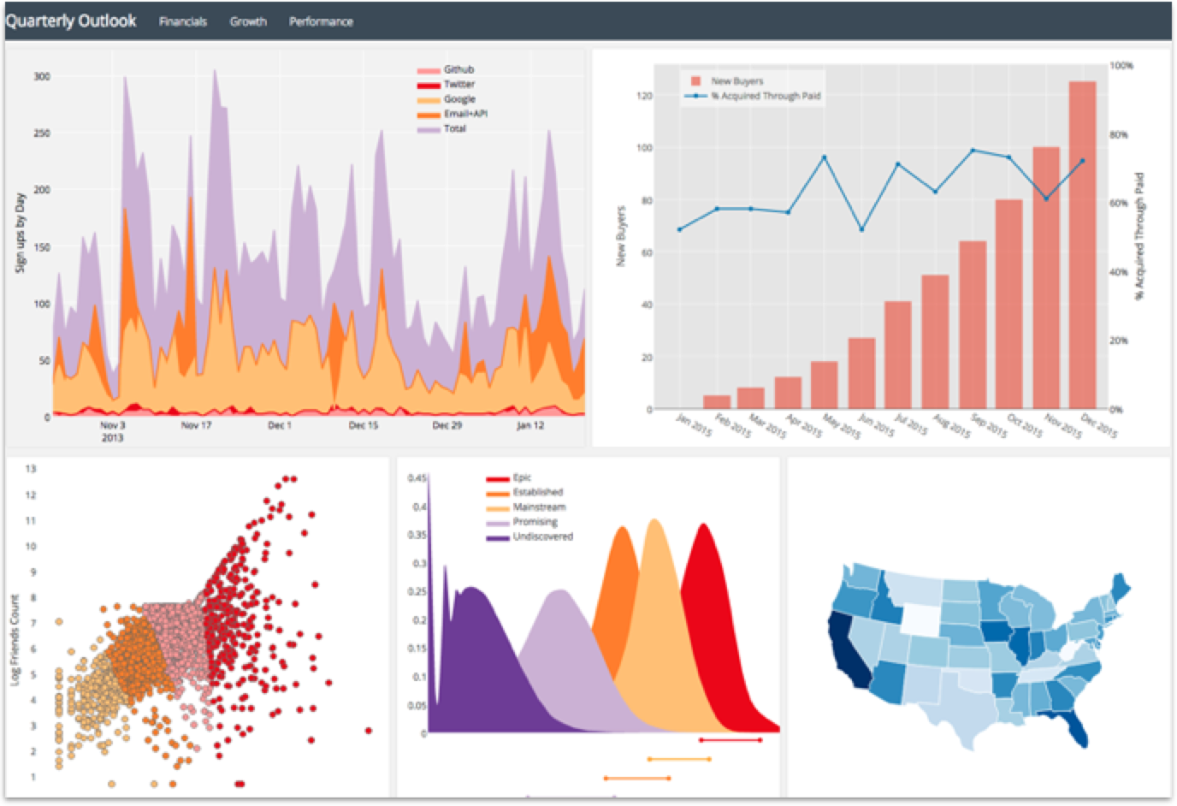
Stock Dashboard
Users can interact with data
Multiple graph options
ML page highlighting predictive analysis

Slide 4
Image Analysis
Use ML to classify images
Webpage to Drag and drop or point to URL for image analysis
Use Azure API for good results
Stack
Flask, Bootstrap, JS
ML to classify People vs not people (or other binary classifier)
Pros
Novel
Azure will work to at least have something good to show
Cons
Hard
Not really dealing with numerical data

Slide 5
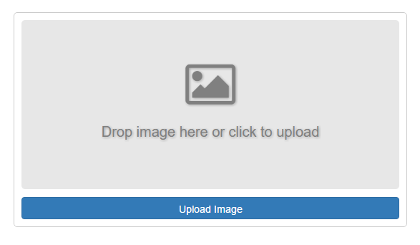

PhotoAnalysis.com
Search Our Database
Link 2
Link 3
Our Analysis
Person?
Yes or No
Yes!
Azure Analysis
Yes Person
Age
Celebrity
Description
Face detection
Tags
Face coordinates
Adult Content

Slide 6
Image Analysis
User Interface
HTML
Bootstrap
JavaScript
ML
Train and test images
Azure
Image Analysis
Deploy to Heroku
Named Domain

