Slide 1
OM_CHANDRA_2021700014
File created on: 11/10/2024 3:32:38 PM
LINK - https://public.tableau.com/views/OM_CHANDRA_2021700014/Story1?:language=en-US&:sid=&:redirect=auth&:display_count=n&:origin=viz_share_link

Slide 2
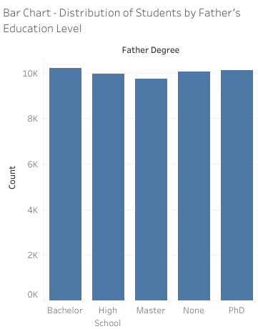
Observations:
There are slightly more number of students' fathers having a Bachelor's degree, followed by PhD.
There are comparatively few students whose fathers have a Master Degree.
The data shows that almost every degree is equally present.
Questions Answered:
What is the distribution of students by their father's education level?
How many students' fathers have completed higher education compared to lower education levels?
Is there a significant number of students whose fathers have no formal education?

Slide 3
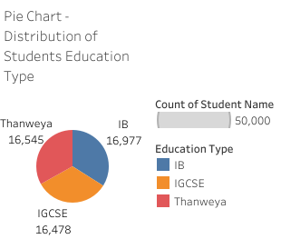
Observations:
There are slightly more no of students enrolled in the IB education system.
A slightly smaller portion of students are enrolled in IGCSE system.
Every Education Type is almost equally present.
Questions Answered:
What is the distribution of students by education type?
Which education type has the highest number of students?
How significant is the share of students in each education system?

Slide 4
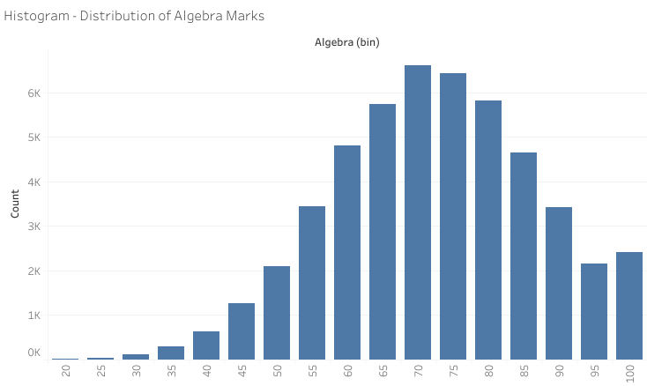
Observations:
The majority of students have Algebra marks within the 60%-85% range.
There is a noticeable decline in the number of students who score below 40%.
There are more students in 95-100 marks bin than 90-95 marks bin.
Questions Answered:
What is the distribution of Algebra marks among students?
How many students score above or below average in Algebra?
Is there a significant number of students with marks close to the failing range (below 40%)?

Slide 5
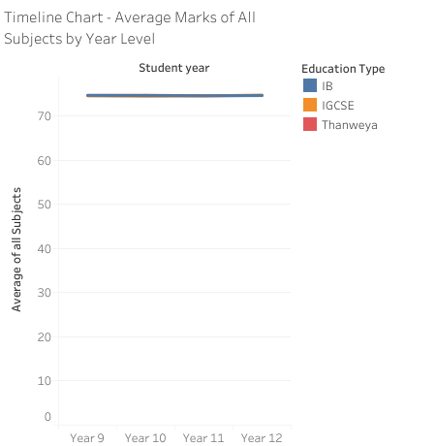
Observations:
1.There is no significant difference in Average marks for students in different Years.
Questions Answered:
How do the average marks of all subjects vary across different student year levels?
What year shows the highest overall academic performance?
Are there any trends in student performance over the years?

Slide 6
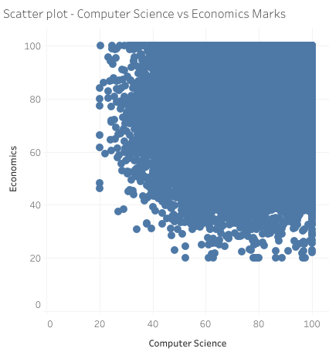
Observations:
There is no clear linear relationship between Computer Science and Economics marks.
Some students perform well in both subjects, while others show a large discrepancy.
Most of the data points are clustered in the higher and middle performance ranges.
Questions Answered:
Is there a correlation between Computer Science and Economics marks?
How do students perform in both Computer Science and Economics simultaneously?
Are there any outliers or patterns where students perform disproportionately better in one subject over the other?

Slide 7
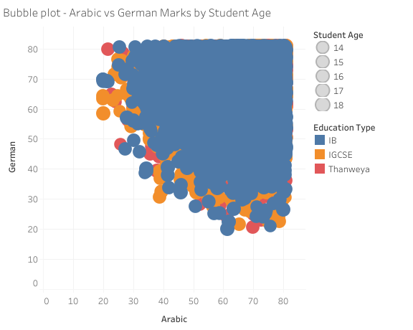
7. Word Cloud
Observations:
The size of the bubbles correlates with student age, showing that older students tend to have higher marks.
There is a cluster of smaller bubbles in the lower range of both Arabic and German marks.
The distribution of Arabic and German marks shows no distinct pattern by age, but age influences the size of the bubble.
Questions Answered:
How do student age and marks in Arabic and German relate?
Does the age of the student correlate with performance in Arabic and German?
How does the spread of marks look when considering both subjects and age?

Slide 8

Observations:
Every degree is equally present
There is very slight difference between count of each mother degrees.
The word cloud visually highlights the most frequent education levels
.
Questions Answered:
What are the most common educational degrees held by mothers?
Is there a higher prevalence of mothers with Bachelor’s degrees?
How does the frequency of various mother degrees compare?

Slide 9
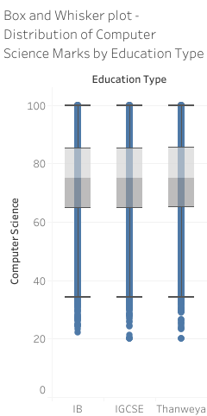
Observations:
Students enrolled in the IGSCE system show a wider range of Computer Science marks.
The median score for every type is almost same.
The IB group has fewer outliers than the IGSCE and Thanweya groups.
Questions Answered:
How do Computer Science marks vary by education type?
Which education system shows the greatest variance in Computer Science performance?
Are the students in the IB system performing better than those in IGCSE or Thanweya?

Slide 10
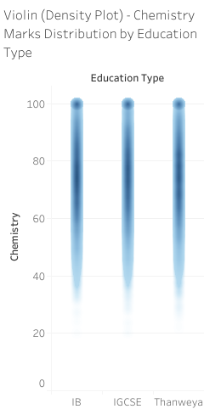
Observations:
The distribution of Chemistry marks is more spread out in the Thanweya group, showing higher variance.
The IB students have a more centralized distribution, with fewer students at the extremes.
Questions Answered:
How are Chemistry marks distributed across education types?
Which education type has the most consistent performance in Chemistry?
Is there more variation in Chemistry marks for any specific education type?

Slide 11
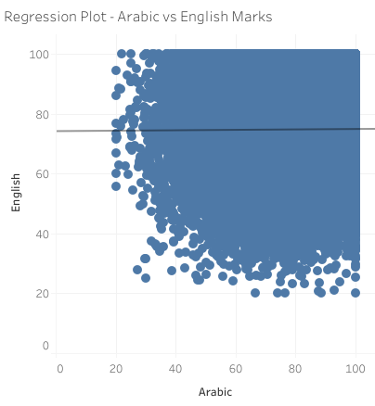
Observations:
The regression trend line indicates no significant relationship between Arabic and English marks.
Most data points are scattered, showing no clear pattern between the two variables.
The absence of a correlation suggests that students' performances in Arabic are independent of their performance in English.
Questions Answered:
Is there any correlation between Arabic and English marks?
Do students tend to perform similarly in both Arabic and English?
What does the trend line suggest about the relationship between these two subjects?

Slide 12
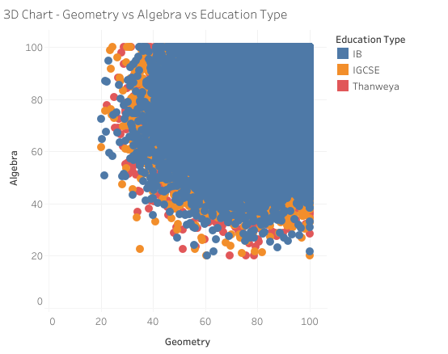
Observations:
The data points are colored based on education type, showing how performance in Geometry and Algebra varies across groups.
The chart indicates that Thanweya students perform better in both subjects compared to others.
The 3D perspective helps visualize the interactions between Algebra, Geometry, and Education Type, with clearer differentiation by color.
Questions Answered:
How do Geometry and Algebra marks relate in terms of education type?
Which education type tends to perform better in both Geometry and Algebra?
How do the marks in both subjects differ across the three education types?

Slide 13
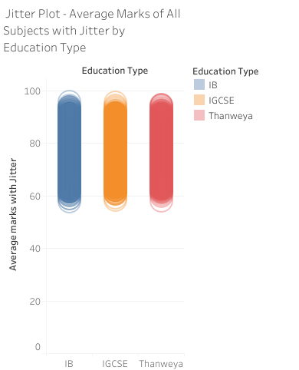
Observations:
The marks for each education type show slight variation due to jitter, making it easier to distinguish individual data points.
The performance of IB students show more spread.
The jittered plot helps reveal patterns of overlap between the education types, especially for lower-performing students. But because of large data size we cant visualize it more easily.
Questions Answered:
How does the average marks distribution vary across education types with jitter applied?
Are there significant differences in the average marks of students in different education types?
Does the jitter help in identifying specific performance clusters for each education type?

Slide 14
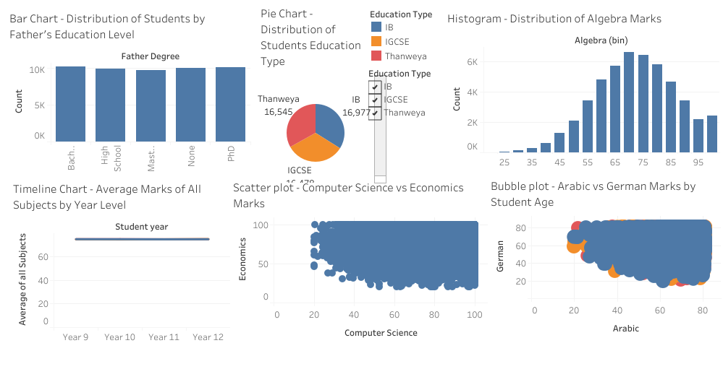
Dashboard 1

Slide 15
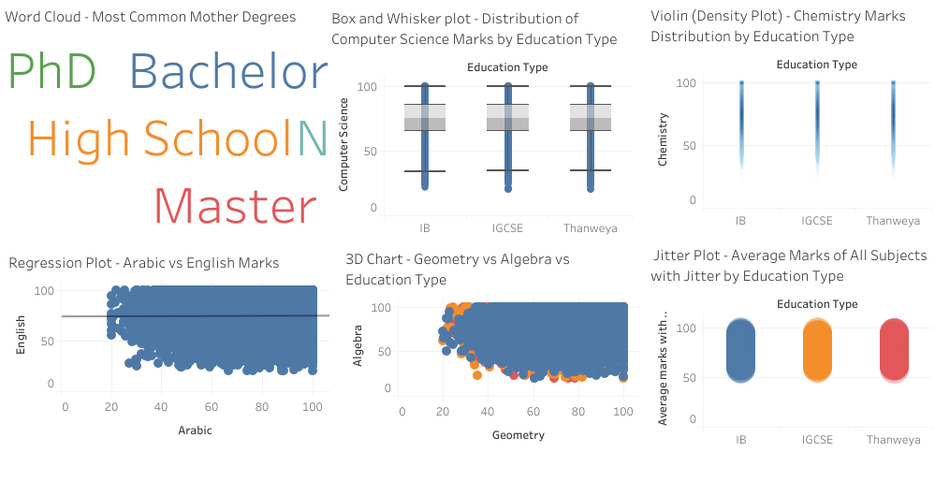
Dashboard 2

