Slide 1
Om_2021700014
File created on: 11/10/2024 6:02:24 PM
Link - https://public.tableau.com/views/Om_2021700014/Story1?:language=en-US&:sid=&:redirect=auth&:display_count=n&:origin=viz_share_link

Slide 2
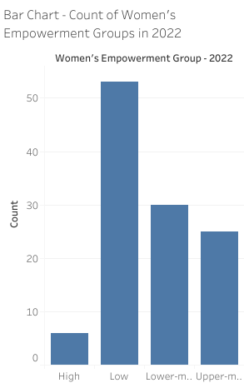
Observations:
There are many Women Empowermet group with Low Cateogry
There are less Women Empowerment group with High Category.
Questions Answered:
Which Women's Empowerment Group has the highest count?
Are there any groups with very few representations?
How do counts vary between different regions or countries?

Slide 3
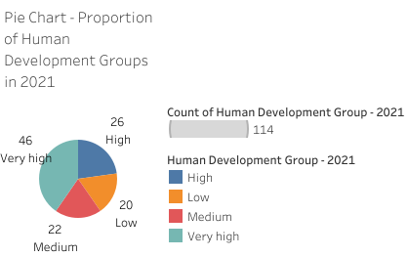
Observations:
Human Development Groups with High Category take up a large portion of the chart, indicating global trends in human development levels.
Group with Low Category ais represented by smaller slices, showing disparities.
The color distribution helps highlight how different groups are categorized.
Questions Answered:
Which Human Development Group dominates the distribution?
Are there significant imbalances between groups?
How evenly is human development distributed across the dataset?

Slide 4
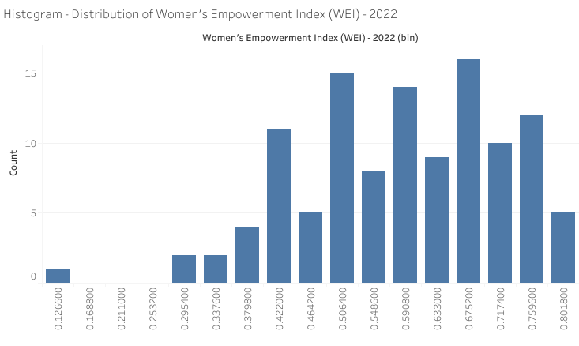
Observations:
The distribution may show a skew towards lower or higher empowerment levels.
Peaks or clusters indicate common WEI values among countries.
The range of WEI values provides insight into global disparities.
Questions Answered:
What is the most common WEI range?
Is the data normally distributed or skewed?
Are there outliers that need further investigation?

Slide 5
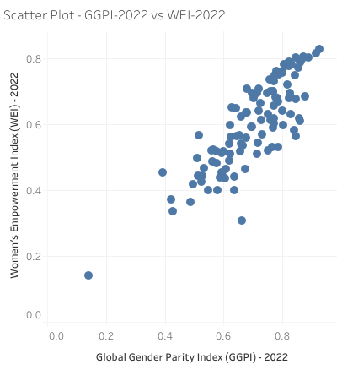
Observations:
A positive correlation suggests countries with higher WEI also have higher GGPI.
Outliers may indicate countries that deviate from the trend.
Clusters show where most countries fall on the empowerment and parity scale.
Questions Answered:
Is there a linear or non-linear relationship between GGPI and WEI?
Which countries are outliers with disproportionate WEI or GGPI scores?
How strong is the correlation between the two indices?

Slide 6
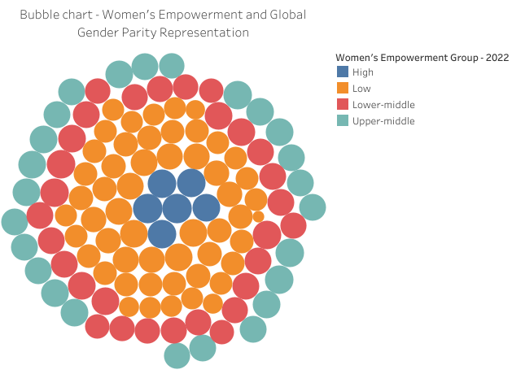
Observations:
Larger bubbles indicate countries with higher GGPI values.
Color variations reveal how empowerment groups are distributed.
Size and color combinations may show if higher GGPI correlates with certain empowerment groups.
Questions Answered:
Which countries have the highest GGPI, represented by larger bubbles?
Do higher GGPI scores correspond to specific Women's Empowerment Groups?
Are there clear patterns between bubble size and color?

Slide 7
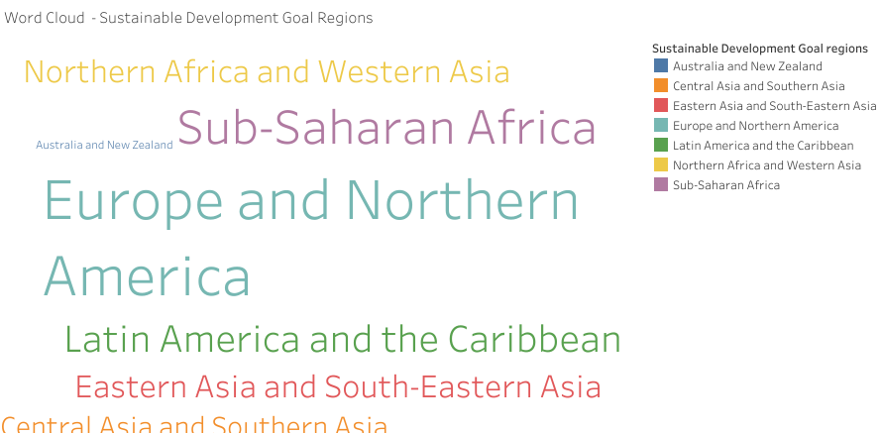
Observations:
Frequently appearing regions like Europe ,America are larger, indicating common representation.
Less common regions lkke New Zealand appear smaller, highlighting areas with fewer data points.
The distribution may show which regions are central to the dataset.
Questions Answered:
Which Sustainable Development Goal region appears most frequently?
Are there any regions that stand out due to high or low frequency?
How do regions compare in terms of representation?

Slide 8
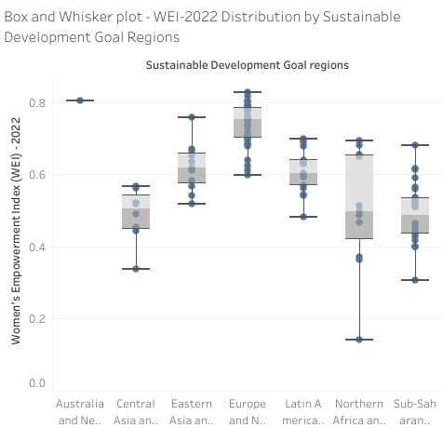
Observations:
Regions with higher median WEI values show better empowerment like Europe.
The range of each box shows variability within regions.
Outliers indicate unique data points that need further analysis like Northern Africa.
Questions Answered:
Which region has the highest median WEI?
Are there significant variations within any region?
Are there regions with outliers indicating unique circumstances?

Slide 9
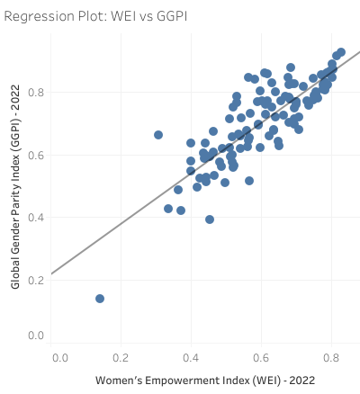
Observations:
A clear trend line shows how WEI correlates with GGPI.
Points close to the trend line indicate strong conformity to the linear relationship.
Points far from the trend line may indicate anomalies or exceptions.
Questions Answered:
Is there a positive linear relationship between WEI and GGPI?
How well does the data fit the regression line?
Which countries deviate significantly from the expected trend?

Slide 10
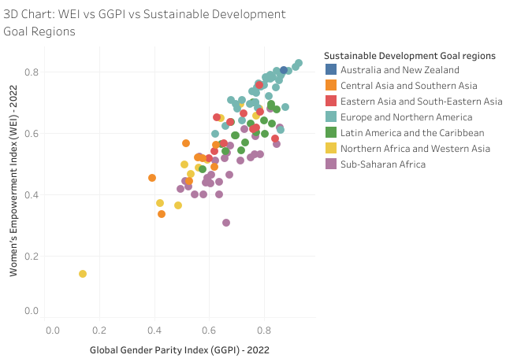
Observations:
The 3D plot provides insight into how WEI and GGPI vary across regions.
Patterns can emerge showing which regions have higher overall values.
The depth of data reveals potential clusters by region.
Questions Answered:
Are there specific regions where both WEI and GGPI are consistently high?
How do the three variables interact on a larger scale?
Which regions stand out for having unique combinations of WEI and GGPI?

Slide 11
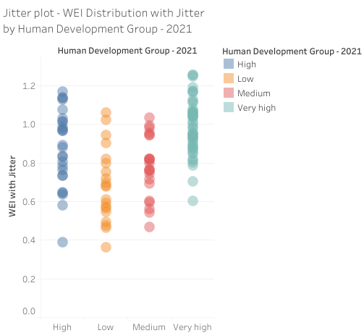
Observations:
Jitter spreads data points for better visualization of overlapping points.
Each Human Development Group have a different concentration of WEI scores.
Patterns reveal how groups are distributed across the WEI spectrum.
Questions Answered:
Which Human Development Group has the widest spread of WEI?
Are there groups clustered at specific WEI levels?
How do WEI scores differ between various Human Development Groups?

Slide 12
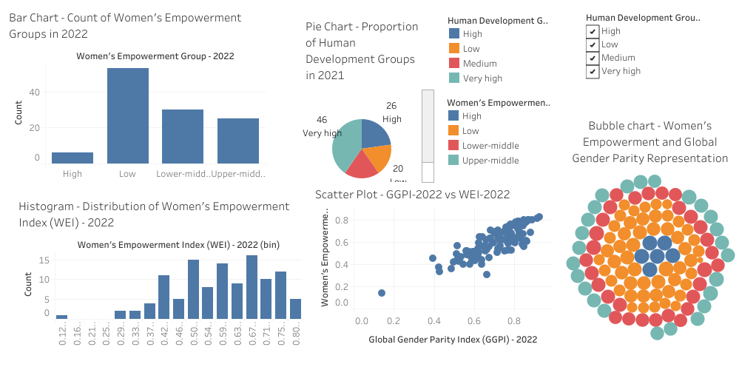
Dashboard 1

Slide 13
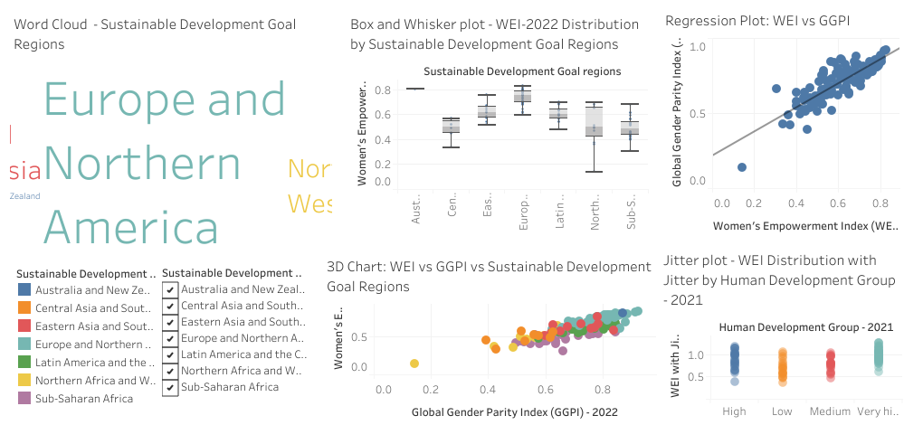
Dashboard 2

