Slide 1
OM_CHANDRA_ADV_EXPT-3
File created on: 9/7/2024 5:10:53 PM
Name – OM CHANDRA
UID – 2021700014
DIV – CSE DS
BATCH – L
LINK TO TABLEAU PUBLIC: https://public.tableau.com/app/profile/om.chandra/viz/OM_CHANDRA_ADV_EXPT-3/Story1

Slide 2
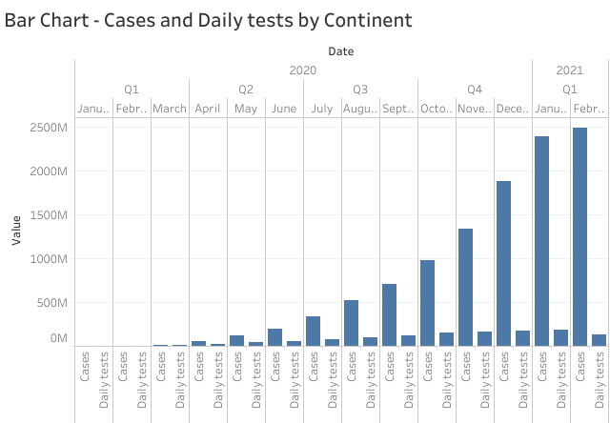

Slide 3
Questions Answered:
How have the number of cases and daily tests evolved over time (by year, quarter, or date)?
Were there significant fluctuations or steady trends in testing and case numbers?
Are there specific periods where the number of cases or tests spiked or dropped?
Observations:
Testing-Case Relationship: There are months where an increase in daily tests correlates with a rise in cases, showing the impact of testing efforts also there are months where an increase in daily tests does not significantly increase the cases.
Pandemic Spike: We can see a spike in testing as well as cases in month on June and July as many countries were largely hit by Covid during that time.

Slide 4
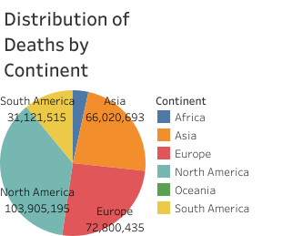
Questions Answered:
How are deaths distributed across continents?
Which continent has the highest or lowest proportion of deaths?
Is there a large imbalance in death rates between different continents?
Observations:
Continent-Wise Impact: We can see North America,Europe and Asia had a large impact of Covid-19.
Insights on Public Health and Population: Continents like South America and ,Oceania and Africa had a less impact either because of less population share or because of good public health

Slide 5
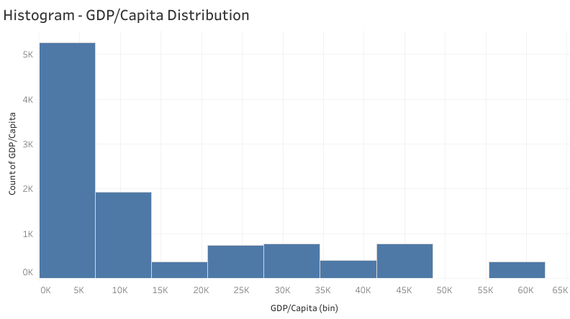
Questions Answered:
How is the GDP per capita distributed across countries?
Are most countries clustered in a particular GDP range?
Does the distribution show any skewness or is it normally distributed?
Observations:
Wealth Distribution: There’s a skew towards lower GDP,most of the countries have a low GDP.
Economic Outliers: There are some wealthy countries with high GDP per capita being the outliers.

Slide 6
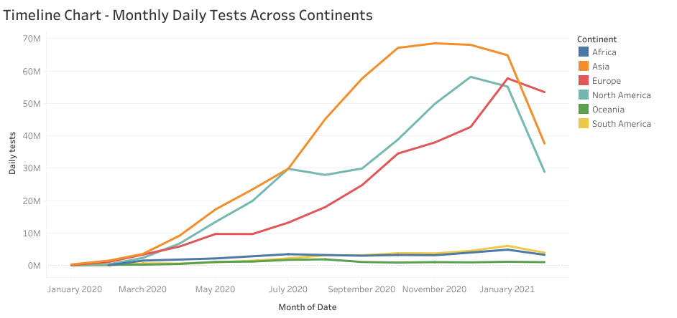
Questions Answered:
How has daily testing evolved across months?
Are there any periods where testing efforts were significantly ramped up or reduced?
Do different continents show similar or distinct testing patterns over time?
Observations:
Testing Surge: We can see sharp increases in daily tests in July month that corresponds to critical points in the pandemic which is the increase in severity.
Continental Differences: We can see aggreesive nature of Asia in testing.

Slide 7
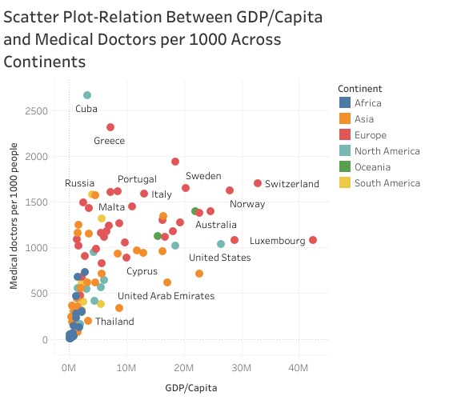
Questions Answered:
Is there a relationship between GDP per capita and the availability of medical doctors?
Which countries have the highest or lowest number of doctors relative to their GDP?
Do wealthier continents have better medical infrastructure in terms of doctors?
Observations:
Positive Correlation: Countries with higher GDP have more medical doctors per 1000 people, indicating a stronger healthcare infrastructure.
Outliers: Some countries like Luxemberg have a high GDP but relatively few doctors , which reveals healthcare inefficiencies.

Slide 8
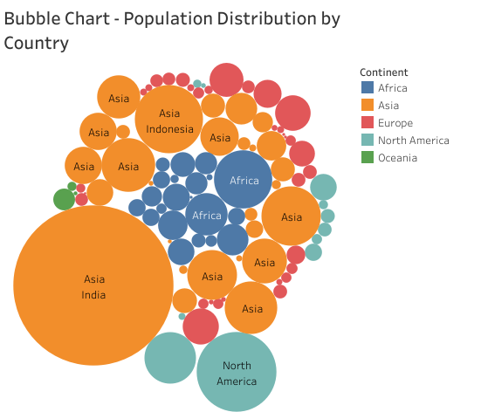
Questions Answered:
Which countries have the largest populations, and how are they distributed across different continents?
Is there a noticeable difference in population size between countries from different continents?
How does the population size vary across continents?
Observations:
Population Disparities: Larger bubbles indicate countries with significantly higher populations, like China and India, standing out among others.
Continental Grouping: Certain continents have more evenly distributed population sizes (e.g., Europe) compared to others where a few countries dominate the population (e.g., Asia).

Slide 9
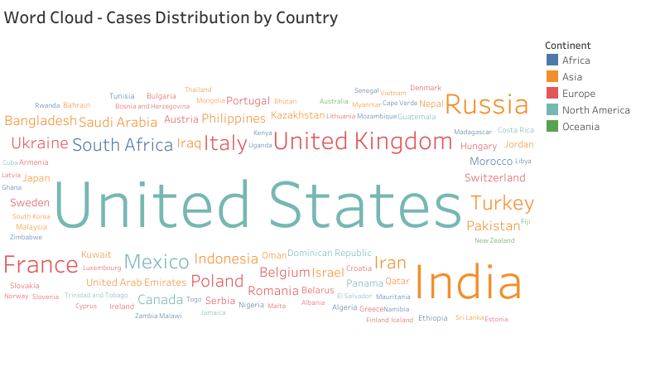
Questions Answered:
Which countries have reported the highest number of cases, and how are they distributed across different continents?
Are certain continents more affected than others in terms of case counts?
How do the sizes of reported cases vary across countries within each continent?
Observations:
Countries with the most cases will have larger text, making them immediately identifiable (e.g., the United States, India).
Asia and North America are the most severely affected continents.

Slide 10
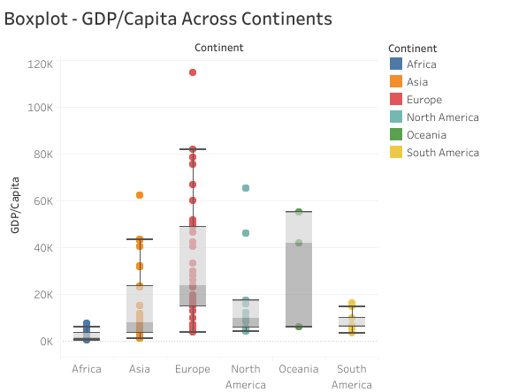

Slide 11
Questions Answered:
How does GDP per capita vary across different continents?
Which continents have the highest and lowest GDP per capita distributions?
Are there any outliers in GDP per capita within continents?
Observation:
The spread of GDP per capita varies significantly across continents, with wealthier regions like Europe having higher median values.
Some continents may show a large range in GDP per capita, indicating income disparity within the continent like Oceania
Outliers represent countries with significantly higher or lower GDP per capita compared to the continental average.

Slide 12
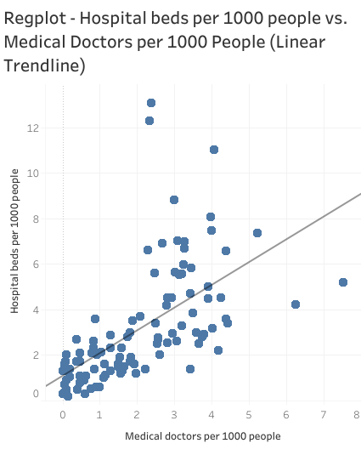

Slide 13
Questions Answered:
What is the relationship between the number of hospital beds and medical doctors per 1000 people?
Do countries with more hospital beds also have more medical doctors?
Observations:
The linear trendline shows a positive correlation: countries with more hospital beds tend to have more medical doctors.
Countries above the trendline have a higher doctor-to-hospital-bed ratio, while those below have fewer doctors for the same number of beds.

Slide 14
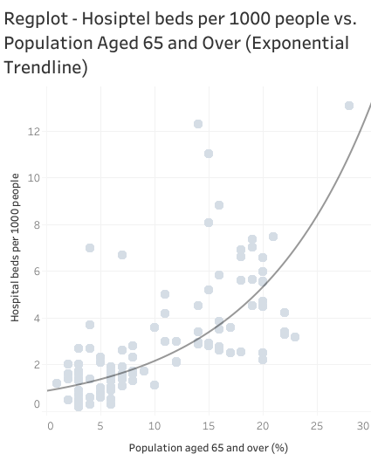

Slide 15
Questions Answered:
Is there a relationship between the proportion of elderly population and hospital bed availability?
Do countries with more elderly populations tend to have more hospital beds?
Observations:
The exponential trendline suggests that as the elderly population increases, the number of hospital beds per 1000 people grows at a faster rate.
Countries with a large elderly population are investing in more healthcare infrastructure.
Outliers could indicate nations with inadequate or excessive healthcare provisions compared to their elderly population.

Slide 16
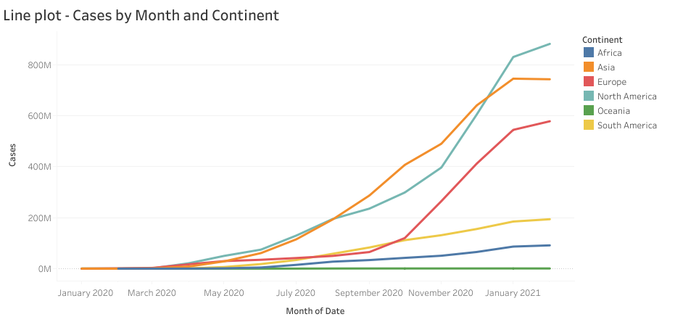

Slide 17
Questions Answered:
How has the number of COVID-19 cases changed over time across continents?
Which continents saw the largest surges in cases during different months?
Observations:
Certain months show spikes in cases, indicating the timeline of COVID-19 waves.
Continents such as Asia and North America show more pronounced spikes due to larger outbreaks.
Oceania and Africa has comparatively lower number of cases

Slide 18
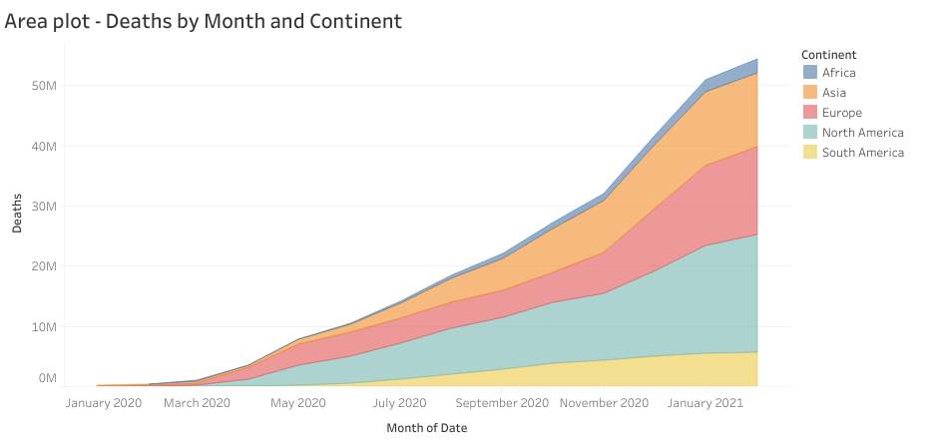

Slide 19
Questions Answered:
How have COVID-19-related deaths progressed across continents over time?
Are there periods where death rates surged on certain continents?
Observations:
The cumulative shape of the area plot highlights the growing number of deaths over time, with some continents showing larger areas (more deaths) for eg North America
The peaks indicate critical points in the pandemic where deaths surged.

Slide 20
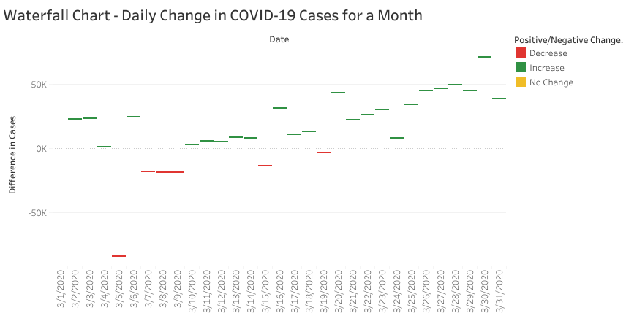

Slide 21
Questions Answered:
What is the daily fluctuation in COVID-19 cases over a given period?
On which days did cases increase, decrease, or remain constant?
Observation:
The chart visually shows the magnitude of daily case changes, making it easy to identify days with significant increases or decreases.
Green segments (increases) and red segments (decreases) indicate trends in the spread of the virus.
Sudden spikes or declines may correlate with policy changes or significant events.

Slide 22
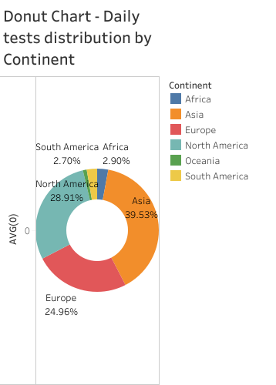

Slide 23
Questions Answered:
How is COVID-19 testing distributed across different continents?
Which continents have conducted the most or least daily tests?
Observations:
The size of each slice indicates the relative number of tests performed on each continent.
Continents with larger slices like Asia and North America have conducted more testing.
Testing disparities are evident, with some continents performing significantly fewer tests like Oceania

Slide 24
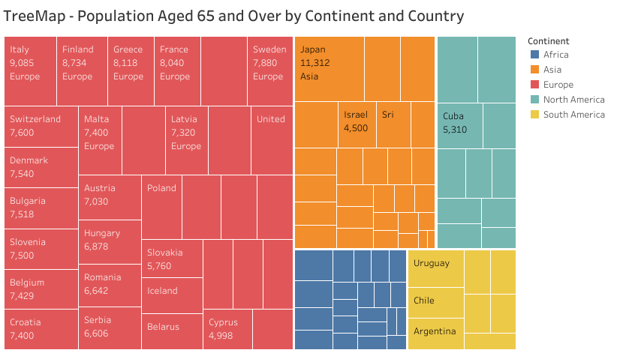

Slide 25
Questions Answered:
Which countries have the largest elderly populations, and how does this vary by continent?
Are there specific regions with high proportions of elderly populations?
Observations:
The size of each block shows countries with a larger elderly population, offering a visual comparison across regions.
Certain continents, like Europe and Asia have a larger elderly population, which could indicate greater healthcare needs.
The distribution of population aged over 65 can help assess which countries need more resources for aging populations.

Slide 26
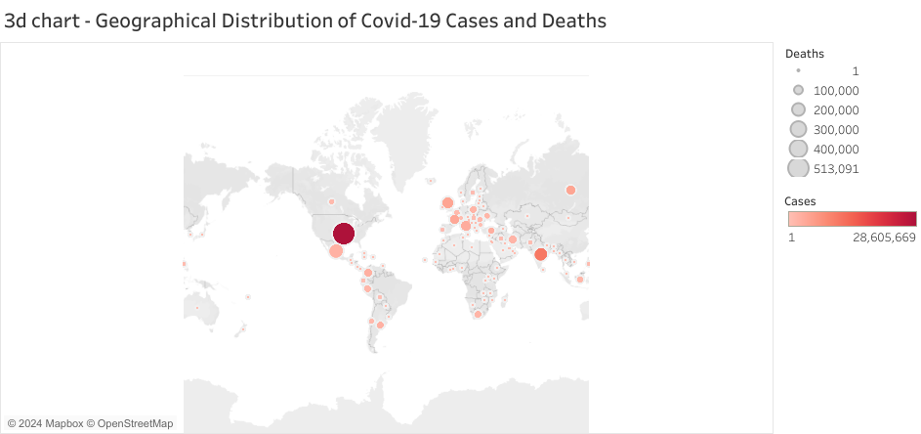

Slide 27
Questions Answered:
How are COVID-19 cases and deaths geographically distributed across the world?
Which regions have reported the highest numbers of cases and deaths?
Observations:
The larger circles indicate regions with more deaths, while darker colors indicate higher case counts.
The chart gives a geographical perspective on how different countries are affected, highlighting global hotspots.
Major epicenters, such as North America and parts of Europe, stand out due to both high cases and deaths.

Slide 28
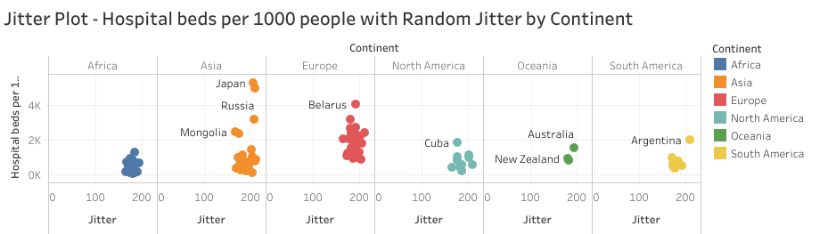

Slide 29
Questions Answered:
How does the availability of hospital beds per 1000 people vary by continent?
Are there any noticeable clusters of countries with similar healthcare infrastructure?
Observations:
The jitter effect spreads out points, preventing overlap and allowing for easier comparison between countries.
Certain continents may show clusters of countries with either high or low hospital bed availability eg Oceanie America and Africa show low bed availability and Europe and Asia have comparatively higher bed availability.

Slide 30
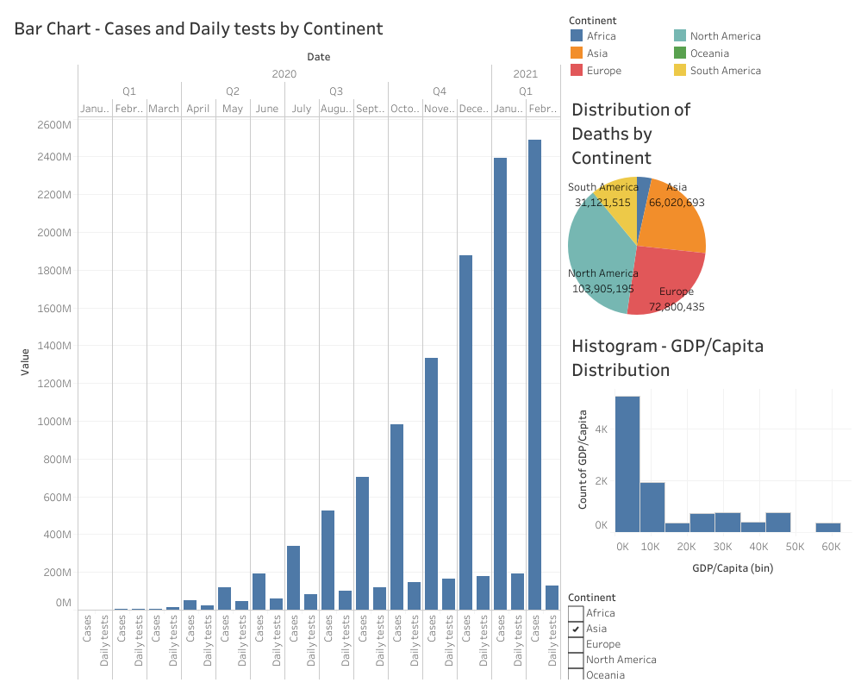

Slide 31
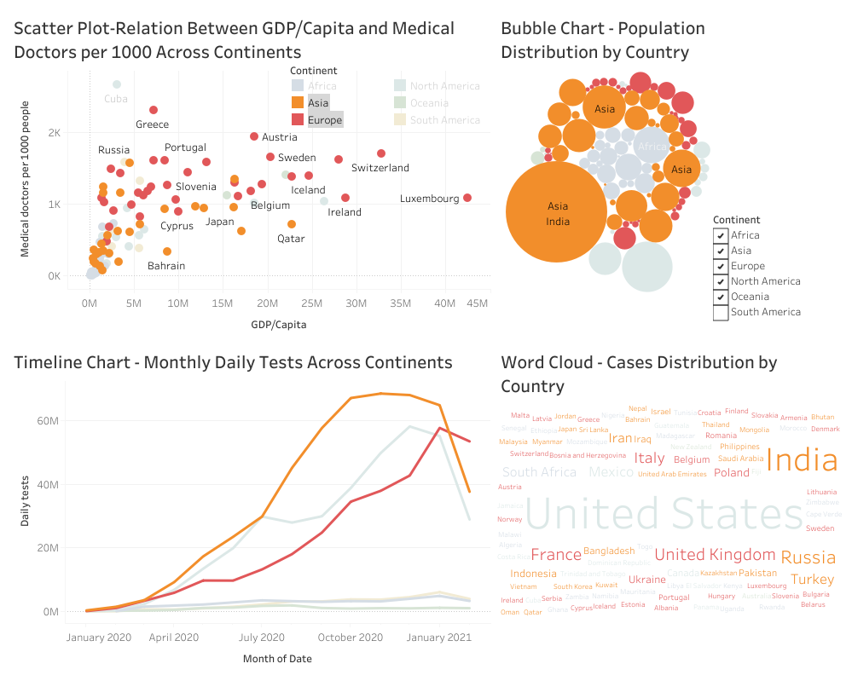

Slide 32
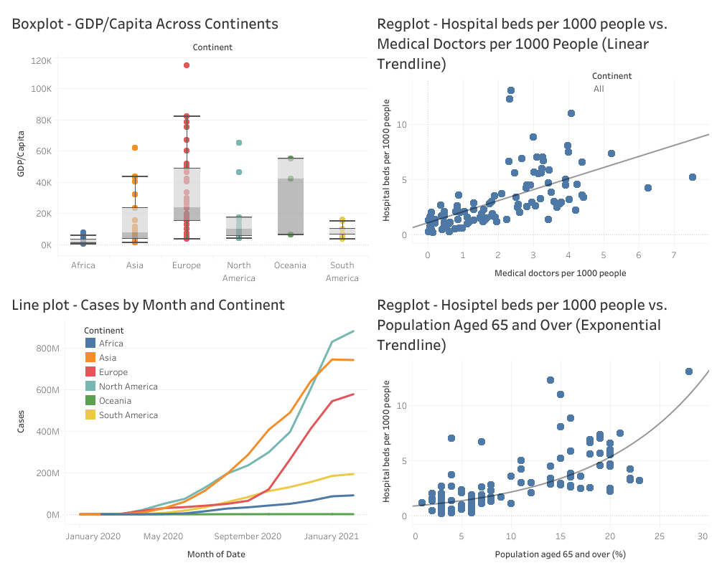

Slide 33
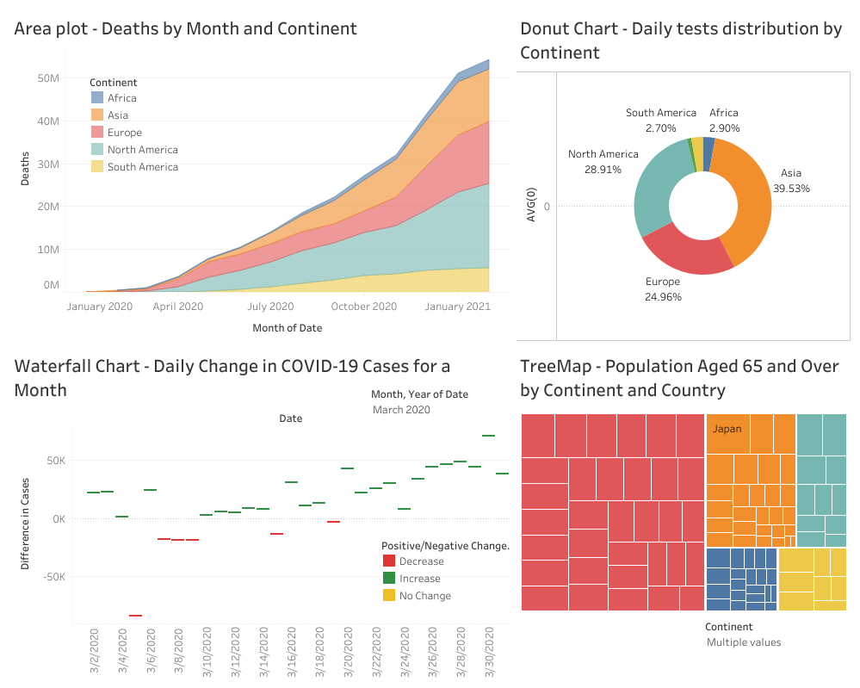

Slide 34
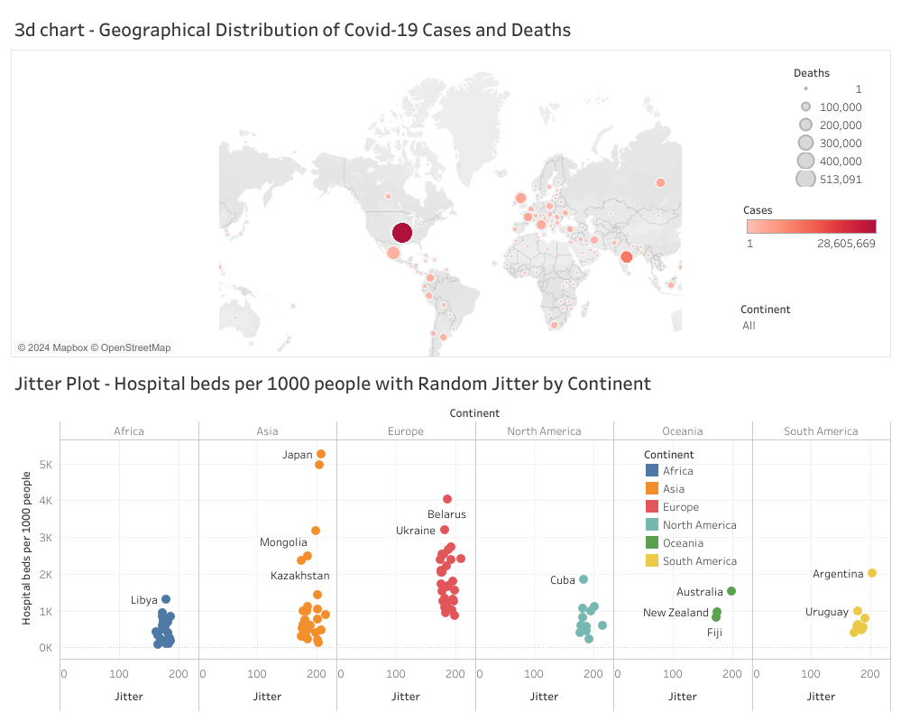

Slide 35
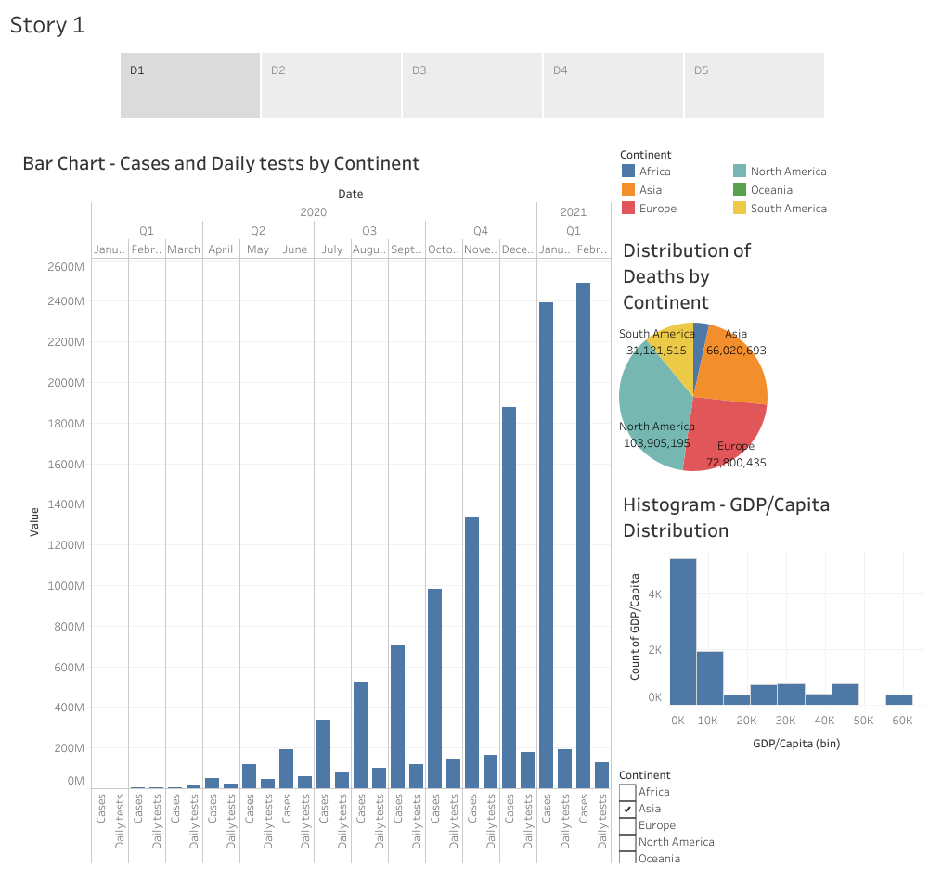

Slide 36
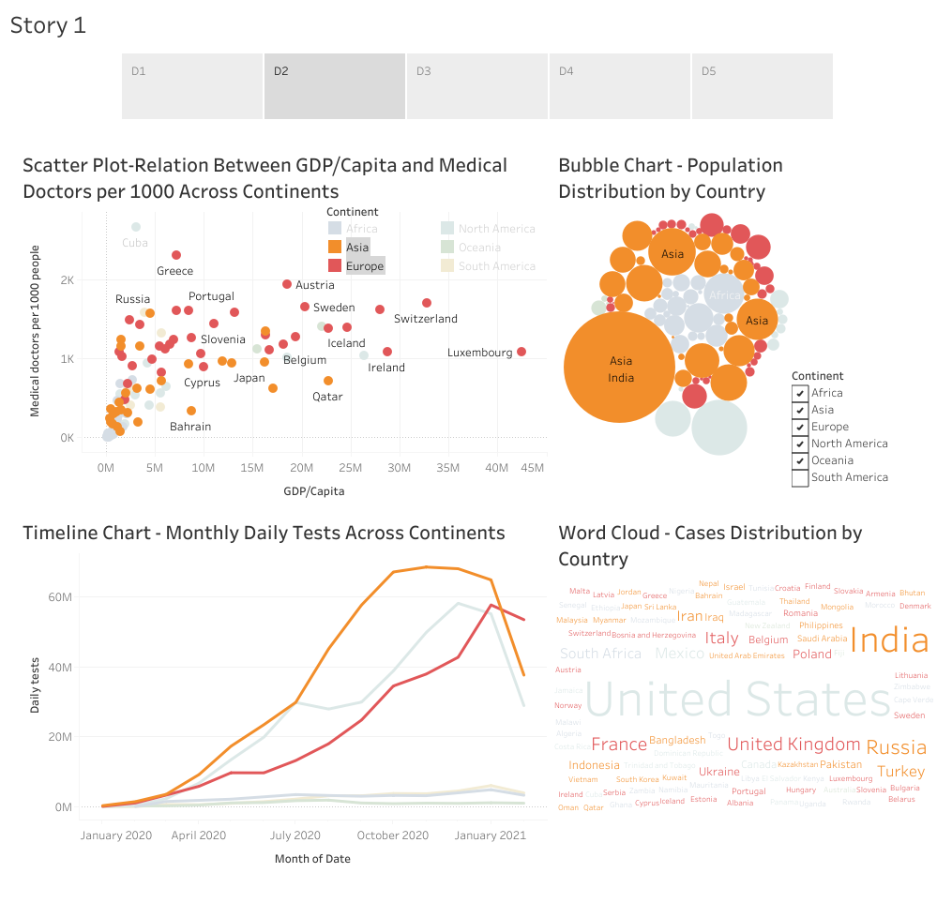

Slide 37
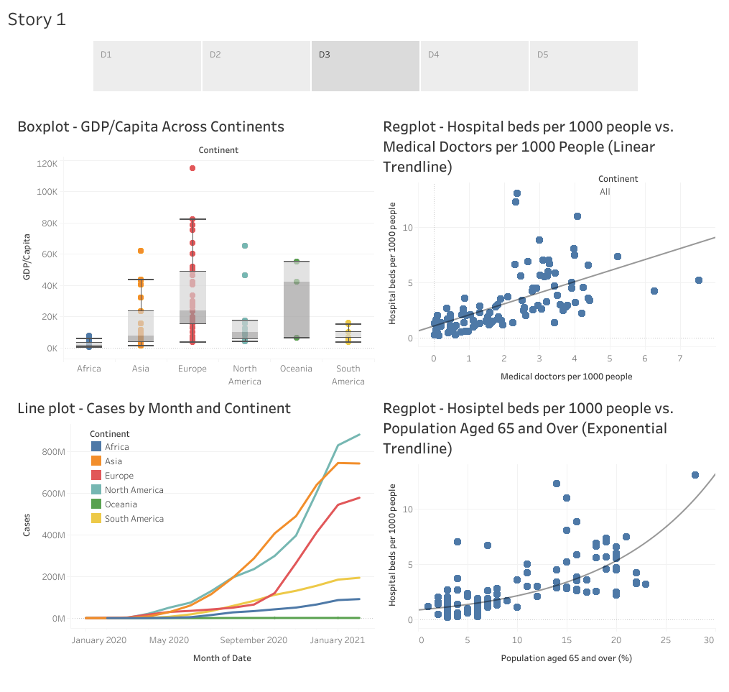

Slide 38
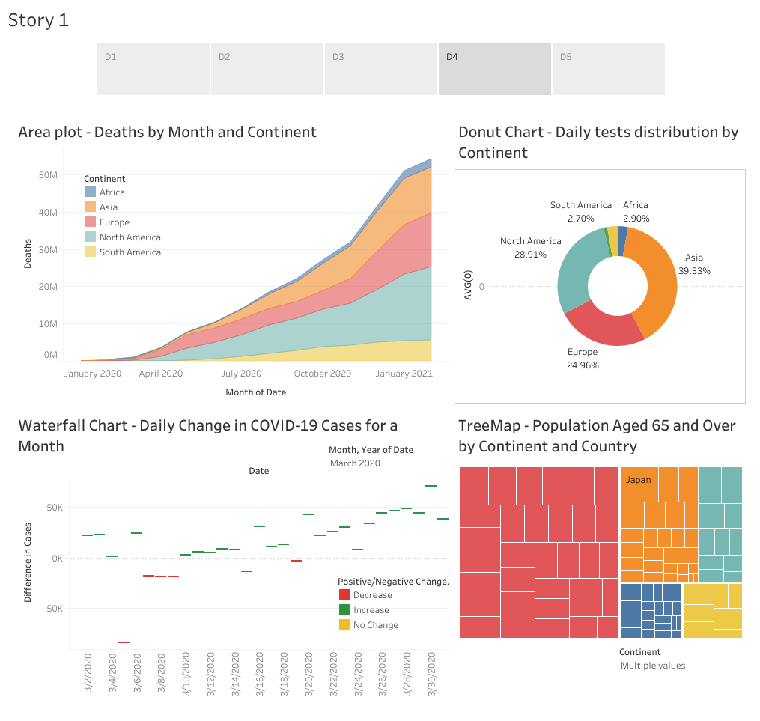

Slide 39
