Slide 1



Om_Chandra_2021700014
View in Power BI
Last data refresh:
9/29/2024 5:42:30 PM UTC
Downloaded at:
9/29/2024 5:46:19 PM UTC

Slide 2
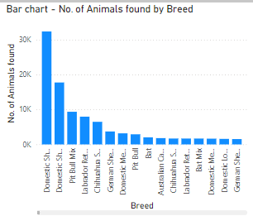
1. Bar Chart - Number of Animals Found by Breed
Observations:
Certain breeds, like Labrador has significantly more animals found compared to others.
Exotic or less common breeds have lower representation in the data.
The distribution is heavily skewed towards popular domestic breeds.
Questions Answered:
Which breed is most frequently found in the dataset?
How does the number of found animals vary between popular and rare breeds?

Slide 3
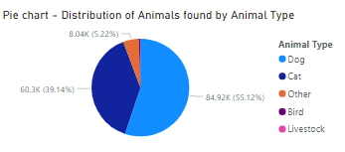
2. Pie Chart - Distribution of Animals Found by Animal Type
Observations:
Dogs and cats dominate the dataset, while other animal types like birds or reptiles are fewer.
The majority of found animals are domestic pets.
Exotic animals form a small percentage of the dataset.
Questions Answered:
What percentage of the total animals are dogs versus cats?
Are certain animal types more likely to be brought in ?

Slide 4
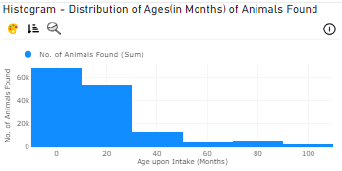
3. Histogram - Distribution of Ages (in Months) of Animals Found
Observations:
The age distribution is mostly skewed towards younger animals (0-20 months).
Fewer older animals (above 40 months) are found.
A large number of animals are within the juvenile to young adult range (12-36 months).
Questions Answered:
Are younger animals more likely to be found?
Is there a peak age range where most animals are found?

Slide 5
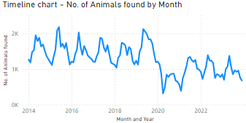
4. Timeline Chart - Number of Animals Found by Month
Observations:
There is a noticeable increase in animal intake during the summer months.
Winter months have fewer animals found.
Intakes spike around specific periods, potentially due to seasonal factors or holidays.
Animal intake has decreased during recent years.
Questions Answered :
What months see the highest number of animal intakes?
Are there trends linked to weather or holidays?
Does the intake type vary by time of year?

Slide 6
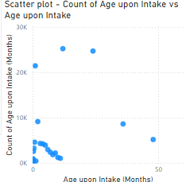
5. Scatter Plot - Count of Age upon Intake vs. Age upon Intake (Months)
Observations:
Younger animals are more frequently found compared to older ones.
There is a dense cluster of data points around the 0-12 month age range.
Some outliers exist where very old animals (over 50 months) were found.
Questions Answered :
Are younger animals more likely to be found than older animals?
How does age distribution change across intake conditions?
What age ranges have the most found animals?

Slide 7
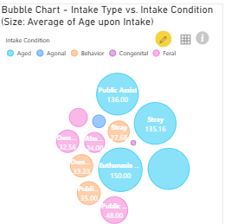
6. Bubble Chart - Intake Type vs. Intake Condition (Size: Average of Age upon Intake)
Observations:
Stray animals tend to have a younger average age upon intake.
Owner-surrendered animals have more varied intake conditions.
Animals found under emergency conditions are often younger.
Questions Answered :
Which intake type is linked to younger animals?
Does intake condition affect the average age of intake?
Are emergency situations more common for younger or older animals?

Slide 8
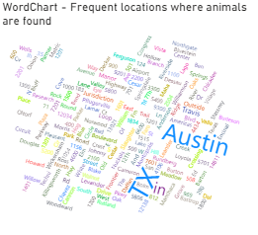
7. Word Chart - Frequent Locations Where Animals Are Found
Observations:
Specific neighborhoods or zones like TX, Austin have a higher frequency of animals found.
Rural locations report fewer animals compared to urban areas.
Certain areas have consistently high numbers of animals being found.
Questions Answered :
Which location reports the highest number of animals found?
Are urban areas more prone to stray animal intakes?
How do the found animals vary by location type (urban, rural)?

Slide 9
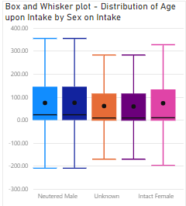
8. Box and Whisker Plot - Distribution of Age upon Intake by Sex on Intake
Observations:
The age distribution for males tends to be wider than for females.
Both males and females have a similar median age upon intake.
There are several outliers, especially among male animals.
Questions Answered :
Do males and females have similar age distributions at intake?
Are there more outliers for one gender?
Does the intake condition affect the age distribution by sex?

Slide 10
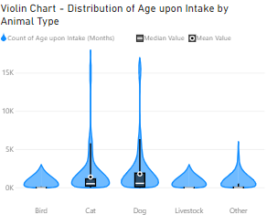
9. Violin Chart - Distribution of Age upon Intake by Animal Type
Observations:
Dogs and cats show a broader age distribution compared to other animal types.
Birds and Livestock tend to have a more concentrated age range, with fewer extremes..
Questions Answered :
Do dogs or cats have a wider range of ages at intake?
Are exotic animals typically younger or older upon intake?
How does animal type influence the spread of age data?

Slide 11
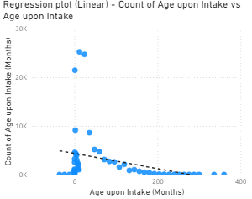
10. Linear Regression Plot - Count of Age upon Intake vs. Age upon Intake
Observations:
There is a downward trend, with younger animals being more frequently found.
Older animals (above 100 months) are less frequently found.
The trend line suggests a decline in the number of animals found as age increases.
Questions Answered :
Is there a significant relationship between age and intake frequency?
How does age predict the likelihood of intake?
Does this trend vary by intake type?

Slide 12
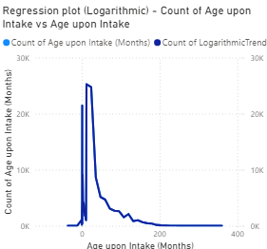
11. Logarithmic Regression Plot - Count of Age upon Intake vs. Age upon Intake
Observations:
The logarithmic curve suggests that the number of animals found drops sharply for older ages.
There is a sharp decline after the first few months.
Few animals are found past a certain age range (e.g., 100 months).
Questions Answered :
How well does a logarithmic model explain the intake of animals by age?
At what age do the number of animals found start declining rapidly?
Is this decline more noticeable for specific intake types?

Slide 13
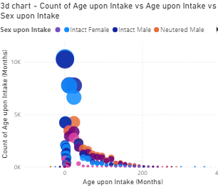
12. 3D Chart - Count of Age upon Intake vs. Age upon Intake vs. Sex on Intake
Observations:
Males have a slightly broader range of ages upon intake.
Females are more clustered around younger age ranges.
There is a higher concentration of found animals within 0-24 months for both sexes.
Questions Answered:
How does sex influence the intake age distribution?
Are there notable differences in age distribution between males and females?
Does the sex of the animal affect the intake frequency?

Slide 14
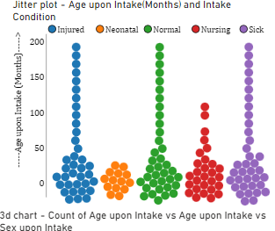
13. Jitter Plot - Age upon Intake (Months) and Intake Condition
Observations:
Younger animals (0-12 months) are spread across different intake conditions.
There is a concentration of younger animals in conditions like “Injured" or “Sick".
Some intake conditions, like “Normal" have animals across all age ranges.
Questions:
Which intake condition is linked to younger animals?
Are older animals more likely to come from specific intake conditions?
How do intake conditions vary with the age of the animal?

Slide 15
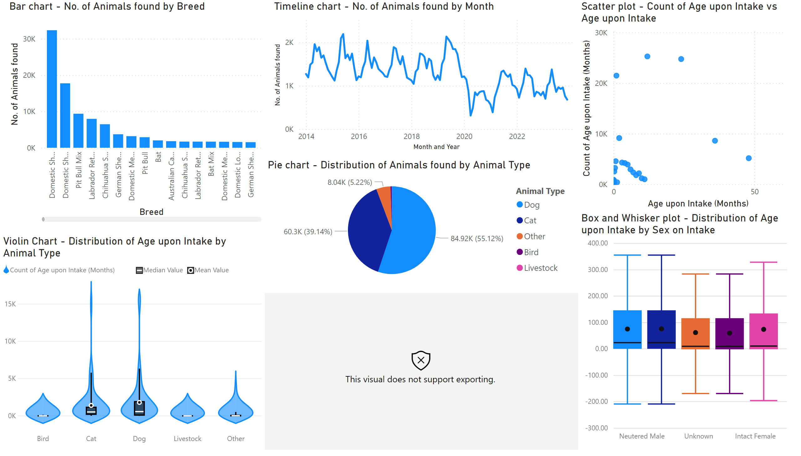
Page 1
Notes:
Bar chart - No. of Animals found by Breed
No alt text provided
Pie chart - Distribution of Animals found by Animal Type
No alt text provided
Timeline chart - No. of Animals found by Month
No alt text provided
Histogram - Distribution of Ages(in Months) of Animals Found
No alt text provided
Scatter plot - Count of Age upon Intake vs Age upon Intake
No alt text provided
Box and Whisker plot - Distribution of Age upon Intake by Sex on Intake
No alt text provided
Violin Chart - Distribution of Age upon Intake by Animal Type
No alt text provided

Slide 16
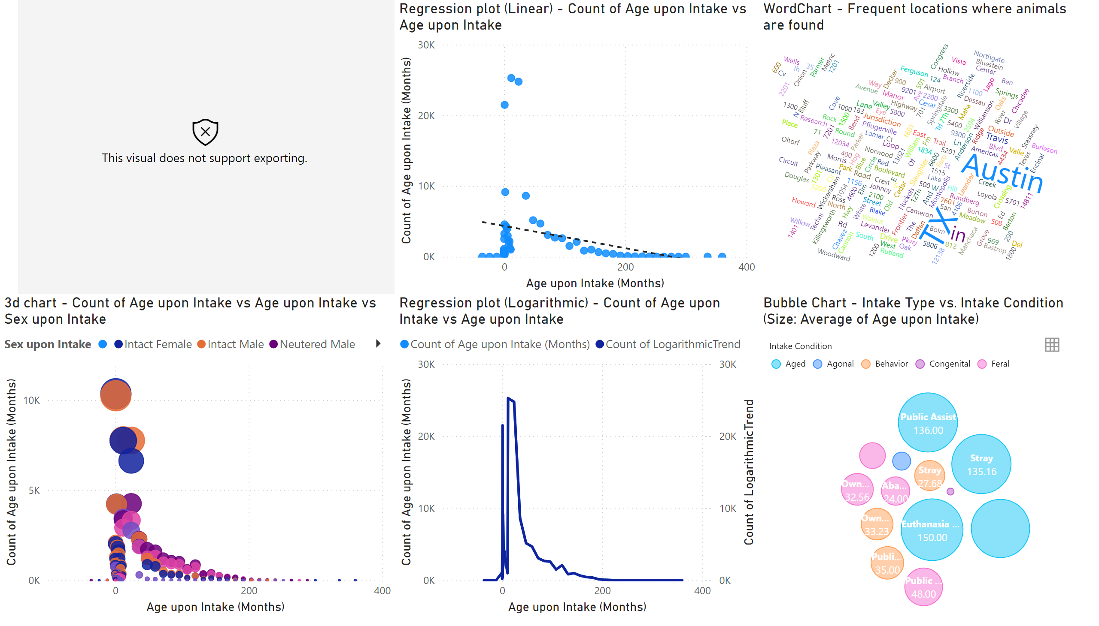
Page 2
Notes:
Jitter plot - Age upon Intake(Months) and Intake Condition
No alt text provided
Regression plot (Linear) - Count of Age upon Intake vs Age upon Intake
No alt text provided
Regression plot (Logarithmic) - Count of Age upon Intake vs Age upon Intake
No alt text provided
Bubble Chart - Intake Type vs. Intake Condition (Size: Average of Age upon Intake)
No alt text provided
WordChart - Frequent locations where animals are found
No alt text provided
3d chart - Count of Age upon Intake vs Age upon Intake vs Sex upon Intake
No alt text provided

