Slide 1

Benefits of Yoga Daily
Yoga is the journey of the self, through the self, to the self.
-Bhagvat Gita

Slide 2

Introduction
Yoga is an ancient practice that connects the body, mind, and breath.
Originated in India thousands of years ago
Practiced worldwide for health and wellness
A simple daily routine of yoga can bring balance, energy,
and peace.

Slide 3
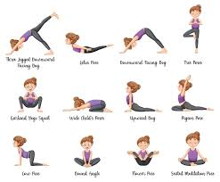
Physical Benefits
Increases flexibility and improves posture
Strengthens muscles and builds balance
Boosts immunity and energy levels
Helps in weight management and overall fitness

Slide 4

Mental & Emotional Benefits
Reduces stress, anxiety, and depression
Improves focus, concentration, and memory
Promotes better sleep and relaxation
Encourages positivity and self-awareness

Slide 5

Conclusion
Practicing yoga daily leads to a healthy body and peaceful mind
Just 15–30 minutes a day can make a big difference
Yoga is not just physical exercise—it’s a lifestyle for overall well-being 🌿

