Slide 1

<organization>
<organization>

Slide 2
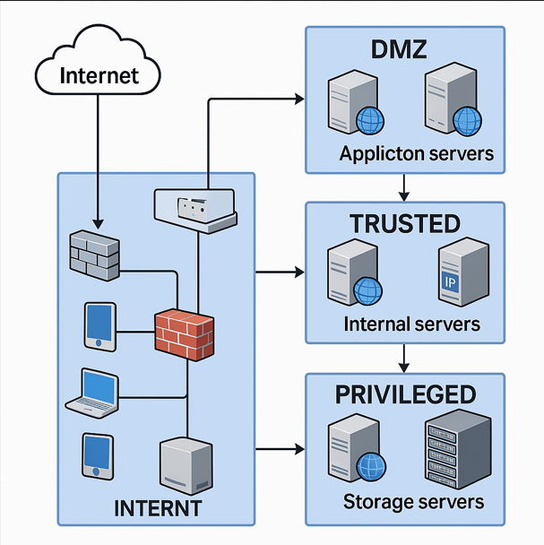

Slide 3
Revision History
Revision | Full Name | <person> | Reviewed Date | Changes Made (If Any)
1.0 | <person> | <email> | <hostname> | Initial draft of network topology diagram created.
1.1 | <person> | <email> | <hostname> | Updated IP addressing scheme and <organization> assignments.
1.2 | <person> | <email> | <hostname> | No changes. Reviewed and approved existing diagram.
1.3 | <person> | <email> | <hostname> | No changes. Confirmed compliance with updated security policies.

