Slide 1
views
Img#: RDFView
Img#: Interactions View
Hands-on#: TouchGraph
Haystack

Slide 2
some use cases (jython)
#generic service
from org.ome.model import *
gs=ctx.getBean(„genericService“)
josh=LSID(Vocabulary.NS+“Josh“)
lsobject=gs.getLSObject(josh)
map={„owner“ : josh}
lsobjects=gs.findLSObjects(„namedQuery“,map)
#image service
gs=ctx.getBean(„imageService“)
list=is.getImagesByDataset(LSID(Vocabulary.NS+„ds1“)

Slide 3
LSID slides, stolen from i3c.org

Slide 4
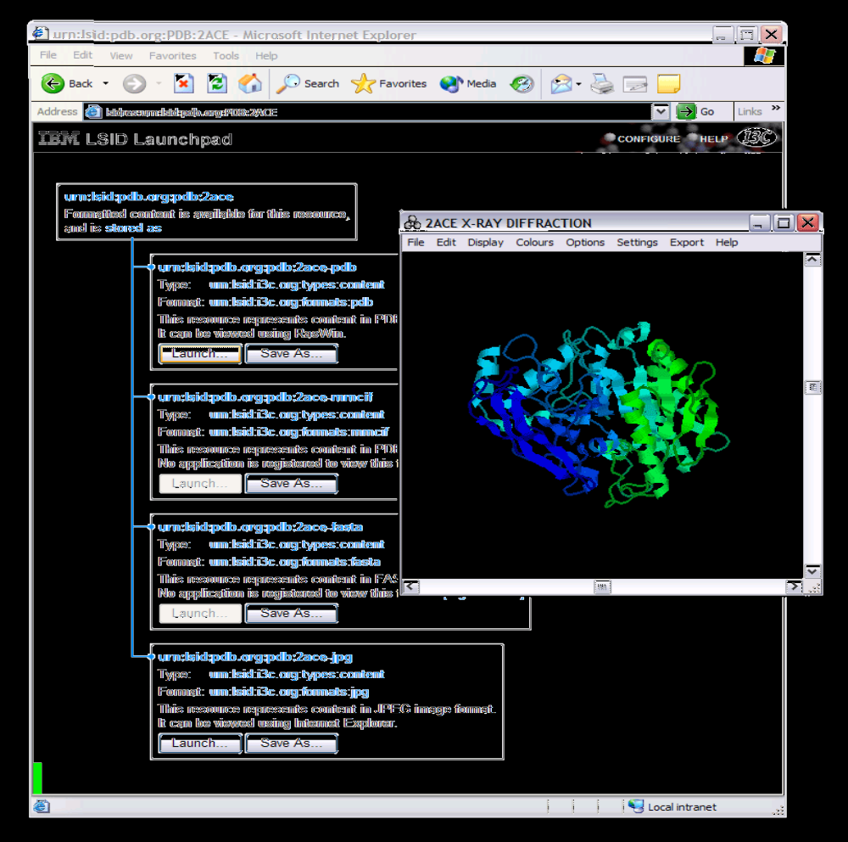

Slide 5
Life Sciences Identifier – The Big Ideas
LSID is an naming standard for distributed data, specifically:
  Biologically significant data items,
  Located in distributed data stores,
  Including files, database records, and data objects managed by N-tier applications,
  That are accessible over public and/or private networks,
  And owned, managed, and/or curated by different academic, research, government or commercial organizations.
LSID names are semantically void/opaque with respect to the objects they identify.
LSID replaces physical addresses with opaque, location independent identifiers expressed as URNs.
LSID complements Web services standards such as SOAP/XML, WSDL, UDDI, SAML, WS-Security, MS Passport, Liberty Alliance, GSS-API and OGSA.

Slide 6
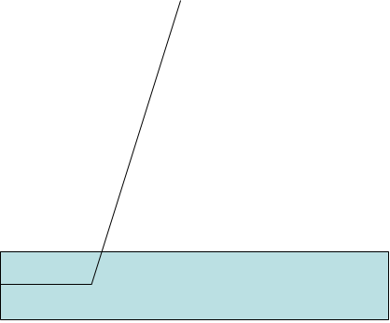
1. Resolve Authority:
Client
Application
Using DNS SRV RR (ref. RFC 2782)
DNS
Authority portion of the LSID
_lsid._tcp SRV RR
Hostname:Port
2. Authority Query:
LSID request
using
http://hostname:port/Authority/...
Methods:
WSDL getAvailableMethods(LSID id)
URIList getKnownURIs()
Version getAuthorityVersion()
Authority
LSID Resolution Model
WSDL/URIList
3. Data retrieval:
Required Methods:
binaryBlob getData(LSID id)
Optional Methods:
LSIDList resolveMetaDataQuery(Query q)
Meta Data
Store
Allowed Method Call
LS Data
Store
LS data via SOAP, HTTP,
FTP,NFS,AFS,
DFS,SCP
MetaData query e.g:
Give me the concrete FASTA format LSID for the protien in an unknown format described by LSID2

Slide 7
LSID Requirements
  Scalability: LSID must scale to a very large number of items distributed across public or private wide area networks.
  Multiple organizations: Biologically significant data objects named with LSID may be managed, owned and/or curated by multiple organizations. These organizations may by geographically separated.
  Location Independence: Over time, a data item named with LSID may be migrated to a different network address, a different computer or a different administrative domain. This should not impact applications that refer to this data item.
  Persistent names: The LSID name for a data item must be immutable and not change for the lifetime of that data item. The lifetime may include events such as data item migration, data store partitioning or network restructuring.
  Replication and caching: For performance reasons, it must be possible to replicate or cache data items named with LSID.
  Transparency: LSID names must be robust and transparent with respect to data item replication, migration and failure.
  Rebind: LSID bindings can become stale, if the physical endpoint of an LSID changes. It must be possible to rebind an LSID.
  Extensibility: LSID names must be extensible to support future revisions of the standard. Newer implementations of LSID must be able to resolve legacy name.

Slide 8
base class
smart hashmap (validation)
efficient (non-redundant) transport
single, castable interface
( *all class-cast exceptions revert back to generic interface* /or/ clients get the generator code as well --> restart! )

Slide 9
owl issues
no GOM but transferable
efficiency
Research-status
????

Slide 10
hands-on: isaviz

Slide 11
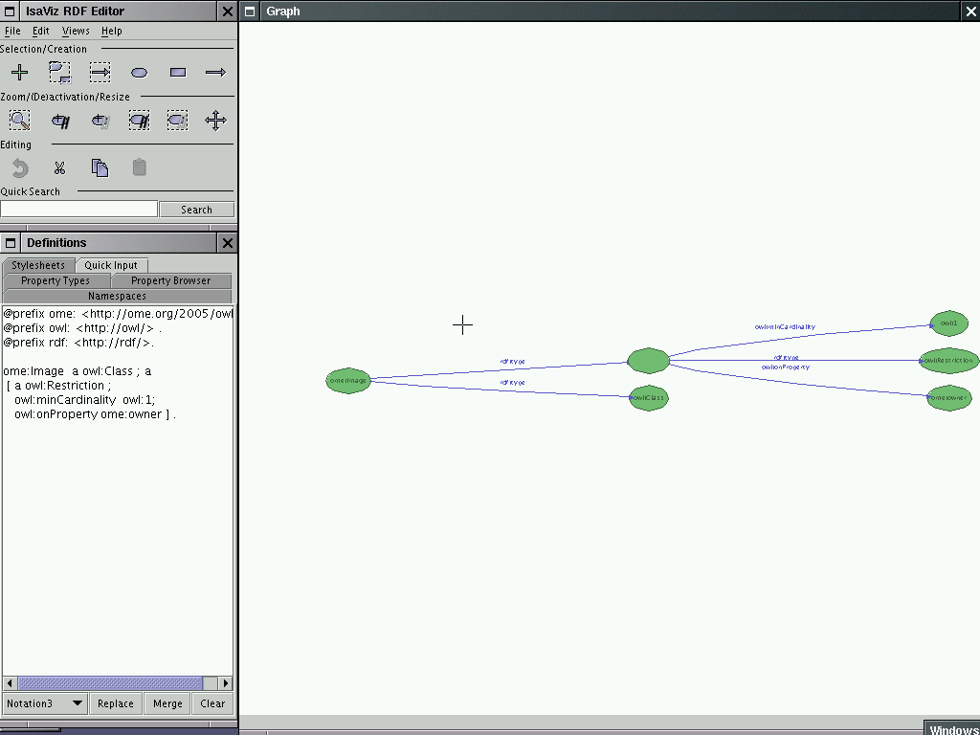
hands-on: isaviz

Slide 12
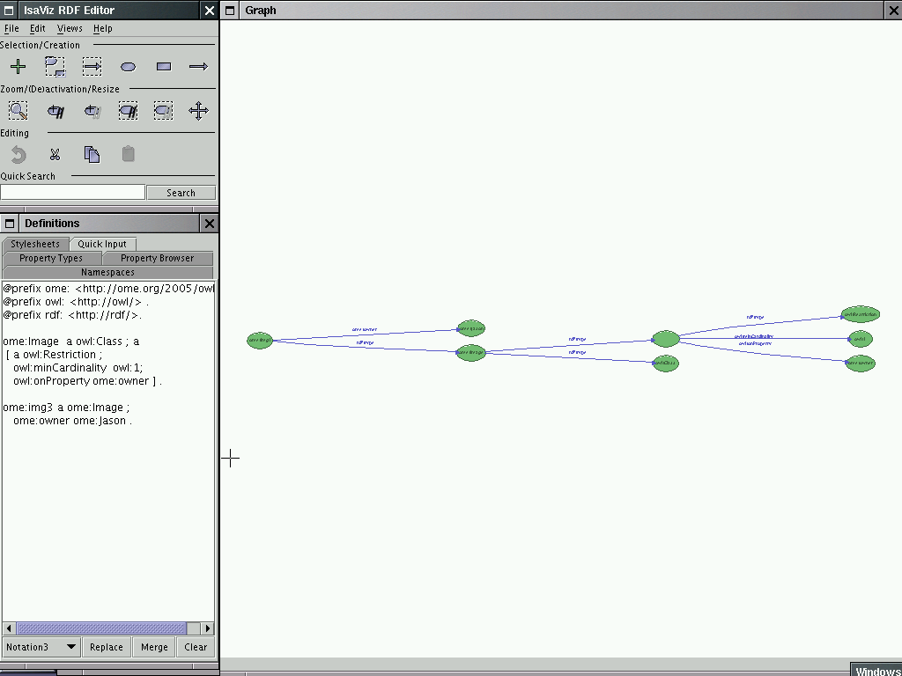
hands-on: isaviz

Slide 13
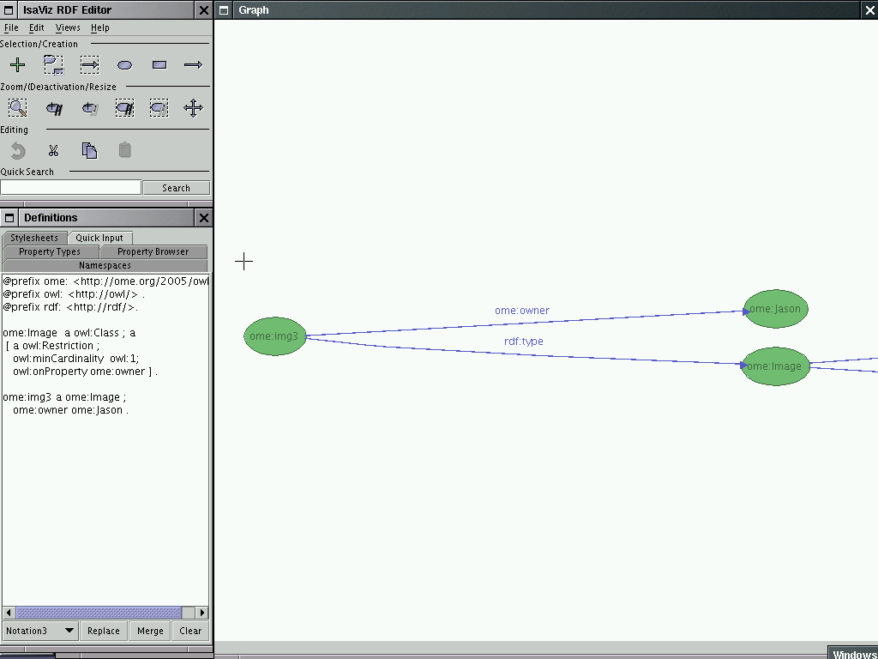
hands-on: isaviz

Slide 14
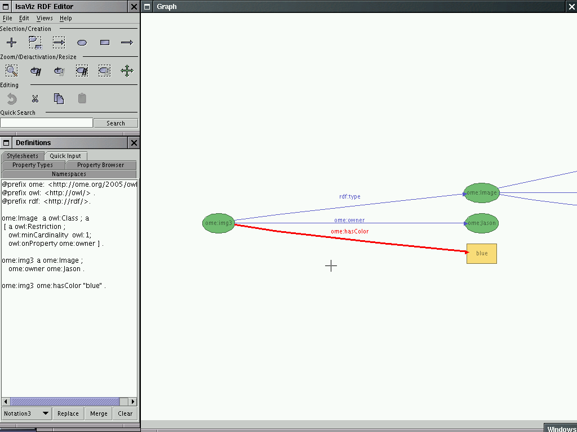
hands-on: isaviz

Slide 15
working with rdf
easy to create
queryies
available tools
Notes:
„easy to create“ yeah right. What i mean is that it's just writing triples, there's a good deal of experience doing it, lots of examples, and tools for doing it.
Good tools and i'm leaving out several.

Slide 16
hands-on: protege

Slide 17
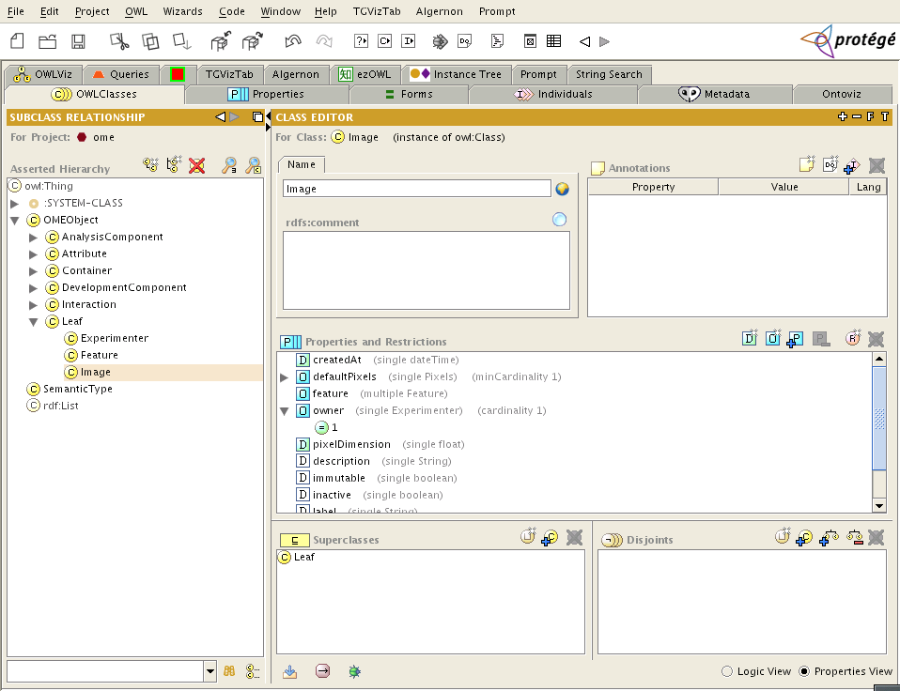
hands-on: protege

