Slide 1
owl metadata server
josh.moore
@gmx.de

Slide 2
owl metadata server
theory
proposal
reality
discussion

Slide 3
owl metadata server
theory
proposal
reality
discussion

Slide 4
(a) theory, or what is owl?
owl* is a schema language for rdf*
rdf is
  metadata, composed of triples
  which form a graph
  of <resources>, bnodes, & (typed) literals
owl is also
  Description Logics
  born of DAML*
  * owl = web ontology language
  * rdf = resource description framework
  * daml = darpa agent markup language
Notes:
That's the high level definitions. I'll cover what rdf and owl are in a bit of detail before we go on

Slide 5
what does rdf look like?
rdf+xml syntax
<rdf:RDF
xmlns="http://www.openmicroscopy.org/2005/OME.owl#"
xmlns:ome="http://www.openmicroscopy.org/2005/OME.owl#"
xmlns:rdf="http://www.w3.org/1999/02/22-rdf-syntax-ns#">
<ome:Image rdf:ID="img3">
<ome:owner>
<ome:Experimenter rdf:ID=“Jason"/>
</ome:owner>
</ome:Image>
</rdf:RDF>

Slide 6
what does rdf look like?
ntriple syntax
<http://www.openmicroscopy.org/2005/OME.owl#img3>
<http://www.w3.org/1999/02/22-rdf-syntax-ns#type>
<http://www.openmicroscopy.org/2005/OME.owl#Image> .
<http://www.openmicroscopy.org/2005/OME.owl#img3>
<http://www.openmicroscopy.org/2005/OME.owl#owner>
<http://www.openmicroscopy.org/2005/OME.owl#Jason> .
<http://www.openmicroscopy.org/2005/OME.owl#Jason>
<http://www.w3.org/1999/02/22-rdf-syntax-ns#type>
<http://www.openmicroscopy.org/2005/OME.owl#Experimenter> .

Slide 7
what does rdf look like?
n3 syntax
@prefix ome: <http://www.openmicroscopy.org/2005/OME.owl#>.
ome:img3 a ome:Image ; ome:owner ome:Jason .
ome:Jason a ome:Experimenter .
Notes:
Here you can see that rdf is just
subject predicate verb

Slide 8
(but it really looks like this!)
rdf:type
ome:img3
ome:Image
ome:owner
ome:Jason
ome:LastName
rdf:type
„Swedlow“
ome:Experimenter
Notes:
Appreciating the graph – nature of rdf is important!
Squares are literals, circles are resources

Slide 9
(though it could be this!!)
kjo:typ
r4h:bleck
r4h:ding
r4h:meister
r4h:teufel
r4h:ruf
kjo:typ
„Swedlow“
r4h:arbeiter
Notes:
Just shows that with rdf you can say anything but it doesn't have a well-defined meaning just as it is easy to write any well-defined xml
Goal is to make the graphs sensible for a computer. There are multiple interprestations of any graph. Need to something to reduce the possible intepretations.

Slide 10
but what does it mean?
rdfs
owl-lite
owl-DL
owl-full
Notes:
There is a stack of schema languages for OWL. The most basic is RDFs.
mention open world model (no real „schema“) and no unique name assumption!

Slide 11
but what does it mean?
rdfs
owl-lite
owl-DL
owl-full
    rdfs:subClassOf
    rdf:Property
    rdfs:subPropertyOf
    rdfs:domain
    rdfs:range
    rdfs:comment
    rdfs:label
    rdfs:seeAlso

Slide 12
but what does it mean?
rdfs
owl-lite
owl-DL
owl-full
    Class
    Individual
    ObjectProperty/
    DatatypeProperty
    Transitive-,
    Symmetric-,
    Functional-,
    InverseProperty
    Restriction
    Cardinality
    versionInfo
    deprecatedProperty
    sameAs

Slide 13
but what does it mean?
rdfs
owl-lite
owl-DL
owl-full
    Complex Classes
    oneOf
    unionOf,
    complementOf
    disjointWith (una)
    hasValue
A box T box
set theory
Notes:
This is the most interesting language in the stack and what i've based this prototype on.

Slide 14
but what does it mean?
rdfs
owl-lite
owl-DL
owl-full
    metaclasses
    classes as properties or
    individuals
not complete

Slide 15
a bit of owl
ome:Image
a owl:Class ;
rdfs:subClassOf
[ a owl:Restriction ;
owl:onProperty ome:defaultPixels ;
owl:minCardinality
"1"^^<http://www.w3.org/2001/XMLSchema#int>
] ;
rdfs:subClassOf
[ a owl:Restriction ;
owl:onProperty default:owner ;
owl:minCardinality
"1"^^<http://www.w3.org/2001/XMLSchema#int>
] .
Notes:
Obviously there are tools to do this. I'll cover that next, but it's interesting to see that owl is really just rdf talking about rdf.

Slide 16
sparql, query language for rdf
select ?volume where
(?image ome:attribute ?semanticType)
(?semanticType rdf:type ome:Spot)
(?semanticType ome:volume ?volume)

Slide 17
sparql, query language for rdf
select ?image,?volume where
(?image ome:attribute ?semanticType)
(?semanticType rdf:type ome:Spot)
(?semanticType ome:volume ?volume)
(?dataset ome:contains ?image)
Notes:
If you want to do multiple images at one, say in a dataset, you can add the image variable to the binding list

Slide 18
sparql, query language for rdf
select ?image,?volume where
(?image ome:attribute ?semanticType)
(?semanticType rdf:type ome:Spot)
(?semanticType ome:volume ?volume)
OPTIONAL
(?dataset ome:contains ?image)

Slide 19
sparql, query language for rdf
select ?image,?volume where
(?image ome:attribute ?semanticType)
(?semanticType rdf:type ome:Spot)
(?semanticType ome:volume ?volume)
OPTIONAL
(?dataset ome:contains ?image)
and
?value >= 0

Slide 20
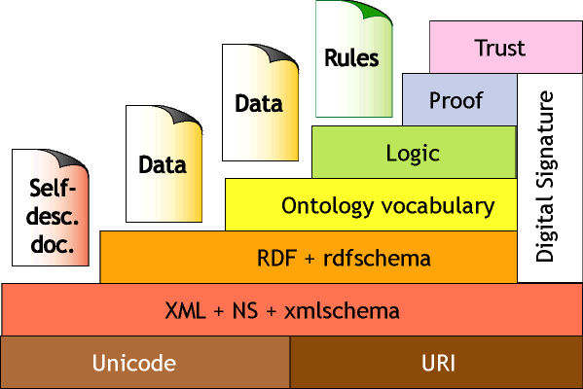
tools, vocabularies, etc.
visualization
  Protege
  IsaViz
  GSS
content
  Dublin core
  Adobe xmp
  Uniprot, GO
standards
  RDF & OWL — W3C recommendations
  future work: SWRL, logic/proof/truth lang.
http://www.w3.org/2000/Talks/
1206-xml2k-tbl/slide10-0.html

Slide 21
owl metadata server
theory
proposal
reality
discussion

Slide 22
(b) proposal
originally
hybrid j2ee server with
hibernate, owl, & lsid

Slide 23
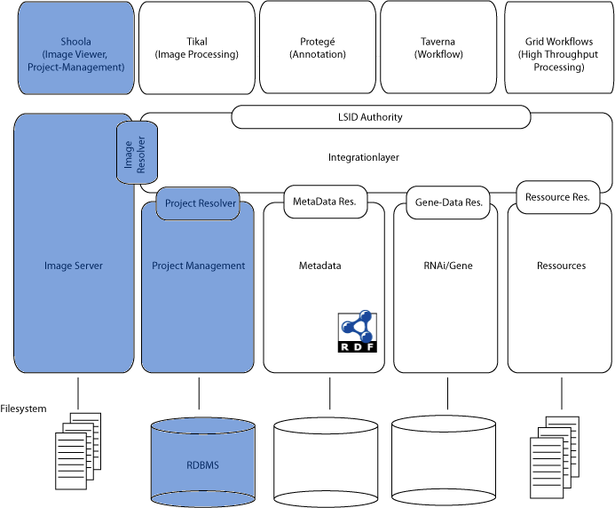
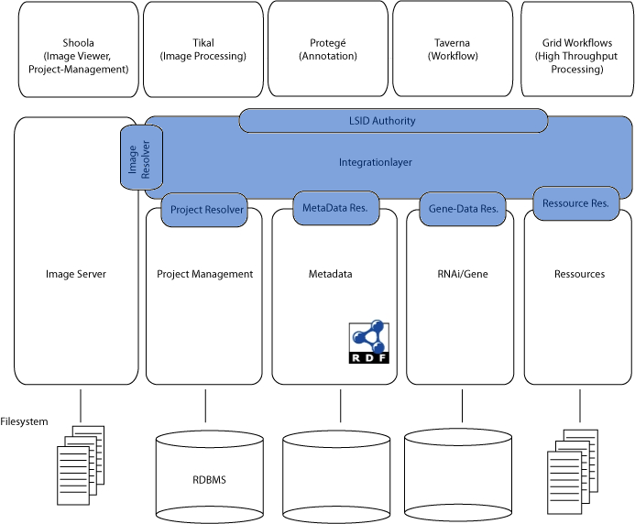
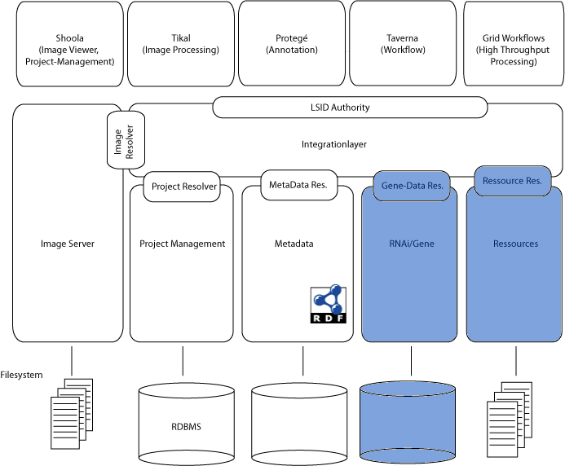
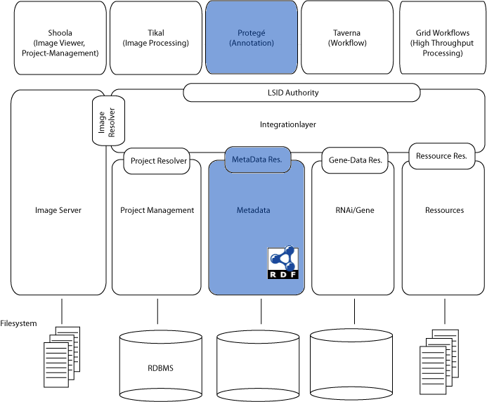
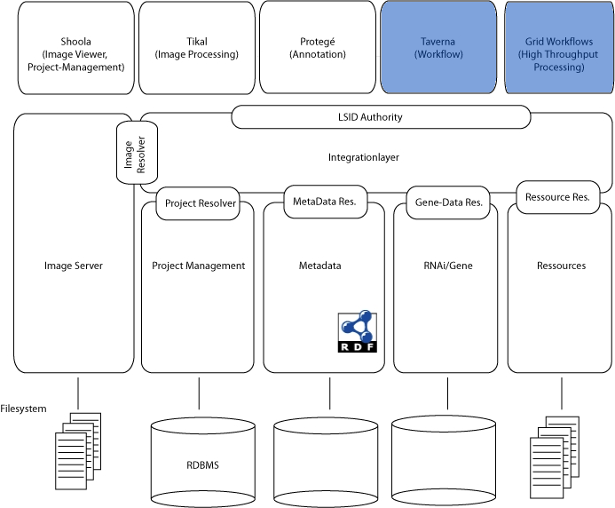
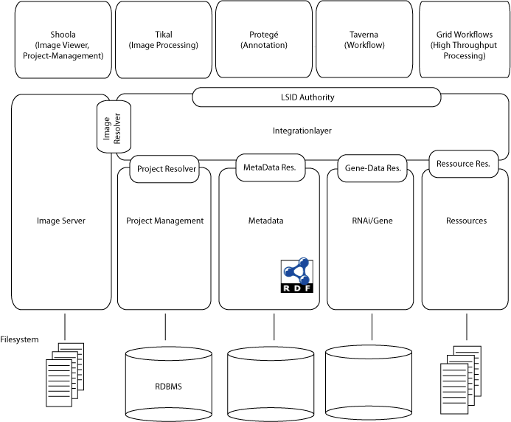
Notes:
The idea was to de-couple everything through the use of lsids, store the core tables in hibernate, and link everything else with owl.

Slide 24
(b) proposal
originally
hybrid j2ee server with
hibernate, owl, & lsid
simplification
only owl and a triple store

Slide 25
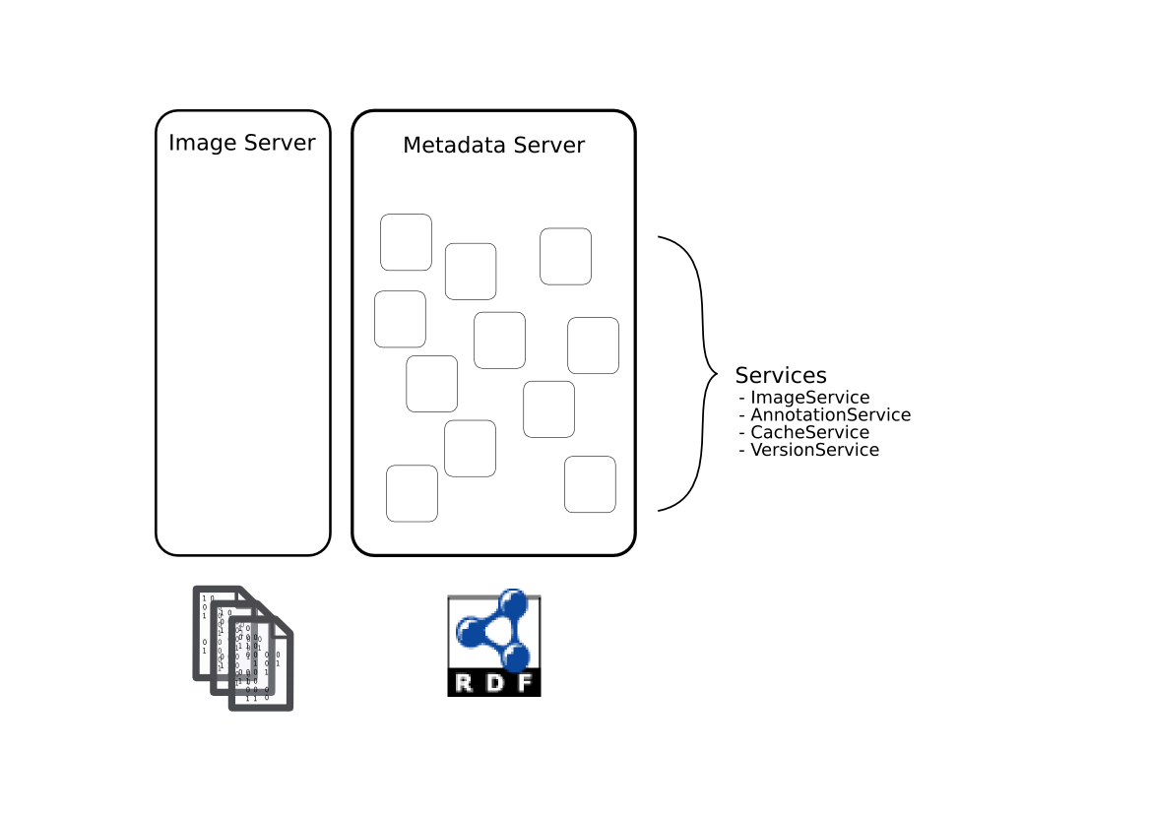
Notes:
SLSB
standard web application with mvc and remoting, business logic, data access objects, container transactions and security, etc.

Slide 26
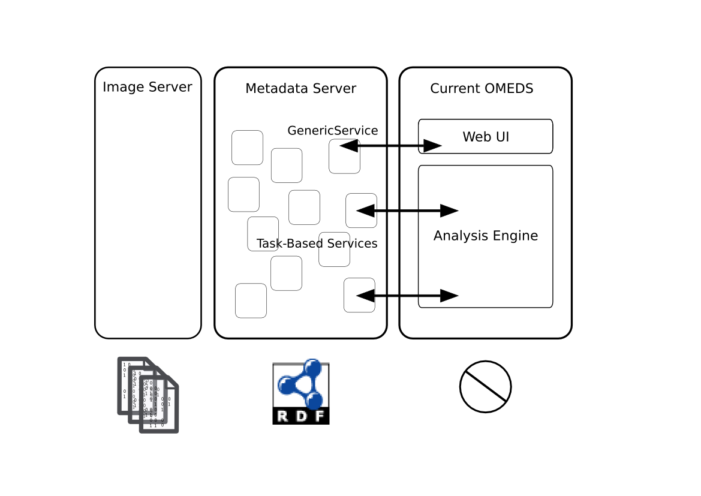

Slide 27
benefits
owl
  flexible,
  meaningful, easily producible &
  queryable model
  joins over graphs & interoperability
  reasoning
java
  container
  security
  clustering
  available
  implementations
Notes:
Include in point (a) validation
i won't really talk about the java benefits in order to prevent a holy war.

Slide 28
building the model
write definition in owl
parsed into „OntologicalClass“
— predicates, or fields
— restrictions: min, max, disjoint
— super class
— lsid
run code generation,
or use information at runtime
Notes:
Everything that is expressible in owl is parseable and can be accessed at generate, compile, or run-time

Slide 29
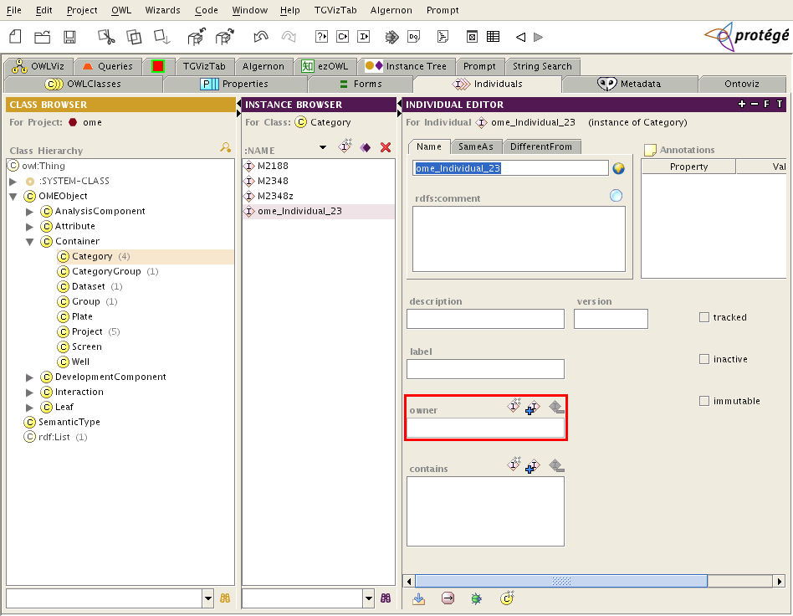
hands-on: creating instances
Notes:
Once that's done, one can see the power of the semantics. Protege has its own internal representation of this informaton but to show what can be done with that info...

Slide 30
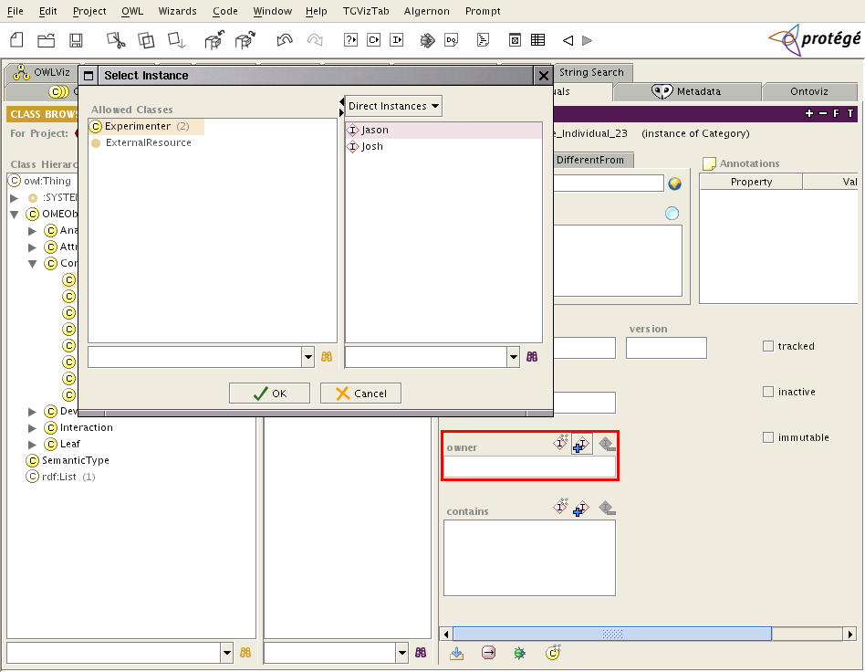
hands-on: creating instances

Slide 31
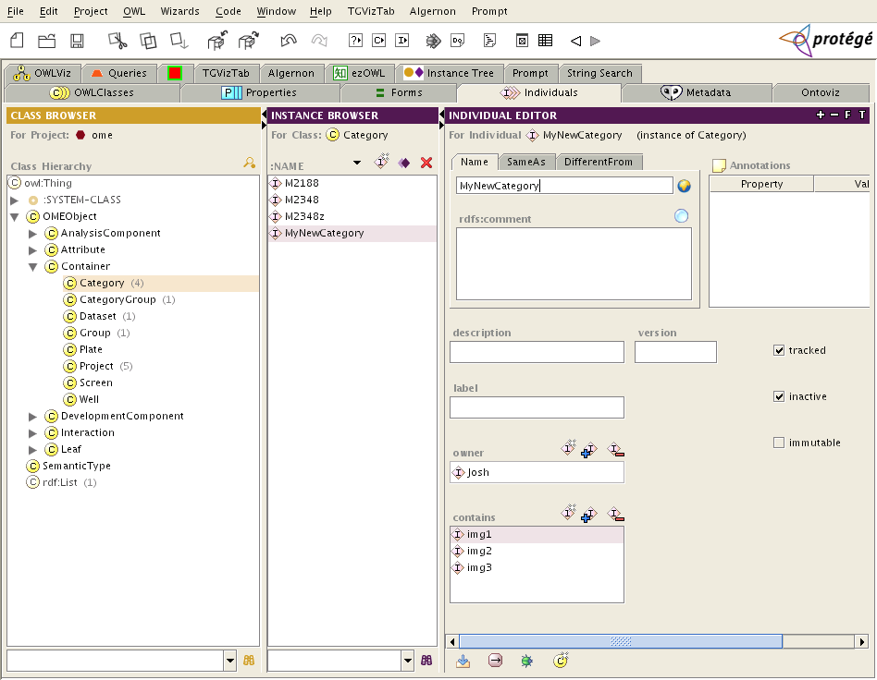
hands-on: creating instances

Slide 32
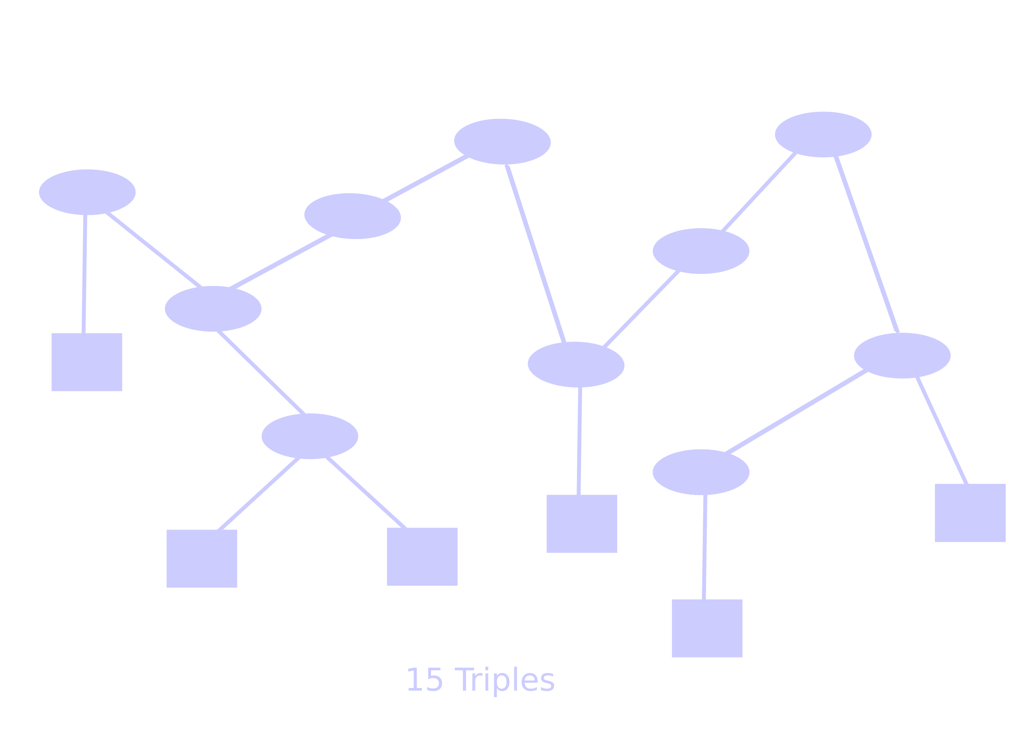
the marriage of graphs
Notes:
Another one of the benefits i mentioned is the ability to join any two graphs.
Mention josiah's worries
this gets us:
Joins,
named/temporary models
partionioning
federating

Slide 33
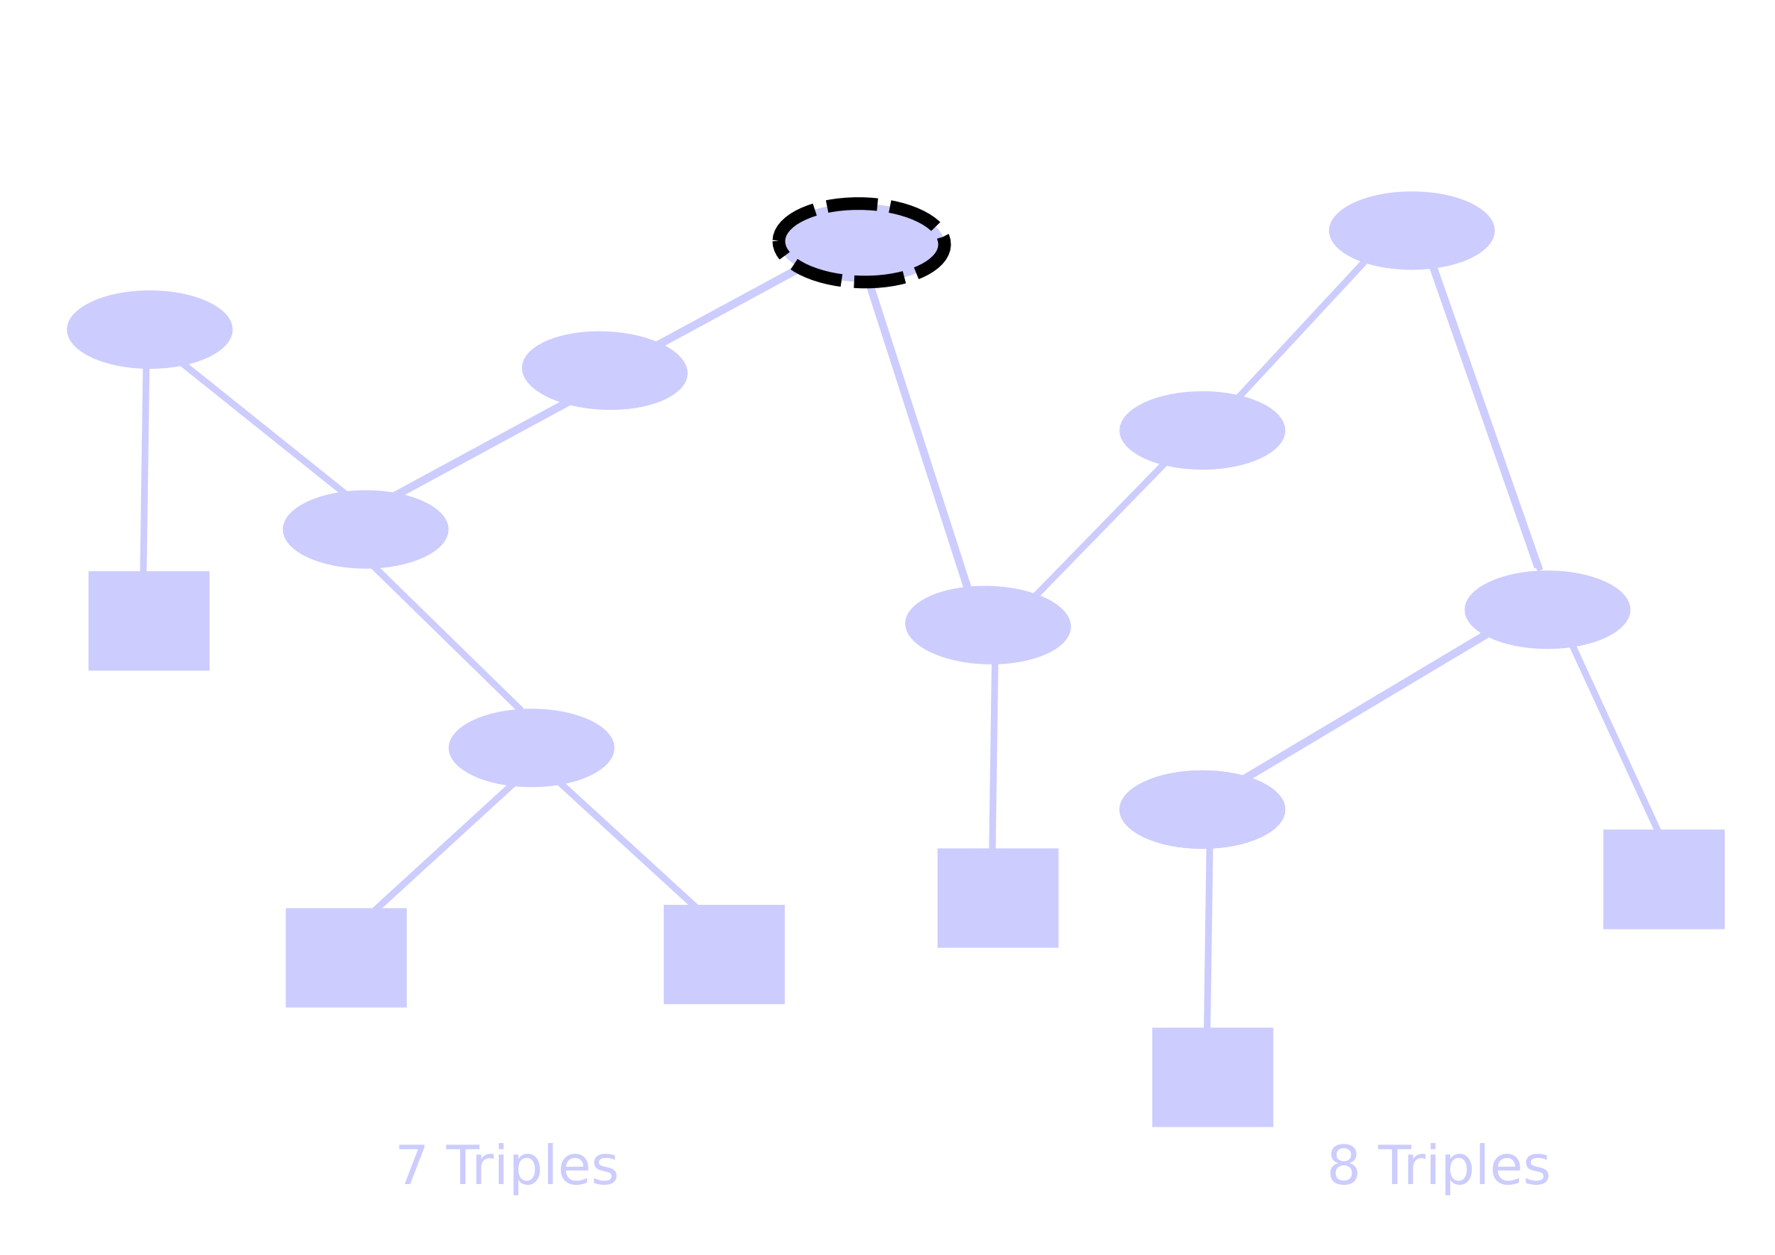
the marriage of graphs

Slide 34
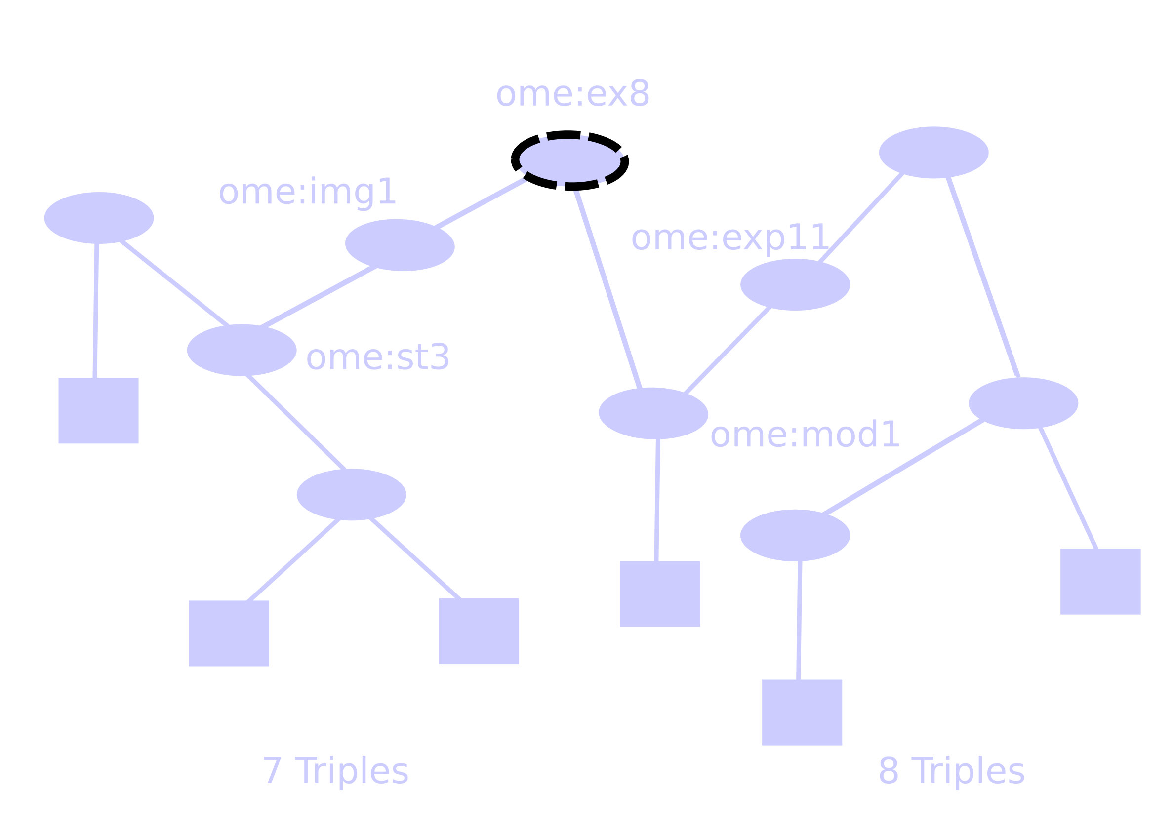
the marriage of graphs

Slide 35

the marriage of graphs

Slide 36
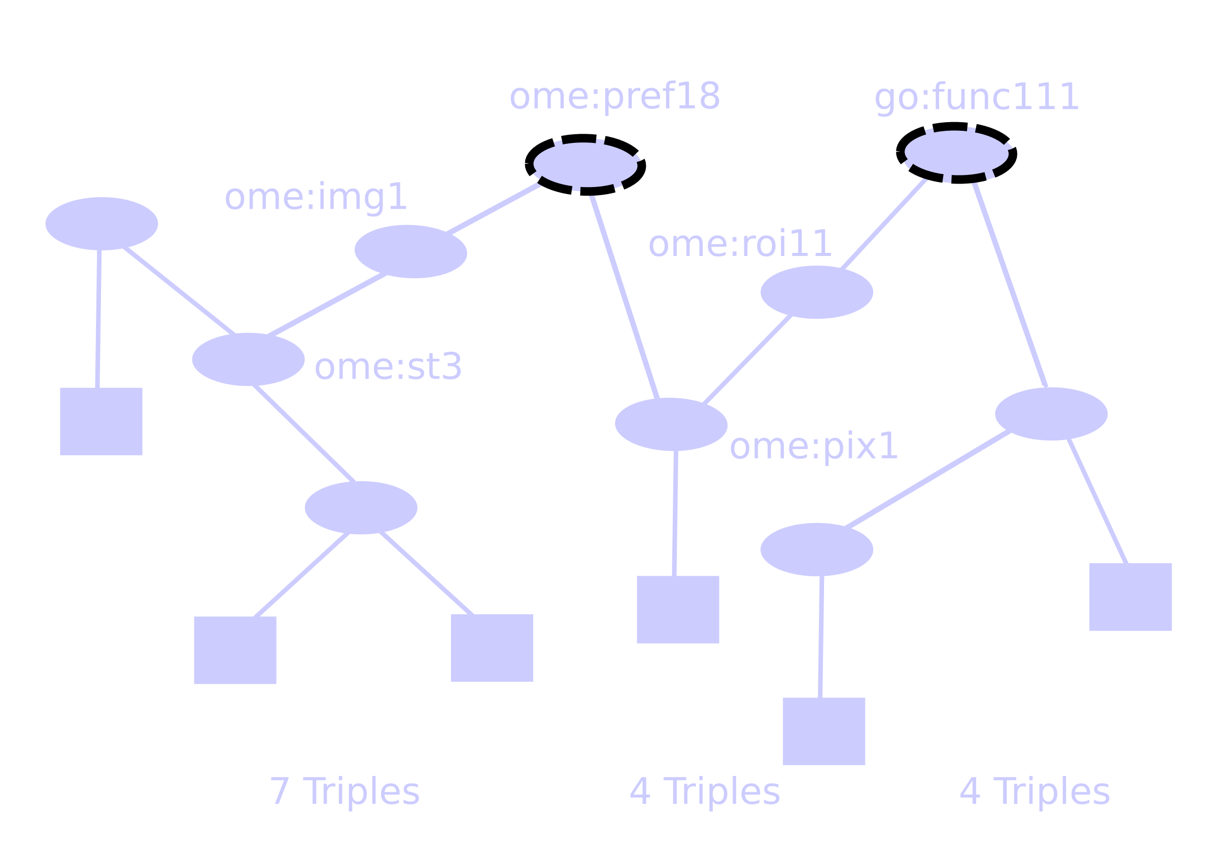
the marriage of graphs

Slide 37
knowledge base
inference engine use case:
  „annotate“ data—
  :img1 :hasST :st1 .
  :st1 a :Spot ; :volume „100“ .
  :cat1 a :TestCategory ; :contains :img1 .
  produce rules—
  { ( ?spot > 50 ) ...
  ( ?nucleusCat :contains ?img ) } ==>
  { ( :ImportantCat :contains ?img ) }
  run inference engine—
Notes:
And finally the real point of owl and friends, and one of the stated goals ome
mention here the simplification that comes from not having containers !! as instances but rather as classes
this becomes another analysis tool beside classification!

Slide 38
owl metadata server
theory
proposal
reality
discussion

Slide 39
© reality, or what's working
code generation (custom)
server (j2ee)
security
integration (over rdf)

Slide 40
owl2code
using apache's velocity
#for ($class in $classes)
public class ${class} {...}
#end
where „$classes“ is a list of OntologicalClasses
generic interface with validation
(type, cardinality, disjoint,...):
  OMEObject get(LSID pred)
  void put(LSID pred, OMEObject obj)
Notes:
currently generating all but three classes of
org.ome.model
hope to generate facades as well

Slide 41
technology stack
rmi
http
xml
ice
web/app server (jboss,tomcat,spring)
sesame
jena
kowari
postgres, mysql
kowari
Notes:
Other than velocity the technology choices have been:
Mention berkely java edition

Slide 42
acegi security
two classes, one config file,
no change to code
currently user-based
extensible to ACLs

Slide 43
integration
affected classes
  DBObject, Factory, SemanticType
  Facades & Task Managers
get RDF representation
$ GET http://host/ome/Image?id=4
ome:img4
ome:owner ome:Josh ;
ome:defaultPixels ome:pix123 .

Slide 44
integration (cont.)
AE, webui, managers, import
become clients of the metadata store
meaning defined in a common,
implementation independent language (owl)

Slide 45
owl metadata server
theory
proposal
reality
discussion

Slide 46
(d) discussion
changes to the model
  containers
  history
  interactions
performance
  options

Slide 47
containers
generalization of current concepts
  containers have single predicate (:contains)
  produce a set in description logic
categories, etc. made equivalent to
datasets, etc.
restrictions include:
  boolean type expressions
  disjoint
  enumerations
Notes:
As i mentioned while talkinga bout the knowledge base features, the fact that our containers are not truly classes but intances of some container class make things a bit more complicated then they actually have to be.
Mention josiahs wish for Qcontainers (runtime resolved)

Slide 48
hands-on: creating instances

Slide 49
history
predicates:
immutable, tracked, inactive
  tracked:
  produces inactive (immutable?) objects on update
  immutable/tracked:
    produces a new object on update
  immutable/inactive:
  doesn't show up, needed for historical reasons
versioning ? ?

Slide 50
interactions
same generalizations possible here
possible interactions
  import
  annotate
  analyze
  delete
each produces an instance
of an interactionAttribute
Notes:
Possible grapic

Slide 51
deletion

Slide 52
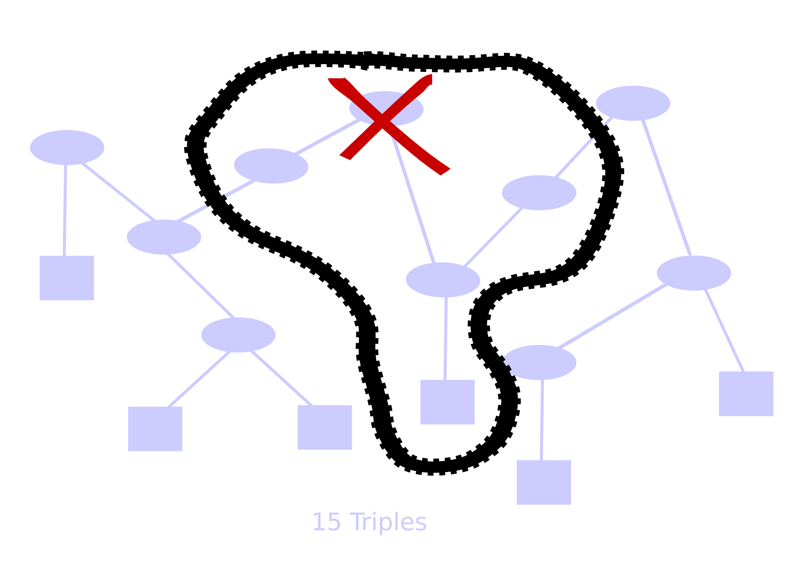
deletion

Slide 53
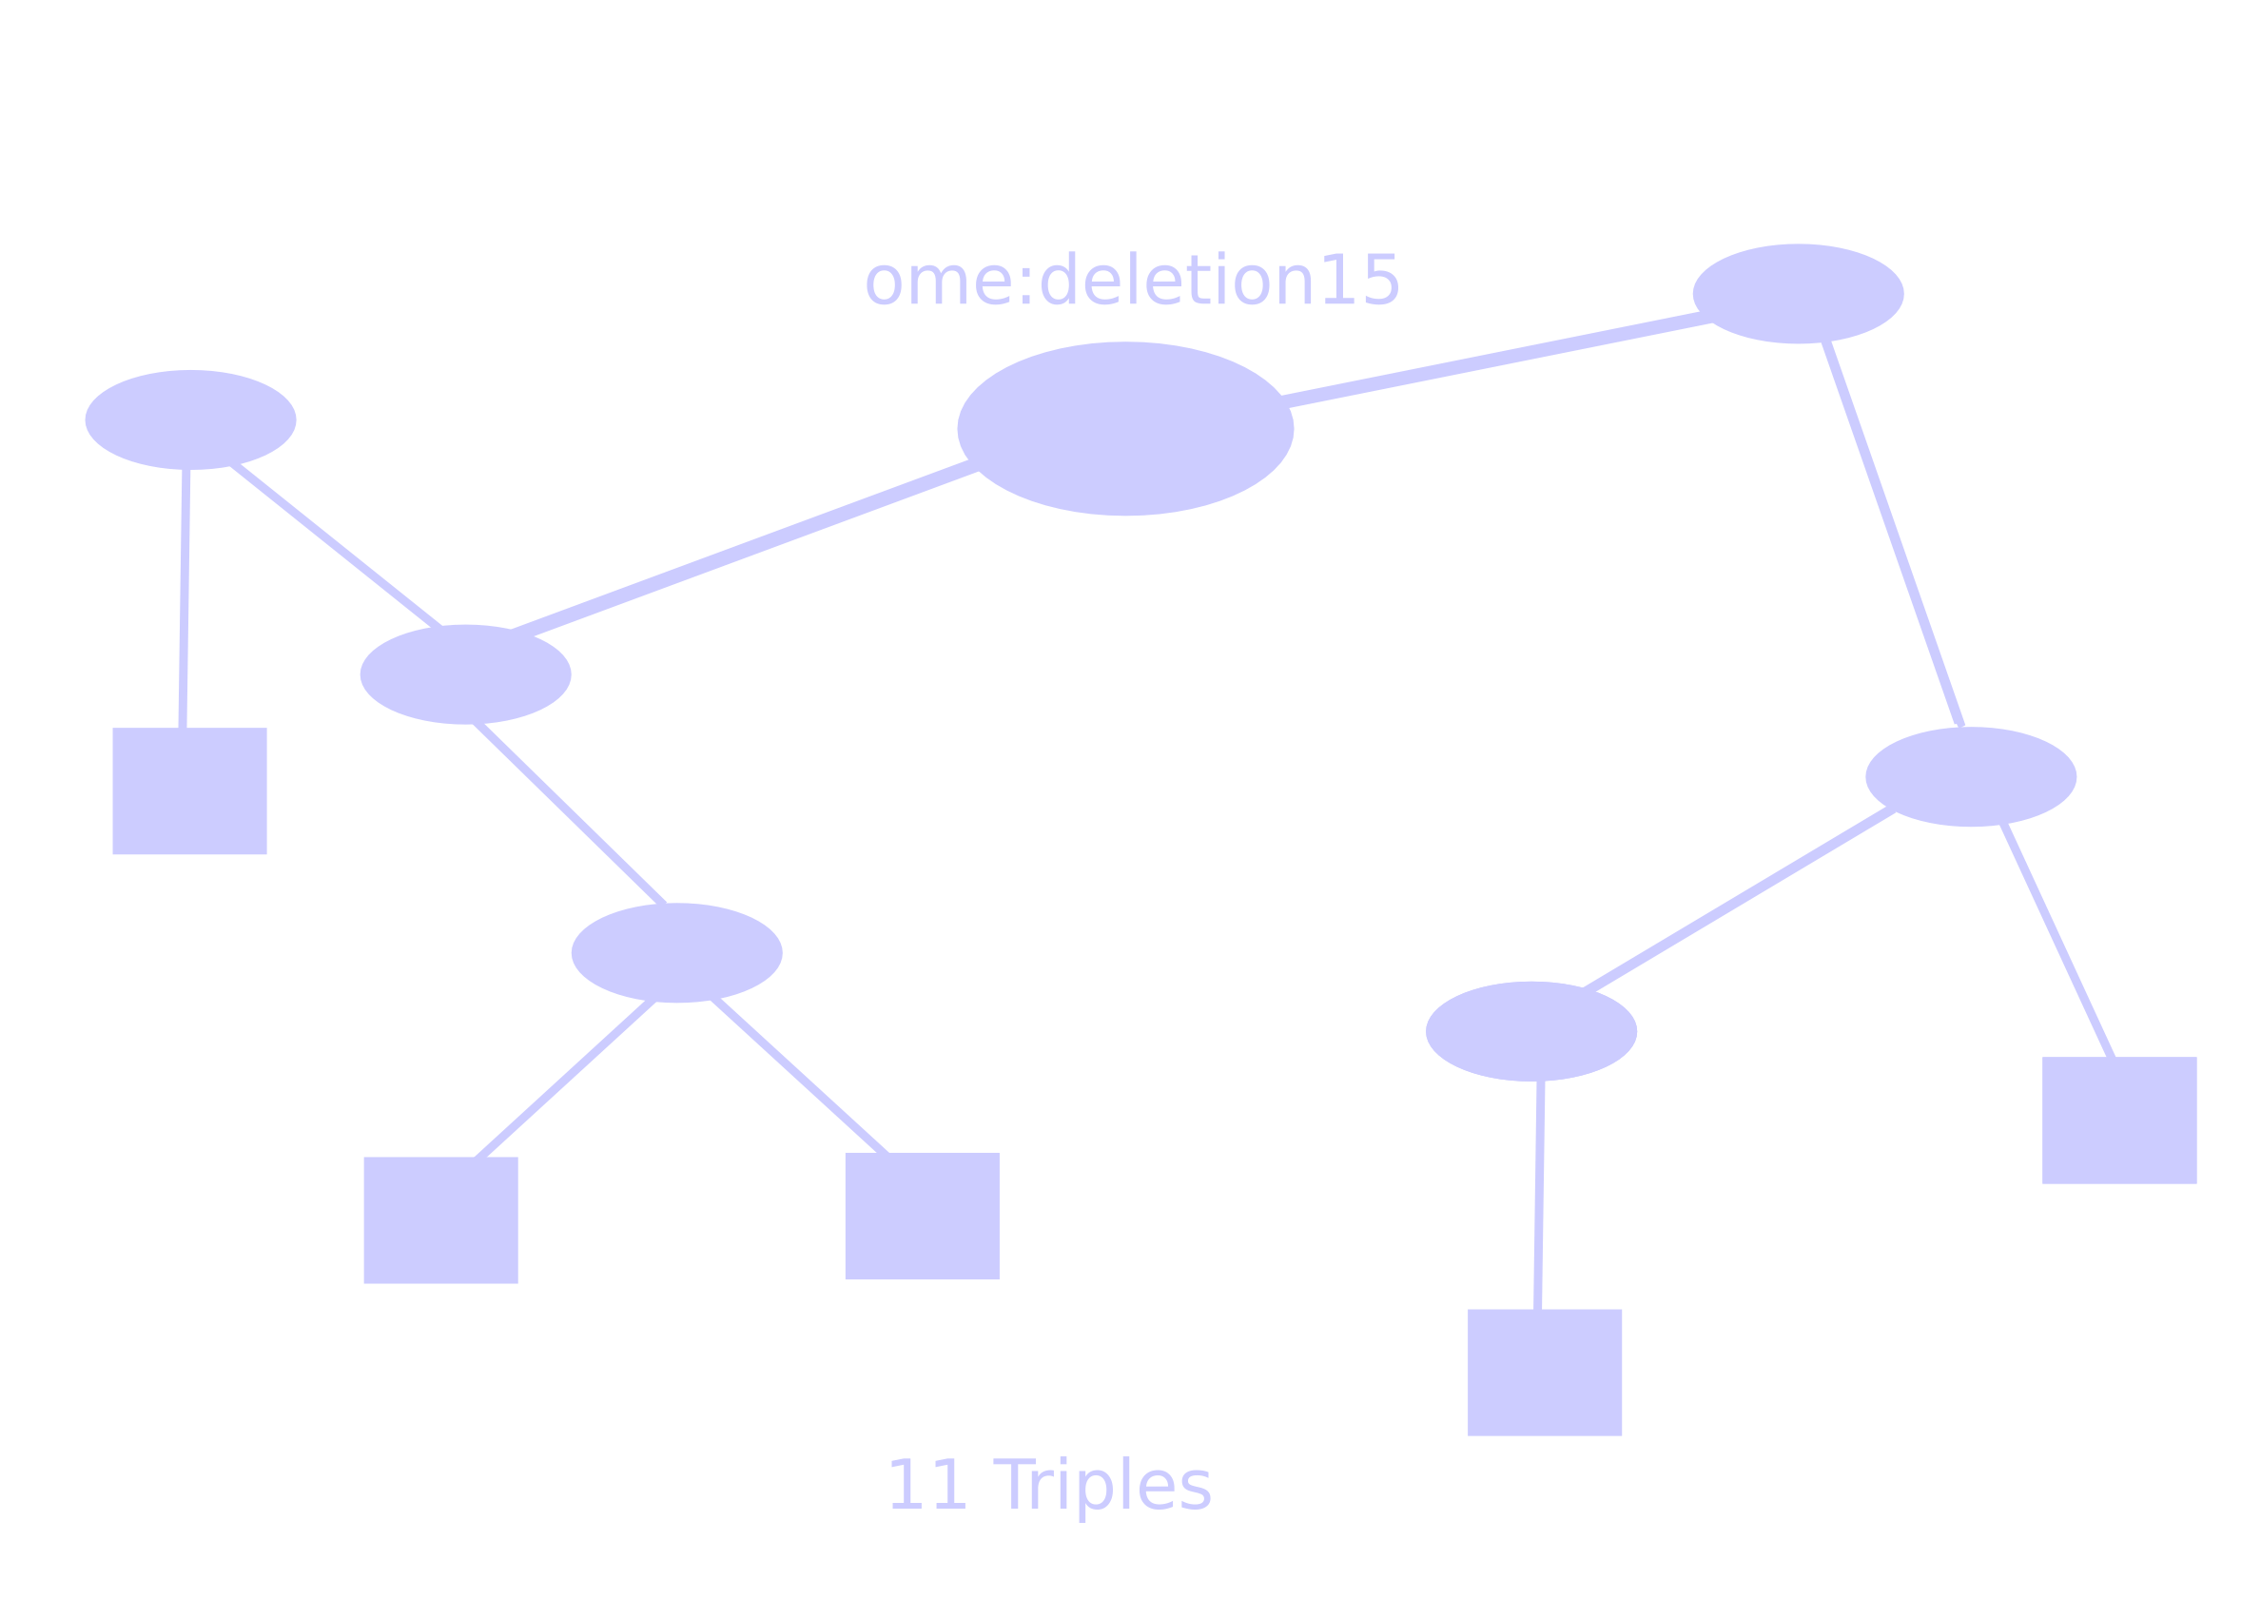
deletion

Slide 54
performance
issues
  serialization
  (see chris)
  db-access
  (todo)
currently
  pooling
  caching
upgradable
  pooling
  caching
  partitioning
  distributing
  hibernating
  other libraries:
  kowari, sesame,...

Slide 55
  F i n

