Slide 1
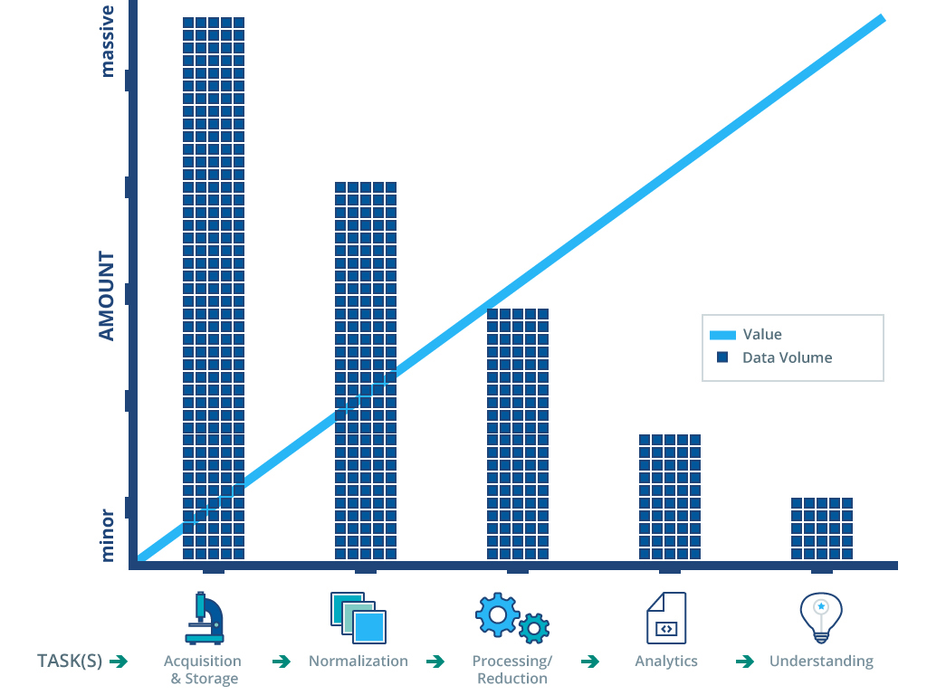
Data Driven Discovery: The Promise

Slide 2
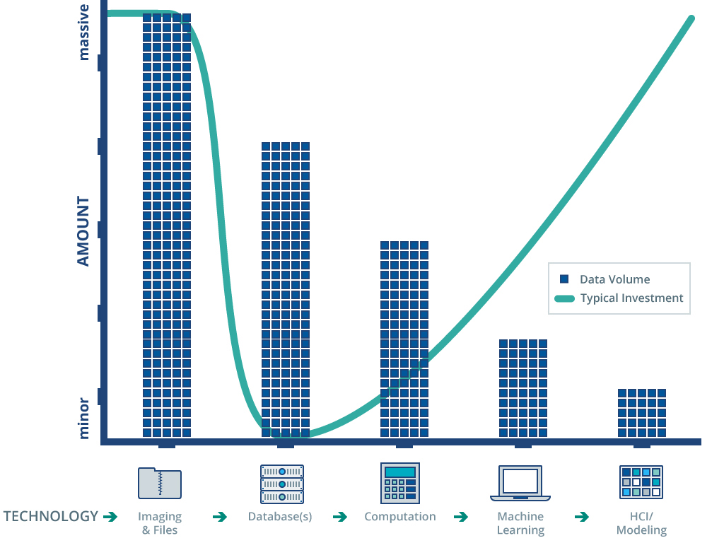
Data Driven Discovery: The Reality

