Slide 1
JBS IntelliQE · API Automation
Manual HTTP Request
Live Authentication Verification
All 9 auth schemes exercised end-to-end against real public REST APIs via the server-side Send path.
None
Bearer
Basic
API key
OAuth2
Digest
AWS SigV4
OAuth1
mTLS
Tested 2026-11-05 · JBS IntelliQE TestOps · every request returned HTTP 200

Slide 2
Verification summary — 9 / 9 passed
# | Scheme | Endpoint | Result | Evidence
1 | No Auth | jsonplaceholder /todos/1 | 200 · 492ms | Real JSON body returned
2 | Bearer | httpbin /bearer | 200 · 739ms | authenticated:true, token echoed
3 | Basic | httpbin /basic-auth | 200 · 1501ms | authenticated:true, user:jbsuser
4 | API key | httpbin /anything | 200 · 691ms | X-Api-Key header applied (hdr/query)
5 | OAuth 2.0 | Duende token → httpbin /bearer | 200 · 708ms | Real JWT fetched → used as Bearer
6 | Digest | httpbin /digest-auth | 200 · 716ms | 401 challenge → MD5 → retry OK
7 | AWS SigV4 | httpbin /anything | 200 · 763ms | AWS4-HMAC-SHA256 signature sent
8 | OAuth 1.0a | postman-echo /oauth1 | 200 · 316ms | Signature verification: pass
9 | mTLS | certauth.idrix.fr /json | 200 · 1337ms | Client cert presented (CN=jbs-mtls-test)

Slide 3
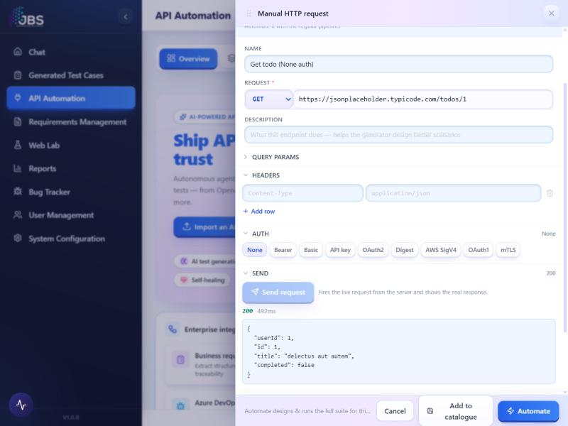
1
No Auth
✓ 200 · 492 ms
ENDPOINT
GET https://jsonplaceholder.typicode.com/todos/1
WHAT WAS PROVEN
Baseline request with no credentials. The real REST API returned its JSON body: {"userId":1,"id":1,"title":"delectus aut autem","completed":false}.

Slide 4
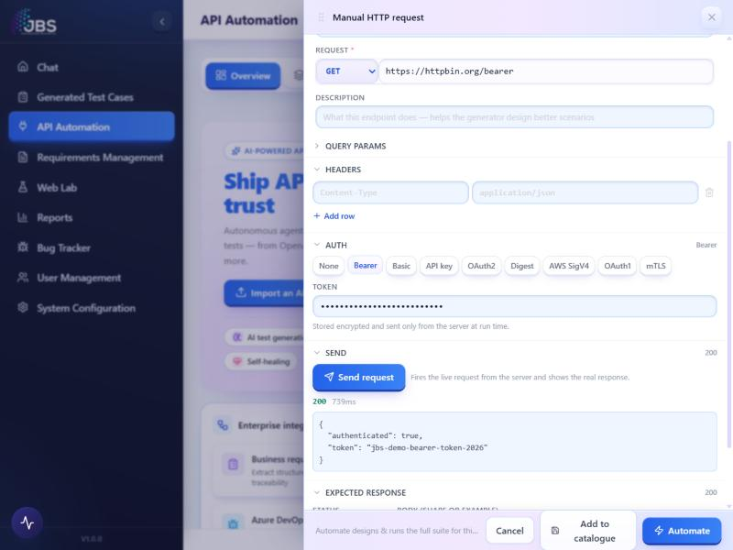
2
Bearer Token
✓ 200 · 739 ms
ENDPOINT
GET https://httpbin.org/bearer
WHAT WAS PROVEN
Token is stored encrypted and attached as Authorization: Bearer at send time. Server replied {"authenticated": true, "token": "jbs-demo-bearer-token-2026"}.

Slide 5
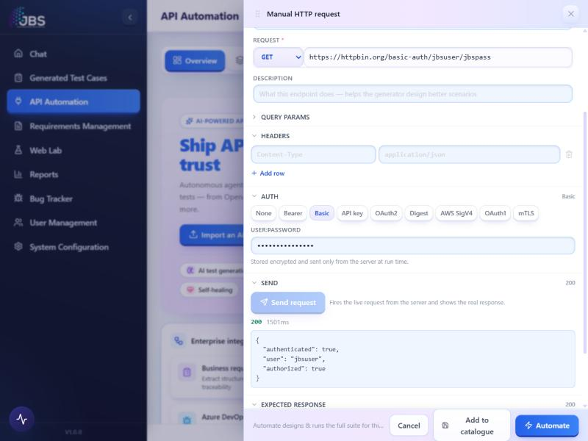
3
Basic Auth
✓ 200 · 1501 ms
ENDPOINT
GET https://httpbin.org/basic-auth/jbsuser/jbspass
WHAT WAS PROVEN
username:password encoded to Authorization: Basic. Server replied {"authenticated": true, "user": "jbsuser", "authorized": true}.

Slide 6
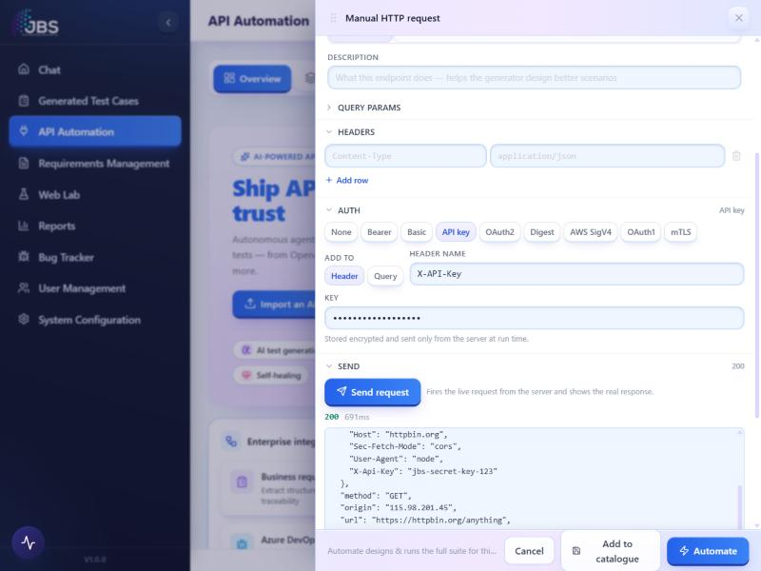
4
API Key
✓ 200 · 691 ms
ENDPOINT
GET https://httpbin.org/anything
WHAT WAS PROVEN
Key sent in a header (Header/Query toggle supported). The echo endpoint reflected "X-Api-Key": "jbs-secret-key-123" — confirming the key was applied.

Slide 7
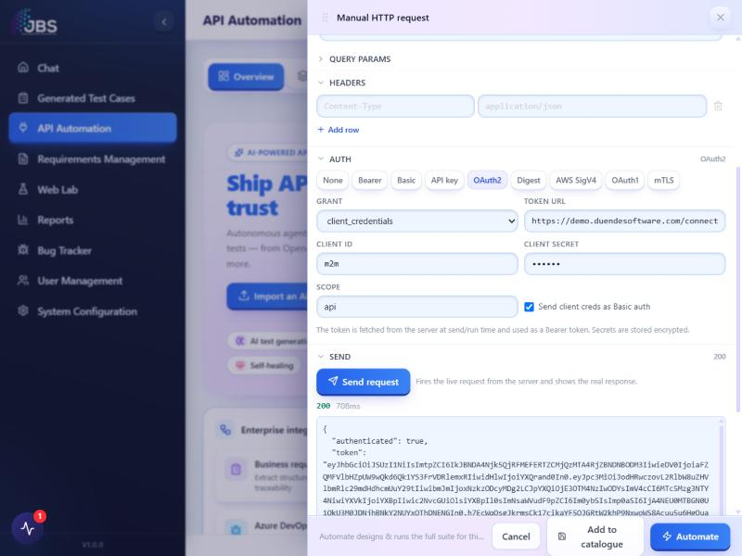
5
OAuth 2.0 (client credentials)
✓ 200 · 708 ms
ENDPOINT
Token: demo.duendesoftware.com/connect/token → GET httpbin.org/bearer
WHAT WAS PROVEN
Full two-step flow: the server fetched a real JWT from Duende IdentityServer using client_credentials, then used it as a Bearer token. Target replied authenticated:true with the issued JWT.

Slide 8
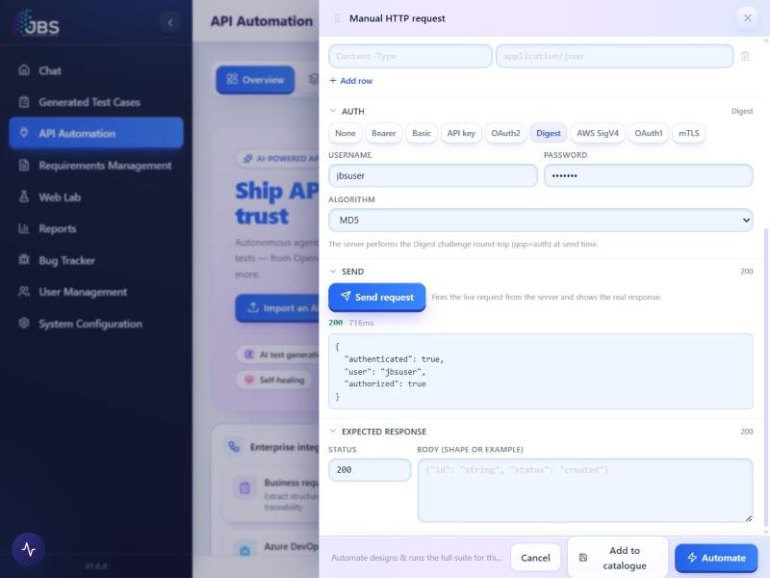
6
HTTP Digest
✓ 200 · 716 ms
ENDPOINT
GET https://httpbin.org/digest-auth/auth/jbsuser/jbspass
WHAT WAS PROVEN
Real challenge-response round-trip: initial 401 WWW-Authenticate → MD5 HA1/HA2 with qop=auth, cnonce, nc → retry. Server replied authenticated:true.

Slide 9
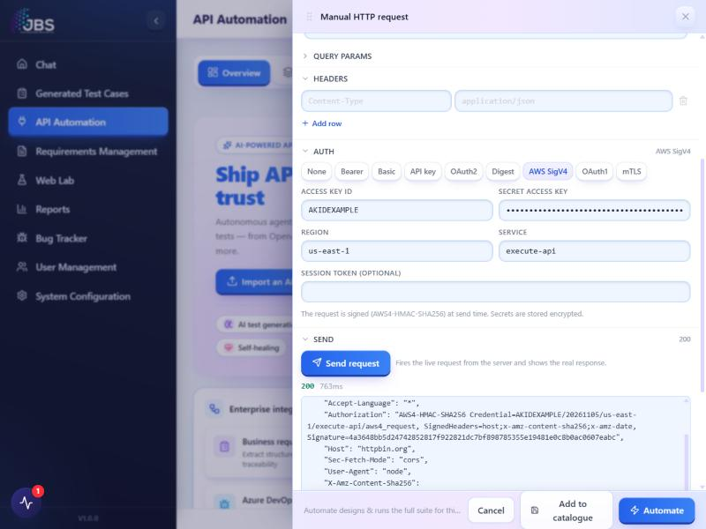
7
AWS Signature v4
✓ 200 · 763 ms
ENDPOINT
GET https://httpbin.org/anything
WHAT WAS PROVEN
Request signed server-side. Echo shows Authorization: AWS4-HMAC-SHA256 Credential=AKIDEXAMPLE/20261105/us-east-1/execute-api/aws4_request, SignedHeaders=host;x-amz-content-sha256;x-amz-date, Signature=4a3648… plus X-Amz-Date & X-Amz-Content-Sha256.

Slide 10
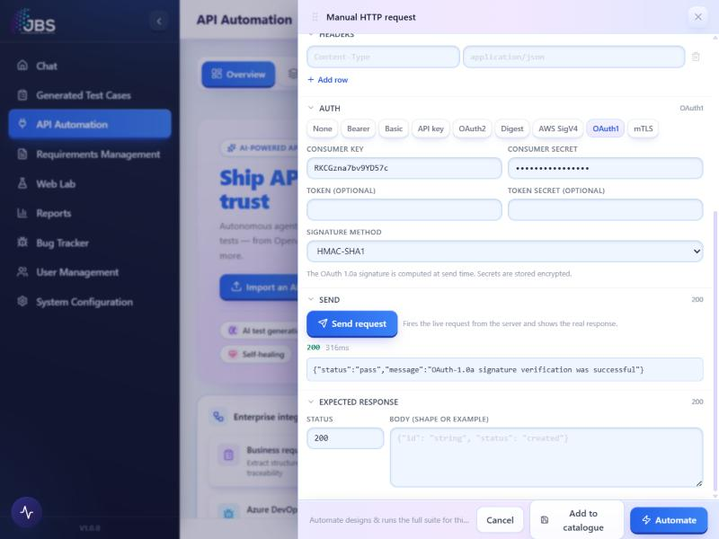
8
OAuth 1.0a (HMAC-SHA1)
✓ 200 · 316 ms
ENDPOINT
GET https://postman-echo.com/oauth1
WHAT WAS PROVEN
Third-party verification: Postman Echo validated the signature and returned {"status":"pass","message":"OAuth-1.0a signature verification was successful"}.

Slide 11
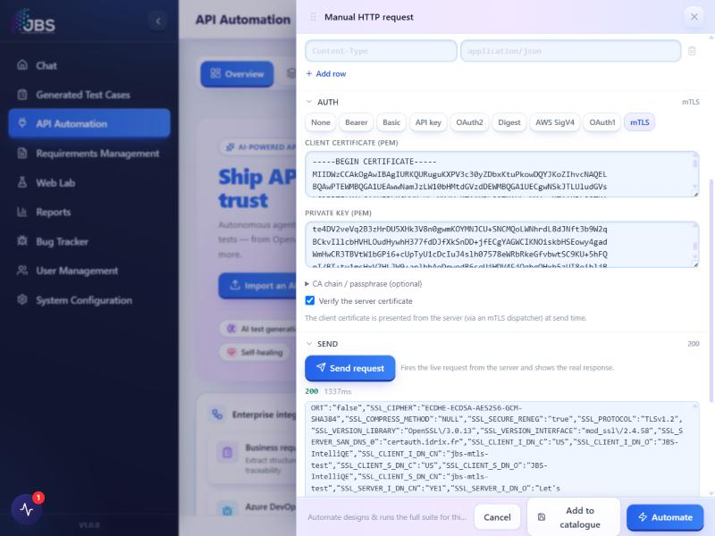
9
mTLS (client certificate)
✓ 200 · 1337 ms
ENDPOINT
GET https://certauth.idrix.fr/json/
WHAT WAS PROVEN
A generated client cert + key were presented over the TLS handshake via the mTLS dispatcher. The server reflected SSL_CLIENT_S_DN_CN=jbs-mtls-test, O=JBS-IntelliQE. (VERIFY reports "self-signed" — expected for a self-signed cert; the handshake and client-cert presentation succeeded.)

