Slide 1
Main menu design
Implementation Details
Station Drops, Dives, Meshes implemented as layer modules, each one adds options to main menu.
A single layer may be loaded multiple times and will add separate option sets to menu (i.e. one mesh layer for each mesh we want to display)
If a dive has been processed already (it has a processed dive data file), enabling the dive will show it processed. Ideally, if a dive is open in another view, you can see changes as it’s being edited.
There may be an option in dive display mode that turns processed mode on/off for all dives.
Dives >
Dive Display Mode >
Station Drops
Station Names
Sonde Mesh
Sonde Mesh Display Options >
Dive Processing Panel
Measuring Stick
Processing Catalog
2008
2009
Select All
Dive1
Dive2
…
Dive colors automaticallycally allocated based on number of visible dives. Dives are not loaded by default, only the AUV traces.
When one dive name is hovered, its trace is visible to give users an idea of what they will load
If this is enabled, the panel for dive processing will be visible
If this is enabled, the measuring stick tool will be visible and some wand keys may be used to control it.
Make them radio buttons so you can have either one or the other?

Slide 2
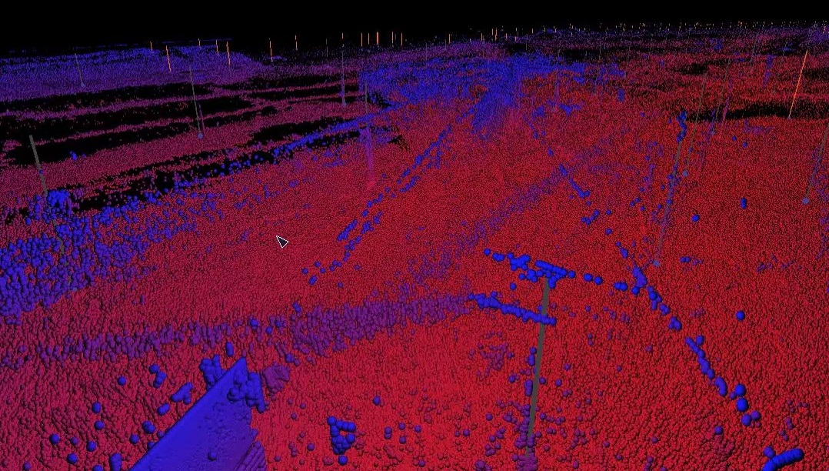
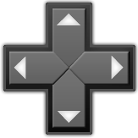
Measuring Stick
Dpad down does point picking and sets measure to one actual point in dataset (unless no intersections are found)
Wand interactor can then be used to move point around.
Distance markers to simplify measuring (0 at bottom point)
X, y, depth
Bring measure tool to spot pointed by wand (using point picker)

Slide 3
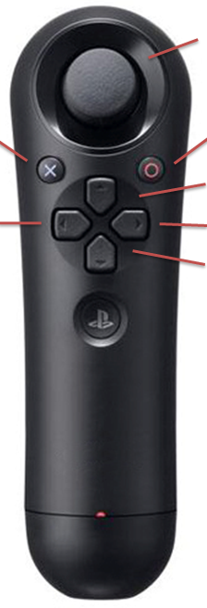
Dive Processing Panel - general
Similar to main menu, but here for the selected dive the AUV trace stays visible when dive is selected.
Load Dive >
Active Parameter: Beam Angle >
Filter Start: val
Filter End: val
Dive Name
Dive section control – see next slide
L/R: control param value
Analog press = 10x speed
When out of menu:
Move dive processing panel around (?)
Toggle: modify start/end filter
prev control param
next control param
Toggle control mode:
Controlling dive section
Vs controlling section parameters
Save Section
Discard Section
Reset Section
Confirm processing params for this section and save
Mark this section and dirty data to throw away
Reset this section and mark it back as unprocessed data

Slide 4
Dive Processing Panel – Dive section
Initial, after a clean dive is selected
Complete
Selectors (green, red flags) can be moved with either mouse or with analog stick (up arrow switches between start/end selection)
Sections cannot overlap.
Selecting a section
Section widths can be used to represent one fiterparameter?
Click on a section to select it
For modification
After changing parameters confirming (or discarding)
RED if deleted

Slide 5
Processing Catalog
Example graph comparing depth and filtered beam angle: possibly shows that as depth increases we have to reject external beams more, and for higher depths data is just noise.
Filters:
All 2008 2009
Check/Uncheck All
As in prev interface: green = accepted data slice, red = rejected data slice
2008 Dive 1
2008 Dive 2
2008 Dive 3
…
2009 Dive26
Depth
Hovering on a dive (unchecked)
Shows data in graph with lighter color
Draws sonde drops on graph
(only if both axes are geographical, one of X,y,Z,depth,filtered depth)
Filtered Angle
X Axis
X
Y
Depth
Filtered Depth
Filtered Angle
Filtered Time
Y Axis
X
Y
Depth
Filtered Depth
Filtered Angle
Filtered Time
Show sone drops
All represent ranges
NOTE: instead of UTM X,Y
I may use a coord sys aligned with lake main direction i.e.
X=distance from glacier
Y=distance from lake center line
(This may be an option)
Scroll bar?

Slide 6
Processing Catalog 2
After a certain depth, data is invalid
Filters:
All 2008 2009
Check/Uncheck All
2008 Dive 1
2008 Dive 2
2008 Dive 3
…
2009 Dive26
Depth
Filtered Depth
X Axis
X
Y
Depth
Filtered Depth
Filtered Angle
Filtered Time
Y Axis
X
Y
Depth
Filtered Depth
Filtered Angle
Filtered Time

