Slide 1


AI reinvention made real
Accenture Innovation Challenge 2026

Slide 2

Team details
TEAM NAME: | DarkOmega
Aviral Pratap Singh (Team Leader)
College: IIT Patna
Stream: Computer Science & Engineering
Year of graduation: 2028
Shrut Gautam
Photo
College: IIT Patna
Stream: Computer Science & Engineering
Year of graduation: 2028
All fields are mandatory

Slide 3
The problem — dashboards say what, never why
A dashboard reports that revenue in a region fell 8%. It cannot say why. The question goes to an analyst, who spends the next three days reading Slack threads, deploy logs, support tickets and vendor emails to assemble an explanation — and by the time the answer arrives, the decision window has closed.
The delay is not the expensive part. Acting on the wrong “why” is. Marketing spend fell the same week revenue did; cutting the campaign looks obvious and fixes nothing, because the real cause was a payment release that silently broke direct-debit renewals for one customer segment. In any given week, dozens of changes coincide with any metric move — correlation is everywhere, causation is rare.
Three things make this hard. Metrics wobble constantly, so most variance is noise. The explanation lives in unstructured systems that share no schema with the numbers. And a language model asked “why” returns a fluent, plausible, unverifiable answer that a CFO may act on.
The requirement is not an explanation. It is an explanation a business leader can check — and defend to their board.
Revenue ▼ 8.2%
flagged Monday 09:00 — cause unknown
Payment gateway release
Marketing campaign cut
US price change
Vendor latency incident
Four changes landed the same week. One caused it. Which one — and can you prove it?

Slide 4
Proposed solution — LedgerLens, an AI business investigator
LedgerLens is an AI investigation engine. It reads the messy human side of the business — Slack threads, support tickets, deploy notes — and reasons about what actually happened.
Every deliberate business change is logged in a Change Ledger with its blast radius: the exact slice of customers it could touch. When a metric breaks, the system isolates the damage to its smallest carrying slice, then surfaces candidates by intersecting that slice against the ledger. AI then takes over the investigation — proposing the checks that would confirm or kill each candidate, and interrogating the results. A payment release is only guilty if card-paying customers stayed unaffected; a demand shock is only guilty if mid-market hurt too. Causes the connected data cannot verify are flagged as exactly that.
Because blast radius is known the moment a change ships, the same ledger also runs preventively: sizing what a release puts at risk and pre-registering what should stay unaffected — before anything breaks. Not a crystal ball, a memory: every confirmed diagnosis sharpens which changes to distrust next time.
Nothing the AI concludes is taken on faith. Every claim ties to the query that produced it — the difference between an AI that explains, and an AI you can act on.
0 · At release time
blast radius known → exposure sized, watch armed
1 · Anomaly isolated
smallest slice carrying the damage
2 · Change Ledger
every change + its blast radius
3 · Overlap
which changes could touch that slice?
4 · AI proposes · evidence decides
alibi checks — marketing decoy rejected ✗
5 · Diagnosis
root cause · $ impact · next action · every claim = a query

Slide 5
Round 1 promised an AI investigator that proposes the checks
which confirm or kill each candidate.
Round 2 ships exactly that.

Slide 6
What we built
github.com/omega-sus67/LedgerLens
A KPI intelligence-to-action engine: root-cause analysis as a set intersection over a ledger of business changes, verified by negative controls.
Diagnoses a −$416,144 renewals shortfall in 1.3 seconds — and rejects the plausible-but-wrong cause a human under time pressure would have acted on.
343 passing tests. Runs end to end with no API key: the ranking path never calls a model.
22 distinct query_ids replayable on a single diagnosis card.
Ten of ten Minimum Prototype Expectations close. Eight of eight Round 2 objectives.

Slide 7
How it decides — five components, every one a query
score = 0.25·T + 0.30·C + 0.15·D + 0.25·N + 0.05·P
T temporal — the change began shortly before the metric broke. Precedence is necessary, never sufficient.
C cohort match — row-level Jaccard of blast radius against the affected cohort. A wide radius scores badly even if it was the cause.
D dose–response — rank correlation of exposure against impact. Uninformative here, and the card says so rather than manufacturing a number.
N negative controls — the fraction of falsifiable predictions that survived. A passing control is a failure to falsify, not a confirmation.
P learned prior — Beta–Bernoulli over analyst verdicts. Weighted 0.05: it sharpens a ranking, it never decides one.
No component is an LLM opinion. All five are reproducible queries — that is the answer to "how is this not hallucination?"

Slide 8
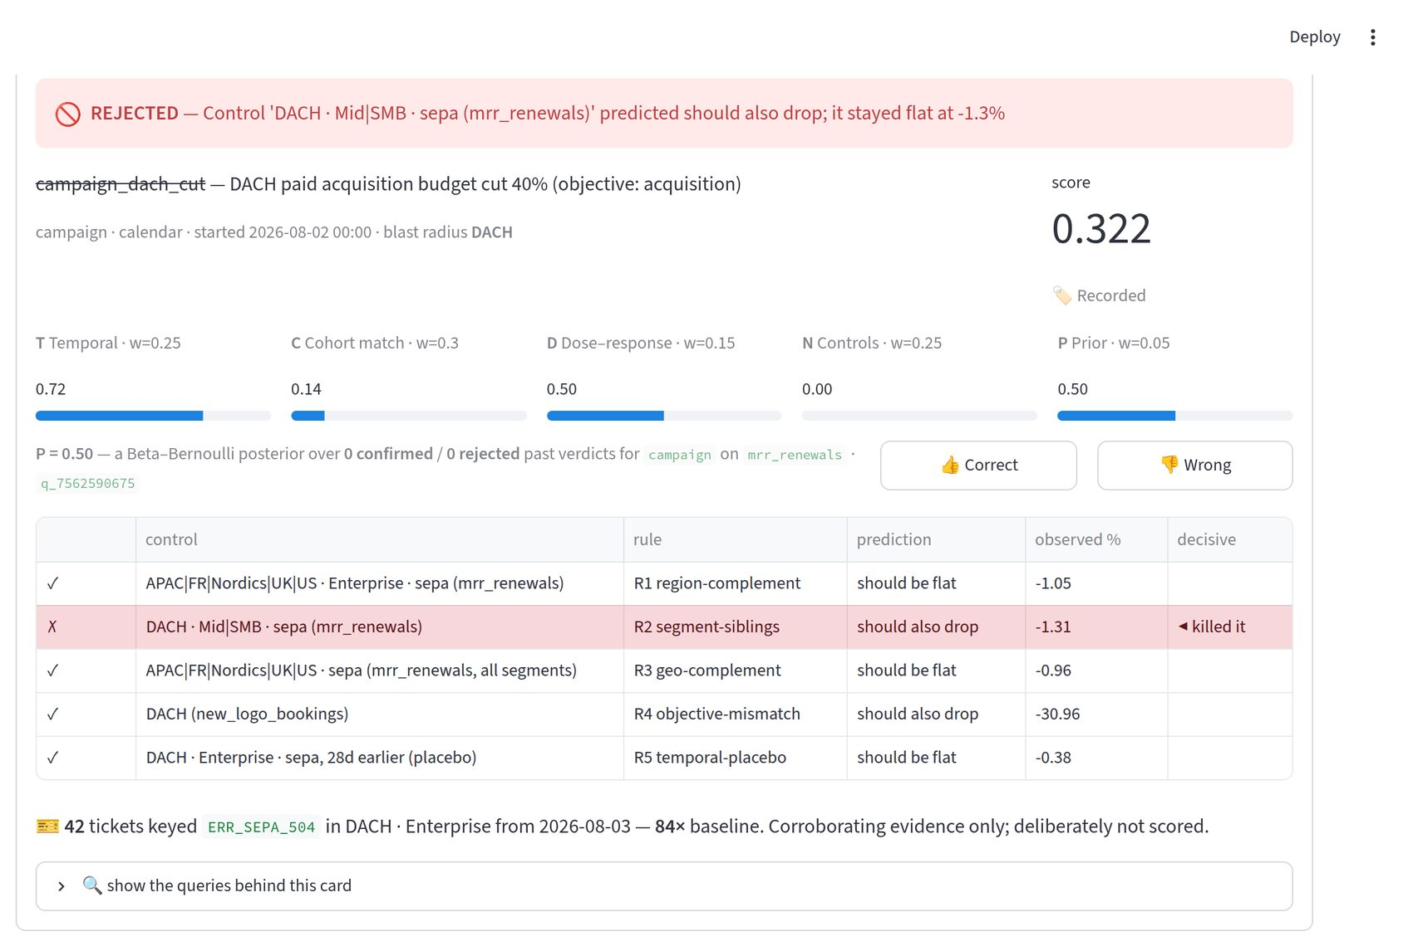
The mechanism that matters: the decoy dies
Marketing cut spend in DACH one day before renewals broke — temporally more plausible than the truth. The engine predicts DACH Mid/SMB should also have dropped. They came in flat at −1.31%. That control failure is decisive: rejected at 0.322, not merely outranked.

Slide 9
LLM versus non-LLM — the split, stated exactly
"The LLM should not be treated as the source of quantitative truth." — Round 2 brief
Non-LLM — detection, drill-down, cohort intersection, all five score components, every negative control, the rejection of the decoy. 89 SQL queries, no model involved.
LLM — proposing additional checks (which this engine then executes in SQL), naming causes the connected data cannot test, and writing the prose.
The boundary is enforced in code, not by convention: proposed checks are built with decisive=False — the field the N-scorer reads — and are never passed to it.
A test asserts every score is byte-identical with the AI lane on and off.

Slide 10
The AI investigator lane — three call sites, all additive
1 · Proposed checks — the model fills a fixed template vocabulary; it never writes SQL. We execute. Hallucinated dimensions are rejected before becoming a query, and the count is shown: "4 accepted, 2 rejected by validation."
2 · Unverifiable causes — a separately labelled panel of explanations the connected data cannot test, each naming the feed that would settle it.
3 · Guarded narration — every numeric token in the model's prose must appear in the verified payload. One invented digit discards the narration for the deterministic template, and the page says so.
Provider-agnostic by construction: Gemini 2.5 Flash by default, Claude Sonnet via one environment variable. Two adapters sharing no code path, behind a one-method interface.
~$0.0048 per diagnosis with the lane on. $0.0000 with it off.

Slide 11
Who it is for — subscription revenue operations
Beachhead: subscription B2B businesses whose renewals ride on payment rails. A silently broken rail books as churn and the coincident change takes the blame — the reference incident is the niche's endemic failure mode, not a demo convenience.
Inside the account, four audiences render from one computation. Persona is accepted only by the narrator, downstream of every query — so it cannot reach a query. The evidence behind all four cards is identical by construction.
Revenue Analyst — every control, every query id, the full drill-down lattice.
CFO — dollars and forecast risk, and an escalation. Never an instruction to roll back a release: she does not hold that lever.
Payments On-Call — the event id, the blast radius, the rollback.
Growth Marketing — their own KPI's real story, and a named policy where a cut is withheld.
Decision rights are mechanical: a persona that does not hold a lever is shown an escalation, never an instruction.

Slide 12
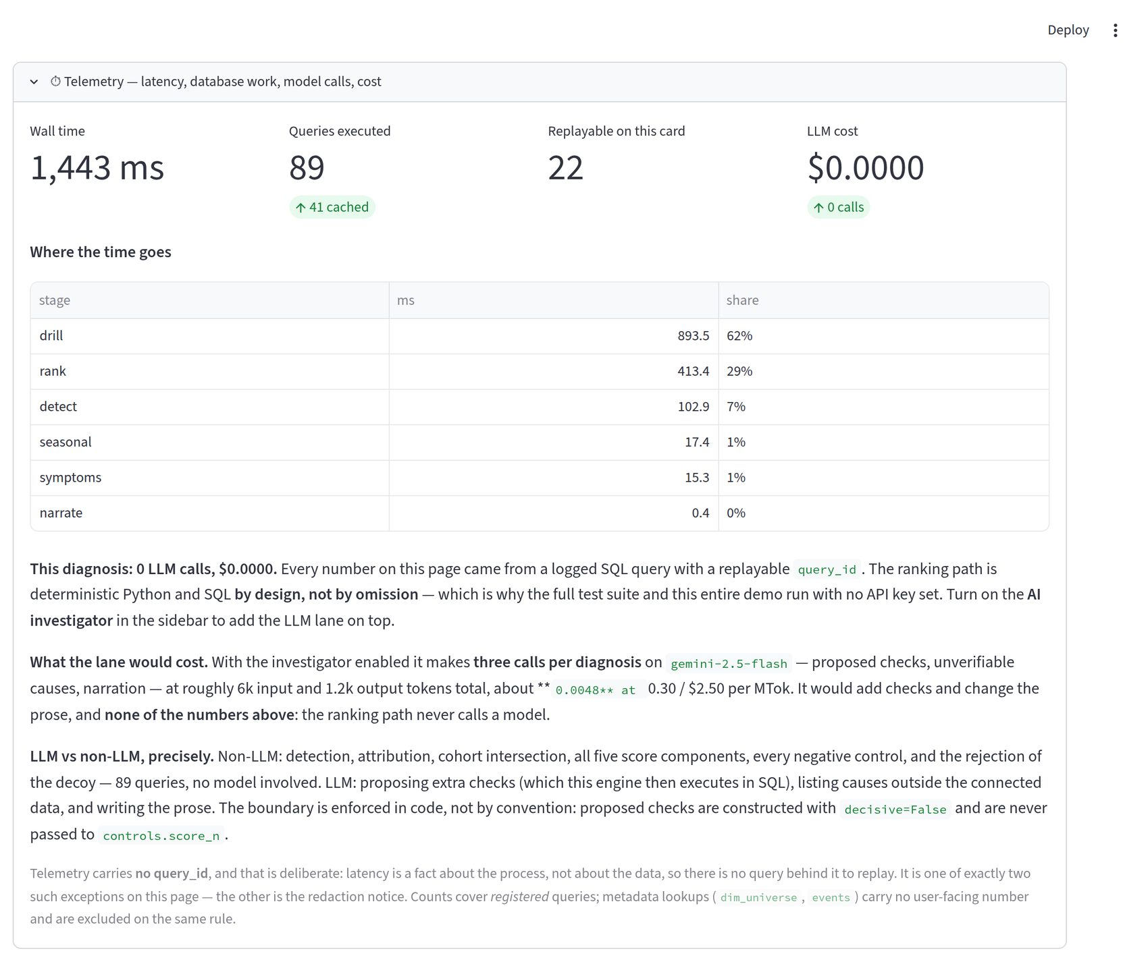
Evidence, telemetry and cost — shown, not asserted
Every number on the page came from a logged SQL query with a replayable query_id. "Queries" is three different numbers and the panel refuses to merge them: what the diagnosis cost, what a reader can audit, and what the cache avoided.

Slide 13
Business case and impact
Stated assumptions — a beachhead-profile customer: subscription B2B at ~€50M ARR, renewals via payment rails. ~40 material KPI movements a year, ~3 analyst-days each, ~$460/day fully loaded. Directional sizing, not measured results.
Analyst time recovered — ~$55k/year of capacity redirected from evidence assembly to judgement. Real, but the smaller half.
Wrong-action avoidance — the larger half. Acting on the decoy leaves the −$410k leak running AND reverses a campaign on a false premise. One avoided misattribution dominates the entire labour saving.
Decision-window preservation — 1.3 seconds instead of three days means the finding lands while the fix is still cheap.
Cost to run — one DuckDB file. No graph database, no vector store, no agent framework. Under $1/year of model spend at 40 diagnoses.

Slide 14
Phased roadmap
Shipped — Round 2 prototype
3 KPIs across 3 sources · semantic contract · drill-down · 5-component scoring · 5 control rules · 4 personas · entitlement · abstention · AI investigator lane · feedback loop · telemetry.
Phase 1 — Rigour (1–2 months)
Difference-in-differences with bootstrap CI · calendar-regressor baseline enabling bidirectional detection · the discriminating test between near-tied candidates · a bounded exploration pass before abstaining.
Phase 2 — Enterprise integration (3–6 months)
Real connectors, beachhead-first — Stripe/Adyen/GoCardless webhooks, Chargebee/Zuora billing events and dunning platforms before the dev stack; the mapping is the only thing that changes. Warehouse-native execution on Snowflake/Databricks/BigQuery, since the engine is already just SQL. SSO and per-user verdict attribution. Push delivery to Slack, email, PagerDuty.
Phase 3 — Proactive (6–12 months)
A watchtower that surfaces anomalies rather than waiting to be pointed · the LLM event normalizer, gated behind confidence calibration · cross-KPI interaction detection.

Slide 15
Key risks and mitigations
The system names a confident wrong cause → negative controls try to kill each candidate; a decisive failure rejects outright and cannot be outvoted. SHIPPED
The LLM hallucinates a number → the numbers guard discards the whole narration for the deterministic template. SHIPPED
The LLM invents a dimension or metric → validation against the registry before execution; rejections counted and displayed. SHIPPED
The LLM quietly influences the verdict → proposed checks built decisive=False, never passed to the scorer; asserted by test. SHIPPED
Blast-radius metadata is wrong → the failure direction is the mitigation: too wide fails its controls, too narrow leaves nothing above the floor. It degrades toward "I don't know". SHIPPED
Feedback poisons the ranking → P weighted 0.05; a prior saturated with 200 confirmations still cannot clear the floor or rescue what a control killed. SHIPPED
Vendor lock-in or outage → one provider table, two live adapters; every failure returns a recorded reason, so "found nothing" never looks like "vendor was down". SHIPPED
Verdicts unattributable to a person → no auth in this build. Named, not fixed: SSO in Phase 2.

Slide 16
How this maps to the rubric
Ten of ten Minimum Prototype Expectations close.
3 KPIs / 3 sources, different grains · semantic contract · 4 personas · multi-factor movement decomposed · two low-confidence scenarios · sparse-history KPI · role entitlement · evidence with freshness and lineage · LLM vs non-LLM breakdown · runtime telemetry.
Eight of eight Round 2 objectives.
Detection and prioritisation · heterogeneous reconciliation · ranked drivers · persona narratives with traceable evidence · uncertainty and abstention · actions grounded in levers and decision rights · a learning mechanism from analyst feedback · realistic security, cost and latency.
What is deliberately not built is named too — the LLM event normalizer is cut because it is the one design that puts a model on the ranking path.

Slide 17
Video
▶ 3-minute walkthrough
[ADD VIDEO LINK HERE — also paste as plain text]
Watch the system diagnose an 8% revenue drop — and reject the plausible-but-wrong cause using evidence.

Slide 18
Thank you

