Slide 1
2024 Hospital Update
Omega Hospital

Slide 2


Slide 3
Top 6 Compliance Issues
Hacking and Malware. Installing antivirus software and firewalls can protect against data theft and destruction. Frequently changing passwords provides another layer of protection.
Loss and Theft of Devices. You can be held responsible for personal health information stolen from a laptop or phone if the information wasn’t secured properly. Data should be password-protected and encrypted. Devices should also be stored in a safe location.
Unsecured Data. Personal health information, whether stored in physical or digital files, should be properly stored and only accessible to those who need it. If information is stored digitally, passwords and encryption are vital. Healthcare entities using artificial intelligence are required to sign a business associate agreement to ensure data can be stored securely and that the AI follows HIPAA regulations.
Employee Use and Disclosure. All employees should understand that they can only share health information needed by medical staff, dependents, and those with power of attorney.
Insufficient Staff Education. Not only is staff education important to protect your patients and your practice, it’s also legally required. Although the law does not define a time interval for training, it’s best practice to train employees annually on HIPAA law.
Improper Records Disposal. Employees must be trained on how to dispose of records This includes shredding of paper files and removing files from all locations on the computer system.

Slide 4
Secure texts and emails
Personal emails should not be used for business use
Never send an unsecured email or text message with patient identifiers
Never use patient identifiers (i.e., name) in the subject line

Slide 5
Patient Rights
Did you know?
Patients have rights:
To receive treatment and medical services without discrimination based on race, age, religion, national origin, sex, sexual preference, handicap, diagnosis, ability to pay or source of payment
To considerate and respectful care
To have a family member, significant other or patient designee, and the physician of choice to be notified of admission to the facility
To be informed about outcomes of care, including unanticipated outcomes
To communicate with people outside of the hospital including receiving visitors and mail; any restrictions are explained and evaluated for their therapeutic effectiveness
To receive, as soon as possible, the services of a translator or interpreter to facilitate communication between the patient and the hospital’s health care personnel
This a just a small portion of the many patient rights.
Patients receive copies of their rights and responsibilities upon admission to the facility.

Slide 6
Emergency Codes
Codes Disaster/Event :
Red:Fire
Black: Bomb Threat
Blue: Cardiac/Medical Emergency
Yellow: External Disaster
White: Agitated Patient/Guest
Orange: Hazardous Chemicals/Toxic Release
Silver: Active Shooter
For Emergencies –
Call 911
Or page your own code overhead!

Slide 7
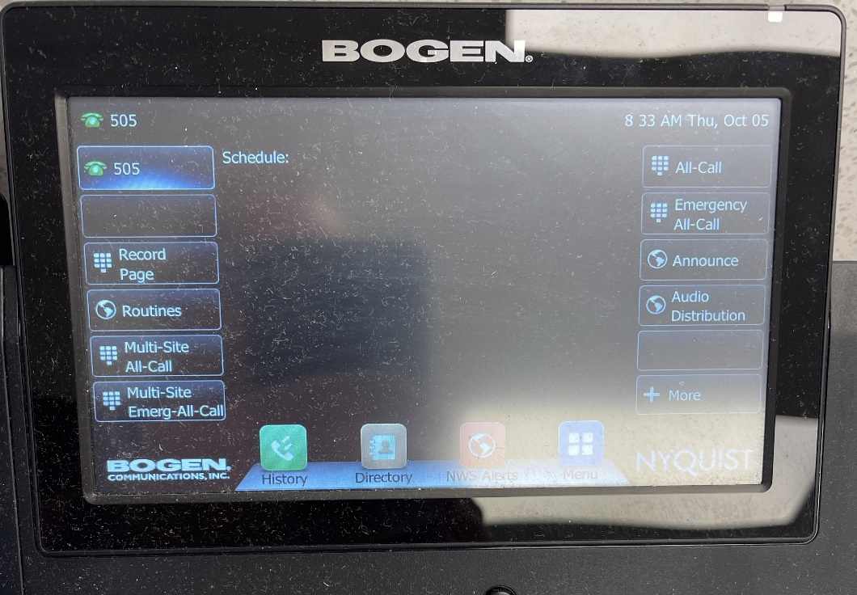
Overhead Paging
To page overhead speakers, lift the phone and press paging button , phone will ring listen for beep, beep.
Select All Call or Emergency
All Call
Disconnect by hanging up
Calmly announce the emergency followed by the location.

Slide 8
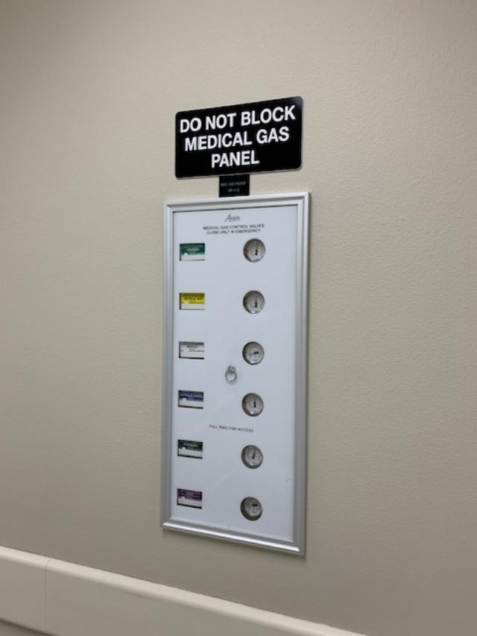
Remember – do not block medical gas panels New signage recently added

Slide 9
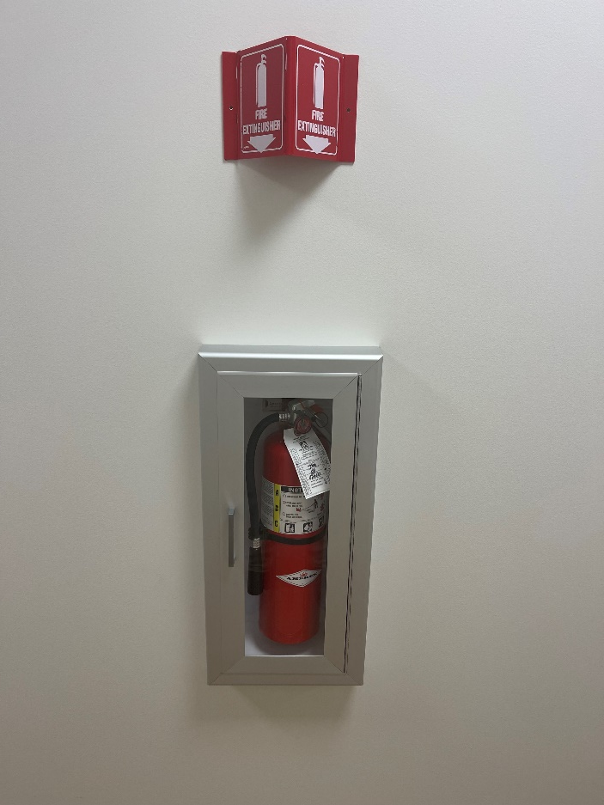
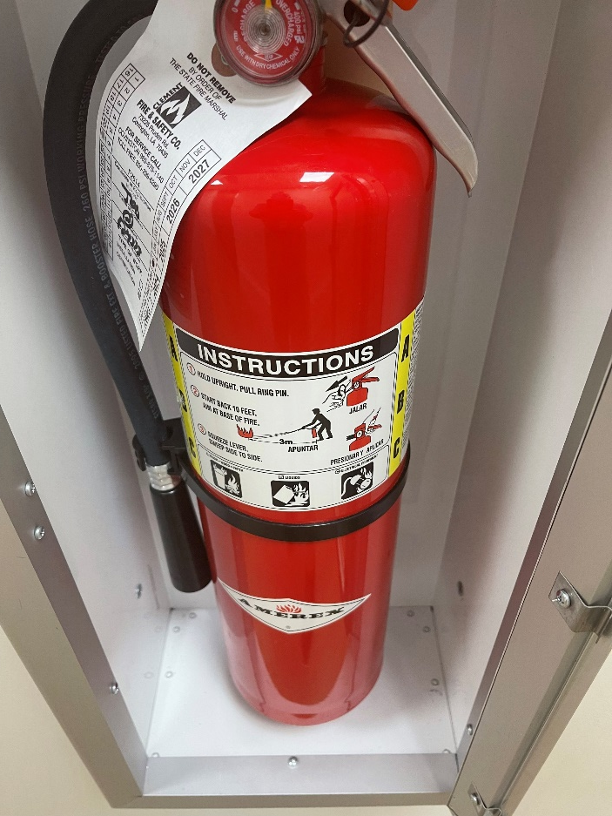
Carbon Dioxide Fire Extinguishers – located in the Operating Room

Slide 10
Workplace Violence
Omega Hospital has zero tolerance for workplace violence
Do not hesitate to call the police or security if confronted with a potentially violent situation
A “Code White” indicates a need for immediate response of all available personnel to report to the area to provide assistance until situation is under control

Slide 11
Fire Safety in the Operating Room
Procedure for extinguishing surgical fire on patient:
Communicate the presence of fire to the OR team
Stop the flow of all airway gases to the patient
Small fire – pour saline or water on the fire slowly to prevent spreading
Remove burning material from patient
If drapes are involved, remove the drape to the ground, rolling it on itself to smother the fire
Avoid moving the drape into evacuation route
Assess the surgical field for a secondary fire on underlying drapes or towels
Activate alarms as necessary
Assess the patient for injuries
Procedure for extinguishing fire on surgical equipment:
Communicate the presence of fire to the OR team
Disconnect equipment from its electrical source
Shut off electricity to the equipment at the electrical panel, if it is not possible to the remove the plug from the outlet
Shut off gases to equipment, if applicable
Assess size of fire and determine whether equipment can be removed from room safely or if room needs to be evacuated
Activate alarms as necessary
Extinguish fire using extinguisher if appropriate

Slide 12
Fire Safety in the Operating Room
Patients are assessed for fire risk at the beginning of each surgical case.
Risk factors are:
presence of ignition source,
use of an open oxygen source
proximity to the fire triangle
Precautions are taken according to risk score of low, medium or high.
Precautions include but are not limited to:
observing prep drying times,
draping patient to avoid pooling,
protecting heat sources,
use of low flow oxygen,
discontinuation of supplemental oxygen before use of cautery
wet sponges readily available
basins of sterile water or saline available for fire suppression.

Slide 13
Reporting disruptive behavior
Always report disruptive behavior to your supervisor
Behavior can be reported anonymously
All reports will be investigated
Reports or incidents warranting confidentiality will be handled appropriately and information disclosed on a need-to-know basis
Reporting makes it possible to identify, address, and correct security problems
No one will be penalized for asking questions, raising concerns or making an honest report of disruptive behavior or improper conduct

Slide 14

Recognizing and Responding to combative or hostile behavior
Levels of hostile behavior include tension, disruptiveness and violence
Anxious people are frustrated and highly sensitive
Stay calm
Apologize (for wait, circumstances, etc)
Listen
Ask questions
Summarize concern
Address the problem
This Photo by Unknown Author is licensed under CC BY

Slide 15
Recognizing and Responding to combative or hostile behavior
Defensive people are verbally abusive, irrational, and difficult to calm down
Stay calm
Choose words carefully
Set clear limits
Show that you want to help
Secretly call for security, assistance
Use verbal de-escalation techniques

Slide 16
Recognizing and Responding to combative or hostile behavior
Risk Behavior - yelling, screaming, acting physically violent, may use weapons
Get yourself and others to safety
Call security or police
Activate Code White or Code Silver process as needed

Slide 17
Steps we have taken to prevent violence in the workplace
Additional hospital security hours and increased visibility after hours
Communication with Law Enforcement agencies to enhance security measures
Addition of badge only access and keypad access to selected areas to limit traffic flow
Limited entrance to the facility after hours to limit traffic flow
System initiated for routine changing of door lock codes
Crisis Prevention Intervention (CPI) Training for staff in higher risk areas or as needed

Slide 18
Code Silver
Minimizes risk and causalities in the event of a person using a weapon or threatening to use a weapon on our campus
Take immediate action to protect the safety of patients, guests, visitors and other team members

Slide 19
Active Shooter – Code Silver
The U.S. Department of Homeland Security offers these suggestions for responding when an active shooter is in your area: Evacuate. Exit if there is an accessible escape route. Leave your belongings behind and try to help others escape. Keep your hands visible so law enforcement can see you are unarmed. Hide. If you can’t get out, find a place to hide. Block entry to your hiding place if possible, for example, by pushing furniture against the door. Silence your cell phone and turn off any other sources of noise such as a radio or television. Turn off room lights and hide opposite of any windows. Take action. As a last resort, and only if your life is in imminent danger, try to incapacitate the shooter. Find a makeshift weapon and act aggressively: yell and throw items. Try to remain calm, particularly if you are with patients at the time. When you contact 9-1-1, give the location of the shooter, the number of shooters, a physical description, number or type of weapons, and number of potential victims.
When law enforcement or security arrives, follow their orders, knowing that they may shout commands and use weapons or force. Employees not in the area can take actions such as ensuring that emergency vehicles are diverted from the facility and monitoring and reassuring patients and others who may be aware of what is happening.

Slide 20

Active Shooter
https://www.youtube.com/watch?v=5VcSwejU2D0
6 minute video – Run, Hide, Fight
Warning – adjust volume as necessary, contains sound of gunshots

Slide 21
Hearing Impaired
Family and Friends should not be used as interpreters. The only case when this is acceptable is when the patient has been made aware of the availability of qualified sign language interpreters/interpreters at no additional charge and without any coercion whatsoever, choose the services of family and/or friends.
Hearing Impaired Patients:
A hearing impaired person presenting for services requesting an interpreter for sign language will be assisted in the following manner:
The Social Worker or designee will contact the Deaf Action Center by email or phone and arrange for interpreter services. If an interpreter is required on an emergency basis, the number is 504-452-3354. An Interpreter Request Form will also be completed and emailed to the Deaf Action Center.
The charges of an interpreter will not be the responsibility of the patient or his/her insurance company.

Slide 22
Abuse and Neglect
Patients admitted to Omega Hospital will be assessed for possible abuse or neglect through the means of the initial assessment (pre-admit and direct admit) process and the utilization of established triggers
Cases of suspected abuse, neglect, or exploitation shall be reported by staff members to a supervisor, director of nursing, or administrator and treated as occurrences. All such occurrences shall immediately be reported
All occurrences of suspected patient abuse and/or neglect shall be promptly reported to the attending physician
If immediate danger exists, notify security so that measures to protect the patient from harm will be taken. In the case of family violence, the law enforcement agency will be notified

Slide 23
Language Line – available for patients with limited English proficiency
Use Language Line Solutions to communicate with the patient who does not speak or understand English.
Family and Friends should not be used as interpreters especially for consent, medical history and patient teaching. We want to ensure accurate information is given and received.
Language Line Solutions is accessed by calling 1-888-808-9008.
Provide the 6-digit Client ID Number: 79626459
Company Name: Omega Hospital.
Press 1 for Spanish. Press 2 for all other languages (State the name of the language at the prompt)
An interpreter will be connected to the call.
Brief the Interpreter. Summarize what you wish to accomplish and give any special instructions.
Add the non-English speaker to the line.
Use speaker phone (in private area) or pass handset.
Conclude conversation by stating “End of Call.”

